Slide 1
Vocera Analytics AI Diagnostics Agent
Intelligent Troubleshooting & Real-time Log Analysis
Presenter: Dhananjay Patil & Amol Shinde
Date: March 20, 2026

Slide 2
The Challenge
Complex Ecosystem
Security Hardening
Log Fatigue
High MTTR

Slide 3
The Solution
AI-Powered Diagnostics
Lightweight Agent
Unified Dashboard
Knowledge Base

Slide 4
Architecture Diagram
[AI DIAGNOSTICS AGENT]
Connected to Filesystem, Gemini API, Knowledge Base
[USER BROWSER]
Vocera Analytics Application & Configuration files

Slide 5
Key Use Cases
MTLS/SSL Validation
Component Health Monitoring
Automated Log Analysis
Connectivity Testing

Slide 6
Workflow (Diagnostic Loop)
Ingest
Analyze
Diagnose
Resolve

Slide 7
Business Benefits
Reduced Downtime
Lower Support Costs
Proactive Security
Knowledge Retention

Slide 8
Integration & Safety
Read-Only Access
Air-Gapped Ready
Standard Stack (Node.js, React)

Slide 9
Demo Highlights
Configuration Tab
Connectivity Tab
Chat Interface
Knowledge base

Slide 10
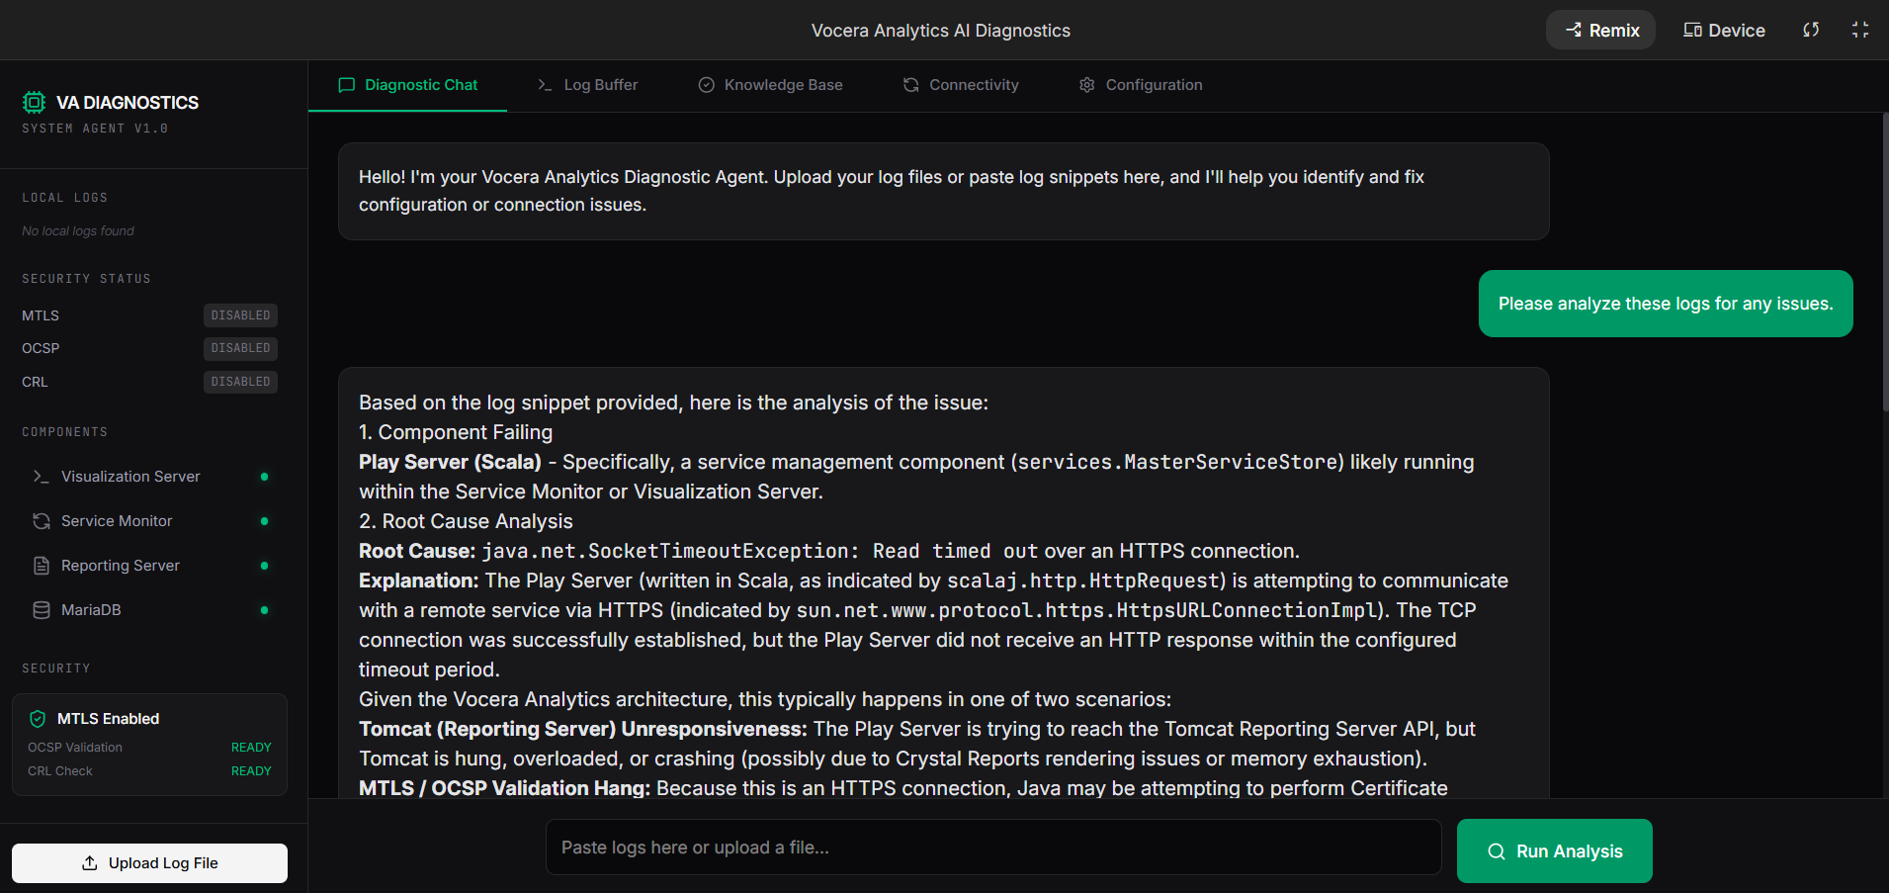
Chat Interface

Slide 11
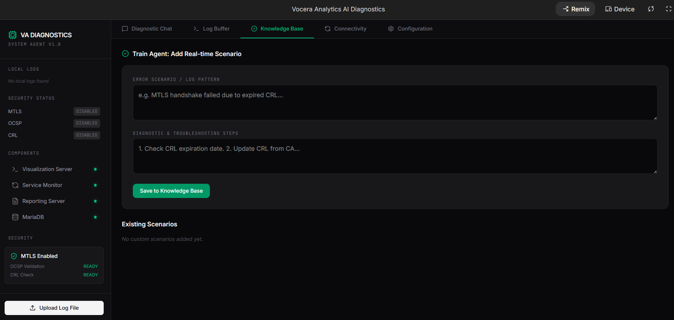
Knowledge Base

Slide 12
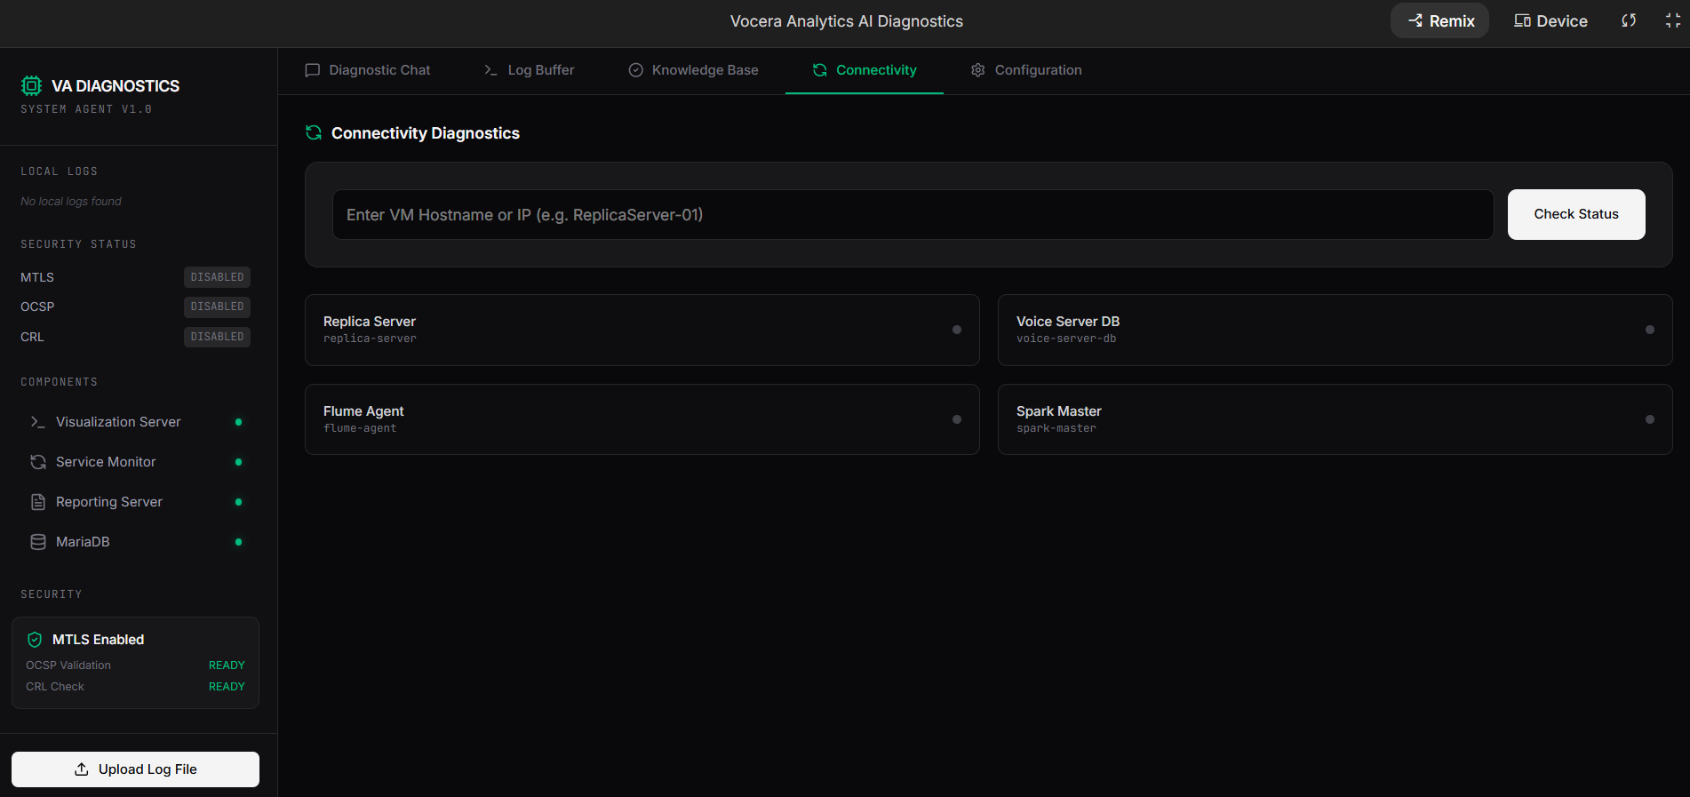
Connectivity Tab

Slide 13
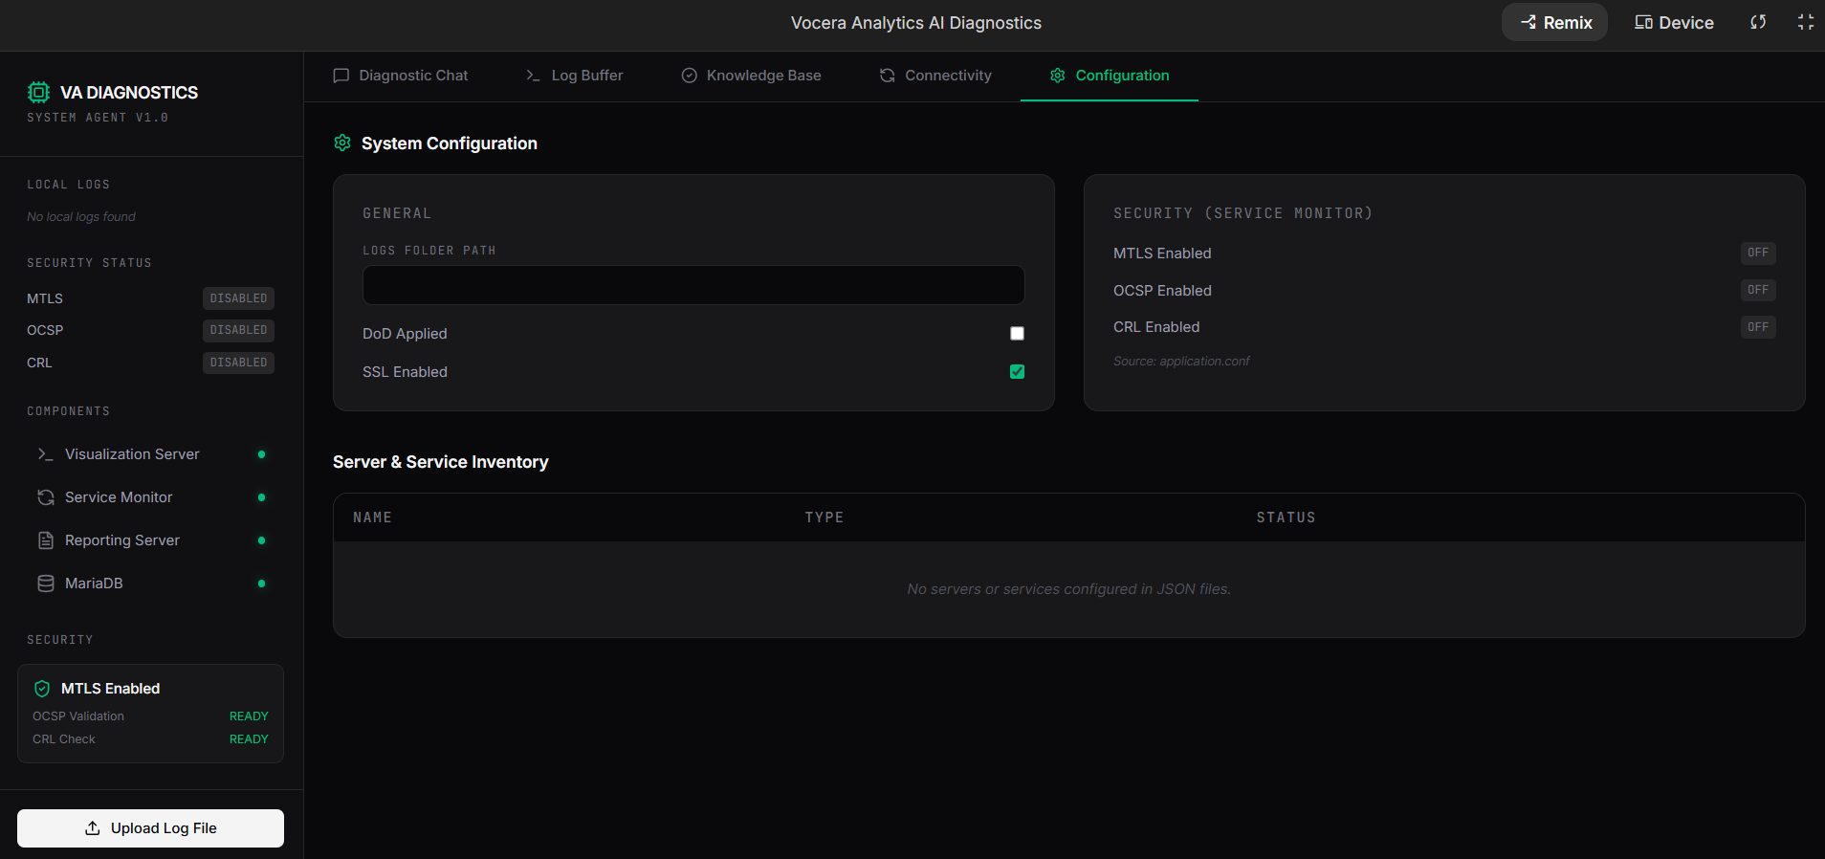
Configuration Tab

Slide 14
Conclusion
AI transforms support
Next Steps: Deploy -> Integrate -> Train
Q&A

