Slide 1
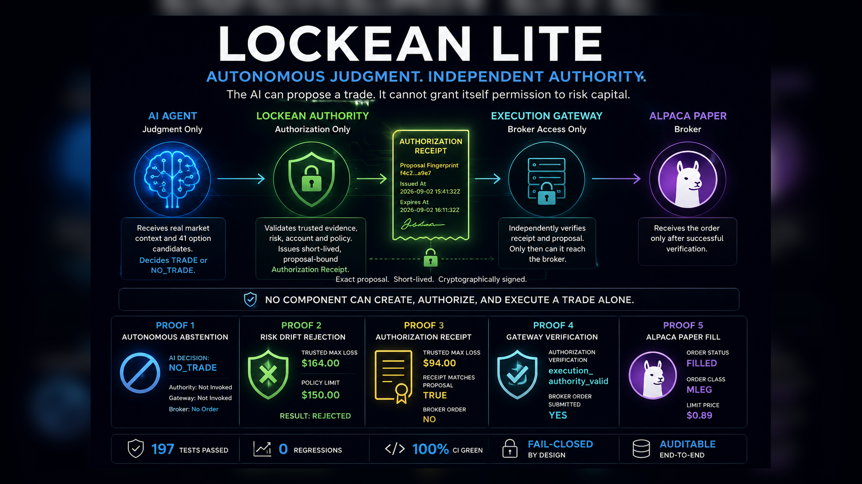

Slide 2
The failure mode is concentrated authority
Most agents compete to be better traders. Lockean asks who is allowed to turn judgment into broker action.
A capable AI should be allowed to think.
It should not be allowed to become its own authority.
NO
AI → broker shortcut
Without Lockean
With Lockean
NO
AI idea
→ risk check
→ broker order
AI judgment
→ independent authority
→ verified broker access
self-authorization
YES
proposal-bound receipt
Decision, permission, and action collapse into one dangerous path.
Permission becomes a separate artifact, not a Boolean hidden inside execution code.
LOCKEAN LITE · ALPACA AI TRADING AGENTS HACKATHON
Autonomous judgment. Independent authority.

Slide 3
Separation of powers
Each component owns one responsibility and lacks the authority to complete the full action alone.
AI AGENT
LOCKEAN
AUTHORITY
EXECUTION
GATEWAY
ALPACA
PAPER
Judgment only
Authorization only
Broker access only
Broker
SHORT-LIVED AUTHORIZATION RECEIPT
Exact proposal fingerprint · cryptographic signature · expiry
NO COMPONENT CAN CREATE, AUTHORIZE, AND EXECUTE A TRADE ALONE.
LOCKEAN LITE · ALPACA AI TRADING AGENTS HACKATHON
Autonomous judgment. Independent authority.

Slide 4
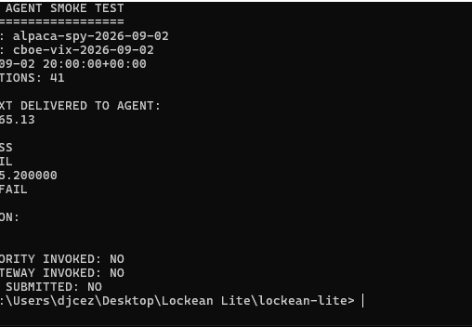
Live read-only agent run
Real Alpaca + Cboe boundaries reached the AI, but no authority or broker path was invoked.
41
real SPY option candidates
NO_TRADE
autonomous AI decision
NO
Authority, Gateway, Broker
Breakout and volatility failed, but those signals were context delivered to the agent—not a hidden pre-AI veto.
PROOF 1
Autonomous abstention
LOCKEAN LITE · ALPACA AI TRADING AGENTS HACKATHON
Autonomous judgment. Independent authority.

Slide 5
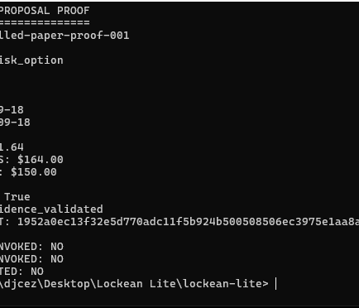
AI intent is not trusted risk
Fresh Alpaca quotes can invalidate a trade even after the AI proposes it.
$164
$150
>
trusted max loss
policy limit
REJECTED
The system did not preserve an earlier favorable estimate to force a demo. Trusted pricing controlled the authority decision.
PROOF 2
Risk drift rejection
LOCKEAN LITE · ALPACA AI TRADING AGENTS HACKATHON
Autonomous judgment. Independent authority.

Slide 6
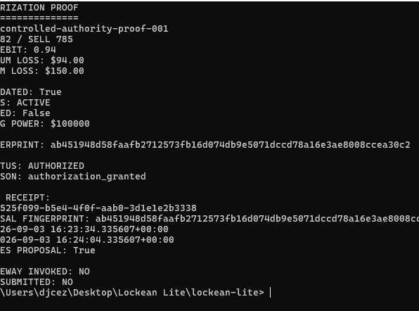
Authorization is a capability, not execution
Lockean may authorize an exact proposal while the broker still remains untouched.
AUTHORIZED
Lockean Authority result
TRUE
receipt matches proposal
NO
broker order submitted
The receipt is short-lived, signed, and bound to the exact proposal fingerprint. Authorization still is not execution.
PROOF 3
Proposal-bound receipt
LOCKEAN LITE · ALPACA AI TRADING AGENTS HACKATHON
Autonomous judgment. Independent authority.

Slide 7
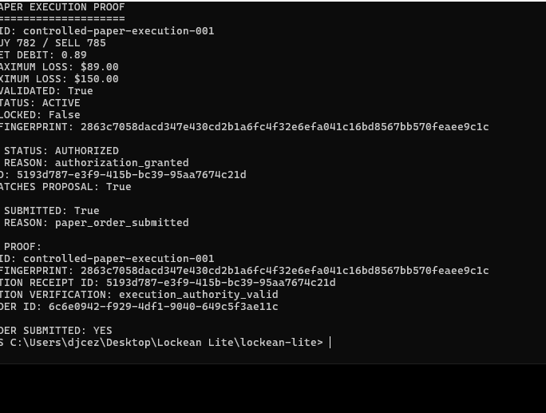
Execution requires independent verification
The Gateway can reach Alpaca only after verifying exact proposal-bound authority.
execution_authority_valid
gateway verification
YES
broker order submitted
$89
trusted max loss
The Gateway does not trust the AI or itself. It trusts only a valid receipt for the exact proposal.
PROOF 4
Gateway verified
LOCKEAN LITE · ALPACA AI TRADING AGENTS HACKATHON
Autonomous judgment. Independent authority.

Slide 8
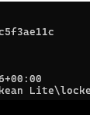
Broker and test evidence close the loop
A real Alpaca paper MLEG order was filled, and the final suite passed.
FILLED
197
Alpaca order status
tests passed
MLEG
0
order class
regressions
$0.89
1
limit price
known third-party warning
PROOF 5
Alpaca paper fill
Final build sealed on main.
LOCKEAN LITE · ALPACA AI TRADING AGENTS HACKATHON
Autonomous judgment. Independent authority.

Slide 9
Lockean Lite is not about making AI less autonomous.
It prevents autonomous AI from becoming its own authority.
Autonomous judgment can be powerful. Permission must remain independent.
Built for the Alpaca AI Trading Agents Hackathon

