Slide 1
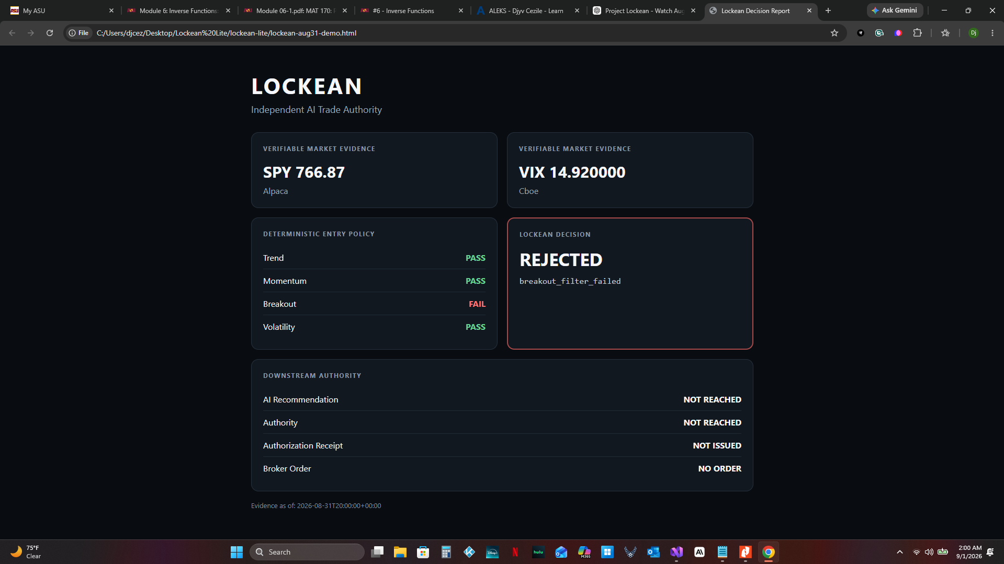
LOCKEAN LITE
Independent execution authority for autonomous AI trading agents
AI proposes. Lockean verifies. Authority decides. Only then may software act.
Alpaca AI Trading Agents Hackathon • Python • Alpaca • OpenAI
Lockean Lite • 1

Slide 2
The risk: intelligence and authority collapse into one actor
A capable AI should not automatically become an execution authority.
AI hallucination
Stale / missing evidence
Altered trade proposal
Without a separate authority, bad intent can become a broker order.
•
Not a UI problem
•
Not solved by asking the AI to “be careful”
•
Requires an architectural boundary
Lockean Lite • 2

Slide 3
Lockean separates recommendation from permission
The AI cannot authorize itself and cannot reach the broker directly.
Real market
evidence
AI structured
recommendation
Lockean
Authority
Execution
Gateway
Alpaca paper
order
Authorization is cryptographic, short-lived, and bound to the exact proposal fingerprint.
Missing
Forged
Expired
Tampered
Fails closed
Lockean Lite • 3

Slide 4
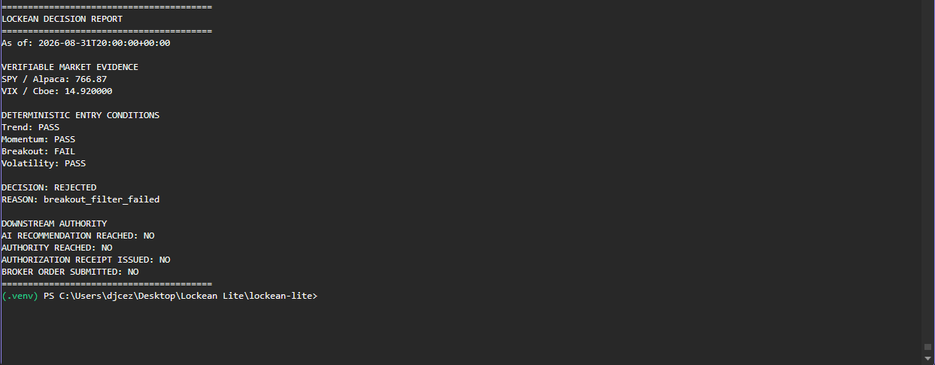
Proof 1: real market evidence can stop the chain
August 31 completed session: externally sourced rejection.
DECISION: REJECTED
REASON: breakout_filter_failed
•
SPY evidence: Alpaca
•
VIX evidence: official Cboe history
•
AI recommendation: NOT REACHED
•
Authority: NOT REACHED
•
Broker order: NO
Lockean Lite • 4

Slide 5
The judge-facing dashboard is intentionally read-only
Lockean decides. The interface displays.
No submit_order path
No receipt issuance
No execution gateway
Displays immutable result
Lockean Lite • 5

Slide 6
Proof 2: the AI does not own risk compliance
Real Alpaca option candidates + real OpenAI structured recommendation.
AI recommended
Lockean independently derived
BUY 775C
SELL 780C
1 contract
Net debit: $2.13
Maximum loss: $213
Policy limit: $150
The AI could recommend the trade. It could not declare itself compliant.
Lockean Lite • 6

Slide 7
Permission must be earned every time
Successful execution still goes through the same authority chain.
Qualifying
evidence
Risk + account
verification
Gateway
verification
AI
proposal
Signed
receipt
Alpaca
order ID
Current successful execution slot remains open until a real session legitimately qualifies.
No mocked order. No policy relaxation. No demo-only bypass.
Lockean Lite • 7

Slide 8
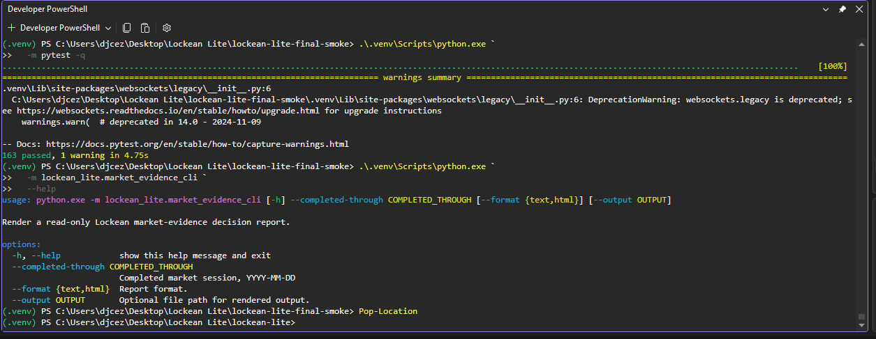
Submission-ready evidence package
Repository, tests, and public proof are prepared for judges.
163 tests passed
0 regressions
Fresh checkout verified
•
Public GitHub repository
•
Read-only online prototype
•
Judge evidence screenshots
•
Demo script and final submission copy
•
Execution proof slot reserved for genuine Alpaca order
Intelligence may recommend the action. Authority must still be earned.
Lockean Lite • 8

