Slide 1

Automation testing with Serenity BDD
Djelloul belarbi

Slide 2
What BDD
Behavioral Driven Development (BDD) is a software development approach that has evolved from TDD (Test Driven Development). It differs by being written in a shared language, which improves communication between tech and non-tech teams and stakeholders. In both development approaches, tests are written ahead of the code, but in BDD, tests are more user-focused and based on the system’s behavior.

Slide 3
What Gherkin Language
Gherkin is a Business Readable, Domain Specific Language created especially for behavior descriptions. It gives you the ability to remove logic details from behavior tests. Gherkin serves two purposes: serving as your project's documentation and automated tests.
gherkin syntax: Like YAML or Python, Gherkin is a line-oriented language that uses indentation to define structure. Line endings terminate statements (called steps) and either spaces or tabs may be used for indentation. (We suggest you use spaces for portability.) Finally, most lines in Gherkin start with a special keyword:
Feature: Some terse yet descriptive text of what is desired
In order to realize a named business value
As an explicit system actor
I want to gain some beneficial outcome which furthers the goal
Scenario: Some determinable business situation
Given some precondition
And some other precondition
When some action by the actor
And some other action
And yet another action
Then some testable outcome is achieved
And something else we can check happens too

Slide 4
What Cucumber
Cucumber is a tool that supports Behaviour-Driven Development(BDD).
Cucumber reads executable specifications written in plain text and validates that the software does what those specifications say.

Slide 5
What Rest Assured
REST Assured is a Java library that provides a domain-specific language (DSL) for writing powerful, maintainable tests for RESTful APIs. In the following sections, I'll show you how to set up and configure REST Assured, write and run REST Assured tests, and apply some of its most powerful features.

Slide 6
What Serenity BDD
is an open source reporting library that helps you to write clean, readable automated acceptance tests.
It also provides tight integration with WebDriver and RestAssured, to make both web testing and API testing easier and more efficient.
Owner John Ferguson Smart
John is an international speaker, consultant, author and trainer well known in the Agile community for his many books, articles and presentations, particularly in areas such as BDD, TDD, test automation, software craft and team collaboration.

Slide 7
Serenity BDD Features
Documentation: http://thucydides.info/docs/serenity/#introduction
serenity.properties
Page Object pattern (Ui Test automation)
different annotation: @Pending @Ignore @Manual:Passed
browser cross-platform support
Environment-specific configuration
jira integration
Running parallel tests
Support: Selenium Grid Appium Saucelabs BrowserStack
Screenshots & Raw Data
Data-driven tests
Executing Javascript

Slide 8
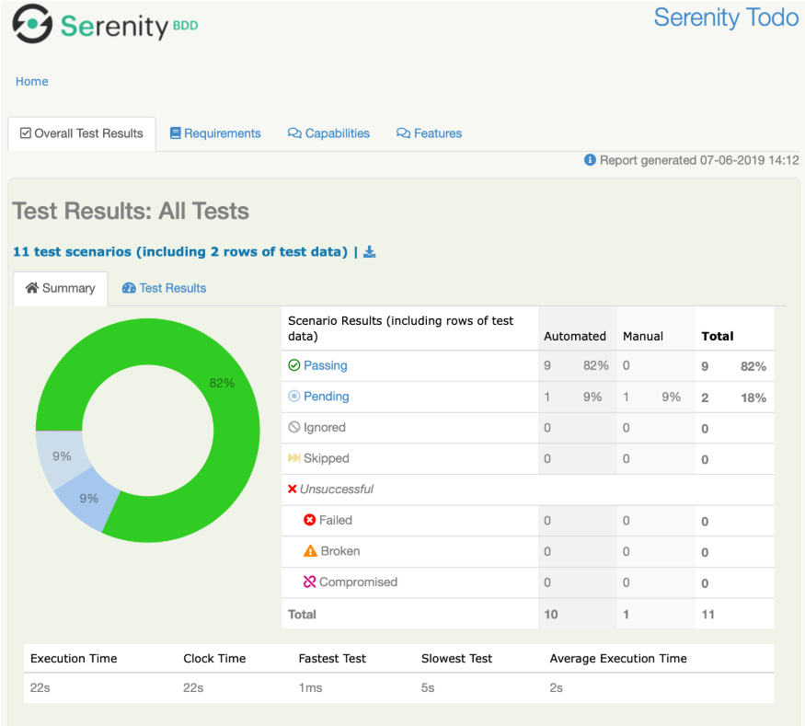
Serenity BDD Report
Serenity makes your reports richer
Serenity reports aim to be more than simple test reports - they are designed to provide living documentation of your product. The reports give an overview of the test results:

Slide 9

Serenity BDD

