Slide 1

Customer Service in the telecommunications industry.

Slide 2
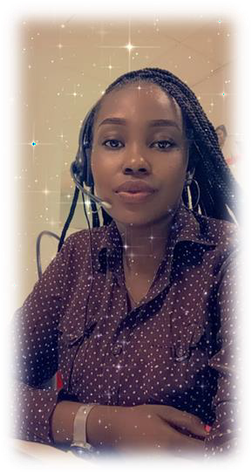
HELLO!
2
I am Djeninah Timothee, a customer service agent and a data analyst.

Slide 3
Agenda
4
Introduction
Define the Subject
Contexte
Methodology
Describing the process of our project
01
02
Recommendations
Limits
03
Other Prespectives

Slide 4


Stakeholders
“
The stakeholders involved are:
The company
The customers
The employees.

Slide 5

“
Data Source
The data used for this project came from Digicel Haiti, dated from October 2020 - March 2021.

Slide 6
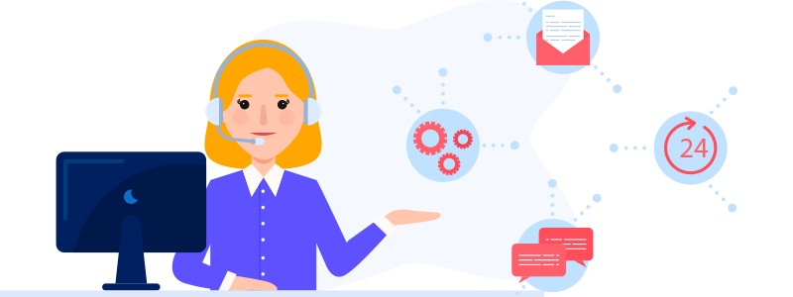
Methodology
9
Cleaning And Analysis
Cleaning Data and EDA using Python Pandas and Numpy
Recommendations
Collect
Limits
Collecting Data from Digicel Haiti.
Other prespectives

Slide 7
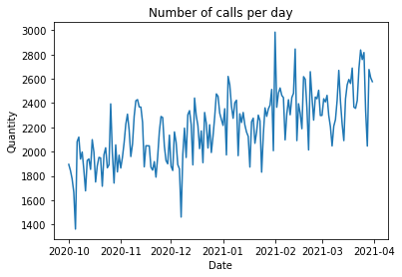

Results
10
Let's calculate the mean of calls per period of 6 months.
This table shows us the trend of calls during these 6 months. For this period, we received 400957 calls.

Slide 8
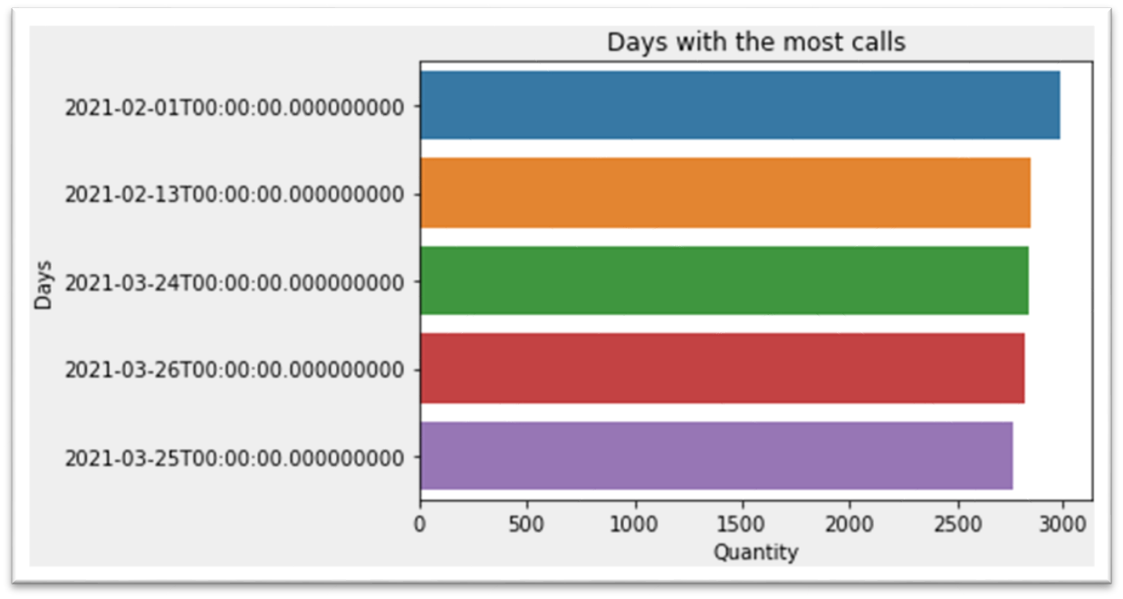

“
Let's do a study on the days with the most calls .
The graph shows us the 5 days with the most calls during these six months period

Slide 9
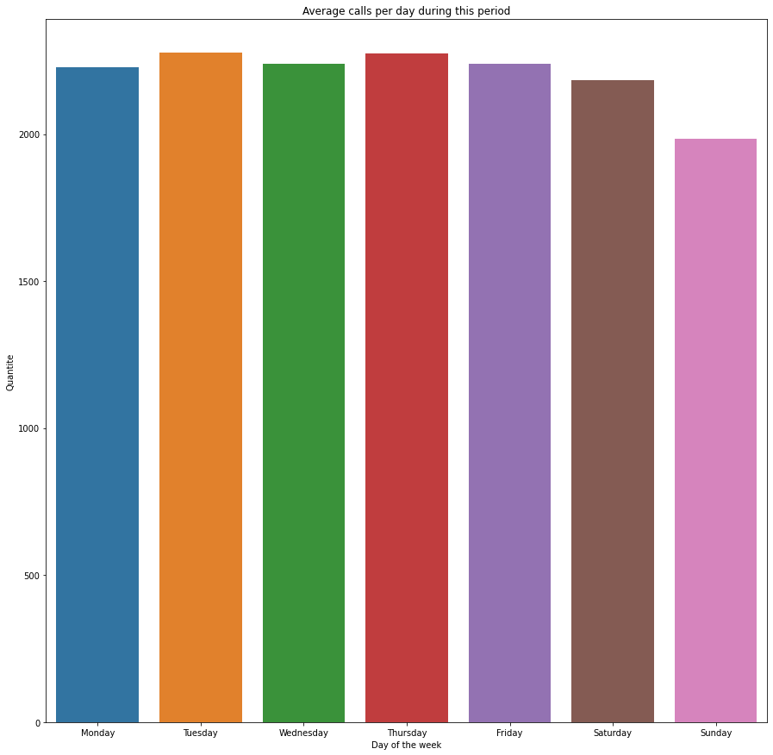

Let's calculate the average number of calls per day during this period.
We can see Tuesdays have the highest average number of calls, with 2276 inbound calls per day.

Slide 10
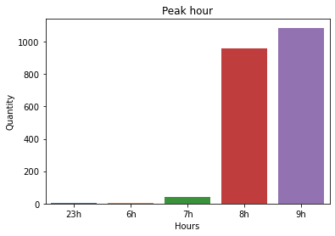

“
Let’s calculate the peak hours
As you can see the hours with the most calls are 9 AM and 8 AM

Slide 11
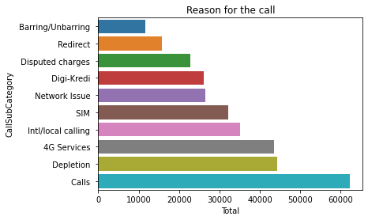

“
What do customers complain about when they call the service
This table shows the different category of calls received on a daily basis. As part of the calls, we also received pranks calls, or depletion calls.

Slide 12
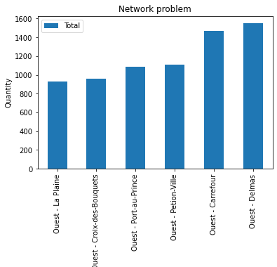

“
Let's see where there is much more of a Network problem.
This table shows us that the People in the commune of Delmas have the most difficulty with their network service.

Slide 13
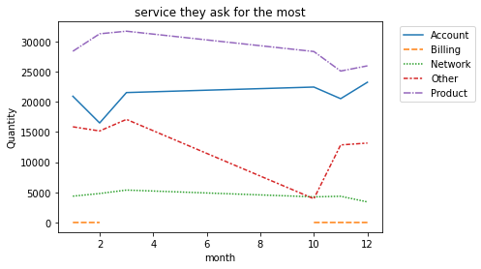

Let's see when customers call for which service they require the most
“
The service that customers ask for the most is product information.

Slide 14


Recommendations
18
As we have just seen customers are calling a lot more to ask for product information. Therefore, I recommend Digicel to send SMS to their customers every weekend so they can better explain the plans.
As the data indicated there are more calls around 8 AM and 9 Am, I suggest to put more agent during those shifts.
I would also suggest having far fewer employees work on Sundays because that is the day when there are not many calls..

Slide 15

19
As we have just seen, customers call most often to gamble or to insult. I have recommended to Digicel to put restrictions on their calls, so that the agents can exercise this rule and tell the customers that if you call the service to insult or gamble more than 3 times, we will block you for a certain time, you will not be able to call the service in case of need.
I suggested that the company pay much more attention to the network coverage of target areas, such as Delmas and Carrefour.

Slide 16

Appendix
20
What resources can the audience use to further understand the message and story being presented?
For further informations, please visit:
-https://github.com/Djeninah/Capstone.git

Slide 17


THANKS!
21
Any questions?
You can find me at Djeninahtimothee@gmail.com

