Slide 1


Ayiti Analytics Data Processing Bootcamp

Slide 2
Problem
What is the business problem?
Ayiti Analytics our customer wants to expand its training centers throughout all the communes of the country.
Who are the stakeholders impacted by the problem?
The stakeholders impacted by this problem are the client itself that wants to develop its organization and also everyone who wants to learn data science but that cannot because they don’t have a training center nearby.
Why is this problem important to the organization?
Ayiti Analytics it’s an organization that is involves In education, right now they are concentred at port-au-prince but they want to grow by implementing other learning centers throughout all the country.

Slide 3
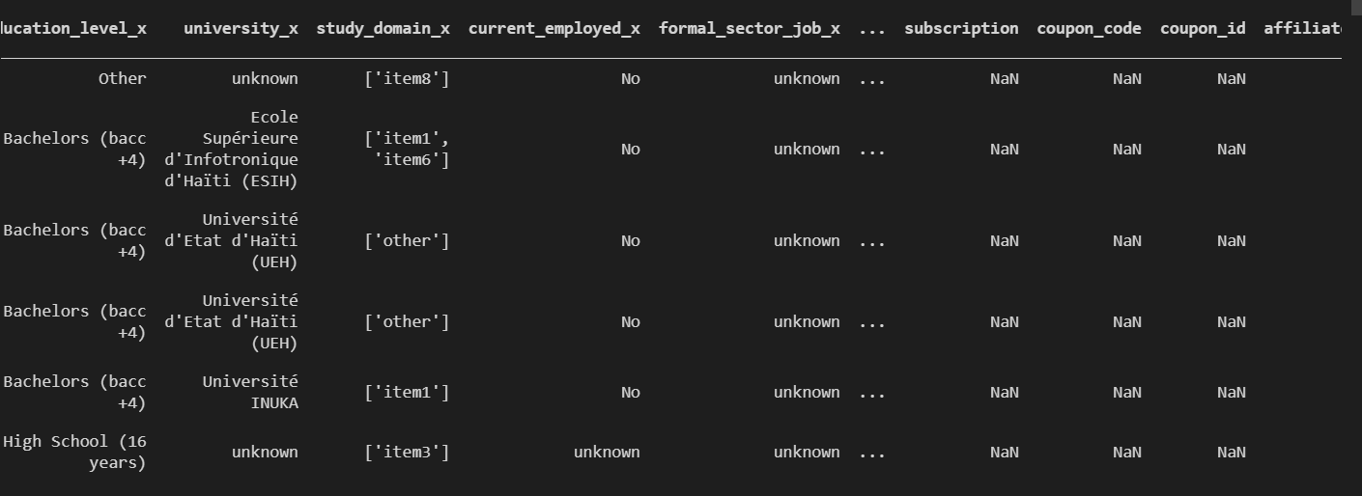
Methodology
The Customer provides all the data we needed to perform the study. Below we have a glance at how the data look in their raw form.

Slide 4
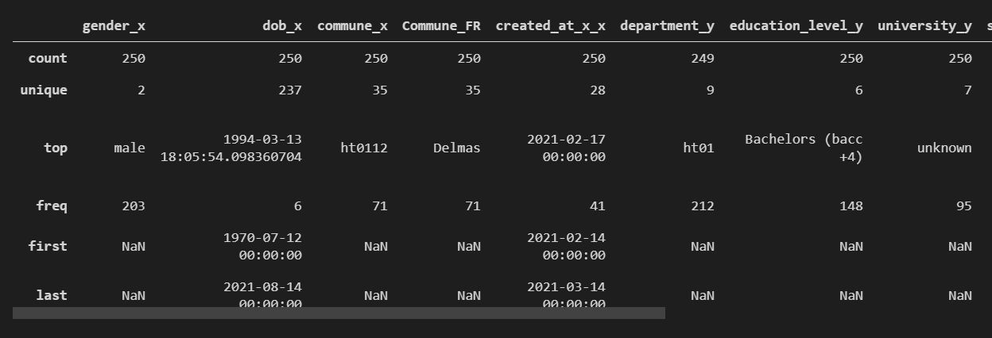
Methodology
First of all we perform all the cleansing methods in order to have a clean dataset. Here’s a glance at our final dataset.

Slide 5
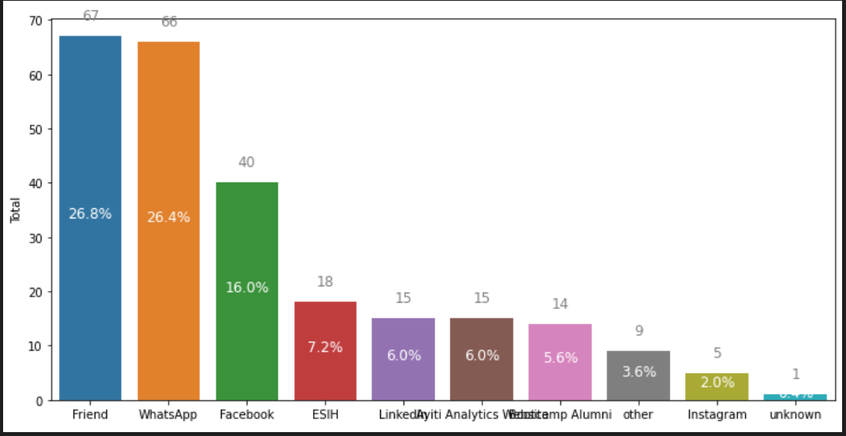
Results
After collecting the data we could see that the most effective communication channels that will allow a student to be likely to be selected are more precisely by Friend,whatsapp, facebook ….

Slide 6
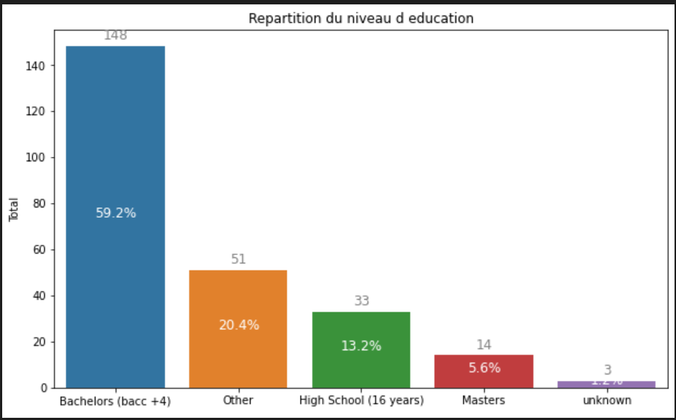
Results
As we can see the highest level of education is the bac +4

Slide 7
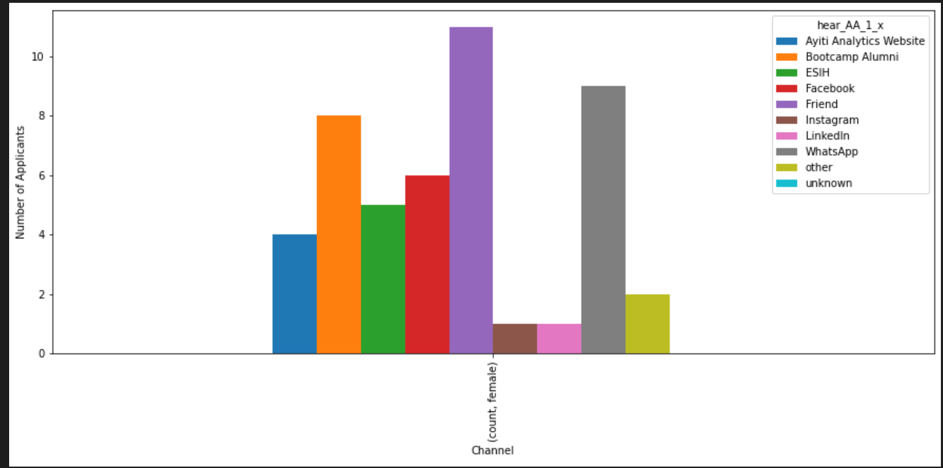
Results
From the graph we can see that the most effective communication channels that will allow a woman to be selected are friends and whatsapp.

Slide 8
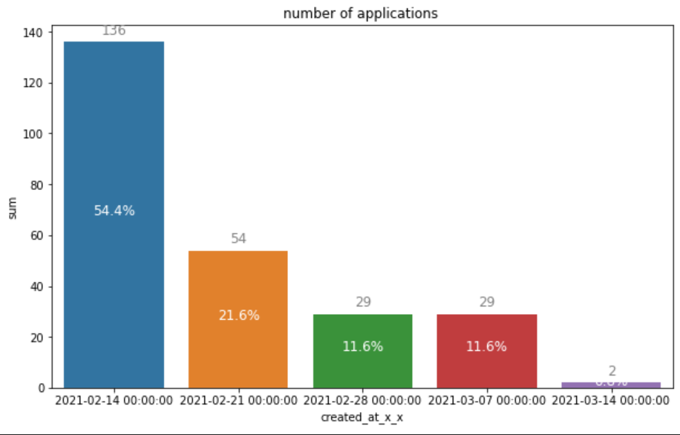
Results
After the calculations, we could see that the highest number of applications is 54.4%.

Slide 9
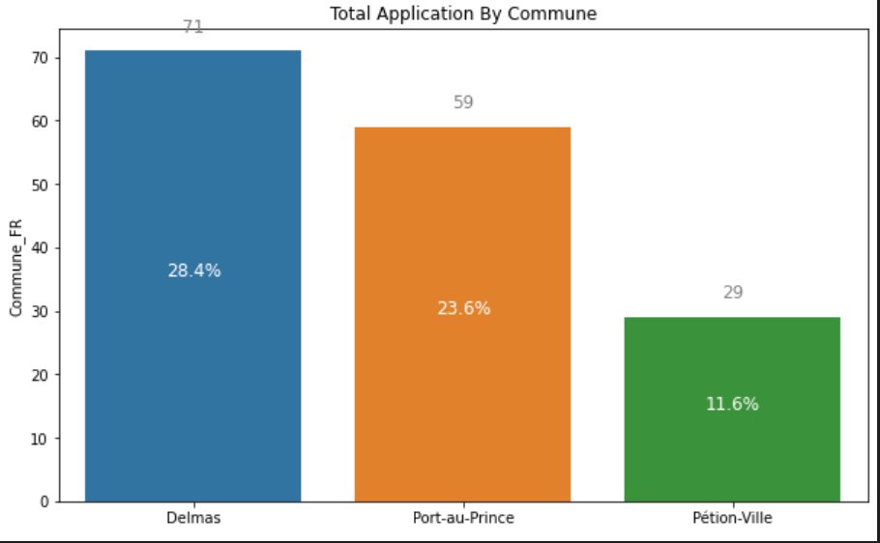
Results
According to the calculations made, the three municipalities in the country that are most likely to expand their training centers are: Delmas with a percentage of 28.4%, Port-au-Prince with 23.6%, and Petion Ville 11.6%.

Slide 10
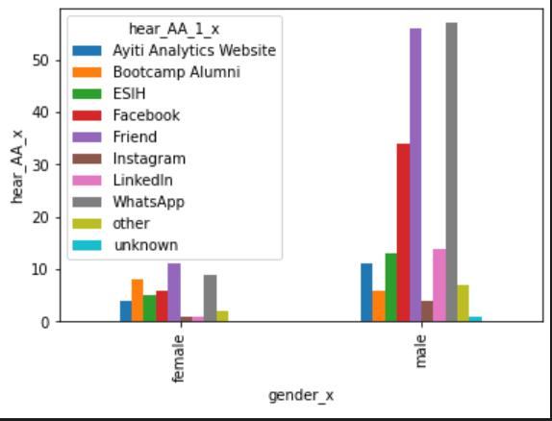
Results
From the graph we could see that the easiest way to get more girls is through friends and for boys it is through the whatsapp application.

Slide 11
Discussion & Proposed Solution
To conclude:
The best three communes of the country that would be the most likely to receive the training centers are Delmas, Port au Prince and Petion Ville.
Then the most effective communication channels are friends, whatsapp, facebook ....
The highest level of education is bac4+
93.6% of people have access to a computer
84% has access to internet.

Slide 12
References & Appendices
For the references please go to GitHub

Slide 13
Present
Djeninah Timothee

