Slide 1
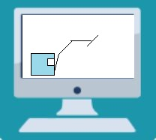
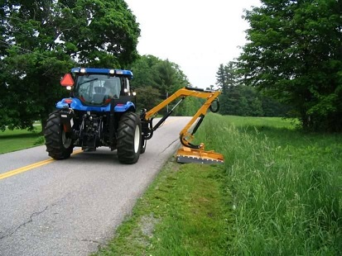


MOWING MACHINE DATA MONITOR
APPLICATION
IMPLEMENTATION
The aim of this project is to design a smart mowing machine monitoring system to log and visualize the machine’s different sensor data
Arduino to control ventilator based on temperature sensor reading
2 Arduinos in cabin
Main Arduino:
-Logs data received over CAN bus and sends it over Wifi to phone
Other Arduino:
-Change joystick output using DAC
Send GPS and joystick data to main Arduino using I²C
Computer using Power Bi to visualize data from cloud DB
CAN Bus
µC
µC
Phone running android app to store received data and push it to cloud DB
-5 IMUs to measure the different angles of the arm.
-Each sensor communicates with an Arduino mini using I²C

