Slide 1
RateMyPlace🏡
Group 13
Connor Fitzmaurice, Dustin Hengel, Mercy Housh, Madison Williams, Bradley Worthen

Slide 2
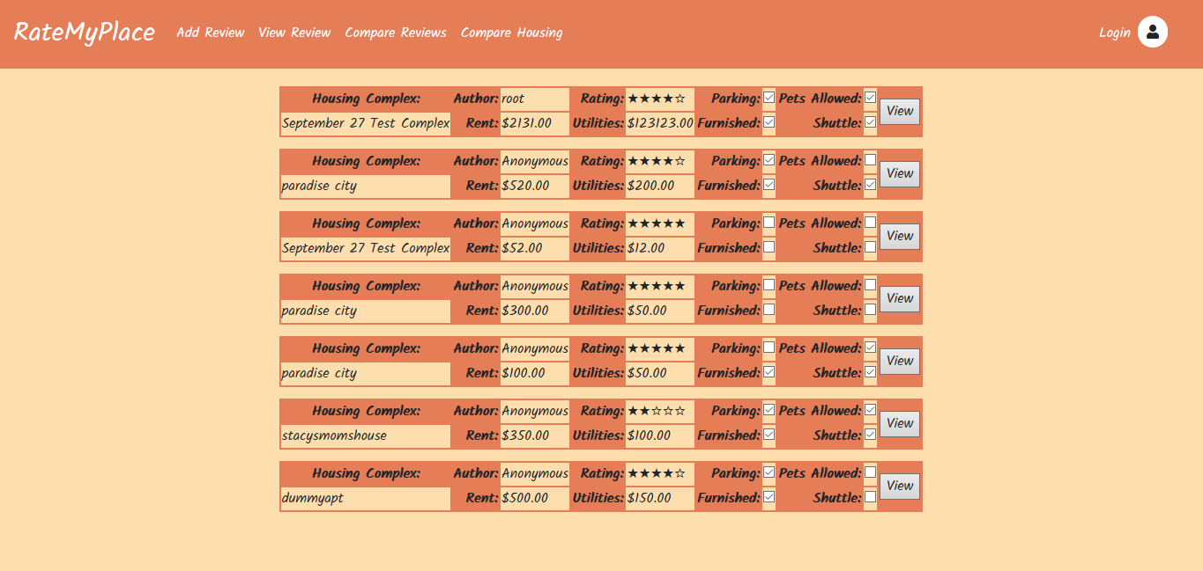
What
View Reviews
Post Reviews
Compare

Slide 3
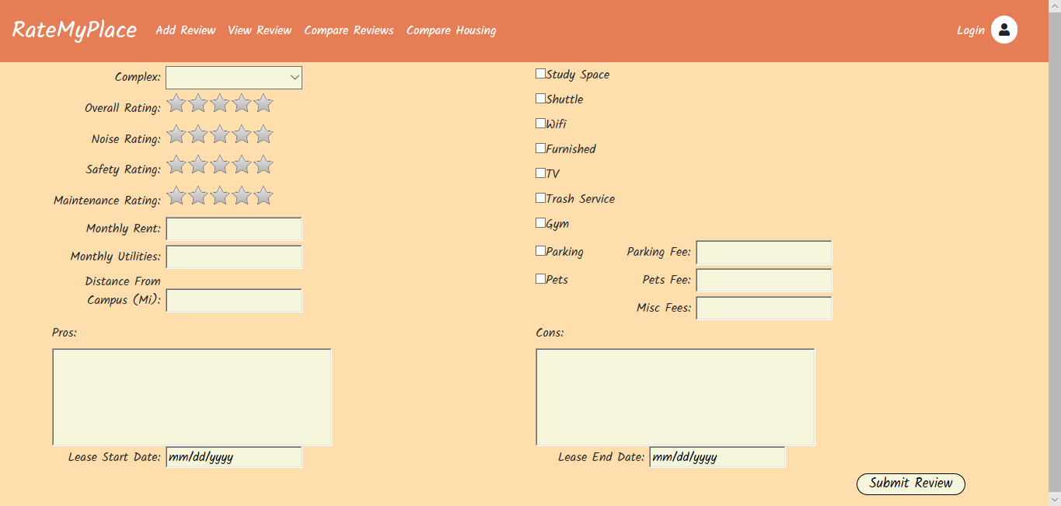
Who
College Students

Slide 4
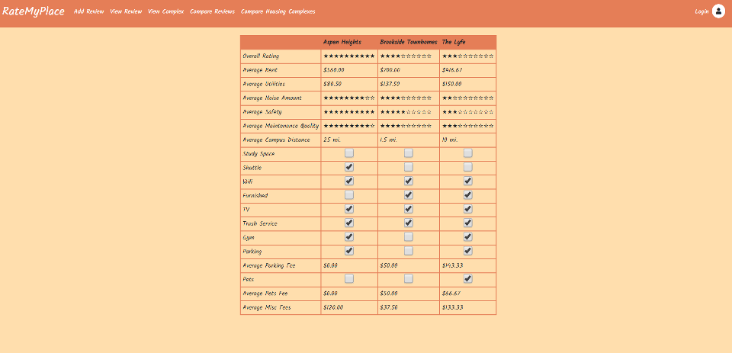
Why
Lack of Transparency
Lack of Comparability
Student Housing Needs

Slide 5
Successfully Implemented Changes
Ability for user to edit and delete their review
Ability for user to compare reviews on a housing complex
Ability to view details of a single review
Addition of a field to identify the square footage of the apartment
Addition of a field that shows the location rating

