Slide 1
MRTOF Timing System
Code-based rewrite
2025-06-25

Slide 2
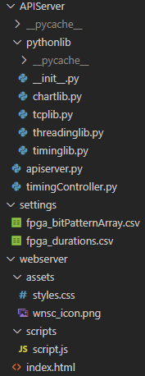
File Structure
The new timing control system consists of:
A backend server to:
Handle timing calculations
Store timing data (in csv)
Communicate with FPGA via TCP
A frontend server to:
Provide user interface
Backend Server Files
FPGA Timing Files
Frontend Server Files

Slide 3
Backend Server
Everything is written in Python
FastAPI Library is used to communicate with frontend server
Four custom libraries:
Tcplib: handles communication with FPGA via TCP
Threadinglib: supporting lib for TCP communication
Timinglib: Handles the timing calculations and storage of timing data
Chartlib: Uses matplotlib to draw charts and send to frontend (e.g. timing pulses)
The backend server can be started by running the command:
fastapi run .\apiserver.py
Inside the APIServer folder.

Slide 4
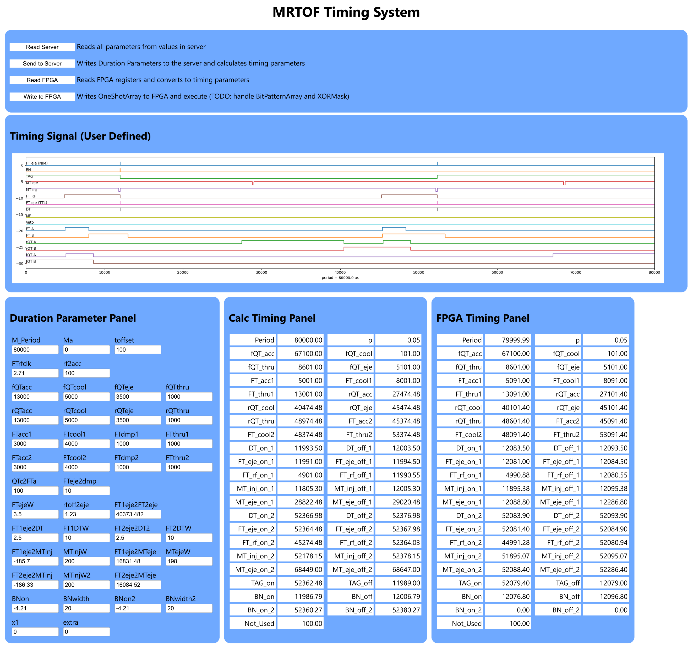
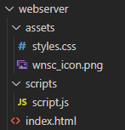
Frontend Server
Front end server is a static server using vanilla html+css+javascript:
No unnecessary frameworks
Uses fetch API to sent http requests to the backend server

Slide 5
Data Model
The FPGA is only interested in 3 things:
OneShotArray (array of 64 32-bit registers)
BitPatternArray (array of 16 32-bit registers)
XORMask (single 32-bit register)
These 3 32-bit registers are stored in the FPGA to define the timing pulses. They can be modified by sending TCP commands to the FPGA.
The User can only input duration parameters (for now).
The Duration parameters define how the exact timings for the FPGA are calculated.
BitPatternArray is fixed for the moment, but can be changed by modifying the fpga_bitPatternArray.csv file.

Slide 6
Data Model – durations, timings, OneShotArray
Duration
Parameters
Stores all timing duration information (e.g. MT ejection width, FT cool duration etc.)
Calculates timings from durations. See Watanabe-san’s document
Timing
Parameters
Stores all timing parameters for pulses
Inserts the timing parameters into the correct OneShotArray registers
OneShotArray
Stores all timing parameters in FGPA compatible oneShotArray
OneShotArray
FPGA
Stores all one shot array information read from the FPGA

Slide 7
Data Model – OneShotArray, BitPatternArray, XORMask
OneShotArray
Stores all timing information
Array of 64 32-bit registers
BitPatternArray
Maps the relation between timings in OneShotArray and 16 output channels of the FPGA
Array of 16 32-bit registers
XORMask
Indicate which output channels has a reversed polarity.
(0 = normal, 1 = reverse)
Single 32-bit register

Slide 8
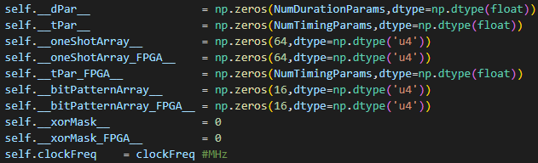
Data Model – timinglib
Timing data is stored in the timinglib.py file:
dPar: duration parameters
tPar: timing parameters
oneShotArray: timing parameters in appropriate addresses
bitPatternArray: map of timing parameters to output channels
xorMask: polarity information of output channels
These values are read from file and can be modified by user .
tPar _FPGA
oneShotArray _FPGA
bitPatternArray _FPGA
xorMask_FPGA
These values are read from FPGA and can only be modified by the calculated timings done by timinglib.

Slide 9
System Architecture
Frontend
Server
Backend
Server
FPGA
Handles User Interaction
Interfaces between frontend server and FPGA
Reads and writes timing information to file
Controls MRTOF Timing

Slide 10
UI
1
User buttons to read and write to server and FPGA.
Timing signal based on user defined values in Duration Parameter
Duration Parameter for User Input. DOES NOT REFLECT FPGA VALUES
Timing values calculated from duration parameters
Timing values read directly from FPGA
2
3
4
5

Slide 11
Multi-lap control
Please refer to Watanabe-san’s document for more information.
Multi-lap measurement can be done for reference side ions only.
FPGA Address | value | note
0x58,0x59 | MTeje on 2 | Base value
0x5A,0x5B | Mteje off 2 | Base value
0xC8, 0xC9 | N_di
0xCA,0xCB | MTeje on 2 | Additional 1
0xCC,0xCD | Mteje off 2 | Additional 1
0xCE,0xCF | MTeje on 2 | Additional 2
0xD0,0xD1 | Mteje off 2 | Additional 2
0xD2,0xD3 | MTeje on 2 | Additional 3
0xD4,0xD5 | Mteje off 2 | Additional 3
N_di is number of additional lap numbers.
If N_di = 0, then MRTOF operates normally.
Example:
N_di = 1
Mteje on 2 is triggered with base value and additional 1 value in alternating pattern.
N_di = 2
Mteje on 2 is triggered with base value, additional 1 value and additional 2 value in cyclical pattern.
…

Slide 12
Future work
UI to modify bitPatternArray values
UI to change xorMask values
UI to add multi-lap control in MRTOF reference cycle

