Slide 1


CEF440: INTERNET AND
MOBILE PROGRAMMING
TASK 5:USER INTERFACE DESIGN
PROJECT:
BIOMETRIC STUDENT ATTENDANCE
Presented by: Group 19
INSTRUCTOR: Dr NKEMENI VALERY

Slide 2
CONTENT
1
VISUAL DESIGN
2
MAIN PAGES

Slide 3







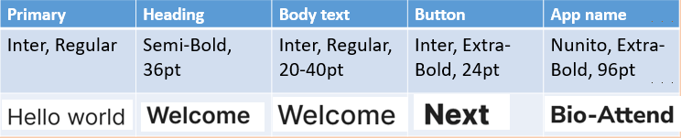


Color Scheme
Typography
The main font family is “Inter” from google fonts with different font size and weights
Icons
Some Icons
Primary Color
C
B
UI Visual design of
BioTrack
Back-ground Color
A
Error Color
Primary Color
Primary Color

Slide 4
LOGIN

Slide 5
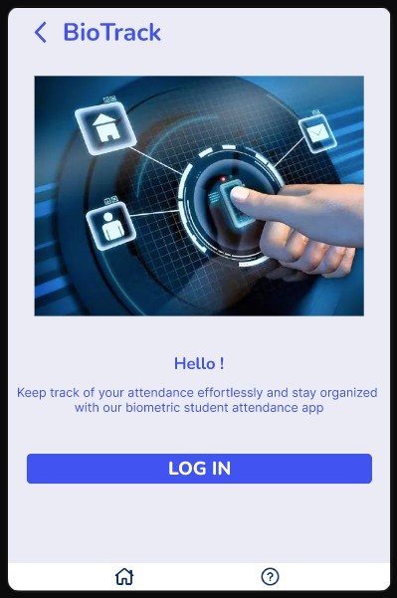
FIRST PAGE

Slide 6
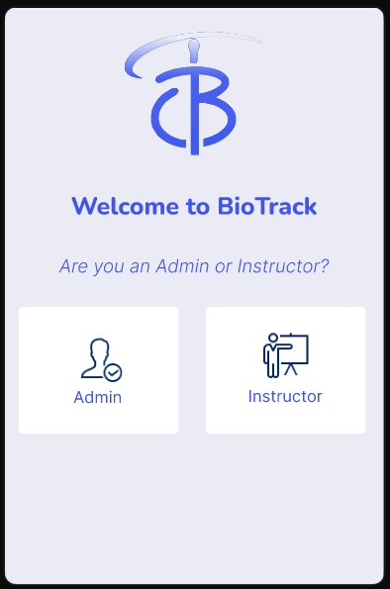
CHOOSE USER TYPE ON SCREEN

Slide 7
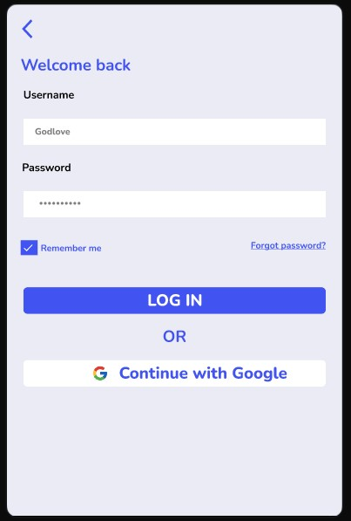
LOGIN BY ADMIN USING PASSWORD

Slide 8
Enrolling our first student

Slide 9
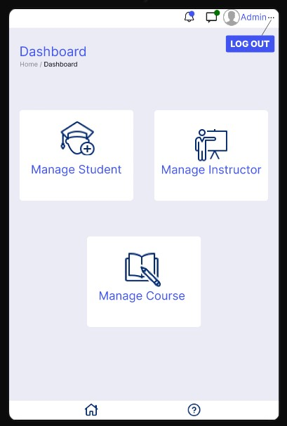
ON THE ADMIN DASHBOARD SELECT MANAGE STUDENT

Slide 10
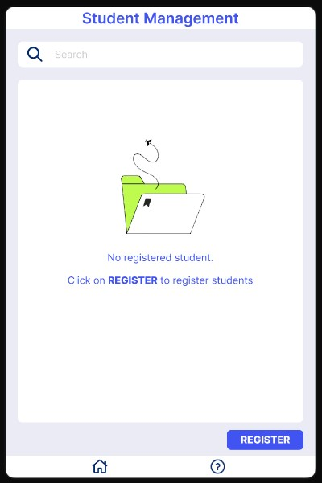
THE LIST IS EMPTY SO WE CHOOSE THE REGISTER OPTION

Slide 11
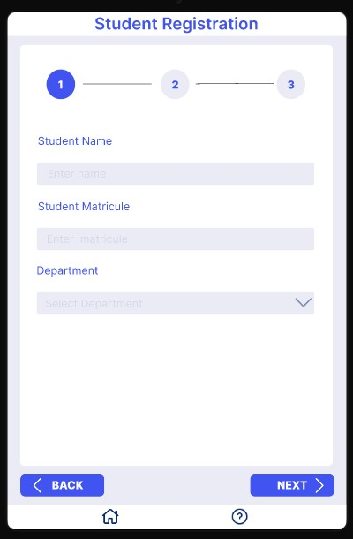
ENTER THE STUDENT INFO AND PRESS NEXT

Slide 12
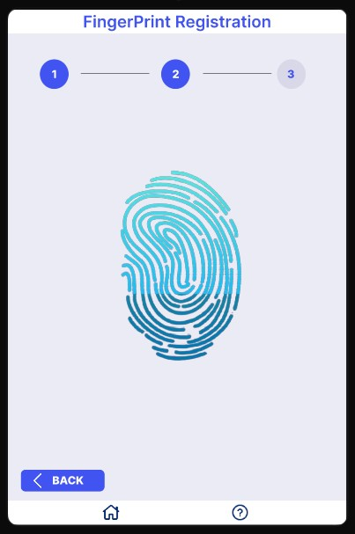
COLLECT FINGERPRINT USING SENSOR

Slide 13
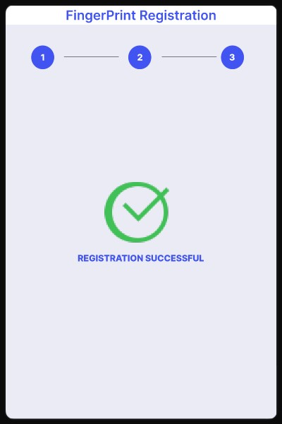
SUCCESSFUL MESSAGE

Slide 14
Register the first instructor

Slide 15
ON THE ADMIN DASHBOARD SELECT MANAGE INSTRUCTOR

Slide 16
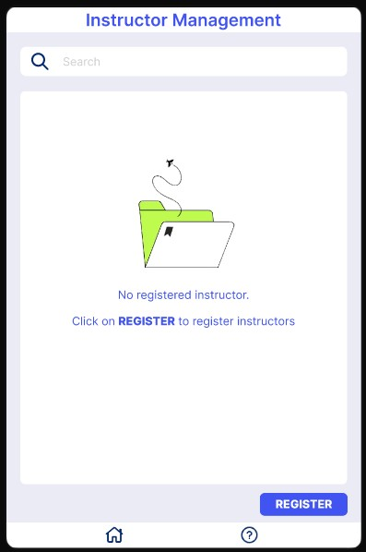
THE LIST IS EMPTY SO WE CHOOSE THE REGISTER OPTION

Slide 17
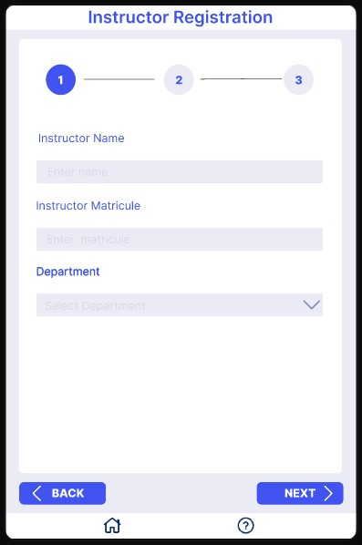
ENTER THE INSTRUCTOR INFO AND PRESS NEXT

Slide 18
COLLECT FINGERPRINT USING SENSOR

Slide 19
SUCCESSFUL MESSAGE

Slide 20
Register the first course

Slide 21
ON THE ADMIN DASHBOARD SELECT MANAGE COURSE

Slide 22
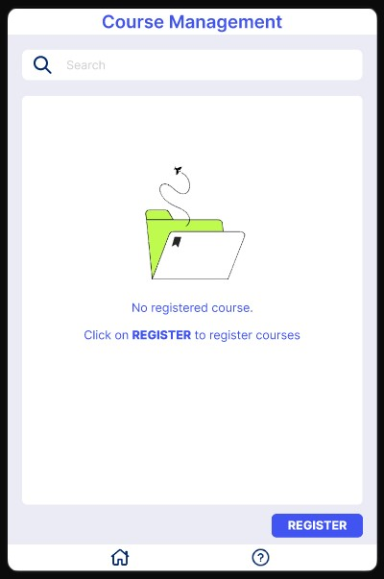
THE LIST IS EMPTY SO WE CHOOSE THE REGISTER OPTION

Slide 23
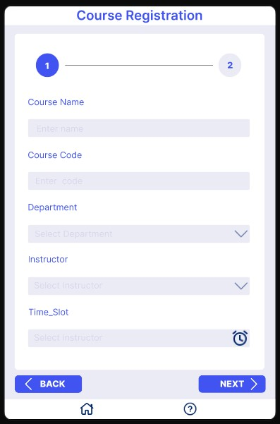
ENTER THE INSTRUCTOR INFO AND PRESS NEXT

Slide 24
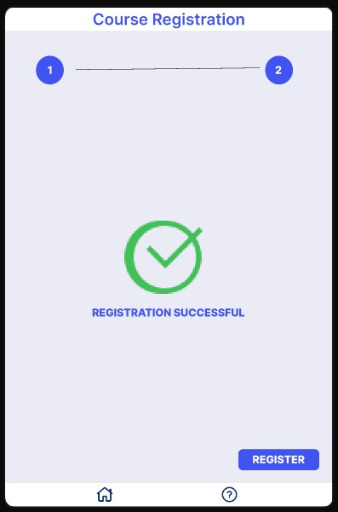
SUCCESSFUL MESSAGE

Slide 25
Conduct attendance

Slide 26
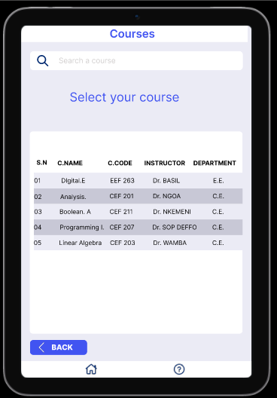
ON THE CLASS TERMINAL INSTRUCTOR SELECTS COURSE

Slide 27
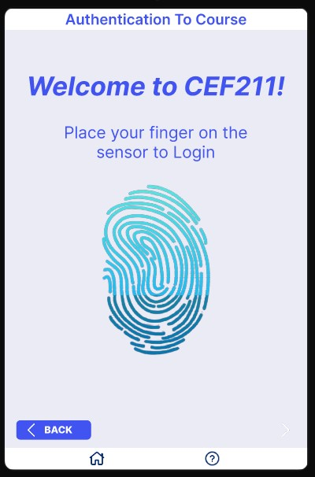
INSTRUCTOR ENTERS FINGERPRINT

Slide 28
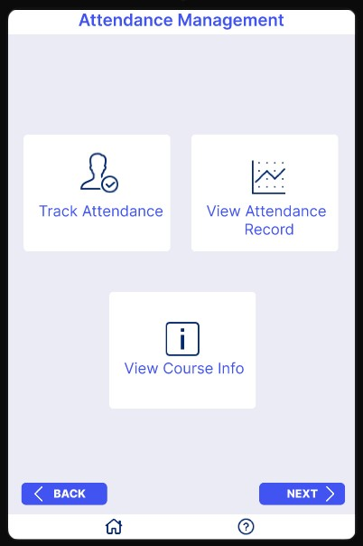
ON THE CLASS DASHBOARD SELECT TRACK ATTENDANCE

Slide 29
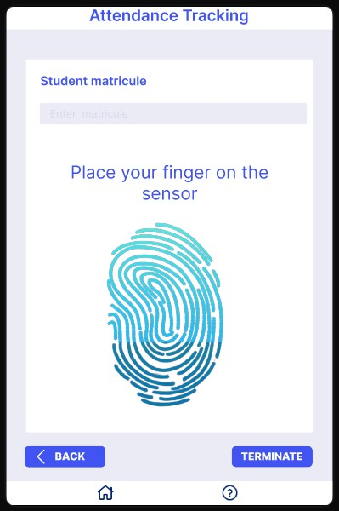
STUDENT ENTERS MATRICULE AND PUTS HIS FINGERPRINT

Slide 30
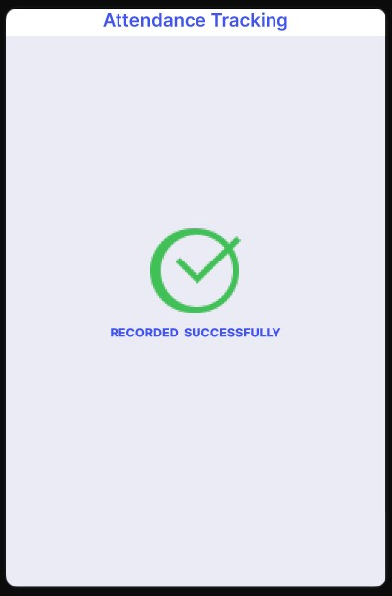
SUCCESSFUL MESSAGE

Slide 31
Viewing attendance report

Slide 32
AFTER LOGIN TO COURSE SELECT VIEW ATTENDANCE RECORD

Slide 33
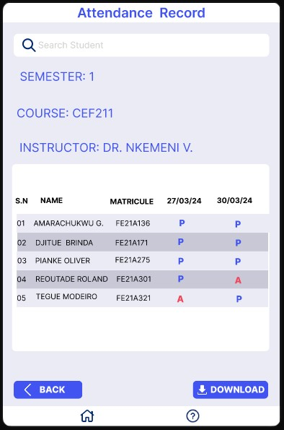
A LIST AS THIS WILL BE SHOWED TO INSTRUCTOR

Slide 34
THANK YOU

