Slide 1


CEF440:INTERNET AND MOBILE PROGRAMMING
PROJECT:
Biometric Student Attendance
Presented by: Group 19
TASK 2:
Requirement gathering
Instructor: Dr NKEMENI VALERY

Slide 2
CONTENT
01
Introduction and definition
Reason for requirement gathering
02
.
03
Requirement gathering processes
04
Benefits of requirement gathering
05
Problem faced
06
Conclusion

Slide 3
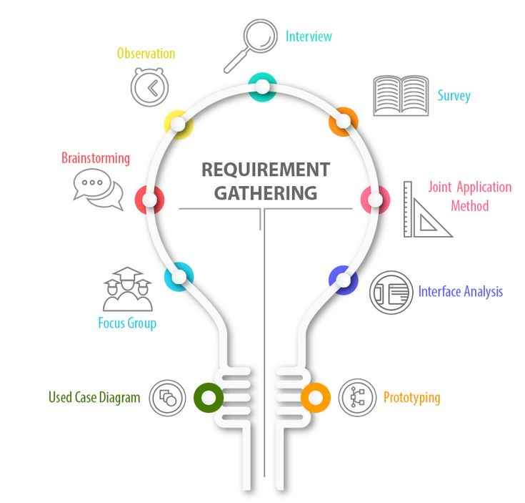
1 INTRODUCTION AND DEFINITION
Introduction
In modern institutions, effectively managing attendance is essential for monitoring student engagement and ensuring accountability which is not
always efficient using traditional methods. To overcome this, we propose a system of
attendance using
biometrics
Definition
It is the act of generating a list of requirements to define what a project is about and its goal.

Slide 4

2.0 REASONS FOR REQUIREMENT GATHERING
Understand stakeholders needs
Minimizing risk and errors
Guiding development decisions
Managing scope creep
Why do we gather requirements?

Slide 5
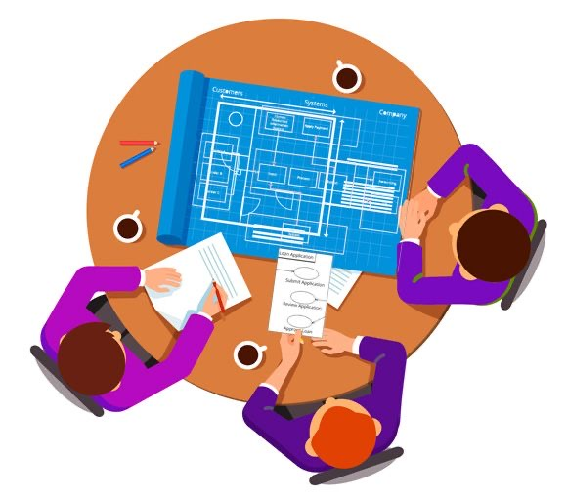
3. REQUIREMENT GATHERING PROCESSES

Slide 6

3.1 ASSIGNING ROLES
For this step
we carried out a
Brainstorming sessions with the group members in order to identify the stakeholders
Meeting session
Who do you think are the stake holders
Main stakeholders
Students
Instructors
Administrators
Developers
Testers
Designers
Project manager

Slide 7

3.2 DEFINE PROJECT SCOPE
Clearly define the scope of the project by outlining its objectives, boundaries, and limitations
1. Document analysis
2. Brainstorming
3. Interviews
Objective: Record student attendance
Boundaries: Use the biometric information only for attendance
Limitations: main constraint is a four month period

Slide 8

3.3 STAKE HOLDERS INTERVIEW
Interviews
Here we conducted interviews with
some students and faculty instructors in order to gather some requirements
Sir, what are your expectations from our system
I will expect your system to verify fingerprint of students after each lecture
Google forms
Google forms were sent to some course delegates and lecturers and the answers were sent to us for analysis of requirements
Team members Stakeholder

Slide 9

3.4 GATHER AND DOCUMENT
From the interview with lecturer I can find out that
From the google form I can see that they need …
From the stakeholder interview and the rest what can we extract?
Workshops:
Workshops were organized among the group members in order to document all the requirements from the previous steps
Ok I will note it down

Slide 10


3.5 VERIFY AND VALIDATE
Verification
Purpose: focus on accuracy of the requirements.
Approach used:
Requirement walkthroughs
Requirement traceability
Is this exactly what
you expect from the
System ?
Validation
Purpose: Ensures that the documented requirements meet project goal.
Approach used:
Prototyping
User acceptance testing
Yes that is what I expected
but we can also add some
other

Slide 11


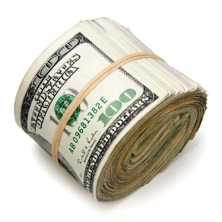

3.6 PRIORITIZE REQUIREMENTS
Here we choose some requirements to prioritize based on our budget, time and some other constraints
Prioritize the requirements based on their importance to the project goals and constraints

Slide 12
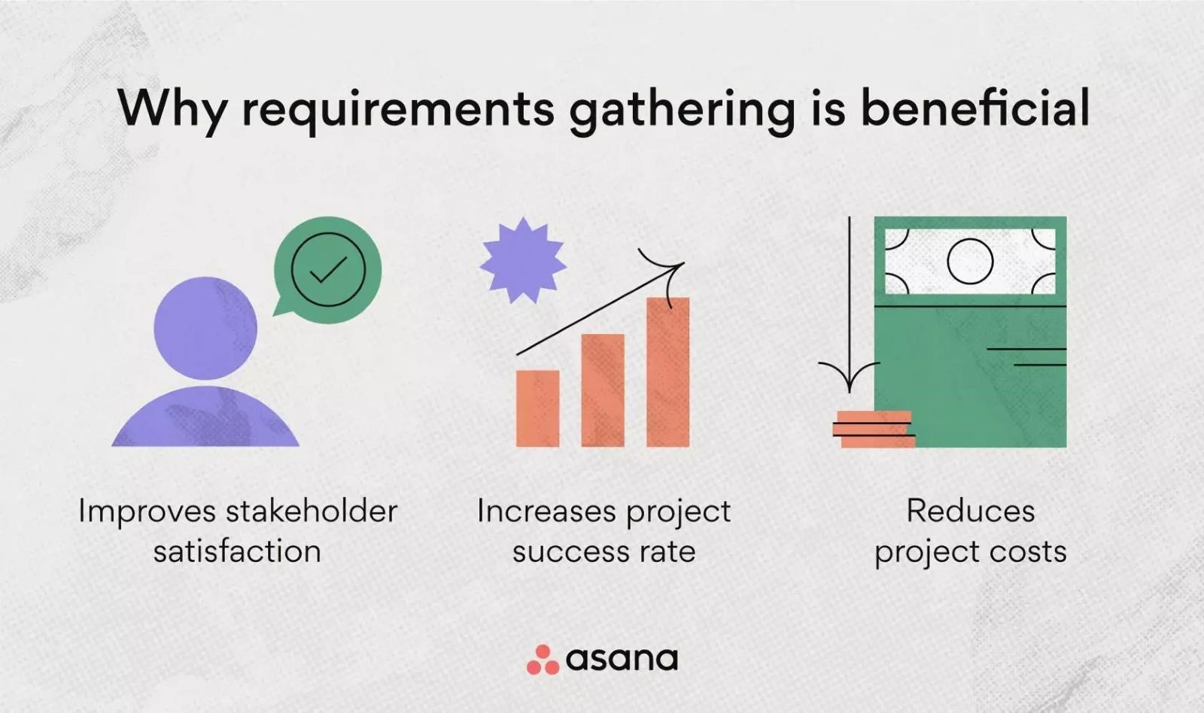
4.0 BENEFITS OF REQUIREMENT GATHERING

Slide 13

5.0 PROBLEM FACED
Poor internet
connection
Availability of
Stakeholders
Electricity
problem

Slide 14
6.0 CONCLUSION
Requirement gathering is the cornerstone of software development projects

Slide 15
7.0 REFERENCE
https://www.geeksforgeeks.org/requirements-gathering-introduction-processesbenefits-and-tools/ visited on 17 April 2024
https://asana.com/resources/requirements-gathering visited on 17 April 2024
https://www.sdd-technology.com/blog/mobile-app-development-process-step-by-stepguide visited on 17 April 2024
https://dev.co/mobile/preparation visited on 17 April 2024
https://www.jamasoftware.com/requirements-management-guide/requirementsgathering-and-management-processes/what-is-requirements-gathering visited on 17 April 2024

Slide 16
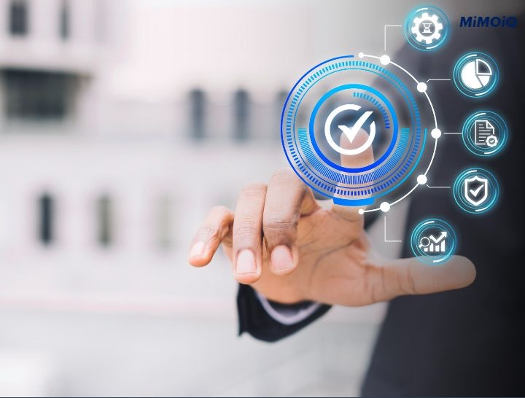

Thanks For Your Attention

