Slide 1

CEF440: INTERNET AND
MOBILE PROGRAMMING
TASK 6:DATABASE DESIGN
AND IMPLEMENTATION
PROJECT:
BIOMETRIC STUDENT ATTENDANCE
Presented by: Group 19
INSTRUCTOR: Dr NKEMENI VALERY

Slide 2
CONTENT
1
DEFINITION
2
HOW TO ENSURE A GOOD DATABASE DESIGN
3
BIO TRACK’S DATABASE
4
NO SQL DATABASE
5
FIREBASE/FIRESTORE
6
DATA MODEL OF BIO-TRACK
7
CONCLUSION

Slide 3
1 DEFINITION

Slide 4
The database design for a Biometrics Student Attendance App is a comprehensive series of procedures and tasks that encompass multiple steps essential for implementing a robust and efficient database system

Slide 5
2 HOW TO ENSURE A GOOD DATABASE DESIGN

Slide 6
Step 1: Determine the goal of your database, and ensure clear communication with the stakeholders
2 STEPS TO GOOD DATABASE
Step 2: List down all the entities that will be present in the database & what relationships exist among them
Step 3: Organize the information into different tables such that no or very little redundancy is there
Step 4: Ensure uniqueness in every table
Step 5: After all the tables are structured, and information is organized

Slide 7
4 BIO TRACK’S DATABASE

Slide 8
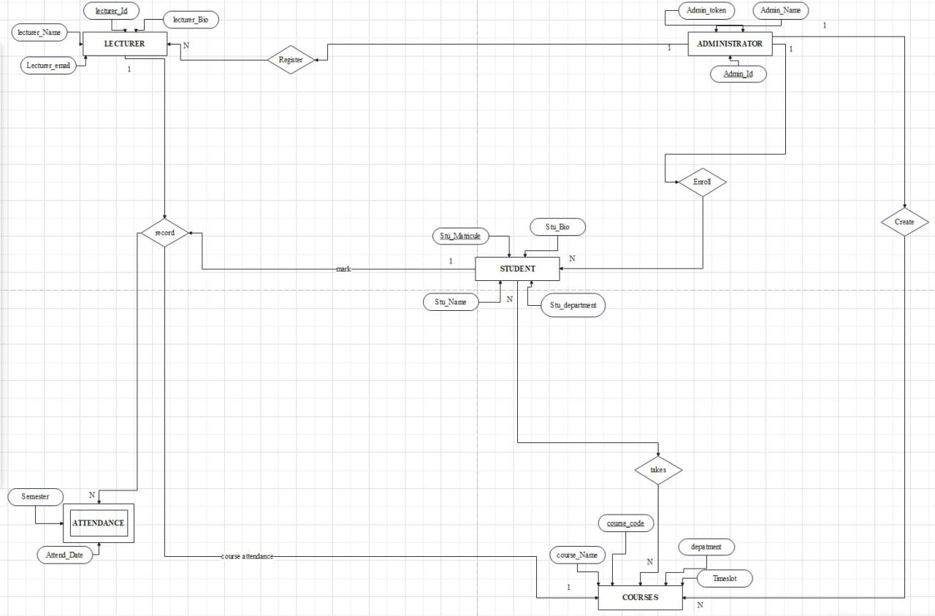

3.1 CONCEPTUAL MODELING
E-R DIAGRAM

Slide 9
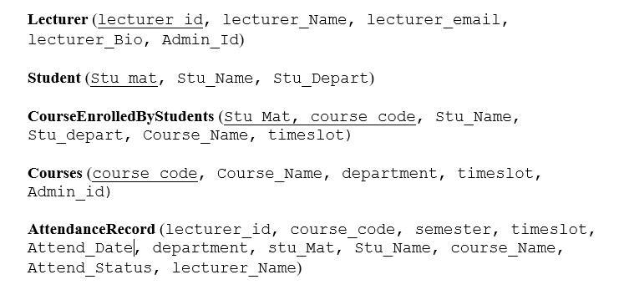
3.2 LOGICAL MODELING(1/3)
STEPS TO PRODUCE RELATIONAL SCHEMA:
Identify Entities
Identify Attributes
Determine Primary Keys
Identify Relationships
Create Junction Tables for Many-to-Many Relationships
Normalize the Schema
Define the Final Schema
Final schema

Slide 10
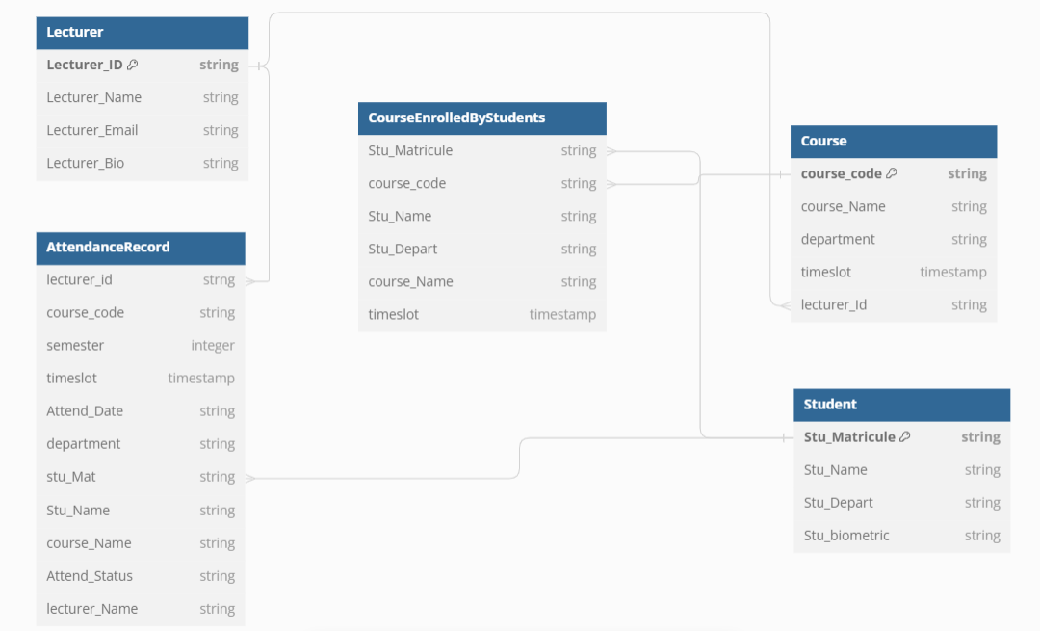
3.2 LOGICAL MODELING(2/3)

Slide 11
3.2 LOGICAL MODELING(3/3)
DRAWBACKS FACED WITH SQL DBMS:
Scalability
Complexity in Handling Large Volumes of Data
Schema Rigidity
Complexity in Distributed Systems
Cost
Handling Unstructured Data
Maintenance and Tuning

Slide 12
NO SQL DATABASE

Slide 13
4 NO SQL DATABASE
What is nosql:
NoSQL is a type of database management system (DBMS) that is designed to handle and store large volumes of unstructured and semi-structured data
Classification of nosql databases:
Document-oriented database
Key-value databases
Wide-column stores
Graph databases
Multi-model databases
WHY DID WE CHOOSE NOSQL DATABASE:
Scalability
Flexibility
Performance
Handling Unstructured Data
High Availability and Fault Tolerance

Slide 14
FIREBASE/FIRESTORE

Slide 15
4 NO SQL DATABASE
WHAT IS FIRESTORE:
Cloud Firestore is a flexible, scalable database for mobile, web, and server development from Firebase and Google Cloud.
WHY WE CHOSE FIRESTORE DATABASE FOR Bio-Track
Real-Time Data Synchronization
Scalability and Performance
Flexible Data Structure
Ease of Integration
Security

Slide 16
DATA MODEL OF BIO-TRACK

Slide 17
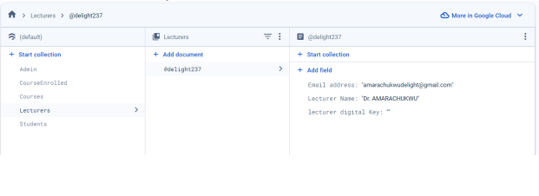
LECTURER COLLECTION

Slide 18
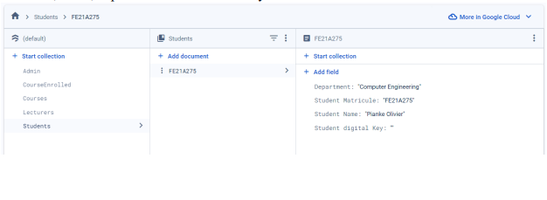
STUDENT COLLECTION

Slide 19
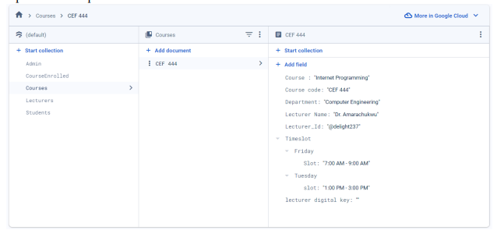
COURSE COLLECTION

Slide 20
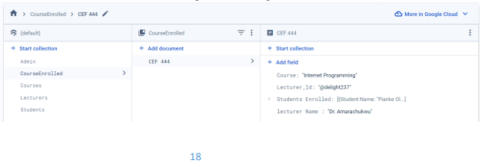
COURSE ENROLLED COLLECTION

Slide 21
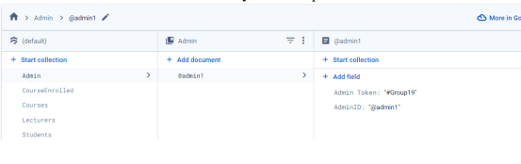
ADMIN COLLECTION

Slide 22
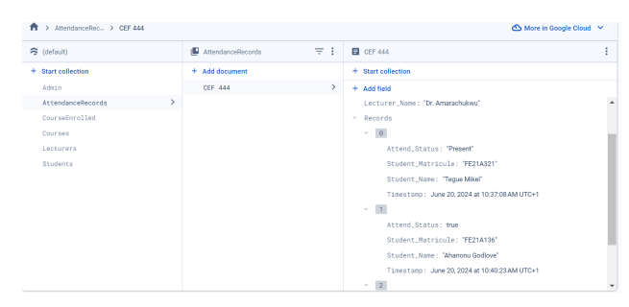
ATTENDANCE RECORD COLLECTION

Slide 23
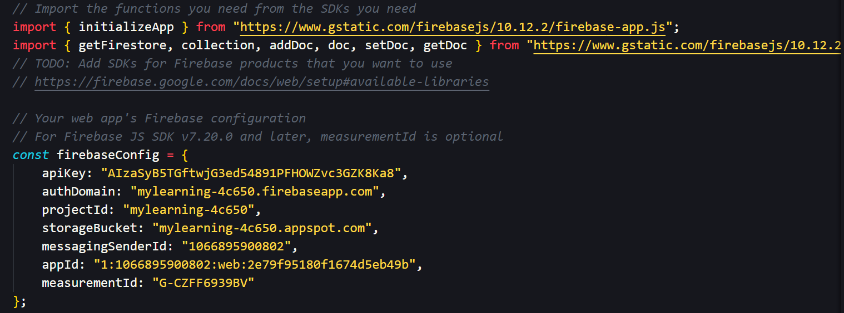
FIRESTORE CONFIGURATION

Slide 24
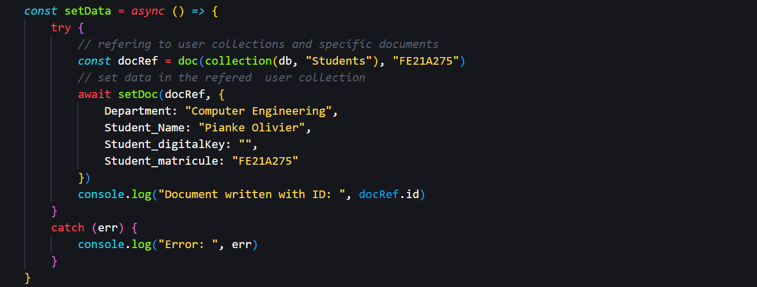
TEST FUNCTION USED TO ACCESS FIRESTORE DATABASE

Slide 25
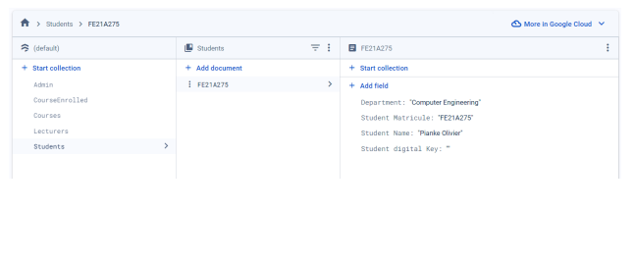
OUTPUT

Slide 26
CONCLUSION

Slide 27
The implementation of a Biometric Student’s Attendance App, supported by a well-designed NoSQL database, offers a solution for managing student attendance in educational institutions. Through careful database design, leveraging the flexibility and scalability of NoSQL databases like Firestore, the system can handle the dynamic and evolving requirements of modern educational environments

Slide 28
THANK YOU

