Slide 1

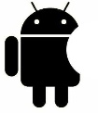
CEF440:INTERNET AND MOBILE PROGRAMMING
TASK 1:
Mobile application overview
Presented by: Group 19
Instructor: Dr NKEMENI VALERY

Slide 2
CONTENT
01
Types of mobile applications and comparison
.
02
Programming languages used for mobile
03
Mobile application development framework s
04
Mobile architecture and design patterns
05
Requirement engineering
06
Development cost estimation

Slide 3
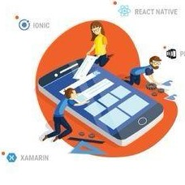
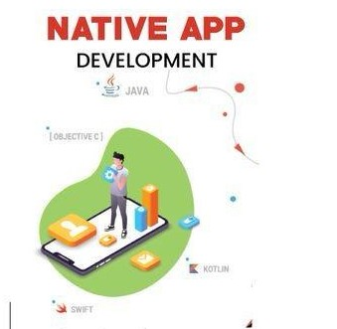
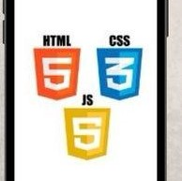
1.1 TYPES OF MOBILE APPLICATIONS
3
Hybrid mobile applications
1
Native mobile applications
Native apps operate on a specific platform or device, like iOS or Android
2
Progressive web applications

Slide 4
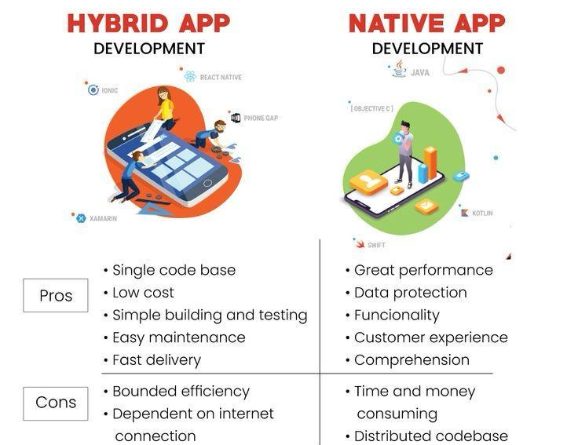
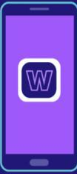
1.2 MOBILE APPLICATION COMPARISON
WEB APPS
DEVELOPMENT
performs on all devices
easier to maintain
Users don’t run out of storage
Dependent on a browser
Needs an internet connection
May not always integrate with device
hardware

Slide 5
2.0 MOBILE APPLICATION DEVELOPMENT PROGRAMMING LANGUAGES
Programming language | Platform | Operating system | Level of difficulty | Framework
JavaScript | Hybrid app Web apps | Android and IOS | Easy to learn | React native
Kotlin | Native app | Android | Easy to learn | Native android SDK
Java | Native app | Android | Easy to learn
Swift | Native app | IOS | Easy to learn
Objective-C | Native app | IOS | Easy to learn
C# | Hybrid apps | Android and IOS | Intermediate
Dart | Hybrid apps | Android and IOS | Easy to learn
Python | Hybrid apps | Android and IOS | One of the Easiest language

Slide 6
3.0 MOBILE APP DEVELOPMENT FRAMEWORKS
Features | Native IOS | Native Android | React Native | Cordova | Flutter | Ionic | Xamarin
Language | Swift | Kotlin | Javascript | Javascript | Dart | Javascript | C#
Performance | Very high | Very high | high | low | high | Low | Average
Cost and time to market | More expensive and slower | More expensive and slower | Cheaper and faster | Cheaper and faster | Cheaper and faster | Cheaper and faster | Cheap and fast
UI/UX | Native | Native | Adapts to platforms | Adapts to platforms | Adapts to platforms | Adapts to platforms | Adapts only partially
Complexity | high | high | moderate | moderate | moderate | low | moderate
Community Support | Very popular | Very popular | Very popular | Not so popular | popular | Not so popular | Not so popular
Where to use | Apple ecosystem only | Andoid only | iOS, Android, web | iOS, Android, web | iOS, Android, web | iOS, Android, web | iOS, Android, web

Slide 7
4 MOBILE ARCHITECTURE
AND DESIGN PATTERNS

Slide 8
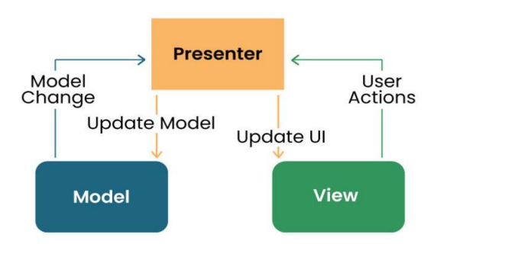
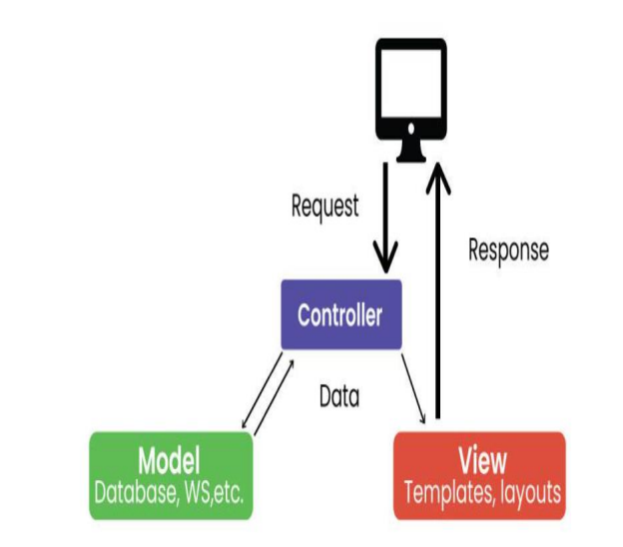
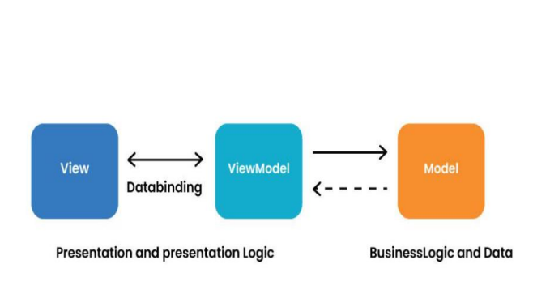
4.1 MOBILE ARCHITECTURE
2
Model View Presenter (MVP) Architecture
MVP is a new architecture that separates an
application into three parts: Model, View,
and Presenter.
Model View Controller (MVC) Architecture: MVC is a design model that separates an application into three interacting parts: Model, View, and Controller.
1
Mobile View ViewModel Architecture MVVM is a design
model widely used in mobile development, especially in
frameworks like Android’s Jetpack.
3

Slide 9
4.2 DESIGN PATTERNS
3
1
SINGLETON METHOD
DESIGN PATTERN
The singleton policy ensures that there is only
one instance of a class and provides global
access.
Adapter Method Design Pattern
The adapter configuration allows you to
use the interface of an existing class as
a link to a new one
2
Factory Method Design Pattern
The Factory Method model defines an interface
for creating an object but allows subclasses to
modify the type of the created object

Slide 10
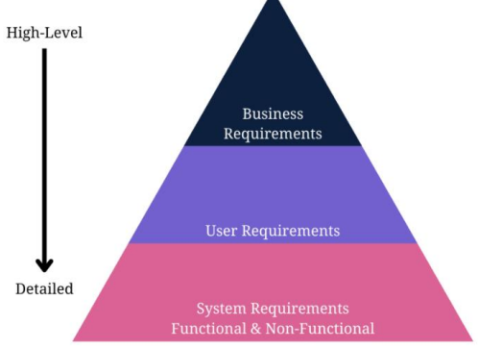
5 REQUIREMENT ENGINEERING
1
2
TYPES
Business requirements
User requirements
Product or system requirements
STEPS TO FOLLOW
Step 1: Define Your App Idea and Purpose
Step 2: Gather and Align the App and Business
Objectives or Goals
Step 3: Run a Market Analysis and Competitor Analysis
Step 4: Determine Scenarios and a User Persona
Step 5: Gather and Prioritize Functional and
Non-Functional Requirements
Step 6: Design Use Cases
Step 7: Write an app requirement document
Step 8: Deploy Prototyping and Wireframing
Step 9: Validate the App Requirements
Step 10: Apply Agile Methodology
NB: Diagrams will be seen on the next slide

Slide 11
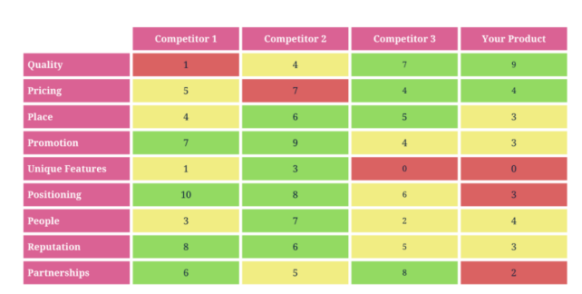
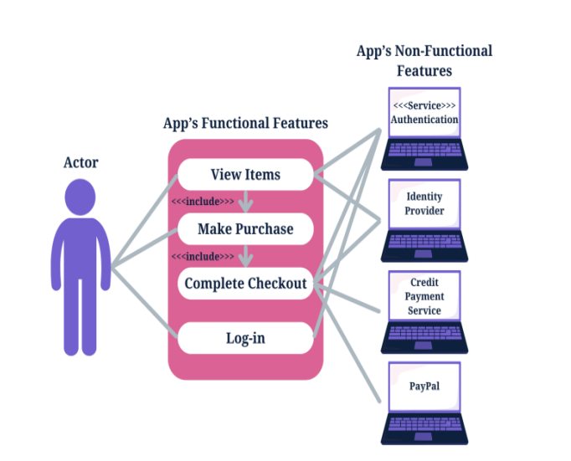
REQUIREMENT ENGINEERING DIAGRAMS
Step 3: Run a Market Analysis and Competitor Analysis
Step 6: Design Use Cases

Slide 12
REQUIREMENT ENGINEERING DIAGRAMS
Step 7: Write an app requirement document

Slide 13
6 DEVELOPMENT COST ESTIMATION
1
2
FACTORS AFFECTING DEVELOPMENT
COST
Scope and Complexity of the App
Platform
Design
Development Approach
Backend Development
Testing
Maintenance and Updates
Geographical Location of the Development Team
ESTIMATION METHODS
Fixed price: A fixed price is set based on the project scope,
features, and requirements.
Time and material: Costs are calculated based on hourly rates
multiplied by estimated development hours.
Value-Based Pricing: Pricing is based on the value provided to the
client or business, considering factors like ROI, market demand, and
competitive landscape.

Slide 14
REFERENCE
https://typeset.io/questions/what-is-requirement-engineering-3zzlhq9j93
https://aws.amazon.com/mobile/mobile-application-development/
https://www.techtarget.com/whatis/definition/mobile-app
https://fireart.studio/blog/types-of-mobile-apps/
https://www.requiment.com/requirements-gathering-and-management-for-mobile-apps/
https://www.youtube.com/watch?v=POih3P783a0
https://www.youtube.com/watch?v=1WWweyBaWZk
https://medium.com/@zorbisinc/pwa-vs-native-vs-hybrid-app-a-comprehensive-comparison9b7fbe870d13
https://www.choicely.com/blog/how-to-estimate-your-total-app-development-costs-free-app-costcalculator
https://www.geeksforgeeks.org/design-patterns-for-mobile-development/?ref=lbp

Slide 15

Thanks For Your Attention

