Slide 1

DA14
Capstone by: Dillon Mayfield

Slide 2

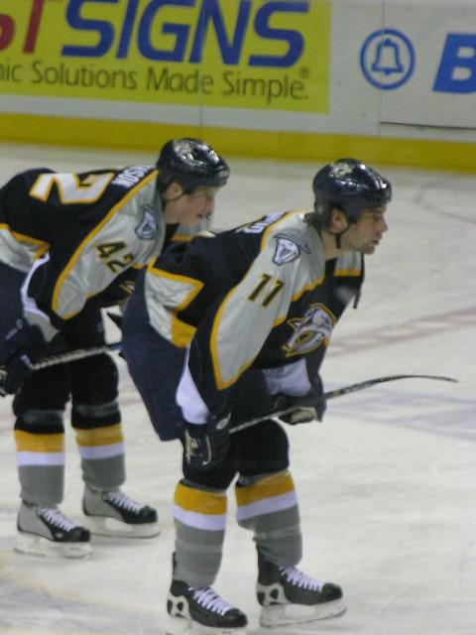
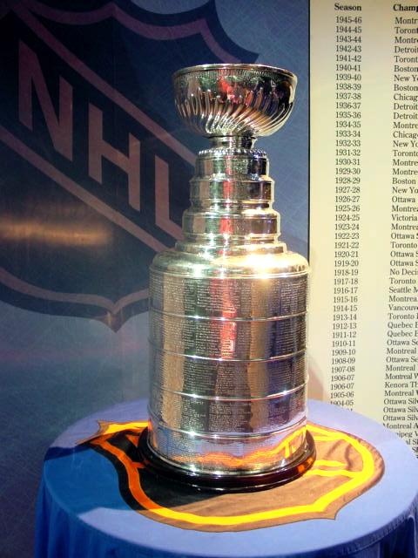
What does it take to make the finals?

Slide 3
Agenda
TABLE OF CONTENTS
Capstone
1
2
3
4
5
6
7
8
9
Intro / Housekeeping
Preseason Odds
Goal Differential
Power Play / Power Play Kill
Hot Streak Going into Playoffs
Presidents Trophy Curse
Putting it all Together
Final Thoughts
Thank You

Slide 4

Housekeeping
We will be looking at seasons 2015 - 2025
(Excluding years ‘20 and ‘21*)
Data was obtained from naturalstattrick.com and nhlreference.com
Calculations were done in Excel and Visuals were made in Tableau.
*2020 was stopped abruptly and 2021 was an abridged “bubble” season.

Slide 5
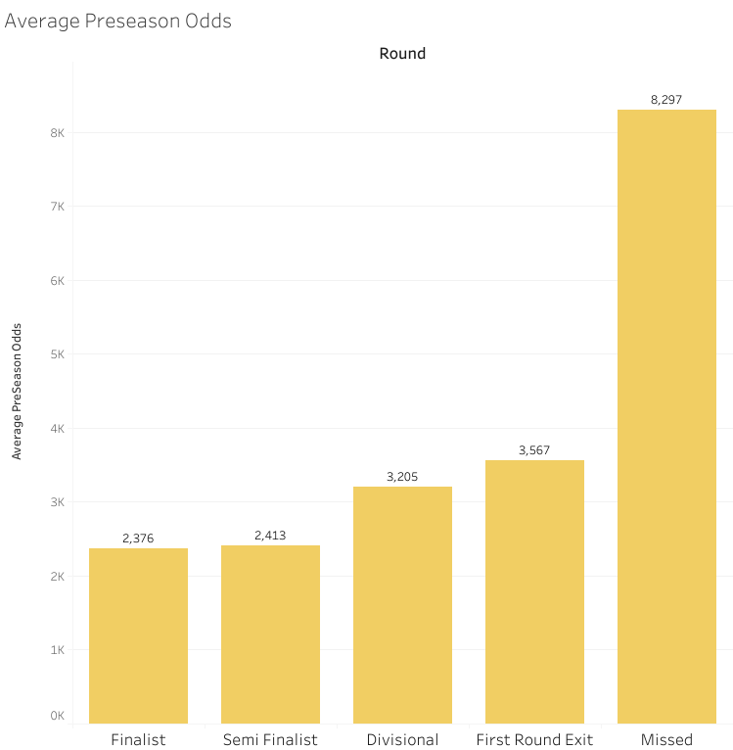
Housekeeping Cont.
NHL Playoffs consist of the Finals (Stanley Cup), Semi Finals, Divisional, and Wild Card rounds.
16 total teams make the playoffs with no Bye-Weeks.
Teams play best of 7.
We will be looking at regular season statistics around teams that made each round of the playoffs each year in this dataset.

Slide 6
Preseason Odds
(How accurate are they really?)

Slide 7
Preseason Odds per Round in Playoffs
Odds represent who “Vegas” thinks will win the championship. The lower the number, the better they think a team will do.
Preseason odds range from
425 - 50000 in this dataset
*Fun Fact - The team with the highest preseason odds to miss the playoffs was the Vegas Golden Knights in 2022 (800)

Slide 8
Goal Differential Ranking
(If you are better at scoring vs being scored against, does that matter?)

Slide 9
Calculation
Goals Scored – Goals the Opponent Scored
(Goals For)
(Goals Against)
Goal Differential

Slide 10
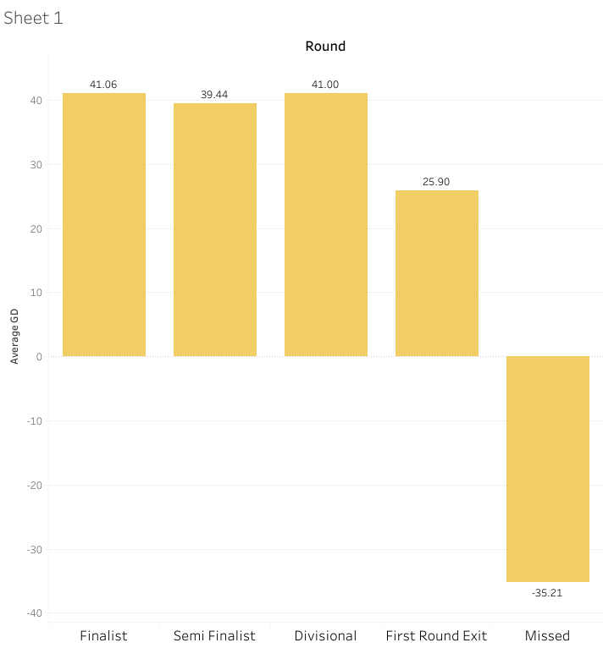
Average Goal Differential per Playoff Round
High Goal Differential = Good offense and good defense.
The 2017 Nashville Predators had the worst Goal Differential to make the Finals. (18)
*Goal Differential = Number of goals scored MINUS Number of goals the opponent scored.
Notes:
The preds came in ranked the 12th best Goal Differential with 18. Meaning they scored 18 more goals than they let through.

Slide 11
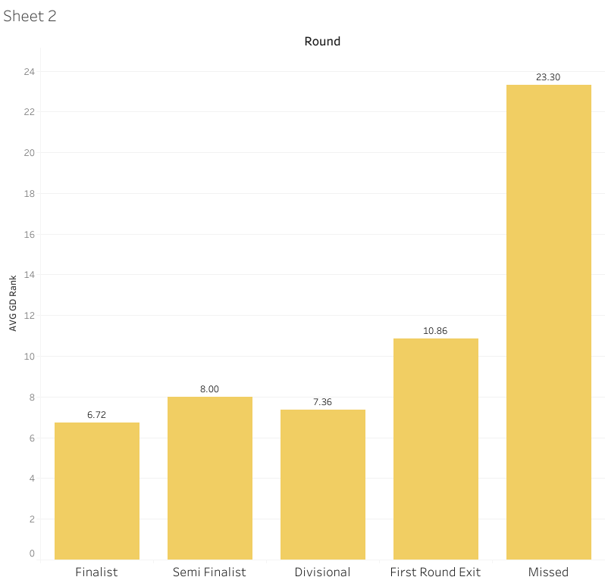
Average Goal Differential Ranking per Playoff Round
The lower Rank, the better the team did against the other teams that season.
The 2017 Nashville Predators had the lowest rank to make the Finals. (12th)
*Goal Differential = Number of goals scored MINUS Number of goals the opponent scored.
Notes:
The preds came in ranked the 12th best Goal Differential with 18. Meaning they scored 18 more goals than they let through.

Slide 12
Power Play% & Power Play Kill%
(Is it better to score on a power play or not letting the opponent score when they have the power play?)

Slide 13
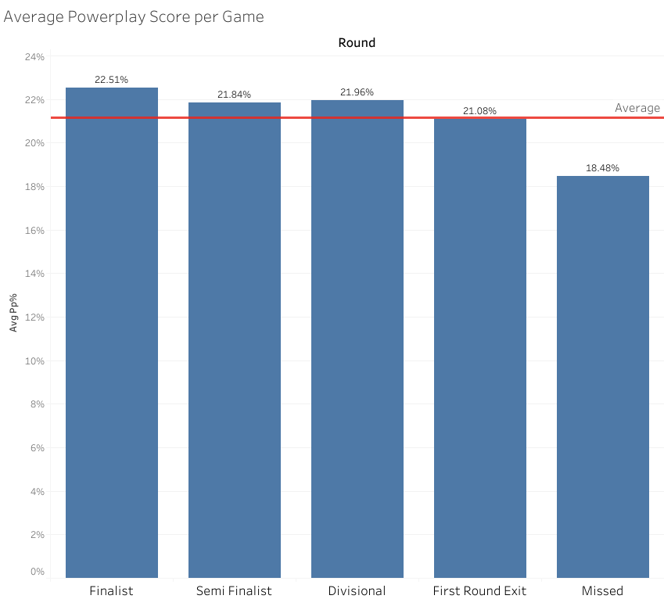
Power Play Success Percentage per Playoff Round
A Power Play is when a team has a one man advantage due to one player on the other team committing a penalty.
Success is scoring when you have a power play.

Slide 14
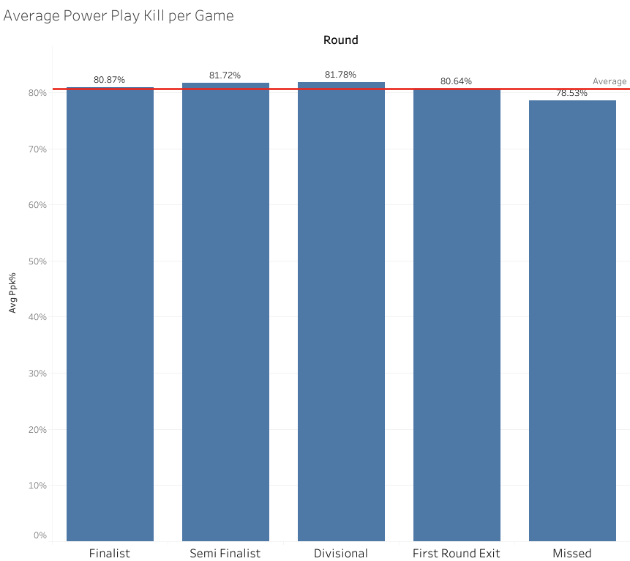
Power Play Kill Percentage per Playoff Round
Killing a power play means that your opponent had the one man advantage but they did not score.

Slide 15
Hot Streak Going into the Playoffs
(How much does this impact performance?)

Slide 16
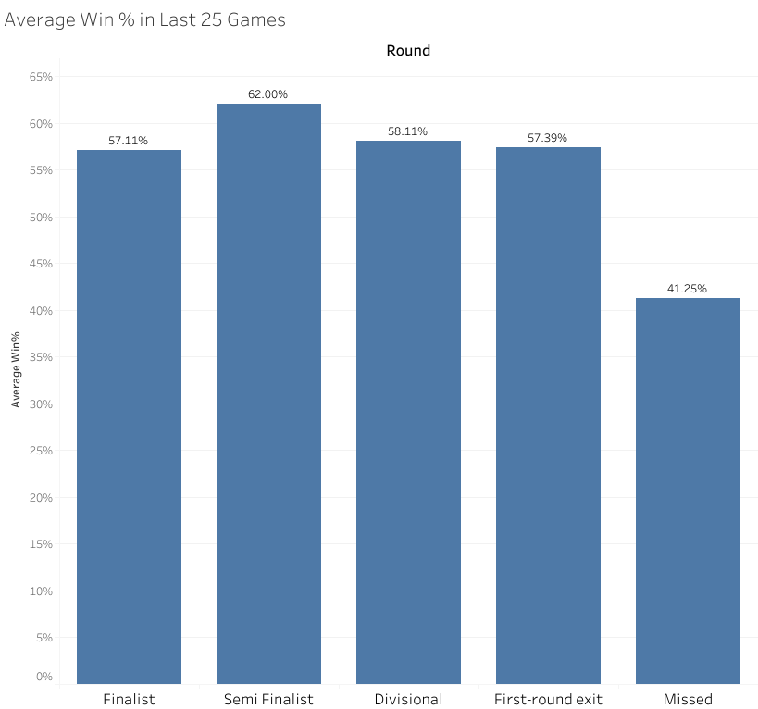
Average Win % of Last 25 Games Per Playoff Round
Number of wins / Total number of games played.
Fun Facts
The team with the worst win % in the last 25 games was the 2015 Chicago Blackhawks (32%).
The team with the best Win% in the last 25 games to not make the playoffs was the 2016 St. Louis Blues (76%).

Slide 17
Presidents Trophy Curse
(How bad is it really?)

Slide 18
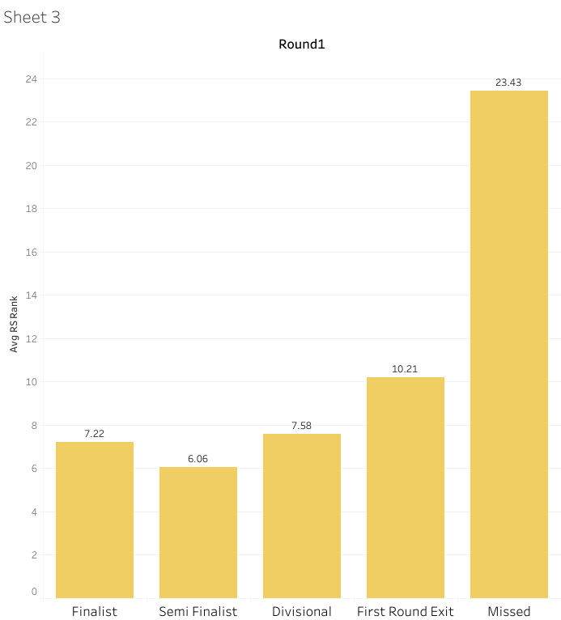
Average Regular Season Ranking Per Playoff Round
Only 8 teams have won both the Presidents Trophy and the Stanley Cup. Ever.
In this dataset - no Presidents Trophy winners made it to the cup.
Fun Facts
The worst ranked team to make it to the Finals was the 2017 Nashville Predators. (15th)
The best? The 2017 Pittsburgh Penguins. (2nd)
Notes:
The most recent time the Presi winner won the cup too was the 2013 Chicago Blackhawks

Slide 19
Bringing it all Together

Slide 20
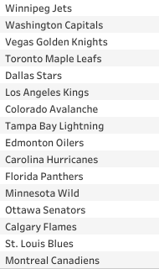
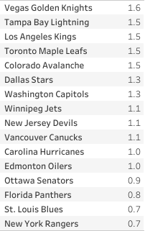
2025 Season Weighted Score
Actual Outcome
(Points Scored)
Dillon’s Weighted Score Outcome
2 Points for stats that made the finals
1 Point for stats that made the playoffs but not the finals
0 Points for Missing the playoffs.
Equation
(PP% Score *.2) + (PPK% Score *.2) + (GD Score *.15) + (Hot Steak Score *.25) + (RS Rank Score *.2) = Final Score

Slide 21
Final Thoughts
The most important stat to make the finals is…
Making the playoffs!

Slide 22
Thank You!
Questions?

