Slide 1

What is new in .NET Core 3(.1) and the future of .NET
Johnny Hooyberghs
www.involved-it.be

Slide 2
Agenda
.NET: a quick history
.NET: what about the future?
.NET Core 3.0 & 3.1
New publish features
Ranges and Indices
Async streams (iterators)
Platform-Dependent Intrinsics
Built-in JSON support
HTTP/2 and gRPC
Worker Services
Windows Desktop

Slide 3
.NET: a quick history
2002
2003
2005
2006
2010
2012
2013
2014
2015
2017
2019
2008
.NET 1.0
Visual Studio .NET (2002)
.NET 2.0
Visual Studio 2005
.NET 3.5
Visual Studio 2008
.NET 4.5
Visual Studio 2012
.NET 4.5.2
Visual Studio 2015
.NET 4.7
Visual Studio 2017
.NET 1.1
Visual Studio .NET 2003
.NET 3.0
Expression Blend
.NET 4.0
Visual Studio 2010
.NET 4.5.1
Visual Studio 2013
.NET 4.6
Visual Studio 2015
.NET 4.8
Visual Studio 2019

Slide 4
.NET: a quick history
.NET Core 1.0
Visual Studio 2015 Update 3
.NET Core 1.1
Visual Studio 2017 Version 15.0
.NET Core 2.0
Visual Studio 2017 Version 15.3
.NET Core 2.1
Visual Studio 2017 Version 15.7
.NET Core 2.2
Visual Studio 2019 Version 16.0
.NET Core 3.0
Visual Studio 2019 Version 16.3
.NET Core 3.1
Visual Studio 2019 Version 16.4
2016
2016
2017
2018
2018
2019
2019
.NET Core 1.0 | June 27, 2019
.NET Core 1.1 | June 27, 2019
.NET Core 2.0 | October 1, 2018
.NET Core 2.1 | August 21, 2021
.NET Core 2.2 | December 23, 2019
.NET Core 3.0 | March 3, 2020
.NET Core 3.1 | Supported

Slide 5
.NET: what about the future?
11/2020 .NET Core 5.0
11/2021
.NET Core 6.0 LTS
11/2022
.NET Core 7.0
11/2023
.NET Core 8.0 LTS

Slide 6
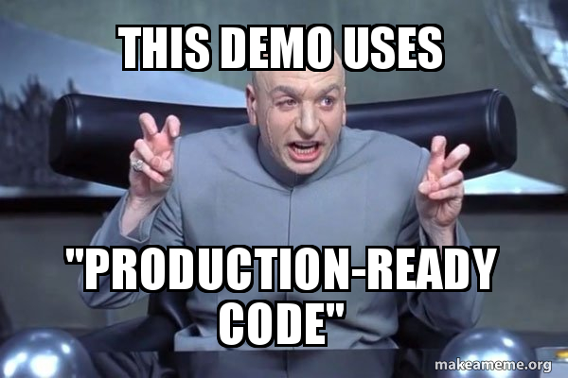
.NET Core 3.0 & 3.1

Slide 7
New Publish Features: Default executables
Since .NET Core 3.0
Build and Publish
DLL that can be executed using “dotnet”
platform independent
Platform SDK decides how to build native executable
Platform dependent

Slide 8
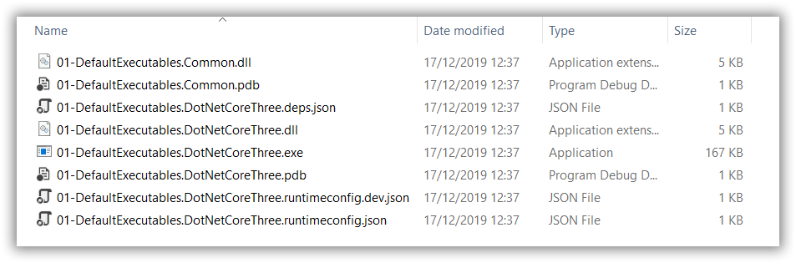
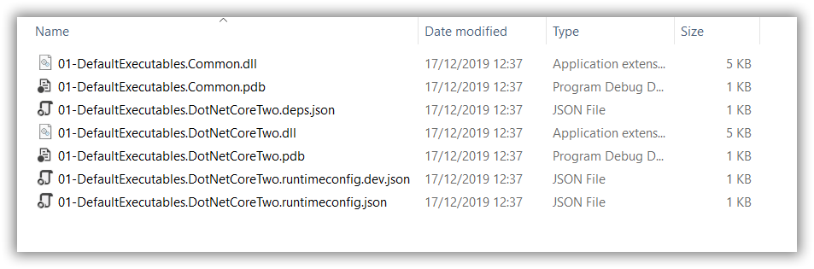
New Publish Features: Default executables
.NET Core 3.1
.NET Core 2.2

Slide 9
New Publish Features: Single File Executables
Since .NET Core 3.0
Publish
Self-extracting executable containing all dependencies
Extracts to temp location on disk
Includes .NET Core runtime
Platform SDK decides how to build native executable

Slide 10
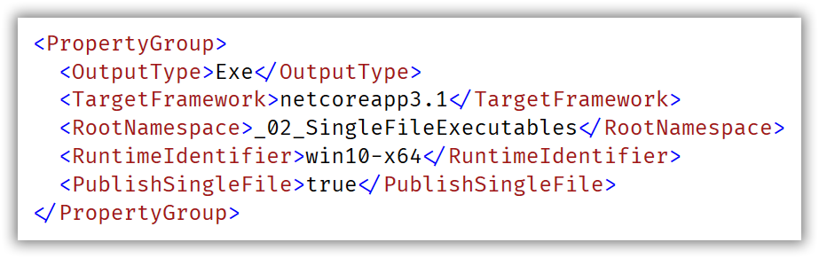
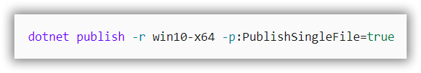
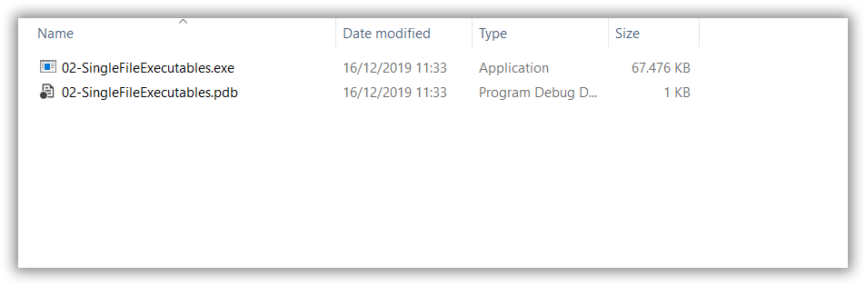
New Publish Features: Single File Executables
OR

Slide 11
Platform-Dependent Intrinsics
Since .NET Core 1.0
SIMD (Single Instruction Multiple Data)
System.Numerics
Fallback if not supported on CPU
Since .NET Core 3.0
More extensive support for SIMD
System.Runtime.Intrinsics
No fallback if not supported on CPU

Slide 12
Platform-Dependent Intrinsics
Getting a billion integers...
Calculating a regular sum... 4941ms
Calculating a sum with SIMD support... 2777ms
Calculating a sum with Hardware Intrinsics support... 1573ms
Calculating a regular sum... 4911ms
Calculating a sum with SIMD support... 2753ms
Calculating a sum with Hardware Intrinsics support... 1529ms
Calculating a regular sum... 4743ms
Calculating a sum with SIMD support... 2718ms
Calculating a sum with Hardware Intrinsics support... 1550ms

Slide 13
Built-in JSON support
Since .NET Core 3.0
Applied by default in ASP.NET Core 3.0 for serialization
No more dependency on JSON.NET (Newtonsoft)
System.Text.Json
Doesn’t rely on System.String (UTF-16)
Uses Span<byte> to manipulate strings (UTF-8)
Can still be replaced by JSON.NET if wanted

Slide 14
Built-in JSON support
Preparing data...
Newtonsoft JSON serialization: 563ms
Newtonsoft JSON deserialization: 206ms
Built-in JSON serialization: 156ms
Built-in JSON deserialization: 159ms
Newtonsoft JSON serialization: 160ms
Newtonsoft JSON deserialization: 159ms
Built-in JSON serialization: 102ms
Built-in JSON deserialization: 89ms
Newtonsoft JSON serialization: 106ms
Newtonsoft JSON deserialization: 126ms
Built-in JSON serialization: 97ms
Built-in JSON deserialization: 83ms

Slide 15
HTTP/2 and gRPC
Since ASP.NET Core 3.0
OpenSource Remote Procedure Call system by Google
Protocol buffers as Interface Description Language
Needs HTTP/2
Needs Transport Layer Security (TLS)
Migration path for .NET Framework WCF to .NET Core gRPC
Supported by Kestrel
Currently not supported on Azure App Service and IIS
Preview/experimental support for gRPC-Web since January 27th, 2020

Slide 16
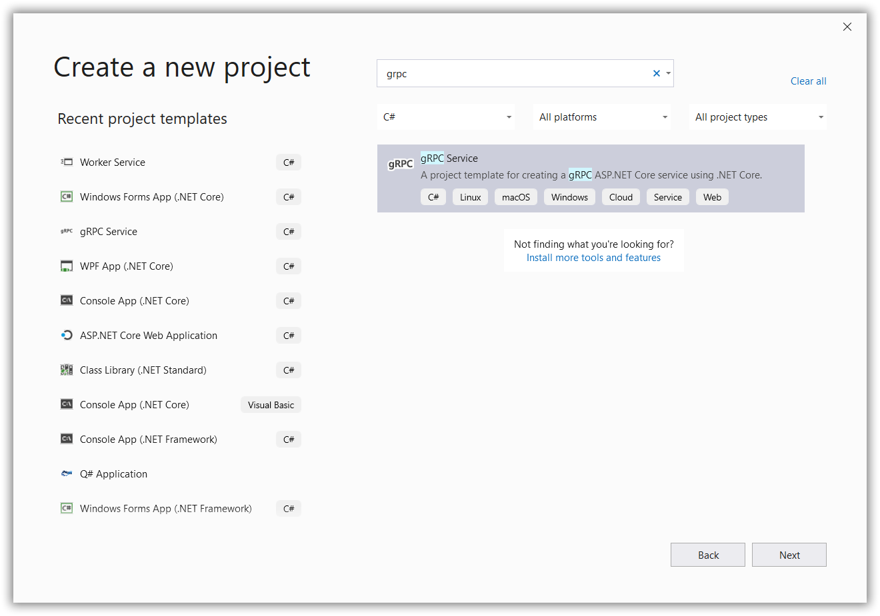
HTTP/2 and gRPC

Slide 17
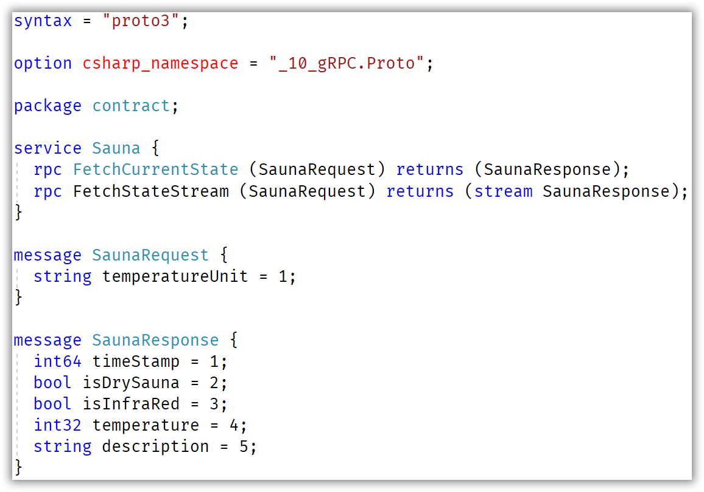
HTTP/2 and gRPC

Slide 18
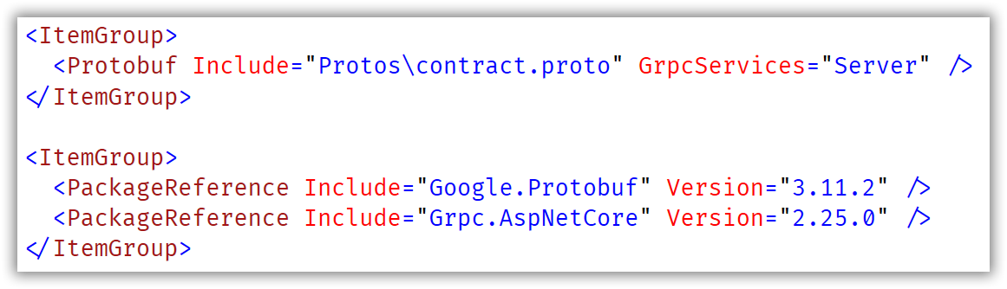
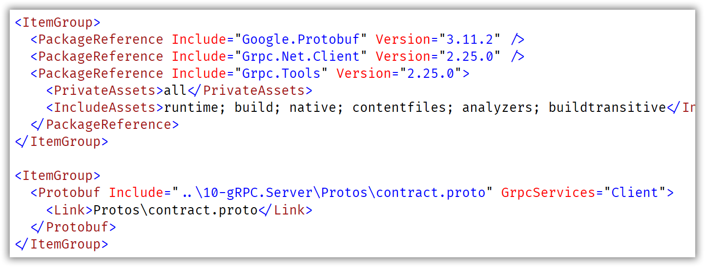
HTTP/2 and gRPC

Slide 19
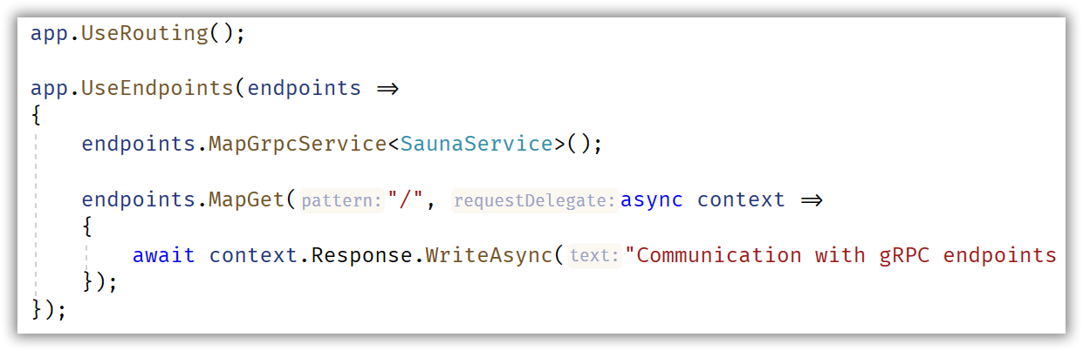
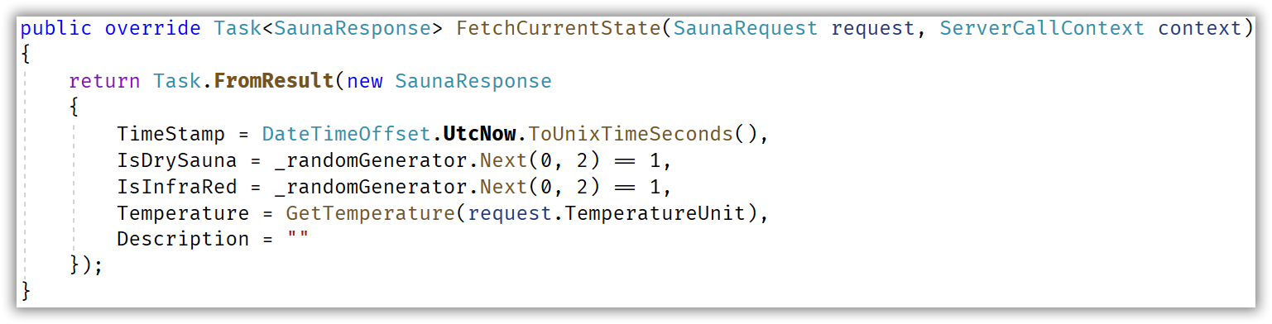
HTTP/2 and gRPC

Slide 20
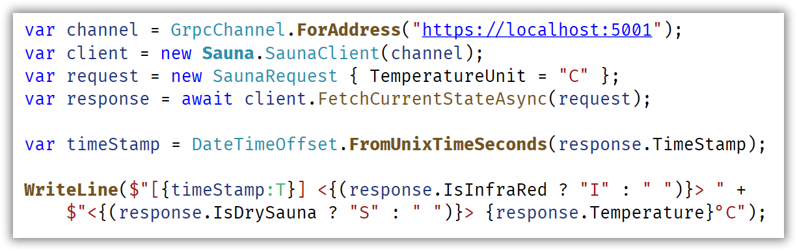
HTTP/2 and gRPC

Slide 21
Worker Services
Since .NET Core 2.1
IHostBuilder support for long running IHostedService
No more need for .NET Core Console applications with while(true)
Support for (Docker) containers
Support for Windows Service deployments
Support for Linux Daemon using systemd

Slide 22
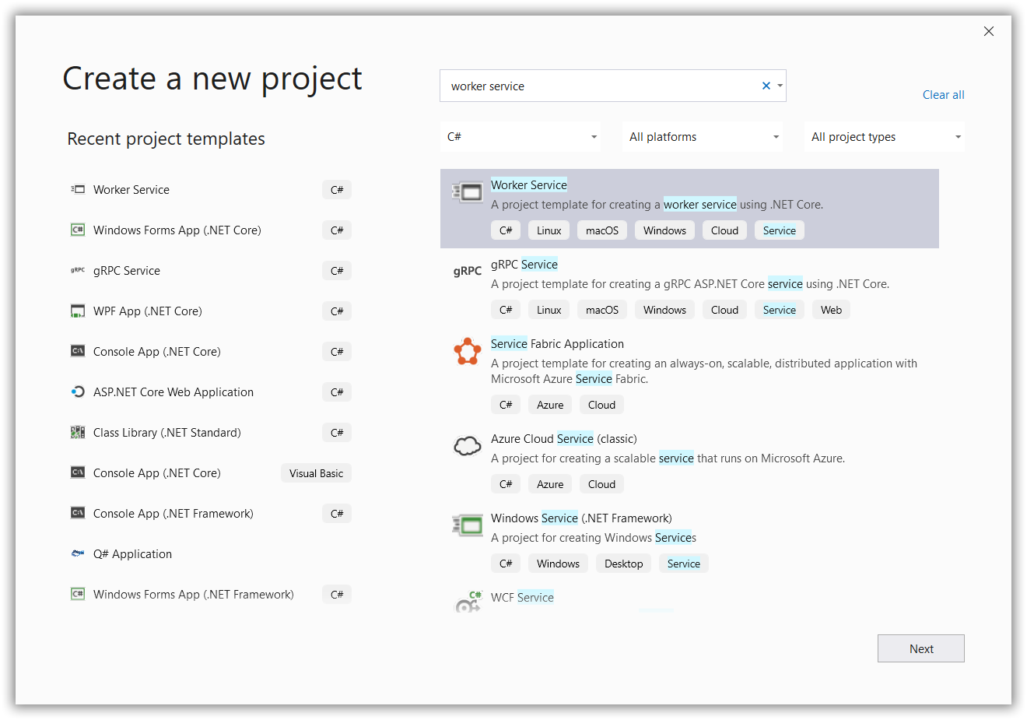
Worker Services

Slide 23
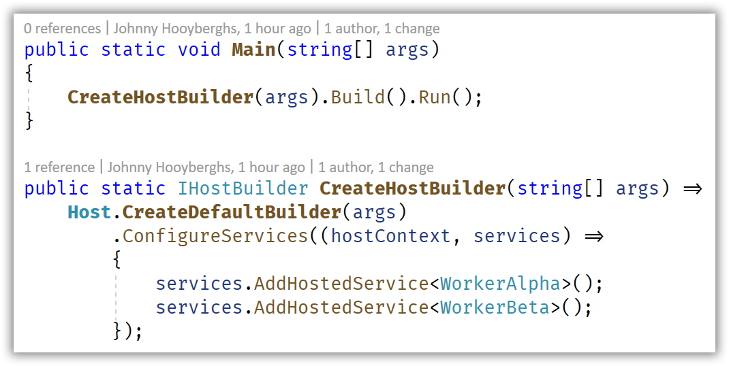
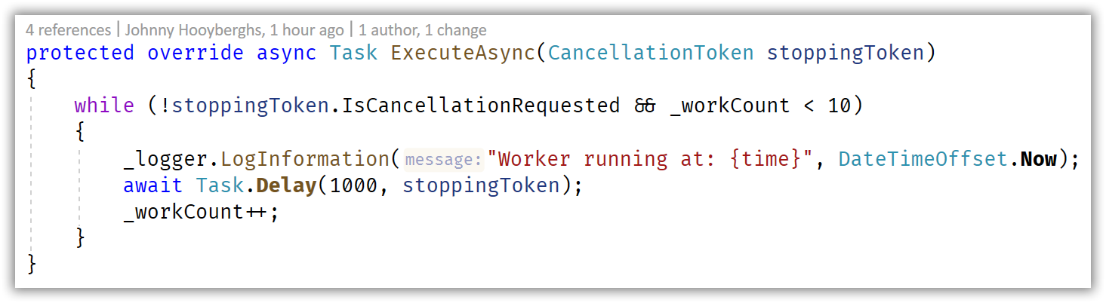
Worker Services

Slide 24
Windows Desktop
Since .NET Core 3.0
Support for WinForms, WPF and UWP
Only on Windows
Wrapper on top op Windows DirectX and GDI+ apis
XAML designer included in Visual Studio 2019
WinForms designer only included in Visual Studio 2019 as a preview externsion (VSIX)

Slide 25
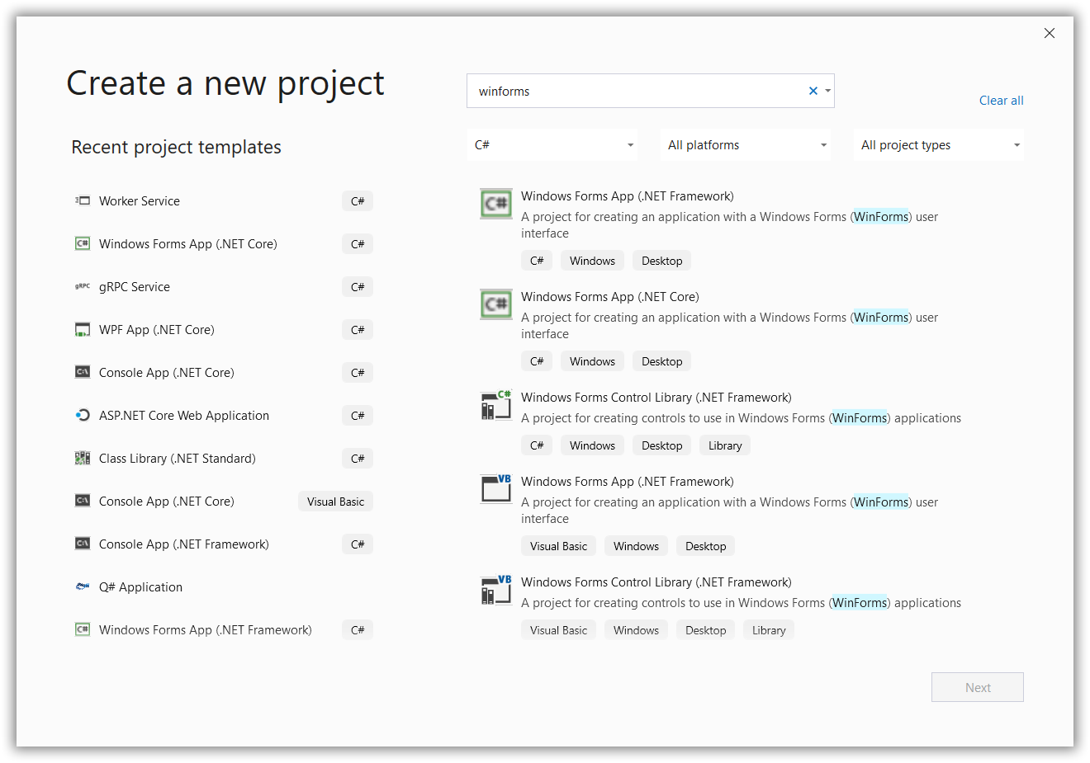
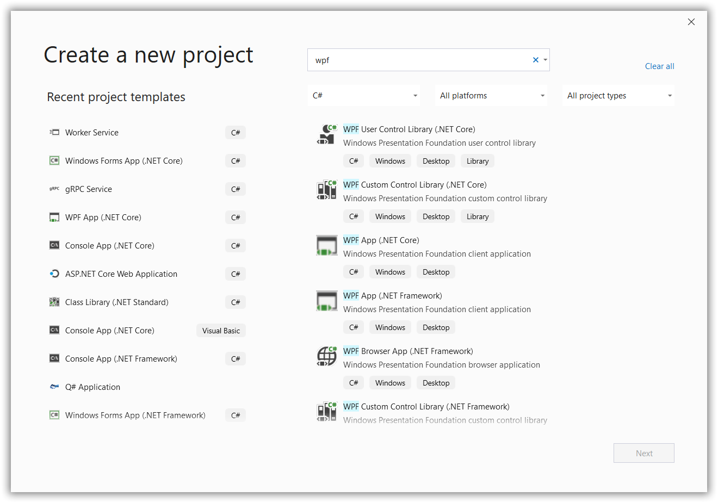
Windows Desktop

Slide 26

johnny.hooyberghs@involved-it.be
@djohnnieke
https://github.com/Djohnnie
https://github.com/Djohnnie/DotNetCore3-TechDaysFinland-2020
www.involved-it.be

Slide 27

johnny.hooyberghs@involved-it.be
@djohnnieke
https://github.com/Djohnnie
https://github.com/Djohnnie/DotNetCore3-TechDaysFinland-2020
www.involved-it.be

