Slide 1

WHAT IS NEW IN .NET CORE 3 AND THE FUTURE OF .NET
Johnny HOOYBERGHS

Slide 3
Agenda
.NET: a quick history
.NET Core
.NET: what about the future?
.NET Core 3.0 & 3.1
New publish features
Tiered compilation and ready2run
Ranges and Indices
Async streams (iterators)
Nullable Reference Types
Platform-Dependent Intrinsics
Built-in JSON support
HTTP/2 and gRPC
Worker Services
Windows Desktop

Slide 4
Next events…
30/01/2020
BLAZOR: BLAZING INTO THE FUTURE OF WEB DEVELOPMENT

Slide 5
.NET: a quick history
2002
2003
2005
2006
2010
2012
2013
2014
2015
2017
2019
2008
.NET 1.0
Visual Studio .NET (2002)
.NET 2.0
Visual Studio 2005
.NET 3.5
Visual Studio 2008
.NET 4.5
Visual Studio 2012
.NET 4.5.2
Visual Studio 2015
.NET 4.7
Visual Studio 2017
.NET 1.1
Visual Studio .NET 2003
.NET 3.0
Expression Blend
.NET 4.0
Visual Studio 2010
.NET 4.5.1
Visual Studio 2013
.NET 4.6
Visual Studio 2015
.NET 4.8
Visual Studio 2019

Slide 6
.NET: a quick history
.NET Core 1.0
Visual Studio 2015 Update 3
.NET Core 1.1
Visual Studio 2017 Version 15.0
.NET Core 2.0
Visual Studio 2017 Version 15.3
.NET Core 2.1
Visual Studio 2017 Version 15.7
.NET Core 2.2
Visual Studio 2019 Version 16.0
.NET Core 3.0
Visual Studio 2019 Version 16.3
.NET Core 3.1
Visual Studio 2019 Version 16.4
2016
2016
2017
2018
2018
2019
2019
.NET Core 1.0 | June 27, 2019
.NET Core 1.1 | June 27, 2019
.NET Core 2.0 | October 1, 2018
.NET Core 2.1 | August 21, 2021
.NET Core 2.2 | December 23, 2019
.NET Core 3.0 | March 3, 2020
.NET Core 3.1 | Supported

Slide 7
.NET Core
.NET FRAMEWORK
.NET CORE
XAMARIN
Base Class Library
Core Library
Mono Class Library
.NET STANDARD FRAMEWORK
COMMON INFRASTRUCTURE
Compilers
Languages
Runtime components

Slide 8
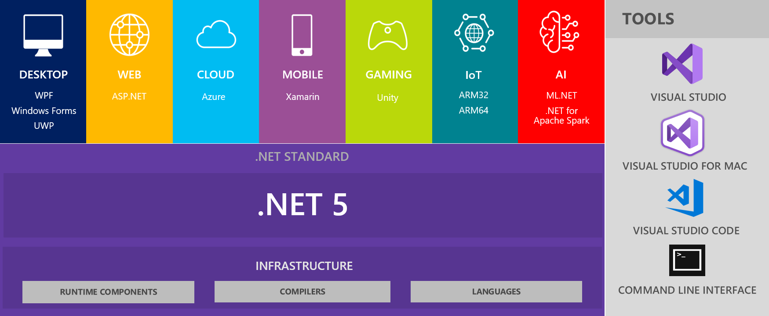
.NET: what about the future?

Slide 9
.NET: what about the future?
09/2019
.NET Core 3.0
11/2019
.NET Core 3.1 LTS
11/2020 .NET Core 5.0
11/2021
.NET Core 6.0 LTS
11/2022
.NET Core 7.0
11/2023
.NET Core 8.0 LTS

Slide 10

.NET Core 3.0 & 3.1

Slide 11
.NET Core 3.0 & 3.1 New Publish Features: Default executables
Since .NET Core 3.0
Build and Publish
*.DLL that can be executed, platform independent, using “dotnet”
Platform SDK decides how to build native executable
https://github.com/Djohnnie/VISUG-2019-DotNetCore3/tree/master/01-DefaultExecutables

Slide 12
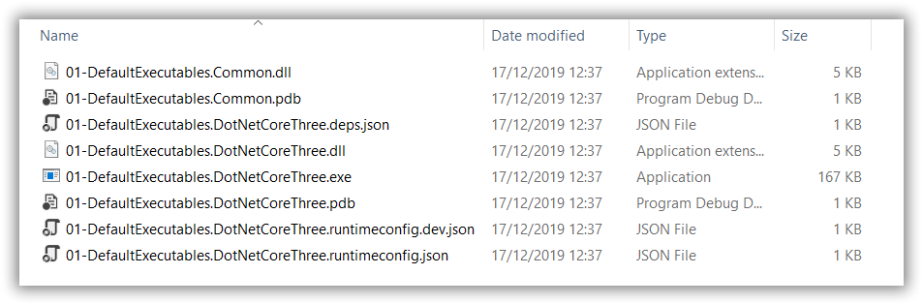
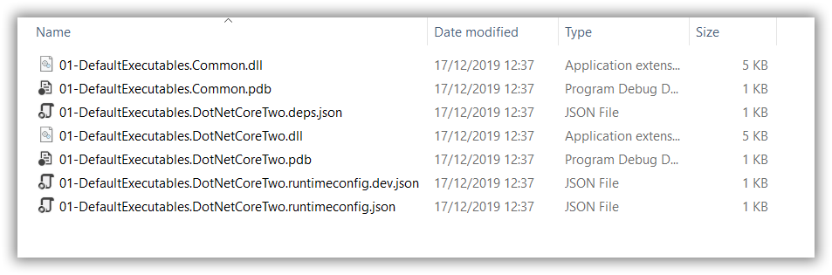
.NET Core 3.0 & 3.1 New Publish Features: Default executables
.NET Core 3.1
.NET Core 2.2

Slide 13
.NET Core 3.0 & 3.1 New Publish Features: Single File Executables
Since .NET Core 3.0
Publish
Self-extracting executable containing all dependencies
Extracts to temp location on disk
Includes .NET Core
Platform SDK decides how to build native executable
https://github.com/Djohnnie/VISUG-2019-DotNetCore3/tree/master/02-SingleFileExecutables

Slide 14
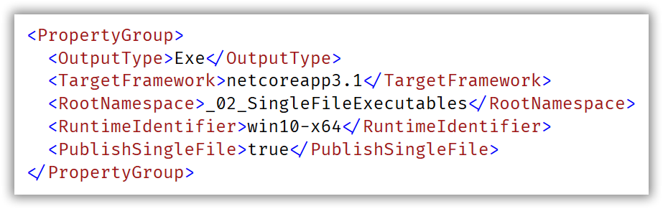
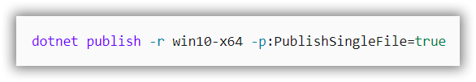
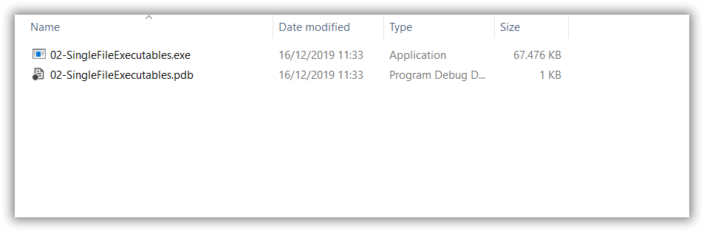
.NET Core 3.0 & 3.1 New Publish Features: Single File Executables
OR

Slide 15
.NET Core 3.0 & 3.1 New Publish Features: Assembly linking
Since .NET Core 3.0
Publish
Self-extracting executable containing all dependencies
Extracts to temp location on disk
Trims unused assemblies
Does not support dynamically loaded assemblies (reflection)
Platform SDK decides how to build native executable
https://github.com/Djohnnie/VISUG-2019-DotNetCore3/tree/master/03-AssemblyLinking

Slide 16
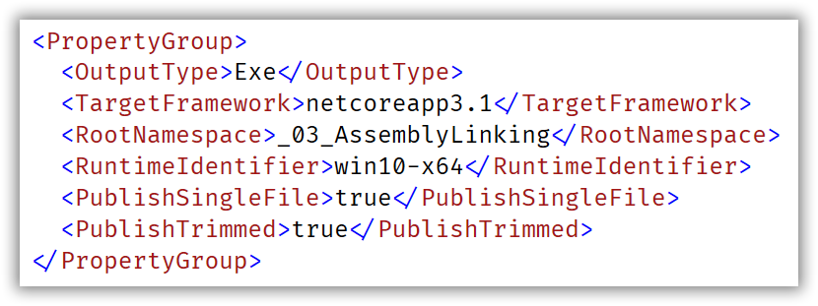
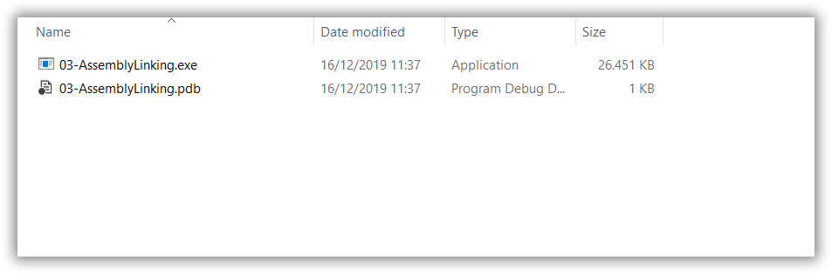
.NET Core 3.0 & 3.1 New Publish Features: Assembly linking

Slide 17
.NET Core 3.0 & 3.1 Tiered Compilation and Ready2Run
Optional since .NET Core 2.1
Default since .NET Core 3.0
Adaptive JIT (Just-in-Time)
lower-quality-but-faster tier OR higher-quality-but-slower tier
AOT-compiled will just be used (Ready2Run)
Otherwise JITted, based on usage
.NET Core Framework is already compiled as part of the runtime (Ready2Run)
https://github.com/Djohnnie/VISUG-2019-DotNetCore3/tree/master/04-TieredCompilation

Slide 18
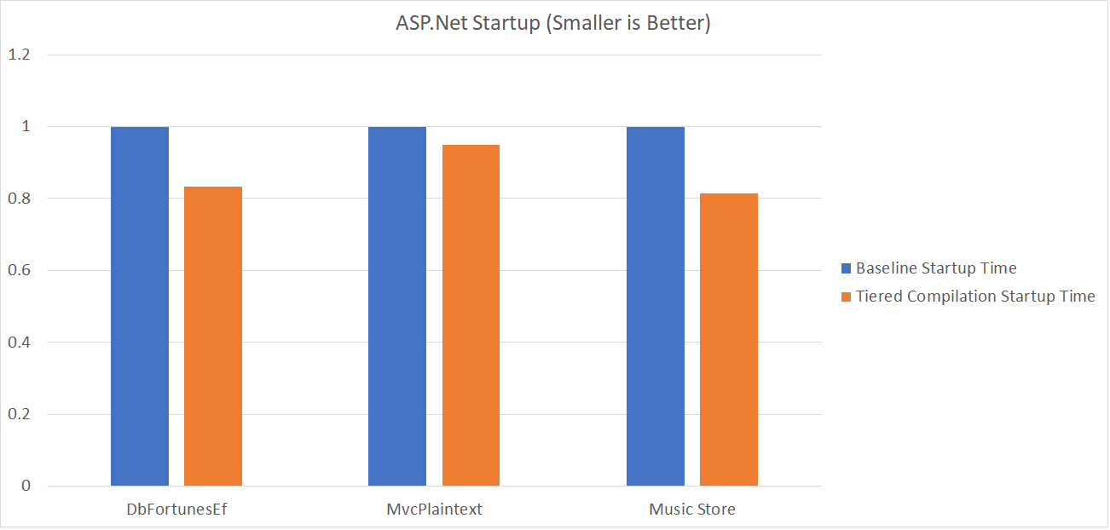
.NET Core 3.0 & 3.1 Tiered Compilation and Ready2Run

Slide 19
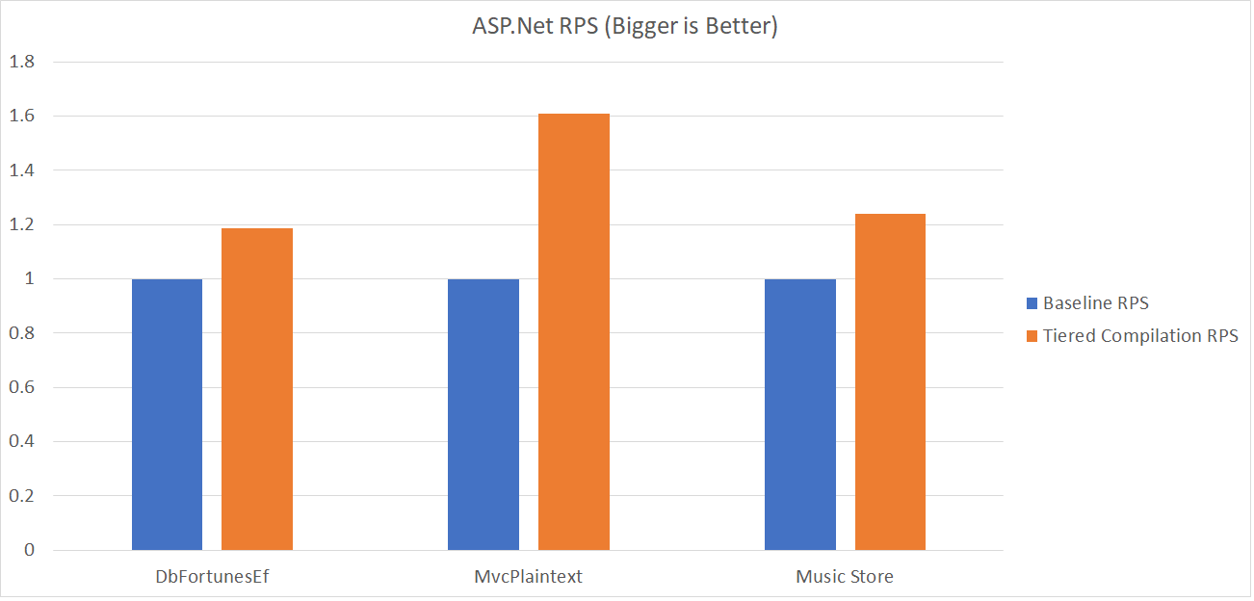
.NET Core 3.0 & 3.1 Tiered Compilation and Ready2Run

Slide 20
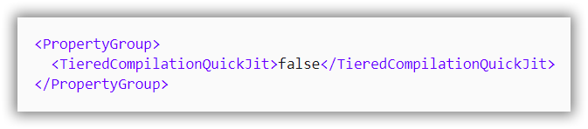
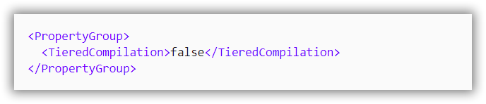
.NET Core 3.0 & 3.1 Tiered Compilation and Ready2Run
Code generated by QuickJIT may run slower, allocate more memory or use more stack space. Any issues? Disable it…
Any issues still? Disable tiered compilation entirely…

Slide 21
.NET Core 3.0 & 3.1 Ranges and Indices
Since .NET 3.0
System.Index used for indexing
System.Range containing indices for start and end (producing a slice)
New types in the BCL + syntaxtic sugar added to C# 8.0
https://github.com/Djohnnie/VISUG-2019-DotNetCore3/tree/master/05-RangesAndIndices

Slide 22
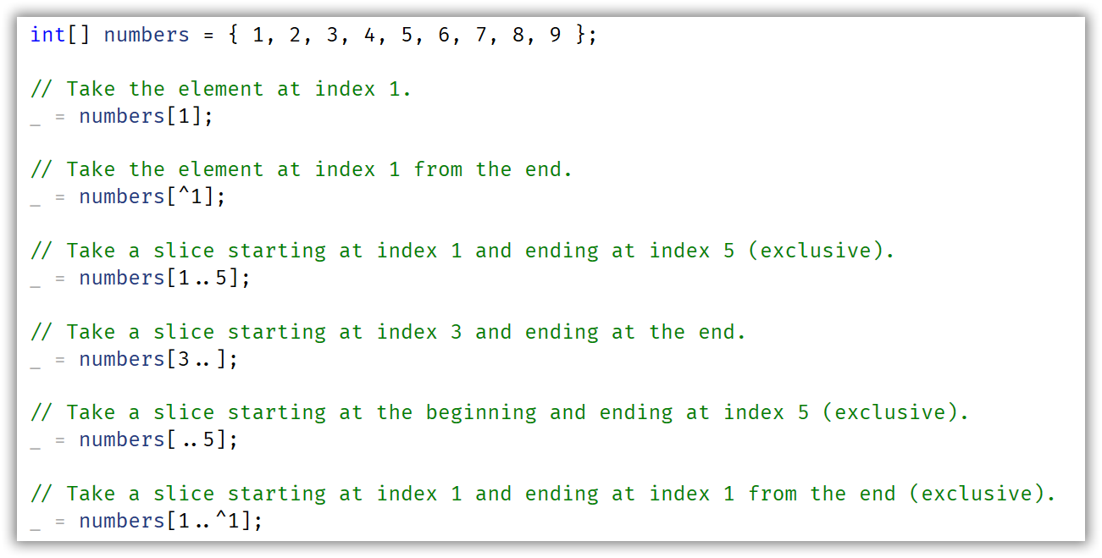
.NET Core 3.0 & 3.1 Ranges and Indices

Slide 23
.NET Core 3.0 & 3.1 Async Streams (Iterators)
Since .NET 3.0
Asynchronous version of IEnumerable<T>
IAsyncEnumerable<T>
Uses yield return with async/await support
Recommended model for using async streams
Added support for IAsyncDisposable => await object.DisposeAsync()
Available for a number of BCL types like Stream and Timer
https://github.com/Djohnnie/VISUG-2019-DotNetCore3/tree/master/06-AsyncStreams

Slide 24
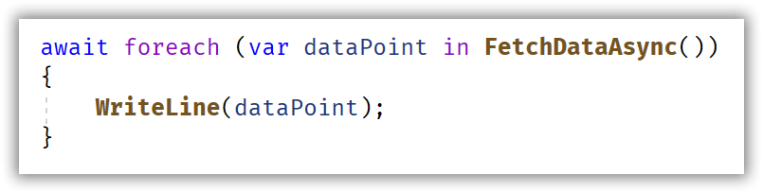
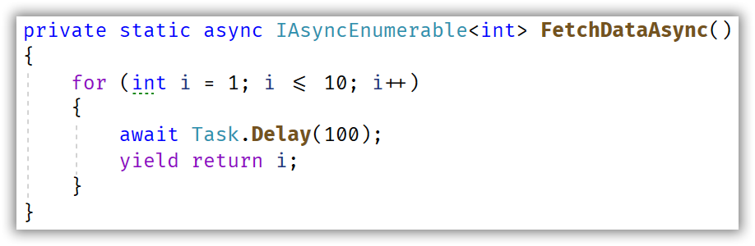
.NET Core 3.0 & 3.1 Async Streams (Iterators)

Slide 25
.NET Core 3.0 & 3.1 Nullable Reference Types
New since C# 8.0
Opt-in for projects, files or code-ranges
Reference Types are concidered non-nullable by default
Nullable reference types need to be appended by the ? syntax
No runtime checks, only compile-time warnings
Compile-time warnings can be optionally converted to errors
Compiler uses flow-analysis to generate compile-time warnings
https://github.com/Djohnnie/VISUG-2019-DotNetCore3/tree/master/07-NullableReferenceTypes

Slide 26
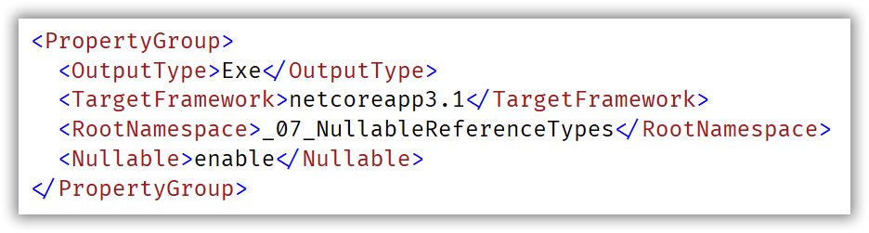
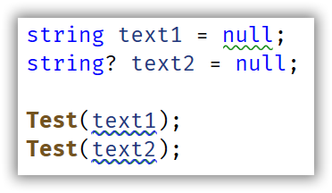
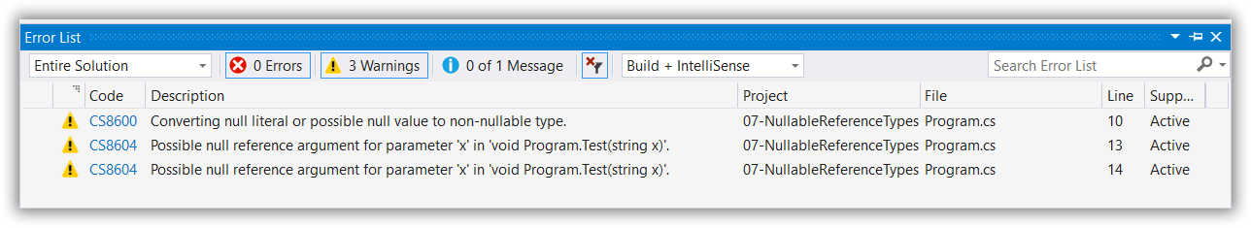
.NET Core 3.0 & 3.1 Nullable Reference Types

Slide 27
.NET Core 3.0 & 3.1 Platform-Dependent Intrinsics
Since .NET Core 1.0
SIMD (Single Instruction Multiple Data)
System.Numerics
Fallback if not supported on CPU
Since .NET Core 3.0
More extensive support for SIMD
System.Runtime.Intrinsics
No fallback if not supported on CPU
https://github.com/Djohnnie/VISUG-2019-DotNetCore3/tree/master/08-HardwareIntrinsics

Slide 28
.NET Core 3.0 & 3.1 Platform-Dependent Intrinsics
Getting a billion integers...
Calculating a regular sum... 4941ms
Calculating a sum with SIMD support... 2777ms
Calculating a sum with Hardware Intrinsics support... 1573ms
Calculating a regular sum... 4911ms
Calculating a sum with SIMD support... 2753ms
Calculating a sum with Hardware Intrinsics support... 1529ms
Calculating a regular sum... 4743ms
Calculating a sum with SIMD support... 2718ms
Calculating a sum with Hardware Intrinsics support... 1550ms

Slide 29
.NET Core 3.0 & 3.1 Built-in JSON support
Since .NET Core 3.0
Applied by default in ASP.NET Core 3.0
No more dependency on JSON.NET (Newtonsoft)
System.Text.Json
Doesn’t rely on System.String (UTF-16)
Uses Span<byte> to manipulate strings (UTF-8)
Can still be replaced by JSON.NET if wanted
https://github.com/Djohnnie/VISUG-2019-DotNetCore3/tree/master/09-BuiltInJsonSupport

Slide 30
.NET Core 3.0 & 3.1 Built-in JSON support
Preparing data...
Newtonsoft JSON serialization: 563ms
Newtonsoft JSON deserialization: 206ms
Built-in JSON serialization: 156ms
Built-in JSON deserialization: 159ms
Newtonsoft JSON serialization: 160ms
Newtonsoft JSON deserialization: 159ms
Built-in JSON serialization: 102ms
Built-in JSON deserialization: 89ms
Newtonsoft JSON serialization: 106ms
Newtonsoft JSON deserialization: 126ms
Built-in JSON serialization: 97ms
Built-in JSON deserialization: 83ms

Slide 31
.NET Core 3.0 & 3.1 HTTP/2 and gRPC
Since ASP.NET Core 3.0
OpenSource Remote Procedure Call system
Protocol buffers as Interface Description Language
Needs HTTP/2
Needs Transport Layer Security (TLS)
Migration path for .NET Framework WCF to .NET Core gRPC
Supported by Kestrel
Currently not supported on Azure App Service and IIS
https://github.com/Djohnnie/VISUG-2019-DotNetCore3/tree/master/10-gRPC

Slide 32
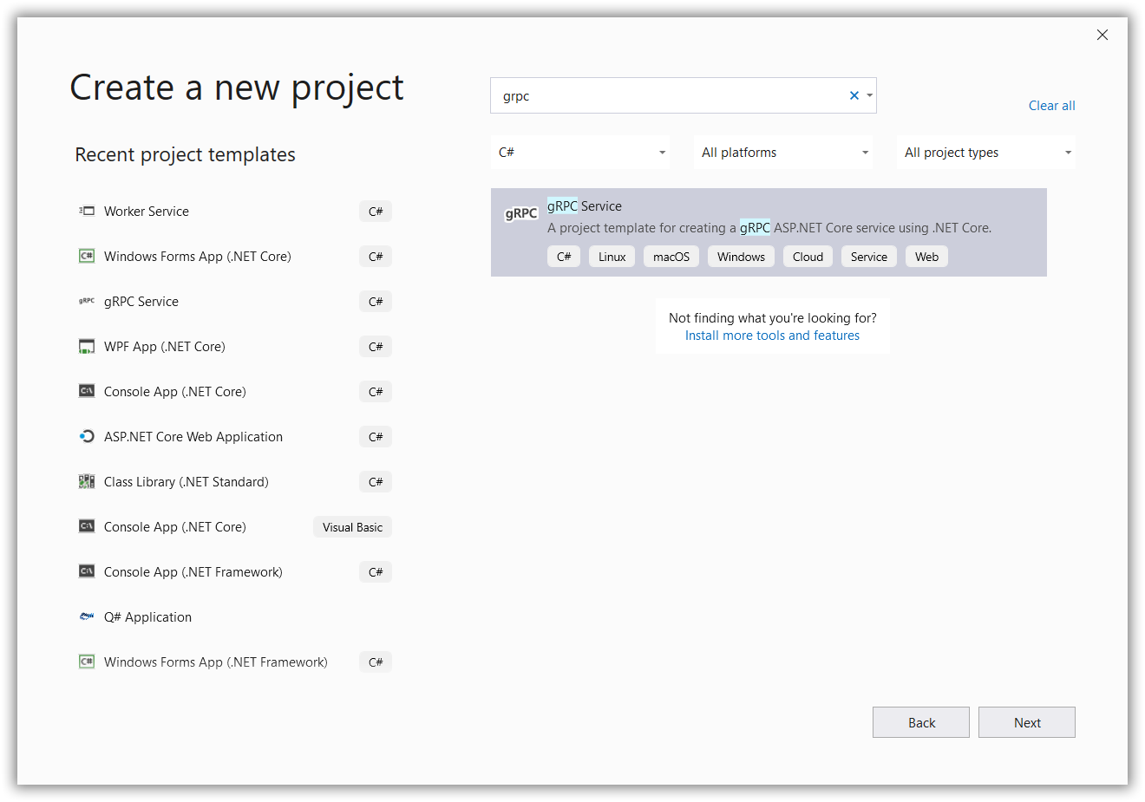
.NET Core 3.0 & 3.1 HTTP/2 and gRPC

Slide 33
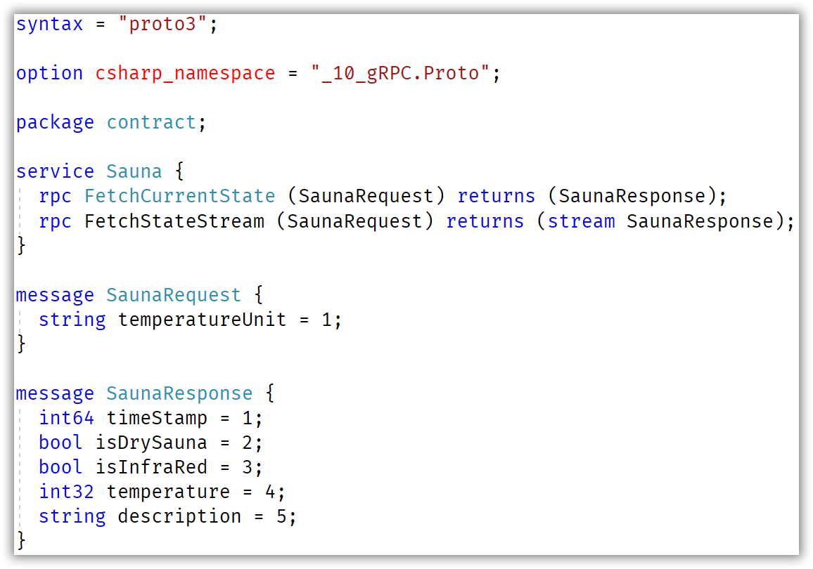
.NET Core 3.0 & 3.1 HTTP/2 and gRPC

Slide 34
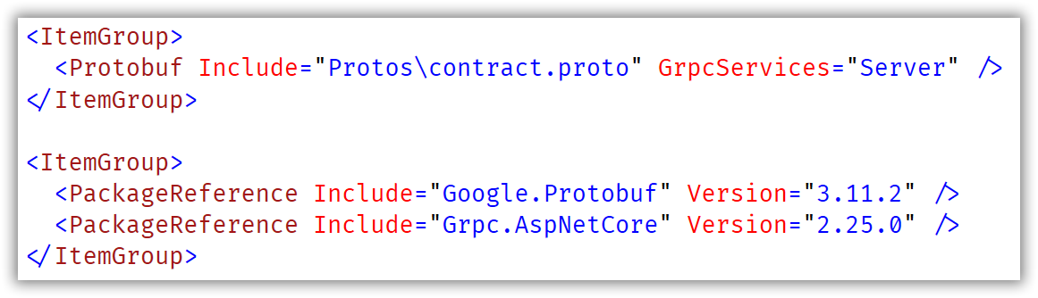
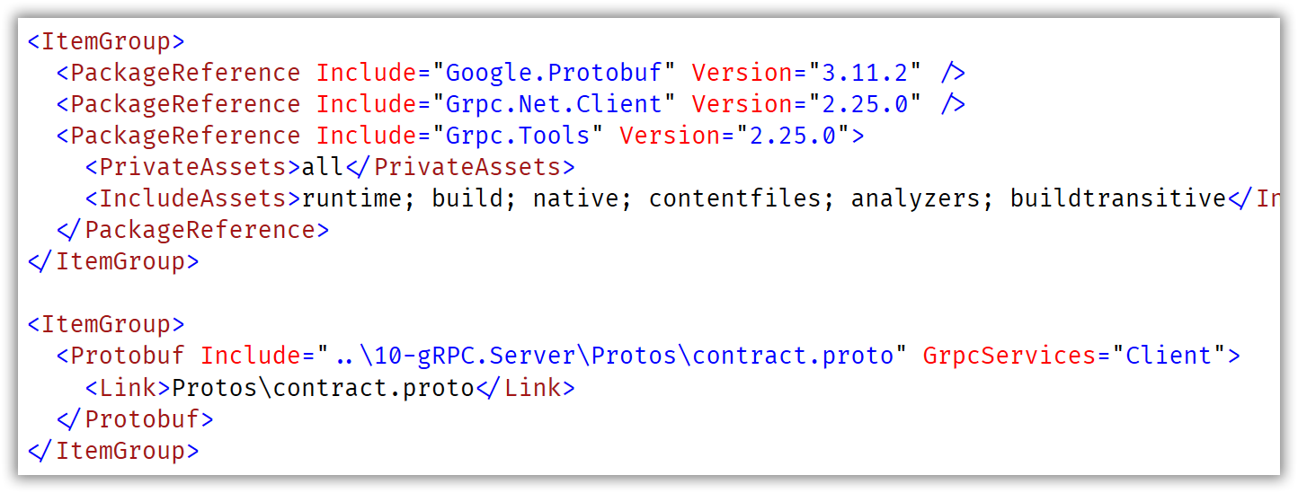
.NET Core 3.0 & 3.1 HTTP/2 and gRPC

Slide 35
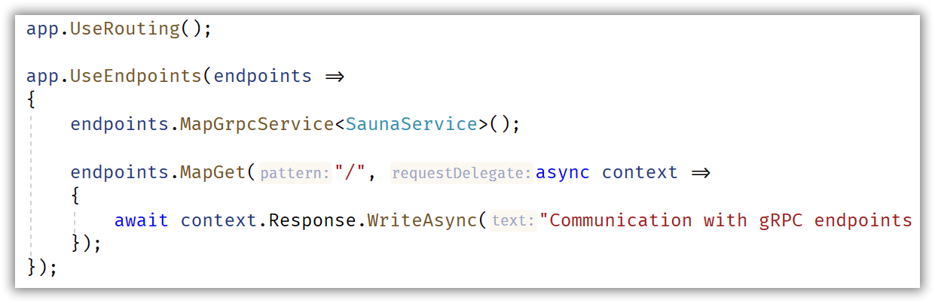
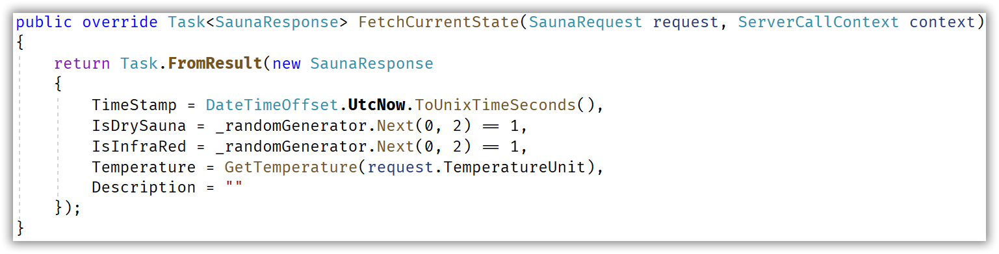
.NET Core 3.0 & 3.1 HTTP/2 and gRPC

Slide 36
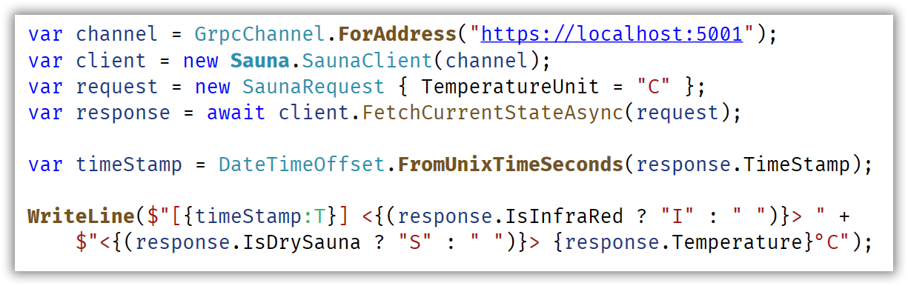
.NET Core 3.0 & 3.1 HTTP/2 and gRPC

Slide 37
.NET Core 3.0 & 3.1 Worker Services
Since .NET Core 2.1
IHostBuilder support for long running IHostedService
No more need for .NET Core Console applications with while(true)
Support for Docker containers
Support for Windows Service deployments
Support for Linux Daemon with systemd
https://github.com/Djohnnie/VISUG-2019-DotNetCore3/tree/master/11-WorkerService

Slide 38
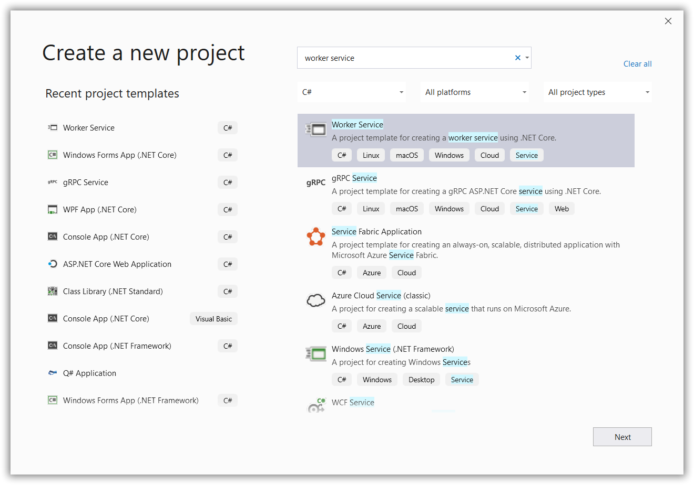
.NET Core 3.0 & 3.1 Worker Services

Slide 39
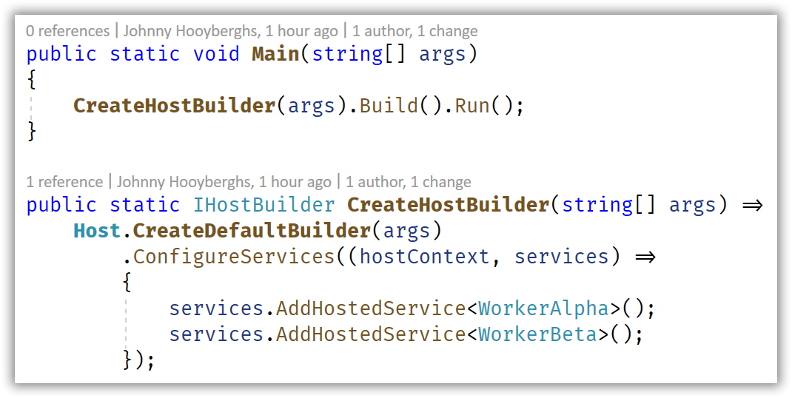
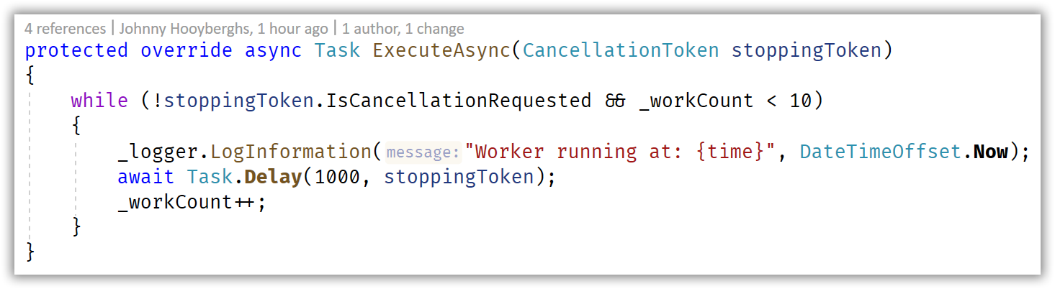
.NET Core 3.0 & 3.1 Worker Services

Slide 40
.NET Core 3.0 & 3.1 Windows Desktop
Since .NET Core 3.0
Support for WinForms, WPF and UWP
Only on Windows
XAML designer included in Visual Studio 2019
WinForms designer only included in Visual Studio 2019 as a preview VSIX
https://github.com/Djohnnie/VISUG-2019-DotNetCore3/tree/master/12-WindowsDesktop

Slide 41
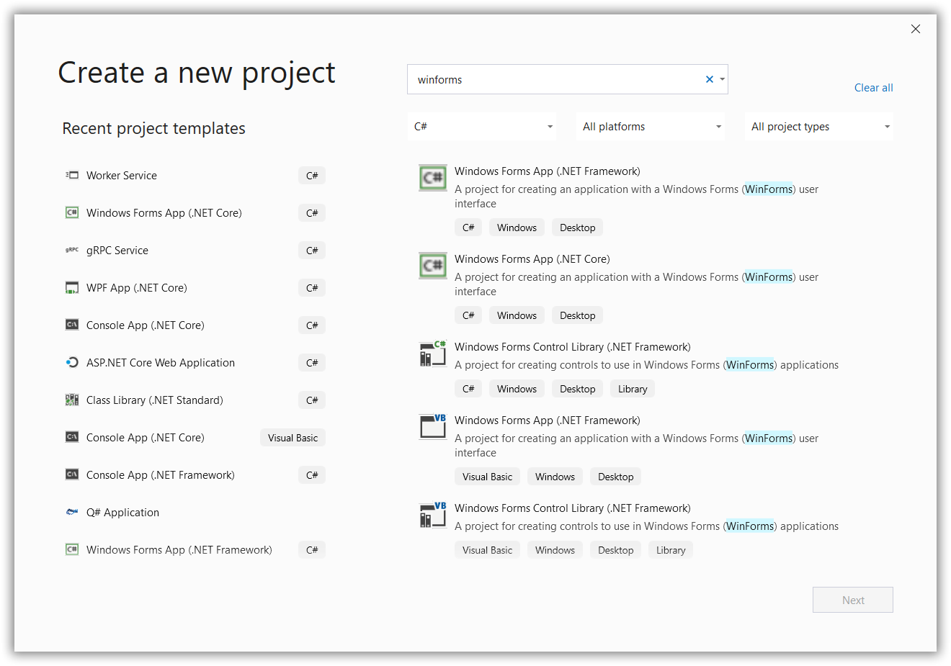
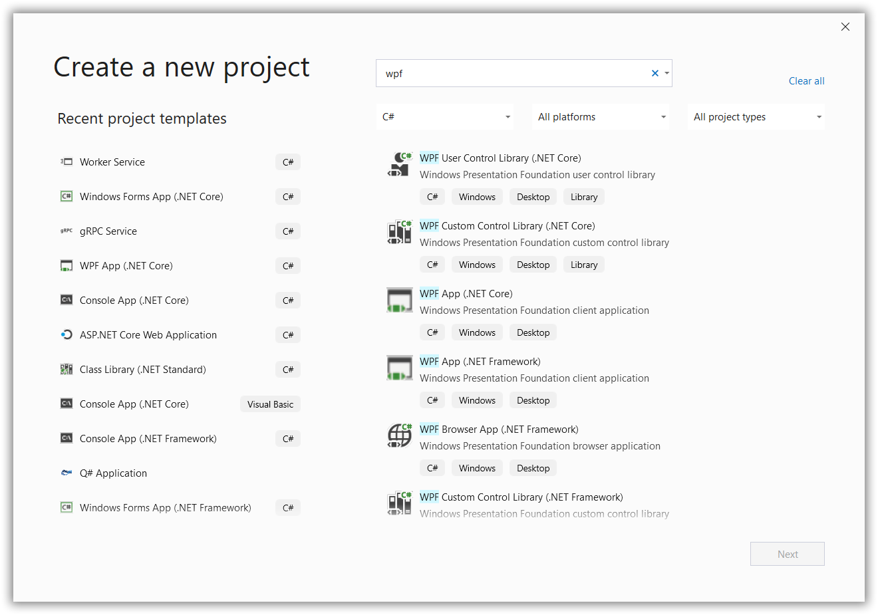
.NET Core 3.0 & 3.1 Windows Desktop

Slide 42



https://github.com/Djohnnie/VISUG-2019-DotNetCore3
https://involved-it.be
@djohnnieke
johnnyhooyberghs

