Slide 1
The New .NET World
Framework, Core, & Standard
Notes:
Hi everyone, thanks for coming today, I hope you’ve had a wonderful time so far, and hopefully we can continue that trend
My name is Calvin Allen and you're here to listen to me talk about what I call, the “rapidly changing .NET world’, which includes discussions on the .NET Framework, .NET Core, .NET Standard.

Slide 2
“I am not an expert, just an enthusiast.”
-- Unknown
Notes:
Before we get to the main talking points, I want to say that, I am not an expert by any means. I’m really just an enthusiast, and I want to share information with like minded folks, such as yourselves.
So, knowing that, at some point you may ask me a question that I don’t know the answer to.
And, if you do, I'll be honest with you, and we can try and continue the discussion afterwards and figure out and answer.

Slide 3
Target Audience
GROUP 1
The developer wants to understand the difference between the old and the new, and what that will mean for them moving forward.
Developers
What has changed?
Will my skills transfer?
GROUP 2
Managers
Notes:
I believe this presentation has two primary groups of people as the core demographic, starting off with
The Developer
The Developer wants to understand the differences between the old and new, and what thats going to mean for them moving forward.
What has changed?
Will my skills transfer?

Slide 4
Target Audience
GROUP 1
The developer wants to understand the difference between the old and the new, and what that will mean for them moving forward.
Developers
Do I need to re-learn .NET?
Will my skills transfer?
GROUP 2
Folks who may not care about the differences at the micro level, but want to understand the pros/cons in terms of cost of migrating - short-term or long-term.
Managers
We’re planning a new app – should we use .NET Core?
Should we migrate our existing app?
Notes:
Followed with….
The Manager / CTO / etc.
Folks who may not care about the differences at the microscopic level, but want to understand the pros/cons, and how that may effect the bottom line - short-term or long-term.
We're planning a new app - should we use .NET Core?
Should we migrate out existing app?
Having said that, my hope is that you'll walk away from this talk with decision-informing facts and information, as well as some of my own opinions that you can take back to your organization

Slide 5
What We’re Going to Cover
1
History & Timeline
.NET Core
Notes:
Now that we’ve discussed the target audience for the talk, let’s take a look at what we’ll actually be covering in the talk
Most of the talk will revolve around .NET Core
And we’ll start by discussing its “history” and timeline, for example, versions and their corresponding release dates to get some background, end of life timelines, and reasons why they’re moving (in my opinion) very quickly.

Slide 6
What We’re Going to Cover
Why you should be paying attention
2
1
History & Timeline
.NET Core
Notes:
After that, we’ll discuss why I think you should be paying attention to it from now on.

Slide 7
What We’re Going to Cover
Why you should be paying attention
2
1
3
Why you should choose it over “Framework”
History & Timeline
.NET Core
Notes:
Followed by why you should choose it over the traditional .NET Framework, and a few reasons why you might not

Slide 8
What We’re Going to Cover
Why you should be paying attention
2
1
3
Why you should choose it over “Framework”
History & Timeline
.NET Core
4
Migration Strategies
Notes:
Finally, we’ll wrap up the .NET core section with some thoughts, and things to look out for, around migrating a .NET Framework application to .NET Core

Slide 9
What We’re Going to Cover (cont.)
2
1
How it differs from .NET Core / .NET Framework
.NET Standard
Notes:
Then, we'll have a discussion about .NET Standard:
Starting with, how it differs from .NET Core and .NET Framework

Slide 10
What We’re Going to Cover (cont.)
2
Who might need to use it & when
1
How it differs from .NET Core / .NET Framework
.NET Standard
Notes:
Followed up by, whose the target audience for .NET Standard – or, who might need to use it and when

Slide 11
What We’re Going to Cover (cont.)
2
Who might need to use it & when
1
How it differs from .NET Core / .NET Framework
3
Version selection, targeting, and evolution
.NET Standard
Notes:
Lastly, if you’re in the target audience for .NET Standard usage, how do you choose which version to target (The version you choose will ultimately effect what APIs and platforms are available to you), and it evolves over time (hint, it’s a little different)?

Slide 12
.NET Core
History & Timeline
Notes:
Let's dive in and discuss .NET Core – starting with it’s history and timeline

Slide 13
.NET Core Timeline
v1.0
June 27th
2016
v1.1
November 16th
Notes:
Development started on .NET Core long before any of the dates I’m showing you – these are just some of the major release dates.
Starting out in 2016, we got version 1.0 in June of that year, followed up with a release of 1.1 in November of the same year.
.NET Core 1.0 was, obviously, a major release, since it’s the beginning. You could attribute it to major selling points like cross-platform support.
.NET Core 1.1 added over 13 hundred new APIs

Slide 14
.NET Core Timeline
v2.0
August 14th
v1.0
June 27th
2016
2017
v1.1
November 16th
Notes:
Then, some time passed, and we finally got version 2.0 in August of 2017. This was the only release we saw that year, however it was a pretty large release.
It added the initial support for VB.NET and included C# 7.1, and it more than doubled the number of APIs, when compared to .NET Core 1.1

Slide 15
.NET Core Timeline
v2.0
August 14th
v1.0
June 27th
v2.1
May 30th
2016
2017
2018
v1.1
November 16th
v2.2
December 4th
Notes:
Onward to 2018, we got version 2.1 in May, and just before the end of 2018, we got version 2.2.
Version 2.1 added support for “global tools”, which we’ll talk about in a bit, and included the new “Span of T” and “Memory of T”, which makes working with arrays and others of memory much more efficient.
Version 2.2 was a little smaller of a release, adding enhancements to application deployment, just-in-time compiler performance, and a handful of other things

Slide 16
.NET Core Timeline
v2.0
August 14th
v3.0
2019
v1.0
June 27th
v2.1
May 30th
2016
2017
2018
2019
v1.1
November 16th
v2.2
December 4th
Notes:
That brings us current – so what else is coming?
This year, supposedly at the “Build” conference, which is slated for May, we’ll get the official release date of .NET Core 3.0.
Now, I suppose theres still time for the feature set to change, but as of right now, we’re supposed to see some major updates.
.NET Core 3.0 adds support for C# 8.0, but also support for Winforms and WPF – missing from .NET Core, currently.
That covers what are considered the "major" releases of .NET Core over the last *three years*!
And, there were plenty of previews and release candidates scattered throughout as well

Slide 17
.NET Core Timeline – for End of Life
v1.0
July 29th
2019
v1.1
July 29th
Notes:
Although its only been three years, by July of this year, we’ll have *three* of those versions already declared end of life.
.NET Core 1.0 and 1.1 are scheduled for July 29th of this year.

Slide 18
.NET Core Timeline – for End of Life
v1.0
July 29th
v2.0
October 1st
2018
2019
v1.1
July 29th
Notes:
You might be thinking – wait, you said three?
Yeah, because .NET Core 2.0 has already been declared end of life on October 1st of last year

Slide 19
.NET Core Timeline – for End of Life
v1.0
July 29th
v2.0
October 1st
2018
2019
Current
v1.1
July 29th
v2.2
Notes:
Technically, for now, version 2.2 is the “current” release. No end of life notification for it – yet. However, it also hasn’t been classified as LTS, or long-term support.

Slide 20
.NET Core Timeline – for End of Life
v1.0
July 29th
v2.0
October 1st
v2.1
August 2021?
2018
2019
Current
LTS
v1.1
July 29th
v2.2
Notes:
That one would be .NET Core 2.1, which as of right now, will be LTS through August of 2021.
Those timelines seem awfully quick. Especially when you compare them to some of the support dates .NET Framework had
For instance,
1. .NET Framework 1.0 had support for 7 years
2. .NET Framework 1.1 had support for 12 years
3..NET Framework 3.5 was initially released in 2007, and will be supported until *2028*
Given those timelines, I expect support for .NET Framework 4.8 (which isn’t even released yet) will take us through, say, 2040?
I show you all of this information to illustrate how *fast* .NET Core is moving.
And, why is that?

Slide 21
Architecture
OS Distribution / Updates
Notes:
It comes down to the architecture and deployment models put in place for .NET Core, allowing them to iterate *much* faster.
For example, most of the .NET Framework releases were bundled in with the OS, and subsequently got a lot of its updates through Windows Update.
That could spell disaster if, for instance, you were updating the .NET Framework on a single server than ran 10 different apps, and there was a bug in the update.
Microsoft took backwards compatibility very seriously, hence the much slower time-frames around releases.
With .NET Core - that's no more – it isn’t tied to the OS, which also means no more patches through Windows Update.

Slide 22
Architecture
OS Distribution / Updates
Side-by-Side Installations
Notes:
And, since side-by-side installation is a core tenet of its design, you can have confidence that installing that new version, won’t interfere with existing applications that specify a different version.
The only time that this isn’t true, is if you’re playing around with any of the patch releases, which will upgrade in place. And, by upgrade, it means the previous version will be uninstalled before installing the new version.
For instance, if you have .NET Core 3.0.100 installed, and 3.0.101 becomes available, 3.0.100 will be uninstalled first.
However, if you have .NET Core 3.0.101, and .NET Core 3.0.200 becomes available, the 101 patch will not be uninstalled. This is using what Microsoft is calling a “Feature Band”, which is essentially the range of numbers between 100 and 199, being the same feature band. 200 would start a new band.

Slide 23
.NET Core
Why you should be paying attention
Notes:
Since .NET Core is iterating so quickly, so can the frameworks on top of it – such as ASP.NET Core, and EF Core, so let’s take a look at some new features that are here, or coming, that you should be paying attention to
After I mention all of them, we’ll head over to Visual Studio for some quick demos.

Slide 24
New Stuff!
Razor Pages
Notes:
First is Razor Pages
I equate these as being similar to webforms, in that you have a code-behind, plus the view, except this is more in line with the MVC paradigm where the code behind is your model, and controller actions, all in the same file

Slide 25
New Stuff!
Razor Pages
Razor Components
Notes:
Next up is Razor Components
Razor components are a way to build interactive client-side Uis with .NET, where your code is written like traditional server-side code, but handles UI updates on the front-end over a SignalR connection
This is inspired by Blazor, the experimental client-side model that runs .NET in the browser on top of web-assembly. I don’t discuss it anymore than that in this talk, but check it out if you get a chance.

Slide 26
New Stuff!
Razor Pages
Razor Components
C# 8.0
Notes:
That brings us to C# 8
I mentioned earlier that .NET Core 3.0 will get support for C# 8.0.

Slide 27
New Stuff!
Razor Pages
Razor Components
C# 8.0
Global Tools
Notes:
On to Global Tools
These are small command-line utilities that you can install, and then execute from the command line to perform various tasks against your codebase. The concept, I believe, is modeled after an NPM feature that allows a has a similar concept

Slide 28
New Stuff!
Razor Pages
Razor Components
C# 8.0
Global Tools
Middleware
Notes:
Back to .NET Framework, we had HTTPModules and handlers, which required that you execute code based on a particular stage of execution in the request pipeline or based on a specific file type. Because of their nature, you could run into scenarios where you’re not even sure what module or handler is executing.
Finally, Middleware, which is the replacement for HTTPModules and Handlers, and are executed in an order you define in your application startup. These are much easier to reason about, and understand.

Slide 29
Feature Demo
Notes:
Let’s hop over and take a look at some demos at each of those features.
The first example is Razor Pages. This is just a basic example, straight from the template.
Except, while we’re here, let’s look at the Middleware example, because most of the website templates (aside from “empty” have middleware included and configured by default). Looking into the “startup.cs” file, we’ll see that we’re configuring the “Cookie Policy Options” in the configure services method, and then in the configure method, we’re saying we want to use the Cookie Policy middleware. This middleware was introduced not too long ago, to help assist in dealing with GDPR.
Next is Razor Components (which also happens to use Middleware)
Here is an example of a couple C# 8.0 features
In those two examples, I showed Ranges and Nullable Reference Types. Those will both be available in .NET Core 3.0, however, the Ranges feature will not be available in .NET Framework. There are a few others that fall into that category as well, however, I don’t have any examples for them.
The decision for this comes from the fact that, to support some of the new language features, the framework needed new types, and other features added. And, since .NET Core can iterate so much faster, and not worry so much about breaking backwards compatibility, it was decided that .NET Framework would only support the C# 8.0 features that didn’t require framework changes.
5. Here’s a simple example tool called ‘upforgrabs’, which helps find issues on open source projects that you could potentially help with.
https://github.com/natemcmaster/dotnet-tools

Slide 30
.NET Core
Why you should choose it over “Framework”
Notes:
Now, if all those new features weren’t enough convince you to choose .NET Core, lets take look at a few more things that might sway your opinion.

Slide 31

Smaller & Performant
05
06
05
06
04
07
04
07
03
08
03
08
02
09
02
09
01
10
01
10
Footprint
Performance
Notes:
The overall footprint of .NET Core is smaller, in general, when compared to the .NET Framework. Alongside of that, Microsoft has “baked in” the concern for "performance" from the ground up.
These two things don’t look like much on screen, so why does it matter?

Slide 32
Smaller & Performant
05
06
05
06
04
07
04
07
03
08
03
08
02
09
02
09
01
10
01
10
Footprint
Performance
Notes:
Money, or potential cost savings.
Imagine, with the smaller footprint, faster execution, cross-platform structure, *now* you can build those microservices and deploy them to linux containers in the cloud. How can you go against all those buzzwords?
Now, to be fair, you can deploy a full .NET Framework app into a docker container, but those containers are huge, averaging around 8GB before you even install anything onto them.

Slide 33

Notes:
If you want to stick with Visual Studio for all of your .NET Core development – then you can, no problems – whether that be the Windows version or the Mac version
How about command-line tooling? If you’re like me, and you like working in the command line, now you can (or at least, even more easily)
And, being able to do things from the command-line also means less of a restriction on what tooling you can use.

Slide 34

Notes:
Maybe you like something a little more light weight and cross platform, like Visual Studio Code? Have at it.

Slide 35

Notes:
Or, maybe you prefer to use JetBrains Rider? Awesome.

Slide 36


+
Notes:
Ah, I know – you’re old school and want to use notepad to write all of your code, and compile it from PowerShell. Have at it!
All of these options – and more – have been opened up thanks to the “command-line first mentality”

Slide 37
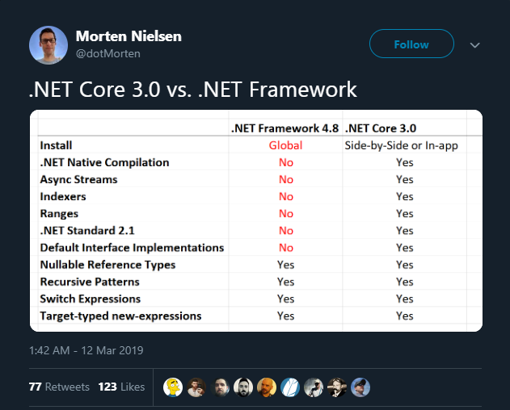
Notes:
I personally believe that, in the years ahead, its going to become a hiring and retention issue.
With .NET Framework 4.8 releasing sometime this year as well with partial C# 8.0 support, are you going to be able to hire and retain, qualified developers who want to work in the "legacy" world?
You can see the feature matrix that Morten tweeted about that goes over some of those features from C# 8.0 that won’t be available in the .NET Framework 4.8 release (or ever, for that matter)

Slide 38




<%
//aspx
%>
@{
//razor
}
Notes:
Okay, so I've been “tooting the Microsoft horn” for a bit here, so let's switch gears and discuss *why you wouldn't* switch.
And, to be fair, there are a couple of reasons -
One – no webforms (and no plans). If you have a .NET Framework 4.7.2 webforms application, you have no upgrade path, other than to completely rewrite your application with MVC.
How about VB.NET Support?
Now, it VB.NET is *supported*, but definitely not as first-class as C#. However, it does appear that Microsoft is working on this.
There are project templates available for VB.NET for creating class libraries and console applications using .NET Core, but there isn’t one for doing any of the web applications that I showed previously. At least for now.
If you still have the aspx style pages in your application (even with MVC), that is completely gone as well. You will have to rewrite your views in Razor. And, more specifically, C# for razor. There is no support, and no plans to support, VB for razor.
As I mentioned before, with the release of .NET Core 3.0, we'll get WinForms and WPF support (Windows only), which that closes a large gap for migration, but its not here yet.
And, Winforms and WPF have been open sourced, and will be included in .NET Core 3.0, there are no plans for a cross-platform version of these frameworks.
Some other issues that may arise would be missing third-party library support, features like AppDomains and Remoting, or the need to create a WCF service.

Slide 39

Notes:
With all the pros and cons aside, will your skills transfer?
Absolutely, but don’t get me wrong, there are differences, and you'll have to learn a few new things, such as the new “Startup” and “Configuration” routines, which include the middleware we talked about earlier.
Although standing up an MVC application and using middleware *is* different, once you're into the "MVC" part of it, you’ll be back in familiar territory with controllers, models, and views.

Slide 40
.NET Core
Migration Strategies
Notes:
Okay, with all of that said, you've decided to migrate. So how do you approach it?
It depends on what you're trying to migrate, as a library, or console application, will be different than an ASP.NET MVC website.
Unfortunately, there are no automated migration tools, at least that I’ve been able to find, so its a manual process. HOW manual, depends on the scale of the application.
Here’s some general advice on getting started….

Slide 41
Migrating
Analyze Dependencies
Notes:
First, analyze all your dependencies, and determine if they have a release that is .NET Core compatible.
If there isn’t a .NET Core compatible version, then you might have to take an alternative route – such as testing out a new library that does have support, or foregoing the library altogether and writing your own code to do it.

Slide 42
Migrating
New Project(s)
Analyze Dependencies
Notes:
Secondly, create all new projects. The reason I say this is because the project files have a new structure, and you’ll want to take advantage of it. It removes a lot of the MSBuild XML stuff, and adds all the files by default instead of you have to add them one by one. This is great, because the days of merge conflicts occurring because two people added a new class file to the project are over.
It also removes the old “packages.config” notion for tracking dependencies, and now includes them as “Package References” inside the project file.

Slide 43
Migrating
New Project(s)
Analyze Dependencies
Copy Code / Install
New Dependencies
Notes:
Third - copy over your code, making any changes as necessary, and start installing those new packages/dependencies as necessary.
Now, granted, this is obviously the tricky part, as there are some changes you’ll need to be aware of, because not all of your code will transfer 1-1

Slide 44
Changes Required
Global.ascx – gone
Program.cs and Startup.cs
Notes:
Here are some things that I can tell you “for sure” that you’ll have to change:
The “global.ascx” file, where you have a lot of your startup code is gone. You’ll need to learn, and use, the Program.cs and Startup.cs files instead

Slide 45
Changes Required
Global.ascx – gone
Program.cs and Startup.cs
HTTPModules – gone
Use Middleware
Notes:
No more HTTPModules / Handlers, so you’ll need to rewrite them as middleware and get those declared in your startup routines

Slide 46
Changes Required
Global.ascx – gone
Program.cs and Startup.cs
Controller Inheritance
Common Ancestor
HTTPModules – gone
Use Middleware
Notes:
In .NET Framework, MVC controllers and WebAPI controllers didn’t share a common base class
Now they do, so if you have both types, you’ll need to make changes to support that.

Slide 47
Changes Required
Global.ascx – gone
Program.cs and Startup.cs
Controller Inheritance
Common Ancestor
HTTPModules – gone
Use Middleware
ASPX Views – gone
Migrate to Razor / cshtml
Notes:
If you’re using aspx files for your views, you’ll need to migrate them to the razor format, and specifically, the C# language variant.

Slide 48
Changes Required
Global.ascx – gone
Program.cs and Startup.cs
Controller Inheritance
Common Ancestor
HTTPModules – gone
Use Middleware
ASPX Views – gone
Migrate to Razor / cshtml
VB.NET Support
Notes:
This might be the time you take the plunge and switch to C#, it kind of depends on your timeframe.
If the support for VB.NET has gotten better before you’re able to migrate, then maybe you don’t need to.
However, with that said, since there are no plans to support the VB.NET language variant in Razor views, you’ll still have to rewrite those in C#
And, no, I'm not telling you to switch from VB.NET to C#, just pointing out some inconsistencies. Ultimately, use what works for you and your team first and foremost

Slide 49
.NET Standard
How it differs from .NET Core / Framework
Notes:
That ends of the section for .NET Core, now let's take a few minutes to discuss .NET Standard.
Specifically, how it differs from .NET Core and the .NET Framework, who the target audience is for its use, how to choose what version to target, and finally, how it evolves over time.

Slide 50
Interface vs. Implementation
.NET
Standard
(interface)
Notes:
.NET Standard is a *specification* - whereas, .NET Core and .NET Framework are *runtimes* - you might be thinking, "what does that mean"?

Slide 51
Interface vs. Implementation
.NET
Standard
(interface)
Implements
.NET
Core
.NET
Framework
Notes:
Well, if we think of it in programming terminology, .NET Standard would be considered an *interface*, with .NET Core and .NET Framework as implementations of that interface.
Except, in the case of .NET Standard, you actually can target it as you would a traditional “runtime”, which essentially gives your library the ability to run on either runtime (we’ll get to the runtime version support in a moment).

Slide 52
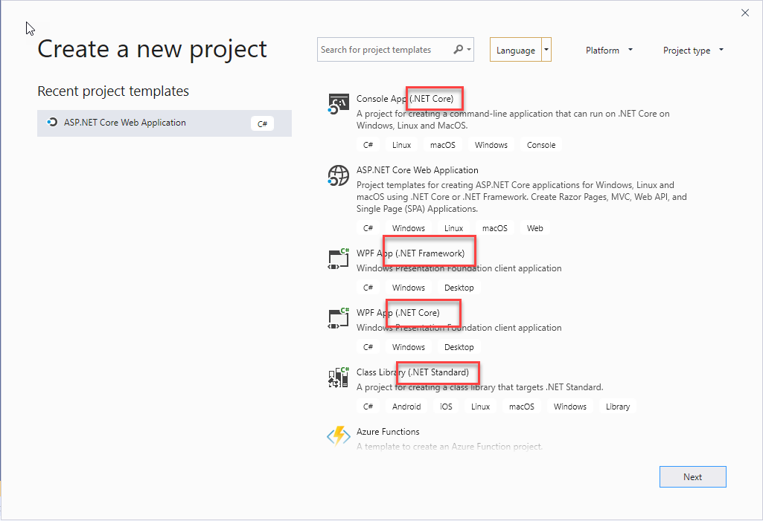
Notes:
Project Creation is a little different, especially in Visual Studio 2019, which I show here, but I find it to be much cleaner, overall.
You can see that we now have a runtime listed with the template name, instead of all of them being .NET Framework, like it used to be.
Now, you’ll create a either a .NET Framework, .NET Core, or .NET Standard project using the appropriate template.

Slide 53
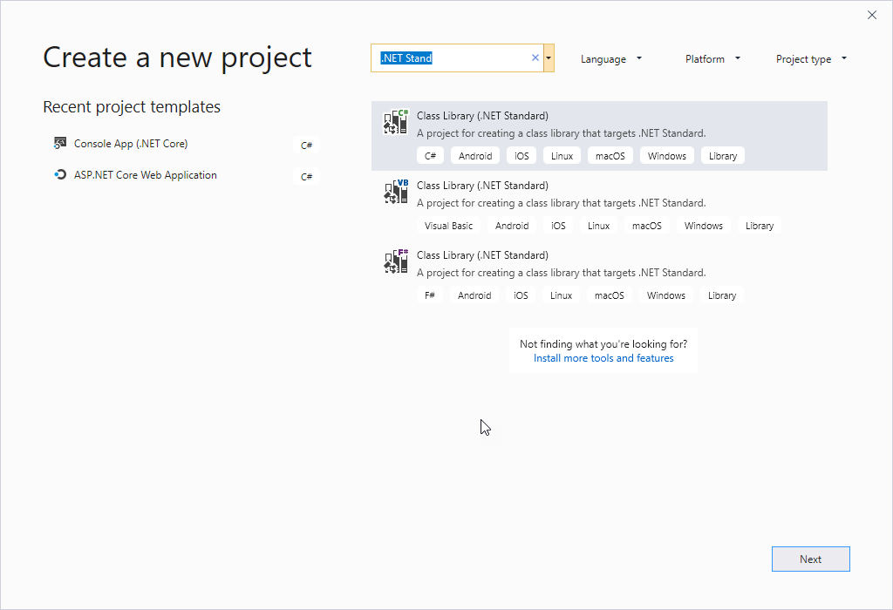
Notes:
The only entries for .NET Standard are language variations of the Class Library.

Slide 54
.NET Standard
Who might need to use it and when
Notes:
So knowing that, who should really care about .NET Standard or be focused on it?

Slide 55



.NET Standard “Audience”
Notes:
Library authors, if the screenshot of the available .NET Standard templates didn’t give it away.
These libraries could be open source on GitHub and published to NuGet, or libraries that you distribute within your own organization.
Having said that, to wrap this section up, there are no templates, and no support for creating, a web application that targets .NET Standard. That just simply isn’t the intent behind it.

Slide 56
.NET Standard
Version selection, targeting, and evolution
Notes:
Now that you know who the target audience is for .NET Standard, let’s go over how to choose which version to select/target, and how it evolves over time.

Slide 57
.NET Standard Version Selection
.NET Standard Version
(lower)
(higher)
Notes:
During development of your libraries - you'll want to choose - as recommended by Microsoft, the *lowest* version of .NET Standard you can, and then work upwards as needed.

Slide 58
.NET Standard Version Selection
.NET Standard Version
(lower)
(higher)
Platforms
Notes:
The reason for that is to get your library available on as many platforms/runtimes as possible.

Slide 59
.NET Standard Version Selection
.NET Standard Version
(lower)
(higher)
API List
Platforms
Notes:
The downside of that is that it gives you access to fewer APIs. So, as you’re developing your library, you may need to go to a higher version of .NET Standard, which will give you access to more APIs, but less platforms that can run it.

Slide 60
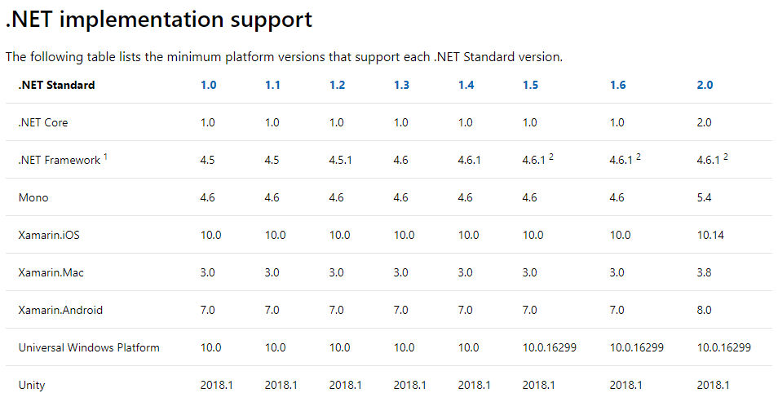
Notes:
Finally, here is a chart that Microsoft provides that outlines which versions of .NET Core and .NET Framework implement what version of .NET Standard.
Up to this point, we've only really discussed .NET Core and .NET Framework as .NET Standard implementations - however, just be aware that there are others, such as Mono and Xamarin, as you can see in the screenshot.
And, the final thing I want to mention about .NET Standard is how it evolves, because it actually evolves *AFTER* the runtimes, and then the runtimes can declare support for it.
For example, if .NET Core adds a new feature, it may not necessarily be available in .NET Standard for some time, until the committee that manages it decides it’s worthwhile to be part of the specification.
For instance, we see from the chart that .NET Framework 4.6.1 is .NET Standard 2.0 valid. But .NET Standard 2.0 wasn’t officially released until August of 2017, whereas .NET Framework 4.6.1 was released almost two full years earlier, in November of 2015.
What this chart doesn’t show, is that .NET Standard 2.1 has also been announced, back in November 2018.
Unfortunately, another downside for .NET Framework is with that announcement, it was stated that .NET Framework 4.8 will still only target .NET Standard 2.0, whereas .NET Core 3.0 will target .NET Standard 2.1
.

Slide 61
Final Thoughts
Notes:
That ends the discussion on .NET Standard.
Let’s wrap up with some final thoughts….

Slide 62
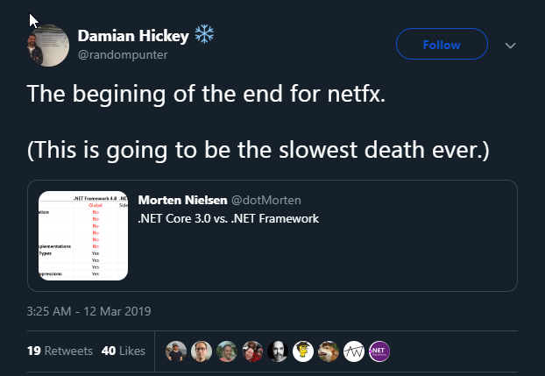
Notes:
It’s my opinion that it is time to take .NET Core, and .NET Standard, seriously.
If I needed to create a new project *tomorrow*, I will choose .NET Core (or .NET Standard if I'm creating a library). Unless for some odd reason we have an explicit requirement to create a webforms app - and then I’ll just be updating my resume instead.
Having said that, the .NET Framework will still be around for a long time to come.
Microsoft hasn't stated that it’s "dead", although the "proverbial writing" is on the wall. We’ve seen much slower release cadences with .NET Framework since development started on .NET Core. I don’t believe we’ll ever see a .NET Framework 5.0. I also don’t believe we’ll ever see full C# 8.0 support, let alone any future versions of the language that would require runtime changes.
I believe it's only a matter of time before 4.8 is released and goes into LTS with no more planned releases at all, and I’m not necessarily the only one that believes the end is nigh – heres on example in the screenshot

Slide 63
Wrapping Up
Notes:
In closing, let's recap quickly we discussed here today

Slide 64
What Did We Talk About?
Why you should be paying attention
2
1
3
Why you should choose it over “Framework”
History & Timeline
.NET Core
4
Migration Strategies
Notes:
Most of the talk revolved around .NET Core.
We discussed things like its history and timeline, why I think you should be paying attention to it, why you should choose it over “Framework” (and why you might not), and finally, migration strategies

Slide 65
What Did We Talk About? (cont.)
2
Who might need to use it & when
1
How it differs from .NET Core / .NET Framework
3
Version selection, targeting, and evolution
.NET Standard
Notes:
Then, we had a discussion about .NET Standard:, specifically, how it differs from .NET Core / .NET Framework, who might need to use it and when, how to select a version of .NET Standard, and finally, how it evolves over time.
We closed out with my thoughts that its time to take .NET Core seriously and to begin considering it the default answer when asking yourselves, “should I choose .NET Core, or .NET Framework?”

Slide 66
Shameless Plugs
Notes:
With the core presentation complete, I do have a couple of shameless plugs, if you’ll indulge me for one more minute…

Slide 67
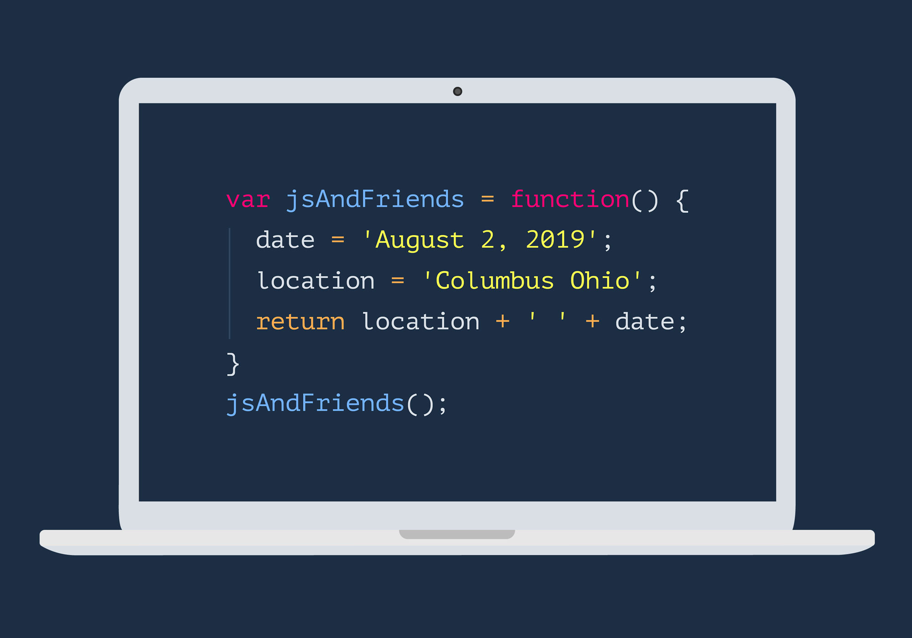
JavaScript & Friends Conference
https://www.javascriptandfriends.com
Notes:
First, I am on the board, helping to found a new Javascript focused conference called, “JavaScript & Friends”, to debut in August of this year, in Columbus, OH.
Our CFP is open until April 11th, if you’re interested in speaking.
Check that out at javascriptandfriends.com

Slide 68

.NET Bytes
The podcast bringing you the news about .NET, C#, Visual Studio, and everything in between, from Redmond and around the world.
https://www.dotnetbytes.fm
Notes:
Secondly, I just launched a podcast (though, who hasn’t) with a buddy of mine, Matt Groves, called, “.NET Bytes”. We’re positioning ourselves as a news source for all things .NET / C# / Visual Studio / etc.
We’ve released two episodes so far, on a bi-weekly schedule.
Check us out on dotnetbytes.fm – also available on just about every podcast provider you could think of.

Slide 69
Thank You!
Notes:
With all that said, thank you very much for joining me today. I hope you’re able to walk away with new information or ideas, and that your time here was worth it.
I do also want to say thank you to the conference organizers for putting on such a great conference, and thanks to the sponsors because really without them there wouldn't be a conference, so if you get a chance, please visit them and thank them for their contribution.

Slide 70





Contact Me
Twitter
LinkedIn
https://www.twitter.com/_CalvinAllen
https://www.linkedin.com/in/calvin-allen
GitHub
Blog
https://github.com/calvinallen
https://www.calvinallen.net
calvin.allen@outlook.com
Notes:
And, finally – Here’s my contact information - if you'd like to reach out, ask more questions, etc.
Again, I can't promise I'll know the answer, but I'll absolutely try to help.
Best way to reach me is through Twitter (_CalvinAllen), or through email – “calvin.allen@outlook.com”
I'm also on GitHub, LinkedIn, and I have a blog as well.
And, the slides for this talk are already available on my github account, shown here, and also through the conferences github repo as well.
Again, Thanks for coming and I hope you have a wonderful day!

