Slide 1
Maximum-Weight stable sets and safe lower bound for graph coloring
Valeriu Motroi
MSAI 2

Slide 2

Graph Coloring Problem
G=(V, E)
Stable set - $S= \left\{x | xy∉E, x, y ∈S\right\}$
Chromatic number – minimum K, such that we can color G with K colors.
Clique number $ω(G)$
$ω\left(G\right)≤χ(G)$ – Clique number is a lower bound for Chromatic number
Issue: Graphs with Clique number 2 and arbitrary high Chromatic number

Slide 3

ILP (CIP)
S – set of all maximal stable sets in G
$$χ\left(G\right)=\min{\sum_{s ∈S}{x_{s}}} \\ s.t. \sum_{s∈S:v∈S}{x_{s}≥1, ∀v∈V} \\ x_{s}∈\left\{0, 1\right\}, ∀s∈S$$
To K-coloring – remove each vertex from all but one of the stable sets to which it is assigned.

Slide 4

LP (CLP) relaxed CIP
S – set of all maximal stable sets in G
$$χ\left(G\right)=\min{\sum_{s ∈S}{x_{s}}} \\ s.t. \sum_{s∈S:v∈S}{x_{s}≥1, ∀v∈V} \\ 0≤x_{s}≤1, ∀s∈S$$

Slide 5
Mehrotra and Trick proposed to solve
CLP via Column Generation
and
We CIP via Branch and price
(The most successful exact coloring method)

Slide 6
Precision issues

Slide 7

CLP-r
$Let S^{′}⊆S, contain a feasible solution to CLP, that is V= \bigcup_{s∈S^{′}}{s}$
$$χ_{f}\left(G, S^{′}\right)=\min{\sum_{s ∈S′}{x_{s}}} \\ s.t. \sum_{s∈S^{′}:v∈S}{x_{s}≥1, ∀v∈V} \\ 0≤x_{s}≤1, ∀s∈S^{′}$$

Slide 8

Let (x, π) be an optimum primal-dual solution pair to CLP-r. By setting $x_{s}=0$ for all $S ∈S\backslash S^{′}$, $x$ can be extended naturally to a feasible solution of CLP.
Now, either $(x,\text{π})$ is also optimum or π is dual infeasible with respect to CLP. In the latter case, there is a stable set $S ∈S\backslash S^{′}$ with $π\left(S\right)>1$.
A stable set satisfying $π\left(S\right)>1$ exists if and only if the weighted stability number is greater than one.

Slide 9

MWSS
$$α_{π}\left(G\right)=\max{\sum_{v ∈V}{{π_{v}y}_{v}}} \\ s.t. y_{v}+y_{w}≤1, ∀\left\{v, w\right\}∈E \\ y_{v}∈\left\{0, 1\right\}, ∀v ∈V$$

Slide 10
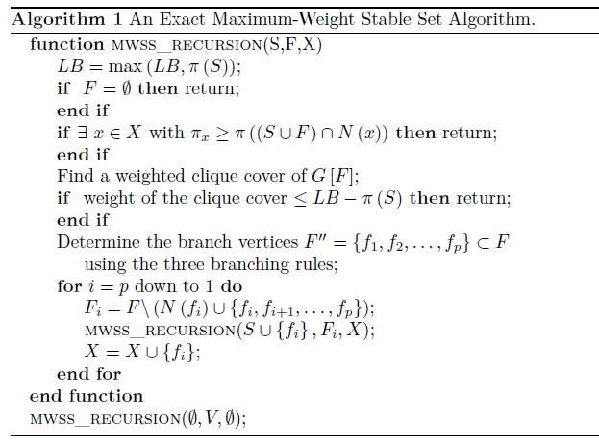
Notes:
Prunning:
Multimea X, nodurile excluse din considerare pentru ca au fost deja explorate in cazuri anterioare.
Foloseste acoperirea ponderata de clici. Si anume faptul ca numarul de stabilitate ponderat intotdeauna e mai mic sau egal cu orice acoperire de clici ponderata. Deci daca gasim o acoperire care are valoarea mai mica, atunci putem sa ne oprim.
Euristici: Incepem cu greedy. Care la randul lui poate fi imbunatatit cu un local search.

Slide 11
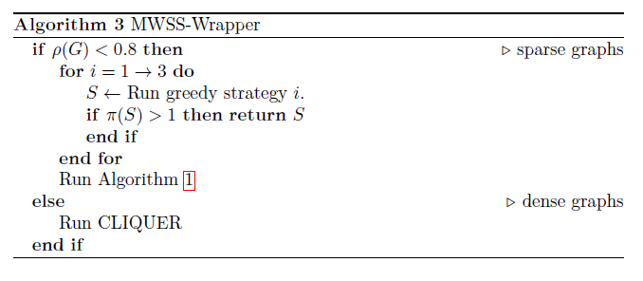

Slide 12
Experimental results
Implemented in C (gcc –O3)
CLP-r Gurobi 3.0.0
Dataset: DIMACS
2.268 GHz Intel Xeon E5520 Server

Slide 13
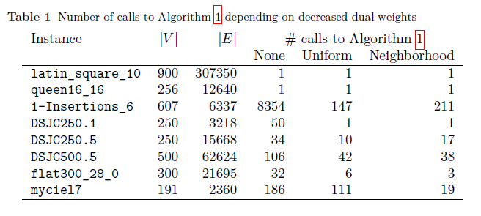

Slide 14
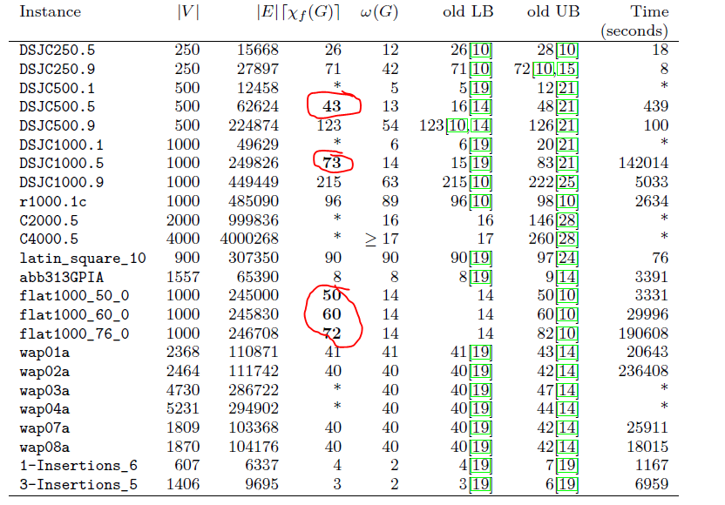
Notes:
Column generation

Slide 15
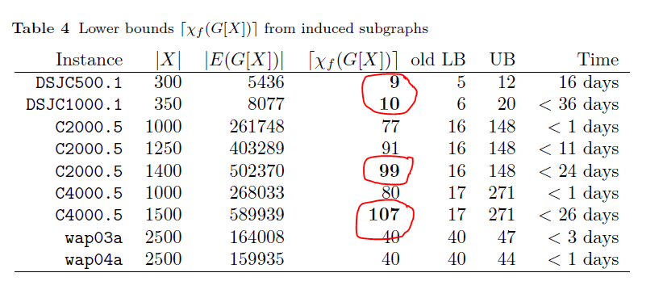
Notes:
Branch and price.

Slide 16

$$p\left(v, w\right)≔ \frac{\sum_{s∈S:v, w ∈S}{x_{s}}}{0.5 (\sum_{s∈S:v∈S}{x_{s}}+\sum_{s∈S:w ∈S}{x_{s}})}$$

Slide 17
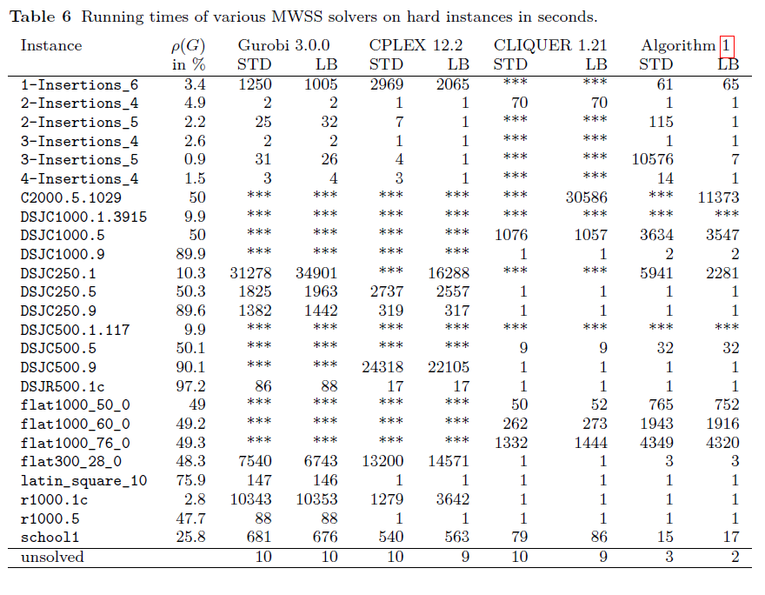
Notes:
10 hours -> ****
Cliquer -> dense graphs
Branch and cut -> sparse graphs <3%
Alg1 -> stable + best performance in between
Gurobi + CPLEX ->rezulate instabile -> double

Slide 18
The END

