Slide 1
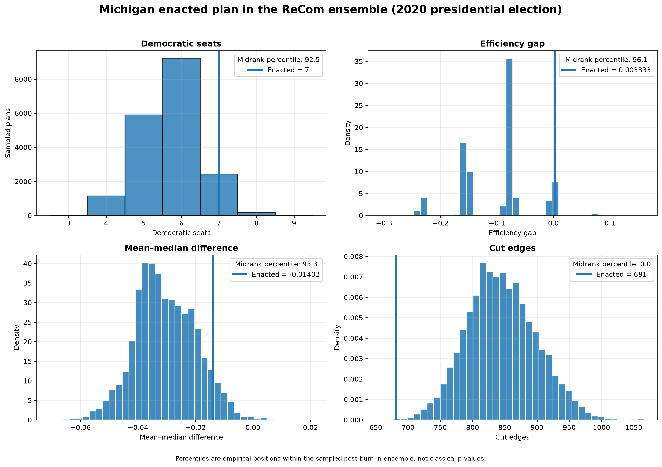
Detecting Outlier Maps with Ensembles
Michigan congressional plan • 2020 presidential election
Research question
Where does the enacted Michigan plan fall relative to thousands of valid alternative maps sampled under explicit neutral constraints?
Not a visual intuition project
Not a legal verdict
A reproducible statistical baseline
1/16

Slide 2
Hypothesis and claim standard
A strong claim needs converging evidence, not one metric.
Hypothesis
If the enacted plan is structurally unusual, it should fall in the tails of the sampled ensemble across multiple forms of evidence: seats, efficiency gap, mean-median, sorted districts, and robustness tests.
Evidence required: percentile tails
Structure required: sorted-district deviations
Credibility required: diagnostics + sensitivity
Boundary required: explicit limitations
2/16

Slide 3
Research context: where this project fits
The paper is stronger when it is explicitly connected to existing computational-redistricting literature.
Guest et al. (2019): computational redistricting makes criteria explicit; compactness is only one possible criterion.
Stephanopoulos (2017): efficiency gap captures packing/cracking but causes and consequences require institutional context.
Kenny et al. (2023): compare enacted plans to simulated nonpartisan baselines to separate map effects from geography.
Bouton et al. (2024): turnout heterogeneity creates pack-crack-pack strategies ordinary metrics may miss.
Positioning: this project is a state-level, reproducible ensemble baseline—not a legal verdict, national causal estimate, or pure compactness optimization.
3/16

Slide 4
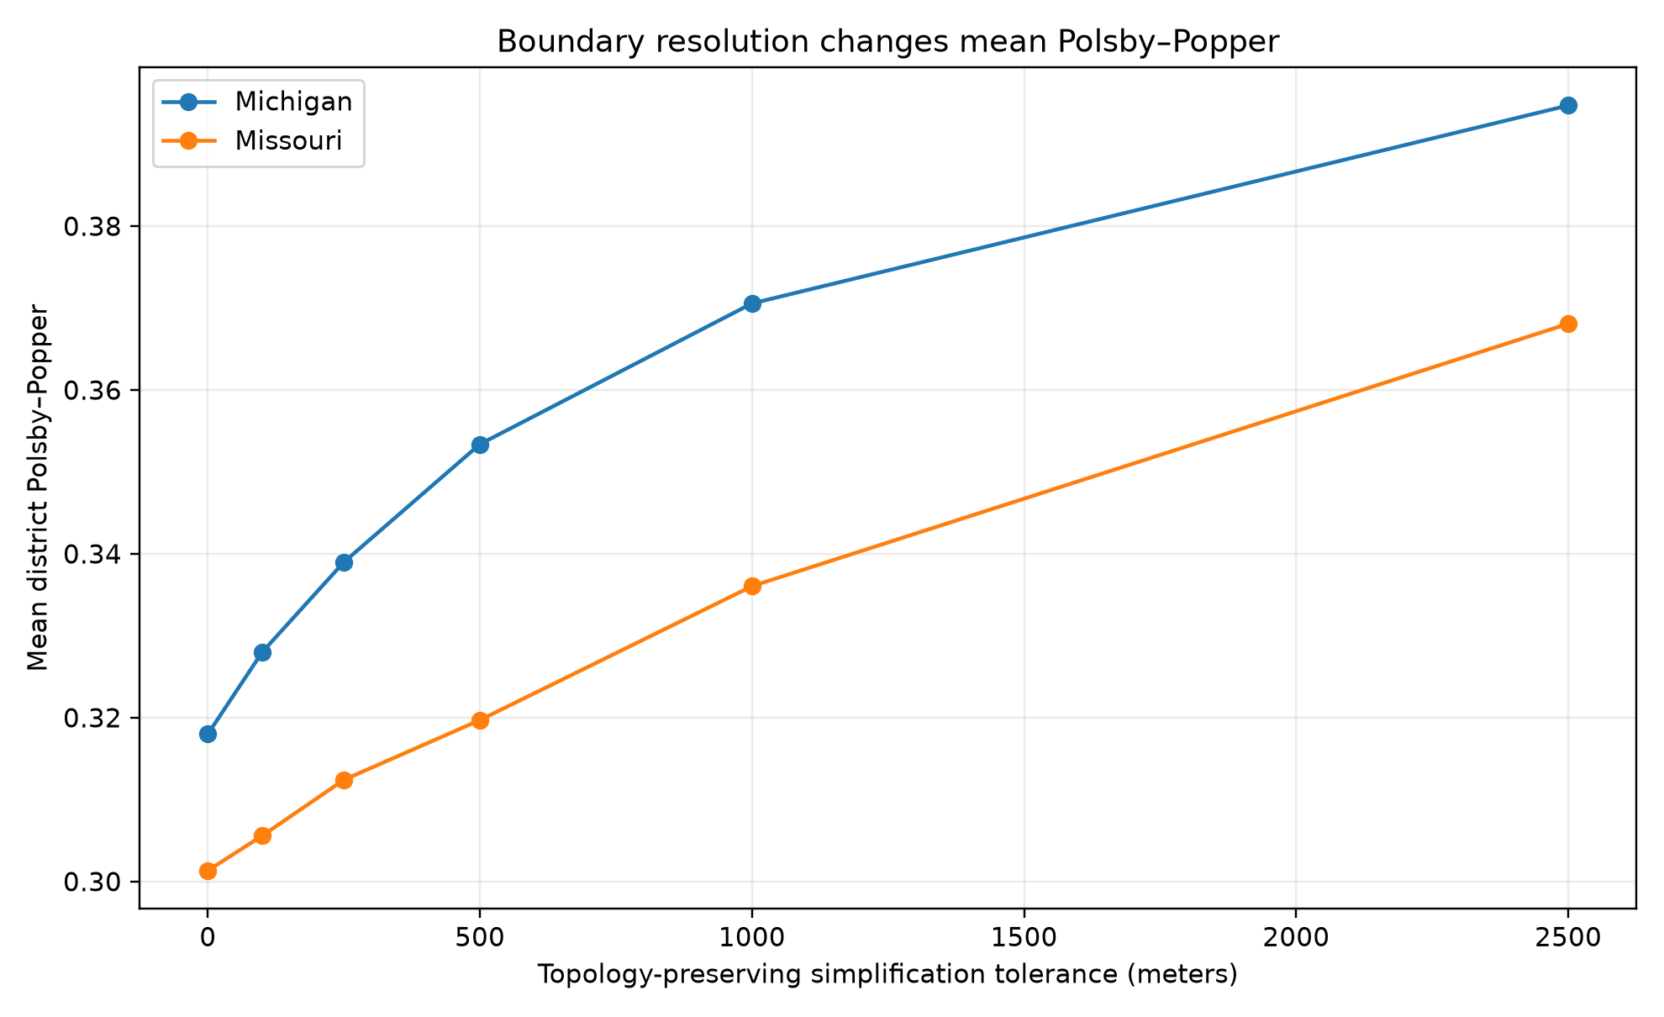
Why visual compactness is not enough
Irregular districts can come from water, boundaries, or legal constraints.
Compact districts can still produce partisan advantage.
Compactness metrics are useful diagnostics, not fairness definitions.
This motivates comparing enacted maps against an ensemble baseline.
4/16

Slide 5
Data model: a map becomes a graph
Nodes = precincts / voting tabulation districts
Edges = shared borders using rook adjacency
Node attributes = population, enacted district, election votes
Disconnected island components repaired with documented artificial bridge edges
Use your Week 1 dual graph map here.
5/16

Slide 6
ReCom ensemble design
Start at enacted plan (step 0)
Merge two adjacent districts
Re-split with a random spanning-tree procedure
Accept plans satisfying population and contiguity constraints
Record seat count and partisan metrics at every step
Main run
3 independent chains
7,000 steps each
700-step burn-in removed
18,900 post-burn-in plans
2% population tolerance baseline
6/16

Slide 7
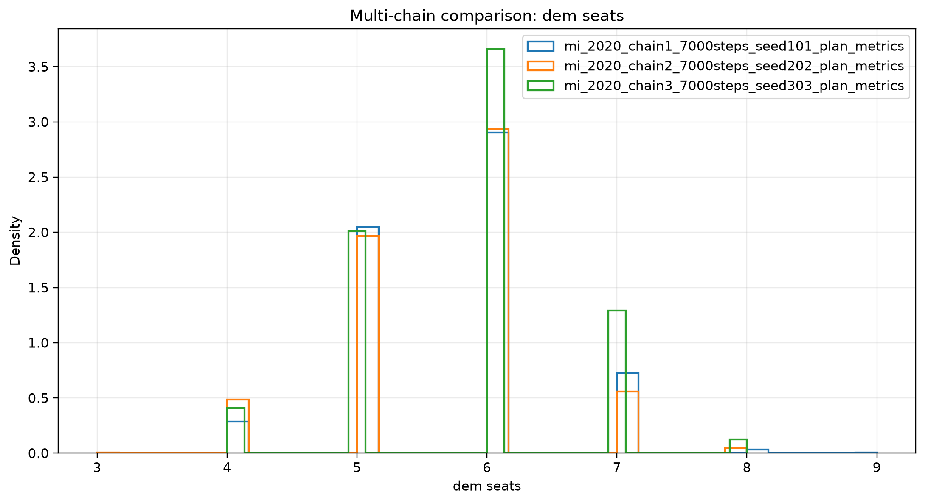
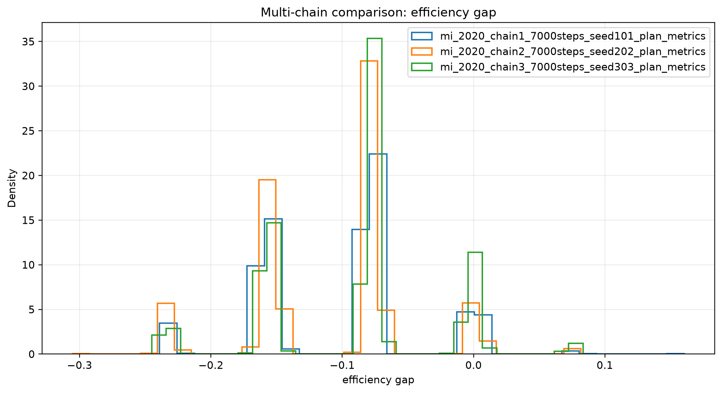
Diagnostics before interpretation
A completed run is not automatically a credible ensemble.
Max split-Rhat: 1.030
Interpretation: reassuring practical diagnostics, not proof of perfect mixing.
7/16

Slide 8
Main evidence: empirical percentiles
Democratic seats: enacted 7, percentile 92.5%
efficiency gap: enacted 0.003, percentile 96.1%
mean-median difference: enacted -0.014, percentile 93.3%
cut edges: enacted 681, percentile 0.0%
maximum population deviation: enacted 0.004, percentile 0%
Percentile = enacted plan's position inside the sampled post-burn-in ensemble, not a classical p-value.
8/16

Slide 9
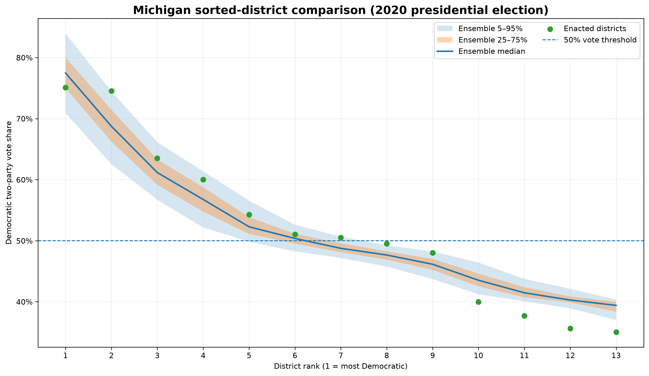
Sorted-district plot: structure behind the aggregate
Rank 2: +5.79 pp vs ensemble median
Rank 12: -4.65 pp vs ensemble median
Rank 13: -4.38 pp vs ensemble median
Why it matters: packing and cracking are visible as rank-level deviations, not just total seats.
9/16

Slide 10
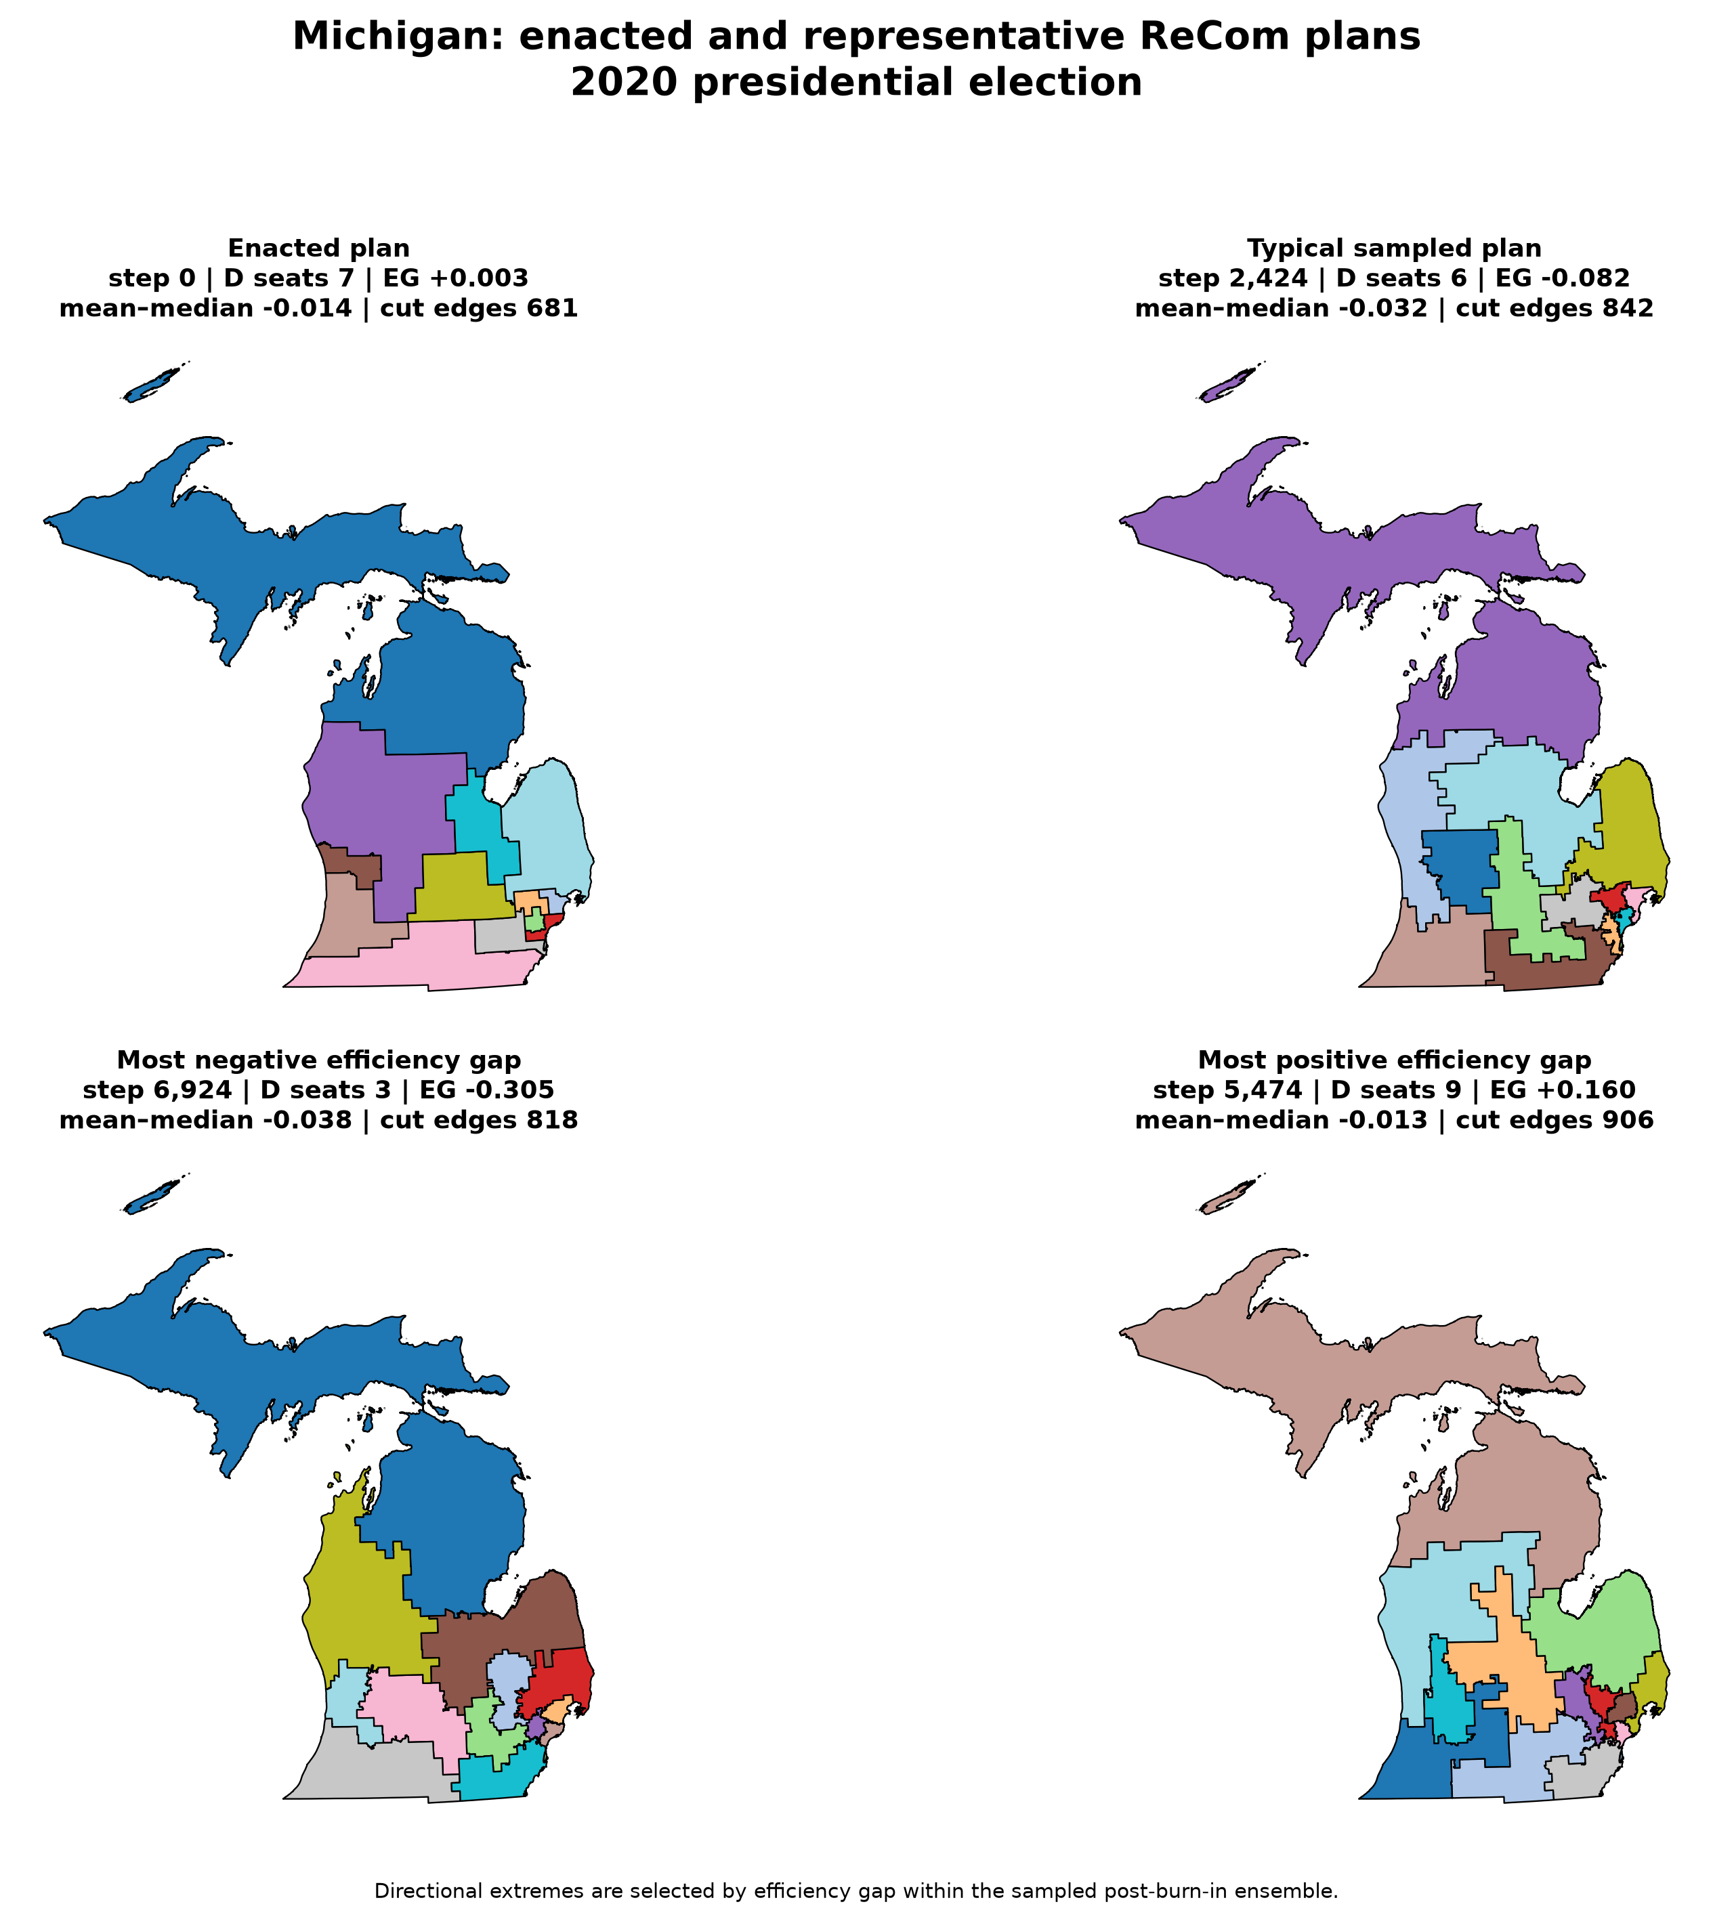
Maps: statistics tied back to geography
10/16

Slide 11
Evidence ledger
What each result supports — and what it does not prove.
Democratic seats
enacted 7 • percentile 92.5%
supports conditional outlier analysis
efficiency gap
enacted 0.003 • percentile 96.1%
supports conditional outlier analysis
mean-median difference
enacted -0.014 • percentile 93.3%
supports conditional outlier analysis
cut edges
enacted 681 • percentile 0.0%
supports conditional outlier analysis
None of these alone proves intent or illegality. The strength comes from cumulative evidence plus limitations.
11/16

Slide 12
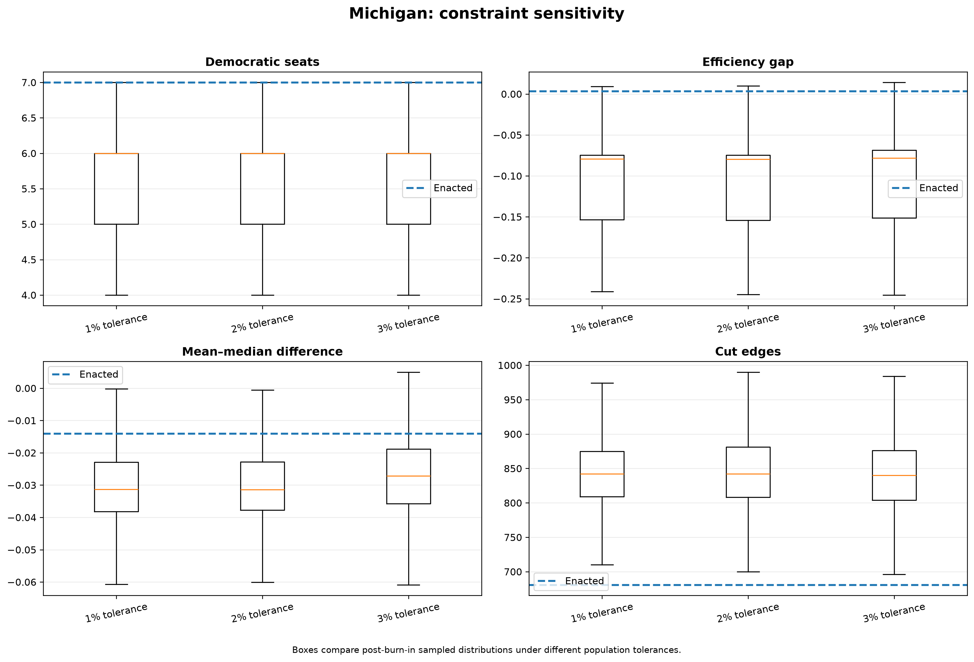
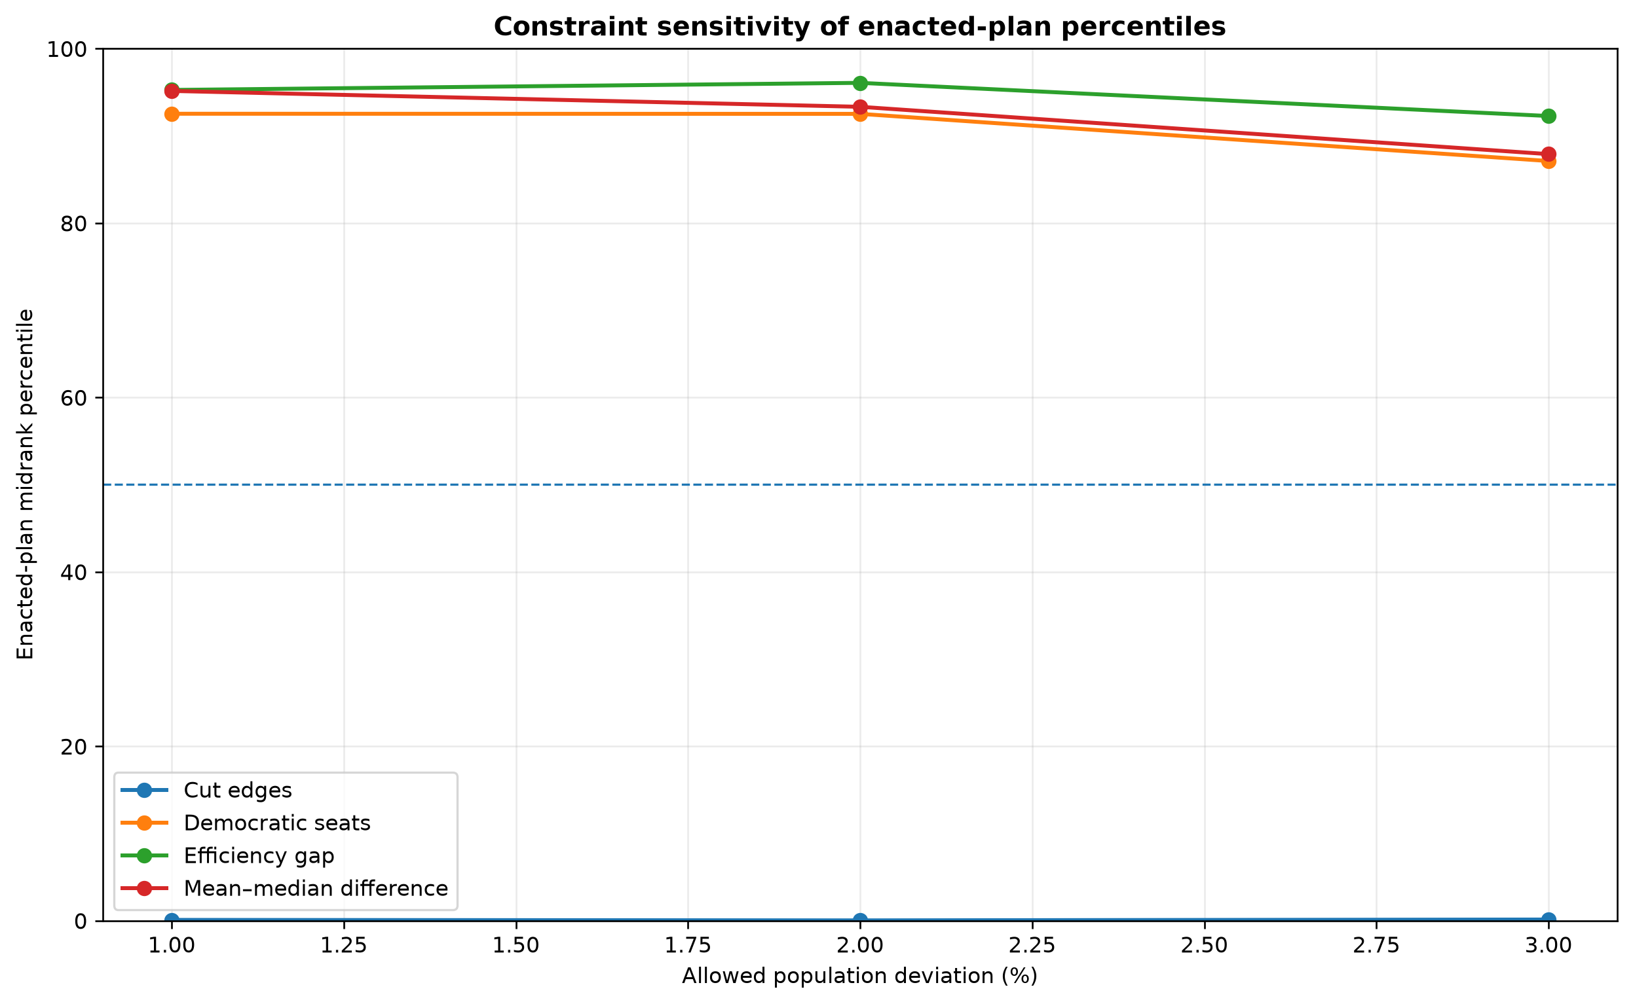
Stress test 1: population tolerance
Largest percentile movement: 7.25 points
12/16

Slide 13
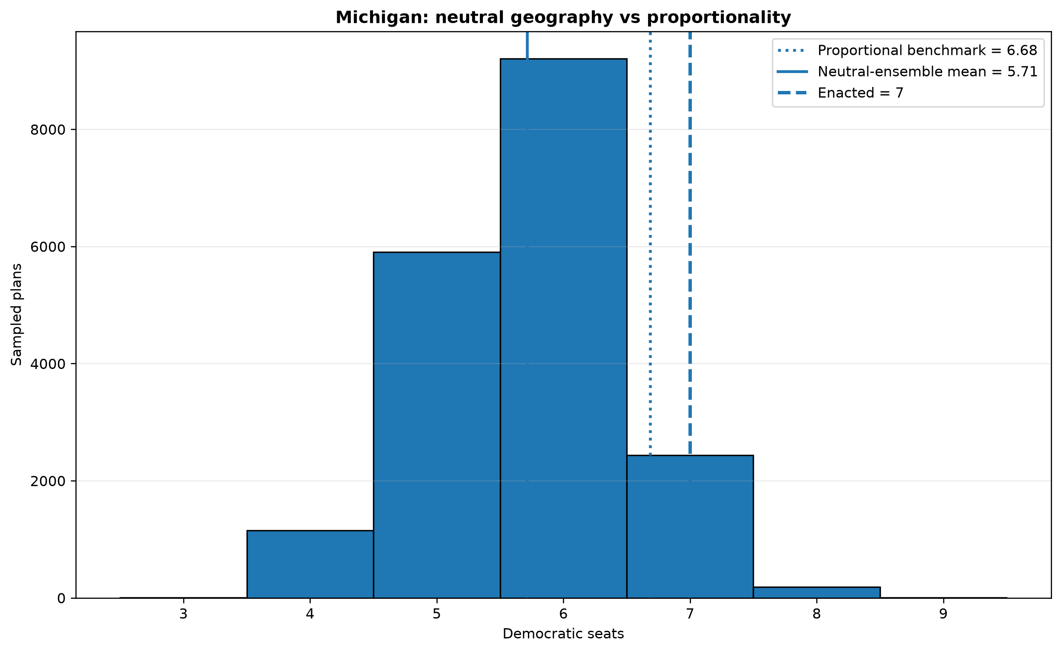
Stress test 2: geography baseline
Proportional benchmark: 6.68 Democratic seats
Ensemble mean: 5.71 Democratic seats
Enacted: 7 Democratic seats
This avoids the weak argument that any disproportionality equals gerrymandering.
13/16

Slide 14
What the paper can and cannot claim
Supported
Not supported
Empirical outlier status relative to sampled ensemble
Transparent assumptions and constraints
Practical multi-chain diagnostics
Robustness checks across tolerances
Legal conclusion
Proof of intent
Proof of perfect mixing
Full modeling of every legal criterion
A universal result across all elections
14/16

Slide 15
Strongest counterargument
The ensemble may not represent every legally realistic plan because it does not fully encode Voting Rights Act compliance, communities of interest, county splits, incumbency, or every state-specific rule.
Response: disclose constraints instead of hiding them
Run sensitivity tests
Avoid claims about intent or legality
Treat this as measurement evidence, not a verdict
15/16

Slide 16
Final conclusion
Under the stated graph, data, ReCom proposal, burn-in, population constraints, and 2020 presidential election scoring data, the enacted Michigan plan falls at the reported empirical percentiles of the sampled ensemble.
This is stronger than visual intuition.
It is more honest than a single metric.
It becomes persuasive because assumptions, diagnostics, and limitations are explicit.
16/16

