Slide 1
INFO 432 — GROUP 5 FINAL REPORT
Gaming vs. Academic Performance
Jeffrey Cheung · Drew Jones · Danny Eapen · Joel Thomas

Slide 2
INTRODUCTION
Three questions, one dataset
College students are told gaming “ruins your grades.” That claim gets repeated far more often than it gets measured — so we measured it, using 8,000 student records.
01
02
03
Which factors
actually relate to grades?
Where are the
thresholds?
How well can
grades be predicted?
Gaming, study, sleep, attendance, and a self-reported addiction score; five candidates, tested for a statistically significant relationship with grades.
A correlation says a relationship exists, not where it starts to bite. We look for the exact hours-per-day where average performance visibly steps down.
We build and compare regression models, then score them on students the model never saw; so the reported accuracy is honest.
2

Slide 3
INTRODUCTION
The dataset
Kaggle: Gaming vs Academic Performance — 8,000 student records, 14 columns covering demographics, gaming habits, study habits, sleep, attendance, stress, and a final grade.
8,000
14
0
STUDENT RECORDS
COLUMNS OF DATA
MISSING VALUES
What the 14 columns cover
Identity & demographics
Gaming behavior
student_id, age, gender
gaming_hours, gaming_genre, device_usage, reaction_time_ms, addiction_score
Academic behavior
Wellbeing
study_hours, attendance, grades
sleep_hours, social_activity, stress_level
3

Slide 4
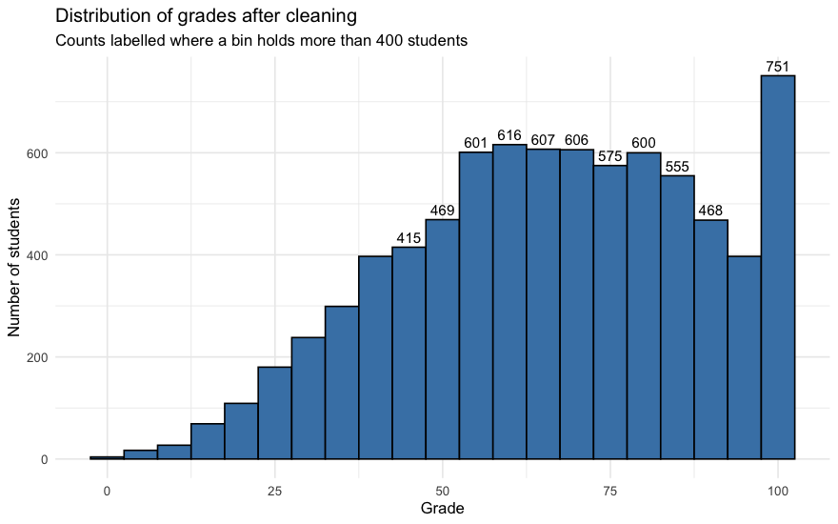
DATA CLEANING
The grade column runs past 100
134 records (1.68%) sit above the ceiling. We checked whether they're errors or genuine top performers — then capped rather than dropped them.
Before cleaning
Over-100 records: errors, or top performers?
Minimum
0.00
Over 100
Rest
Median
67.07
Gaming hrs
2.66
4.11
Mean
66.18
Study hrs
8.65
5.41
Maximum
118.63
Sleep hrs
7.37
6.48
Records over 100
134
Attendance
84.3
79.8
Addiction
7.20
9.95
Percent of sample
1.68%
They study more, game less, and score lower on addiction — the profile of strong students, not data errors.
4

Slide 5
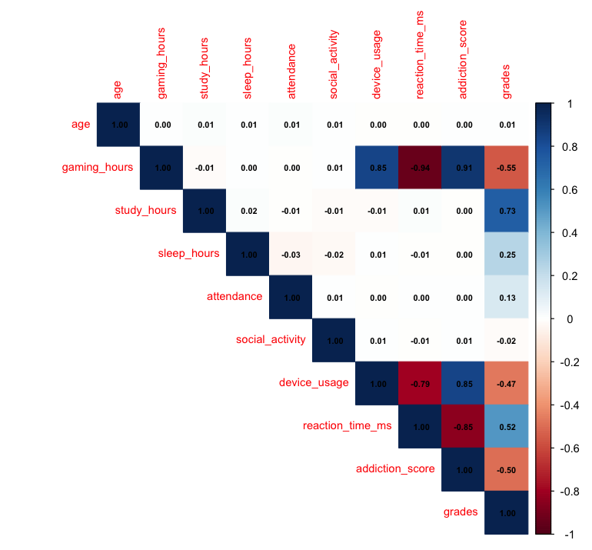
EXPLORATORY ANALYSIS
What actually moves with grades
Correlations worth naming
study_hours → grades
+0.733
gaming_hours → grades
−0.552
addiction_score → grades
−0.496
sleep_hours → grades
+0.249
attendance → grades
+0.130
addiction_score correlates 0.909 with gaming_hours — those two columns are close to the same measurement. That collinearity becomes the central issue in the regression section.
5

Slide 6
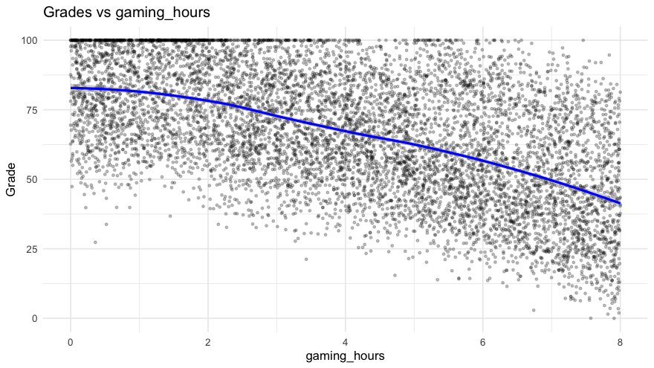
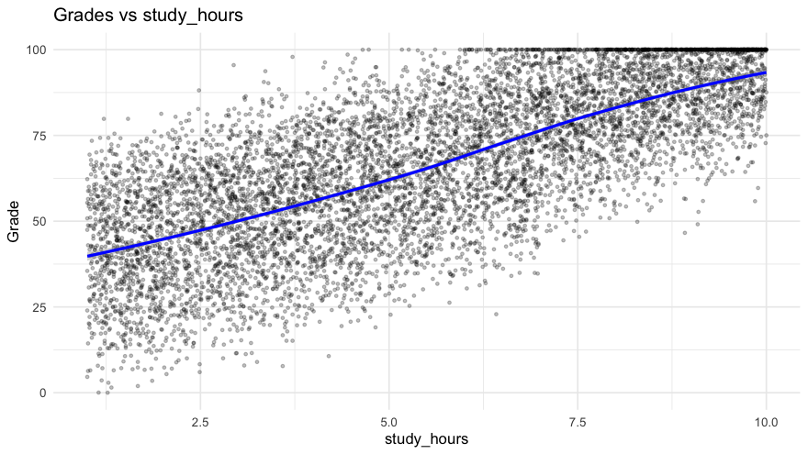
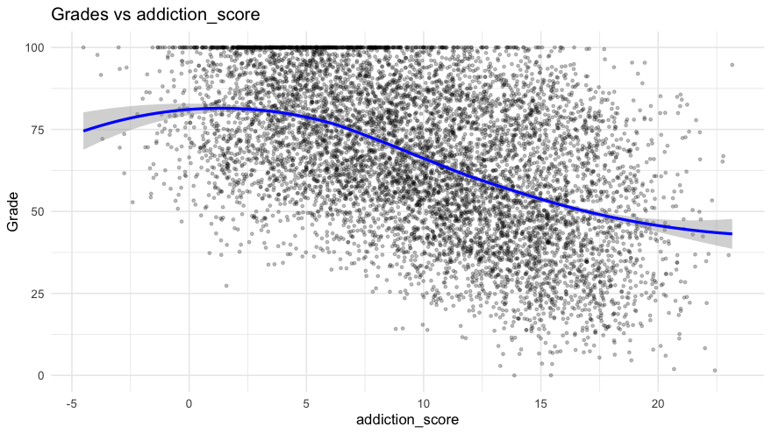
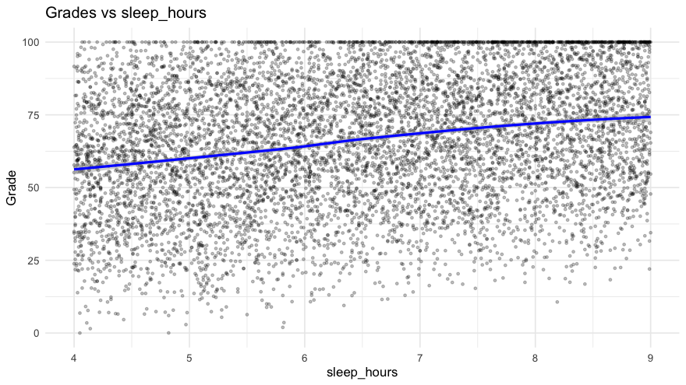
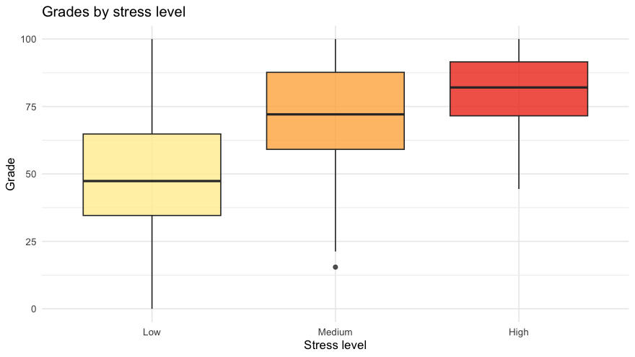
EXPLORATORY ANALYSIS
Grades vs. each factor
Gaming pulls grades down; study time pulls them up — the two dominant, opposite-direction relationships in the data.
addiction_score and gaming_hours both bend rather than run straight — the true relationship is curved, not linear, which the modeling section confirms. Stress level runs the “wrong” way too: students under more self-reported stress score higher, most likely because heavier academic pressure comes with more studying, not because stress itself helps.
6

Slide 7
STATISTICAL TESTING
Why we replaced ANOVA with correlation tests
With near-continuous predictors, ANOVA's groups hold almost nobody — attendance has 3,472 distinct values across 8,000 students, just 2.3 per group.
Variable
ANOVA p-value
ANOVA says
Correlation p-value
Correlation says
gaming_hours
< 1e-300
Reject H0
< 1e-300
Reject H0
study_hours
< 1e-300
Reject H0
< 1e-300
Reject H0
sleep_hours
5.65e-36
Reject H0
1.10e-113
Reject H0
attendance
0.114
Fail to reject
1.52e-31
Reject H0
addiction_score
5.26e-129
Reject H0
< 1e-300
Reject H0
Attendance is significant — the opposite of what the original ANOVA concluded. Addiction score is significant here too, but that fades once other factors are controlled for — see the modeling section.
7

Slide 8
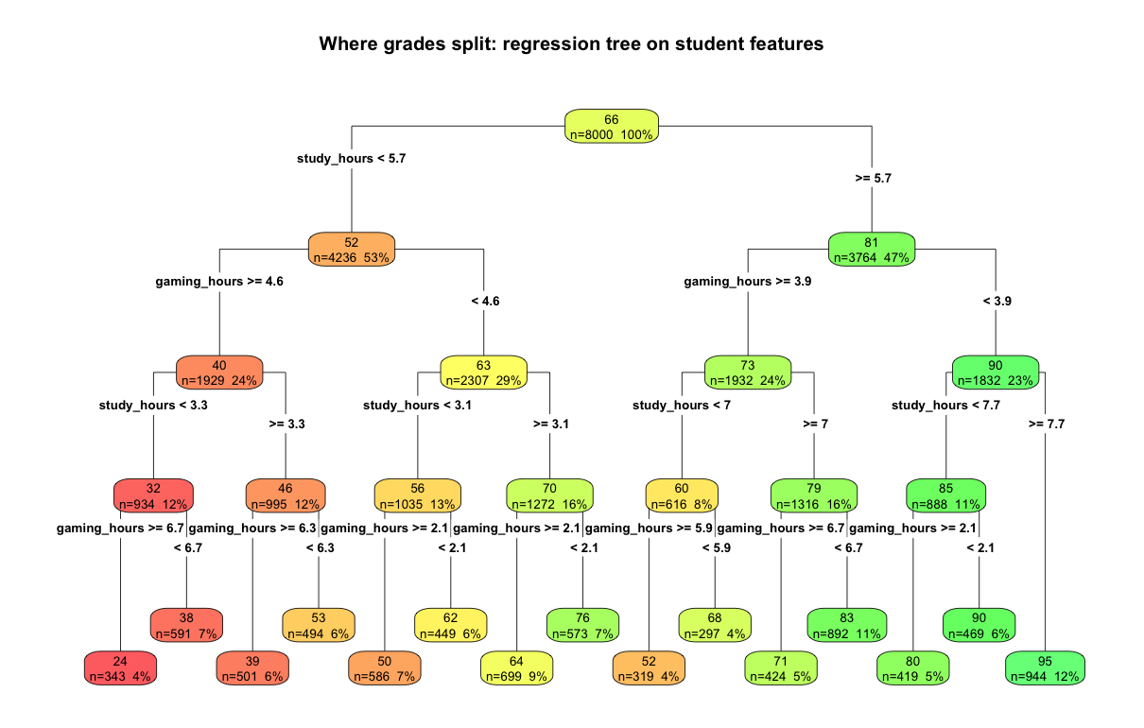
THRESHOLD ANALYSIS
Where grades actually split
A regression tree picks its own cutoffs. It splits on study hours first, then gaming hours — at a different value in each branch.
Root split
study_hours < 5.7
Second split
gaming_hours ≥ 4.6 (low-study branch)
gaming_hours ≥ 3.9 (high-study branch)
The finding: the point where gaming starts to cost depends on how much a student studies — the definition of an interaction effect.
8

Slide 9
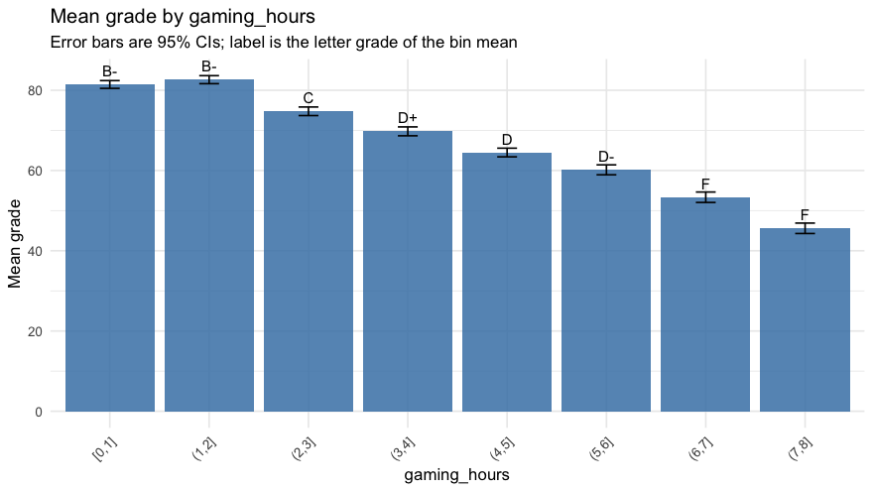
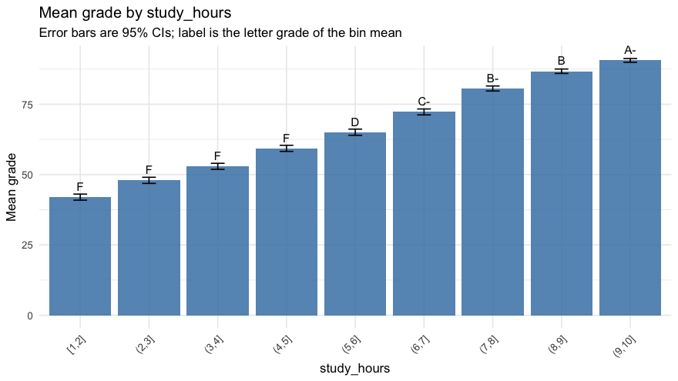
THRESHOLD ANALYSIS
Binned averages confirm — and quantify — the cutoffs
Mean grade per bin (95% CI, letter grade labeled) cross-checks the tree, then the steepest drop names each threshold in plain language.
Variable
Boundary
Drop
Shift
Threshold?
addiction_score
(5,10] → (10,15]
−13.4
C → F
Yes
gaming_hours
(1,2] → (2,3]
−7.9
B- → C
Yes
attendance
(85,90]→(90,95]
+0.6
D+→D+
None
sleep_hours
(7,8] → (8,9]
+2.7
C-→ C
None
study_hours
(8,9] → (9,10]
+3.8
B → A-
None
9

Slide 10
PREDICTIVE MODELING
Five candidate models, scored honestly
Each model is trained on 80% of students and scored on the other 20% — students it never saw — so the accuracy is honest.
Model
Terms
Train RMSE
Test RMSE
Test R²
study_only
1
15.153
15.107
0.535
main_effects
5
6.332
6.187
0.922
with_curves
7
6.194
6.045
0.926
with_interaction
8
5.936
5.850
0.930
no_addiction ★ chosen
6
5.938
5.851
0.930
Not simply the lowest error: two models land within 0.001 of each other — noise, not a real difference. We take the fewest terms that gets within 1% of the best error.
10

Slide 11
PREDICTIVE MODELING
The final model
grades ≈ 11.64 − 4.53·gaming + 4.71·study − 0.35·gaming² + 3.70·sleep + 0.28·attendance + 0.38·(gaming×study)
Term
Estimate
Std. error
p-value
0.9265
Intercept
11.639
0.666
< .001
gaming_hours
−4.534
0.133
< .001
ADJUSTED R²
study_hours
+4.715
0.053
< .001
gaming_hours²
−0.349
0.014
< .001
6.03
sleep_hours
+3.704
0.047
< .001
RESIDUAL SE (GRADE PTS)
attendance
+0.280
0.006
< .001
gaming × study
+0.380
0.011
< .001
Fit on all 8,000 students after refitting the chosen structure. gaming_hours × study_hours confirms the tree's finding: the gaming penalty is worse for students who study less.
11

Slide 12
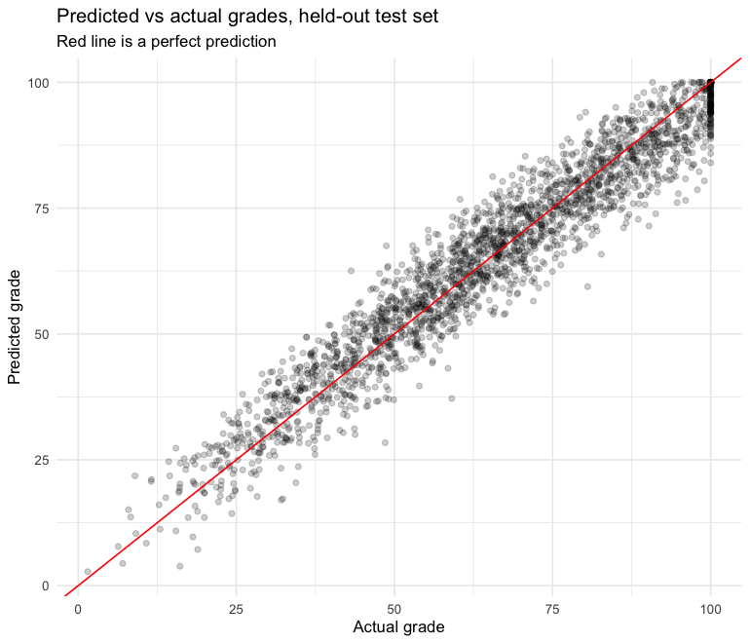
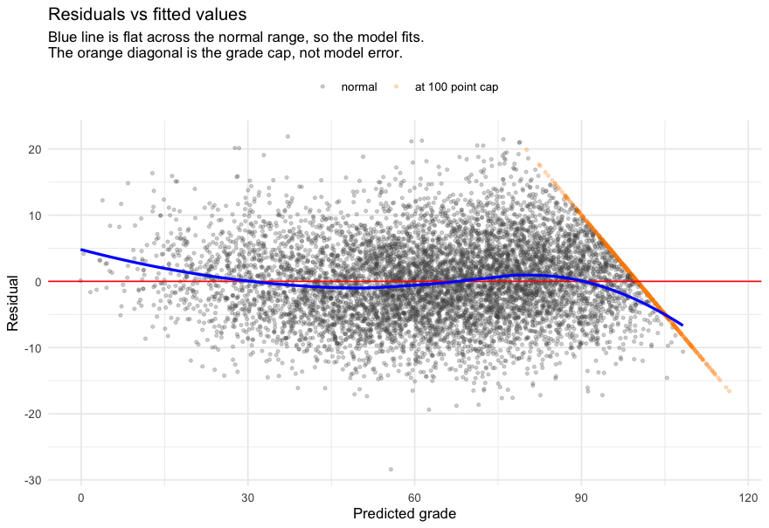
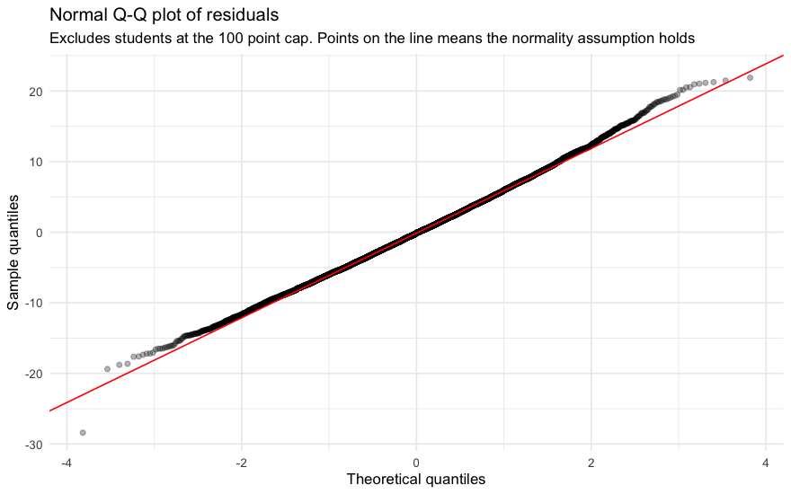
PREDICTIVE MODELING
Does the model actually hold up?
Held-out test RMSE of 5.85 grade points, test R² of 0.930. Train and test error stay close — the sign of a model that isn't overfitting.
Predicted vs. actual
Residuals vs. fitted
Normal Q-Q plot
573 students (7.2%) sit exactly on the 100-point cap and are flagged separately (orange). Their residual is forced negative by the cap, not by model error — mixing them into the trend line would misrepresent the fit.
12

Slide 13
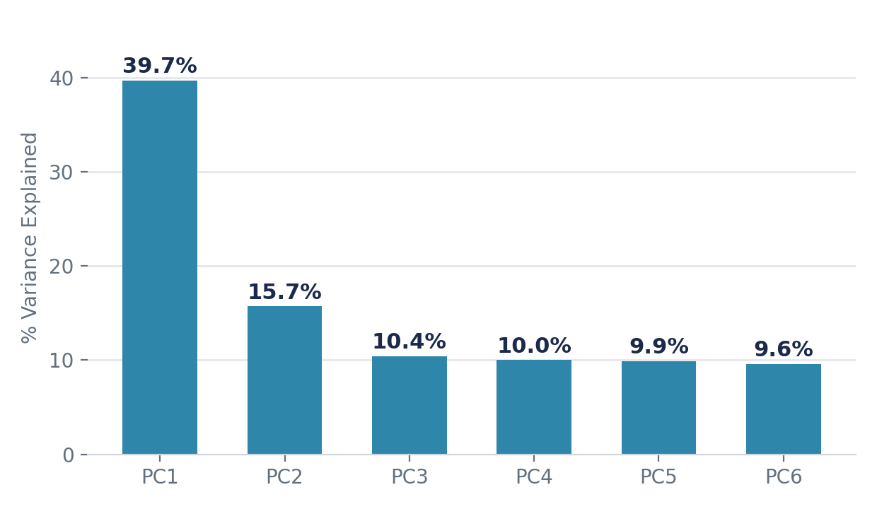
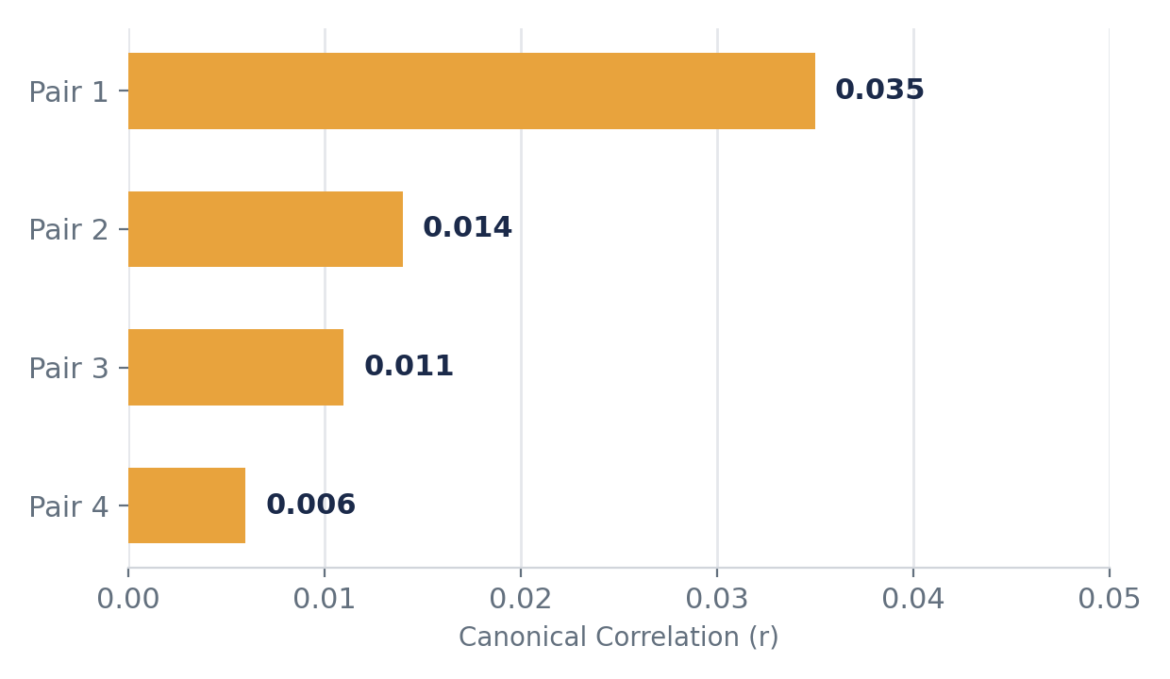
DIMENSIONAL REDUCTION
PCA & CCA: collapsing 13 features into their strongest signals
PCA finds the axes that explain the most variance; CCA tests whether the gaming and lifestyle variable sets move together as groups.
Component
Top Features
Variance
Meaning
Notes
PC1
gaming_hours, addiction_score, device_usage, reaction_time
39.7%
Screen engagement axis
Strongest PC
PC2
study_hours, grades, sleep_hours
15.7%
Academic effort axis
2nd strongest
PC1 + PC2
combined
55.4%
Over half of total variance
—
CCA pair 1
gaming set ↔ lifestyle set
r = 0.035
Essentially no relationship
Groups don’t align
CCA pairs 2–4
remaining canonical pairs
r ≤ 0.014
Negligible
—
13

Slide 14
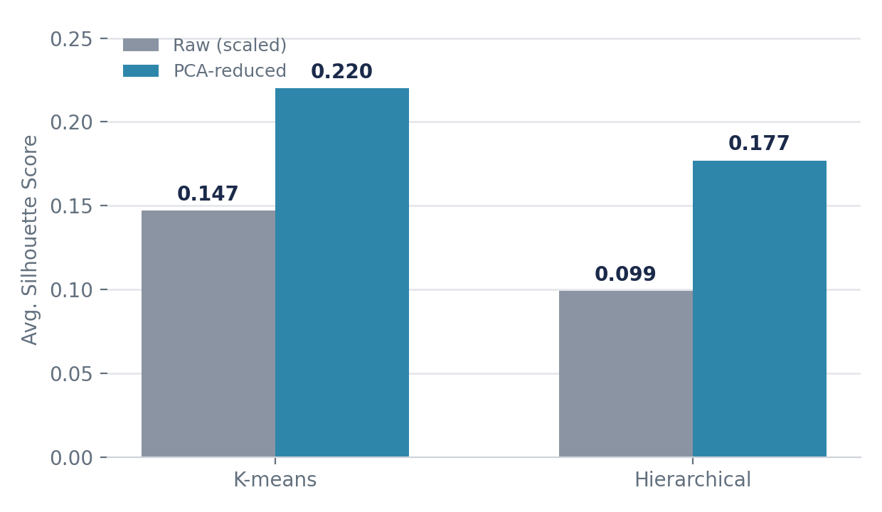
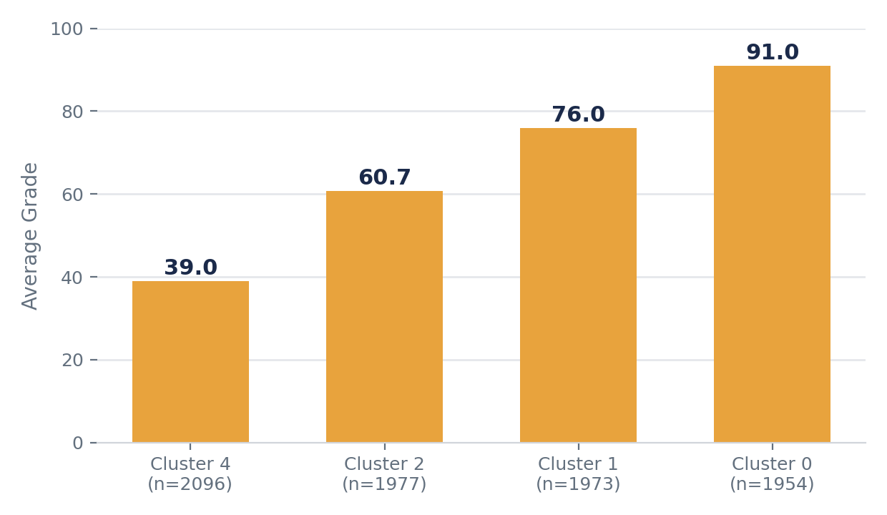
UNSUPERVISED CLUSTERING
K-means & hierarchical clustering reveal real student groups
Comparing raw vs. PCA-reduced features, then checking whether clusters found blind to grades still separate by performance.
Method
Feature Set
Silhouette
Best?
Notes
K-means
Raw (scaled)
0.147
No
—
K-means
PCA-reduced
0.220
Yes
Best overall
Hierarchical
Raw (scaled)
0.099
No
Weakest
Hierarchical
PCA-reduced
0.177
No
—
Cluster grades
39.0 / 60.7 / 76.0 / 91.0
4 groups
Yes
Matches real grade tiers
14

Slide 15
CONCLUSIONS
What we found — and where to be careful
FINDINGS
LIMITATIONS
Which factors relate to grades?
Censored outcome
Study, gaming, sleep and attendance are all significant (p < .05), individually and jointly.
573 students (7.2%) sit exactly on the 100-point cap; the model can't tell a would-be 101 from a would-be 118.
Which matters most?
Study hours — the largest single effect.
Likely simulated data
What about addiction score?
An adjusted R² near 0.93 and a 0.91 correlation between “independent” variables are too clean for real surveys.
Significant alone, but fades once other factors are controlled for — it's a proxy for gaming (r = 0.91).
Where are the thresholds?
Observational, not causal
Steepest drop: addiction_score at (5,10]→(10,15], a 13.4-point fall.
Gamers also study less. The coefficients describe association, not proof that cutting gaming raises grades.
Is it linear?
No — gaming and addiction both bend, and the gaming penalty is worse for low-study students.
Self-reported measures
Gaming, study, sleep and addiction score are exactly the variables misreported in surveys.
How accurate?
Held-out test RMSE 5.85 points, test R² 0.930 — not overfitting.
15

