Slide 1

Flora Web Service
Team: Eldin Abdic, Djordje Rajic, Nikola Tomic

Slide 2
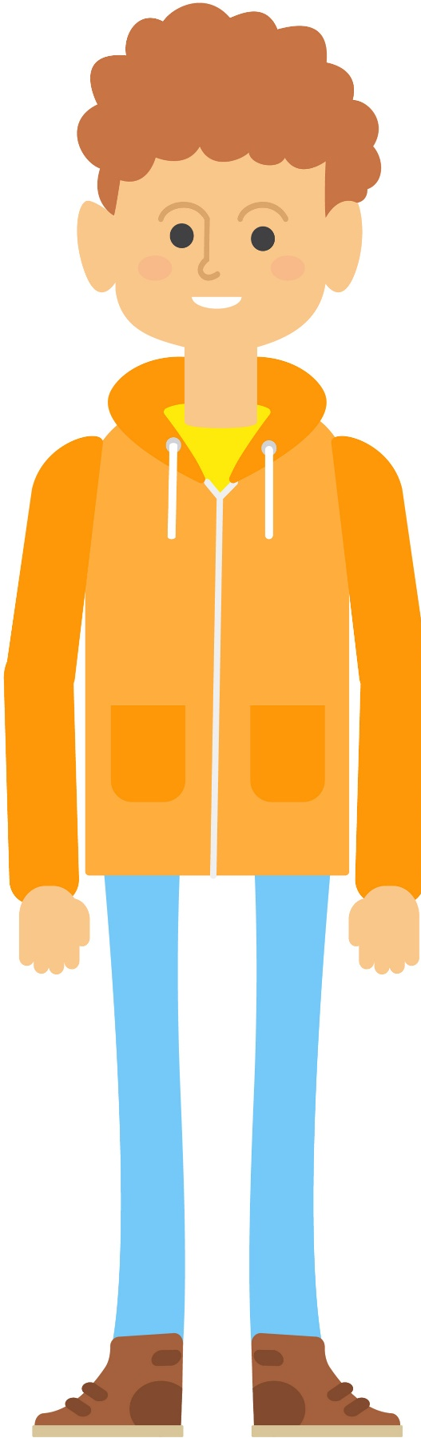
This is John

Slide 3
John made an application

Slide 4
To improve his application he needs more
data about the plants

Slide 5
Where can I get more information about plants?

Slide 6
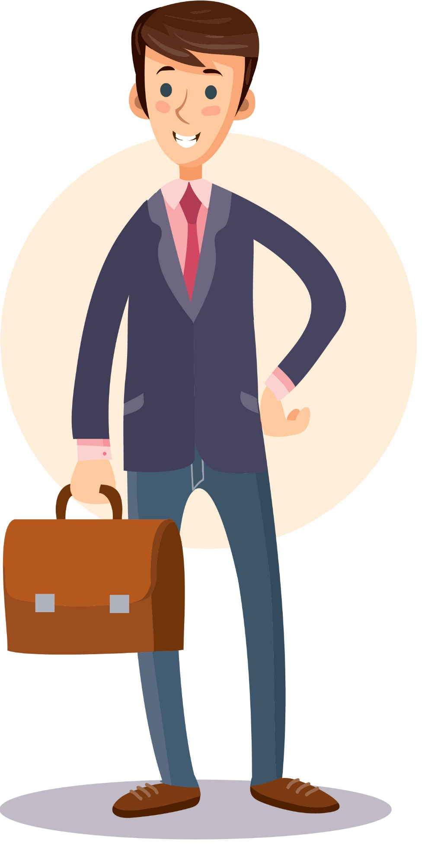
Where can I get more information about plants?
Do you know about Flora Web Service?

Slide 7
No, what is it?
Do you know about Flora Web Service?

Slide 8
No, what is it?
It is exactly what you need.

Slide 9
No, what is it?
Use REST API

Slide 10
No, what is it?
And search for plants
GET
/search?q=Acacia

Slide 11
No, what is it?
And search for plants
GET
/search?q=Acacia
{"hits": [
{
"latin_name": "Acacia alata",
"common_name": [
"Winged wattle“
],
"metadata": {
"Category:": "shrub - medium, shrub - small",
"Flower Colour:": "white, cream, yellow",
"Flowering Time:": "Jun to Sep",“
“Botanical Family:": "Fabaceae“
}
}
...
],
"offset": 0,
"limit": 20,
"query": "Acacia",
"nbHits": 20
}

Slide 12
No, what is it?
Try another one
GET
/search?q=Daisy

Slide 13
No, what is it?
No results ?
Do not worry !
GET
/search?q=Daisy
{
"hits":
[],
"offset": 0,
"limit": 20,
"query": “Daisy",
"nbHits": 0
}

Slide 14

No, what is it?
Our scapers are working to find you that data
GET
/search?q=Daisy
{
"hits":
[],
"offset": 0,
"limit": 20,
"query": “Daisy",
"nbHits": 0
}
Scraping internet for data about
Daisy,try again later ...

Slide 15
No, what is it?
While we are waiting for scaper, let me give you some info
GET
/search?q=Daisy
{
"hits":
[],
"offset": 0,
"limit": 20,
"query": “Daisy",
"nbHits": 0
}

Slide 16
No, what is it?
While we are waiting for scaper, let me give you some info
GET
/search?q=Daisy
{
"hits":
[],
"offset": 0,
"limit": 20,
"query": “Daisy",
"nbHits": 0
}
We use Meilisearch to index all the plants in our database
In case there are no hits, our Scraping service starts up
Next time you run the same search results will be available
Users can register and contribute
Registered users can add or remove plant data to improve accuracy

Slide 17
No, what is it?
Time to try out search again
GET
/search?q=Daisy

Slide 18
No, what is it?
And there we go
GET
/search?q=Daisy
{
"hits":
[
"latin_name": "Osteospermum spp.",
"common_name": [
"African daisy",
"blue-eyed daisy",
"Cape daisy“
],
"metadata": {
"Soil pH": "Acidic",
"Sun Exposure": "Full",
...
}
],
"offset": 0,
"limit": 20,
"query": “Daisy",
"nbHits": 1
}

Slide 19

No, what is it?
Check out rest of our API too
GET
/plant
You need to be logged in

Slide 20
No, what is it?
Check out rest of our API too
GET
/plant
POST
/plant
You need to be logged in

Slide 21
No, what is it?
Check out rest of our API too
GET
/plant
POST
/plant
GET
/plant/{latin_name}
You need to be logged in

Slide 22
No, what is it?
Check out rest of our API too
GET
/plant
POST
/plant
GET
/plant/{latin_name}
PUT
/plant/{latin_name}
You need to be logged in

Slide 23
No, what is it?
And for authorization ...
POST
/auth/token

Slide 24
No, what is it?
And for authorization ...
POST
/auth/token
POST
/auth/refresh

Slide 25
No, what is it?
And for authorization ...
POST
/auth/token
POST
/auth/refresh
POST
/auth/register

Slide 26
No, what is it?
Does that solve your problems?

Slide 27
Yes, thank you!
Does that solve your problems?

Slide 28
Can you tell me more about architecture?
Does that solve your problems?

Slide 29
Can you tell me more about architecture?
Sure!

Slide 30
Can you tell me more about architecture?
What you see from outside is the main service.
Main service
Login

Slide 31
Can you tell me more about architecture?
What you see from outside is the main service.
Main service
Login
Search

Slide 32
Can you tell me more about architecture?
What you see from outside is the main service.
Main service
Login
Search
Update

Slide 33
Can you tell me more about architecture?
What you see from outside is the main service.
Authentication service
Main service
Login
Search
Update

Slide 34
Can you tell me more about architecture?
What you see from outside is the main service.
Authentication service
Main service
Login
Search
Search service
Update

Slide 35
Can you tell me more about architecture?
What you see from outside is the main service.
Authentication service
Main service
Login
Search
Search service
Update
Scraping service

Slide 36
Can you tell me more about architecture?
What you see from outside is the main service.
Authentication service
Main service
Login
Search
Search service
Update
Scraping service

Slide 37
Yes, thank you! Great product.
Does that answer you question?

Slide 38
Thank you for your attention!

