Slide 1
NATIONWIDE SAT and ACT TEST 2017 & 2018 RESULT SUMMARY
https://reports.collegeboard.org/archive/sat-suite-program-results/2017/detailed-2017-reports
https://blog.prepscholar.com/act-scores-by-state-averages-highs-and-lows

Slide 2
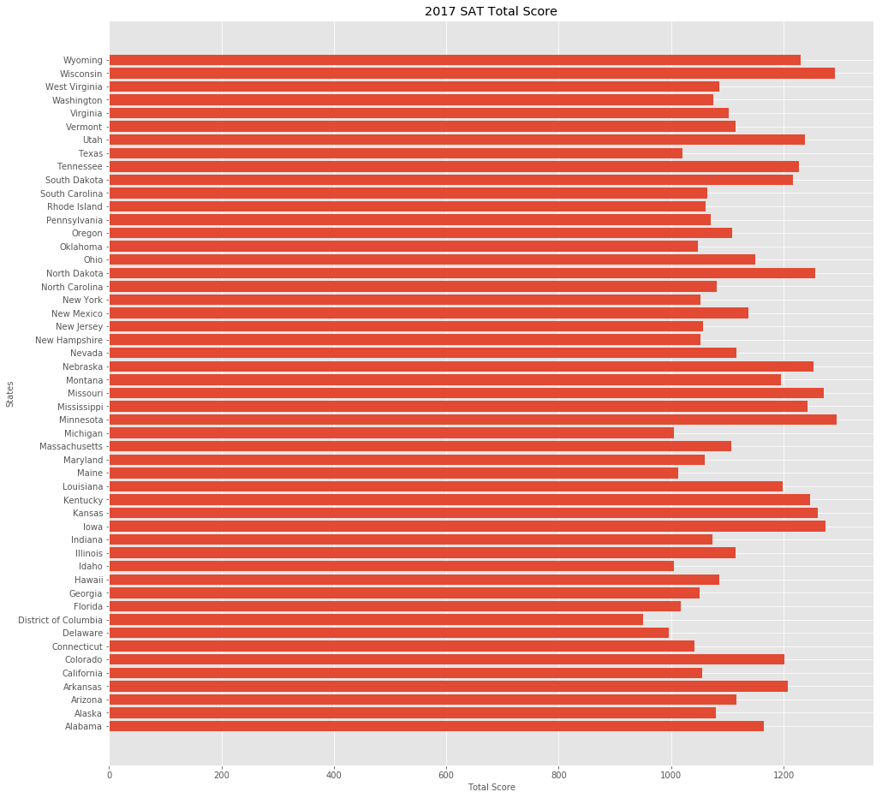

Slide 3
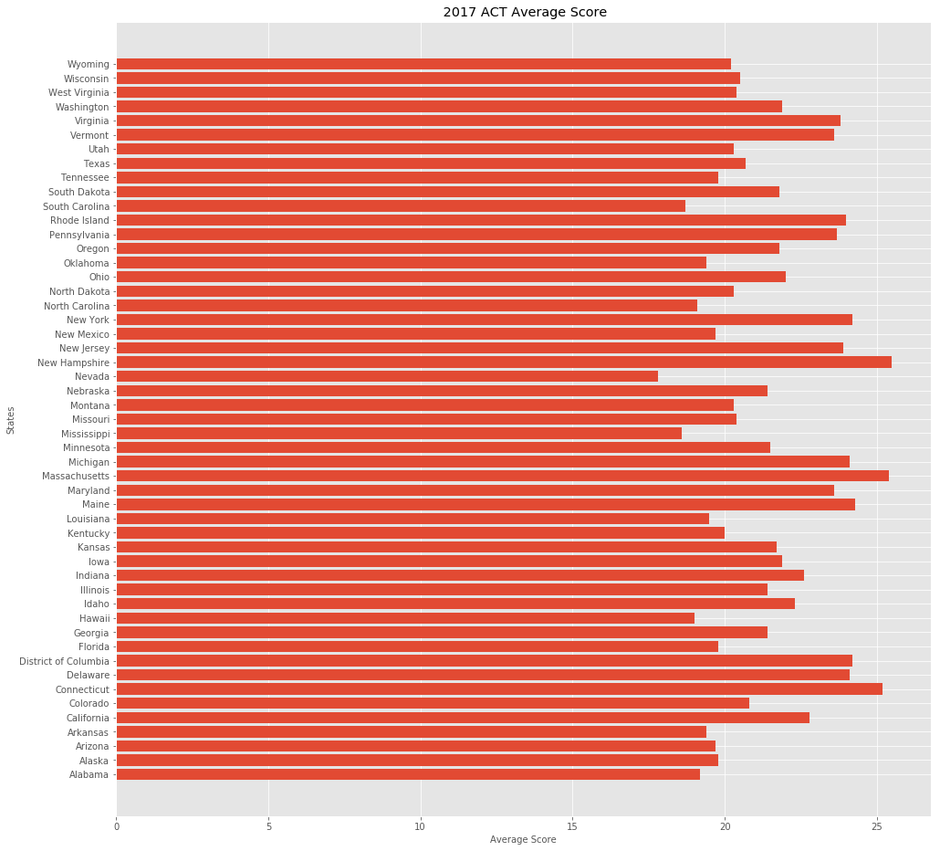

Slide 4
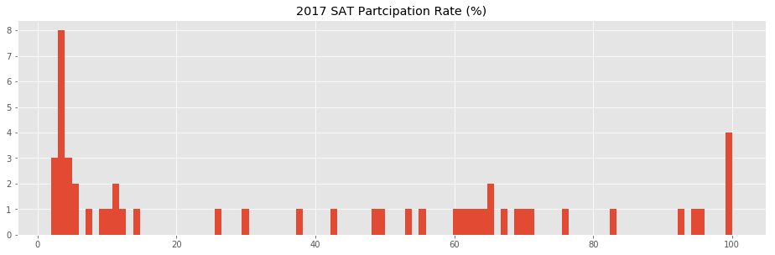

Slide 5
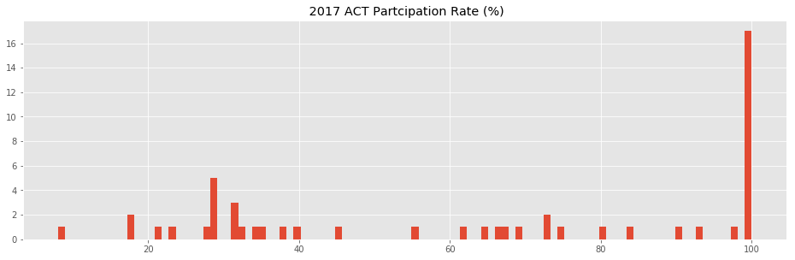

Slide 6
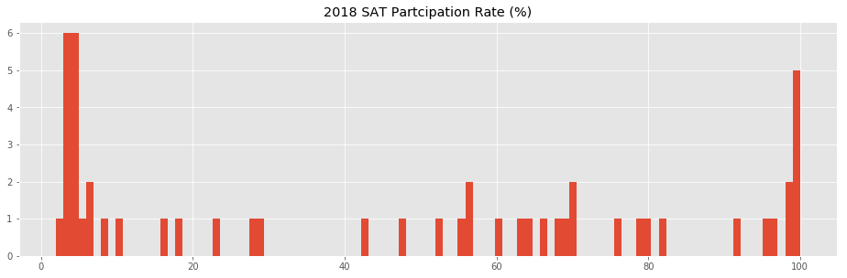

Slide 7
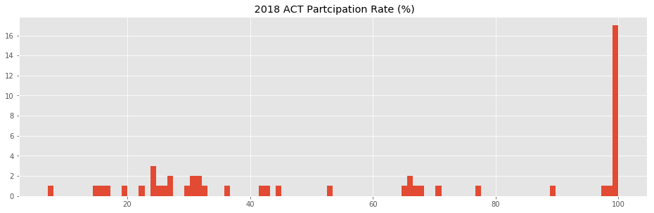

Slide 8
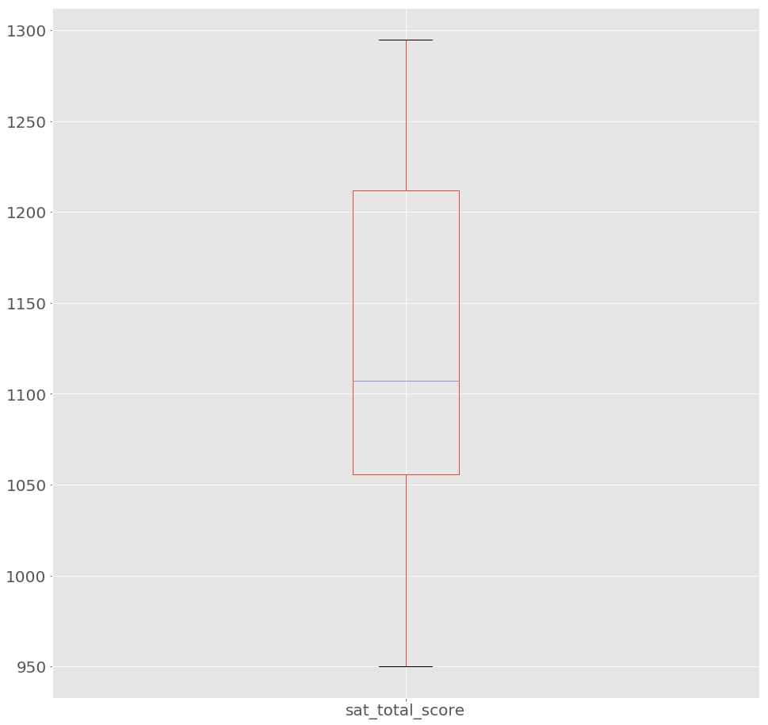
Median 1107
Max = 1295
Min = 950
First quartile = 1055
Third quartile = 1210
SAT Total Score 2017

Slide 9
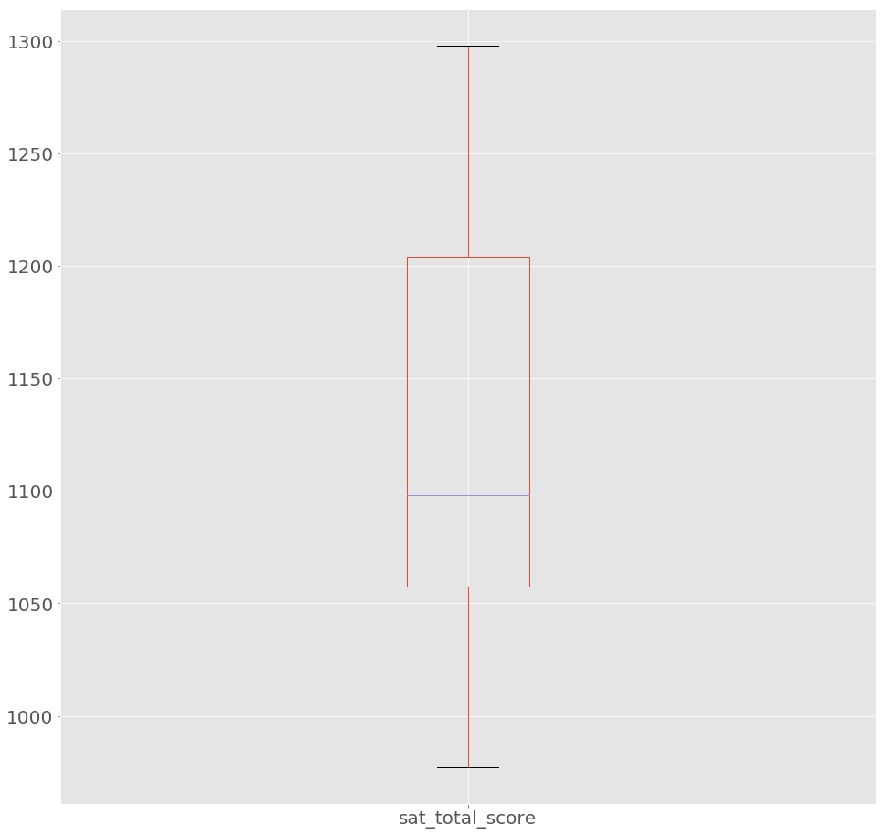
Median 1098
Max = 1298
Min = 977
First quartile = 1055
Third quartile = 1205
SAT Total Score 2018

Slide 10
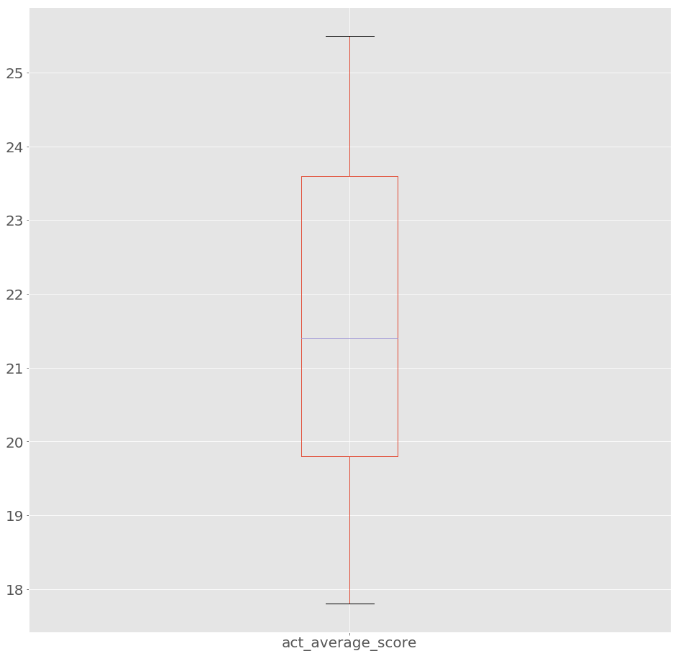
Median 21.4
Max = 25.5
Min = 17.8
First quartile = 19.8
Third quartile = 23.6
ACT Total Score 2017

Slide 11

Median 21.3
Max = 25.6
Min = 17.7
First quartile = 20
Third quartile = 23.6
ACT Total Score 2018

Slide 12
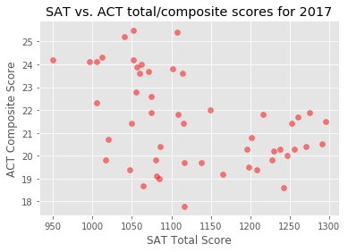

Slide 13
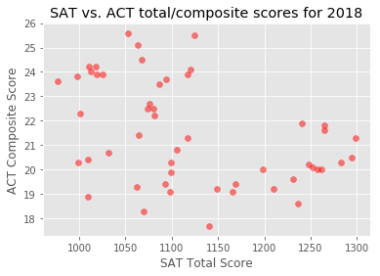

Slide 14
Conclusion & Recommendation
Conclusion
ACT has more participation in 2017 and 2018 compared to SAT
Minnesota has the highest SAT score in 2017 and 2018 (1297 & 1298, respectively)
New Hampshire has the highest ACT score in 2017 (25.5) and Connecticut has the highest ACT score in 2018 (25.6)
Based on this set of data we can see that the states with high scores of SAT do not necessarily also have high scores of ACT
Interestingly it is observed that students with the ACT scores around average values have the high SAT scores, and visa versa, those who have SAT score around the average, have the high scores of ACT
Recommendation:
Grant access for every student to take both test if they want to
Limit the number of test taken so the results will represent the students’ real intelligent
than the number of test taken

