Slide 1
Deep Learning Project Landmark Recognition
NCSR Demokritos x University of Peloponnese

Slide 2
The idea
Classify famous landmarks using deep learning.
Models Used:
Custom Convolutional Neural Networks (CNNs)
Transfer Learning techniques
Scope:
International model: 50 worldwide landmarks
Local model: 20 Greek landmarks
Application: Deploy models in a real-world environment, "spot the spot" application.

Slide 3
Dataset
International Model
Dataset: 50 landmarks (Haleakala National Park, Mount Rainier National Park, Ljubljana Castle, Dead Sea, etc.)
Source: Google Landmarks Dataset v2
Data Collection: Images sourced from Google Landmarks Dataset v2.
Local Model
Dataset: 20 Greek landmarks (Arch of Hadrian, Bridge of Arta, Erechtheum, etc.)
Source: Wikimedia Commons
Data Collection: Images downloaded using a custom scraper defined in wikimedia_scrapper.ipyb.

Slide 4
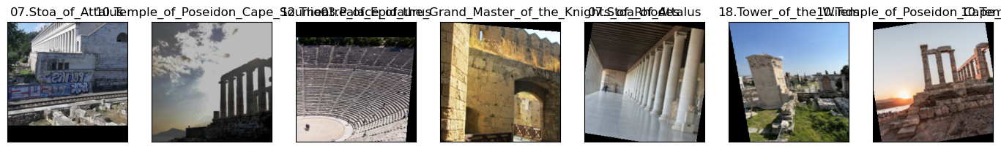
Preprocessing
Resizing: All images resized to a uniform size.
Normalization: Pixel values normalized.
Augmentation: Techniques like rotation, flipping, and zooming to increase dataset diversity.

Slide 5
Custom CNN Architecture
Defined In: LandMarkModel.py
Layers:
Convolutional layers with ReLU activations and batch normalization
Pooling layers
Fully connected (dense) layers
Dropout layers for regularization
Implementation: LandmarkCnnModel class

Slide 6
Transfer Learning Architecture
Pre-trained Models: ResNet18, ResNet50, ResNet152
Defined In: TransferModel.py
Fine-Tuning:Initial layers leverage pre-trained weights from ImageNet
Final layer trained on landmark datasets

Slide 7
Training and Optimization
Training Script: Training.py
Training Loop: Functions for training the model for one epoch and for the entire training process
Real-time loss plotting using livelossplot
Optimization Script: Optimization.py
Hyperparameter Tuning: Optimizing learning rate, batch size, etc.
Data Handling: Data.py
Data Loaders: Create training, validation, and test data loaders

Slide 8
Model Export and Prediction
Model Export: ModelExporter.py
Function to save the trained model for inference
Prediction Script: PredictorWrapper.py
Predictor Class: Handles preprocessing and prediction
Confusion Matrix: Evaluates model performance

Slide 9
Results
Accuracy:
Custom CNN: Local - 81%, International - 57%
ResNet18: Local - 87%, International - 76%
ResNet50: Local - 90%, International - 80%
ResNet152: Local - 89%, International - 80%
Training Time and Computational Efficiency:
Transfer learning models outperformed custom CNNs

Slide 10
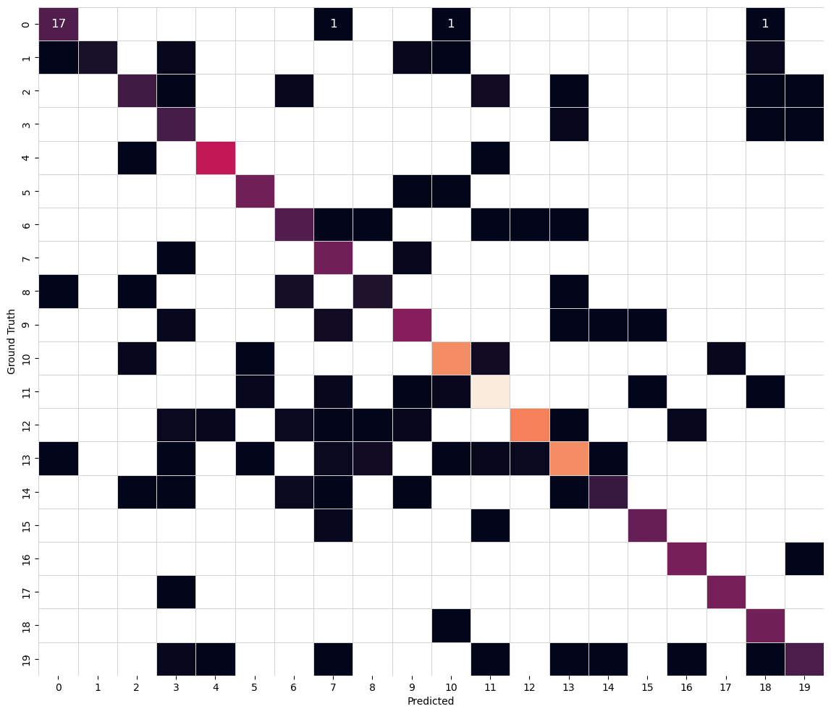
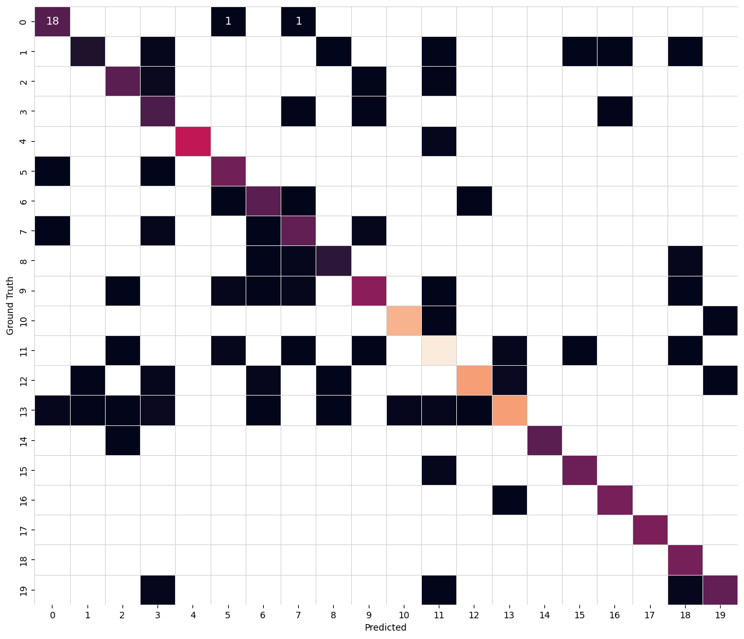
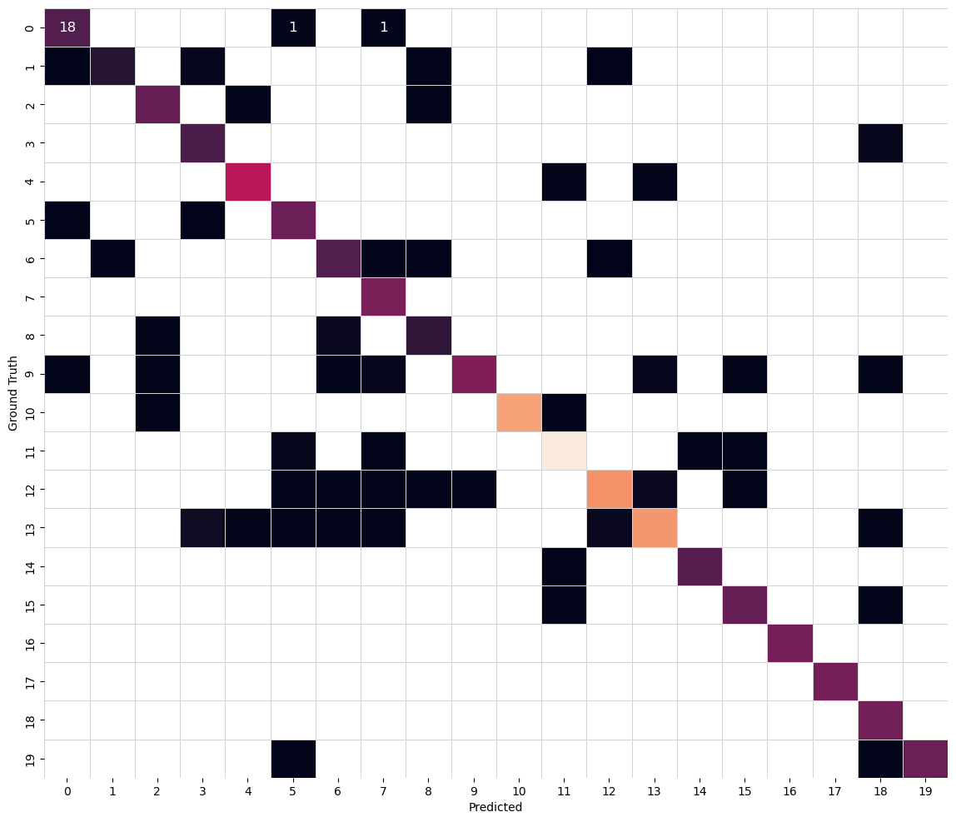
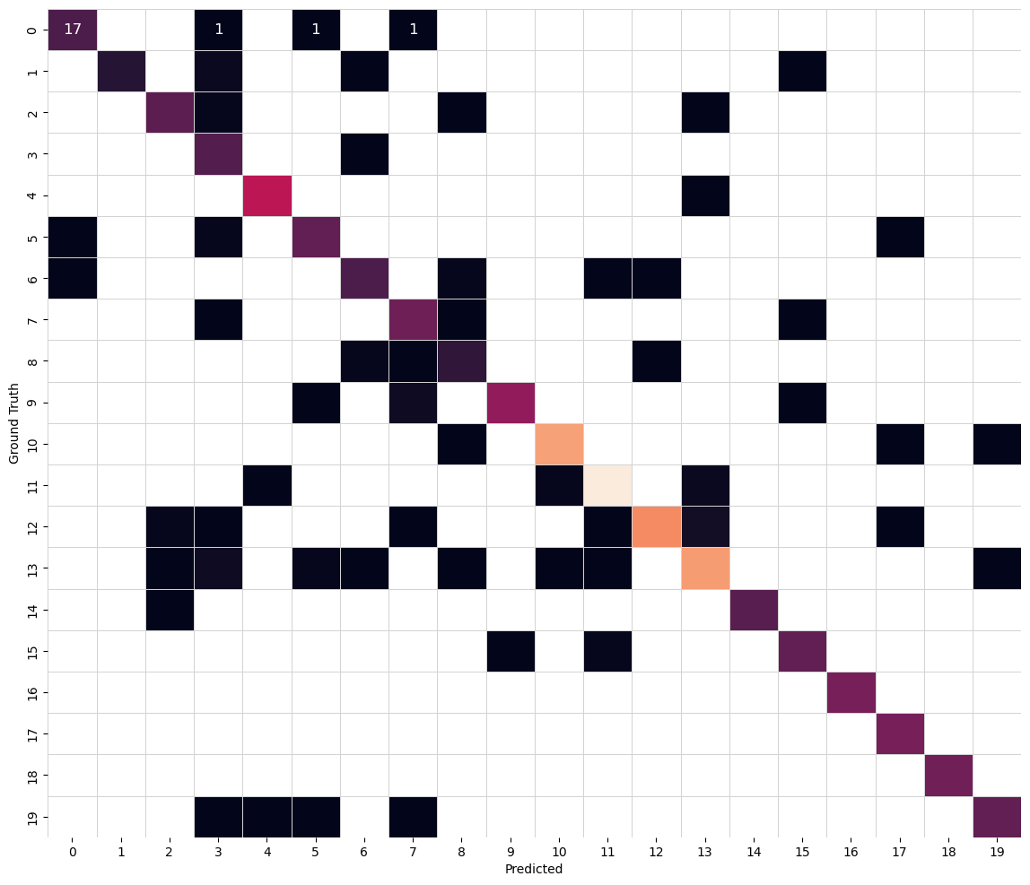
Confusion Matrices – Local Model
Custom CNN ResNet18
ResNet 50 ResNet152

Slide 11
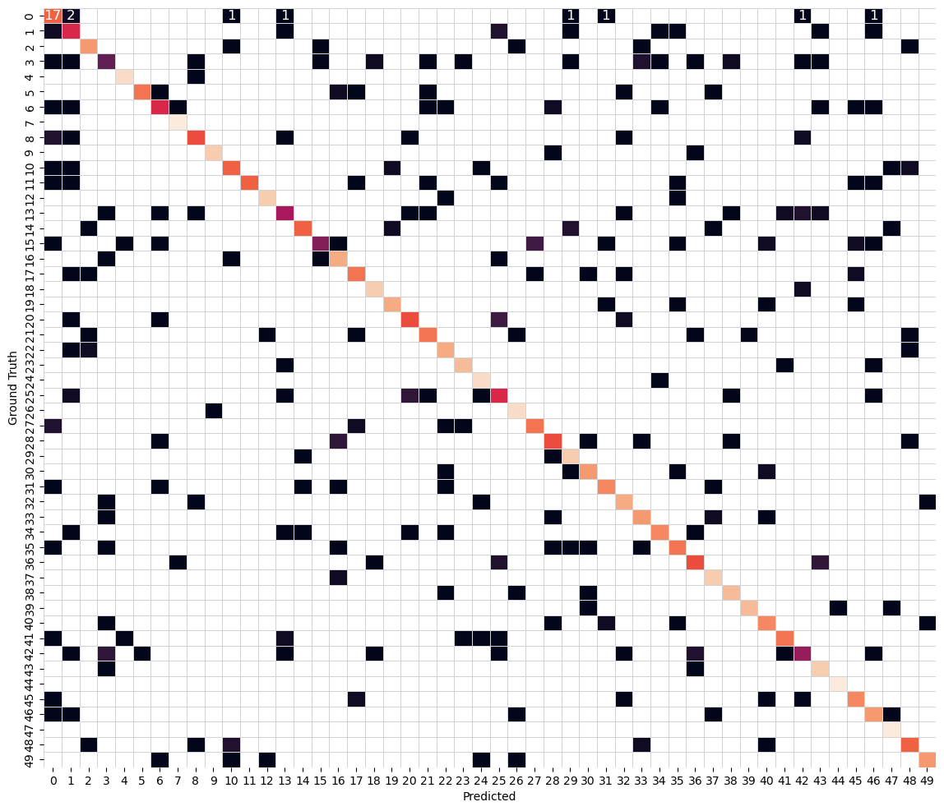
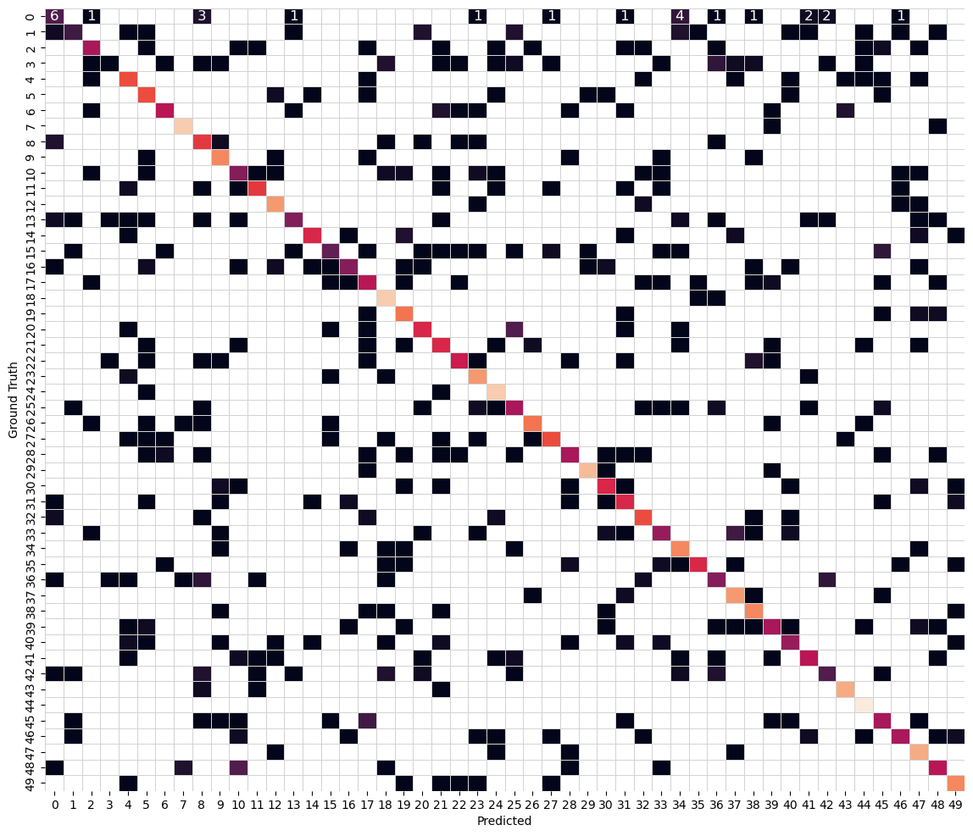
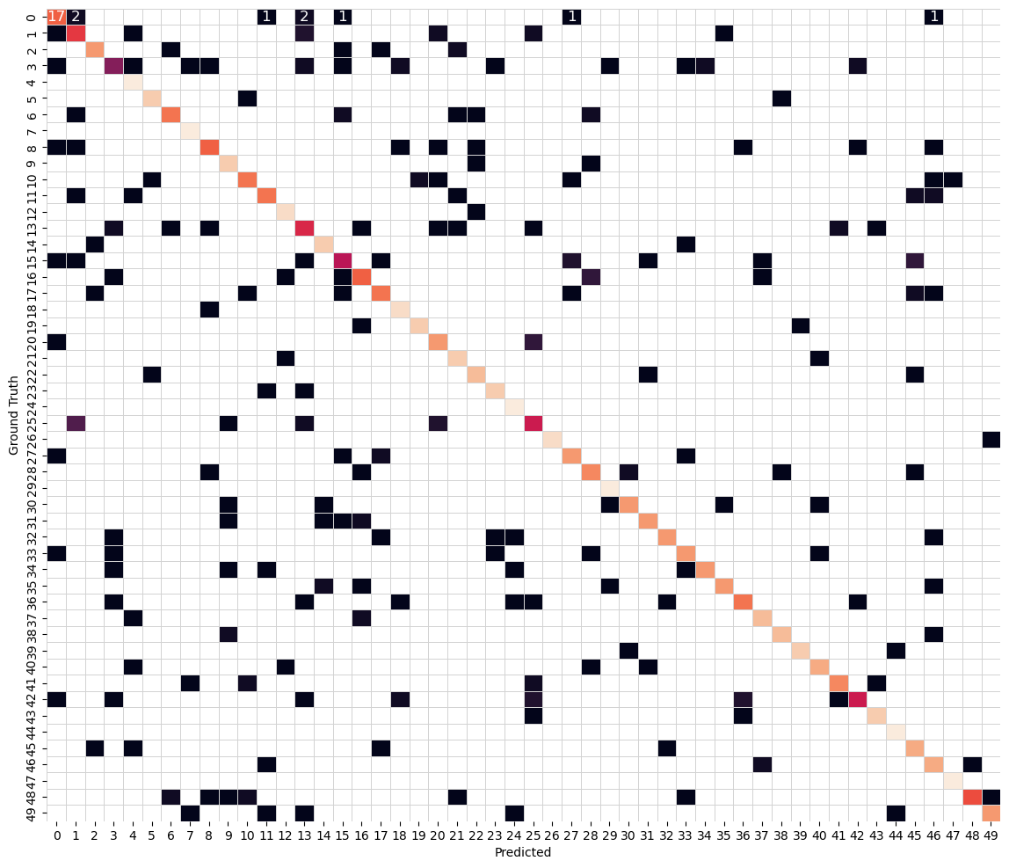
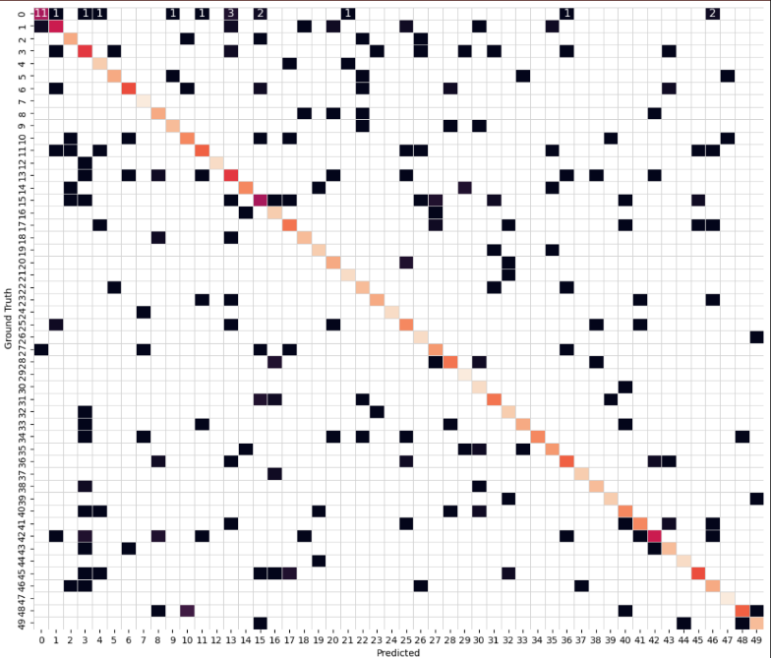
Confusion Matrices – Int/al Model
Custom CNN ResNet18
ResNet50 ResNet152

Slide 12

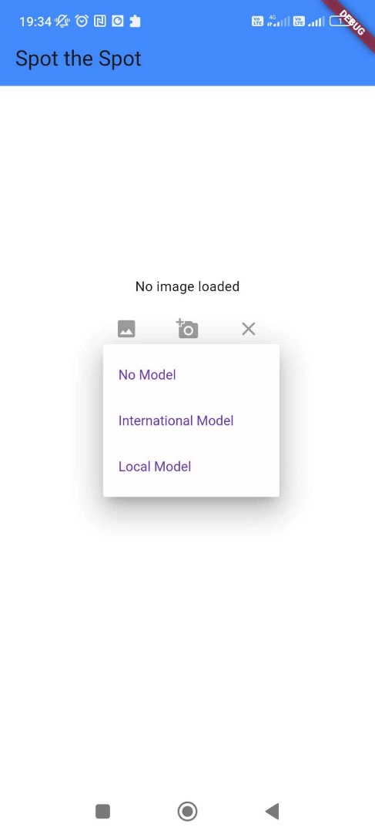

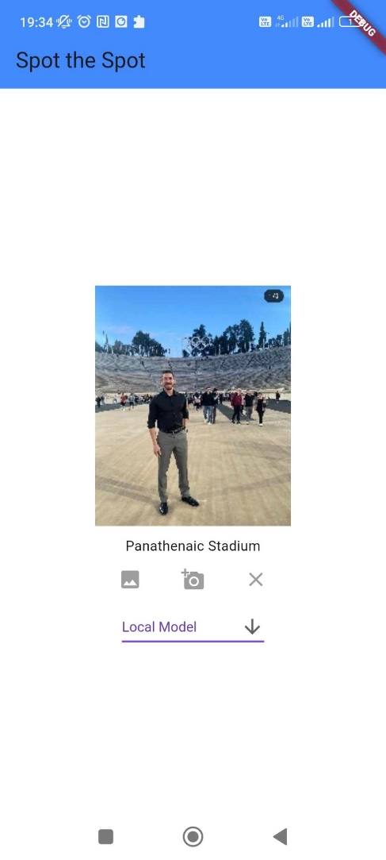

Deployment – SpotTheSpot

