Slide 1
WELCOME IN HARIOM DEFENSIVE TECHNOLOGY

Slide 2
C++ (CLASSES AND OBJECTS)

Slide 3
ALL AT ONE GLANCE
AGENDA
PREREQUISITE
CLASS AND OBJECT
ACCESS-SPECIFIER
STRUCTURES AND CLASSES
UNIONS AND CLASSES
FRIEND FUNCTIONS
FRIEND CLASSES
INLINE FUNCTIONS
CONSTRUCTORS AND DESTRUCTORS
STATIC CLASS MEMBERS
THE SCOPE RESOLUTION OPERATOR
NESTED CLASSES
LOCAL CLASSES
PASSING OBJECTS TO FUNCTIONS
RETURNING OBJECTS
OBJECT ASSIGNMENT
DEMOs

Slide 4
AGENDA
UNDERSTANDING
CLASS n OBJECT
IN
C++

Slide 5
PREREQUISITE

Slide 6
C FOUNDATION

Slide 7
CLASS AND OBJECT
Class forms the basis for OOP.
Class is used to define the nature of an object.
Class is C++'s basic unit of encapsulation.
It is created using keyword class.
A class declaration defines a new type that links code and data.
This new type is then used to declare objects of that class.
So a class is a logical abstraction, but an object has physical existence.
An object is an instance of a class.
A class declaration is similar syntactically to a structure.

Slide 8
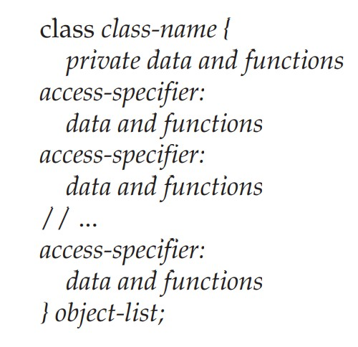
CLASS DECLARATION

Slide 9
CONT.
The object-list is optional.
If present, it declares objects of the class.

Slide 10
ACCESS-SPECIFIER
public
private
protected

Slide 11
CONT..
By default, functions and data declared within a class are private to that class and may be accessed only by other members of the class.
The public access specifier allows functions or data to be accessible to other parts of your program.
The protected access specifier is needed only when inheritance is involved .
NOTE:
1.Once an access specifier has been used, it remains in effect until either another access specifier is encountered or the end of the class declaration is reached.
2.Programmers find it easier to have only one private, protected, and public section within each class.

Slide 12
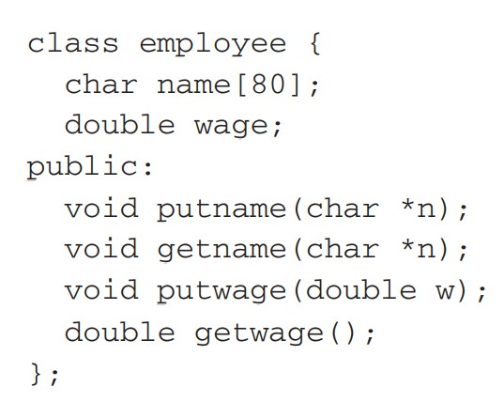

Slide 13
MEMBER FUNCTIONS
Functions that are declared within a class are called member functions.
Member functions may access any element of the class of which they are a part.
This includes all private elements.

Slide 14
MEMBER VARIABLES INSTANCE VARIABLE DATA MEMBERS
Variables that are elements of a class.
NOTE:
Any element of a class can be referred to as a member of that class.

Slide 15
RESTRICTIONS TO CLASS MEMBERS.
A non-static member variable cannot have an initializer.
No member can be an object of the class that is being declared. (Although a member can be a pointer to the class that is being declared.)
No member can be declared as auto, extern, or register.

Slide 16
IMPORTANT POINTS
We should make all data members of a class private to that class.
This is part of the way that encapsulation is achieved.
However, there may be situations in which we will need to make one or more variables public.
(e.g a heavily used variable may need to be accessible globally in order to achieve faster run times.)

Slide 17
Cont…
When a variable is public, it may be accessed directly by any other part of your program.
The syntax for accessing a public data member is the same as for calling a member function:
[Specify the object's name, the dot operator, and the variable name]

Slide 18
STRUCTURES AND CLASSES
A class is syntactically similar to a struct.
In C++, the role of the structure was expanded, making it an alternative way to specify a class.
The only difference between a class and a struct is that by default all members are public in a struct and private in a class.
In C++, a structure defines a class type.

Slide 19
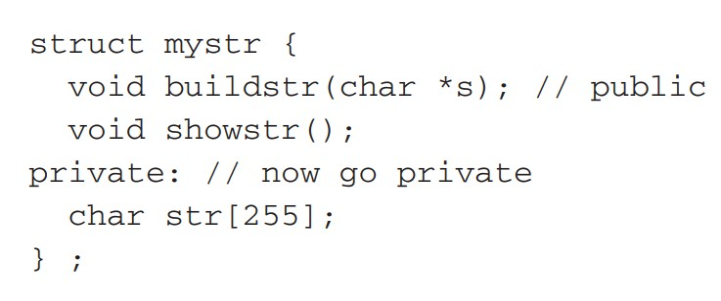
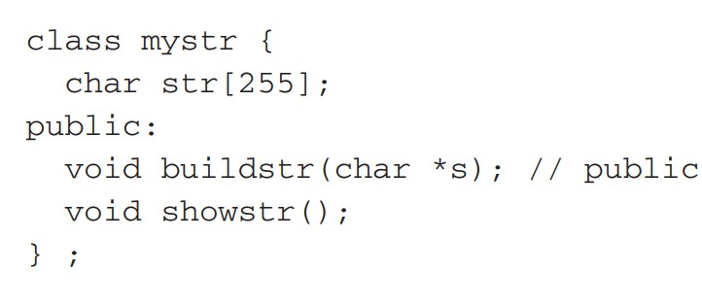

Slide 20
if struct then why class in C++
There is no fundamental reason not to increase the capabilities of a structure.
In C, structures already provide a means of grouping data.
Therefore, it is a small step to allow them to include member functions.
Second, because structures and classes are related, it may be easier to port existing C programs to C++.
Finally, although struct and class are virtually equivalent today, providing two different keywords allows the definition of a class to be free to evolve.
In order for C++ to remain compatible with C, the definition of struct must always be tied to its C definition

Slide 21
Cont…
It is best to use a class when you want a class, and a struct when you want a C-like structure.
Sometimes the acronym POD is used to describe a C-style structure—one that does not contain member functions, constructors, or destructors. It stands for Plain Old Data.

Slide 22
UNIONS AND CLASSES
union may also be used to define a class.
In C++, unions may contain both member functions and variables.
They may also include constructors and destructors.
A union in C++ retains all of its C-like features, the most important being that all data elements share the same location in memory.
Like the structure, union members are public by default and are fully compatible with C
NOTE:
Like a structure, a union declaration in C++ defines a special type of class.
This means that the principle of encapsulation is preserved

Slide 23
RESTRICTIONS TO UNION
a union cannot inherit any other classes of any type.
Further, a union cannot be a base class.
A union cannot have virtual member functions.
No static variables can be members of a union.
A reference member cannot be used.
A union cannot have as a member any object that overloads the = operator.
Finally, no object can be a member of a union if the object has an explicit constructor or destructor function.
As with struct, the term POD is also commonly applied to unions that do not contain member functions, constructors, or destructors.

Slide 24
Anonymous Unions
An anonymous union does not include a type name, and no objects of the union can be declared.
An anonymous union tells the compiler that its member variables are to share the same location.
However, the variables themselves are referred to directly, without the normal dot operator syntax

Slide 25
Cont…
They are at the same scope level as any other local variable within the same block.
This implies that the names of the members of an anonymous union must not conflict with other identifiers known within the same scope.
RESTRICTIONS:
The only elements contained within an anonymous union must be data.
No member functions are allowed.
Anonymous unions cannot contain private or protected elements.
Finally, global anonymous unions must be specified as static

Slide 26
FRIEND FUNCTIONS
It is used to grant a nonmember function access to the private members of a class by using a friend.
A friend function has access to all private and protected members of the class for which it is a friend.
To declare a friend function, include its prototype within the class, preceding it with the keyword friend.
NOTE:
It has full access to its private members.
Also, notice that sum( ) is called without the use of the dot operator.
Because it is not a member function, it does not need to be qualified with an object's name.

Slide 27
USAGE OF FRIEND FUNCTIONS
friends can be useful when we are overloading certain types of operators .
friend functions make the creation of some types of I/O functions easier .
In some cases, two or more classes may contain members that are interrelated relative to other parts of your program.
NOTE:
Although we can create member functions in each class that return a value indicating whether a message is active, this means additional overhead when the condition is checked
A friend of one class may be a member of another.
[06c-friendFunction-usages-otherway]:Because idle( ) is a member of C1, it can access the status variable of objects of type C1 directly. Thus, only objects of type C2 need be passed to idle( ).

Slide 28
RESTRICTIONS TO FRIEND FUNCTIONS
A derived class does not inherit friend functions.
friend functions may not have a storage-class specifier. i.e they may not be declared as static or extern.

Slide 29
FRIEND CLASSES
It is possible for one class to be a friend of another class.
So the friend class and all of its member functions have access to the private members defined within the other class.
NOTE:
When one class is a friend of another, it only has access to names defined within the other class.
It does not inherit the other class.
Specifically, the members of the first class do not become members of the friend class.
So it is rarely used.

Slide 30
INLINE FUNCTIONS
In C++, we can create short functions that are not actually called;
Rather, their code is expanded in line at the point of each invocation.
This process is similar to using a function-like macro.
To cause a function to be expanded in line rather than called, precede its definition with the inline keyword.

Slide 31
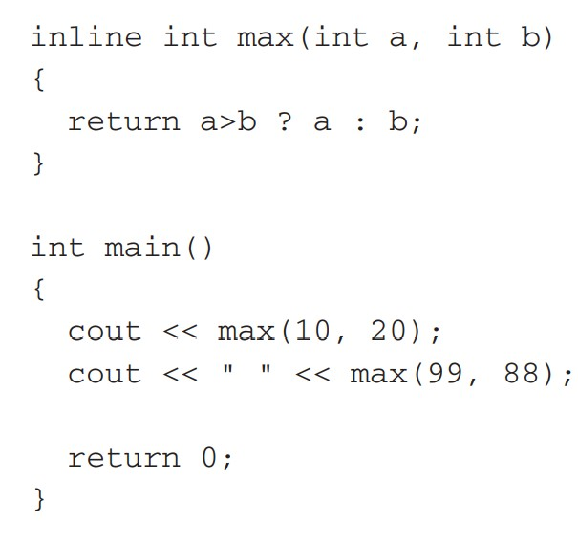
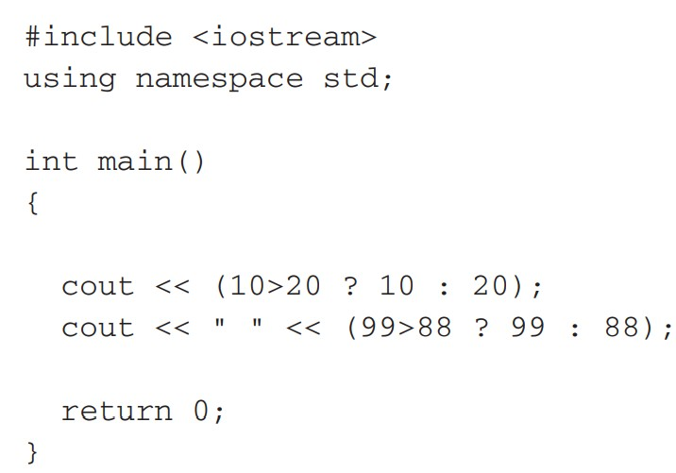
CODE IS EXPANDED LIKE THIS

Slide 32
CONT…
They allow us to create very efficient code.
Since classes typically require several frequently executed interface functions (which provide access to private data), the efficiency of these functions is of critical concern.
As we know, each time a function is called, a significant amount of overhead is generated by the calling and return mechanism. Typically, arguments are pushed onto the stack and various registers are saved when a function is called, and then restored when the function returns.
However, when a function is expanded in line, none of those operations occur.
Although expanding function calls in line can produce faster run times, it can also result in larger code size because of duplicated code.
For this reason, it is best to inline only very small functions.
Further, it is also a good idea to inline only those functions that will have significant impact on the performance of your program

Slide 33
Cont…
Like the register specifier, inline is actually just a request, not a command, to the compiler.
The compiler can choose to ignore it.
Some compilers may not inline all types of functions.
For example, it is common for a compiler not to inline a recursive function.
Inline functions may be class member functions.
NOTE:
It is not defined by C89. However, it has been added by C99.

Slide 34
DEFINING INLINE FUNCTIONS WITHIN A CLASS
It is possible to define short functions completely within a class declaration.
When a function is defined inside a class declaration, it is automatically made into an inline function (if possible).
It is not necessary (but not an error) to precede its declaration with the inline keyword.
NOTE:
Because inline functions are often short, such style of coding within a class is fairly typical. However, we are free to use any format.
Inlining of the show( ) function is of limited value because (in general) the amount of time the I/O statement will take far exceeds the overhead of a function call.
However, it is extremely common to see all short member functions defined inside their class in C++ programs.

Slide 35
CONSTRUCTORS AND DESTRUCTORS

Slide 36
CONSTRUCTORS
It is very common for some part of an object to require initialization before it can be used.
Because the requirement for initialization is so common, C++ allows objects to initialize themselves when they are created.
This automatic initialization is performed through the use of a constructor function.
A constructor is a special function that is a member of a class and has the same name as that class.
In C++, constructors cannot return values and, thus, have no return type.
In actual practice, most constructors will not output or input anything. They will simply perform various initializations.

Slide 37
Cont…
An object's constructor is automatically called when the object is created.
This means that it is called when the object's declaration is executed.
In C++, a declaration statement is a statement that is executed.
The code executed to construct an object may be quite significant.
An object's constructor is called once for global or static local objects.
For local objects, the constructor is called each time the object declaration is encountered.

Slide 38
DESTRUCTOR
The complement of the constructor is the destructor.
In many circumstances, an object will need to perform some action or actions when it is destroyed.
Local objects are created when their block is entered, and destroyed when the block is left.
Global objects are destroyed when the program terminates.
When an object is destroyed, its destructor (if it has one) is automatically called.
There are many reasons why a destructor may be needed.
[e.g an object may need to deallocate memory that it had previously allocated or it may need to close a file that it had opened.]
In C++, it is the destructor that handles deactivation events.
The destructor has the same name as the constructor, but it is preceded by a ~.
like constructors, destructors do not have return values.

Slide 39
PARAMETERIZED CONSTRUCTORS
It is possible to pass arguments to constructors.
Typically, these arguments help initialize an object when it is created.
To create a parameterized constructor, simply add parameters to it the way you would to any other function.
When we define the constructor's body,we use the parameters to initialize the object.

Slide 40
CONT…
IMP:
myclass ob(3, 4) [MOST USED] causes an object called ob to be created and passes the arguments 3 and 4 to the i and j parameters of myclass( ).
also pass arguments using this type of declaration statement:
myclass ob = myclass(3, 4);
CAUTION:
Actually, there is a small technical difference between the two types of declarations that relates to copy constructors.
NOTE:
Parameterized constructors are very useful because they allow you to avoid having to make an additional function call simply to initialize one or more variables in an object.
Each function call you can avoid makes your program more efficient.

Slide 41
CONSTRUCTORS WITH ONE PARAMETER: A SPECIAL CASE
If a constructor only has one parameter, there is a third way to pass an initial value to that constructor.
X ob = 99;
In this form of initialization, 99 is automatically passed to the j parameter in the X( ) constructor.
i.e the declaration statement is handled by the compiler as if it were written like this: X ob = X(99);
NOTE:
use either ob(i) or ob = i to initialize an object.
The reason for this is that whenever you create a constructor that takes one argument, you are also implicitly creating a conversion from the type of that argument to the type of the class.

Slide 42
WHEN CONSTRUCTORS AND DESTRUCTORS ARE EXECUTED
An object's constructor is called when the object comes into existence, and an object's destructor is called when the object is destroyed.
A local object's constructor is executed when the object's declaration statement is encountered.
The destructors for local objects are executed in the reverse order of the constructor functions.
Global objects have their constructors execute before main( ) begins execution.
Global constructors are executed in order of their declaration, within the same file.
We cannot know the order of execution of global constructors spread among several files.
Global destructors execute in reverse order after main( ) has terminated.

Slide 43
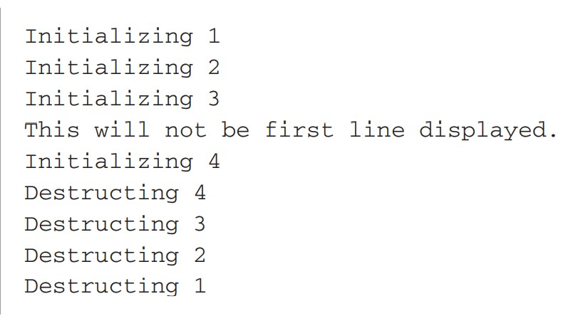
Cont… [10d-constructor-destructor-order]

Slide 44
STATIC CLASS MEMBERS

Slide 45
STATIC DATA MEMBERS
When we precede a member variable's declaration with static, we are telling the compiler that only one copy of that variable will exist and that all objects of the class will share that variable.
Unlike regular data members, individual copies of a static member variable are not made for each object.
No matter how many objects of a class are created, only one copy of a static data member exists.
All objects of that class use that same variable.
All static variables are initialized to zero before the first object is created.

Slide 46
Cont…
When we declare a static data member within a class, we are not defining it.
(i.e we are not allocating storage for it.)
Instead, we must provide a global definition for it elsewhere, outside the class.
This is done by redeclaring the static variable using the scope resolution operator to identify the class to which it belongs.
This causes storage for the variable to be allocated.
(Remember, a class declaration is simply a logical construct that does not have physical reality.)
[11-staticMember] :integer a is declared both inside shared and outside of it.
As mentioned earlier, this is necessary because the declaration of a inside shared does not allocate storage.
NOTE: may still find older C++ code that does not redeclare static member variables.
In these cases, you will need to add the required definitions.

Slide 47
Cont… [11b-staticMember-beforeObject]
A static member variable exists before any object of its class is created.
a is both public and static. Thus it may be directly accessed in main( ).
Further, since a exists before an object of shared is created, a can be given a value at any time.
As this program illustrates, the value of a is unchanged by the creation of object x. For this reason, both output statements display the same value: 99.
In general, to refer to a static member independently of an object, we must qualify it by using the name of the class of which it is a member.

Slide 48
BEST USAGE OF STATIC (accessing control to shared resources) [11c-staticMember-accessingResources]
Creating several objects, each of which needs to write to a specific disk file. Clearly, however, only one object can be allowed to write to the file at a time.
In this case, we will want to declare a static variable that indicates when the file is in use and when it is free.
Each object then interrogates this variable before writing to the file.

Slide 49
STATIC MEMBER FUNCTIONS
RESTRICTIONS::
They may only directly refer to other static members of the class.
(Of course, global functions and data may be accessed by static member functions.)
A static member function does not have a this pointer.
There cannot be a static and a non-static version of the same function.
A static member function may not be virtual.
Finally, they cannot be declared as const or volatile.
NOTE:
static member functions have limited applications, but one good use for them is to "preinitialize" private static data before any object is actually created.

Slide 50
THE SCOPE RESOLUTION OPERATOR
the :: operator links a class name with a member name in order to tell the compiler what class the member belongs to.
However, the scope resolution operator has another related use: it can allow access to a name in an enclosing scope that is "hidden" by a local declaration of the same name.

Slide 51
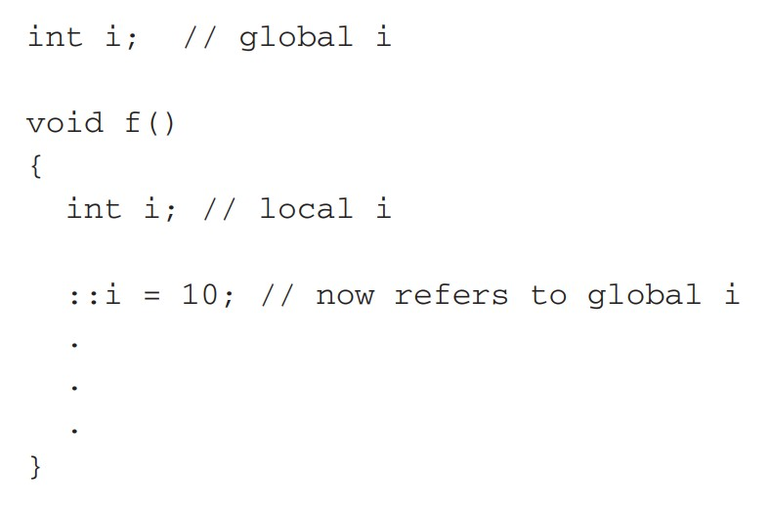
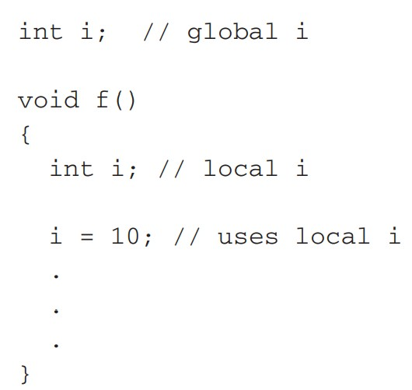
Cont…

Slide 52
NESTED CLASSES
Defining one class within another.
Doing so creates a nested class.
Since a class declaration does, in fact, define a scope, a nested class is valid only within the scope of the enclosing class.
Nested classes are seldom used.
Because of C++'s flexible and powerful inheritance mechanism, the need for nested classes is virtually nonexistent

Slide 53
LOCAL CLASSES
A class may be defined within a function….called LOCAL CLASS
When a class is declared within a function, it is known only to that function and unknown outside of it.
RESTRICTIONS:
All member functions must be defined within the class declaration.
The local class may not use or access local variables of the function in which it is declared (except that a local class has access to static local variables declared within the function or those declared as extern).
It may access type names and enumerators defined by the enclosing function, however.
No static variables may be declared inside a local class.
Because of these restrictions, local classes are not common in C++ programming.

Slide 54
PASSING OBJECTS TO FUNCTIONS
Objects are passed to functions through the use of the standard call-byvalue mechanism.
Although the passing of objects is straightforward, some rather unexpected events occur that relate to constructors and destructors.
[13-passingObjects]: As the output shows, there is one call to the constructor, which occurs when o is created in main( ), but there are two calls to the destructor.
When an object is passed to a function, a copy of that object is made (and this copy becomes the parameter in the function).
This means that a new object comes into existence.
When the function terminates, the copy of the argument (i.e., the parameter) is destroyed.

Slide 55
Cont…
When a copy of an argument is made during a function call, the normal constructor is not called.
Instead, the object's copy constructor is called.
A copy constructor defines how a copy of an object is made.
However, if a class does not explicitly define a copy constructor, as is the case here, then C++ provides one by default.
The default copy constructor creates a bitwise (that is, identical) copy of the object.
The reason a bitwise copy is made is easy to understand if you think about it.
Since a normal constructor is used to initialize some aspect of an object, it must not be called to make a copy of an already existing object.
Such a call would alter the contents of the object.
When passing an object to a function, you want to use the current state of the object, not its initial state.

Slide 56
Cont…
However, when the function terminates and the copy of the object used as an argument is destroyed, the destructor is called.
This is necessary because the object has gone out of scope.
This is why the preceding program[13-passingObjects] had two calls to the destructor.
The first was when the parameter to f( ) went out-of-scope. The second is when o inside main( ) was destroyed when the program ended.

Slide 57
Cont…
CAUTION:
Because the default copy constructor creates an exact duplicate of the original, it can, at times, be a source of trouble.
Even though objects are passed to functions by means of the normal call-by-value parameter passing mechanism which, in theory, protects and insulates the calling argument, it is still possible for a side effect to occur that may affect, or even damage, the object used as an argument.
e.g
If an object used as an argument allocates memory and frees that memory when it is destroyed, then its local copy inside the function will free the same memory when its destructor is called.
This will leave the original object damaged and effectively useless.
To prevent this type of problem you will need to define the copy operation by creating a copy constructor for the class,

Slide 58
RETURNING OBJECTS
When an object is returned by a function, a temporary object is automatically created that holds the return value.
It is this object that is actually returned by the function.
After the value has been returned, this object is destroyed.
The destruction of this temporary object may cause unexpected side effects in some situations. e.g
if the object returned by the function has a destructor that frees dynamically allocated memory, that memory will be freed even though the object that is receiving the return value is still using it.
There are ways to overcome this problem that involve overloading the assignment operator and defining a copy constructor.

Slide 59
OBJECT ASSIGNMENT
Assuming that both objects are of the same type, we can assign one object to another.
This causes the data of the object on the right side to be copied into the data of the object on the left.
By default, all data from one object is assigned to the other by use of a bit-by-bit copy.
However, it is possible to overload the assignment operator and define some other assignment procedure.

Slide 60
DEMOs-ON::

Slide 61
DEMO GOING ON

Slide 62
THANK YOU

