Slide 1
WELCOME IN HARIOM DEFENSIVE TECHNOLOGY

Slide 2
C++ (OPERATOR OVERLOADING)

Slide 3
ALL AT ONE GLANCE
AGENDA
CREATING A MEMBER OPERATOR FUNCTION
Creating Prefix and Postfix Forms of the Increment and Decrement Operators
OVERLOADING THE SHORTHAND OPERATORS
OPERATOR OVERLOADING USING A FRIEND FUNCTION
Overloading new and delete
Overloading new and delete for Arrays
Overloading Some Special Operators: [] () -> ,
DEMOs

Slide 4
AGENDA
UNDERSTANDING
OPERATOR OVERLOADING
IN
C++

Slide 5
OVERVIEW
When an operator is overloaded, none of its original meanings are lost.
Instead, the type of objects it can be applied to is expanded.
After overloading the appropriate operators, you can use objects in expressions in just the same way that you use C++'s built-in data types.
You overload operators by creating operator functions.
An operator function defines the operations that the overloaded operator will perform relative to the class upon which it will work.
An operator function is created using the keyword operator.
Operator functions can be either members or nonmembers of a class.
Nonmember operator functions are almost always friend functions of the class

Slide 6
CREATING A MEMBER OPERATOR FUNCTION
ret-type class-name::operator#(arg-list)
{
// operations
}
Operator functions return an object of the class they operate on, but ret-type can be any valid type.
The # is a placeholder.
When you are overloading a unary operator, arg-list will be empty.etc

Slide 7
Cont…
[29-OprOver-plus]:
The reason that operator+( ) takes only one parameter is that the operand on the left side of the + is passed implicitly to the function through the this pointer.
The operand on the right is passed in the parameter op2.
The fact that the left operand is passed using this also implies one important point:-
When binary operators are overloaded, it is the object on the left that generates the call to the operator function.
(ob1+ob2).show(); //ALSO VALID… displays outcome of ob1+ob2
In this situation, ob1+ob2 generates a temporary object that ceases to exist after the call to show( ) terminates.
Because the traditional use of the + operator does not modify either operand, it makes sense for the overloaded version not to do so either. (For example, 5+7 yields 12, but neither 5 nor 7 is changed.)

Slide 8
Cont…
[29b-OprOver-4]:
Because it is the object on the left that generates the call to the operator–( ) function, op2's data must be subtracted from the data pointed to by this.
It is important to remember which operand generates the call to the function.
If the = is not overloaded, a default assignment operation is created automatically for any class you define.
The default assignment is simply a member- by-member, bitwise copy.
By overloading the =, you can define explicitly what the assignment does relative to a class.
In this example, the overloaded = does exactly the same thing as the default.
Notice that the operator=( ) function returns *this, which is the object that generated the call.
This arrangement is necessary for multiple assignment operations :
ob1 = ob2 = ob3; // multiple assignment

Slide 9
Cont…
operator++( ). it takes no parameters.
Since ++ is a unary operator, its only operand is implicitly passed by using the this pointer.
operator=( ) and operator++( ) alter the value of an operand.
In the case of assignment, the operand on the left (the one generating the call to the operator=( ) function) is assigned a new value.

Slide 10
Creating Prefix and Postfix Forms of the Increment and Decrement Operators
Must define two versions of the operator++( ) function.
The other is declared like this:
loc operator++(int x);
If the ++ precedes its operand, the operator++( ) function is called.
If the ++ follows its operand, the operator++(int x) is called and x has the value zero.

Slide 11
Cont…
// Prefix decrement
type operator– –( ) {
// body of prefix operator
}
// Postfix decrement
type operator– –(int x) {
// body of postfix operator
}
NOTE:
In older versions of C++… The prefix form was used for both.

Slide 12
OVERLOADING THE SHORTHAND OPERATORS
C++'s "shorthand" operators, such as +=, –=, and the like.
loc loc::operator+=(loc op2)
{
longitude = op2.longitude + longitude;
latitude = op2.latitude + latitude;
return *this;
}
NOTE:
Keep in mind that you are simply combining an assignment with another type of operation.

Slide 13
OPERATOR OVERLOADING RESTRICTIONS
Cannot alter the precedence of an operator.
Cannot change the number of operands that an operator takes.
(can choose to ignore an operand, however.)
Except for the function call operator (described later), operator functions cannot have default arguments.
Finally, these operators cannot be overloaded:
. : : .* ?
CAUTION:
Overloading + operator in such a way that it writes I like C++ 10 times to a disk file, can do so.
However, when you stray significantly from the normal meaning of an operator, you run the risk of dangerously destructuring your program.
Therefore, before decoupling an overloaded operator from its normal meaning, be sure that you have sufficient reason to do so

Slide 14
Cont…
One good example where decoupling is successful is found in the way C++ overloads the << and >> operators for I/O.
Except for the = operator, operator functions are inherited by a derived class.
However, a derived class is free to overload any operator
(including those overloaded by the base class) it chooses relative to itself.

Slide 15
OPERATOR OVERLOADING USING A FRIEND FUNCTION
Since a friend function is not a member of the class, it does not have a this pointer.
Therefore, an overloaded friend operator function is passed the operands explicitly.
When overloading a binary operator using a friend function, the left operand is passed in the first parameter and the right operand is passed in the second parameter.
RESTRICTIONS:
Not overloading the =, ( ), [ ], or –> operators by using a friend function.
When overloading the increment or decrement operators,
you will need to use a reference parameter when using a friend function.

Slide 16
Using a Friend to Overload ++ or – –
Must pass the operand as a reference parameter.
This is because friend functions do not have this pointers.
If you overload these operators by using a friend, then the operand is passed by value as a parameter.
This means that a friend operator function has no way to modify the operand.
Since the friend operator function is not passed a this pointer to the operand,
but rather a copy of the operand, no changes made to that parameter affect the operand that generated the call.
However, you can remedy this situation by specifying the parameter to the friend operator function as a reference parameter.
If you want to overload the postfix versions of the increment and decrement operators using a friend, simply specify a second, dummy integer parameter.
// friend, postfix version of ++
friend loc operator++(loc &op, int x);

Slide 17
Friend Operator Functions Add Flexibility
Using a friend or a member function makes no functional difference.
In those cases, it is usually best to overload by using member functions. However….
Ob + 100 // valid…Ob generates the call to the overloaded + function.
100 + Ob // invalid
Since an integer is a built-in type, no operation between an integer and an object of Ob's type is defined. Therefore, the compiler will not compile this expression.
Also in some applications, having to always position the object on the left could be a significant burden and cause of frustration.
To allow both object+integer and integer+object, simply overload the function twice—one version for each situation.

Slide 18
Overloading new and delete
Useful if we want to use some special allocation method.
e.g you may want allocation routines that automatically begin using a disk file as virtual memory when the heap has been exhausted.

Slide 19
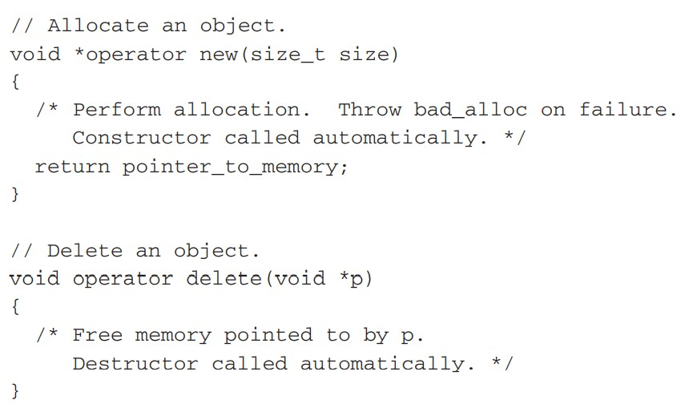
Cont…

Slide 20
Cont…
type size_t(an unsigned integer) is a defined type capable of containing the largest single piece of memory that can be allocated.
The overloaded new function must return a pointer to the memory that it allocates, or throw a bad_alloc exception if an allocation error occurs.
When you allocate an object using new (whether your own version or not), the object's constructor is automatically called.
The delete function receives a pointer to the region of memory to be freed.
It then releases the previously allocated memory back to the system.
When an object is deleted, its destructor is automatically called.
The new and delete operators may be overloaded globally so that all uses of these operators call your custom versions.
They may also be overloaded relative to one or more classes.

Slide 21
overloading new and delete relative to a class
For the sake of simplicity, no new allocation scheme will be used.
Instead, the overloaded operators will simply invoke the standard library functions malloc( ) and free( ).
To overload the new and delete operators for a class, simply make the overloaded operator functions class members.
e.g
here the new and delete operators are overloaded for the loc class::
[31-OprOver-newNdelete]

Slide 22
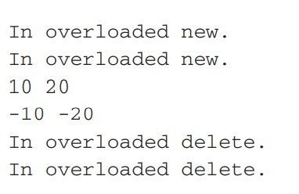
OUTPUT

Slide 23
Cont…
When new and delete are for a specific class, the use of these operators on any other type of data causes the original new or delete to be employed.
The overloaded operators are only applied to the types for which they are defined.
int *f = new float; // uses default new

Slide 24
overloading new and delete globally
C++'s default new and delete are ignored.
When new or delete are encountered, the compiler first checks to see whether they are defined relative to the class they are operating on.
If so, those specific versions are used.
If not, C++ uses the globally defined new and delete.
[31b-OprOver-newNdelete-globally]

Slide 25
Overloading new and delete for Arrays
Need to overload new and delete a second time.
To allocate and free arrays, you must use these forms of new and delete.
// Allocate an array of objects.
void *operator new[](size_t size)
{
/* Perform allocation. Throw bad_alloc on failure. Constructor for each element called automatically. */
return pointer_to_memory;
}
// Delete an array of objects.
void operator delete[](void *p)
{
/* Free memory pointed to by p.
Destructor for each element called automatically.
*/
}

Slide 26
Cont…
When allocating an array, the constructor for each object in the array is automatically called.
When freeing an array, each object's destructor is automatically called.
You do not have to provide explicit code to accomplish these actions.
[31c-OprOver-newNdelete-ArrayOfObjects]

Slide 27
Overloading the nothrow Version of new and delete
// Nothrow version of new.
void *operator new(size_t size, const nothrow_t &n)
{
// Perform allocation.
if(success) return pointer_to_memory;
else return 0;
}
// Nothrow version of new for arrays.
void *operator new[](size_t size, const nothrow_t &n)
{
// Perform allocation.
if(success) return pointer_to_memory;
else return 0;
}
void operator delete(void *p, const nothrow_t &n)
{
// free memory
}
void operator delete[](void *p, const nothrow_t &n)
{
// free memory
}
NOTE:The type nothrow_t is defined in <new> . This is the type of the nothrow object. The nothrow_t parameter is unused.

Slide 28
Overloading Some Special Operators
C++ defines array subscripting, function calling, and class member access as operations.
The operators that perform these functions are the [ ], ( ), and –>, respectively.
RESTRICTION applies to overloading these three operators: They must be
nonstatic member functions.
cannot be friends.

Slide 29
Overloading [ ]
In C++, the [ ] is considered a binary operator when you are overloading it.
Therefore, the general form of a member operator[ ]( ) function :
type class-name::operator[](int i)
{
// . . .
}
Technically, the parameter does not have to be of type int, but an operator[ ]( ) function is typically used to provide array subscripting,
and as such, an integer value is generally used.
O[3] translates into this call to the operator[ ]( ) function:
O.operator[](3)
i.e the value of the expression within the subscripting operators is passed to the operator[ ]( ) function in its explicit parameter.
The this pointer will point to O, the object that generated the call.
[32-OprOver-SplOpr-subscript]:The overloaded operator[ ]( ) function returns the value of the array as indexed by the value of its parameter.

Slide 30
Cont…
You can design the operator[ ]( ) function in such a way that the [ ] can be used on both the left and right sides of an assignment statement.
To do this, simply specify the return value of operator[ ]( ) as a reference.
[32b-OprOver-SplOpr-subscript_bothSide]:
Because operator[ ]( ) now returns a reference to the array element indexed by i, it can be used on the left side of an assignment to modify an element of the array.
One advantage of being able to overload the [ ] operator is that it allows a means of implementing safe array indexing in C++.
In C++, it is possible to overrun (or underrun) an array boundary at run time without generating a run-time error message.
So intercepting an out-of-range index.
[32c-OprOver-SplOpr-subscript_bothSide-OutOfRange]:So boundary error is intercepted by operator[]( ),
and the program is terminated before any damage can be done.

Slide 31
Overloading ( )
When you overload the ( ) function call operator, you are not, per se, creating a new way to call a function.
Rather, you are creating an operator function that can be passed an arbitrary number of parameters.
e.g
O(10, 23.34, "hi");
translates into this call to the operator( ) function:
O.operator()(10, 23.34, "hi");
Overloading the ( ) operator,→ defining the parameters that you want to pass to that function.
When you use the ( ) operator in your program, the arguments you specify are copied to those parameters.
NOTE:
when overloading ( ),-- can use any type of parameters and return any type of value.
These types will be dictated by the demands of your programs.
You can also specify default arguments.
[33-OprOver-SplOpr-functioncall]

Slide 32
Overloading –>
The –> pointer operator, also called the class member access operator, is considered a unary operator when overloading.
Its general usage is shown here:
object->element;
The operator–>( ) function must return a pointer to an object of the class that operator–>( ) operates upon.
The element must be some member accessible within the object.
[34-OprOver-SplOpr-pointerOperator]:Equivalence between ob.i and ob–>i when operator–>( ) returns the this pointer.
NOTE:
An operator–>( ) function must be a member of the class upon which it works.

Slide 33
Overloading the Comma Operator
The comma is a binary operator, and like all overloaded operators, you can make an overloaded comma perform any operation you want.
However, if you want the overloaded comma to perform in a fashion similar to its normal operation, then your version must discard the values of all operands except the rightmost.
The rightmost value becomes the result of the comma operation.
[35-OprOver-SplOpr-CommaOperator]:
Notice that although the values of the left-hand operands are discarded, each expression is still evaluated by the compiler so that any desired side effects will be performed.
Remember, the left-hand operand is passed via this, and its value is discarded by the operator,( ) function.
The value of the right-hand operation is returned by the function.
This causes the overloaded comma to behave similarly to its default operation

Slide 34
DEMOs-ON::

Slide 35
DEMO GOING ON

Slide 36
THANK YOU

