Slide 1
WELCOME IN HARIOM DEFENSIVE TECHNOLOGY

Slide 2
C++ (INHERITANCE)

Slide 3
ALL AT ONE GLANCE
AGENDA
Base-Class Access Control:private,public,protected
Inheritance and protected Members
INHERITING MULTIPLE BASE CLASSES
Constructors, Destructors, and Inheritance
Passing Parameters to Base-Class Constructors
GRANTING ACCESS
DEMOs

Slide 4
AGENDA
UNDERSTANDING
INHERITANCE
IN
C++

Slide 5
OVERVIEW
One of the cornerstones of OOP because it allows the creation of hierarchical classifications.
Using inheritance, you can create a general class that defines traits common to a set of related items.
This class may then be inherited by other, more specific classes, each adding only those things that are unique to the inheriting class.
A class that is inherited is referred to as a base class. The class that does the inheriting is called the derived class.
A derived class can be used as a base class for another derived class.
So multiple inheritance is achieved.

Slide 6
Base-Class Access Control
When a class inherits another, the members of the base class become members of the derived class.
class derived-class-name : access base-class-name {
// body of class
};
The access status of the base-class members inside the derived class is determined by access.
The base-class access specifier must be either public, private, or protected.
If no access specifier is present, the access specifier is private by default if the derived class is a class.

Slide 7
Base-Class Access :-> public
All public members of the base become public members of the derived class,
and all protected members of the base become protected members of the derived class.
In all cases, the base's private elements remain private to the base and are not accessible by members of the derived class.

Slide 8
Base-Class Access :-> private
When the base class is inherited by using the private access specifier,
all public and protected members of the base class become private members of the derived class.
This means that they are still accessible by members of the derived class but cannot be accessed by parts of your program that are not members of either the base or derived class.

Slide 9
Inheritance and protected Members
Included in C++ to provide greater flexibility in the inheritance mechanism.
When a member of a class is declared as protected, that member is not accessible by other, nonmember elements of the program.
Access to a protected member is the same as access to a private member—it can be accessed only by other members of its class.
The sole exception to this is when a protected member is inherited.
A private member of a base class is not accessible by other parts of your program, including any derived class.
However, protected members behave differently.
If the base class is inherited as public, then the base class' protected members become protected members of the derived class and are, therefore, accessible by the derived class.
By using protected, you can create class members that are private to their class but that can still be inherited and accessed by a derived class.

Slide 10
Cont…
[37-Inheritance-protectedMember]:
Because base is inherited by derived as public and because i and j are declared as protected, derived's function setk( ) may access them.
If i and j had been declared as private by base, then derived would not have access to them.
When a derived class is used as a base class for another derived class,
any protected member of the initial base class that is inherited (as public) by the first derived class may also be inherited as protected again by a second derived class.
[37b-Inheritance-protectedMember-multipleInheritance]:
If base were inherited as private, then all members of base would become private members of derived1, which means that they would not be accessible by derived2.
(However, i and j would still be accessible by derived1.)
[37c-Inheritance-protectedMember-multipleInheritance-privateAccess]:
Even though base is inherited as private by derived1, derived1 still has access to base's public and protected elements.
However, it cannot pass along this privilege.

Slide 11
Protected Base-Class Inheritance
Inheriting a base class as protected.
When this is done, all public and protected members of the base class become protected members of the derived class.
[38-Inheritance-protectedAccess]:
Even though setij( ) and showij( ) are public members of base,
they become protected members of derived when it is inherited using the protected access specifier.
This means that they will not be accessible inside main( ).

Slide 12
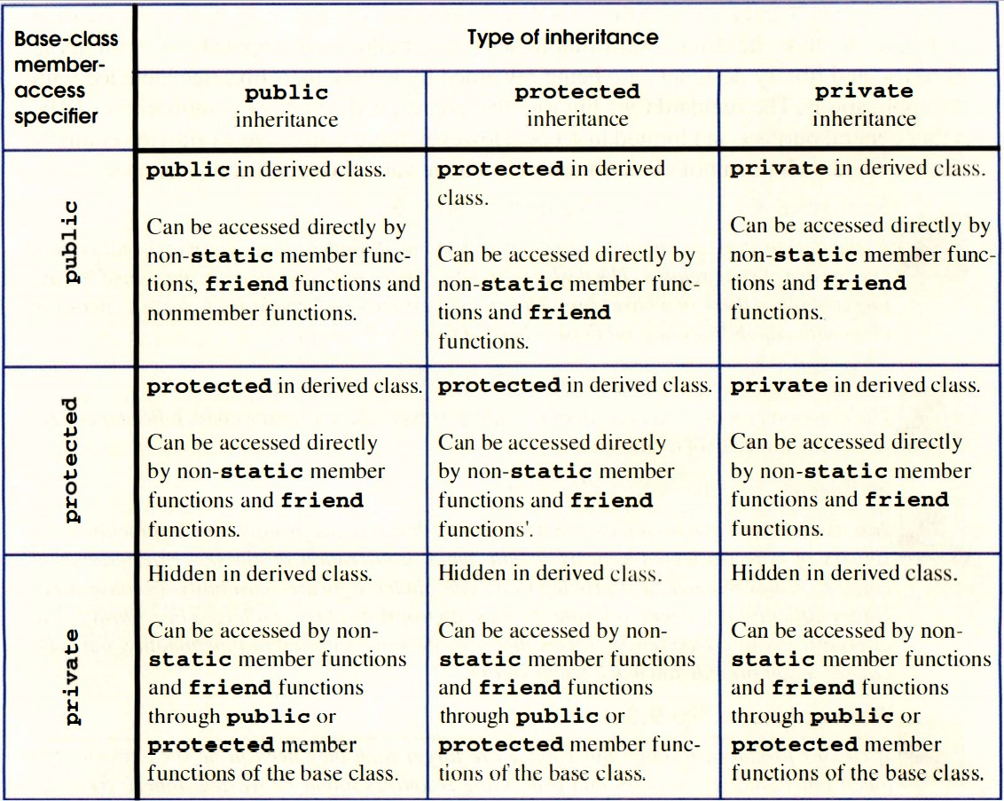

Slide 13
INHERITING MULTIPLE BASE CLASSES

Slide 14
It is possible for a derived class to inherit two or more base classes.
[39-Inheritance-MultipleBaseClasses]: derived inherits both base1 and base2.
To inherit more than one base class, use a comma-separated list.
Be sure to use an access-specifier for each base inherited .

Slide 15
Constructors, Destructors, and Inheritance

Slide 16
When are base-class and derived-class constructors and destructors called?
How can parameters be passed to base-class constructors?

Slide 17
When Constructors and Destructors Are Executed
It is possible for a base class, a derived class, or both to contain constructors and/or destructors.
It is important to understand the order in which these functions are executed when an object of a derived class comes into existence and when it goes out of existence.
[40-Inheritance-ConstructorDestructorOrder]:
first base's constructor is executed followed by derived's.
Next (because ob is immediately destroyed in this program), derived's destructor is called, followed by base's.
When an object of a derived class is created, the base class’ constructor will be called first, followed by the derived class’ constructor.
When a derived object is destroyed, its destructor is called first, followed by the base class' destructor.

Slide 18
Cont…
Constructors are executed in order of derivation.
Because a base class has no knowledge of any derived class,
Any initialization it needs to perform is separate from and possibly prerequisite to any initialization performed by the derived class.
So it must be executed first.
Because the base class underlies the derived class,
the destruction of the base object implies the destruction of the derived object.
So the derived destructor must be called before the object is fully destroyed.
In cases of multiple inheritance ( where a derived class becomes the base class for another derived class), the general rule applies:
Constructors are called in order of derivation, destructors in reverse order.

Slide 19
Cont…
The same general rule applies in situations involving multiple base classes.
Constructors are called in order of derivation, left to right, as specified in derived's inheritance list.
Destructors are called in reverse order, right to left.
If base2 had been specified before base1 in derived's list:
class derived: public base2, public base1 { …. ??? …..

Slide 20
Passing Parameters to Base-Class Constructors
How do you pass arguments to a constructor in a base class?
To use an expanded form of the derived class's constructor declaration that passes along arguments to one or more base-class constructors.
The general form of this expanded derived-class constructor declaration:
derived-constructor(arg-list) : base1(arg-list),
base2(arg-list),
// ...
baseN(arg-list)
{
// body of derived constructor
}

Slide 21
Cont…
base1 through baseN are the names of the base classes inherited by the derived class.
Notice that a colon separates the derived class' constructor declaration from the base-class specifications, and that
the base-class specifications are separated from each other by commas, in the case of multiple base classes.
[41-Inheritance-ConstructorDestructorOrder-PassingParameterToBaseClass]:
derived's constructor is declared as taking two parameters, x and y. However, derived( ) uses only x;
y is passed along to base( ).
In general, the derived class' constructor must declare both the parameter(s) that it requires as well as any required by the base class.
[41b-Inheritance-ConstructorDestructorOrder-PassingParameterToBaseClass-MultipleBaseClasses]

Slide 22
Cont…
Arguments to a base-class constructor are passed via arguments to the derived class' constructor.
So even if a derived class' constructor does not use any arguments, it will still need to declare one if the base class requires it.
So the arguments passed to the derived class are simply passed along to the base.
[41c-Inheritance-ConstructorDestructorOrder-PassingParameterToBaseClass-MultipleBaseClasses-NoArgByDerived]

Slide 23
A derived class' constructor is free to make use of any and all parameters that it is declared as taking, even if one or more are passed along to a base class.
Put differently, passing an argument along to a base class does not preclude its use by the derived class as well.
class derived: public base {
int j;
public:
// derived uses both x and y and then passes them to base.
derived(int x, int y): base(x, y)
{ j = x*y; cout << "Constructing derived\n"; }
NOTE:
The argument can consist of any expression valid at the time.
This includes function calls and variables.
This is in keeping with the fact that C++ allows dynamic initialization.

Slide 24
GRANTING ACCESS
To restore one or more inherited members to their original access specification.
In Standard C++, 2 Ways:
using statement is designed primarily to support namespaces [chap23]
access declaration within the derived class.
[2nd:supported by Standard C++, but they are deprecated.
This means that they should not be used for new code.]
base-class::member;
The access declaration is put under the appropriate access heading in the derived class' declaration. Notice that no type declaration is required.

Slide 25
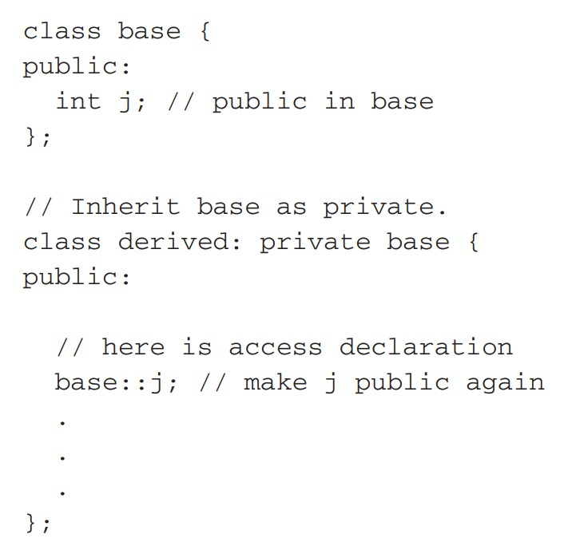
Cont…

Slide 26
Cont…
You can use an access declaration to restore the access rights of public and protected members.
However, you cannot use an access declaration to raise or lower a member's access status.
(If C++ allowed this to occur, it would destroy its encapsulation mechanism!)
[42-Inheritance-grantingAccess]:it uses access declarations to restore j, seti( ), and geti( ) to public status.
Used to accommodate those situations in which most of an inherited class is intended to be made private, but a few members are to retain their public or protected status.
CAUTION:deprecated- means that they are allowed for now, but they might not be supported in the future.
Instead, the standard suggests achieving the same effect by applying the using keyword.

Slide 27
Virtual Base Classes
An element of ambiguity can be introduced into a C++ program when multiple base classes are inherited.
[43-Inheritance-ambiguity]:
derived3 inherits both derived1 and derived2. This means that there are two copies of base present in an object of type derived3.
Because there are two copies of base present in object ob, there are two ob.is!
The statement is inherently ambiguous.
Two ways to remedy:
The first is to apply the scope resolution operator to i and manually select one i.

Slide 28
Cont…
[43b-Inheritance-ambiguity-resolved1stWay]:
Because the :: was applied, the program has manually selected derived1's version of base.
However, this solution raises a deeper issue:
What if only one copy of base is actually required? Is there some way to prevent two copies from being included in derived3?
This solution is achieved using virtual base classes.

Slide 29
Cont…
When two or more objects are derived from a common base class,
you can prevent multiple copies of the base class from being present in an object derived from those objects by declaring the base class as virtual when It is inherited.
[44-Inheritance-ambiguity-resolved-virtual]:
Keyword virtual precedes the rest of the inherited class' specification.
Now that both derived1 and derived2 have inherited base as virtual,
any multiple inheritance involving them will cause only one copy of base to be present.
So in derived3, there is only one copy of base and ob.i = 10 is perfectly valid and unambiguous.

Slide 30
Cont…
Even though both derived1 and derived2 specify base as virtual, base is still present in objects of either type.
// define a class of type derived1
derived1 myclass;
myclass.i = 88;
The only difference between a normal base class and a virtual one is what occurs when an object inherits the base more than once.
If virtual base classes are used, then only one base class is present in the object.
Otherwise, multiple copies will be found.

Slide 31
DEMOs-ON::

Slide 32
DEMO GOING ON

Slide 33
THANK YOU

