Slide 1
WELCOME IN HARIOM DEFENSIVE TECHNOLOGY

Slide 2
C++ (TEMPLATES)

Slide 3
ALL AT ONE GLANCE
AGENDA
GENERIC FUNCTIONS
A FUNCTION WITH TWO GENERIC TYPES
EXPLICITLY OVERLOADING A GENERIC FUNCTION
OVERLOADING A FUNCTION TEMPLATE
Using Standard Parameters with Template Functions
GENERIC CLASSES
DEMOs

Slide 4
AGENDA
UNDERSTANDING
TEMPLATES
IN
C++

Slide 5
OVERVIEW
C++'s most sophisticated and high-powered features.
Supported by all modern C++ compilers.
Possible to create generic functions and classes.
In a generic function or class, the type of data upon which the function or class operates is specified as a parameter.
So we can use one function or class with several different types of data without having to explicitly recode specific versions for each data type.

Slide 6
GENERIC FUNCTIONS

Slide 7
A generic function defines a general set of operations that will be applied to various types of data.
The type of data that the function will operate upon is passed to it as a parameter.
Through a generic function, a single general procedure can be applied to a wide range of data.
[Many algorithms are logically the same no matter what type of data is being operated upon.]
By creating a generic function, you can define the nature of the algorithm, independent of any data.
[Once you have done this, the compiler will automatically generate the correct code for the type of data that is actually used when you execute the function.]
In essence, when you create a generic function you are creating a function that can automatically overload itself.

Slide 8
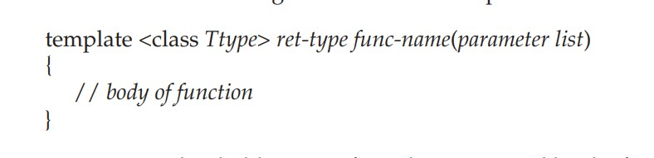
The normal meaning of the word "template" accurately reflects its use in C++. It is used to create a template (or framework) that describes what a function will do, leaving it to the compiler to fill in the details as needed.

Slide 9
Ttype is a placeholder name for a data type used by the function.
This name may be used within the function definition.
However, it is only a placeholder that the compiler will automatically replace with an actual data type when it creates a specific version of the function.
Although the use of the keyword class to specify a generic type in a template declaration is traditional, you may also use the keyword typename.

Slide 10
[51-template]:
template <class X> void swapargs(X &a, X &b);
tells the compiler two things:->
that a template is being created and
that a generic definition is beginning.
Because swapargs( ) is a generic function, the compiler automatically creates 3 versions of swapargs( ):->
one that will exchange integer values,
one that will exchange floating-point values,
and one that will swap characters.

Slide 11
TERMINOLOGY
A generic function (that is, a function definition preceded by a template statement) is also called a template function.
When the compiler creates a specific version of this function, it is said to have created a specialization.
This is also called a generated function.
The act of generating a function is referred to as instantiating it.
Put differently, a generated function is a specific instance of a template function.

Slide 12
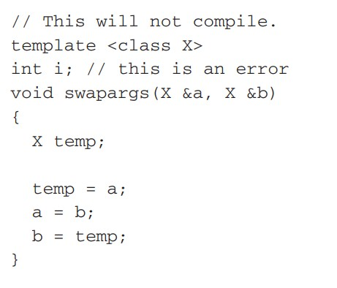
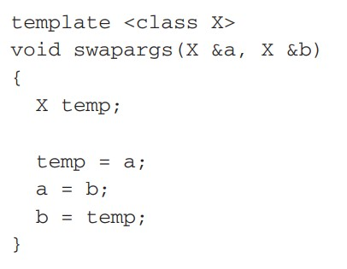
2nd WAY Since C++ does not recognize end-of-line as a statement terminator, the template clause of a generic function definition does not have to be on the same line as the function's name.

Slide 13
A FUNCTION WITH TWO GENERIC TYPES (by using a comma-separated list)
[52-template-2GenericTypes]:
placeholder types type1 and type2 are replaced by the compiler with the data types int and char *, and double and long, respectively,
when the compiler generates the specific instances of myfunc( ) within main( ).
CONCLUSION:
When you create a template function, you are, in essence, allowing the compiler to generate as many different versions of that function as are necessary for handling the various ways that your program calls the function.

Slide 14
EXPLICITLY OVERLOADING A GENERIC FUNCTION
Even though a generic function overloads itself as needed,
you can explicitly overload one, too.
This is formally called explicit specialization.
If you overload a generic function, that overloaded function overrides (or "hides") the generic function relative to that specific version.
[53-template-overloadGenericFunctionExplicit]:
when swapargs(i, j) is called, it invokes the explicitly overloaded version of swapargs( ) defined in the program.
So the compiler does not generate this version of the generic swapargs( ) function,
because the generic function is overridden by the explicit overloading.

Slide 15
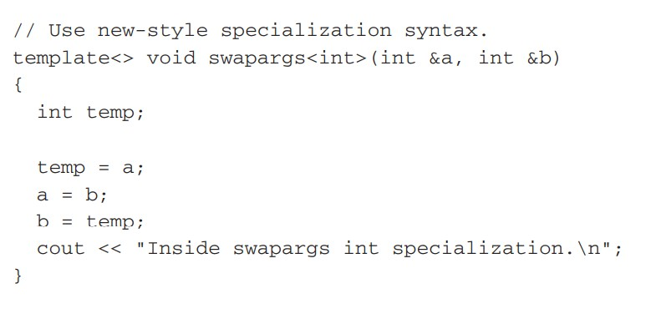
A new-style syntax was introduced to denote the explicit specialization of a function. This new method uses the template keyword.

Slide 16
template<> construct to indicate specialization.
The type of data for which the specialization is being created is placed inside the angle brackets following the function name.
This same syntax is used to specialize any type of generic function.
While there is no advantage to using one specialization syntax over the other at this time, the new-style is probably a better approach for the long term.
Explicit specialization of a template allows you to tailor a version of a generic function to accommodate a unique situation—perhaps to take advantage of some performance boost that applies to only one type of data.
However, as a general rule, if you need to have different versions of a function for different data types, you should use overloaded functions rather than templates.

Slide 17
OVERLOADING A FUNCTION TEMPLATE
In addition to creating explicit, overloaded versions of a generic function,
we can also overload the template specification itself.
To do so, simply create another version of the template that differs from any others in its parameter list.
[54-template-overloadTemplate]:
template for f( ) is overloaded to accept either one or two parameters.

Slide 18
Using Standard Parameters with Template Functions
We can mix standard parameters with generic type parameters in a template function.
These nongeneric parameters work just like they do with any other function.
[55-template-stdParameter]:
Since the first argument is a generic type, tabOut( ) can be used to display any type of data.
The tab parameter is a standard, call-by-value parameter.
The mixing of generic and nongeneric parameters causes no trouble and is, indeed, both common and useful.

Slide 19
GENERIC FUNCTION RESTRICTIONS
Generic functions are similar to overloaded functions except that they are more restrictive.
When functions are overloaded, you may have different actions performed within the body of each function.
But a generic function must perform the same general action for all versions—only the type of data can differ.
[56-template-restriction]:
These functions could not be replaced by a generic function because they do not do the same thing.

Slide 20
APPLYING GENERIC FUNCTIONS
Applied to all types of situations.
Whenever you have a function that defines a generalizable algorithm,
you can make it into a template function.
Once you have done so, you may use it with any type of data without having to recode it.
A Generic Sort
Compacting an Array

Slide 21
A Generic Sort
Creating a generic bubble sort.
The bubble( ) function will sort any type of array.
It is called with a pointer to the first element in the array and the number of elements in the array.
[57a-template-Practical-genericSort]:
Because bubble( ) is a template function, it is automatically over-loaded to accommodate the two different types of data.
You might want to try using bubble( ) to sort other types of data, including classes that you create.
In each case, the compiler will create the right version of the function.

Slide 22
Compacting an Array
A template is called compact( ).
This function compacts the elements in an array.
It is not uncommon to want to remove elements from the middle of an array and then move the remaining elements down so that all unused elements are at the end.
[57b-template-Practical-compactArray]:->
The generic compact( ) function is called with a pointer to the first element in the array, the number of elements in the array, and the starting and ending indexes of the elements to be removed.
The function then removes those elements and compacts the array.
For the purposes of illustration, it also zeroes the unused elements at the end of the array that have been freed by the compaction.
NOTE:
As long as the underlying logic of a function is independent of the data, it can be made into a generic function.

Slide 23
GENERIC CLASSES

Slide 24
Doing so, you create a class that defines all the algorithms used by that class; however, the actual type of the data being manipulated will be specified as a parameter when objects of that class are created.
Generic classes are useful when a class uses logic that can be generalized.
When you create a generic class, it can perform the operation you define, such as maintaining a queue or a linked list, for any type of data.
The compiler will automatically generate the correct type of object, based upon the type you specify when the object is created.
template class<Ttype> class-name {
.
.
.
}

Slide 25
Once you have created a generic class,
you create a specific instance of that class using:
class-name<type> ob;
type is the type name of the data that the class will be operating upon.
Member functions of a generic class are themselves automatically generic.
You need not use template to explicitly specify them.
stack class is reworked into a generic class.
So it can be used to store objects of any type.
[58-template-GenericClass-stack]:
a character stack and a floating-point stack are created, but any data type can be used.

Slide 26
Cont…
The actual type of data stored by the stack is generic in the class declaration.
It is not until an object of the stack is declared that the actual data type is determined.
When a specific instance of stack is declared, the compiler automatically generates all the functions and variables necessary for handling the actual data.
stack s1, s2; // create two character stacks
stack ds1, ds2; // create two double stacks
Notice how the desired data type is passed inside the angle brackets.
By changing the type of data specified when stack objects are created,
you can change the type of data stored in that stack.
stack chrptrQ; //can create another stack that stores character pointers.

Slide 27
Cont…
can also create stacks to store data types that you create.
struct addr {
char name[40];
char street[40];
char city[30];
char state[3];
char zip[12];
};
then to use stack to generate a stack that will store objects of type addr,
use a declaration like this:
stack<addr> obj;

