Slide 1
WELCOME IN HARIOM DEFENSIVE TECHNOLOGY

Slide 2
C++ (EXCEPTION-HANDLING)

Slide 3
ALL AT ONE GLANCE
AGENDA
EXCEPTION HANDLING FUNDAMENTALS
CATCHING CLASS TYPES
DEMOs

Slide 4
AGENDA
UNDERSTANDING
EXCEPTION-HANDLING
IN
C++

Slide 5
OVERVIEW
The exception handling subsystem.
Exception handling allows you to manage run-time errors in an orderly fashion.
Using exception handling, your program can automatically invoke an error-handling routine when an error occurs.
The principal advantage of exception handling is that it automates much of the error-handling code that previously had to be coded "by hand" in any large program.

Slide 6
EXCEPTION HANDLING FUNDAMENTALS

Slide 7
3 keywords: try, catch, and throw.
Program statements that you want to monitor for exceptions are contained in a try block.
If an exception (i.e., an error) occurs within the try block, it is thrown (using throw).
The exception is caught, using catch, and processed.
(Functions called from within a try block may also throw an exception.)
Exceptions that can be thrown by the monitored code are caught by a catch statement, which immediately follows the try statement in which the exception was thrown.

Slide 8
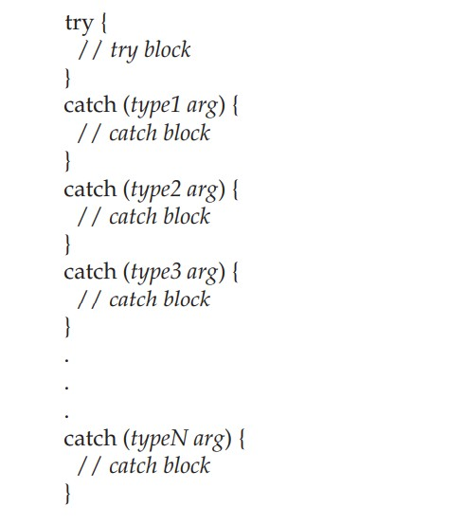

Slide 9
The try can be as short as a few statements within one function or as all-encompassing as enclosing the main( ) function code within a try block
(which effectively causes the entire program to be monitored).
When an exception is thrown, it is caught by its corresponding catch statement, which processes the exception.
Which catch statement is used is determined by the type of the exception.
i.e if the data type specified by a catch matches that of the exception,
then that catch statement is executed (and all others are bypassed).
When an exception is caught, arg will receive its value.
Any type of data may be caught, including classes that you create.
If no exception is thrown (i.e no error occurs within the try block), then no catch statement is executed.

Slide 10
The general form of the throw statement
throw exception;
throw generates the exception specified by exception.
If this exception is to be caught, then throw must be executed either from within a try block itself, or from any function called from within the try block (directly or indirectly).
If you throw an exception for which there is no applicable catch statement, an abnormal program termination may occur.
Throwing an unhandled exception causes the standard library function terminate( ) to be invoked.
By default, terminate( ) calls abort( ) to stop your program,
but you can specify your own termination handler.

Slide 11
[59-EH-simple]:
catch(int i) statement that processes an integer exception.
Once an exception has been thrown, control passes to the catch expression and the try block is terminated.
i.e catch is not called.
Rather, program execution is transferred to it.
(The program's stack is automatically reset as needed to accomplish this.)
Usually, the code within a catch statement attempts to remedy an error by taking appropriate action.
If the error can be fixed, execution will continue with the statements following the catch. However, often an error cannot be fixed and a catch block will terminate the program with a call to exit( ) or abort( ).
Type of the exception must match the type specified in a catch statement.
If you change the type in the catch statement to double, the exception will not be caught and abnormal termination will occur.

Slide 12
[59b-EH-simple-notCatching]:
Integer exception will not be caught by the catch(double i) statement.
(Of course, the precise message describing abnormal termination will vary from compiler to compiler.)
An exception can be thrown from outside the try block as long as
it is thrown by a function that is called from within try block.
[59c-EH-simple-FromFunction]
A try block can be localized to a function.
When this is the case, each time the function is entered,
the exception handling relative to that function is reset.
[59d-EH-simple-FromFunction-localized]:->
3 exceptions are thrown. After each exception, the function returns.
When the function is called again, the exception handling is reset.

Slide 13
Cont…
The code associated with a catch statement will be executed only if it catches an exception.
Otherwise, execution simply bypasses the catch altogether.
(i.e execution never flows into a catch statement.)
e.g [59e-EH-simple-NoThrow]:-
no exception is thrown, so the catch statement does not execute.

Slide 14
CATCHING CLASS TYPES

Slide 15
An exception can be of any type, including class types that you create.
Actually, in real-world programs, most exceptions will be class types rather than built-in types.
Perhaps the most common reason that you will want to define a class type for an exception is to create an object that describes the error that occurred.
[60-EH-class]:
If a negative number is entered, an object of the class MyException is created that describes the error.
Thus, MyException encapsulates information about the error.
This information is then used by the exception handler.
In general, you will want to create exception classes that will encapsulate information about an error to enable the exception handler to respond effectively.

Slide 16
Using Multiple catch Statements
We can have more than one catch associated with a try.
In fact, it is common to do so.
However, each catch must catch a different type of exception.
[61-EH-class-multipleCatch]:
Each catch statement responds only to its own type.
In general, catch expressions are checked in the order in which they occur in a program.
Only a matching statement is executed.
All other catch blocks are ignored.

Slide 17
Handling Derived-Class Exceptions

Slide 19
DEMOs-ON::

Slide 20
DEMO GOING ON

Slide 21
THANK YOU

