Slide 1
WELCOME IN HARIOM DEFENSIVE TECHNOLOGY

Slide 2
PYTHON (LIST)

Slide 3
ALL AT ONE GLANCE
AGENDA
OVERVIEW
Creating an Empty List
Accessing Values in Lists
Accessing using LOOP
Getting User input
Updating Lists
Delete List Elements
Basic List Operations
Indexing, Slicing and Matrixes
Built-in List Functions
Built-in List Methods
NESTED LIST
LIST AND FUNCTION
DEMOs

Slide 4
AGENDA
UNDERSTANDING
LIST
IN
PYTHON

Slide 5
OVERVIEW

Slide 7
Creating an Empty List
Syntax:- list_name = [ ]
Ex:- a = [ ]

Slide 8
Index
An index represents the position number of an list’s element.
The index start from 0 onwards and written inside square braces.
Ex:- a = [10, 20, -50, 21.3, ‘Hariom’]
[0] | 10
[1] | 20
[2] | -50
[3] | 21.3
[4] | Hariom
[-5] | 10
[-4] | 20
[-3] | -50
[-2] | 21.3
[-1] | Hariom
a
a

Slide 9
Accessing List’s Element
a = [10, 20, -50, 21.3, ‘Hariom’]
print(a[0])
print(a[1])
print(a[2])
print(a[3])
print(a[4])
10 | 20 | -50 | 21.3 | Hariom
a[0] | a[1] | a[2] | a[3] | a[4]

Slide 10
Modifying or Updating Element
Lists are mutable so we can modify it’s element.
a = [10, 20, -50, 21.3, ‘Hariom’]
a[1] = 40
20
10 |  | -50 | 21.3 | Hariom
40
a[0] | a[1] | a[2] | a[3] | a[4]

Slide 11
Accessing using for loop
a = [10, 20, -50, 21.3, ‘Hariom’]
Without index
for element in a:
print(element)
With index
n = len(a)
for i in range(n):
print(a[i])

Slide 12
Accessing using while loop
a = [10, 20, -50, 21.3, ‘Hariom’]
n = len(a)
i = 0
while i < n :
print(a[i])
i+=1

Slide 13
Deletion
del statement is used to delete an element of list or we can delete entire list using del statement.
a = [10, 20, -50, 21.3, ‘Hariom’]
Deleting Element
del a[2]
Deleting Entire List
del a

Slide 14
append ( )
This method is used to add an element at the end of the existing list.
Syntax:-
list_name.append(new_element)

Slide 15
Getting User input
a = []
n = int(input("Enter Number of Elements: "))
for i in range(n):
a.append(int(input("Enter Element:")))
print("List:")
for element in a:
print (element)

Slide 17
The most basic data structure in Python is the sequence.
Each element of a sequence is assigned a number - its position or index.
The first index is zero, the second index is one, and so forth.
Python has six built-in types of sequences, but the most common ones are lists and tuples.
There are certain things you can do with all the sequence types.
These operations include indexing, slicing, adding, multiplying, and checking for membership.
In addition, Python has built-in functions for finding the length of a sequence and for finding its largest and smallest elements.

Slide 18
Python Lists
The list is the most versatile datatype available in Python, which can be written as a list of comma-separated values (items) between square brackets.
Important thing about a list is that the items in a list need not be of the same type.
list1 = ['physics', 'chemistry', 1997, 2000];
list2 = [1, 2, 3, 4, 5 ];
list3 = ["a", "b", "c", "d"];
NOTE:
Similar to string indices, list indices start at 0, and lists can be sliced, concatenated and so on.

Slide 19
Accessing Values in Lists
To access values in lists, use the square brackets for slicing along with the index or indices to obtain value available at that index.
#!/usr/bin/python3
list1 = ['physics', 'chemistry', 1997, 2000]
list2 = [1, 2, 3, 4, 5, 6, 7 ]
print ("list1[0]: ", list1[0])
print ("list2[1:5]: ", list2[1:5])
#OUTPUT-
list1[0]: physics
list2[1:5]: [2, 3, 4, 5]

Slide 20
Updating Lists
You can update single or multiple elements of lists by giving the slice on the left- hand side of the assignment operator, and you can add to elements in a list with the append() method.
#!/usr/bin/python3
list = ['physics', 'chemistry', 1997, 2000]
print ("Value available at index 2 : ", list[2])
list[2] = 2001
print ("New value available at index 2 : ", list[2])
#OUTPUT-
Value available at index 2 : 1997
New value available at index 2 : 2001

Slide 21
Delete List Elements
To remove a list element, you can use either the del statement if you know exactly which element(s) you are deleting.
You can use the remove() method if you do not know exactly which items to delete.
#!/usr/bin/python3
list = ['physics', 'chemistry', 1997, 2000]
print (list)
del list[2]
print ("After deleting value at index 2 : ", list)
#OUTPUT-
['physics', 'chemistry', 1997, 2000]
After deleting value at index 2 : ['physics', 'chemistry', 2000]

Slide 22
Basic List Operations
Lists respond to the + and * operators much like strings;
they mean concatenation and repetition here too, except that the result is a new list, not a string.
In fact, lists respond to all of the general sequence operations we used on strings in the prior chapter.
Python Expression Results Description
----------------------- -------------------- -------------------
len([1, 2, 3]) 3 Length
[1, 2, 3] + [4, 5, 6] [1, 2, 3, 4, 5, 6] Concatenation
['Hi!'] * 4 ['Hi!', 'Hi!', 'Hi!', 'Hi!'] Repetition
3 in [1, 2, 3] True Membership
for x in [1,2,3] : print (x,end = ' ') 1 2 3 Iteration

Slide 23
Indexing, Slicing and Matrixes
Since lists are sequences, indexing and slicing work the same way for lists as they do for strings.
Assuming the following input −
L = ['C++'', 'Java', 'Python']
Python Expression Results Description
----------------- --------------- --------------------------
L[2] 'Python' Offsets start at zero
L[-2] 'Java' Negative: count from the right
L[1:] ['Java', 'Python'] Slicing fetches sections

Slide 24
::Built-in List Functions and Methods::

Slide 25
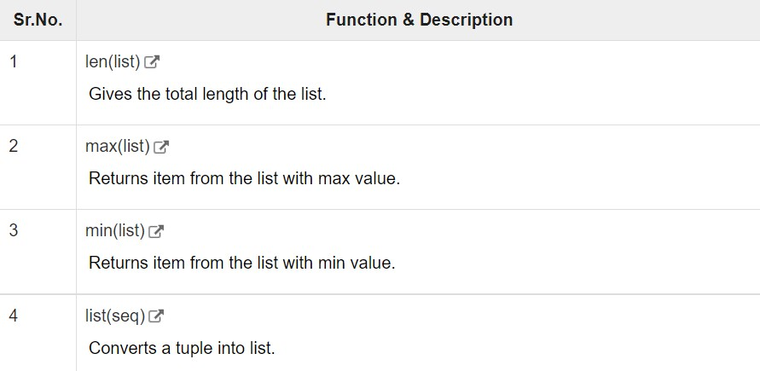
Python includes the following list functions:->

Slide 26
Python 3 - List len() Method
The len() method returns the number of elements in the list.
len(list)
list − This is a list for which number of elements to be counted.
This method returns the number of elements in the list.
#!/usr/bin/python3
list1 = ['physics', 'chemistry', 'maths']
print (len(list1))
list2 = list(range(5)) #creates list of numbers between 0-4
print (len(list2))
#OUTPUT-
3
5

Slide 27
List max() Method
The max() method returns the elements from the list with maximum value.
max(list)
list − This is a list from which max valued element to be returned.
This method returns the elements from the list with maximum value.
#!/usr/bin/python3
list1, list2 = ['C++','Java', 'Python'], [456, 700, 200]
print ("Max value element : ", max(list1))
print ("Max value element : ", max(list2))
#OUTPUT-
Max value element : Python
Max value element : 700

Slide 28
List min() Method
The min() method returns the elements from the list with minimum value.
min(list)
list − This is a list from which min valued element to be returned.
This method returns the elements from the list with minimum value.
#!/usr/bin/python3
list1, list2 = ['C++','Java', 'Python'], [456, 700, 200]
print ("min value element : ", min(list1))
print ("min value element : ", min(list2))
#OUTPUT-
min value element : C++
min value element : 200

Slide 29
List list() Method
The list() method takes sequence types and converts them to lists.
This is used to convert a given tuple into list.
Note − Tuple are very similar to lists with only difference that element values of a tuple can not be changed and tuple elements are put between parentheses instead of square bracket.
This function also converts characters in a string into a list.
list( seq )
seq − This is a tuple or string to be converted into list.
This method returns the list.

Slide 30
#!/usr/bin/python3
aTuple = (123, 'C++', 'Java', 'Python')
list1 = list(aTuple)
print ("List elements : ", list1)
str = "Hello World"
list2 = list(str)
print ("List elements : ", list2)
#OUTPUT-
List elements : [123, 'C++', 'Java', 'Python']
List elements : ['H', 'e', 'l', 'l', 'o', ' ', 'W', 'o', 'r', 'l', 'd']

Slide 31
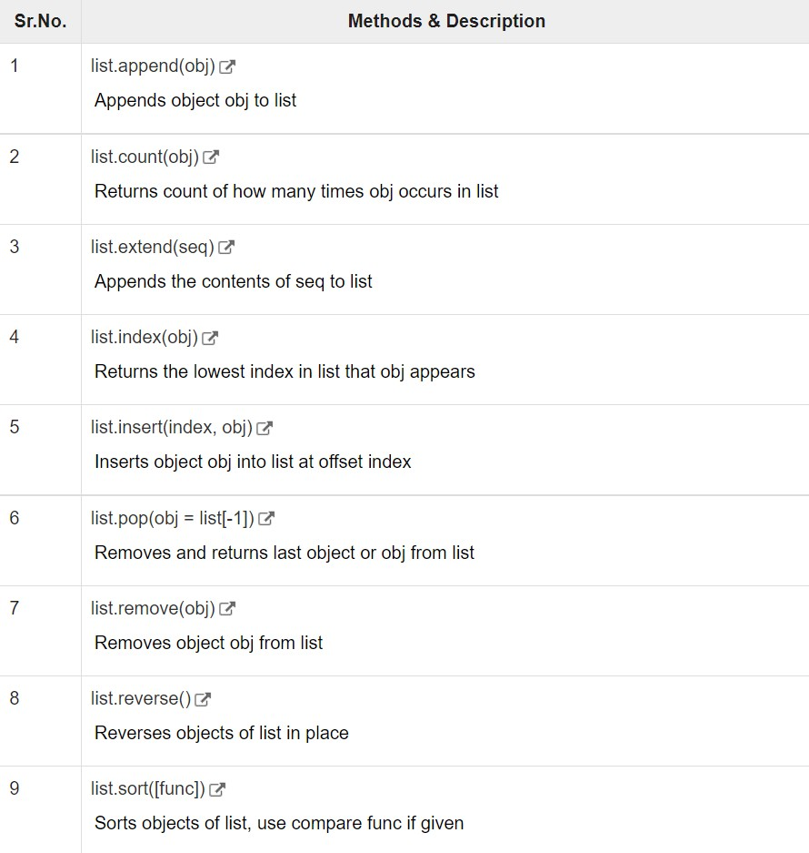
Python includes the following list methods:->

Slide 32
List append() Method
The append() method appends a passed obj into the existing list.
list.append(obj)
obj − This is the object to be appended in the list.
This method does not return any value but updates existing list.
#!/usr/bin/python3
list1 = ['C++', 'Java', 'Python']
list1.append('C#')
print ("updated list : ", list1)
#OUTPUT-
updated list : ['C++', 'Java', 'Python', 'C#']

Slide 33
List count() Method
The count() method returns count of how many times obj occurs in list.
list.count(obj)
obj − This is the object to be counted in the list.
This method returns count of how many times obj occurs in list.
#!/usr/bin/python3
aList = [123, 'xyz', 'zara', 'abc', 123];
print ("Count for 123 : ", aList.count(123))
print ("Count for zara : ", aList.count('zara'))
#OUTPUT-
Count for 123 : 2
Count for zara : 1

Slide 34
List extend() Method
The extend() method appends the contents of seq to list.
list.extend(seq)
seq − This is the list of elements
This method does not return any value but add the content to existing list.
#!/usr/bin/python3
list1 = ['physics', 'chemistry', 'maths']
list2 = list(range(5)) #creates list of numbers between 0-4
list1.extend(list2)
print ('Extended List :', list1)
#OUTPUT-
Extended List : ['physics', 'chemistry', 'maths', 0, 1, 2, 3, 4]

Slide 35
List index() Method
The index() method returns the lowest index in list that obj appears.
list.index(obj)
obj − This is the object to be find out.
This method returns index of the found object otherwise raise an exception indicating that value does not find.
#!/usr/bin/python3
list1 = ['physics', 'chemistry', 'maths']
print ('Index of chemistry', list1.index('chemistry'))
print ('Index of C#', list1.index('C#'))
#OUTPUT-
Index of chemistry 1
Traceback (most recent call last):
File "test.py", line 3, in <module>
print ('Index of C#', list1.index('C#'))
ValueError: 'C#' is not in list

Slide 36
List insert() Method
The insert() method inserts object obj into list at offset index.
list.insert(index, obj)
index − This is the Index where the object obj need to be inserted.
obj − This is the Object to be inserted into the given list.
This method does not return any value but it inserts the given element at the given index.
#!/usr/bin/python3
list1 = ['physics', 'chemistry', 'maths']
list1.insert(1, 'Biology')
print ('Final list : ', list1)
#OUTPUT-
Final list : ['physics', 'Biology', 'chemistry', 'maths']

Slide 37
List pop() Method
The pop() method removes and returns last object or obj from the list.
list.pop(obj = list[-1])
obj − This is an optional parameter, index of the object to be removed from the list.
This method returns the removed object from the list.
#!/usr/bin/python3
list1 = ['physics', 'Biology', 'chemistry', 'maths']
list1.pop()
print ("list now : ", list1)
list1.pop(1)
print ("list now : ", list1)
#OUTPUT-
list now : ['physics', 'Biology', 'chemistry']
list now : ['physics', 'chemistry']

Slide 38
List remove() Method
obj − This is the object to be removed from the list.
This method does not return any value but removes the given object from the list.
#!/usr/bin/python3
list1 = ['physics', 'Biology', 'chemistry', 'maths']
list1.remove('Biology')
print ("list now : ", list1)
list1.remove('maths')
print ("list now : ", list1)
#OUTPUT-
list now : ['physics', 'chemistry', 'maths']
list now : ['physics', 'chemistry']

Slide 39
List reverse() Method
The reverse() method reverses objects of list in place.
list.reverse()
Parameters-NA
This method does not return any value but reverse the given object from the list.
#!/usr/bin/python3
list1 = ['physics', 'Biology', 'chemistry', 'maths']
list1.reverse()
print ("list now : ", list1)
#OUTPUT-
list now : ['maths', 'chemistry', 'Biology', 'physics']

Slide 40
List sort() Method
The sort() method sorts objects of list, use compare function if given.
list.sort([func])
Parameters-NA
This method does not return any value; it simply sorts the contents of the given list.
#!/usr/bin/python3
list1 = ['physics', 'Biology', 'chemistry', 'maths']
list1.sort()
print ("list now : ", list1)
#OUTPUT-
list now : ['Biology', 'chemistry', 'maths', 'physics']

Slide 42
NESTED LIST

Slide 43
Nested List
A list within another list is called as nested list or nesting of a list.
Ex:-
a = [10, 20, 30, [50, 60]]
b = [50, 60]
a = [10, 20, 30, b]
a = [ [10, 20, 30], [40, 50, 60] ]
a = [ [10, 20, 30],
[40, 50, 60] ]

Slide 44
Index
a = [10, 20, 30, [50, 60]]
b = [50, 60]
a = [10, 20, 30, b]
a = [ [10, 20, 30], [40, 50, 60] ]
a = [ [10, 20, 30],
[40, 50, 60] ]
10 | 20 | 30
50 | 60
[0] | [1]
[0] | [1] | [2] | [3]
0 | 1 | 2
0
1
10 | 20 | 30
40 | 50 | 60

Slide 45
Accessing Nested List
a = [10, 20, 30, [50, 60]]
b = [50, 60]
a = [10, 20, 30, b]
print(a[0])
print(a[1])
print(a[2])
print(a[3][0])
print(a[3][1])
print(a) # All elements
10 | 20 | 30
50 | 60
[0] | [1]
[0] | [1] | [2] | [3]

Slide 46
cont..
a = [ [10, 20, 30],
[40, 50, 60] ]
print(a[0][0])
print(a[0][1])
print(a[0][2])
print(a[1][0])
print(a[1][1])
print(a[1][2])
print(a) # All elements
0 | 1 | 2
0
1
10 | 20 | 30
40 | 50 | 60

Slide 47
Modifying Nested List:-
a = [10, 20, 30, [50, 60]]
b = [50, 60]
a = [10, 20, 30, b]
a[1] = 100
a[3][0] = 5
10 | 20 | 30
50 | 60
[0] | [1]
[0] | [1] | [2] | [3]

Slide 48
Cont…
a = [ [10, 20, 30],
[40, 50, 60] ]
a[0][1] = 2
a[1][2] = 6
0 | 1 | 2
0
1
10 | 20 | 30
40 | 50 | 60

Slide 49
Accessing Nested list using for loop:-
a = [ [10, 20, 30],
[40, 50, 60] ]
Without index
for r in a:
for c in r:
print(c)
print( )
With index
n = len(a)
for i in range(n):
for j in range(len(a[i])):
print(a[i][j])
print ( )
Outer for loop
Inner for loop
Inner for loop
Outer for loop
The outer for loop represents the rows and the inner for loop represents the columns in each row.

Slide 50
Accessing Nested list using while loop:-
a = [ [10, 20, 30],
[40, 50, 60] ]
n = len(a)
i = 0
while i < n :
j = 0
while j < len(a[i]):
print(a[i][j])
j+=1
i+=1

Slide 52
LIST AND FUNCTION

Slide 53
List ( ) Function
This is used to create a list. It returns a mutable list of elements.
Syntax:-
list()
list(iterable_object)
Ex:-
list()
list(“HariOm”)
Creates Empty List
Creates a list of elements

Slide 54
List ( ) Function With range()
We can use list and range function to create a list.
Syntax:-
list(range(start,stop,stepsize))
Ex:-
list(range(0, 5))

Slide 55
[CAUTION->AFTER FUNCTION]

Slide 56
Passing List to Function
We can pass a list to a function while calling function.
def show(l):
print(l)
print(type(l))
for i in l:
print(i)
lst = [10, 20, 30, ‘HariOm']
show(lst)

Slide 58
DEMOs-ON::

Slide 59
DEMO GOING ON

Slide 60
THANK YOU

