Slide 1
WELCOME IN HARIOM DEFENSIVE TECHNOLOGY

Slide 2
PYTHON (DICTIONARY)

Slide 3
ALL AT ONE GLANCE
AGENDA
OVERVIEW
Empty Dictionary
Accessing-Updating-Insert-Delete
Testing Key
Pop() and popitem() Method
Properties of Dictionary Keys
Built-in Dictionary Functions and Methods
NESTED DICTIONARY
DEMOs

Slide 4
AGENDA
UNDERSTANDING
DICTIONARY
IN
PYTHON

Slide 5
OVERVIEW

Slide 6
Dictionary
A Dictionary represents a group of elements in the form of key value pairs.
Dictionary in Python is an unordered collection.
Dictionaries are mutable so we can modify it’s item, without changing their identity.
Dictionaries are represented using curly bracket { }.
Ex:-
stu = {101: ‘Rahul’, 102: ‘Raj’, 103: ‘Sonam’ }
fees= {‘rahul’:2000, ‘raj’:3000, ‘sonam’:8000}

Slide 7
Creating an Empty Dictionary
Syntax:-
dict_name = { }
Ex:-
fees = { }

Slide 8
Creating a Dictionary
A dictionary is created in the form of key-value pair where keys can’t be repeated and must be immutable and values can be of any datatype and can be duplicated.
keys are case sensitive.
Syntax:- dict_name = {key1:value1, key2:value2,…}
Ex:-
stu = {101: ‘Rahul’, 102: ‘Raj’, 103: ‘Sonam’ }
fees = {‘rahul’:2000, ‘raj’:3000, ‘sonam’:8000 }
fees = {
‘rahul’: 2000,
‘raj’: 3000,
‘sonam’: 8000
}

Slide 9
Key Rules
While writing key we must follow the following rules:
Key should be unique.
If we mention same key again, the old key will be overwritten.
Key should be immutable type ex:- integer, string or tuple.
We can not use list or dictionary as key.

Slide 10
Accessing Dictionary
We can access the value of a dictionary by referring to its key name, inside square brackets.
stu = {101: ‘Rahul’, 102: ‘Raj’, 103: ‘Sonam’ }
fees = {‘rahul’:2000, ‘raj’:3000, ‘sonam’:8000}
print(stu[101])
print(stu[102])
print(stu[103])
print(fees[‘rahul’])
print(fees[‘raj’])
print(fees[‘sonam’])
[101] | Rahul
[102] | Raj
[103] | Sonam
stu
[‘rahul’] | 2000
[‘raj’] | 3000
[‘sonam’] | 8000
fees

Slide 11
Modifying
We can modify the existing value of key by assigning a new value.
stu = {101: ‘Rahul’, 102: ‘Raj’, 103: ‘Sonam’ }
stu[102] = ‘Python’

Slide 12
Inserting/Adding new item
We can add an item to dictionary just by mentioning a new key-value pair into an existing dictionary.
If we mention a key which is already exists in the dictionary then the value gets updated/modified rather then adding a new item.
The new item my be added at any place in the dictionary as dictionary is an unordered collection.
stu = {101: ‘Rahul’, 102: ‘Raj’, 103: ‘Sonam’ }
stu[104] = ‘HariOm’

Slide 13
Deletion
We can delete an item of dictionary or entire dictionary using del statement.
stu = {101: ‘Rahul’, 102: ‘Raj’, 103: ‘Sonam’ }
Deleting an item
del stu[102]
Deleting entire Dictionary
del stu

Slide 14
Testing Key
We can check whether a key is already exists in the dictionary or not, for this purpose we use membership operator.
stu = {101: ‘Rahul’, 102: ‘Raj’, 103: ‘Sonam’ }
101 in stu # If exists returns True
104 not in stu # If not exists returns True

Slide 15
Clear ( ) Method
This method is used to remove all the elements from the dictionary.
Syntax:-
dict.clear( )
Ex:-
stu.clear( )

Slide 16
copy ( ) Method
This method is used to copy all the elements from the existing dictionary into a new dictionary.
Syntax:-
dict.copy( )
Ex:-
new_stu = stu.copy( )

Slide 17
fromkeys ( ) Method
This method is used to create a new dictionary with the specified keys and values.
Syntax:-
dict.fromkeys(keys, value)
Ex:-
key = (101, 102, 103)
value = ‘GeekyShows’
new_stu = dict.fromkeys(key, value)

Slide 18
get ( ) Method
This method returns the value of the specified key.
If key is not found then it will return none or default value.
Syntax:-
dict_name.get(key, defaultvalue)
Ex:-
stu.get(104)
stu.get(104, ‘GeekyShows’)

Slide 19
items ( ) Method
This method returns an object that contains key-value pairs of dictionary.
The pairs are stored as tuples in the object.
Syntax:-
dict_name.items()
Ex:-
stu.items()

Slide 20
keys ( ) Method
This method returns a sequence of keys from the dictionary .
Syntax:-
dict_name.keys()
Ex:-
stu.keys()

Slide 21
values ( ) Method
This method returns a sequence of values from the dictionary .
Syntax:-
dict_name.values()
Ex:-
stu.values()

Slide 22
update ( ) Method
This method is used to update the dictionary with the specified key value pair.
Syntax:-
dict_name.update(iterable)
Ex:-
stu.update({105: ‘Gupchup’})

Slide 23
pop ( ) Method
This method is used to remove the item with specified key.
It returns the removed item’s value.
If key is not found then the a default value is returned.
If key is not found and default value is not given then shows KeyError.
Syntax:- dict_name.pop(key, defaultvalue)
Ex:- stu.pop(101)
stu.pop(110, ‘HariOm’)

Slide 24
popitem ( ) Method
This method is used to remove the item which was last inserted into the dictionary.
It returns the removed item in the form of tuple, Pairs are returned in LIFO order.
Syntax:-
dict_name.popitem( )
Ex:-
stu.popitem()

Slide 25
setdefault ( ) Method
This method returns the value of the specified key.
If key is not found then it inserts key with the specified value.
Syntax:-
dict_name.setdefault(key, value)
Ex:-
stu.setdefault(109, ‘Rohit’)

Slide 27
Each key is separated from its value by a colon (:), the items are separated by commas, and the whole thing is enclosed in curly braces.
An empty dictionary without any items is written with just two curly braces, like this: {}.
Keys are unique within a dictionary while values may not be.
The values of a dictionary can be of any type, but the keys must be of an immutable data type such as strings, numbers, or tuples.

Slide 28
Accessing Values in Dictionary
To access dictionary elements, you can use the familiar square brackets along with the key to obtain its value.
#!/usr/bin/python3
dict = {'Name': 'Zara', 'Age': 7, 'Class': 'First'}
print ("dict['Name']: ", dict['Name'])
print ("dict['Age']: ", dict['Age'])
#OUTPUT-
dict['Name']: Zara
dict['Age']: 7
CAUTION->
If we attempt to access a data item with a key, which is not a part of the dictionary, we get an error.

Slide 29
Updating Dictionary
You can update a dictionary by adding a new entry or a key-value pair, modifying an existing entry, or deleting an existing entry.
#!/usr/bin/python3
dict = {'Name': 'Zara', 'Age': 7, 'Class': 'First'}
dict['Age'] = 8; # update existing entry
dict['School'] = "DPS School" # Add new entry
print ("dict['Age']: ", dict['Age'])
print ("dict['School']: ", dict['School'])
#OUTPUT-
dict['Age']: 8
dict['School']: DPS School

Slide 30
Delete Dictionary Elements
You can either remove individual dictionary elements or clear the entire contents of a dictionary.
You can also delete entire dictionary in a single operation.
To explicitly remove an entire dictionary, just use the del statement.
#!/usr/bin/python3
dict = {'Name': 'Zara', 'Age': 7, 'Class': 'First'}
del dict['Name'] # remove entry with key 'Name'
dict.clear() # remove all entries in dict
del dict # delete entire dictionary
print ("dict['Age']: ", dict['Age'])
print ("dict['School']: ", dict['School'])
[ERROR-An exception is raised because after del dict, the dictionary does not exist anymore.]

Slide 31
Properties of Dictionary Keys
Dictionary values have no restrictions.
They can be any arbitrary Python object, either standard objects or user-defined objects.
However, same is not true for the keys.
There are two important points to remember about dictionary keys −
(a) More than one entry per key is not allowed.
This means no duplicate key is allowed.
When duplicate keys are encountered during assignment, the last assignment wins.
(b) Keys must be immutable.
This means you can use strings, numbers or tuples as dictionary keys but something like ['key'] is not allowed.

Slide 32
#!/usr/bin/python3
dict = {'Name': 'Zara', 'Age': 7, 'Name': 'Manni'}
print ("dict['Name']: ", dict['Name'])
#OUTPUT-
dict['Name']: Manni
#!/usr/bin/python3
dict = {['Name']: 'Zara', 'Age': 7}
print ("dict['Name']: ", dict['Name'])
#OUTPUT-
TypeError: list objects are unhashable

Slide 33
::Built-in Dictionary Functions and Methods::

Slide 34
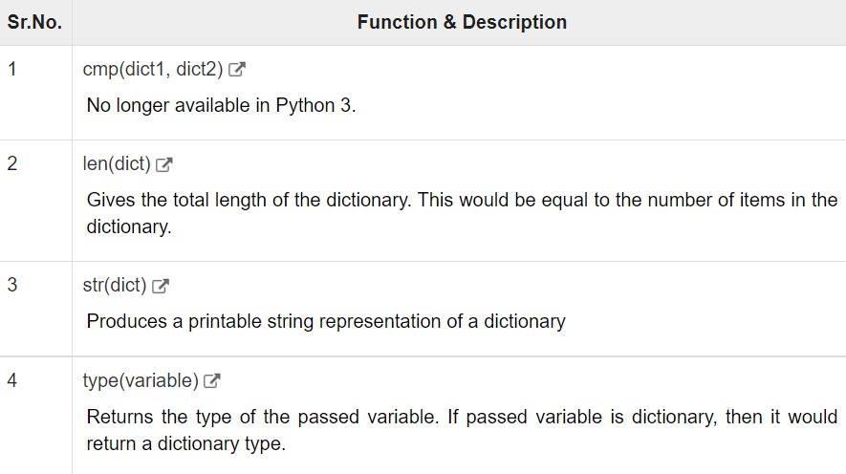
Python includes the following dictionary functions −>>>

Slide 35
dictionary cmp() Method
The method cmp() compares two dictionaries based on key and values.
cmp(dict1, dict2)
dict1 − This is the first dictionary to be compared with dict2.
dict2 − This is the second dictionary to be compared with dict1.
This method returns 0 if both dictionaries are equal, -1 if dict1 < dict2 and 1 if dict1 > dic2.

Slide 36
#!/usr/bin/python3
dict1 = {'Name': 'Zara', 'Age': 7};
dict2 = {'Name': 'Mahnaz', 'Age': 27};
dict3 = {'Name': 'Abid', 'Age': 27};
dict4 = {'Name': 'Zara', 'Age': 7};
print ("Return Value : %d" % cmp (dict1, dict2))
print ("Return Value : %d" % cmp (dict2, dict3))
Print( "Return Value : %d" % cmp (dict1, dict4))
#OUTPUT-[IN MY SYSTEM--GETTING ERROR]
Return Value : -1
Return Value : 1
Return Value : 0

Slide 37
dictionary len() Method
The method len() gives the total length of the dictionary.
This would be equal to the number of items in the dictionary.
len(dict)
dict − This is the dictionary, whose length needs to be calculated.
This method returns the length.
#!/usr/bin/python3
dict = {'Name': 'Manni', 'Age': 7, 'Class': 'First'}
print ("Length : %d" % len (dict))
#OUTPUT-
Length : 3

Slide 38
dictionary str() Method
The method str() produces a printable string representation of a dictionary.
str(dict)
dict − This is the dictionary.
This method returns string representation.
#!/usr/bin/python3
dict = {'Name': 'Manni', 'Age': 7, 'Class': 'First'}
print ("Equivalent String : %s" % str (dict))
#OUTPUT-
Equivalent String : {'Name': 'Manni', 'Age': 7, 'Class': 'First'}

Slide 39
dictionary type() Method
The method type() returns the type of the passed variable.
If passed variable is dictionary then it would return a dictionary type.
type(dict)
dict − This is the dictionary.
This method returns the type of the passed variable.
#!/usr/bin/python3
dict = {'Name': 'Manni', 'Age': 7, 'Class': 'First'}
print ("Variable Type : %s" % type (dict))
#OUTPUT-
Variable Type : <type 'dict'>

Slide 40
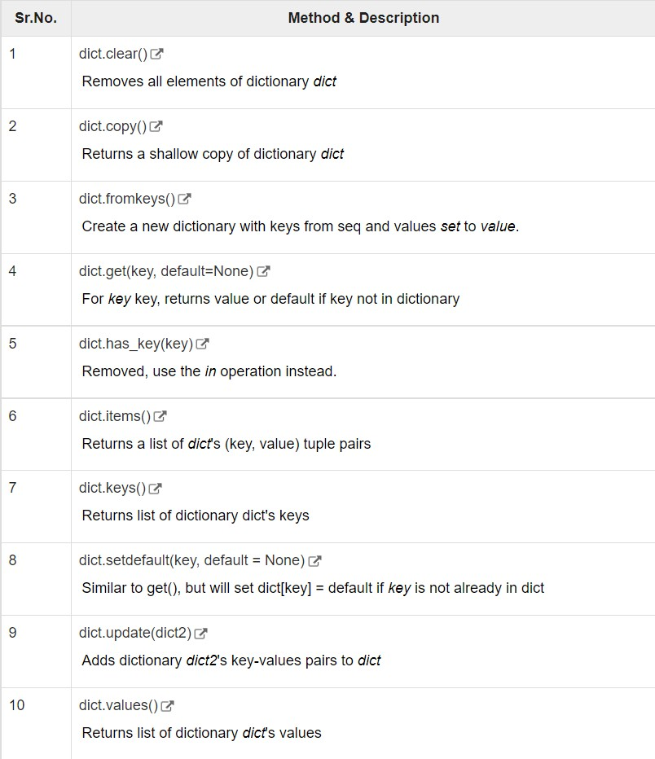
Python includes the following dictionary methods −>>>

Slide 41
dictionary clear() Method
The method clear() removes all items from the dictionary.
dict.clear()
Parameters-NA
This method does not return any value.
#!/usr/bin/python3
dict = {'Name': 'Zara', 'Age': 7}
print ("Start Len : %d" % len(dict))
dict.clear()
print ("End Len : %d" % len(dict))
#OUTPUT-
Start Len : 2
End Len : 0

Slide 42
dictionary copy() Method
The method copy() returns a shallow copy of the dictionary.
dict.copy()
Parameters-NA
This method returns a shallow copy of the dictionary.
#!/usr/bin/python3
dict1 = {'Name': 'Manni', 'Age': 7, 'Class': 'First'}
dict2 = dict1.copy()
print ("New Dictionary : ",dict2)
#OUTPUT-
New dictionary : {'Name': 'Manni', 'Age': 7, 'Class': 'First'}

Slide 43
dictionary fromkeys() Method
The method fromkeys() creates a new dictionary with keys from seq and values set to value.
dict.fromkeys(seq[, value]))
seq − This is the list of values which would be used for dictionary keys preparation.
value − This is optional, if provided then value would be set to this value
This method returns the list.
#!/usr/bin/python3
seq = ('name', 'age', 'sex')
dict = dict.fromkeys(seq)
print ("New Dictionary : %s" % str(dict))
dict = dict.fromkeys(seq, 10)
print ("New Dictionary : %s" % str(dict))
#OUTPUT-
New Dictionary : {'age': None, 'name': None, 'sex': None}
New Dictionary : {'age': 10, 'name': 10, 'sex': 10}

Slide 44
dictionary get() Method
The method get() returns a value for the given key. If key is not available then returns default value None.
dict.get(key, default=None)
key − This is the Key to be searched in the dictionary.
default − This is the Value to be returned in case key does not exist.
This method return a value for the given key. If key is not available, then returns default value None.
#!/usr/bin/python3
dict = {'Name': 'Zara', 'Age': 27}
print ("Value : %s" % dict.get('Age'))
print ("Value : %s" % dict.get('Sex', "NA"))
#OUTPUT-
Value : 27
Value : NA

Slide 45
dictionary has_key() Method
The method has_key() returns true if a given key is available in the dictionary, otherwise it returns a false.
dict.has_key(key)
key − This is the Key to be searched in the dictionary.
This method return true if a given key is available in the dictionary, otherwise it returns a false.
dict = {'Name': 'Zara', 'Age': 7}
print ("Age" in dict)
#print ("Sex" in duct)
print ("Sex" in duct)
#OUTPUT-
Value : True
Value : False

Slide 46
dictionary items() Method
The method items() returns a list of dict's (key, value) tuple pairs
dict.items()
Parameters-NA
This method returns a list of tuple pairs.
#!/usr/bin/python
dict = {'Name': 'Zara', 'Age': 7}
print ("Value : %s" % dict.items())
#OUTPUT-
Value : [('Age', 7), ('Name', 'Zara')]

Slide 47
dictionary keys() Method
The method keys() returns a list of all the available keys in the dictionary.
dict.keys()
Parameters-NA
This method returns a list of all the available keys in the dictionary.
#!/usr/bin/python3
dict = {'Name': 'Zara', 'Age': 7}
print ("Value : %s" % dict.keys())
#OUTPUT-
Value : dict_keys(['Age', 'Name'])

Slide 48
dictionary setdefault() Method
The method setdefault() is similar to get(), but will set dict[key] = default if key is not already in dict.
dict.setdefault(key, default = None)
key − This is the key to be searched.
default − This is the Value to be returned in case key is not found.
This method returns the key value available in the dictionary and if given key is not available then it will return provided default value.
#!/usr/bin/python3
dict = {'Name': 'Zara', 'Age': 7}
print ("Value : %s" % dict.setdefault('Age', None))
print ("Value : %s" % dict.setdefault('Sex', None))
print (dict)
#OUTPUT-
Value : 7
Value : None
{'Name': 'Zara', 'Sex': None, 'Age': 7}

Slide 49
dictionary update() Method
The method update() adds dictionary dict2's key-values pairs in to dict.
This function does not return anything.
dict.update(dict2)
dict2 − This is the dictionary to be added into dict.
This method does not return any value.
#!/usr/bin/python3
dict = {'Name': 'Zara', 'Age': 7}
dict2 = {'Sex': 'female' }
dict.update(dict2)
#OUTPUT-
updated dict : {'Sex': 'female', 'Age': 7, 'Name': 'Zara'}

Slide 50
dictionary values() Method
The method values() returns a list of all the values available in a given dictionary.
dict.values()
Parameters-NA
This method returns a list of all the values available in a given dictionary.
#!/usr/bin/python3
dict = {'Sex': 'female', 'Age': 7, 'Name': 'Zara'}
print ("Values : ", list(dict.values()))
#OUTPUT-
Values : ['female', 7, 'Zara']

Slide 52
NESTED DICTIONARY

Slide 53
Nested Dictionary
A dictionary within another dictionary is called as nested dictionary or nesting of a dictionary.
nested_dict = { 'dict1': {'key_A': 'value_A'},
'dict2': {'key_B': 'value_B'} }

Slide 54
Creating Empty Nested Dict
Syntax:-
nested_dict = { 'dict1': { },
'dict2': { } }
Ex:-
a = {1: { },
2: { } }

Slide 55
Creating Nested Dict
Syntax:-
nested_dict = { 'key_A': 'value_A', 'dict1': {'key_A': 'value_A'} }
Ex:-
a = {‘course’: ‘Python’, ‘fees’:15000, 1: {‘course’: ‘JavaScript’, ‘fees’: 10000 } }

Slide 56
Accessing Dictionary
a = {‘course’: ‘Python’, ‘fees’:15000, 1: {‘course’: ‘JavaScript’, ‘fees’: 10000 } }
print(a[‘course’])
print(a[‘fees’])
print(a[1][‘course’])
print(a[1][‘fees’])
[‘course’] | Python
[‘fees’] | 15000
[1][‘course’] | JavaScript
[1][‘fees’] | 10000
a

Slide 57
Modifying Nested Dict
a = {‘course’: ‘Python’, ‘fees’:15000, 1: {‘course’: ‘JavaScript’, ‘fees’: 10000 } }
a[‘course’] = ‘Machine Learning’
a[1][‘fees’] = 200000

Slide 58
Creating Nested Dict
Syntax:-
nested_dict = { 'dict1': {'key_A': 'value_A'},
'dict2': {'key_B': 'value_B'} }
Ex:-
a = {1: {‘course’: ‘Python’, ‘fees’:15000},
2: {‘course’: ‘JavaScript’, ‘fees’: 10000 } }

Slide 59
Accessing Dictionary
a = {1: {‘course’: ‘Python’, ‘fees’:15000},
2: {‘course’: ‘JavaScript’, ‘fees’: 10000 } }
print(a[1][‘course’])
print(a[1][‘fees’])
print(a[2][‘course’])
print(a[2][‘fees’])
[1][‘course’] | Python
[1][‘fees’] | 15000
[2][‘course’] | JavaScript
[2][‘fees’] | 10000
a

Slide 60
Modifying Nested Dict
a = {1: {‘course’: ‘Python’, ‘fees’:15000},
2: {‘course’: ‘JavaScript’, ‘fees’: 10000 } }
a[1][‘course’] = ‘Machine Learning’
a[2][‘fees’] = 200000

Slide 61
PASSING DICTIONARY TO FUNCTION
[CAUTION->AFTER FUNCTION]

Slide 63
DEMOs-ON::

Slide 64
DEMO GOING ON

Slide 65
THANK YOU

