Slide 1

WINE QUALITY PREDICTION
COMPARATIVE ANALYSIS OF REGRESSION ALGORITHMS ON THE WINE QUALITY DATASET

Slide 2
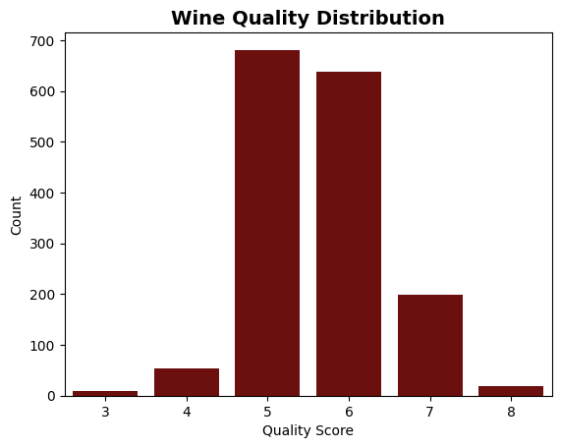
Data Overview
This dataset contains physicochemical test results of red wines (such as acidity, alcohol, pH, sulphates, etc.) along with a quality score rated by professional wine tasters. This dataset contains physicochemical test results of red wines (such as acidity, alcohol, pH, sulphates, etc.) along with a quality score rated by professional wine tasters.
DATASET STATISTICS
  Total samples: 1599
  Input features: 11
  Target variable: 1 (quality)
  Data type: Numeric (continuous)

Slide 3
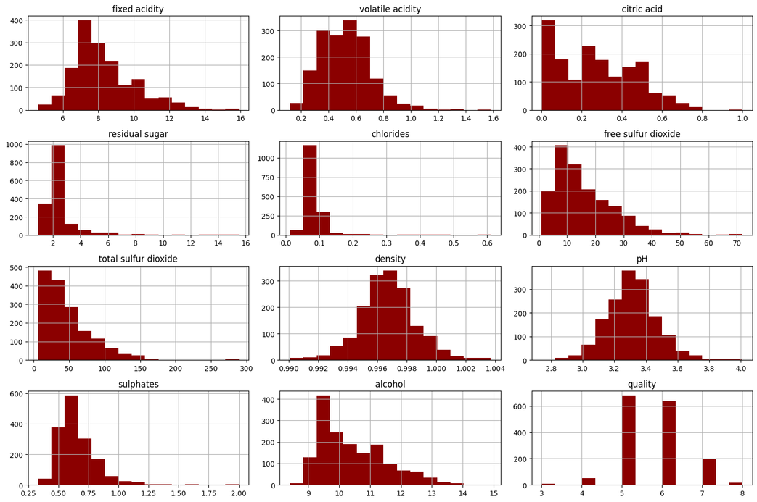
Feature Distribution
  Analyzed all 11 chemical features using histograms.
  Identified key influential features — alcohol, sulphates, volatile acidity.
  Most features are right-skewed but relevant, so none were removed.
  Applied Standard Scaler for normalization before training.

Slide 4
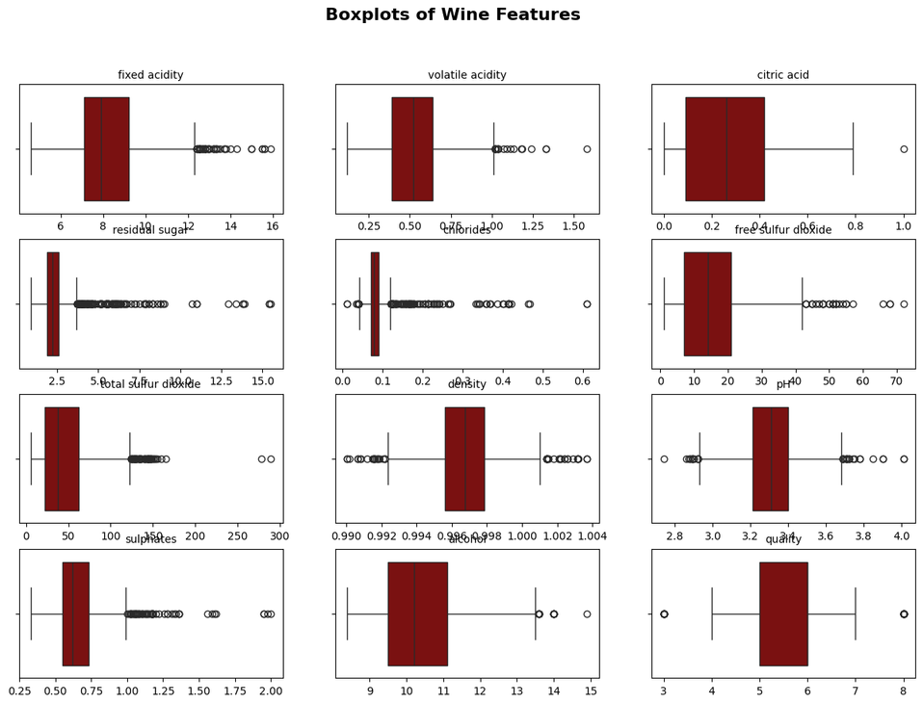
Outliers
  Boxplots show the spread and variability of each feature.
  Outliers are visible in features like residual sugar, total sulfur dioxide, and volatile acidity.
  These values represent natural variations in wine chemistry rather than data errors.
  Outliers were retained to preserve data authenticity and capture real-world conditions.

Slide 5
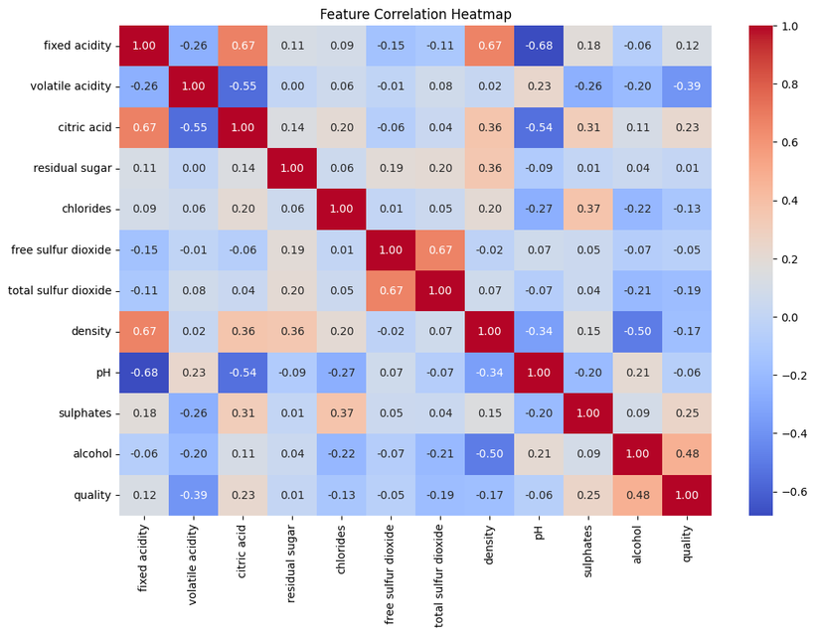
Feature Correlation
  Alcohol (0.48) and sulphates (0.25) show strong positive correlation with wine quality.
  Volatile acidity (-0.39) shows a negative correlation, meaning higher acidity reduces quality.
  Features with very low correlation were still retained, as they may add value in non-linear models.
  Based on analysis, alcohol, sulphates, and volatile acidity were selected as the most important predictors.

Slide 6
ALGORITHM | R2 VALUE | MSE | MAE | REMARK
Simple Linear Regression | 0.2356 | 0.499528 | 0.574966 | Alcohol alone — weak fit
Multiple Linear Regression | 0.4032 | 0.390025 | 0.503530 | Better than simple LR
K-Nearest Neighbors (KNN) | 0.3346 | 0.434875 | 0.505625 | Sensitive to scaling
Decision Tree Regressor | 0.3366 | 0.433510 | 0.496386 | Nonlinear, can overfit
Random Forest Regressor | 0.5390 | 0.301238 | 0.422438 | Strong, stable ensemble
Gradient Boosting Regressor | 0.4648 | 0.349781 | 0.457674 | Good boosting performance
XGBoost Regressor | 0.5087 | 0.321057 | 0.402241 | Powerful gradient boosting
LightGBM Regressor | 0.5186 | 0.314589 | 0.421394 | Fast, efficient boosting
CatBoost Regressor | 0.5631 | 0.285546 | 0.413892 | Best single-model performance
Stacking Regressor | 0.5409 | 0.300015 | 0.418013 | Ensemble of top models, stable

Slide 7
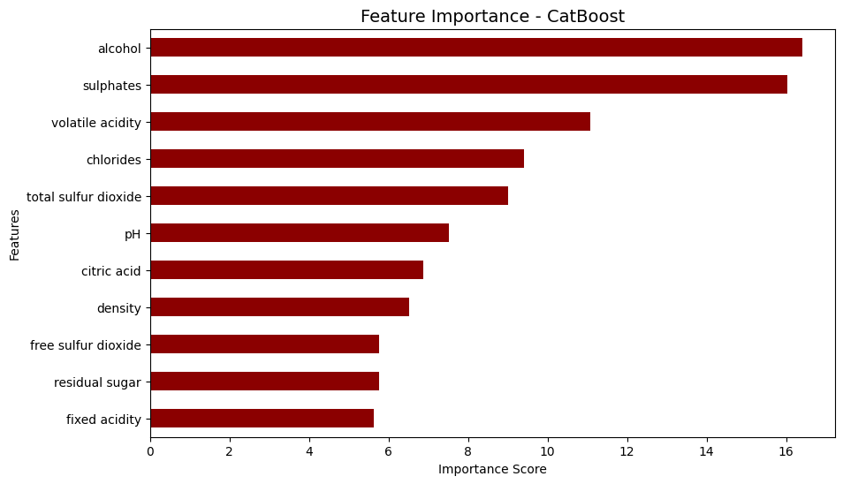
Best Model
  CatBoost achieved the highest accuracy among all models with R² = 0.56 and lowest MSE = 0.28.
  It efficiently handled complex non-linear relationships in the wine dataset.
  Key predictors identified: alcohol, sulphates, and volatile acidity.
  Demonstrated best overall balance between performance, stability, and interpretability.

Slide 8
Conclusion
CatBoost Regressor delivered the best results with an R² score of 0.56 and the lowest MSE (0.28), proving highly effective in capturing complex non-linear relationships.
Wine quality mainly depends on alcohol, sulphates, and volatile acidity.
Higher alcohol and balanced sulphate levels increase quality, while higher volatile acidity lowers it.
The analysis revealed that alcohol, sulphates, and volatile acidity are the most influential factors affecting wine quality.
Simpler models such as Linear Regression and KNN were less effective due to the dataset’s non-linear nature.
Overall, the results demonstrate that ensemble models provide more accurate, stable, and interpretable predictions for wine quality.

Slide 9
Thank You

