Slide 1
數位系統實驗
Thu 9:00 pm – 12:00 pm
陳培殷
國立成功大學 資訊工程系

Slide 2
LAB - 02
陳培殷
國立成功大學 資訊工程系

Slide 3
Outline (9/30)
Boolean Algebra Part 1 (影片 13:34)
Boolean Algebra Part 2 (影片 9:34)
Lab2_1 (線上)
Lab2_1_1 (影片2:35)
Lab2_1_2 (影片0:49)
Lab2_2 & Lab2_3 (線上)
Lab2_2 (影片2:44)
Lab2_3 (影片1:55)

Slide 4
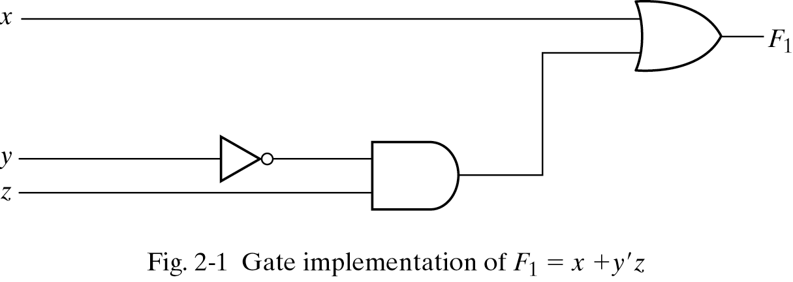
Three representations for a circuit
1. Boolean Algebra
2. Truth Table
真值表
n input variables ➔ 2^{n} combinations
F₁=x+y’z
Inputs
3. Circuit Diagram

Slide 5
Equipment
Names | Amount
Solerless Breadboard | ×1
74LS00 | ×1
74LS04 | ×1
74LS08 | ×1
74LS32 | ×1

Slide 6
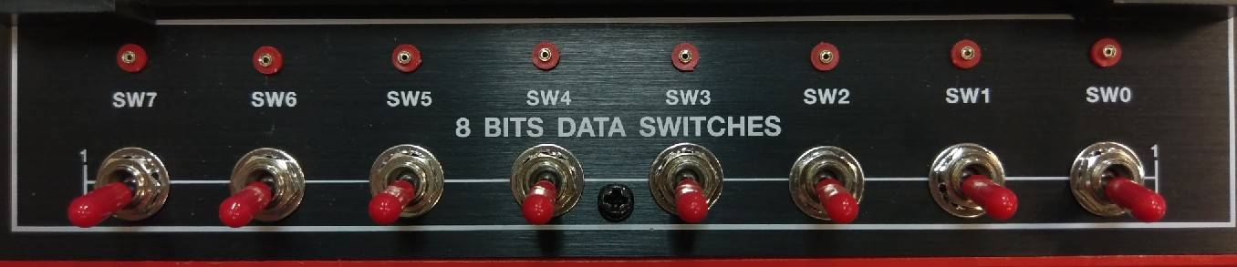
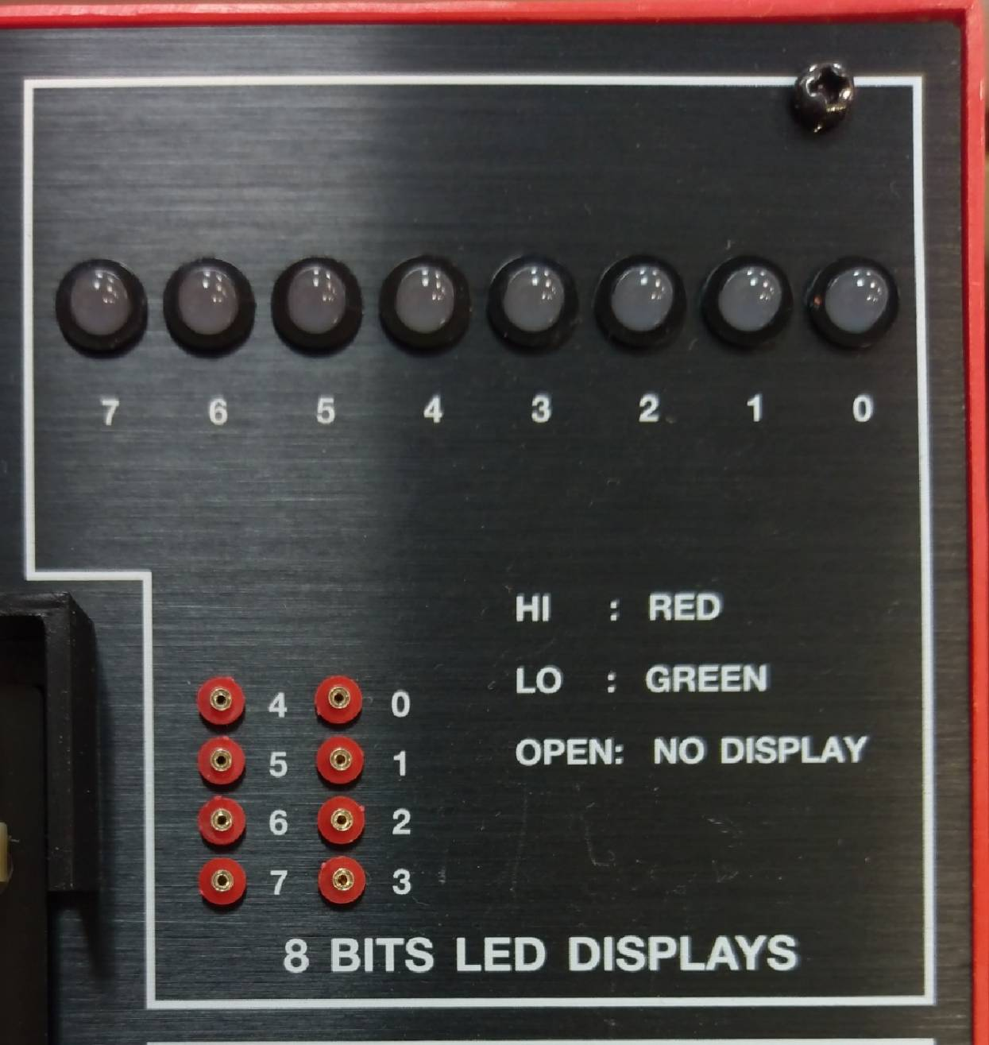
Lab notice
Input
Output

Slide 7
Lab 02_1
Please draw their Truth Tables and implement the circuits with breadboard.
F₁(A, B) = (A + B)’(A’ + B’)
F₂(A, B) = A’+ AB
A | B | F₁
0 | 0 | 1
0 | 1 | 0
1 | 0 | 0
1 | 1 | 0
A | B | F₂
0 | 0 | 1
0 | 1 | 1
1 | 0 | 0
1 | 1 | 1
Notes:
錯誤：此時不需化簡(已修正)

Slide 8
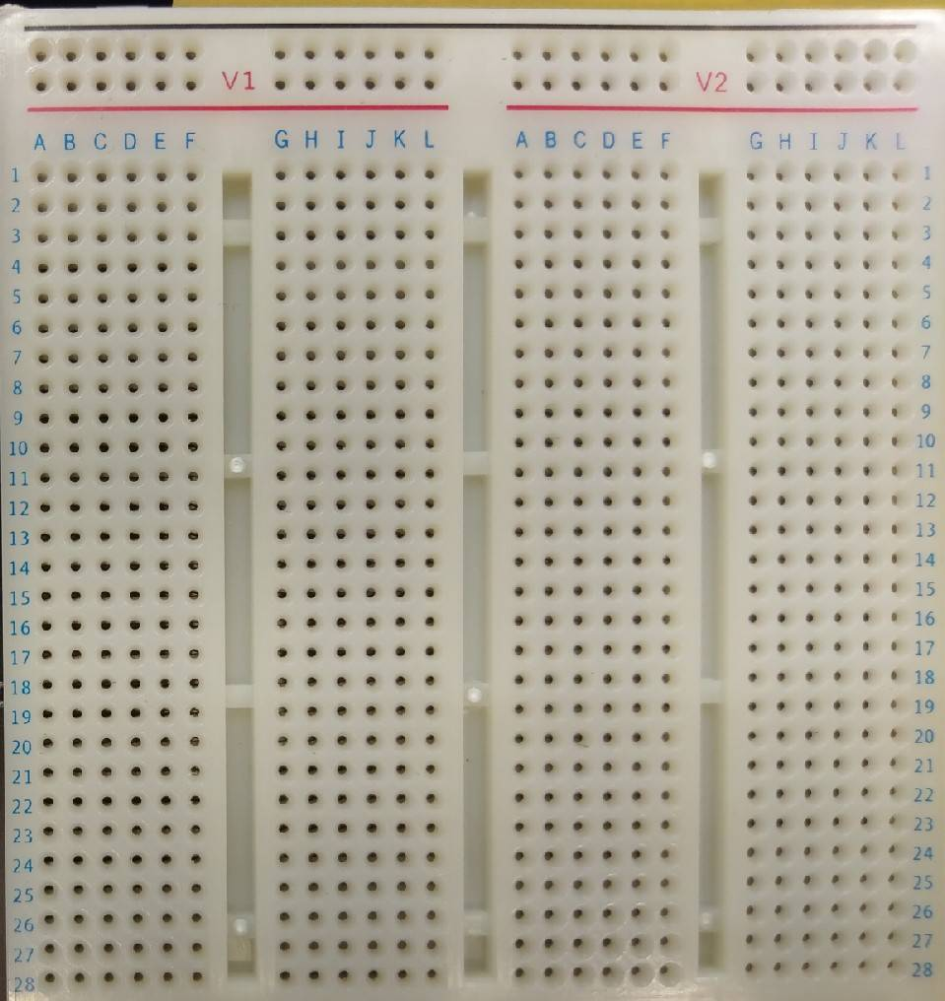
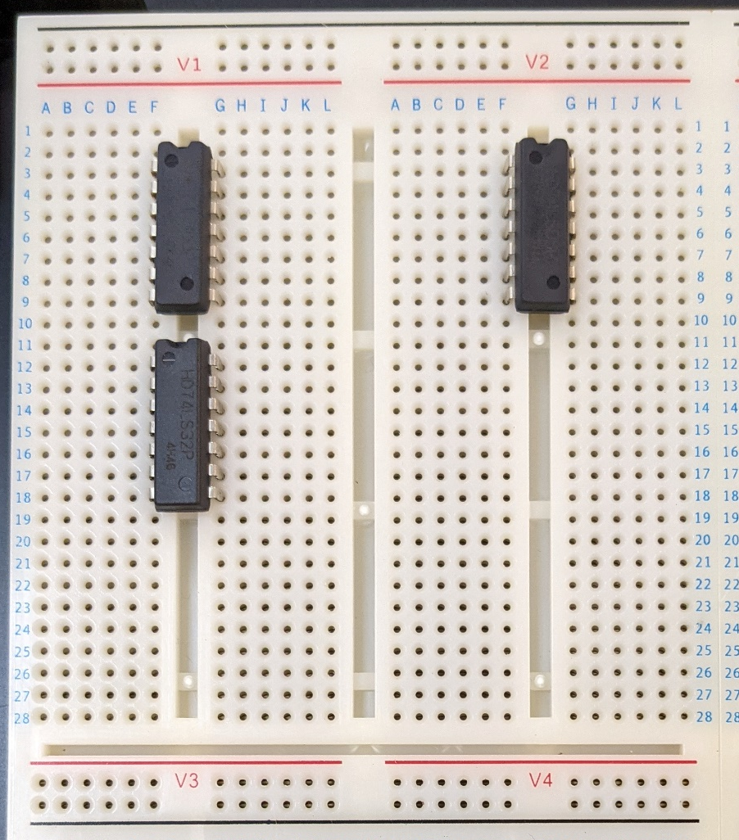
Lab notice
Correct
VCC：
GND：

Slide 9
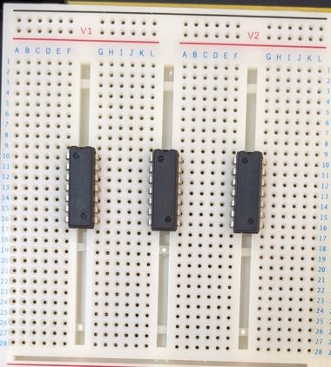
Lab notice
Wrong
Overlap

Slide 10
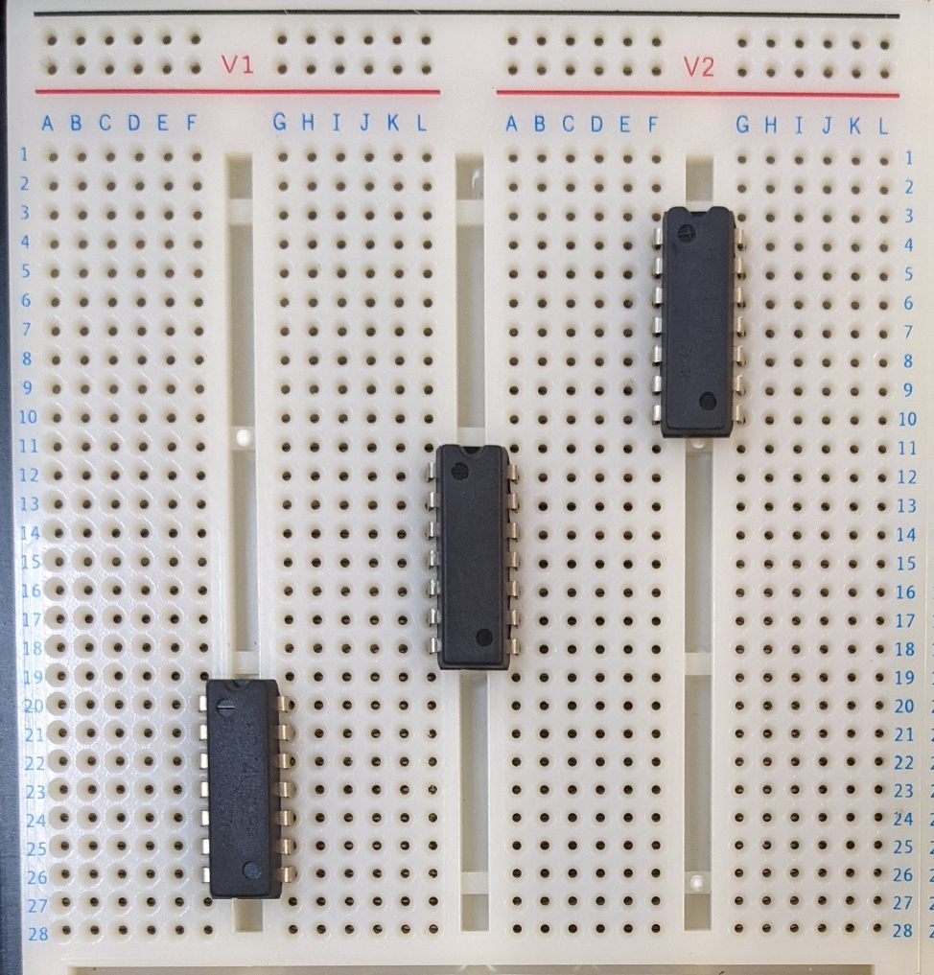
Lab notice
Correct
VCC：
GND：

Slide 11
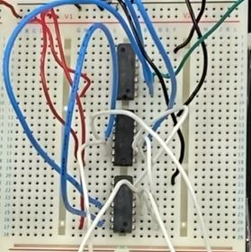
Lab notice
Correct
VCC：
GND：

Slide 12
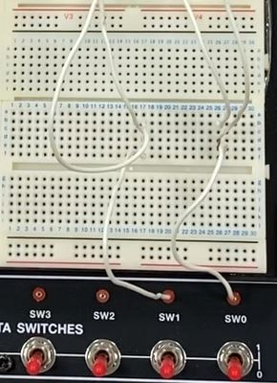
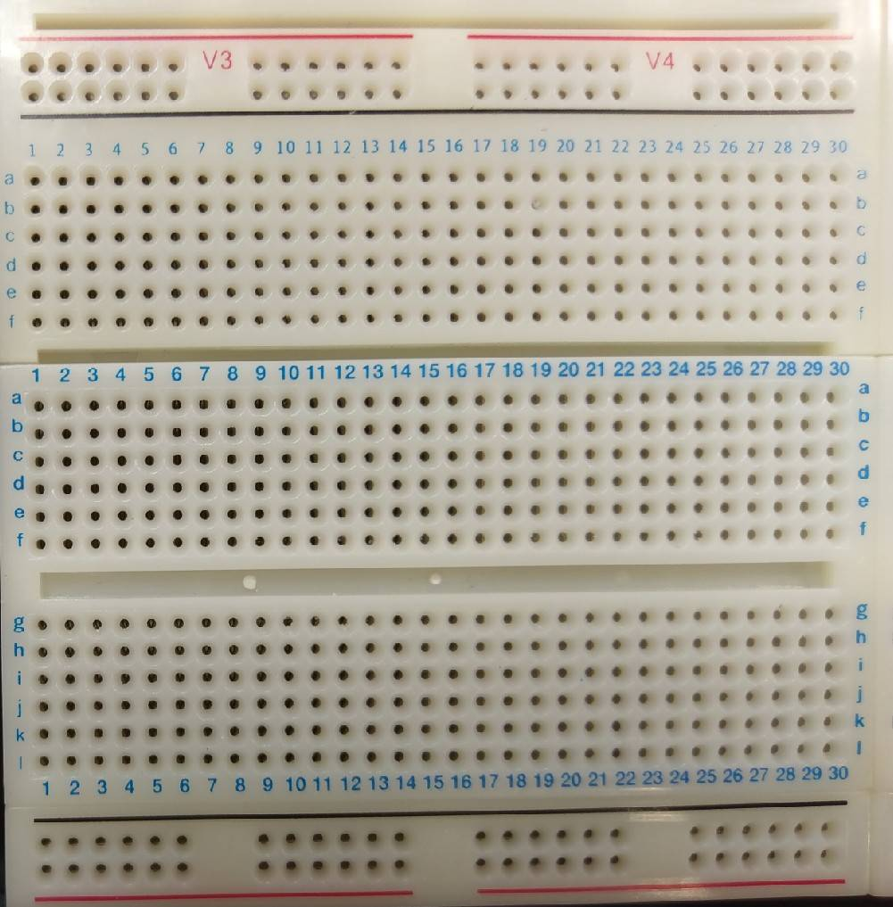
Lab notice
A
B
A
B

Slide 13
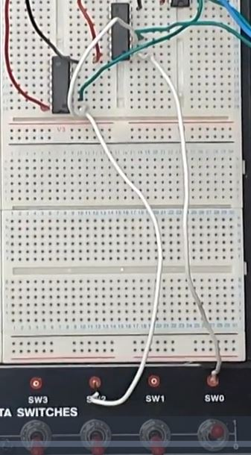
Lab notice
A
A
B

Slide 14
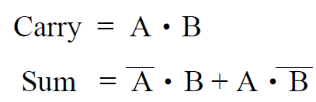
Lab 02_2 - Half Adder (1/2)
A half adder (HA) consists of two inputs (A and B) and two outputs (Sum and Carry). “A” denotes the summand and “B” is the addend. Sum and Carry mean the output sum and carry for input “A” and “B”. The truth table and Boolean algebra for the half adder are as follows.
A | B | Sum | Carry
0 | 0 | 0 | 0
0 | 1 | 1 | 0
1 | 0 | 1 | 0
1 | 1 | 0 | 1
F(A, B) = A’B’ + A’B + AB’ + AB

Slide 15
Lab 02_2 - Half Adder (2/2)
Please
(a) draw the circuit diagram of the half adder according
to the truth table shown in previous page.
(b) implement the circuit on the breadboard.

Slide 16
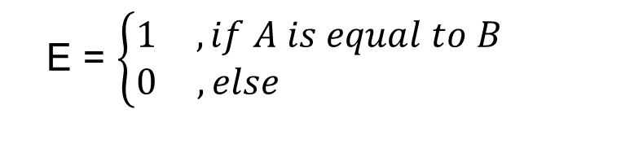
Lab 02_3 – Comparator(1/2)
There are two inputs denoted as A and B. Both A and B are 1-bit value. A comparator is designed to determine whether A is equal to B or not. The output results are represented with E .
E = $\left\{\begin{matrix}1 & , if A is equal to B \\ 0 & ,else \end{matrix}\right.$

Slide 17
Lab 02_3 – Comparator(2/2)
Please
(a) draw the truth table of the comparator.
(b) draw the circuit diagram of the comparator.
(c) implement the circuit on the breadboard.
A | B | F
0 | 0 | 1
0 | 1 | 0
1 | 0 | 0
1 | 1 | 1
F(A, B) = (A’B’) + (AB)
F(A, B) = A’B’ + A’B + AB’ + AB

