Slide 1
Chapter 6 Heapsort
Chi-Yeh Chen
陳奇業
成功大學資訊工程學系

Slide 2

Overview
Like merge sort, but unlike insertion sort, heapsort’s running time is $O\left(n\lg{n}\right)$.
Like insertion sort, but unlike merge sort, heapsort sorts in place.

Slide 3
Heap
complete
from the left up to a point

Slide 4
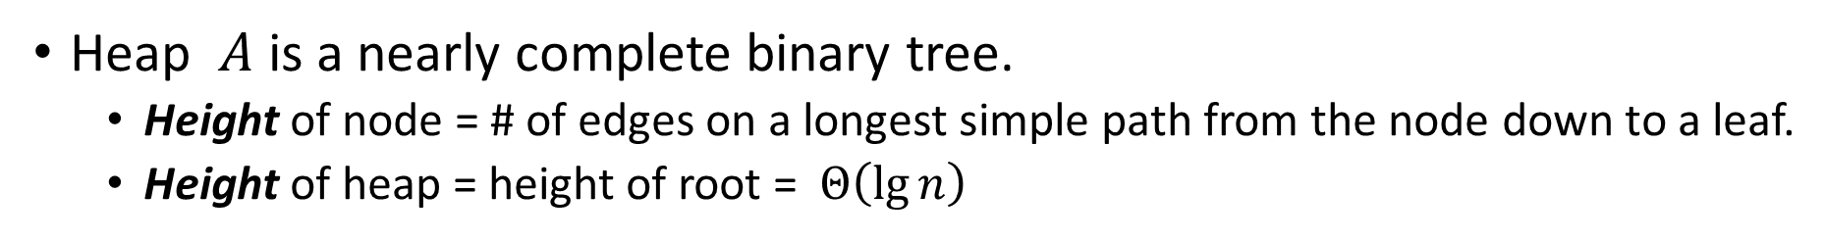
Heap

Slide 5
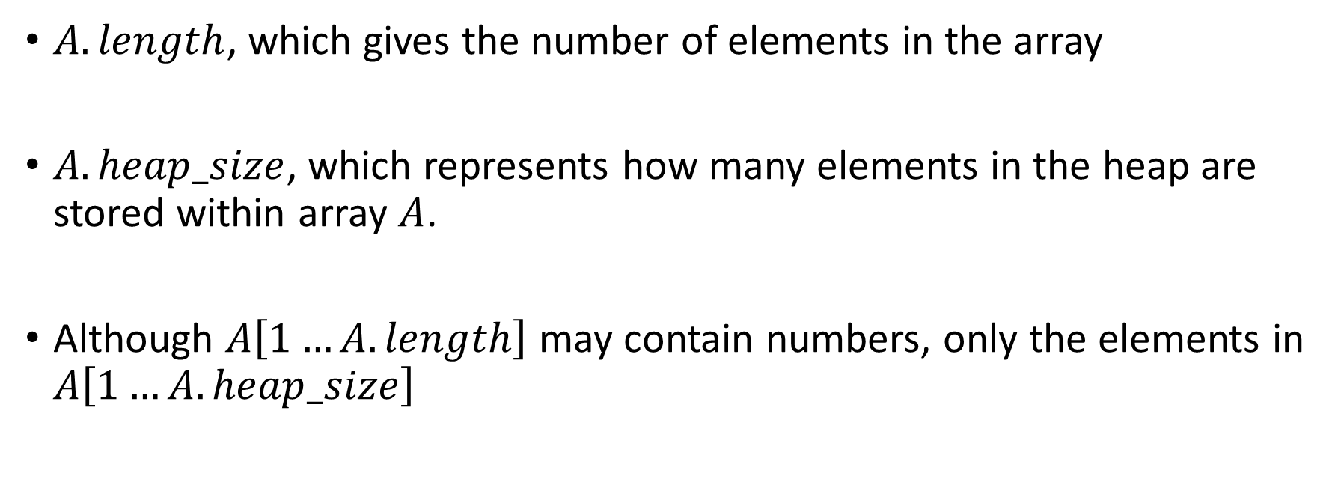
Heap
$A.length$, which gives the number of elements in the array
$A.heap_size$, which represents how many elements in the heap are stored within array $A$.
Although $A\left[1…A.length\right]$ may contain numbers, only the elements in $A\left[1…A.heap_size\right]$

Slide 6
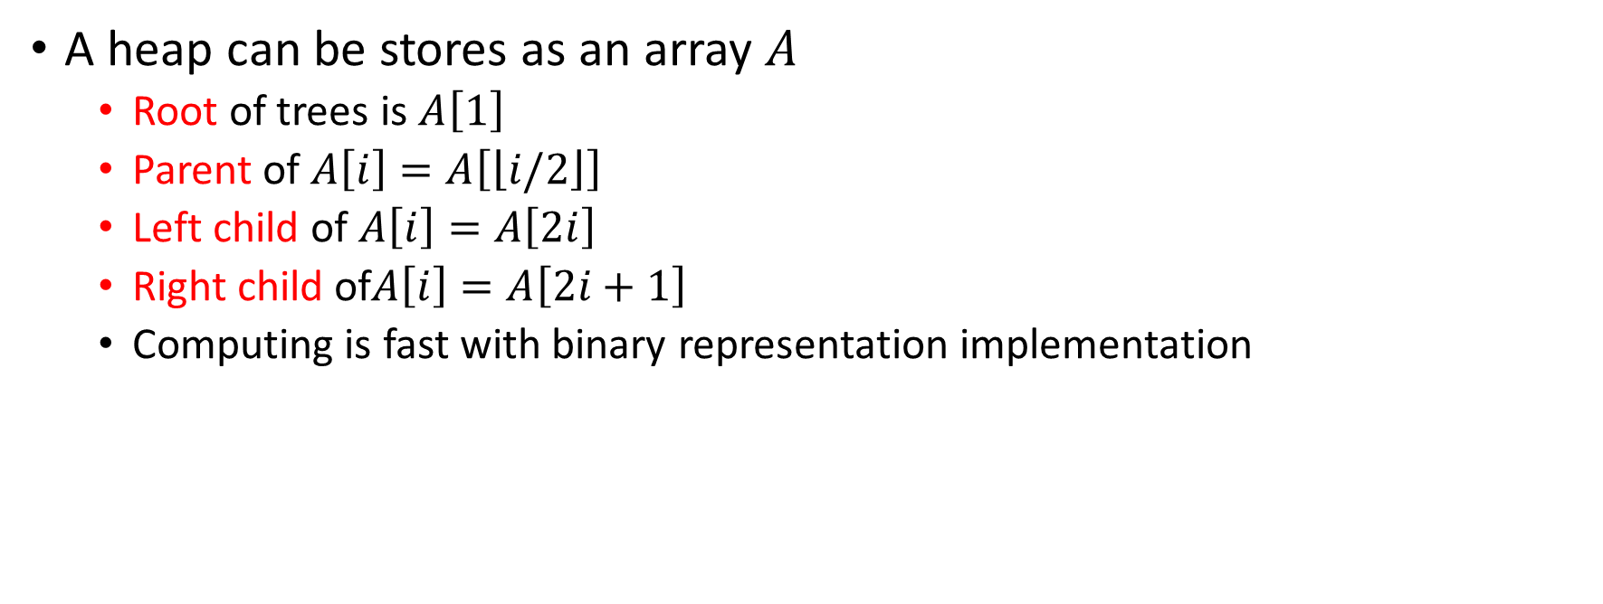
Heap
A heap can be stores as an array $A$
Root of trees is $A\left[1\right]$
Parent of $A\left[i\right]=A\left[\left\lfloor i/2\right\rfloor \right]$
Left child of $A\left[i\right]=A\left[2i\right]$
Right child of$A\left[i\right]=A\left[2i+1\right]$
Computing is fast with binary representation implementation

Slide 7
Heap

Slide 8
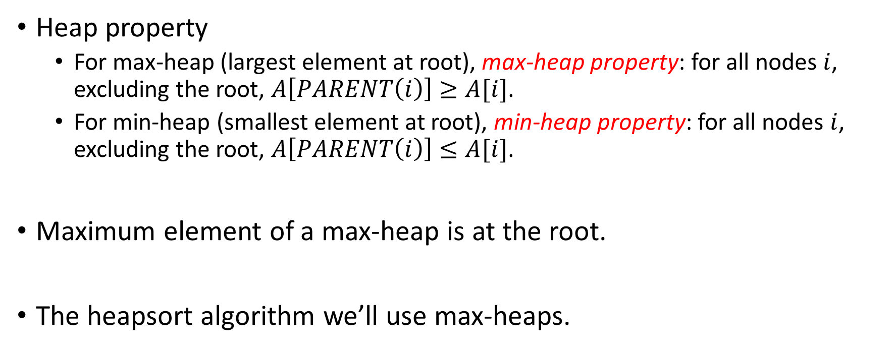
Heap property
Heap property
For max-heap (largest element at root), max-heap property: for all nodes $i$, excluding the root, $A\left[PARENT\left(i\right)\right]≥A[i]$.
For min-heap (smallest element at root), min-heap property: for all nodes $i$, excluding the root, $A\left[PARENT\left(i\right)\right]≤A[i]$.
Maximum element of a max-heap is at the root.
The heapsort algorithm we’ll use max-heaps.

Slide 9




Example
1
16
A max-heap
2
3
14
10
4
5
6
7
8
7
9
3
8
9
10
2
4
1
1 | 2 | 3 | 4 | 5 | 6 | 7 | 8 | 9 | 10
16 | 14 | 10 | 8 | 7 | 9 | 3 | 2 | 4 | 1

Slide 10
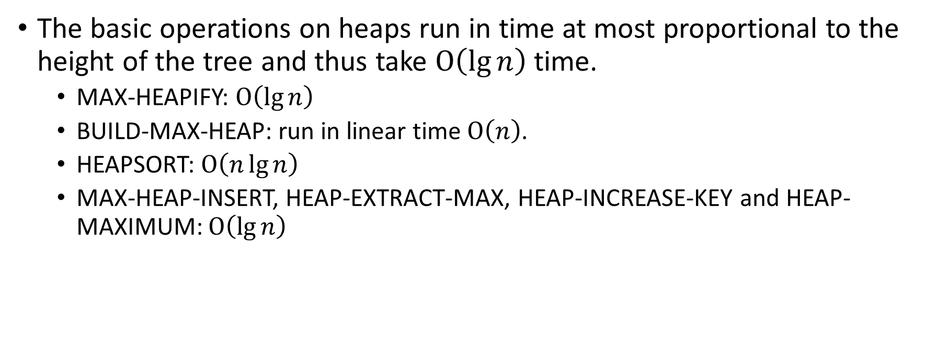
Heap property
The basic operations on heaps run in time at most proportional to the height of the tree and thus take $O\left(\lg{n}\right)$ time.
MAX-HEAPIFY: $O\left(\lg{n}\right)$
BUILD-MAX-HEAP: run in linear time $O\left(n\right)$.
HEAPSORT: $O\left(n\lg{n}\right)$
MAX-HEAP-INSERT, HEAP-EXTRACT-MAX, HEAP-INCREASE-KEY and HEAP-MAXIMUM: $O\left(\lg{n}\right)$

Slide 11
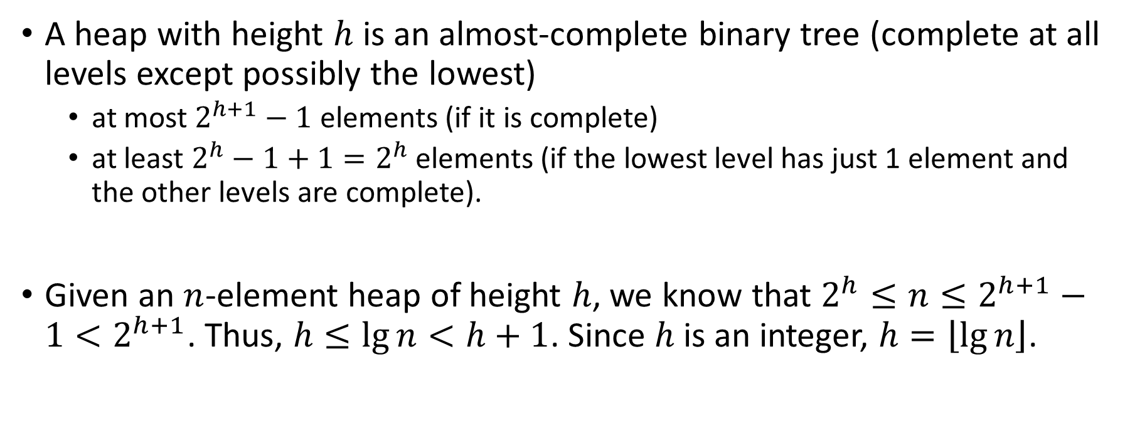
A heap with height $h$ is an almost-complete binary tree (complete at all levels except possibly the lowest)
at most $2^{h+1}−1$ elements (if it is complete)
at least $2^{h}−1+1=2^{h}$ elements (if the lowest level has just 1 element and the other levels are complete).
Given an $n$-element heap of height $h$, we know that $2^{h}≤n≤2^{h+1}−1<2^{h+1}$. Thus, $h≤\lg{n}<h+1$. Since $h$ is an integer, $h=\left\lfloor \lg{n}\right\rfloor$.

Slide 12
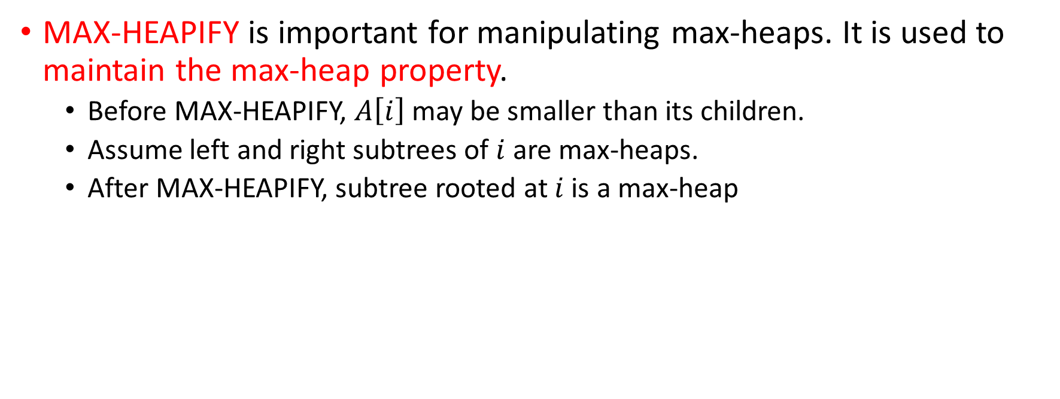
Maintaining the heap property
MAX-HEAPIFY is important for manipulating max-heaps. It is used to maintain the max-heap property.
Before MAX-HEAPIFY, $A\left[i\right]$ may be smaller than its children.
Assume left and right subtrees of $i$ are max-heaps.
After MAX-HEAPIFY, subtree rooted at $i$ is a max-heap

Slide 13
Pseudocode

Slide 14
Example
Run MAX-HEAPIFY on the following heap example.
1
1
1
16
16
16
2
i
3
2
3
2
3
4
10
14
10
14
10
4
5
6
7
4
i
5
6
7
4
5
6
7
14
7
9
3
4
7
9
3
8
7
9
3
i
8
9
10
8
9
10
8
9
10
2
8
1
2
8
1
2
4
1
(a)
(b)
(c)

Slide 15


Analysis of MAX-HEAPIFY
$$T\left(n\right)$$
root
$$≤T\left(2n/3\right)$$
$$n^{′}−1$$
# of nodes= $$n^{′}−1$$
$$n′$$
The children’s subtrees each have size at most $2n/3$

Slide 16
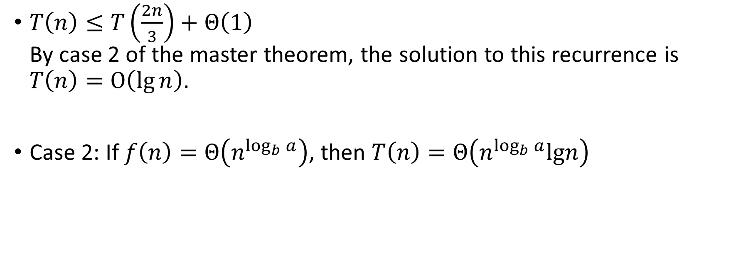
Analysis of MAX-HEAPIFY
$T\left(n\right)≤T\left(\frac{2n}{3}\right)+Θ\left(1\right)$ By case 2 of the master theorem, the solution to this recurrence is $T\left(n\right)=O\left(\lg{n}\right)$.
Case 2: If $f\left(n\right)=Θ\left(n^{\log_{b}{a}}\right)$, then $T\left(n\right)=Θ\left(n^{\log_{b}{a}}lgn\right)$

Slide 17
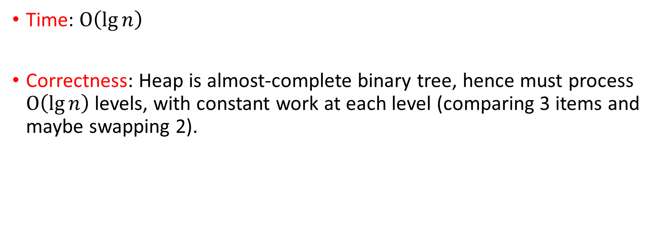
Analysis of MAX-HEAPIFY
Time: $O\left(\lg{n}\right)$
Correctness: Heap is almost-complete binary tree, hence must process $O\left(\lg{n}\right)$levels, with constant work at each level (comparing 3 items and maybe swapping 2).

Slide 18
The following procedure, given an unordered array, will produce a max-heap.
With the array representation for storing an 𝑛-element heap, the leaves are the nodes indexed by ⌊𝑛/2⌋+1,⌊𝑛/2⌋+2,…,𝑛.
Assume 𝐴[⌊𝑛/2⌋+1] is not a leaf, then LEFT(⌊𝑛/2⌋+1)≤𝑛 LEFT(⌊𝑛/2⌋+1)=2(⌊𝑛/2⌋+1)>2(𝑛/2−1+1)=𝑛→←

Slide 19

Example
Building a max-heap from the following unsorted array results in the first heap example.
$i$ starts off as 5.
MAX-HEAPIFY is applied to subtrees rooted at nodes (in order): 16, 2, 3, 1, 4.
 | 1 | 2 | 3 | 4 | 5 | 6 | 7 | 8 | 9 | 10
A | 4 | 1 | 3 | 2 | 16 | 9 | 10 | 14 | 8 | 7

Slide 20
 | 1 | 2 | 3 | 4 | 5 | 6 | 7 | 8 | 9 | 10
A | 4 | 1 | 3 | 2 | 16 | 9 | 10 | 14 | 8 | 7
1
4
2
3
1
3
i
4
5
6
7
2
16
9
10
8
9
10
14
8
7
1
1
4
4
2
3
2
3
1
3
1
3
4
i
5
6
7
4
i
5
6
7
2
16
9
10
14
16
9
10
8
9
10
8
9
10
14
8
7
2
8
7

Slide 21
1
1
4
4
2
i
i
3
2
3
1
10
1
3
4
5
6
7
4
5
6
7
14
16
9
3
14
16
9
10
8
9
10
8
9
10
2
8
7
2
8
7
1
1
1
4
4
4
2
i
3
2
i
3
2
i
3
1
10
16
10
16
10
4
5
6
7
4
5
6
7
4
5
6
7
14
16
9
3
14
1
9
3
14
7
9
3
8
9
10
8
9
10
8
9
10
2
8
7
2
8
7
2
8
1

Slide 22
1
1
1
i
4
i
16
i
16
2
3
2
3
2
3
16
10
4
10
14
10
4
5
6
7
4
5
6
7
4
5
6
7
14
7
9
3
14
7
9
3
4
7
9
3
8
9
10
8
9
10
8
9
10
2
8
1
2
8
1
2
8
1
1
1
16
i
16
2
3
2
3
14
10
14
10
4
5
6
7
4
5
6
7
8
7
9
3
8
7
9
3
8
9
10
8
9
10
2
4
1
2
4
1

Slide 23
Correctness
A loop invariant is a property of a program loop that is true before (and after) each iteration.
We must show three things about a loop invariant:
Initialization: It is true prior to the first iteration of the loop.
Maintenance: If it is true before an iteration of the loop, it remains true before the next iteration.
Termination: When the loop terminates, the invariant gives us a useful property that helps show that the algorithm is correct.

Slide 24
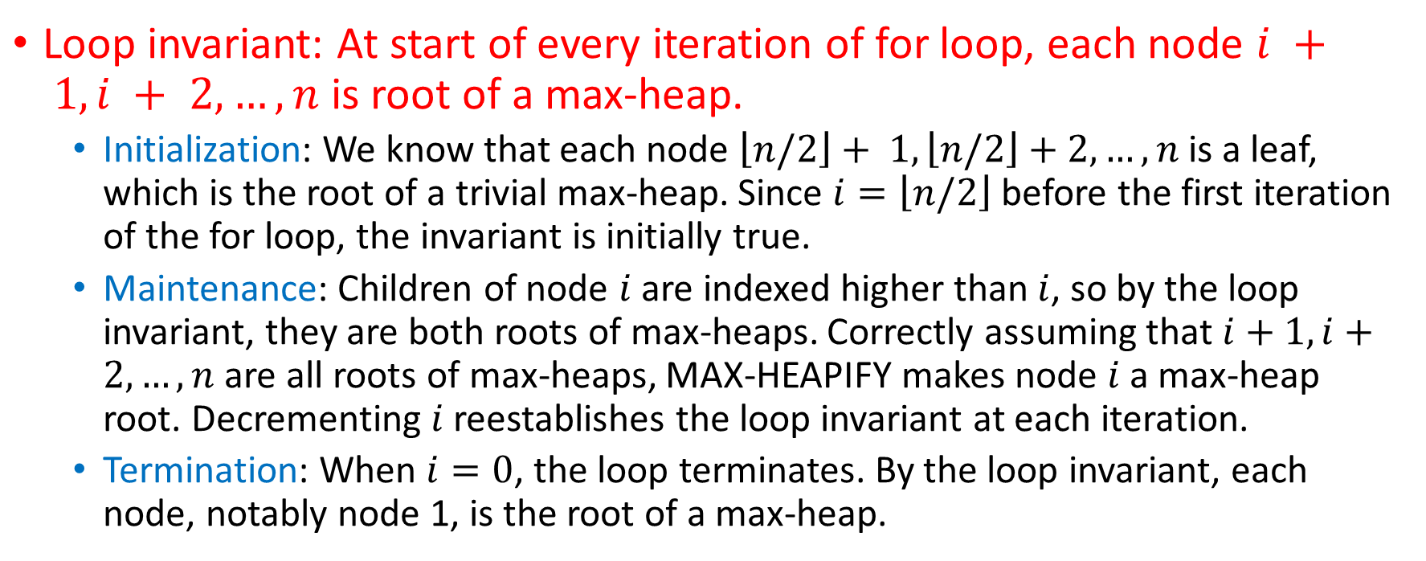
Correctness
Loop invariant: At start of every iteration of for loop, each node $i + 1, i + 2,…, n$is root of a max-heap.
Initialization: We know that each node $\left\lfloor n/2\right\rfloor + 1, \left\lfloor n/2\right\rfloor +2,…, n$ is a leaf, which is the root of a trivial max-heap. Since $i=\left\lfloor n/2\right\rfloor$before the first iteration of the for loop, the invariant is initially true.
Maintenance: Children of node $i$ are indexed higher than $i$, so by the loop invariant, they are both roots of max-heaps. Correctly assuming that $i+1, i+2,…, n$are all roots of max-heaps, MAX-HEAPIFY makes node $i$ a max-heap root. Decrementing $i$ reestablishes the loop invariant at each iteration.
Termination: When $i=0$, the loop terminates. By the loop invariant, each node, notably node 1, is the root of a max-heap.

Slide 25
Be careful not to confuse the height of a node (longest distance from a leaf) with its depth (distance from the root).
If the heap is not a complete binary tree (bottom level is not full), then the nodes at a given level (depth) don’t all have the same height. For example, although all nodes at depth 𝐻 have height 0, nodes at depth 𝐻−1 can have either height 0 or height 1.

Slide 26

Analysis
There are at most $\left\lceil n/2^{h+1}\right\rceil$ nodes of height $h$ in any $n$-element heap.
For a complete binary tree, it’s easy to show that there are $\left\lceil n/2^{h+1}\right\rceil$nodes of height $h$.
But the proof for an incomplete tree is tricky and is not derived from the proof for a complete tree.

Slide 27
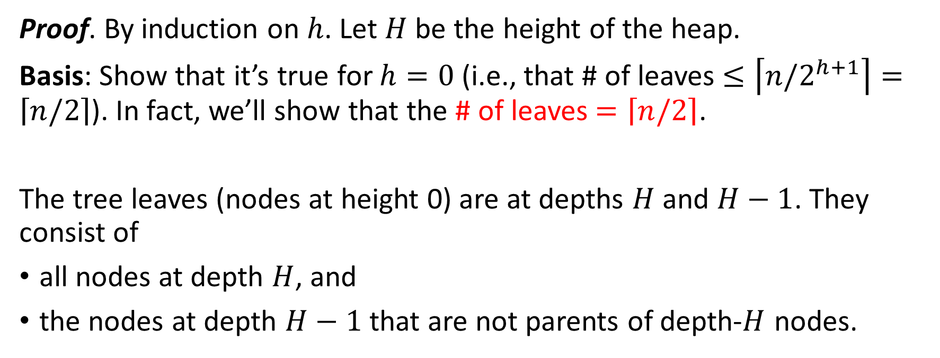
Proof. By induction on $h$. Let $H$ be the height of the heap.
Basis: Show that it’s true for $h=0$ (i.e., that # of leaves $≤\left\lceil n/2^{h+1}\right\rceil =\left\lceil n/2\right\rceil$). In fact, we’ll show that the # of leaves $=\left\lceil n/2\right\rceil$.
The tree leaves (nodes at height 0) are at depths $H$ and $H−1$. They consist of
all nodes at depth $H$, and
the nodes at depth $H−1$that are not parents of depth-$H$ nodes.

Slide 28
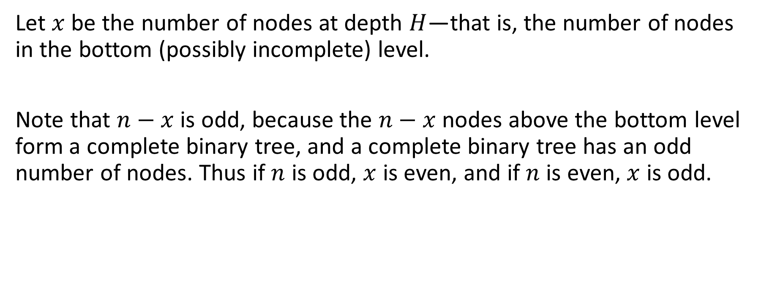
Let $x$ be the number of nodes at depth $H$—that is, the number of nodes in the bottom (possibly incomplete) level.
Note that $n−x$ is odd, because the $n−x$ nodes above the bottom level form a complete binary tree, and a complete binary tree has an odd number of nodes. Thus if $n$ is odd, $x$ is even, and if $n$ is even, $x$ is odd.

Slide 29
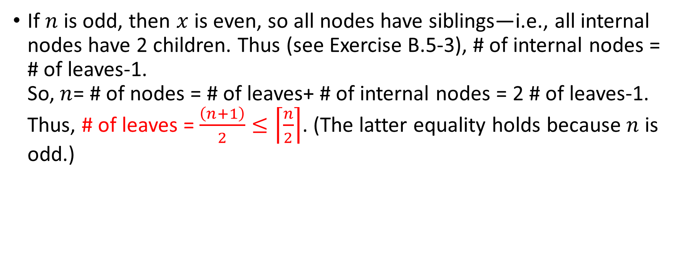
If $n$ is odd, then $x$ is even, so all nodes have siblings—i.e., all internal nodes have 2 children. Thus (see Exercise B.5-3), # of internal nodes = # of leaves-1. So, $n$= # of nodes = # of leaves+ # of internal nodes = 2 # of leaves-1. Thus, # of leaves = $\frac{\left(n+1\right)}{2}≤\left\lceil \frac{n}{2}\right\rceil$. (The latter equality holds because $n$ is odd.)

Slide 30
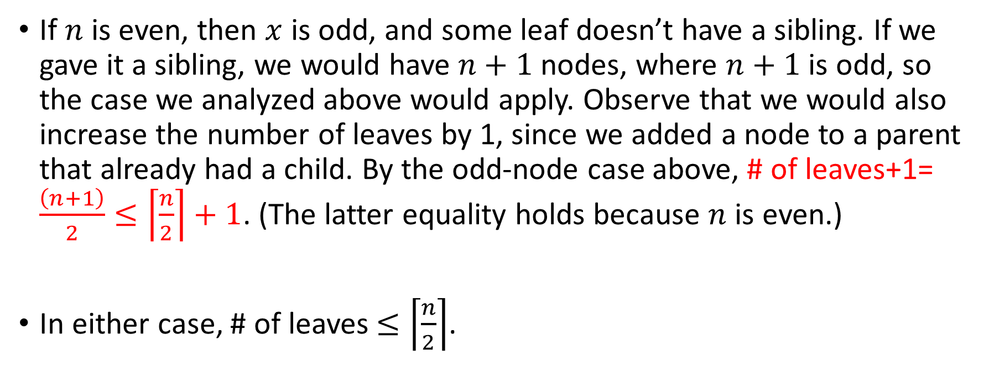
If $n$ is even, then $x$ is odd, and some leaf doesn’t have a sibling. If we gave it a sibling, we would have $n+1$ nodes, where $n+1$is odd, so the case we analyzed above would apply. Observe that we would also increase the number of leaves by 1, since we added a node to a parent that already had a child. By the odd-node case above, # of leaves+1= $\frac{\left(n+1\right)}{2}≤\left\lceil \frac{n}{2}\right\rceil +1$. (The latter equality holds because $n$ is even.)
In either case, # of leaves $≤\left\lceil \frac{n}{2}\right\rceil$.

Slide 31
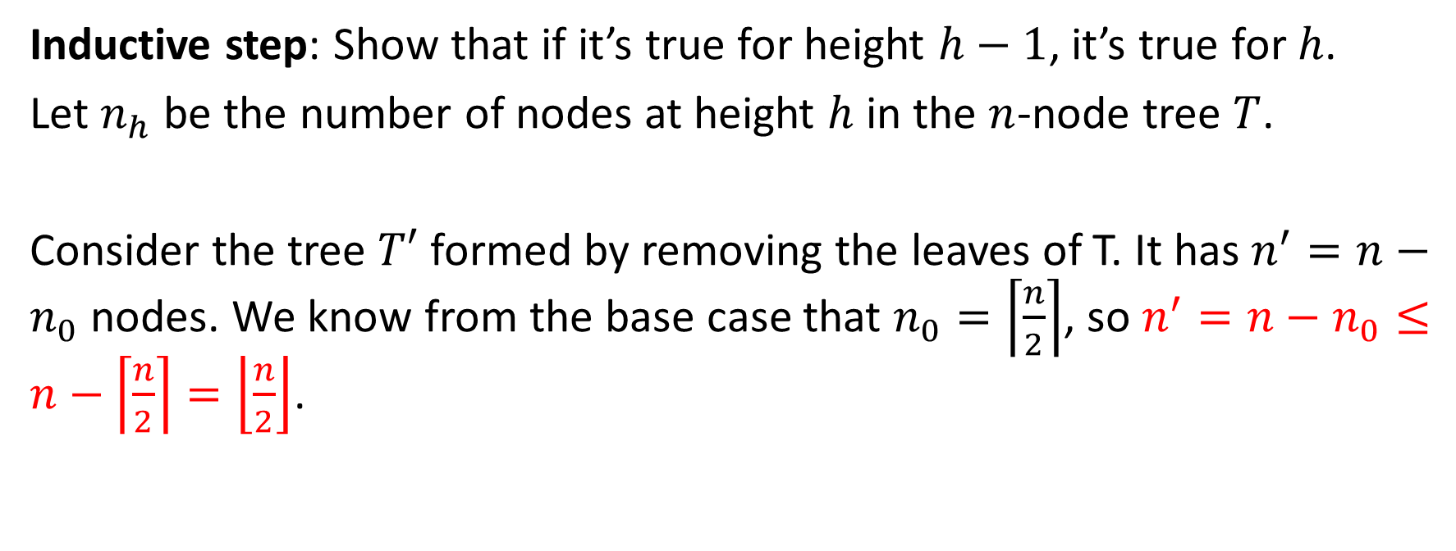
Inductive step: Show that if it’s true for height $h−1$, it’s true for $h$.
Let $n_{h}$ be the number of nodes at height $h$ in the $n$-node tree $T$.
Consider the tree $T′$ formed by removing the leaves of T. It has $n^{′}=n−n_{0}$ nodes. We know from the base case that $n_{0}=\left\lceil \frac{n}{2}\right\rceil$, so $n^{′}=n−n_{0}≤n−\left\lceil \frac{n}{2}\right\rceil =\left\lfloor \frac{n}{2}\right\rfloor$.

Slide 32
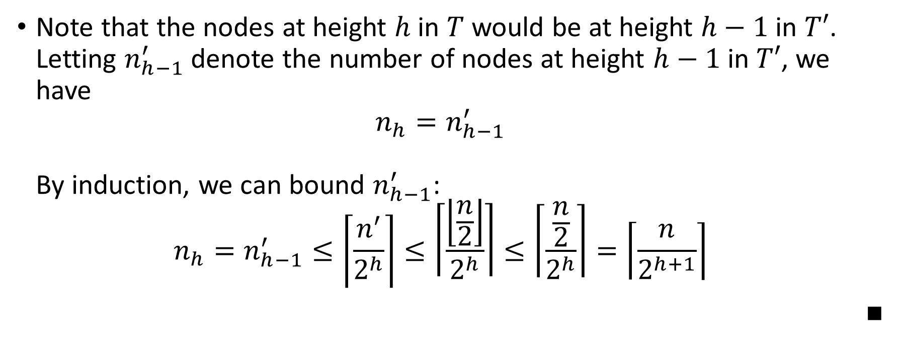
Note that the nodes at height $h$ in $T$ would be at height $h−1$ in $T′$. Letting $n_{h−1}^{′}$ denote the number of nodes at height $h−1$ in $T′$, we have $n_{h}=n_{h−1}^{′}$ By induction, we can bound $n_{h−1}^{′}$: $n_{h}=n_{h−1}^{′}≤\left\lceil \frac{n^{′}}{2^{h}}\right\rceil ≤\left\lceil \frac{\left\lfloor \frac{n}{2}\right\rfloor }{2^{h}}\right\rceil ≤\left\lceil \frac{\frac{n}{2}}{2^{h}}\right\rceil =\left\lceil \frac{n}{2^{h+1}}\right\rceil$
■

Slide 33
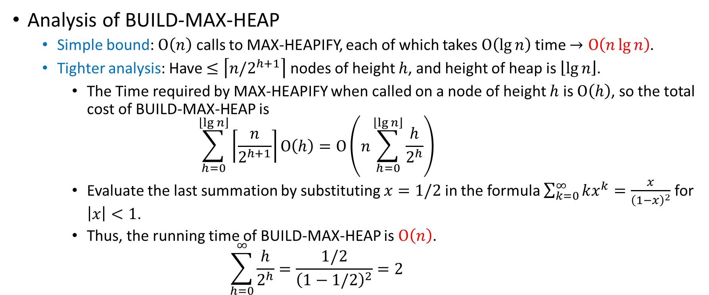
Analysis
Analysis of BUILD-MAX-HEAP
Simple bound: $O\left(n\right)$ calls to MAX-HEAPIFY, each of which takes $O\left(\lg{n}\right)$ time $→O\left(n\lg{n}\right)$.
Tighter analysis: Have $≤\left\lceil n/2^{h+1}\right\rceil$ nodes of height $h$, and height of heap is $\left\lfloor \lg{n}\right\rfloor$.
The Time required by MAX-HEAPIFY when called on a node of height $h$ is $O\left(h\right)$, so the total cost of BUILD-MAX-HEAP is $\sum_{h=0}^{\left\lfloor \lg{n}\right\rfloor }{\left\lceil \frac{n}{2^{h+1}}\right\rceil O\left(h\right)}=O\left(n\sum_{h=0}^{\left\lfloor \lg{n}\right\rfloor }{\frac{h}{2^{h}}}\right)$
Evaluate the last summation by substituting $x=1/2$ in the formula $\sum_{k=0}^{∞}{kx^{k}=\frac{x}{{\left(1−x\right)}^{2}}}$ for $\left|x\right|<1$.
Thus, the running time of BUILD-MAX-HEAP is $O\left(n\right)$. $\sum_{h=0}^{∞}{\frac{h}{2^{h}}}=\frac{1/2}{{\left(1−1/2\right)}^{2}}=2$

Slide 34
Building a min-heap
Building a min-heap from an unordered array can be done by calling MIN-HEAPIFY instead of MAX-HEAPIFY, also taking linear time.

Slide 35
The heapsort algorithm

Slide 36
Example: Heapsort Algorithm
7
4
3
4
3
2
3
2
1
1
2
1
i
7
i
4
7
(a)
(b)
(c)
2
1
i
i
1
3
2
3
A | 1 | 2 | 3 | 4 | 7
4
7
4
7
(d)
(e)

Slide 37

Analysis
Analysis of heapsort
BUILD-MAX-HEAP: $O\left(n\right)$
for loop: $n−1$ times
Exchange elements: $O\left(1\right)$
MAX-HEAPIFY: $O\left(\lg{n}\right)$ Total time: $O\left(n lg{n}\right)$

Slide 38
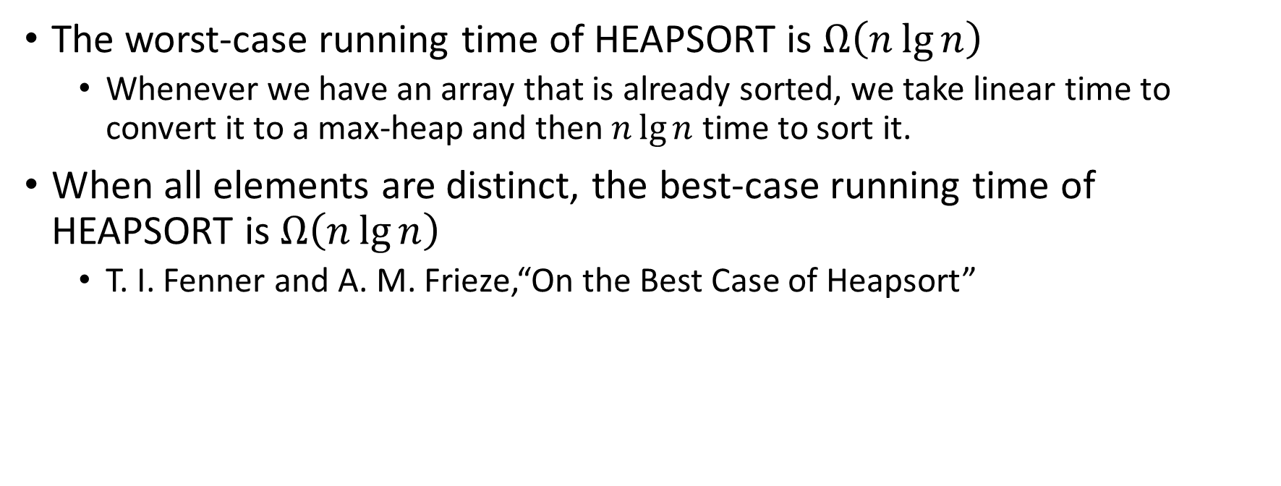
The worst-case running time of HEAPSORT is $Ω\left(n\lg{n}\right)$
Whenever we have an array that is already sorted, we take linear time to convert it to a max-heap and then $n\lg{n}$ time to sort it.
When all elements are distinct, the best-case running time of HEAPSORT is $Ω\left(n\lg{n}\right)$
T. I. Fenner and A. M. Frieze,“On the Best Case of Heapsort”

Slide 39
Analysis
Though heapsort is a great algorithm, it is usually not quite as fast as quicksort for large 𝑛.
On the other hand, unlike quicksort, its performance is guaranteed.

Slide 40
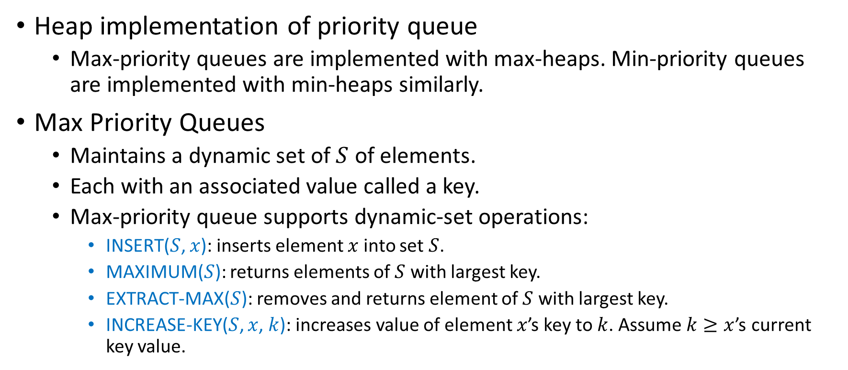
Priority queue
Heap implementation of priority queue
Max-priority queues are implemented with max-heaps. Min-priority queues are implemented with min-heaps similarly.
Max Priority Queues
Maintains a dynamic set of $S$ of elements.
Each with an associated value called a key.
Max-priority queue supports dynamic-set operations:
INSERT($S$, $x$): inserts element $x$ into set $S$.
MAXIMUM($S$): returns elements of $S$ with largest key.
EXTRACT-MAX($S$): removes and returns element of $S$ with largest key.
INCREASE-KEY($S$, $x$, $k$): increases value of element $x$’s key to $k$. Assume $k≥x$’s current key value.

Slide 41
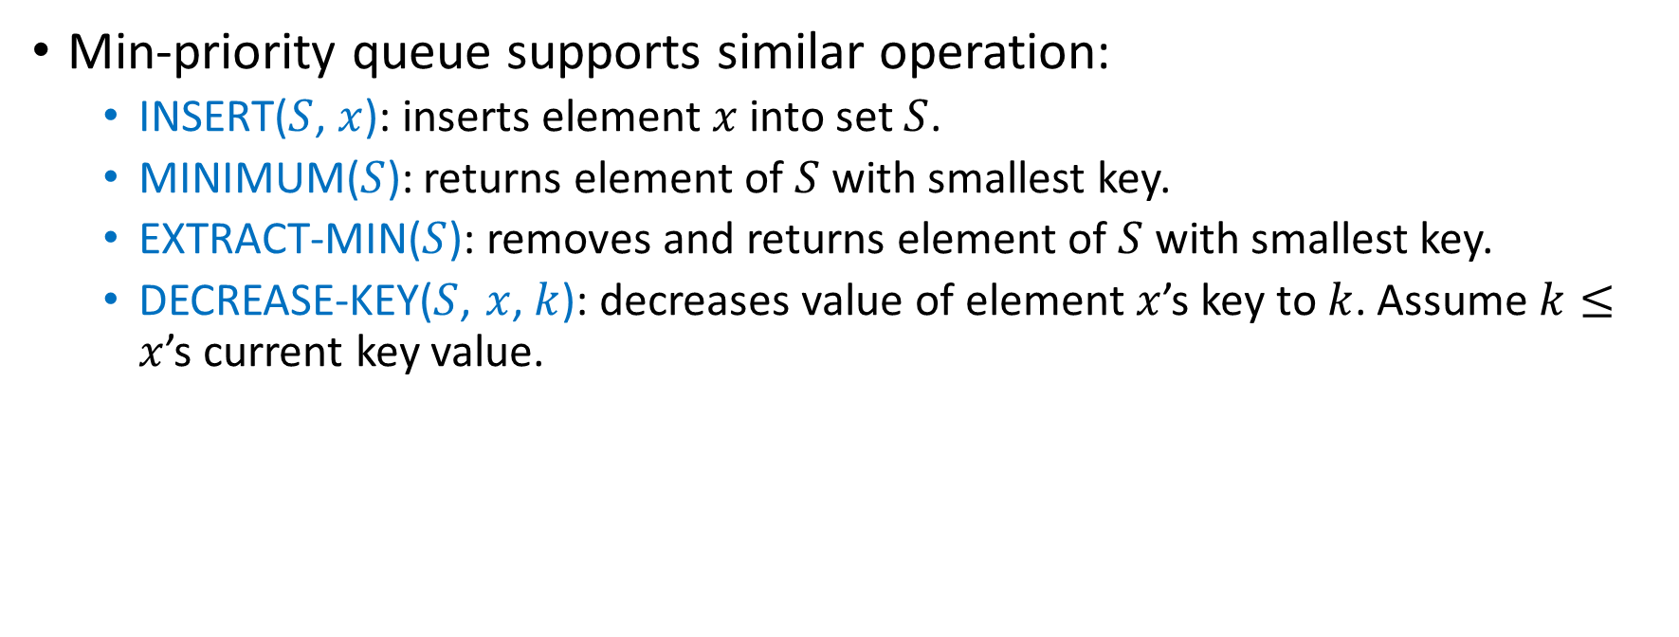
Min-priority queue supports similar operation:
INSERT($S$, $x$): inserts element $x$ into set $S$.
MINIMUM($S$): returns element of $S$ with smallest key.
EXTRACT-MIN($S$): removes and returns element of $S$ with smallest key.
DECREASE-KEY($S$, $x$, $k$): decreases value of element $x$’s key to $k$. Assume $k≤x$’s current key value.

Slide 42

Finding the maximum element
Getting the maximum element is easy: it’s the root.
Time: $Θ\left(1\right)$
7
4
3
1
2
HEAP-MAXIMUM(A) returns 7

Slide 43
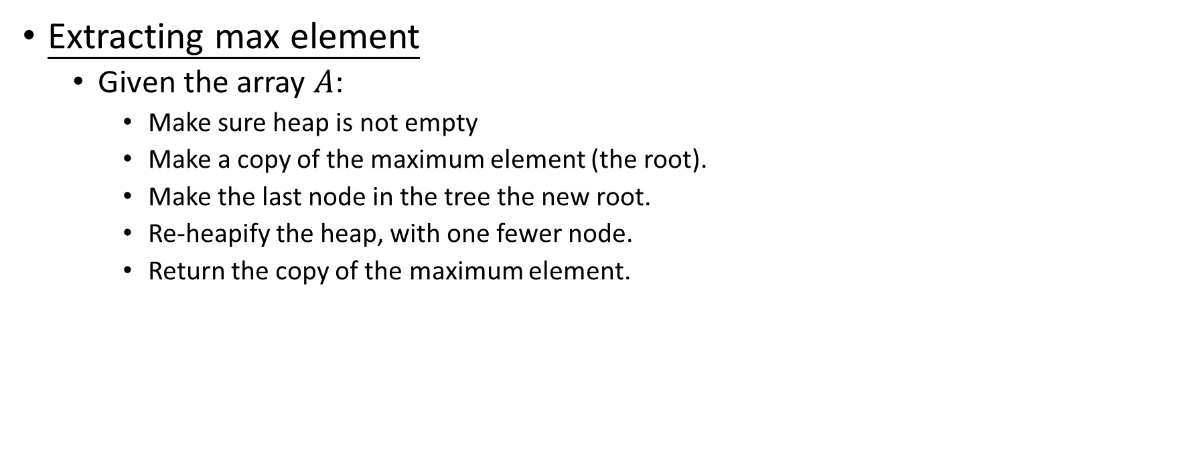
Extracting max element
Given the array $A$:
Make sure heap is not empty
Make a copy of the maximum element (the root).
Make the last node in the tree the new root.
Re-heapify the heap, with one fewer node.
Return the copy of the maximum element.

Slide 44

7
$$max=7$$
4
4
3
2
3
1
2
1
2

Slide 45

Analysis: constant time assignments plus time for MAX-HEAPIFY.
Time: $O\left(\lg{n}\right)$

Slide 46

Increasing key value
Given set $S$, element $x$ and new key value $k$:
Make sure $k≥x$’s current key.
Update $x$’s key value to $k$.
Traverse the tree upward comparing $x$ to its parent and swapping keys if necessary, until $x$’s key in smaller than parent’s key.

Slide 48






7
7
4
3
4
3
i
1
2
1
15
HEAP-INCREASE-KEY($A$, 5, 15)
$$A\left[i\right]←key$$
7
7
7
$$PARANT\left(i\right)$$
4
3
i
15
3
15
3
i
i
1
15
1
4
1
4
$$A\left[PARANT\left(i\right)\right]<A\left[i\right]$$
$$A\left[PARANT\left(i\right)\right]↔A\left[i\right]$$
$$i←PARANT\left(i\right)$$

Slide 49



7
15
i
15
i
i
15
3
7
3
7
3
1
4
1
4
1
4
$$A\left[PARANT\left(i\right)\right]<A\left[i\right]$$
$$A\left[PARANT\left(i\right)\right]↔A\left[i\right]$$
$$i←PARANT\left(i\right)$$

Slide 50

Analysis: Upward path from node $i$ has length $O\left(\lg{n}\right)$in an $n$-element heap.
Time: $O\left(\lg{n}\right)$

Slide 51

Inserting into the heap
Given a key $k$ to insert into the heap:
Insert a new node in the key last position in the tree with key $−∞$
Increase the $−∞$ key to $k$ using the HEAP-INCREASE-KEY procedure defined above.

Slide 52

7
7
7
4
3
4
3
4
3
1
2
1
2
$$−∞$$
1
2
15
7
15
15
4
15
4
7
4
7
1
2
3
1
2
3
1
2
3

Slide 53
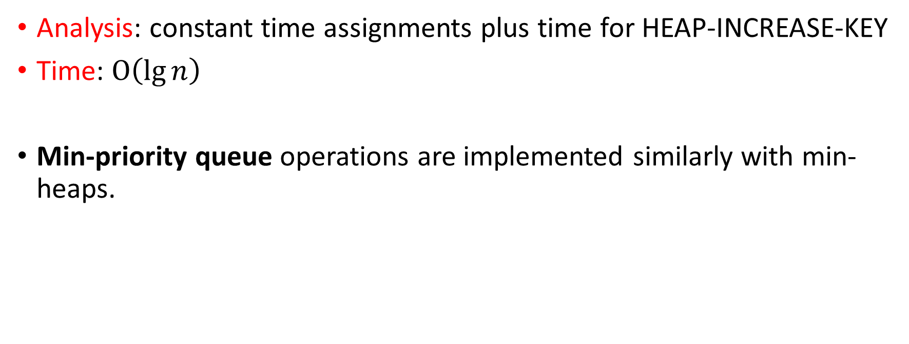
Analysis: constant time assignments plus time for HEAP-INCREASE-KEY
Time: $O\left(\lg{n}\right)$
Min-priority queue operations are implemented similarly with min-heaps.

