Slide 1
Chapter 7 Quicksort
Chi-Yeh Chen
陳奇業
成功大學資訊工程學系

Slide 2

Overview
Quicksort
Worst-case running time: $Θ\left(n^{2}\right)$
Expected running time: $Θ\left(n\lg{n}\right)$
Constants hidden in $Θ\left(n\lg{n}\right)$ are small
Sorts in place

Slide 3
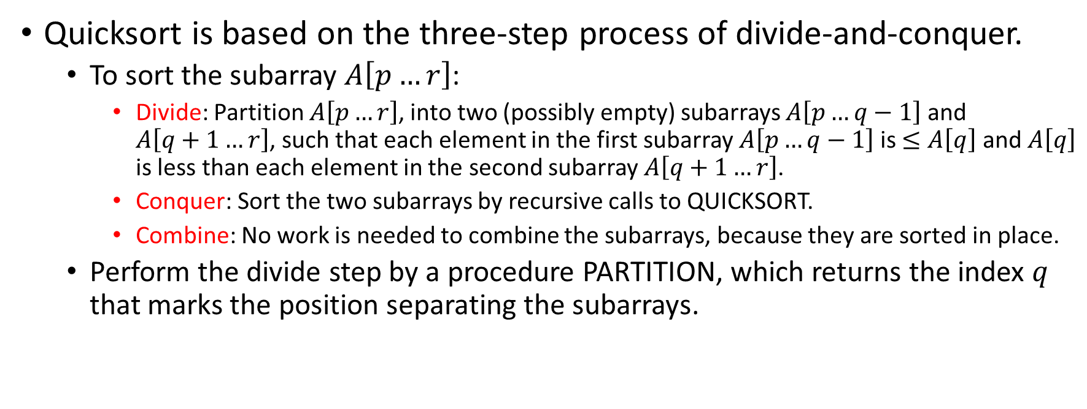
Description of Quicksort
Quicksort is based on the three-step process of divide-and-conquer.
To sort the subarray $A\left[p…r\right]$:
Divide: Partition $A\left[p…r\right]$, into two (possibly empty) subarrays $A\left[p…q−1\right]$ and $A\left[q+1…r\right]$, such that each element in the first subarray $A\left[p…q−1\right]$is $≤A\left[q\right]$ and $A\left[q\right]$ is less than each element in the second subarray $A\left[q+1…r\right]$.
Conquer: Sort the two subarrays by recursive calls to QUICKSORT.
Combine: No work is needed to combine the subarrays, because they are sorted in place.
Perform the divide step by a procedure PARTITION, which returns the index $q$ that marks the position separating the subarrays.

Slide 4

Initial call is QUICKSORT($A$, 1, $n$)

Slide 5

Partitioning
Partition subarray $A\left[p…r\right]$ by the following procedure:

Slide 6

PARTITION always selects the last element $A\left[r\right]$ in the subarray $A\left[p…r\right]$ as the pivot—the element around which to partition.

Slide 7
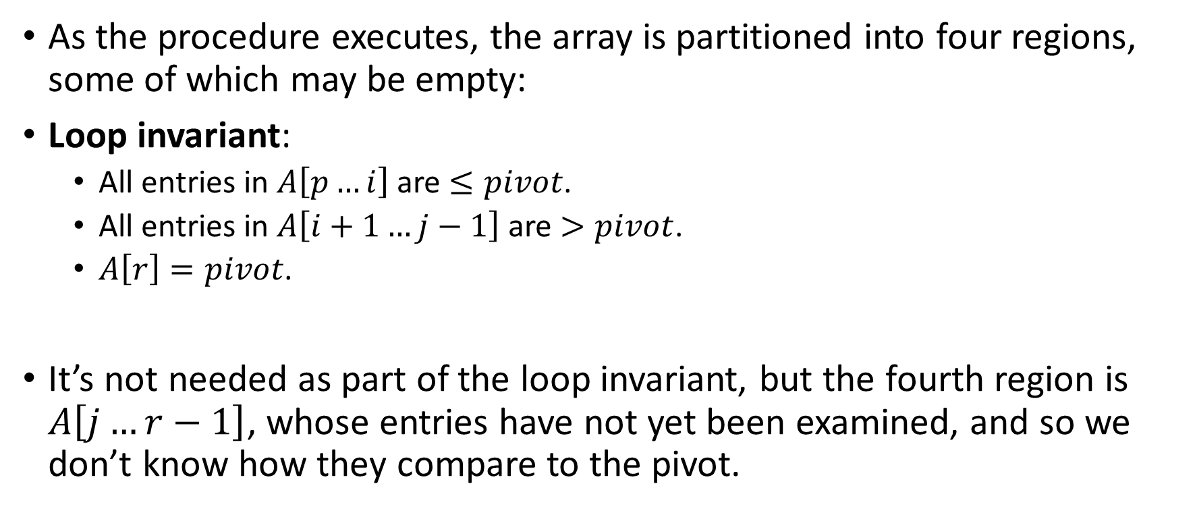
As the procedure executes, the array is partitioned into four regions, some of which may be empty:
Loop invariant:
All entries in $A\left[p…i\right]$ are $≤pivot$.
All entries in $A\left[i+1…j−1\right]$ are $>pivot$.
$A\left[r\right]=pivot$.
It’s not needed as part of the loop invariant, but the fourth region is $A\left[j…r−1\right]$, whose entries have not yet been examined, and so we don’t know how they compare to the pivot.

Slide 8




Example: On an 8-element subarray.
i
p,j
r
8
1
6
4
0
3
9
5
i
p
j
r
8
1
6
4
0
3
9
5
j
r
1
8
6
4
0
3
9
5
p,i
j
r
1
8
6
4
0
3
9
5
p
i
j
r
1
4
6
8
0
3
9
5
A[r]: pivot
A[j .. r-1]: not yet examined
A[i+1 .. j-1]: known to be> pivot
A[p .. i]: known to be ≤ pivot

Slide 9

i
j
r
1
4
0
8
6
3
9
5
[The index $j$ disappears because it is no longer needed once the for loop is exited.]
p
i
j
r
1
4
0
3
6
8
9
5
p
i
r
1
4
0
3
6
8
9
5
p
i
r
1
4
0
3
5
8
9
6

Slide 10
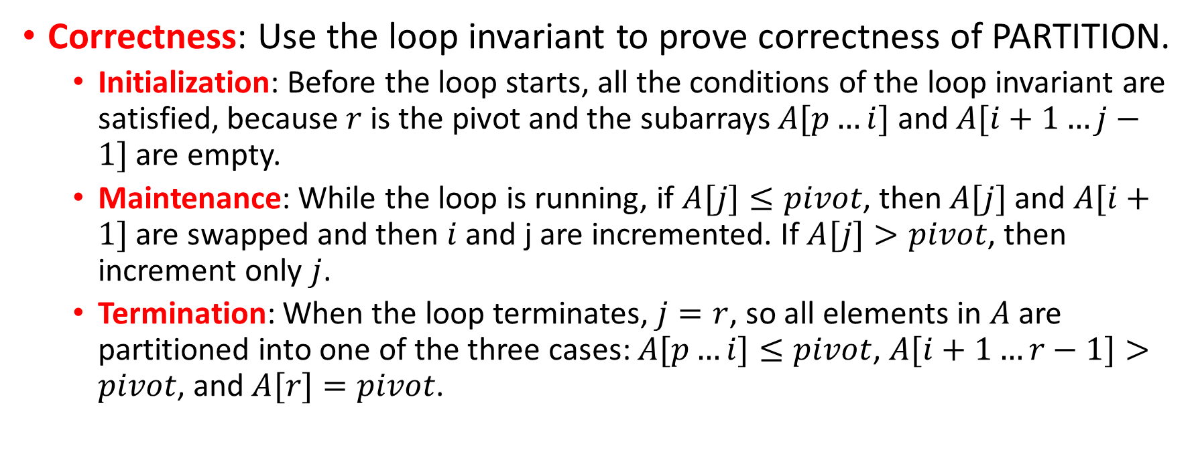
Correctness: Use the loop invariant to prove correctness of PARTITION.
Initialization: Before the loop starts, all the conditions of the loop invariant are satisfied, because $r$ is the pivot and the subarrays $A[p…i]$ and $A[i+1…j−1]$are empty.
Maintenance: While the loop is running, if $A[j]≤pivot$, then $A[j]$ and $A[i+1]$ are swapped and then $i$ and j are incremented. If $A[j]>pivot$, then increment only $j$.
Termination: When the loop terminates, $j=r$, so all elements in $A$ are partitioned into one of the three cases: $A[p…i]≤pivot$, $A[i+1…r−1]>pivot$, and $A[r]=pivot$.

Slide 11
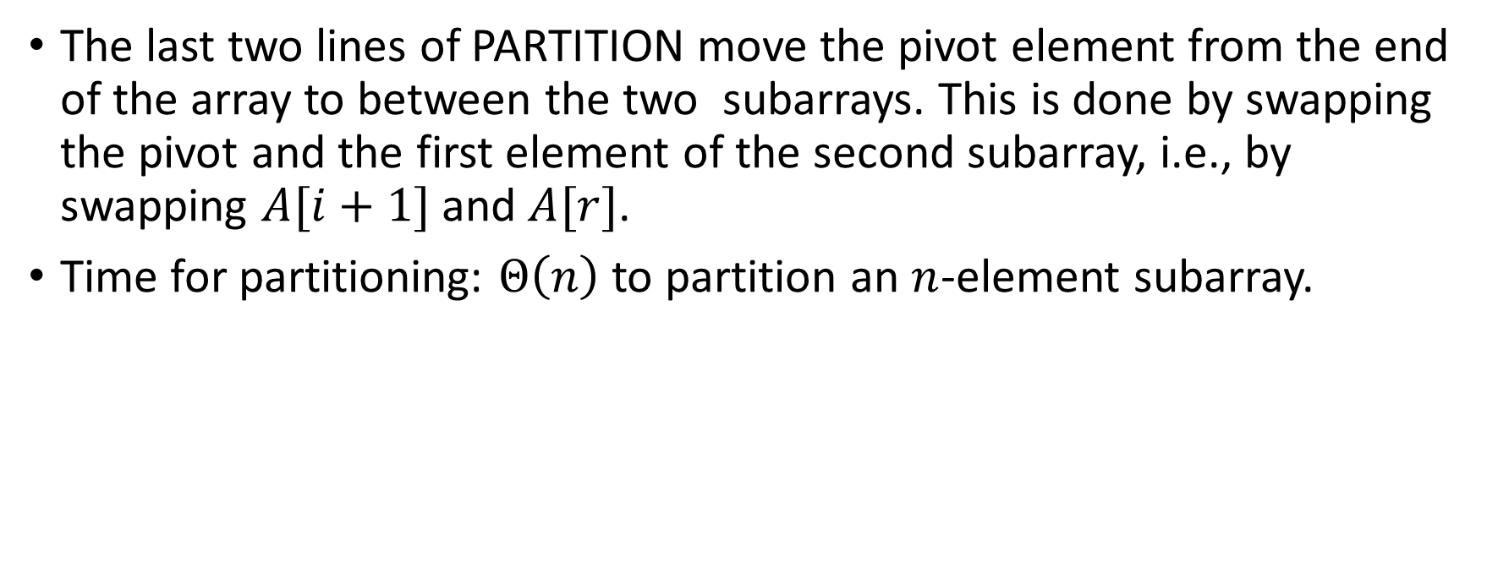
The last two lines of PARTITION move the pivot element from the end of the array to between the two subarrays. This is done by swapping the pivot and the first element of the second subarray, i.e., by swapping $A[i+1]$ and $A[r]$.
Time for partitioning: $Θ\left(n\right)$ to partition an $n$-element subarray.

Slide 12
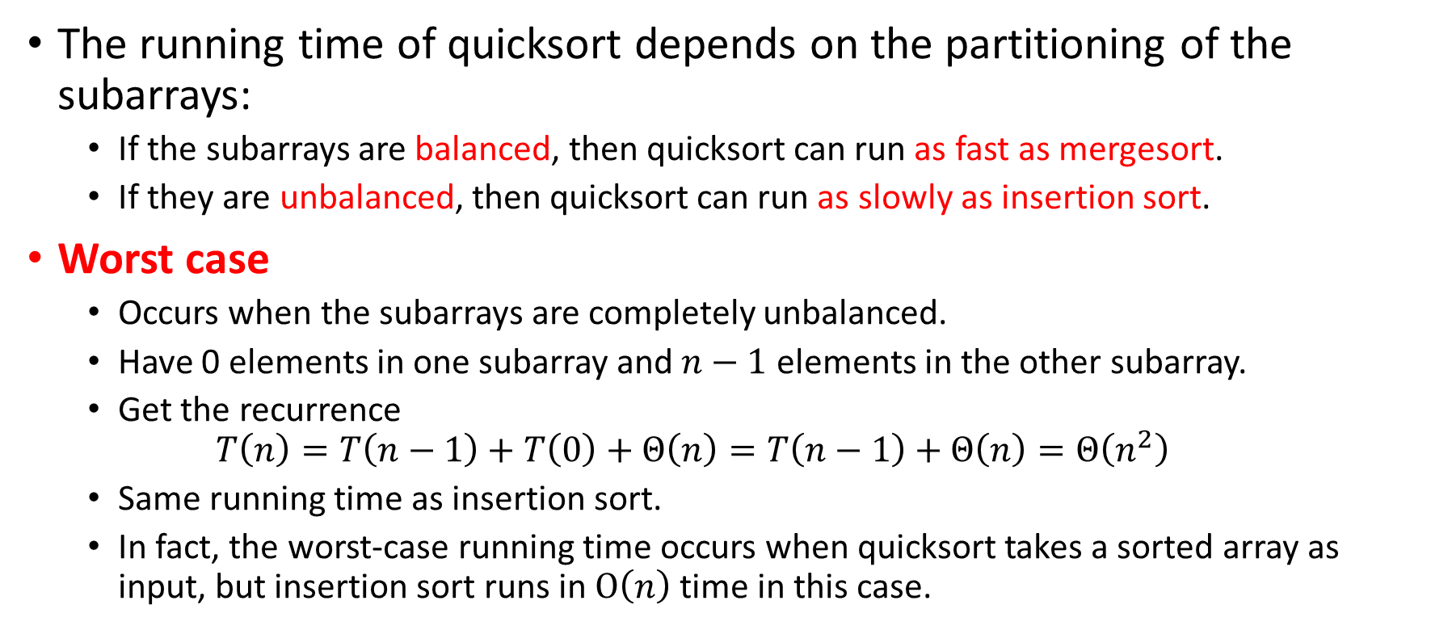
Performance of Quicksort
The running time of quicksort depends on the partitioning of the subarrays:
If the subarrays are balanced, then quicksort can run as fast as mergesort.
If they are unbalanced, then quicksort can run as slowly as insertion sort.
Worst case
Occurs when the subarrays are completely unbalanced.
Have 0 elements in one subarray and $n−1$ elements in the other subarray.
Get the recurrence $T\left(n\right)=T\left(n−1\right)+T\left(0\right)+Θ\left(n\right)=T\left(n−1\right)+Θ\left(n\right)=Θ\left(n^{2}\right)$
Same running time as insertion sort.
In fact, the worst-case running time occurs when quicksort takes a sorted array as input, but insertion sort runs in $O\left(n\right)$ time in this case.

Slide 13

The running time of QUICKSORT is $Θ\left(n^{2}\right)$ when the array $A$ contains distinct elements and is already completely sorted.
PARTITION does a “worst-case partitioning” when the elements are sorted. It reduces the size of the subarray under consideration by only 1 at each step, which we’ve seen has running time $Θ\left(n^{2}\right)$.

Slide 14
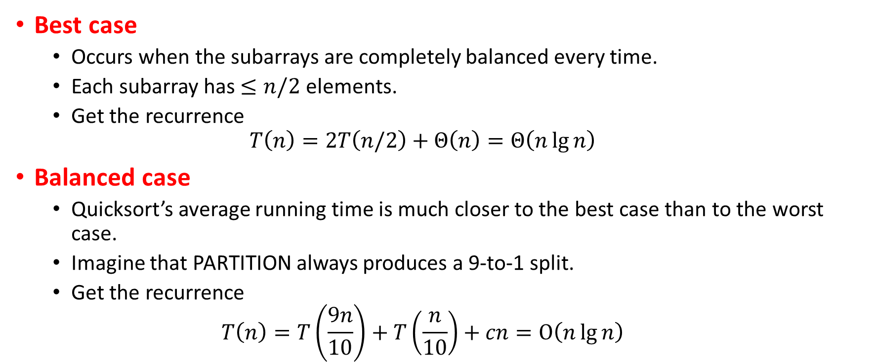
Best case
Occurs when the subarrays are completely balanced every time.
Each subarray has $≤n/2$ elements.
Get the recurrence $T\left(n\right)=2T\left(n/2\right)+Θ\left(n\right)=Θ\left(n\lg{n}\right)$
Balanced case
Quicksort’s average running time is much closer to the best case than to the worst case.
Imagine that PARTITION always produces a 9-to-1 split.
Get the recurrence $T\left(n\right)=T\left(\frac{9n}{10}\right)+T\left(\frac{n}{10}\right)+cn=O\left(n\lg{n}\right)$

Slide 15




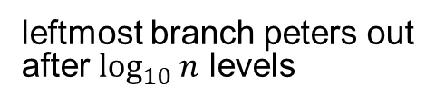







$$cn$$
$$cn$$
$$c\left(n/10\right)$$
$$c\left(9n/10\right)$$
$$cn$$
$$c\left(n/100\right)$$
$$c\left(9n/100\right)$$
$$c\left(9n/100\right)$$
$$c\left(81n/100\right)$$
$$cn$$
leftmost branch peters out after $\log_{10}{n}$ levels
rightmost branch peters out after $\log_{10/9}{n}$ levels

Slide 16
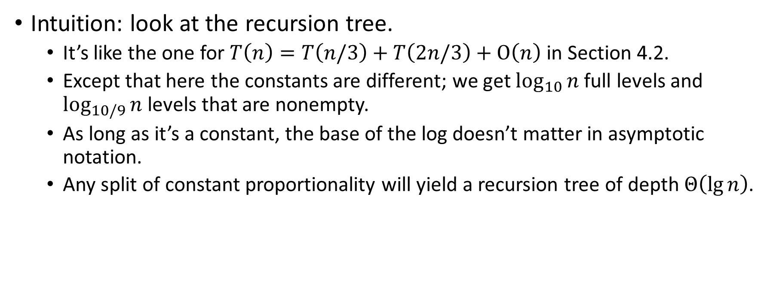
Intuition: look at the recursion tree.
It’s like the one for $T\left(n\right)=T\left(n/3\right)+T\left(2n/3\right)+O\left(n\right)$ in Section 4.2.
Except that here the constants are different; we get $\log_{10}{n}$ full levels and $\log_{10/9}{n}$ levels that are nonempty.
As long as it’s a constant, the base of the log doesn’t matter in asymptotic notation.
Any split of constant proportionality will yield a recursion tree of depth $Θ\left(\lg{n}\right)$.

Slide 17
Intuition for the average case
Splits in the recursion tree will not always be constant.
There will usually be a mix of good and bad splits throughout the recursion tree.
To see that this doesn’t affect the asymptotic running time of quicksort, assume that levels alternate between best-case and worst-case splits.
n
Θ(n)
Θ(n)
n
0
n-1
(n-1)/2
(n-1)/2
(n-1)/2 - 1
(n-1)/2

Slide 18
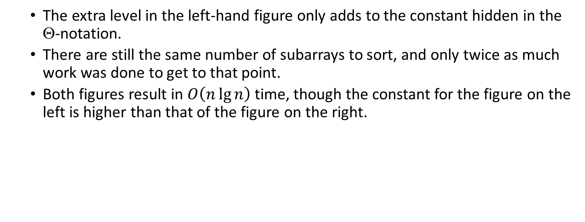
The extra level in the left-hand figure only adds to the constant hidden in the $$-notation.
There are still the same number of subarrays to sort, and only twice as much work was done to get to that point.
Both figures result in $O\left(n\lg{n}\right)$ time, though the constant for the figure on the left is higher than that of the figure on the right.

Slide 19
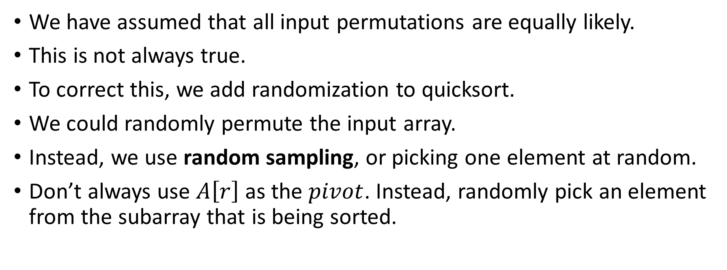
Randomized version of Quicksort
We have assumed that all input permutations are equally likely.
This is not always true.
To correct this, we add randomization to quicksort.
We could randomly permute the input array.
Instead, we use random sampling, or picking one element at random.
Don’t always use $A\left[r\right]$ as the $pivot$. Instead, randomly pick an element from the subarray that is being sorted.

Slide 20
Randomly selecting the pivot element will, on average, cause the split of the input array to be reasonably well balanced.

Slide 21
Randomization of quicksort stops any specific type of array from causing worst-case behavior.
For example, an already-sorted array causes worst-case behavior in non-randomized QUICKSORT, but not in RANDOMIZED QUICKSORT.

Slide 22
Analysis of Quicksort
We will analyze
The worst-case running time of QUICKSORT and RANDOMIZED-QUICKSORT (the same), and
The expected (average-case) running time of RANDOMIZED QUICKSORT.

Slide 23
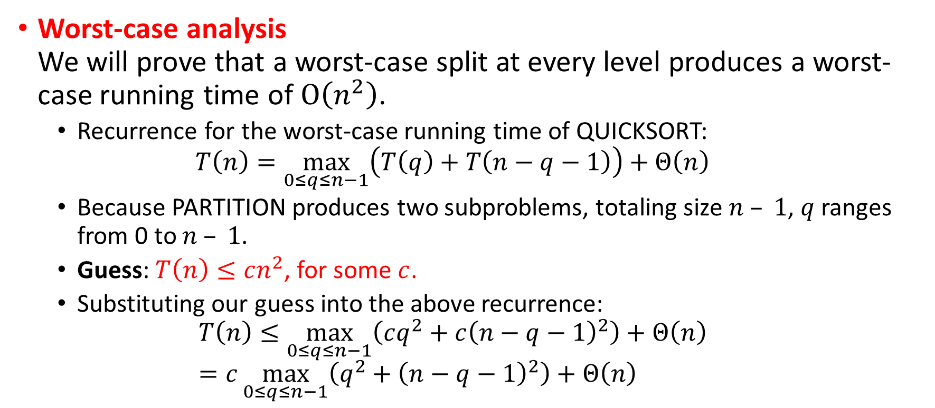
Worst-case analysis We will prove that a worst-case split at every level produces a worst-case running time of $O\left(n^{2}\right)$.
Recurrence for the worst-case running time of QUICKSORT: $T\left(n\right)=\max_{0≤q≤n−1}\left(T\left(q\right)+T\left(n−q−1\right)\right)+Θ\left(n\right)$
Because PARTITION produces two subproblems, totaling size $n – 1$, $q$ ranges from 0 to $n – 1$.
Guess: $T\left(n\right)≤cn^{2}$, for some $c$.
Substituting our guess into the above recurrence: $T\left(n\right)≤\max_{0≤q≤n−1}\left(cq^{2}+c{\left(n−q−1\right)}^{2}\right)+Θ\left(n\right)$ $=c\max_{0≤q≤n−1}\left(q^{2}+{\left(n−q−1\right)}^{2}\right)+Θ\left(n\right)$

Slide 24
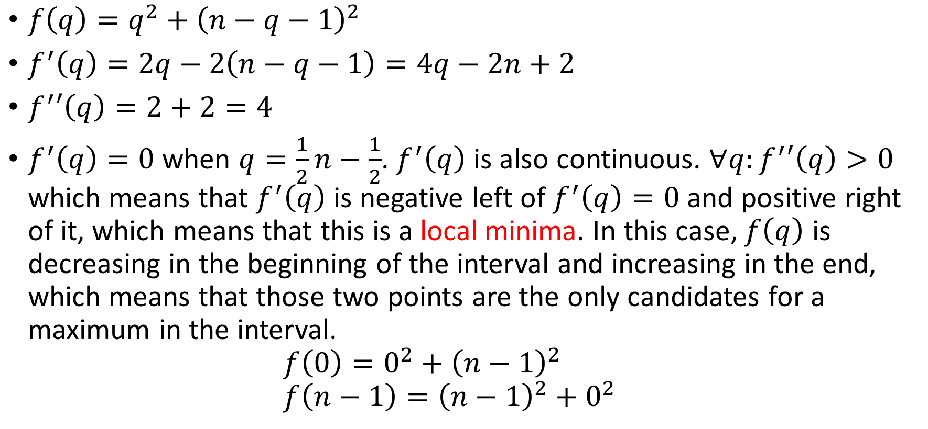
$f\left(q\right)=q^{2}+{\left(n−q−1\right)}^{2}$
$f^{′}\left(q\right)=2q−2\left(n−q−1\right)=4q−2n+2$
$f^{′}′\left(q\right)=2+2=4$
$f^{′}\left(q\right)=0$ when $q=\frac{1}{2}n−\frac{1}{2}$. $f^{′}\left(q\right)$ is also continuous. $∀q:f^{′}′\left(q\right)>0$ which means that $f^{′}\left(q\right)$ is negative left of $f^{′}\left(q\right)=0$ and positive right of it, which means that this is a local minima. In this case, $f\left(q\right)$ is decreasing in the beginning of the interval and increasing in the end, which means that those two points are the only candidates for a maximum in the interval. $f\left(0\right)=0^{2}+{\left(n−1\right)}^{2}$ $f\left(n−1\right)={\left(n−1\right)}^{2}+0^{2}$

Slide 25
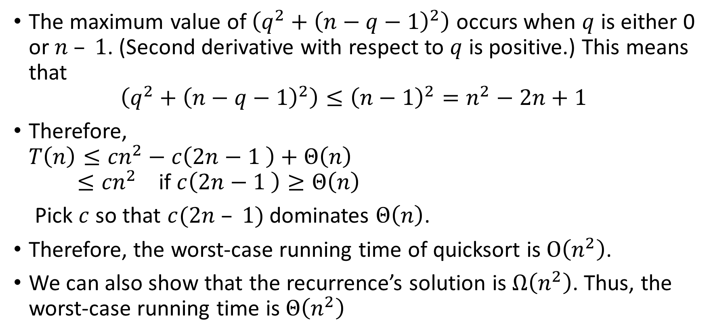
The maximum value of $\left(q^{2}+{\left(n−q−1\right)}^{2}\right)$ occurs when $q$ is either 0 or $n – 1$. (Second derivative with respect to $q$ is positive.) This means that $\left(q^{2}+{\left(n−q−1\right)}^{2}\right)≤{\left(n−1\right)}^{2}=n^{2}−2n+1$
Therefore, $T\left(n\right)≤{cn}^{2}−c\left(2n−1 \right)+Θ\left(n\right)$ $≤{cn}^{2}$ if $c\left(2n−1 \right)≥Θ\left(n\right)$
Pick $c$ so that $c(2n – 1)$dominates $Θ\left(n\right)$.
Therefore, the worst-case running time of quicksort is $O\left(n^{2}\right)$.
We can also show that the recurrence’s solution is $Ω\left(n^{2}\right)$. Thus, the worst-case running time is $Θ\left(n^{2}\right)$

Slide 26
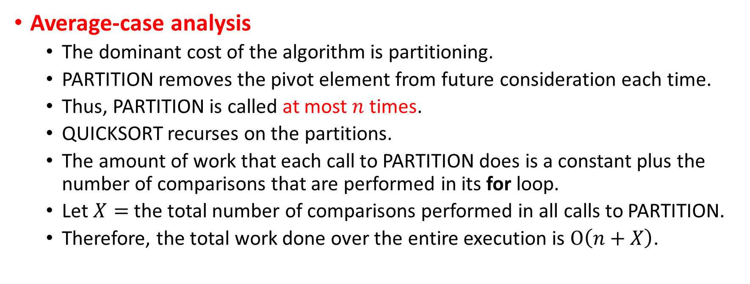
Average-case analysis
The dominant cost of the algorithm is partitioning.
PARTITION removes the pivot element from future consideration each time.
Thus, PARTITION is called at most $n$ times.
QUICKSORT recurses on the partitions.
The amount of work that each call to PARTITION does is a constant plus the number of comparisons that are performed in its for loop.
Let $X=$ the total number of comparisons performed in all calls to PARTITION.
Therefore, the total work done over the entire execution is $O\left(n+X\right)$.

Slide 28
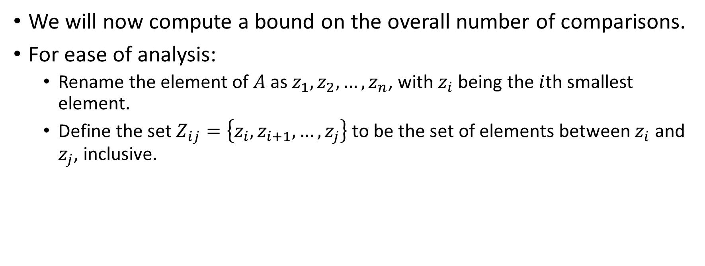
We will now compute a bound on the overall number of comparisons.
For ease of analysis:
Rename the element of $A$as $z_{1},z_{2}, …, z_{n}$, with $z_{i}$ being the $i$th smallest element.
Define the set $Z_{ij}=\left\{z_{i},z_{i+1}, …,z_{j}\right\}$ to be the set of elements between $z_{i}$ and $z_{j}$, inclusive.

Slide 29
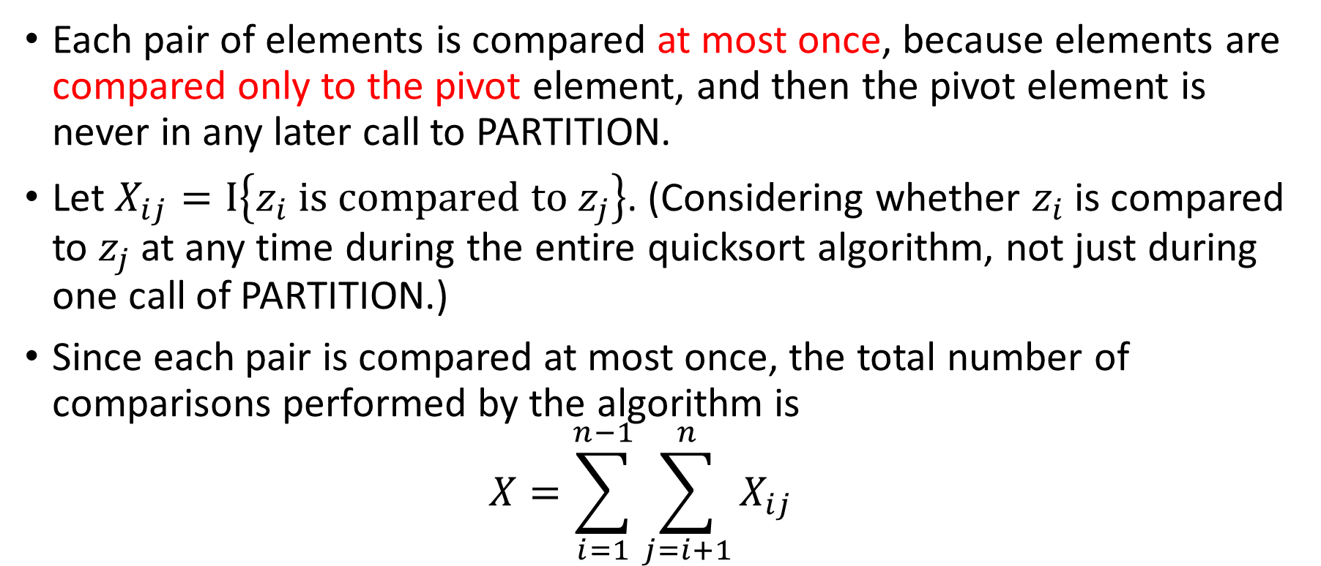
Each pair of elements is compared at most once, because elements are compared only to the pivot element, and then the pivot element is never in any later call to PARTITION.
Let $X_{ij}=Ι\left\{z_{i} is compared to z_{j}\right\}$. (Considering whether $z_{i}$ is compared to $z_{j}$ at any time during the entire quicksort algorithm, not just during one call of PARTITION.)
Since each pair is compared at most once, the total number of comparisons performed by the algorithm is $X=\sum_{i=1}^{n−1}{\sum_{j=i+1}^{n}{X_{ij}}}$

Slide 30
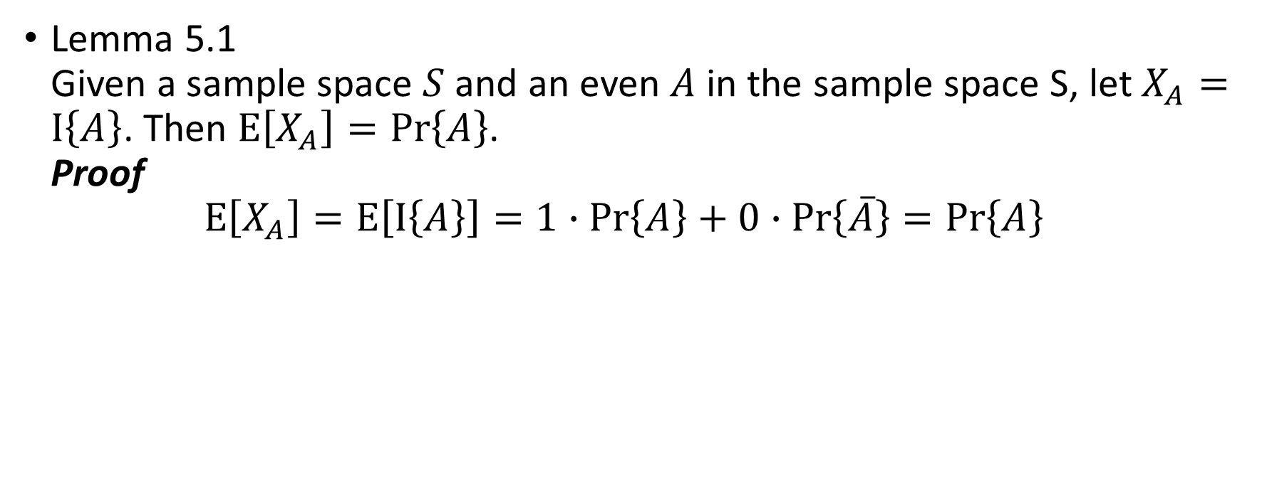
Lemma 5.1 Given a sample space $S$ and an even $A$ in the sample space S, let $X_{A}=I\left\{A\right\}$. Then $E\left[X_{A}\right]=Pr\left\{A\right\}$. Proof $E\left[X_{A}\right]=E\left[I\left\{A\right\}\right]=1∙Pr\left\{A\right\}+0∙Pr\left\{\overline{A}\right\}=Pr\left\{A\right\}$

Slide 31
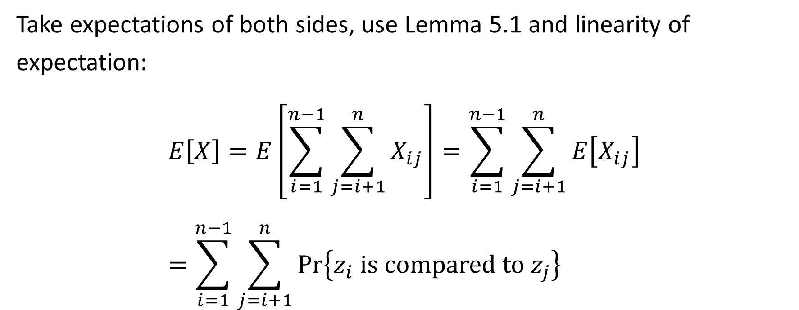
Take expectations of both sides, use Lemma 5.1 and linearity of expectation: $$E\left[X\right]=E\left[\sum_{i=1}^{n−1}{\sum_{j=i+1}^{n}{X_{ij}}}\right]=\sum_{i=1}^{n−1}{\sum_{j=i+1}^{n}{E\left[X_{ij}\right]}} \\ =\sum_{i=1}^{n−1}{\sum_{j=i+1}^{n}{Pr\left\{z_{i} is compared to z_{j}\right\}}}$$

Slide 32
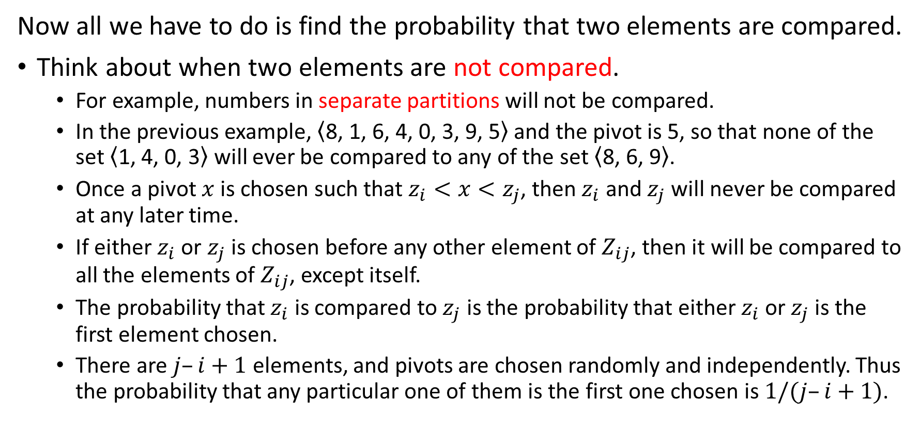
Now all we have to do is find the probability that two elements are compared.
Think about when two elements are not compared.
For example, numbers in separate partitions will not be compared.
In the previous example, $\left\langle \text{8, 1, 6, 4, 0, 3, 9, 5}\right\rangle$ and the pivot is 5, so that none of the set $\left\langle \text{1, 4, 0, 3}\right\rangle$ will ever be compared to any of the set $\left\langle \text{8, 6, 9}\right\rangle$.
Once a pivot $x$ is chosen such that $z_{i}<x<z_{j}$, then $z_{i}$ and $z_{j}$ will never be compared at any later time.
If either $z_{i}$ or $z_{j}$ is chosen before any other element of $Z_{ij}$, then it will be compared to all the elements of $Z_{ij}$, except itself.
The probability that $z_{i}$ is compared to $z_{j}$ is the probability that either $z_{i}$ or $z_{j}$is the first element chosen.
There are $j–i+1$ elements, and pivots are chosen randomly and independently. Thus the probability that any particular one of them is the first one chosen is $1/(j–i+1)$.

Slide 33
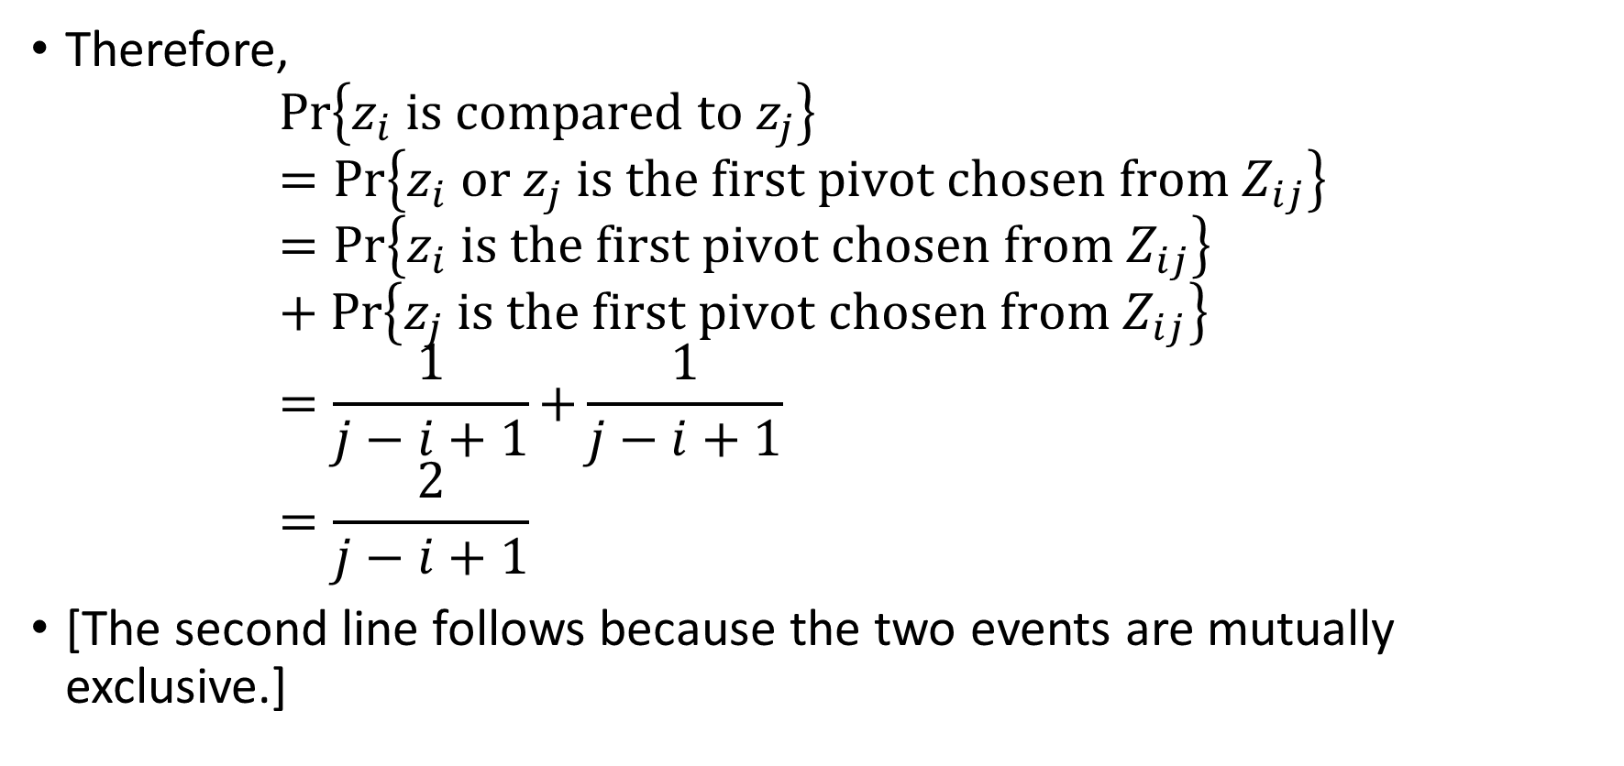
Therefore, $Pr\left\{z_{i} is compared to z_{j}\right\}⁡ =Pr⁡\left\{z_{i} or z_{j} is the first pivot chosen from Z_{ij}\right\}$ $=Pr⁡\left\{z_{i} is the first pivot chosen from Z_{ij}\right\}$ $+ Pr\left\{z_{j} is the first pivot chosen from Z_{ij}\right\}$ $=\frac{1}{j−i+1}{+\frac{1}{j−i+1}}$ $=\frac{2}{j−i+1}$
[The second line follows because the two events are mutually exclusive.]

Slide 34
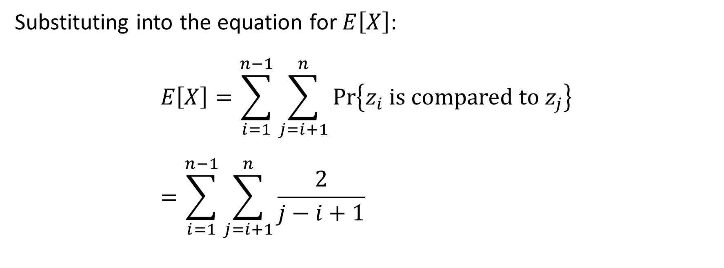
Substituting into the equation for $E\left[X\right]$: $$E\left[X\right]=\sum_{i=1}^{n−1}{\sum_{j=i+1}^{n}{Pr\left\{z_{i} is compared to z_{j}\right\}}} \\ =\sum_{i=1}^{n−1}{\sum_{j=i+1}^{n}{\frac{2}{j−i+1}}}$$

Slide 35

Harmonic series For positive integers $n$, the $n$th harmonic number is $H_{n}=1+\frac{1}{2}+\frac{1}{3}+\frac{1}{4}+⋯+\frac{1}{n}$ $=\sum_{k=1}^{n}{\frac{1}{k}}$ $=\ln{n}+O\left(1\right)$
(A.7)

Slide 36
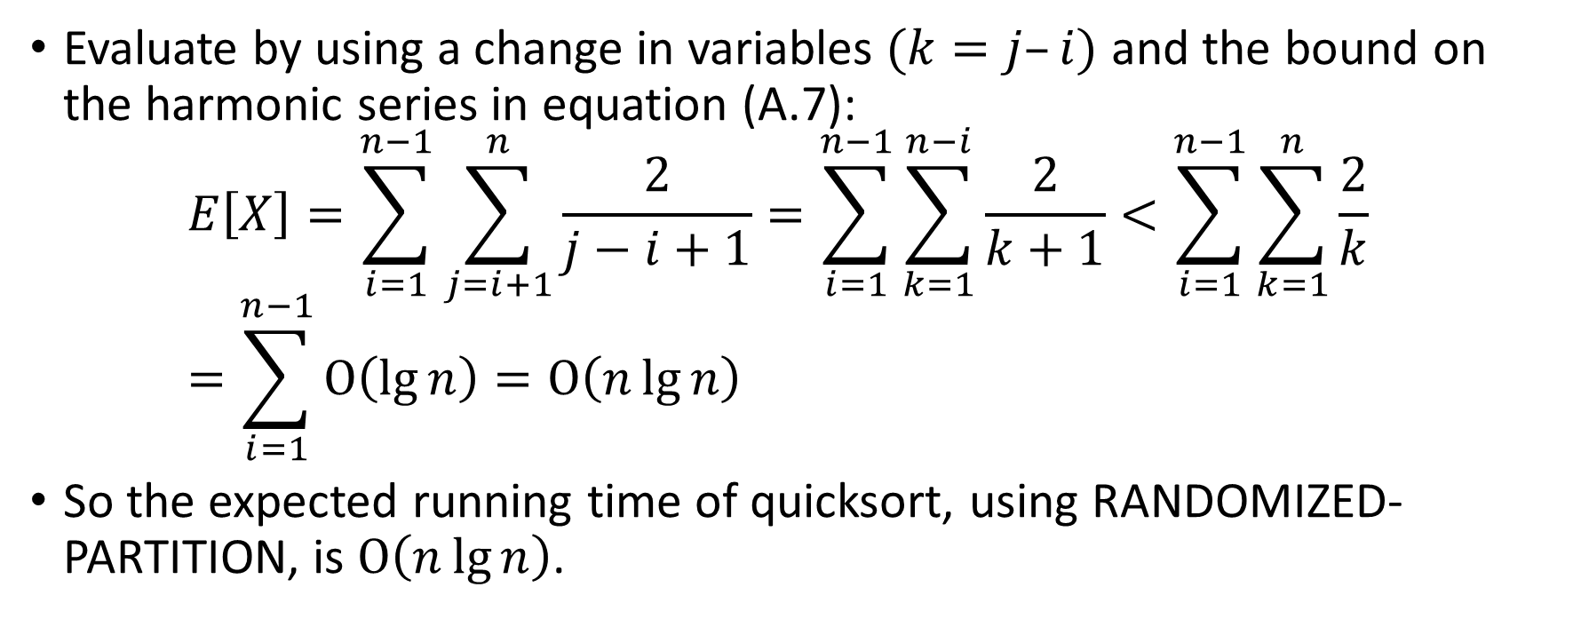
Evaluate by using a change in variables $(k=j–i)$ and the bound on the harmonic series in equation (A.7): $E\left[X\right]=\sum_{i=1}^{n−1}{\sum_{j=i+1}^{n}{\frac{2}{j−i+1}}}=\sum_{i=1}^{n−1}{\sum_{k=1}^{n−i}{\frac{2}{k+1}}}<\sum_{i=1}^{n−1}{\sum_{k=1}^{n}{\frac{2}{k}}}$ $=\sum_{i=1}^{n−1}{O\left(\lg{n}\right)}=O\left(n\lg{n}\right)$
So the expected running time of quicksort, using RANDOMIZED-PARTITION, is $O\left(n\lg{n}\right)$.

