Slide 1
Chapter 6. Numerical Solution of O.D.E.
Chuan-Ching Sue
Dept. of Computer Science and Information Engineering,
National Cheng Kung University

Slide 2
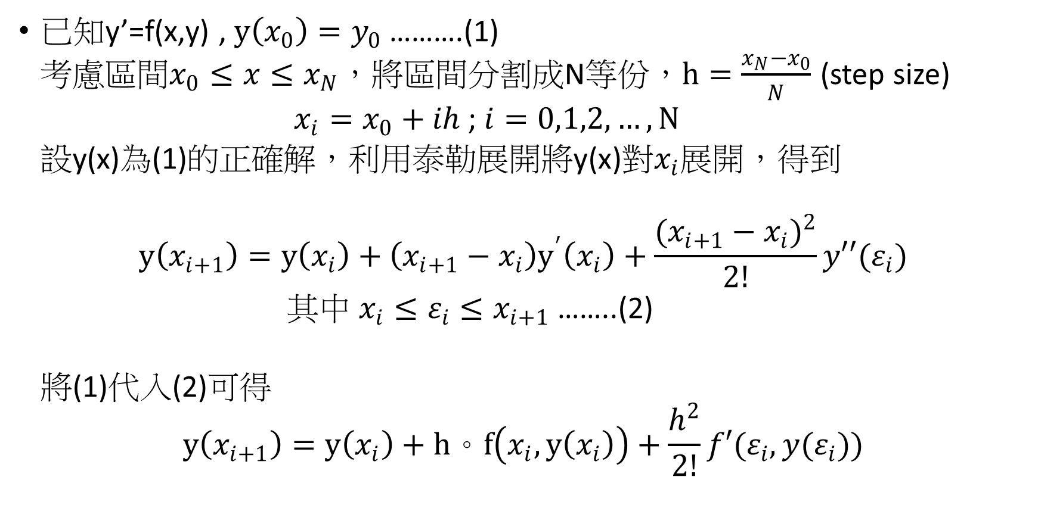
Euler’s Method
已知y’=f(x,y) , $y\left(x_{0}\right)=y_{0}$ ……….(1)
考慮區間$x_{0}≤x≤x_{N}$，將區間分割成N等份，$h=\frac{x_{N}−x_{0}}{N}$ (step size)
$x_{i}=x_{0}+ih$ ; $i=0,1,2,…,N$
設y(x)為(1)的正確解，利用泰勒展開將y(x)對$x_{i}$展開，得到
$$y\left(x_{i+1}\right)=y\left(x_{i}\right)+\left(x_{i+1}−x_{i}\right)y^{′}\left(x_{i}\right)+\frac{{(x_{i+1}−x_{i})}^{2}}{2!}y′′(ε_{i})$$
其中 $x_{i}≤ε_{i}≤x_{i+1}$ ……..(2)
將(1)代入(2)可得
$$y\left(x_{i+1}\right)=y\left(x_{i}\right)+h。f\left(x_{i},y\left(x_{i}\right)\right)+\frac{h^{2}}{2!}f′(ε_{i},y(ε_{i}))$$

Slide 3

Euler’s Method
設$h^{2}$極小可忽略
$$y\left(x_{i+1}\right)=y\left(x_{i}\right)+h。f(x_{i},y(x_{i}))$$
令$u_{i}=y\left(x_{i}\right)$, $u_{i+1}=y(x_{i+1})$也就是$u_{i}$為$y\left(x_{i}\right)的預估值$
$$u_{i+1}=u_{i}+h。f\left(x_{i},u_{i}\right) i=0,1,2,…,N−1$$
$$u_{0}=y_{0}$$

Slide 4
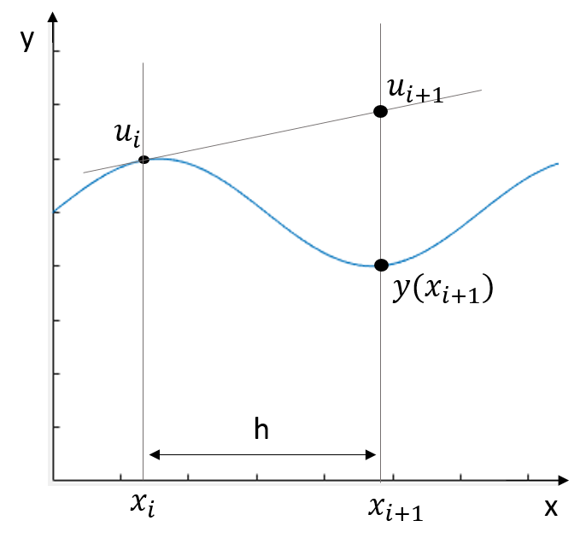

Euler’s Method
以圖觀之 斜率=f($x_{i},u_{i}$)

Slide 5
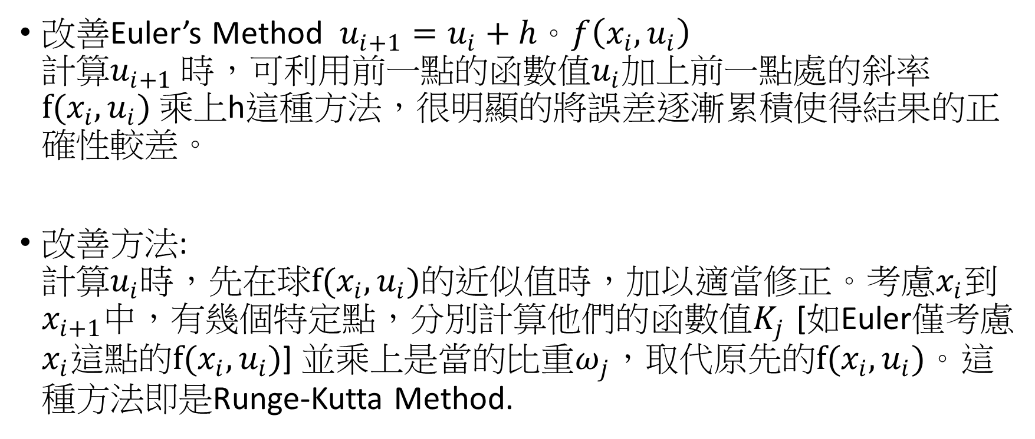
Runge-Kutta Method
改善Euler’s Method $u_{i+1}=u_{i}+h。f\left(x_{i},u_{i}\right)$ 計算$u_{i+1}$ 時，可利用前一點的函數值$u_{i}$加上前一點處的斜率$f(x_{i},u_{i})$ 乘上h這種方法，很明顯的將誤差逐漸累積使得結果的正確性較差。
改善方法: 計算$u_{i}$時，先在球$f(x_{i},u_{i})$的近似值時，加以適當修正。考慮$x_{i}$到$x_{i+1}$中，有幾個特定點，分別計算他們的函數值$K_{j}$ [如Euler僅考慮$x_{i}$這點的$f(x_{i},u_{i})$] 並乘上是當的比重$ω_{j}$，取代原先的$f(x_{i},u_{i})$。這種方法即是Runge-Kutta Method.

Slide 6
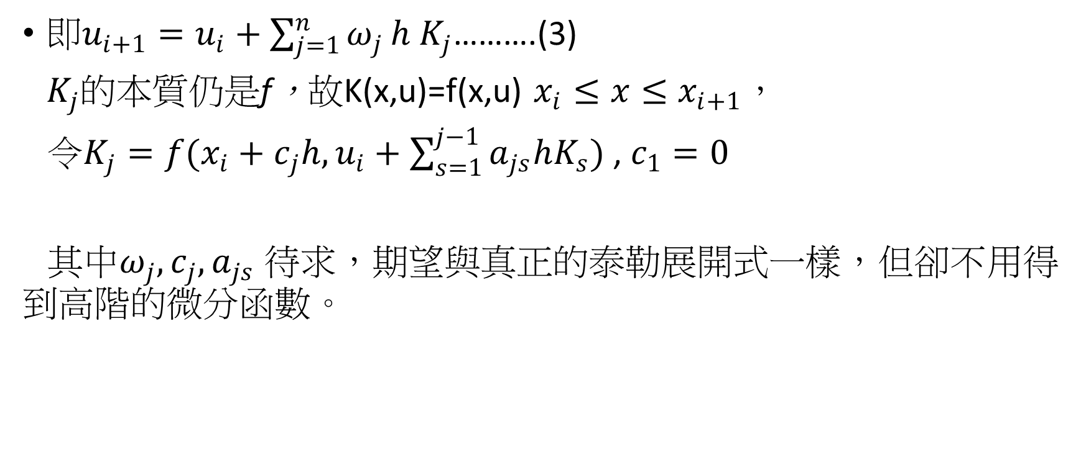
Runge-Kutta Method
${即u}_{i+1}=u_{i}+\sum_{j=1}^{n}{ω_{j}}h K_{j}$……….(3)
$K_{j}$的本質仍是f，故K(x,u)=f(x,u) $x_{i}≤x≤x_{i+1}$，
令$K_{j}=f(x_{i}+c_{j}h,u_{i}+\sum_{s=1}^{j−1}{a_{js}hK_{s}})$ , $c_{1}=0$
其中$ω_{j},c_{j},a_{js}$ 待求，期望與真正的泰勒展開式一樣，但卻不用得 到高階的微分函數。

Slide 7

Runge-Kutta Method
例子: 一階時，$u_{i+1}=u_{i}+ω_{1}hK_{1}$ 其中$K_{1}=f\left(x_{i},u_{i}\right),c_{1}$已知為0 $u_{i+1}=u_{i}+ω_{1}hf(x_{i},u_{i})$ 此時$ω_{1}$必為1，即Euler’s Method

Slide 8
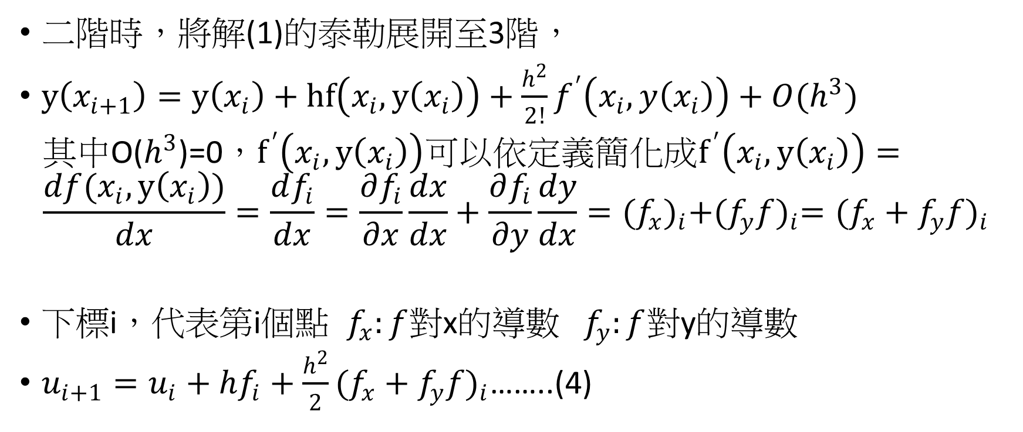
Runge-Kutta Method
二階時，將解(1)的泰勒展開至3階，
$y\left(x_{i+1}\right)=y\left(x_{i}\right)+hf\left(x_{i},y\left(x_{i}\right)\right)+\frac{h^{2}}{2!}f^{′}\left(x_{i},y\left(x_{i}\right)\right)+O(h^{3})$
其中O($h^{3}$)=0，$f^{′}\left(x_{i},y\left(x_{i}\right)\right)可以依定義簡化成f^{′}\left(x_{i},y\left(x_{i}\right)\right)=$
$$\frac{df(x_{i},y\left(x_{i}\right))}{dx}=\frac{df_{i}}{dx}=\frac{∂f_{i}}{∂x}\frac{dx}{dx}+\frac{∂f_{i}}{∂y}\frac{dy}{dx}={(f_{x})}_{i}+{(f_{y}f)}_{i}={(f_{x}+f_{y}f)}_{i}$$
下標i，代表第i個點 $f_{x}:f$對x的導數 $f_{y}:f$對y的導數
$u_{i+1}=u_{i}+hf_{i}+\frac{h^{2}}{2}{(f_{x}+f_{y}f)}_{i}$……..(4)

Slide 9
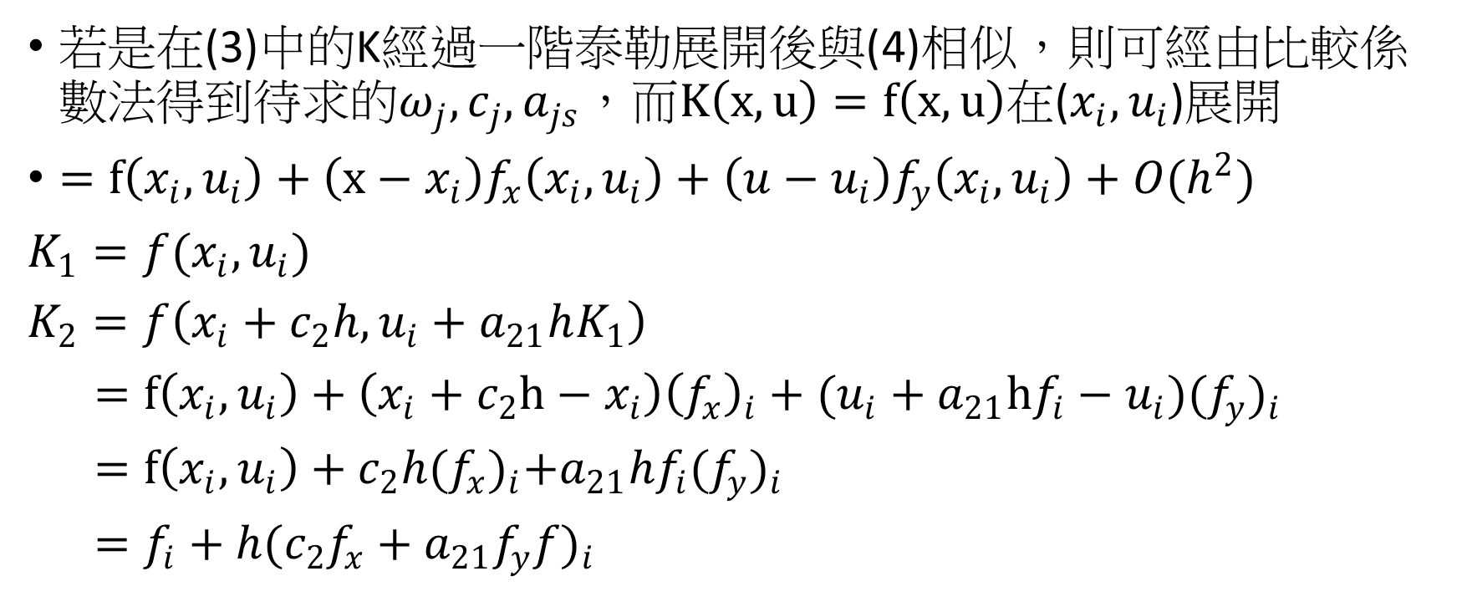
Runge-Kutta Method
若是在(3)中的K經過一階泰勒展開後與(4)相似，則可經由比較係數法得到待求的$ω_{j},c_{j},a_{js}，$而$K\left(x,u\right)=f\left(x,u\right)$在($x_{i},u_{i}$)展開
$=f\left(x_{i},u_{i}\right)+\left(x−x_{i}\right)f_{x}\left(x_{i},u_{i}\right)+\left(u−u_{i}\right)f_{y}\left(x_{i},u_{i}\right)+O(h^{2})$
$K_{1}=f(x_{i},u_{i})$
$K_{2}=f\left(x_{i}+c_{2}h,u_{i}+a_{21}hK_{1}\right)$
$=f\left(x_{i},u_{i}\right)+\left(x_{i}+c_{2}h−x_{i}\right){\left(f_{x}\right)}_{i}+(u_{i}+a_{21}hf_{i}−u_{i}){(f_{y})}_{i}$
$=f\left(x_{i},u_{i}\right)+c_{2}h{(f_{x})}_{i}+a_{21}hf_{i}{(f_{y})}_{i}$
$=f_{i}+h{(c_{2}f_{x}+a_{21}f_{y}f)}_{i}$

Slide 10

Runge-Kutta Method
而Runge-Kutta
$u_{i+1}=u_{i}+ω_{1}hK_{1}+ω_{2}hK_{2}$
$=u_{i}+ω_{1}hf_{i}+ω_{2}h(f_{i}+h{(c_{2}f_{x}+a_{21}f_{y}f)}_{i})$
$=u_{i}+\left(ω_{1}+ω_{2}\right)hf_{i}+ω_{2}c_{2}h^{2}{(f_{x})}_{i}+ω_{2}a_{21}h^{2}{(f_{y}f)}_{i}$……..(5)

Slide 11
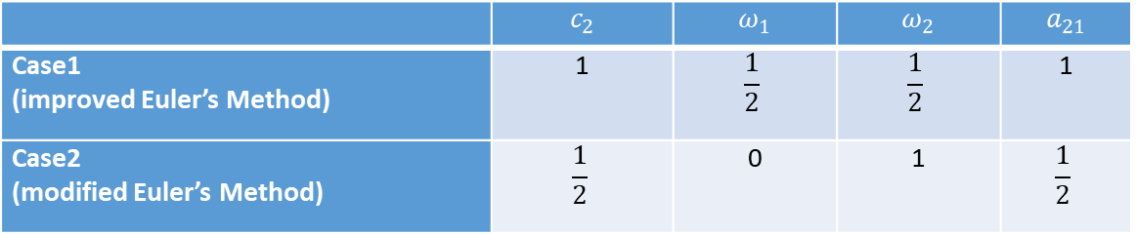

Runge-Kutta Method
(4) $u_{i+1}=u_{i}+hf_{i}+\frac{h^{2}}{2}{(f_{x})}_{i}+\frac{h^{2}}{2}{(f_{y}f)}_{i}$
So $ω_{1}+ω_{2}=1$
$ω_{2}c_{2}=\frac{1}{2}$
$ω_{2}a_{21}=\frac{1}{2}$
有無窮多解，取簡單的兩組case
 | $$c_{2}$$ | $$ω_{1}$$ | $$ω_{2}$$ | $$a_{21}$$
Case1 (improved Euler’s Method) | 1 | $$\frac{1}{2}$$ | $$\frac{1}{2}$$ | 1
Case2 (modified Euler’s Method) | $$\frac{1}{2}$$ | 0 | 1 | $$\frac{1}{2}$$

Slide 12
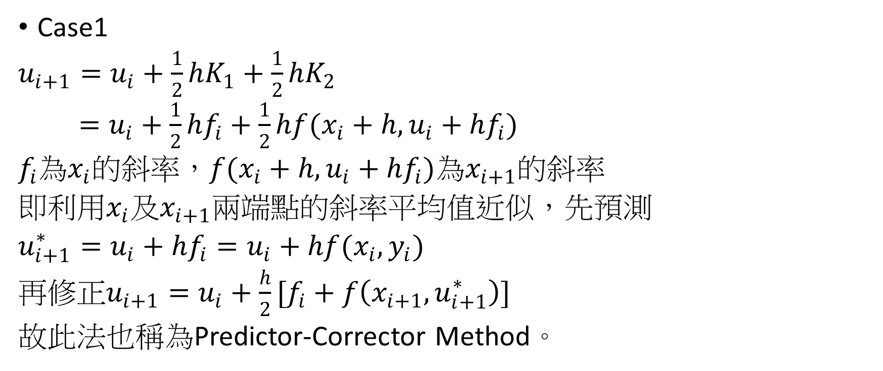
Runge-Kutta Method
Case1
$u_{i+1}=u_{i}+\frac{1}{2}hK_{1}+\frac{1}{2}hK_{2}$
$=u_{i}+\frac{1}{2}hf_{i}+\frac{1}{2}hf(x_{i}+h,u_{i}+hf_{i})$
$f_{i}$為$x_{i}$的斜率，$f(x_{i}+h,u_{i}+hf_{i})$為$x_{i+1}$的斜率
即利用$x_{i}$及$x_{i+1}$兩端點的斜率平均值近似，先預測
$u_{i+1}^{∗}=u_{i}+hf_{i}=u_{i}+hf(x_{i},y_{i})$
再修正$u_{i+1}=u_{i}+\frac{h}{2}[f_{i}+f\left(x_{i+1},u_{i+1}^{∗}\right)]$
故此法也稱為Predictor-Corrector Method。

Slide 13
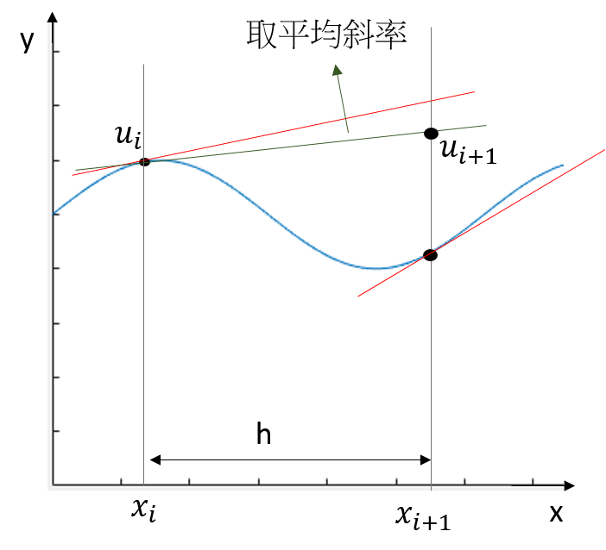
Runge-Kutta Method

Slide 14

Runge-Kutta Method
Case2
$u_{i+1}=u_{i}+hf(x_{i}+\frac{h}{2},u_{i}+\frac{1}{2}hf_{i})$
又稱為中點法，Modified Euler

Slide 15
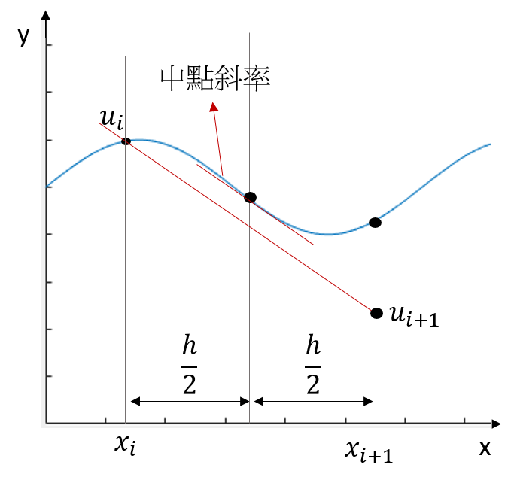
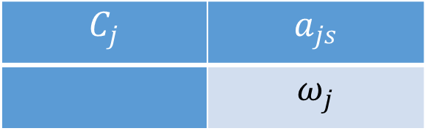
Runge-Kutta Method
$$C_{j}$$ | $$a_{js}$$
 | $$ω_{j}$$

Slide 16
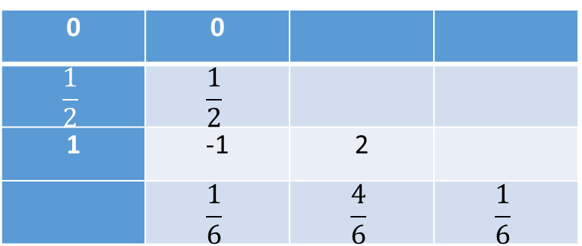

Runge-Kutta Method
同理3rd-order R-K method
$u_{i+1}=u_{i}+\frac{h}{6}(K_{1}+4K_{2}+K_{3})$
$K_{1}=f(x_{i},u_{i})$
$K_{2}=f(x_{i}+\frac{h}{2},u_{i}+\frac{h}{2}K_{1})$
$K_{3}=f(x_{i}+h,u_{i}−hK_{1}+2hK_{2})$
0 | 0
$$\frac{1}{2}$$ | $$\frac{1}{2}$$
1 | -1 | 2
 | $$\frac{1}{6}$$ | $$\frac{4}{6}$$ | $$\frac{1}{6}$$

Slide 17

Runge-Kutta Method
4th-order
$u_{i+1}=u_{i}+\frac{h}{6}(K_{1}+2K_{2}+2K_{3}+K_{4})$
$K_{1}=f\left(x_{i},u_{i}\right)$
$K_{2}=f(x_{i}+\frac{h}{2},u_{i}+\frac{h}{2}K_{1})$
$K_{3}=f(x_{i}+\frac{h}{2},u_{i}+\frac{h}{2}K_{2})$
$K_{4}=f(x_{i}+h,u_{i}+hK_{3})$

Slide 18
Runge-Kutta Method
只與前一間距的值有關，稱Single-step method
但一旦用這類方法取得部分資料後，我們對所積分的函數(及其導數)事實上有了額外的資料，此類方法稱為Multistep Method
利用以前所獲得的y和y’，建立導函數的近似多項式，並外插到下一積分間距。
為了方便，大多數Multistep都取等間距，主要是讓多項式易於建立，如Adams method。

Slide 19
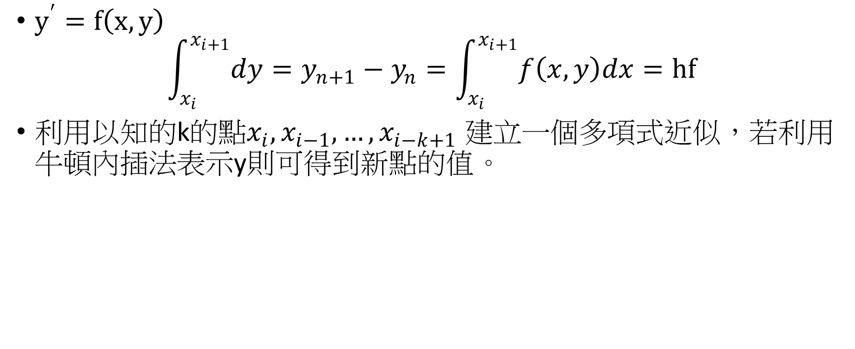
Adams method
$y^{′}=f\left(x,y\right)$
$$\int_{x_{i}}^{x_{i+1}}{dy}=y_{n+1}−y_{n}=\int_{x_{i}}^{x_{i+1}}{f\left(x,y\right)dx}=hf$$
利用以知的k的點$x_{i},x_{i−1},…,x_{i−k+1}$ 建立一個多項式近似，若利用牛頓內插法表示y則可得到新點的值。

Slide 20

Adams method
Adams-Bashforth Method 利用之前求得的f也就是y’求得外插之$u_{i+1}$
其型式為
$$u_{i+1}=u_{i}+h\sum_{j=1}^{k}{β_{j}u_{i−(j−1)}^{′}}$$
其中$u_{j}^{′}=f(x_{j},u_{j})$

Slide 21
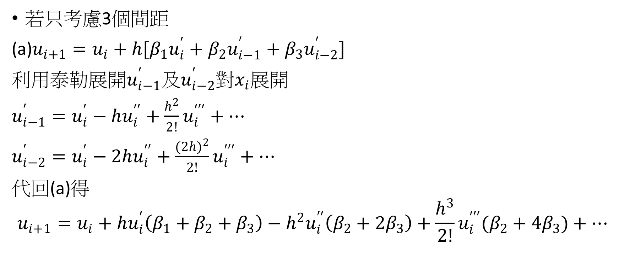
Adams method
若只考慮3個間距
(a)$u_{i+1}=u_{i}+h[β_{1}u_{i}^{′}+β_{2}u_{i−1}^{′}+β_{3}u_{i−2}^{′}]$
利用泰勒展開$u_{i−1}^{′}$及$u_{i−2}^{′}$對$x_{i}$展開
$u_{i−1}^{′}=u_{i}^{′}−hu_{i}^{′′}+\frac{h^{2}}{2!}u_{i}^{′′′}+…$
$u_{i−2}^{′}=u_{i}^{′}−2hu_{i}^{′′}+\frac{(2{h)}^{2}}{2!}u_{i}^{′′′}+…$
代回(a)得
$$u_{i+1}=u_{i}+hu_{i}^{′}\left(β_{1}+β_{2}+β_{3}\right)−h^{2}u_{i}^{′′}\left(β_{2}+2β_{3}\right)+\frac{h^{3}}{2!}u_{i}^{′′′}(β_{2}+4β_{3})+…$$

Slide 22
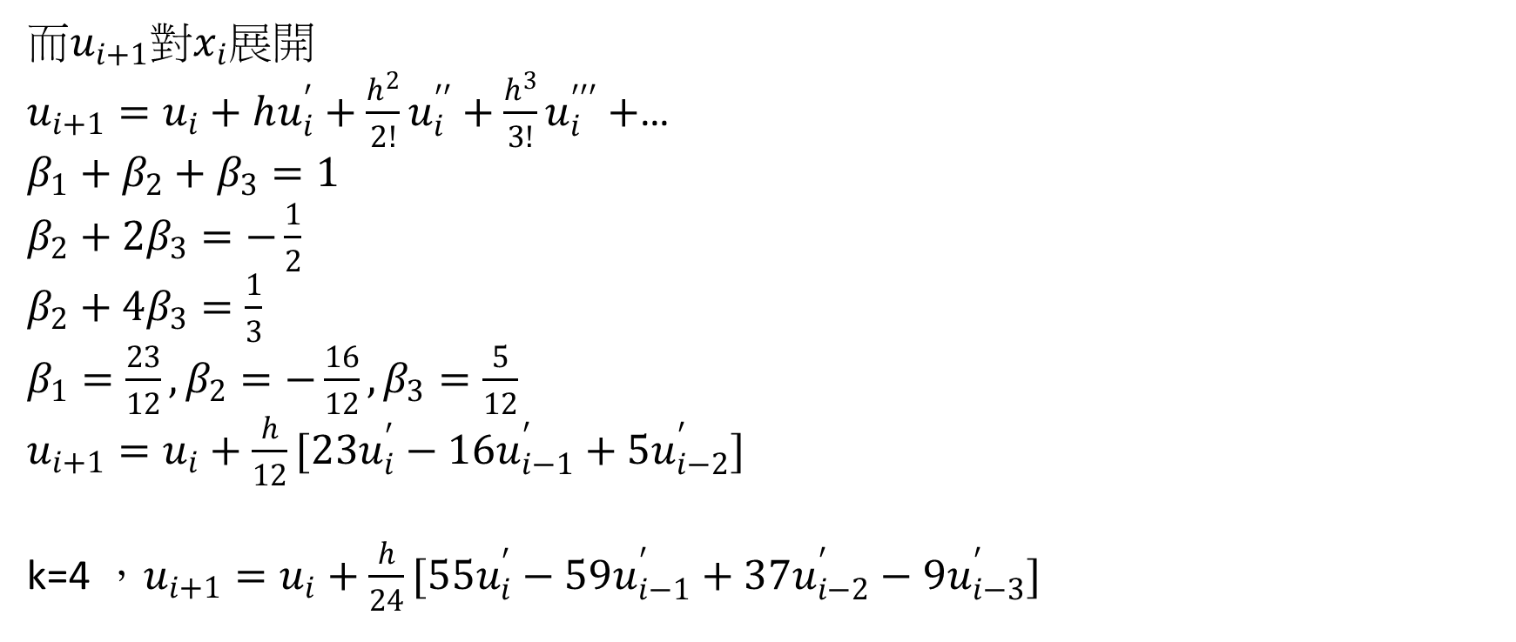
Adams method
而$u_{i+1}$對$x_{i}$展開
$u_{i+1}=u_{i}+hu_{i}^{′}+\frac{h^{2}}{2!}u_{i}^{′′}+\frac{h^{3}}{3!}u_{i}^{′′′}+$…
$β_{1}+β_{2}+β_{3}=1$
$β_{2}+2β_{3}=−\frac{1}{2}$
$β_{2}+4β_{3}=\frac{1}{3}$
$β_{1}=\frac{23}{12},β_{2}=−\frac{16}{12},β_{3}=\frac{5}{12}$
$u_{i+1}=u_{i}+\frac{h}{12}[23u_{i}^{′}−16u_{i−1}^{′}+5u_{i−2}^{′}]$
k=4 ，$u_{i+1}=u_{i}+\frac{h}{24}[55u_{i}^{′}−59u_{i−1}^{′}+37u_{i−2}^{′}−9u_{i−3}^{′}]$

Slide 23
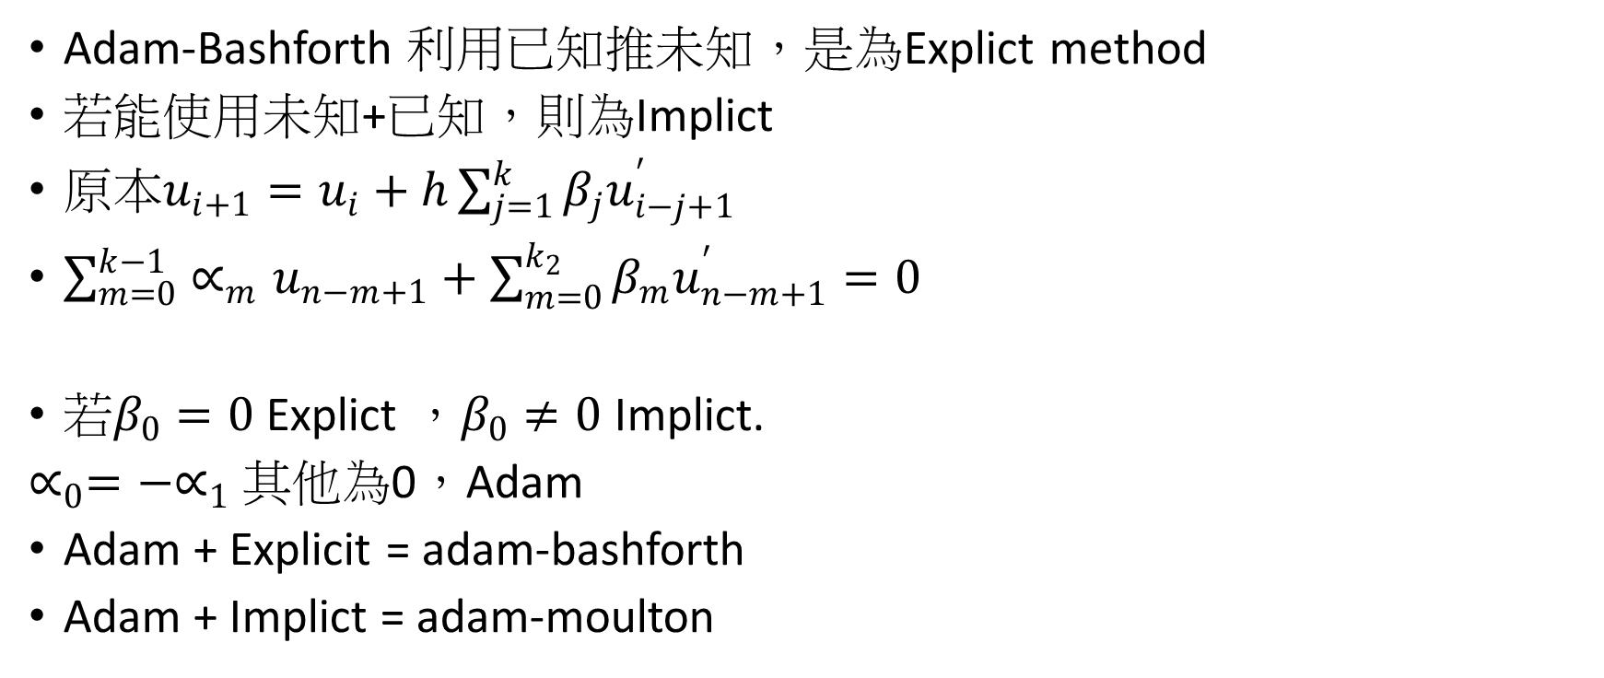
Adams method
Adam-Bashforth 利用已知推未知，是為Explict method
若能使用未知+已知，則為Implict
原本$u_{i+1}=u_{i}+h\sum_{j=1}^{k}{β_{j}u_{i−j+1}^{′}}$
$\sum_{m=0}^{k−1}{∝_{m}u_{n−m+1}}+\sum_{m=0}^{k_{2}}{β_{m}u_{n−m+1}^{′}}=0$
若$β_{0}=0$ Explict ，$β_{0}≠0$ Implict.
$∝_{0}=−∝_{1}$ 其他為0，Adam
Adam + Explicit = adam-bashforth
Adam + Implict = adam-moulton

Slide 24
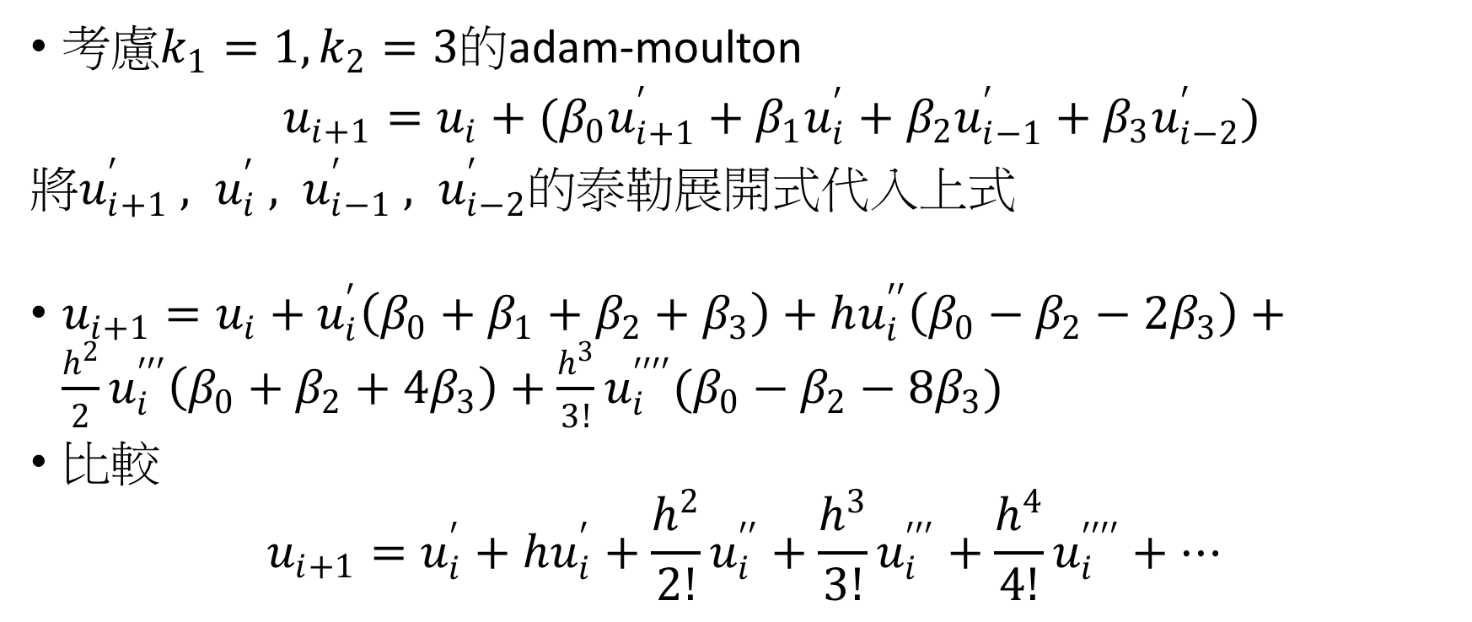
Adams method
考慮$k_{1}=1,k_{2}=3$的adam-moulton
$u_{i+1}=u_{i}+(β_{0}u_{i+1}^{′}+β_{1}u_{i}^{′}+β_{2}u_{i−1}^{′}+β_{3}u_{i−2}^{′})$
將$u_{i+1}^{′} , u_{i}^{′} , u_{i−1}^{′} , u_{i−2}^{′}$的泰勒展開式代入上式
$u_{i+1}=u_{i}+u_{i}^{′}\left(β_{0}+β_{1}+β_{2}+β_{3}\right)+hu_{i}^{′′}\left(β_{0}−β_{2}−2β_{3}\right)+\frac{h^{2}}{2}u_{i}^{′′′}\left(β_{0}+β_{2}+4β_{3}\right)+\frac{h^{3}}{3!}u_{i}^{′′′′}(β_{0}−β_{2}−8β_{3})$
比較
$$u_{i+1}=u_{i}^{′}+hu_{i}^{′}+\frac{h^{2}}{2!}u_{i}^{′′}+\frac{h^{3}}{3!}u_{i}^{′′′}+\frac{h^{4}}{4!}u_{i}^{′′′′}+…$$

Slide 25
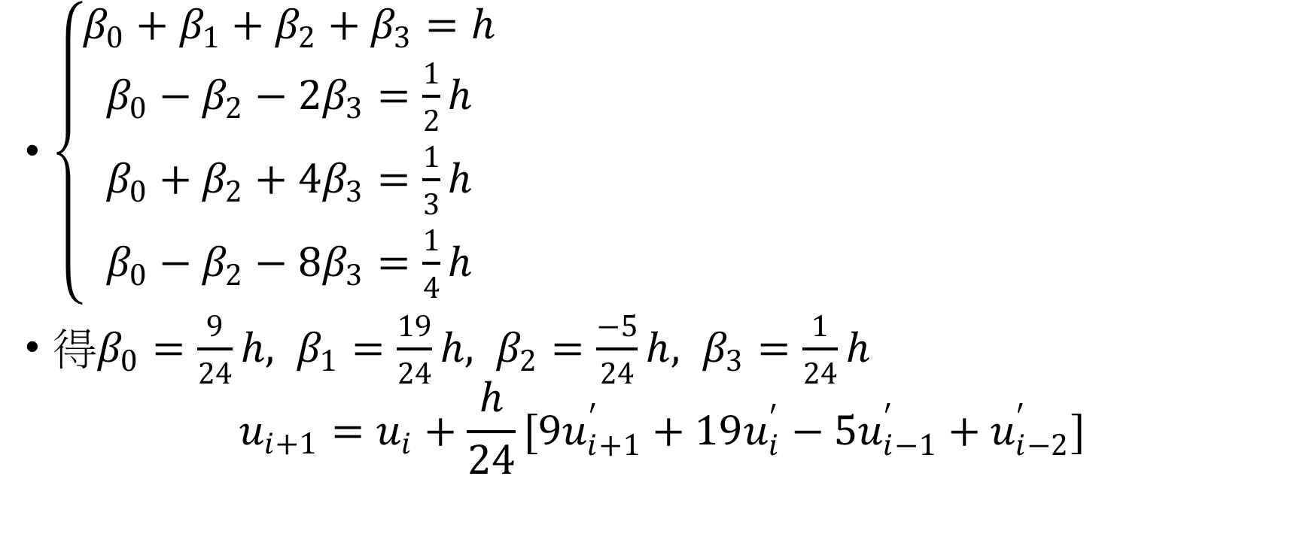
Adams method
$\left\{\begin{aligned}\begin{aligned}β_{0}+β_{1}+β_{2}+β_{3}=h \\ β_{0}−β_{2}−2β_{3}=\frac{1}{2}h \\ β_{0}+β_{2}+4β_{3}=\frac{1}{3}h\end{aligned} \\ β_{0}−β_{2}−8β_{3}=\frac{1}{4}h\end{aligned}\right.$
得$β_{0}=\frac{9}{24}h, β_{1}=\frac{19}{24}h, β_{2}=\frac{−5}{24}h, β_{3}=\frac{1}{24}h$
$$u_{i+1}=u_{i}+\frac{h}{24}[9u_{i+1}^{′}+19u_{i}^{′}−5u_{i−1}^{′}+u_{i−2}^{′}]$$

Slide 26
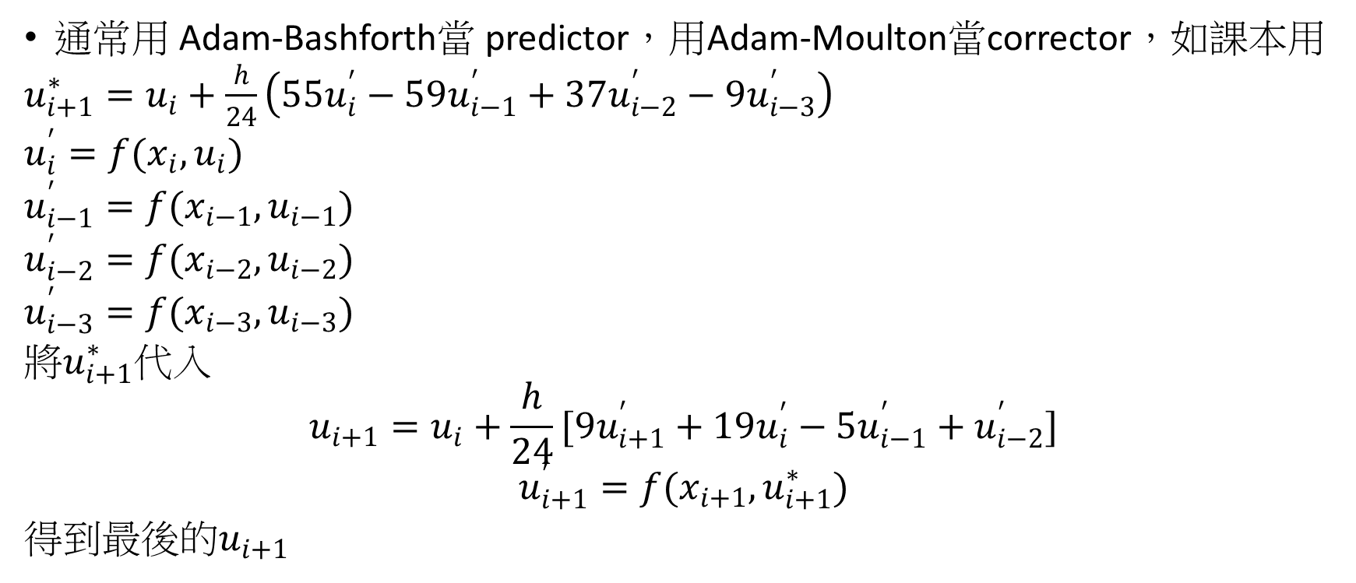
Adams method
通常用 Adam-Bashforth當 predictor，用Adam-Moulton當corrector，如課本用
$u_{i+1}^{∗}=u_{i}+\frac{h}{24}\left(55u_{i}^{′}−59u_{i−1}^{′}+37u_{i−2}^{′}−9u_{i−3}^{′}\right)$
$u_{i}^{′}=f(x_{i},u_{i})$
$u_{i−1}^{′}=f(x_{i−1},u_{i−1})$
$u_{i−2}^{′}=f(x_{i−2},u_{i−2})$
$u_{i−3}^{′}=f(x_{i−3},u_{i−3})$
將$u_{i+1}^{∗}$代入
$$u_{i+1}=u_{i}+\frac{h}{24}[9u_{i+1}^{′}+19u_{i}^{′}−5u_{i−1}^{′}+u_{i−2}^{′}]$$
$$u_{i+1}^{′}=f(x_{i+1},u_{i+1}^{∗})$$
得到最後的$u_{i+1}$

Slide 27
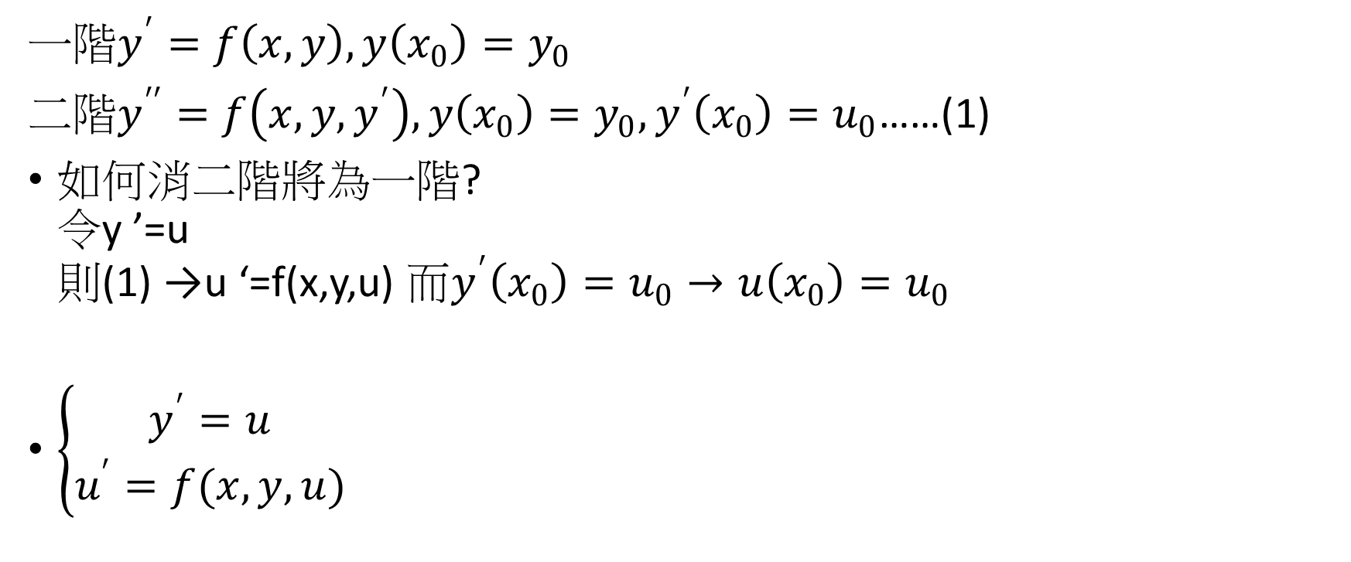
High-order
一階$y^{′}=f\left(x,y\right),y\left(x_{0}\right)=y_{0}$
二階$y^{′′}=f\left(x,y,y^{′}\right),y\left(x_{0}\right)=y_{0},y^{′}\left(x_{0}\right)=u_{0}$……(1)
如何消二階將為一階? 令y ’=u 則(1) →u ‘=f(x,y,u) 而$y^{′}\left(x_{0}\right)=u_{0}→u\left(x_{0}\right)=u_{0}$
$\left\{\begin{aligned}y^{′}=u \\ u^{′}=f(x,y,u)\end{aligned}\right.$

Slide 28

High-order
以Euler為例
$y_{n+1}=y_{n}+hu_{n}$
$u_{n+1}=u_{n}+hf(x_{n},y_{n},u_{n})$
$u_{0}$已知$y_{0}$已知，可求$y_{1}$
$x_{0},y_{0},u_{0}\text{已知，可求}u_{1}$
可以再代入上式

Slide 29
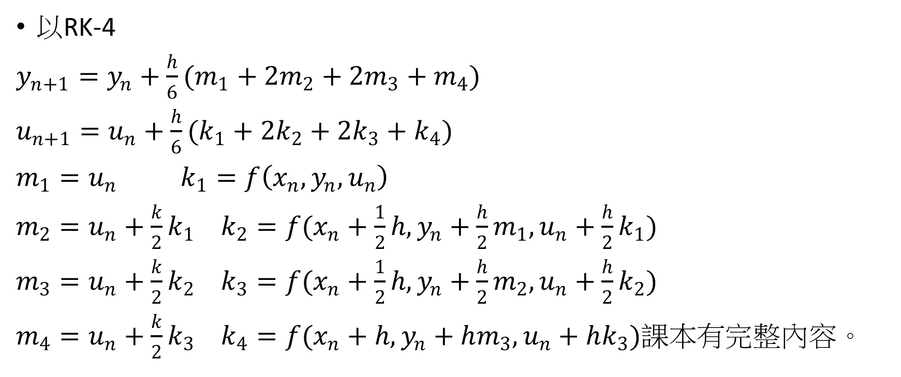
High-order
以RK-4
$y_{n+1}=y_{n}+\frac{h}{6}(m_{1}+2m_{2}+2m_{3}+m_{4})$
$u_{n+1}=u_{n}+\frac{h}{6}(k_{1}+2k_{2}+2k_{3}+k_{4})$
$m_{1}=u_{n}$ $k_{1}=f\left(x_{n},y_{n},u_{n}\right)$
$m_{2}=u_{n}+\frac{k}{2}k_{1}$ $k_{2}=f(x_{n}+\frac{1}{2}h,y_{n}+\frac{h}{2}m_{1},u_{n}+\frac{h}{2}k_{1})$
$m_{3}=u_{n}+\frac{k}{2}k_{2}$ $k_{3}=f(x_{n}+\frac{1}{2}h,y_{n}+\frac{h}{2}m_{2},u_{n}+\frac{h}{2}k_{2})$
$m_{4}=u_{n}+\frac{k}{2}k_{3}$ $k_{4}=f(x_{n}+h,y_{n}+hm_{3},u_{n}+hk_{3})$課本有完整內容。

Slide 30

High-order
m階常微分方程
$$y^{(m)}=f\left(x,y,y^{′},y^{′′},…,y^{\left(m−1\right)}\right)………(1)$$
I.C.
$$y\left(x_{0}\right)=y_{0}$$
$$y′\left(x_{0}\right)=y_{0 , 1}$$
$$y′′\left(x_{0}\right)=y_{0 ,2}$$
……….
$$y^{\left(m−1\right)}\left(x_{0}\right)=y_{0 ,m−1}$$

Slide 31

High-order
可改寫為一組一次微分方程式，首先定義如下
$$y_{1}=y\left(x\right)$$
$$y_{2}=y^{′}\left(x\right)$$
………
$$y_{m}=y^{\left(m−1\right)}(x)$$

Slide 32

High-order
則(1)可變為
$$y_{1}^{′}=y_{2}=f_{1}(x,y_{1},y_{2},…,y_{m})$$
$$y_{2}^{′}=y_{3}=f_{2}(x,y_{1},y_{2},…,y_{m})$$
…………
$y_{m}^{′}=y^{(m)}=f\left(x,y_{1},y_{2},…,y_{m}\right)=f_{m}(x,y_{1},y_{2},…,y_{m})$
I.C.
$$y_{1}\left(x_{0}\right)=y_{0}$$
$$y_{2}\left(x_{0}\right)=y_{0,1}$$
………
$$y_{m}\left(x_{0}\right)=y_{0,m−1}$$

Slide 33
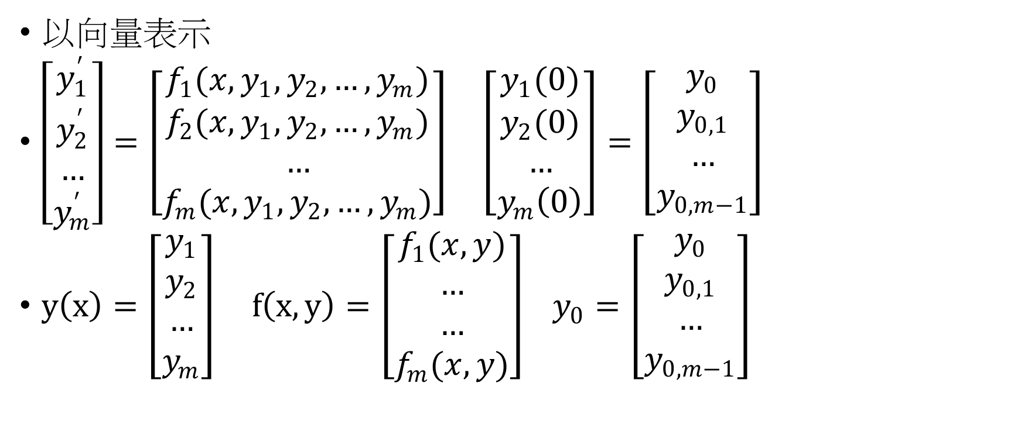
High-order
以向量表示
$\left[\begin{aligned}y_{1}^{′} \\ y_{2}^{′} \\ … \\ y_{m}^{′}\end{aligned}\right]=\left[\begin{aligned}f_{1}(x,y_{1},y_{2},…,y_{m}) \\ f_{2}(x,y_{1},y_{2},…,y_{m}) \\ … \\ f_{m}(x,y_{1},y_{2},…,y_{m})\end{aligned}\right] \left[\begin{aligned}y_{1}(0) \\ y_{2}(0) \\ … \\ y_{m}\left(0\right)\end{aligned}\right]=\left[\begin{aligned}y_{0} \\ y_{0,1} \\ … \\ y_{0,m−1}\end{aligned}\right]$
$y\left(x\right)=\left[\begin{aligned}y_{1} \\ y_{2} \\ … \\ y_{m}\end{aligned}\right] f\left(x,y\right)=\left[\begin{aligned}f_{1}(x,y) \\ … \\ … \\ f_{m}(x,y)\end{aligned}\right] y_{0}=\left[\begin{aligned}y_{0} \\ y_{0,1} \\ … \\ y_{0,m−1}\end{aligned}\right]$

Slide 34

High-order
$y^{′}\left(x\right)=f\left(x,y\right) ，I.C. y\left(0\right)=y_{0}$
$$\frac{dy_{1}}{dx}=f_{1}(x,y_{1},y_{2},…,y_{n})$$
$$\frac{dy_{2}}{dx}=f_{2}(x,y_{1},y_{2},…,y_{n})$$
………
$$\frac{dy_{n}}{dx}=f_{n}(x,y_{1},y_{2},…,y_{n})$$
$y_{j}\left(x=x_{0}\right)=y_{j,0} j=1 to n$

Slide 35
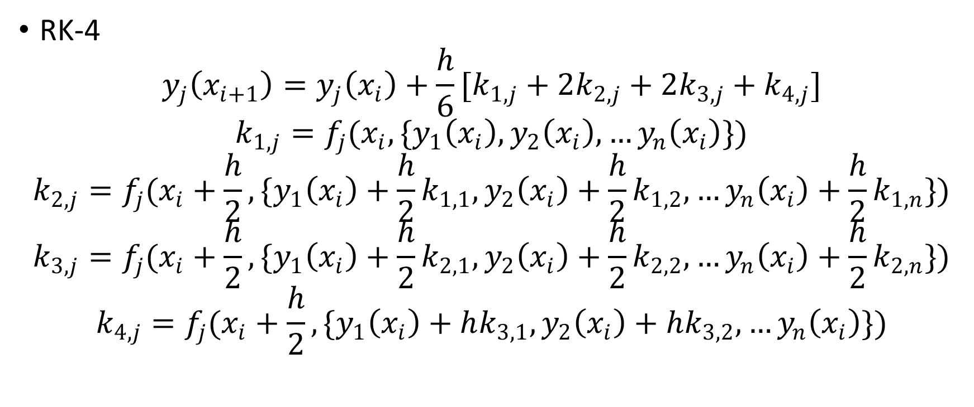
High-order
RK-4
$$y_{j}\left(x_{i+1}\right)=y_{j}\left(x_{i}\right)+\frac{h}{6}[k_{1,j}+2k_{2,j}+2k_{3,j}+k_{4,j}]$$
$$k_{1,j}=f_{j}(x_{i},{\{y}_{1}\left(x_{i}\right),y_{2}\left(x_{i}\right),…y_{n}\left(x_{i}\right)\})$$
$$k_{2,j}=f_{j}(x_{i}+\frac{h}{2},{\{y}_{1}\left(x_{i}\right)+\frac{h}{2}k_{1,1},y_{2}\left(x_{i}\right)+\frac{h}{2}k_{1,2},…y_{n}\left(x_{i}\right)+\frac{h}{2}k_{1,n}\})$$
$$k_{3,j}=f_{j}(x_{i}+\frac{h}{2},{\{y}_{1}\left(x_{i}\right)+\frac{h}{2}k_{2,1},y_{2}\left(x_{i}\right)+\frac{h}{2}k_{2,2},…y_{n}\left(x_{i}\right)+\frac{h}{2}k_{2,n}\})$$
$$k_{4,j}=f_{j}(x_{i}+\frac{h}{2},{\{y}_{1}\left(x_{i}\right)+hk_{3,1},y_{2}\left(x_{i}\right)+hk_{3,2},…y_{n}\left(x_{i}\right)\})$$

Slide 36
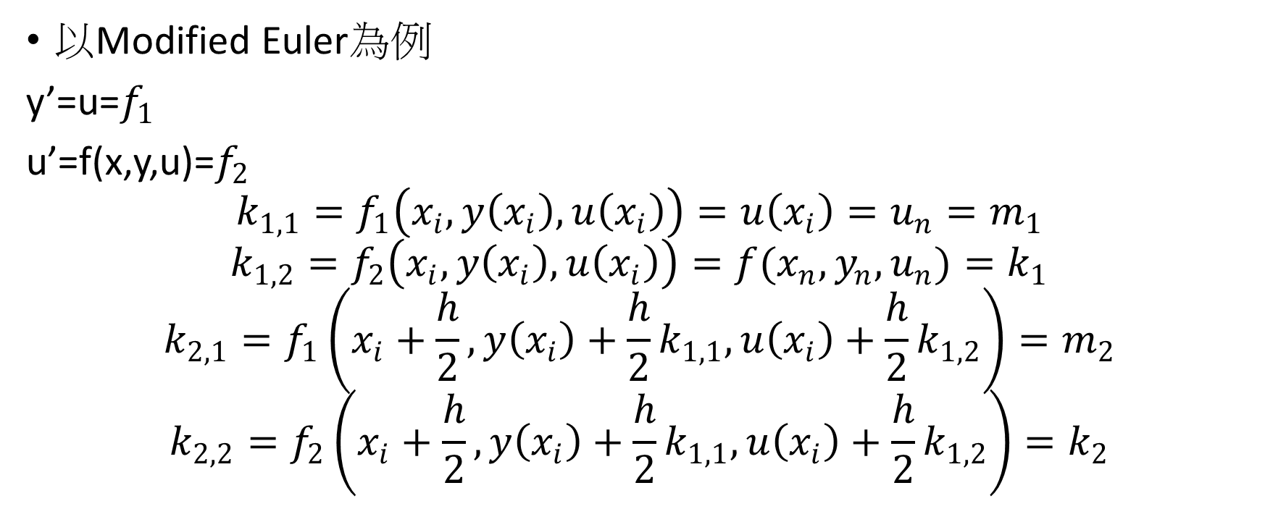
High-order
以Modified Euler為例
y’=u=$f_{1}$
u’=f(x,y,u)=$f_{2}$
$$k_{1,1}=f_{1}\left(x_{i},y\left(x_{i}\right),u\left(x_{i}\right)\right)=u\left(x_{i}\right)=u_{n}=m_{1}$$
$$k_{1,2}=f_{2}\left(x_{i},y\left(x_{i}\right),u\left(x_{i}\right)\right)=f(x_{n},y_{n},u_{n})=k_{1}$$
$$k_{2,1}=f_{1}\left(x_{i}+\frac{h}{2},y\left(x_{i}\right)+\frac{h}{2}k_{1,1},u\left(x_{i}\right)+\frac{h}{2}k_{1,2}\right)=m_{2}$$
$$k_{2,2}=f_{2}\left(x_{i}+\frac{h}{2},y\left(x_{i}\right)+\frac{h}{2}k_{1,1},u\left(x_{i}\right)+\frac{h}{2}k_{1,2}\right)=k_{2}$$

Slide 37
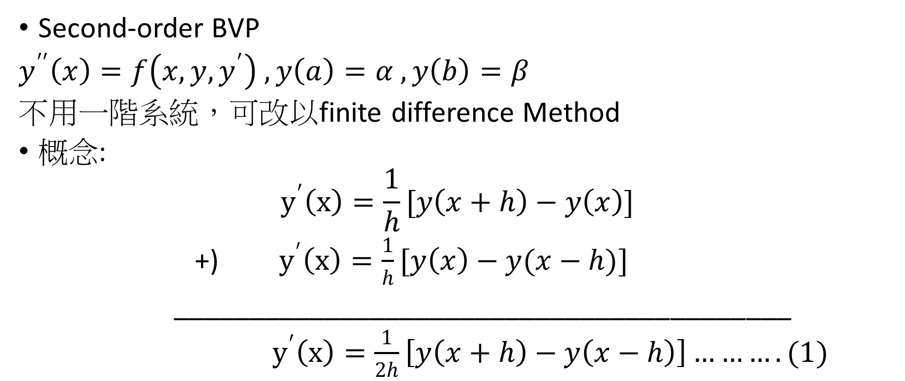
High-order
Second-order BVP
$y^{′′}\left(x\right)=f\left(x,y,y^{′}\right) , y\left(a\right)=α , y\left(b\right)=β$
不用一階系統，可改以finite difference Method
概念:
$$y^{′}\left(x\right)=\frac{1}{h}[y\left(x+h\right)−y\left(x\right)]$$
+) $y^{′}\left(x\right)=\frac{1}{h}[y\left(x\right)−y(x−h)]$
_________________________________________
$y^{′}\left(x\right)=\frac{1}{2h}\left[y\left(x+h\right)−y\left(x−h\right)\right]……….(1)$

Slide 38
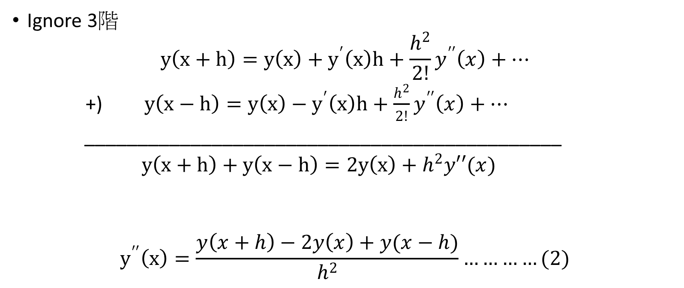
High-order
Ignore 3階
$$y\left(x+h\right)=y\left(x\right)+y^{′}\left(x\right)h+\frac{h^{2}}{2!}y^{′′}\left(x\right)+…$$
+) $y\left(x−h\right)=y\left(x\right)−y^{′}\left(x\right)h+\frac{h^{2}}{2!}y^{′′}\left(x\right)+…$
_____________________________________________
$y\left(x+h\right)+y\left(x−h\right)=2y\left(x\right)+h^{2}y′′(x)$
$$y^{′′}\left(x\right)=\frac{y\left(x+h\right)−2y\left(x\right)+y(x−h)}{h^{2}}…………(2)$$

Slide 39
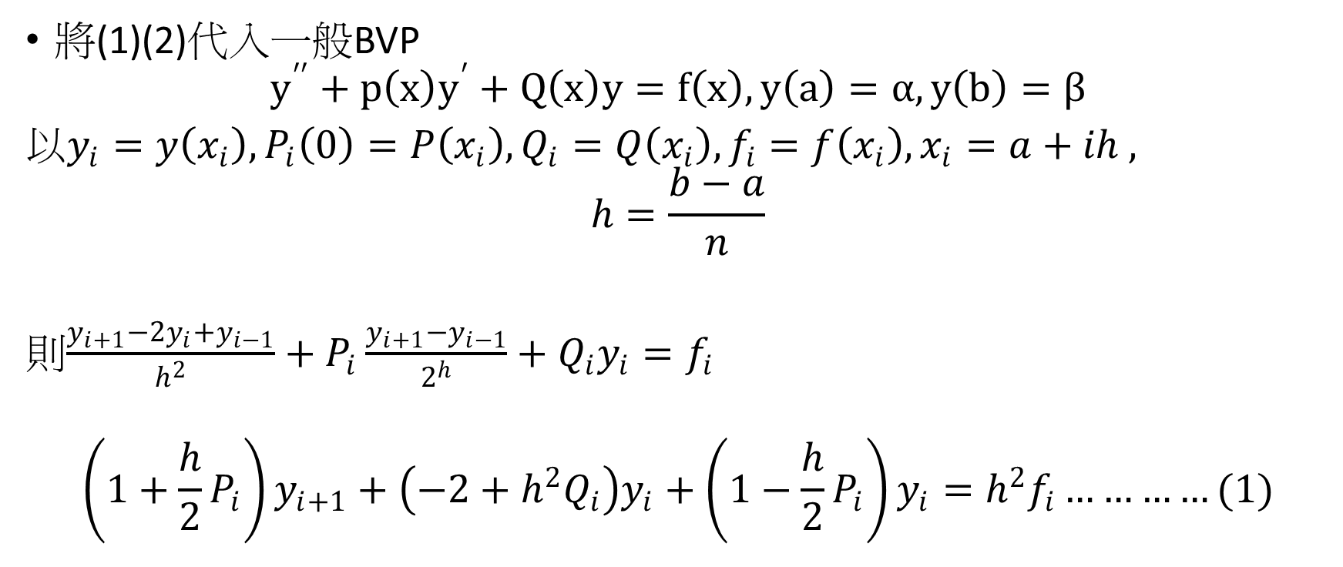
High-order
將(1)(2)代入一般BVP
$$y^{′′}+p\left(x\right)y^{′}+Q\left(x\right)y=f\left(x\right), y\left(a\right)=α, y\left(b\right)=β$$
以$y_{i}=y\left(x_{i}\right), P_{i}\left(0\right)=P\left(x_{i}\right), Q_{i}=Q\left(x_{i}\right), f_{i}=f\left(x_{i}\right), x_{i}=a+ih ,$
$$h=\frac{b−a}{n}$$
則$\frac{y_{i+1}−2y_{i}+y_{i−1}}{h^{2}}+P_{i}\frac{y_{i+1}−y_{i−1}}{2^{h}}+Q_{i}y_{i}=f_{i}$
$$\left(1+\frac{h}{2}P_{i}\right)y_{i+1}+\left(−2+h^{2}Q_{i}\right)y_{i}+\left(1−\frac{h}{2}P_{i}\right)y_{i}=h^{2}f_{i}…………(1)$$

Slide 40
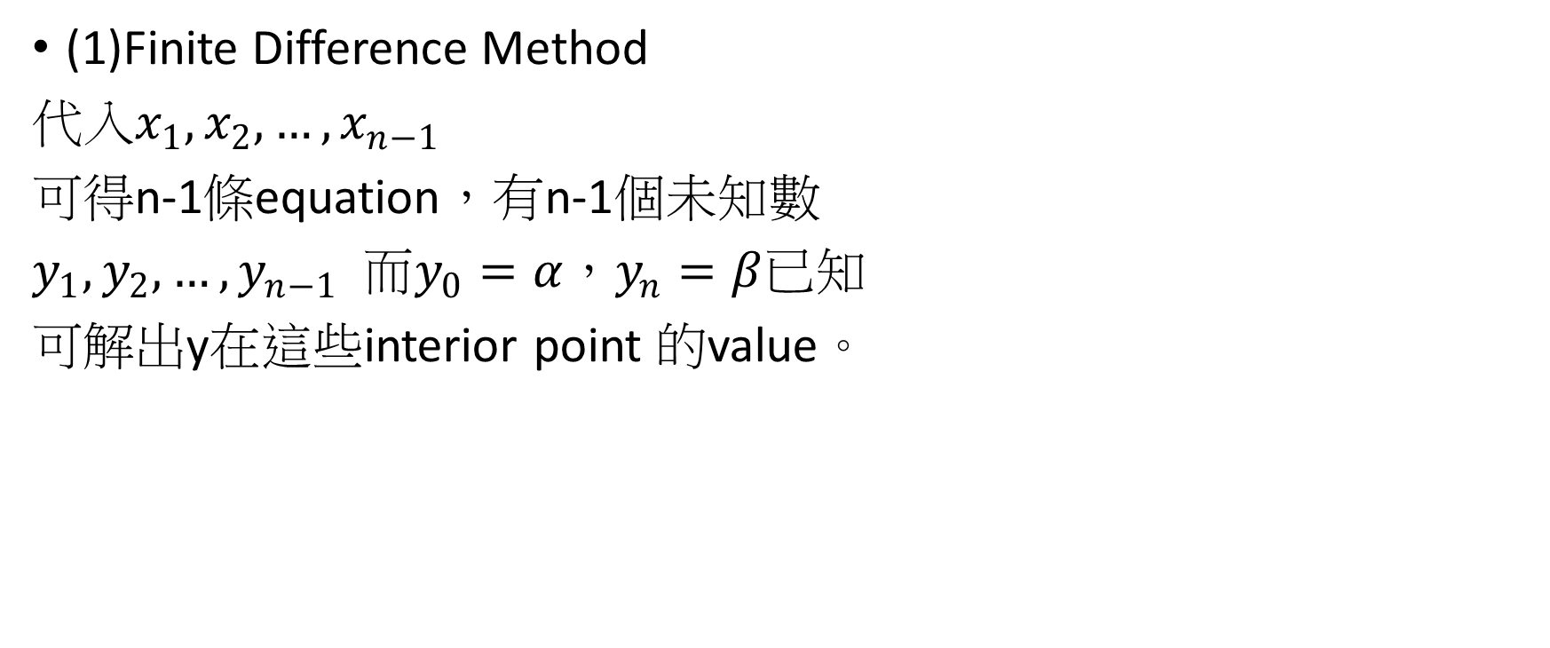
High-order
(1)Finite Difference Method
代入$x_{1},x_{2},…,x_{n−1}$
可得n-1條equation，有n-1個未知數
$y_{1},y_{2},…,y_{n−1}$ 而$y_{0}=α，y_{n}=β$已知
可解出y在這些interior point 的value。

