Slide 1

Team Meeting
Yunjung Jeong
2026. 07. 14
Intelligent Radio Sensing Lab. (IRS Lab)
Department of Electrical Engineering and Computer Science
DGIST
Notes:
Let me start today's team meeting.

Slide 2
Recap
Last Meeting
What I did
Drone selection — Mavic 4 Pro vs Matrice 4E (echo vs RTK ground truth)
Reviewed LaSen (SenSys '26) — the one 5G tracking paper, with RTK ground truth
What I planned
Three parallel tracks — PHY anatomy, AI self-study, and the Sionna simulation
Sionna: a controlled RD-map detection benchmark
Today
Progress on Sionna — the chamber, the drone meshes, and the articulated micro-Doppler model
Paper Introduction — From Denoising to De-Channeling (ICML 2026 Spotlight)
Notes:
Last time I did two things.
First, drone selection — Mavic 4 Pro versus Matrice 4E. The trade-off was echo strength against having RTK as ground truth.
Second, a short review of LaSen, the SenSys paper that tracks a drone using a 5G signal.
Since then I was at ICML and had a few other things going on, so this meeting is a slightly rushed one.
Today I will show the Sionna progress — the chamber, the drone meshes, and the micro-Doppler — and then introduce one paper from ICML.

Slide 3
Today
Contents
1 · Sionna Progress
Two stages — the environment (chamber + drone meshes) and micro-Doppler
2 · Paper Introduction
From Denoising to De-Channeling (ICML 2026) — physics-informed diffusion for WSR
Notes:
Today has two parts.
First, what I built in Sionna: the environment — the chamber and the drone meshes — and then the micro-Doppler of the spinning blades.
I also built the Wi-Fi, LTE and 5G waveforms to compare them as illuminators. But I want to verify that part properly, so I will bring it to the next meeting rather than show it half-checked.
Second, a short introduction to a paper from ICML that I found interesting.

Slide 4
PROGRESS REPORT
Sionna Simulation
From an empty chamber to a drone's radar signature — in two stages
① Environment → ② Micro-Doppler
Notes:
Let me start with the Sionna simulation.

Slide 5
Sionna Progress · Overview
Two Stages, Built on One Scene
① Environment
Shielded chamber
→
5 DJI meshes
→
RF materials
② Micro-Doppler
Articulated drone
→
Blade flash
+ tip Doppler
→
PX4 / Gazebo basis
Notes:
This is the path I took.
First the environment: the chamber, and five DJI drone meshes built from their real published specs. Every part carries its own radio material, so the model is ready for propagation, not just for rendering.
Then the micro-Doppler: I split the drone into a frame plus rotors that spin on their own. That gives the blade signature — and it is also the model we would need later if we want to fly these in PX4 or Gazebo.
Both stages sit on the same scene, so nothing is rebuilt twice.

Slide 6
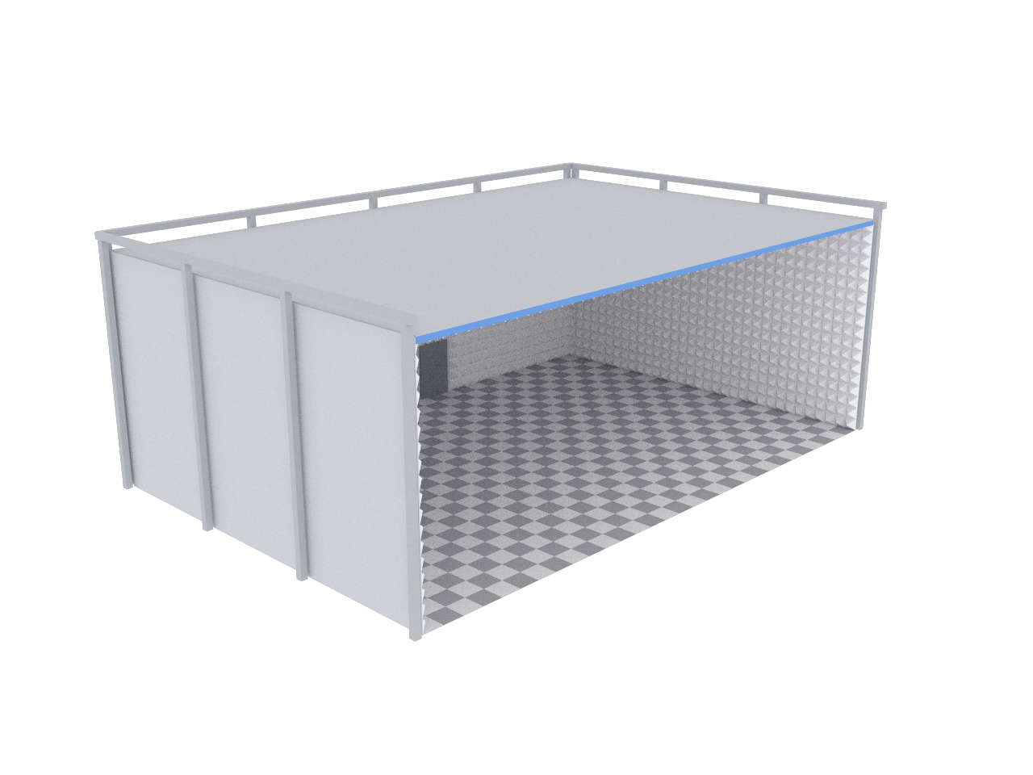
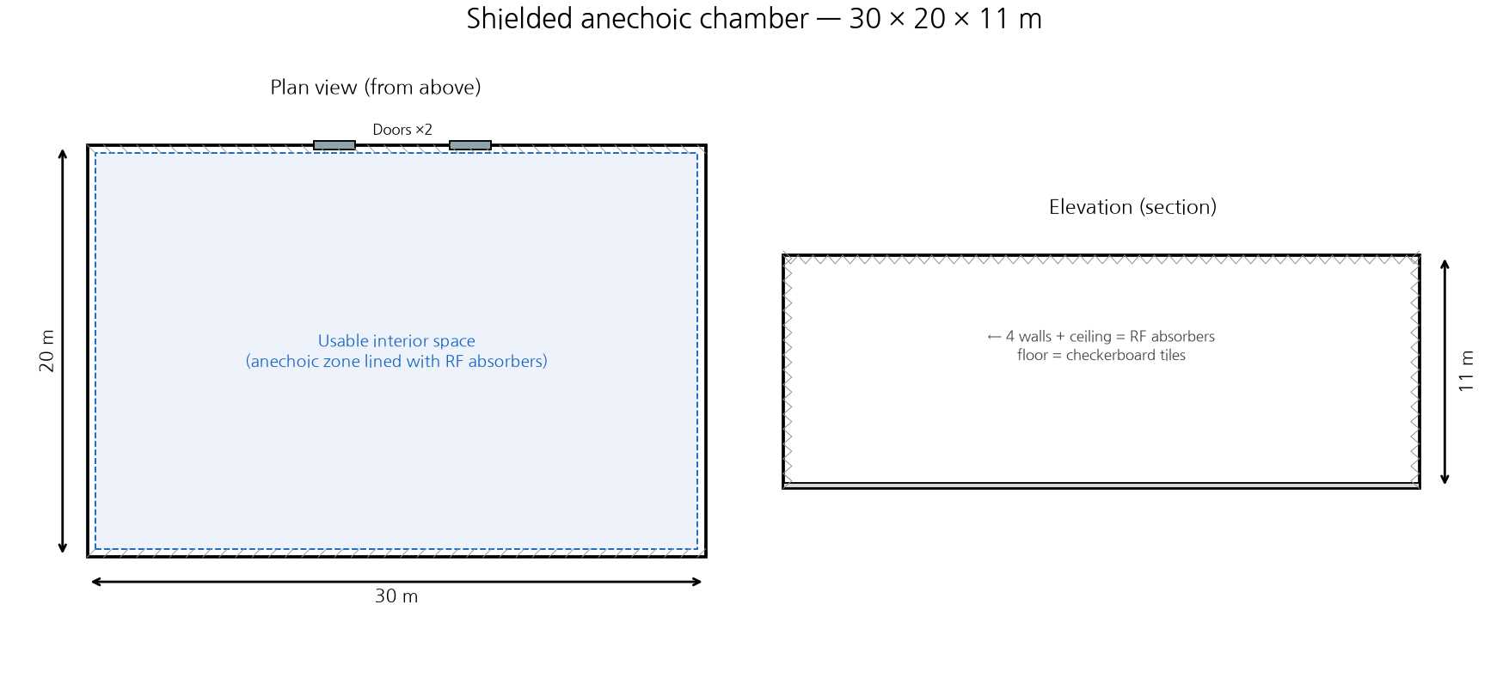
Stage 1 · Environment
The RF Playground — a Shielded Chamber
30 × 20 × 11 m shielded room
Sionna render of the chamber (left) · dimensioned plan & elevation (right) — modelled on a real facility
Notes:
For the chamber I copied the specs of the RF playground we were planning to use for the real experiment.
It is thirty by twenty by eleven meters. The walls are absorber, so the room's own echoes die away and we see only the drone.
On the left is the Sionna render; on the right, the dimensioned plan and elevation.

Slide 7
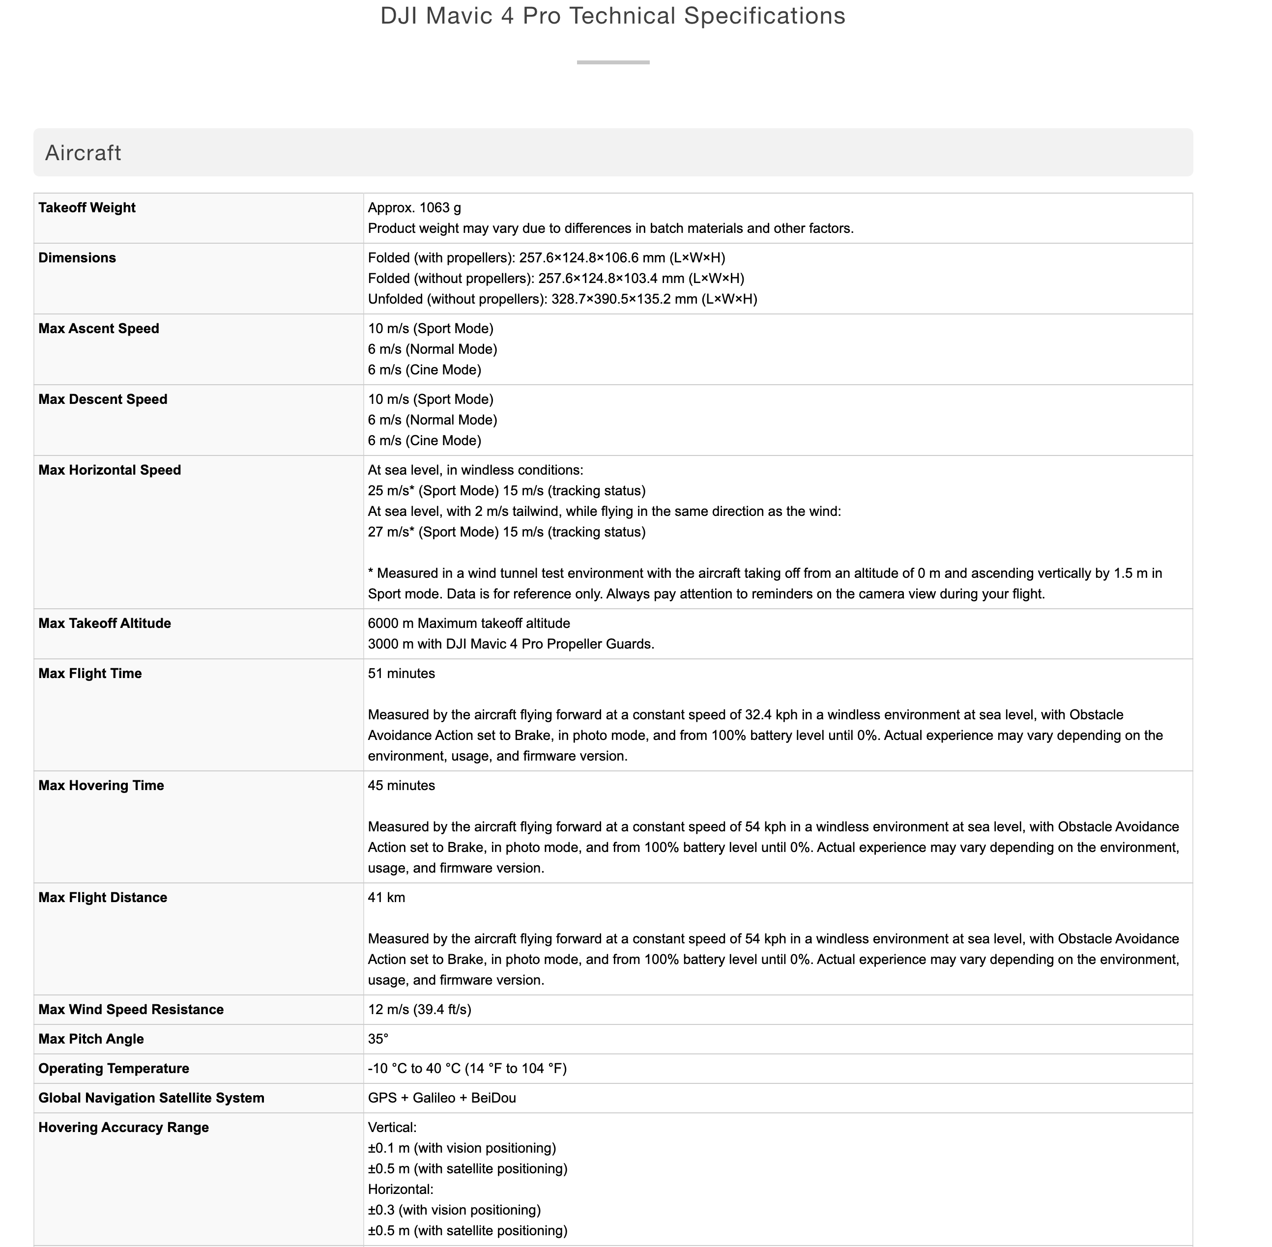
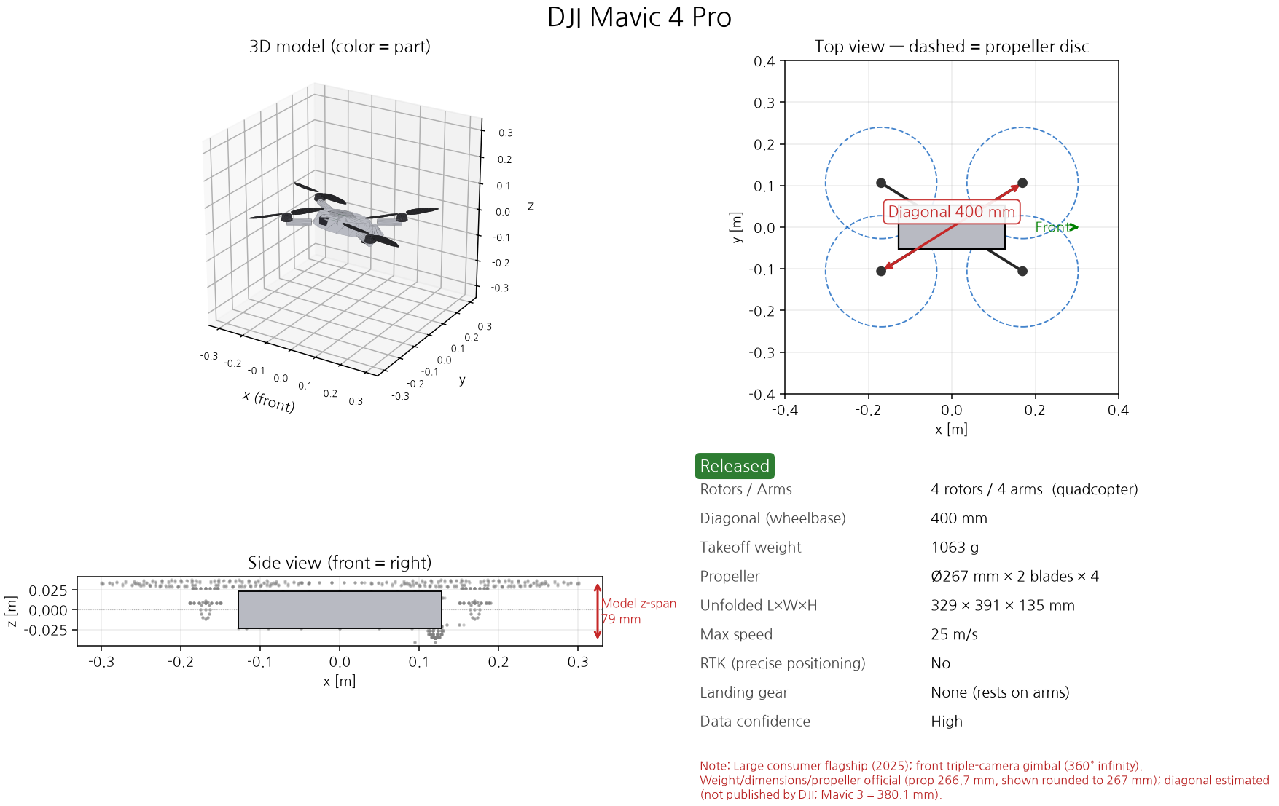
Stage 1 · Spec-Driven Meshes
From a Spec Sheet to a 3D Mesh
Real published specs → a spec-driven 3D model
Notes:
For the drones I first collected the detailed specs — this is the official DJI page on the left — and then built the mesh from those numbers.
Every part is modeled separately: body, arms, motors, propellers, gimbal, landing gear.
If asked — one honest limit: the rotor count, the propeller diameter and the weight come straight from the spec sheet. The diagonal is official for the Matrice 4E, the Phantom 4 and the S1000+, but DJI does not publish it for the Mini 5 Pro or the Mavic 4 Pro, so those two are estimated within about twenty millimetres — that is the red note on the card. And the body is a proportional approximation, so the model's z-span is not the manufacturer's unfolded height. What drives the radar cross-section — the diagonal, the propeller disc and the rotor count — is right.

Slide 8
Stage 1 · Drone Meshes
DJI Drone Meshes — Five Real Models
Meshes rotating (shape comparison) — 4-rotor quads vs the 8-rotor S1000+; each part is its own RF material
Notes:
These are the five meshes.
Here they are drawn at the same size, so you can compare shapes — the four-rotor quads against the eight-rotor S1000+.
Their real sizes are very different, and that is the next slide.

Slide 9
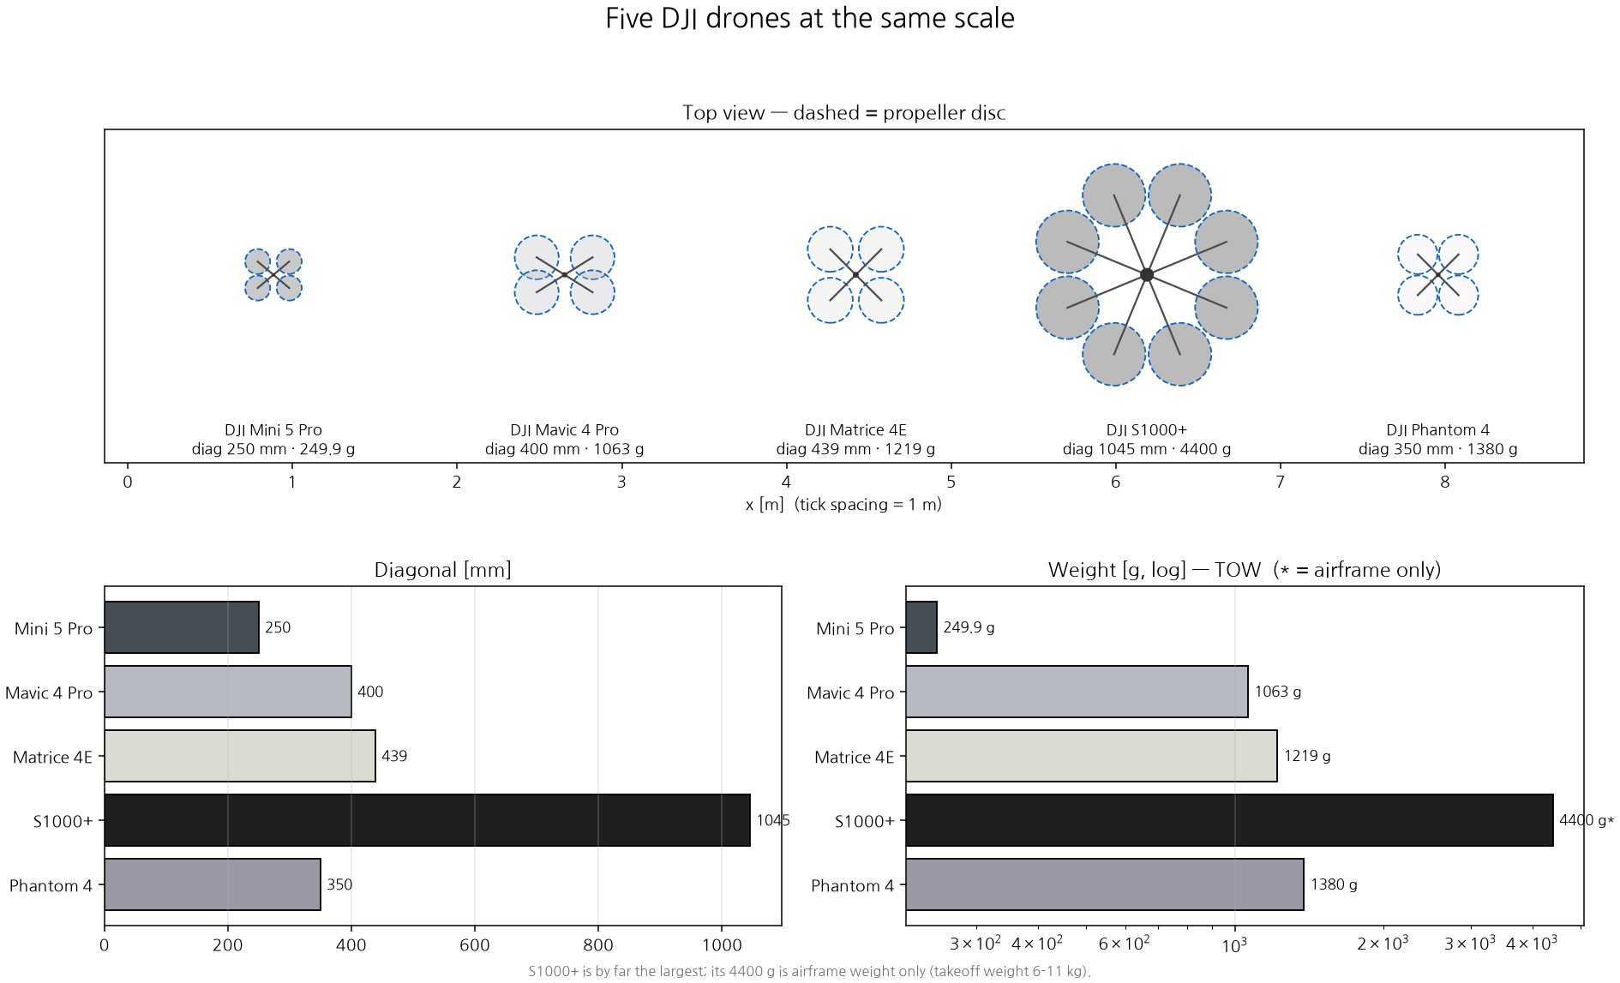
Stage 1 · Drone Meshes
Five Drones at True Scale
Same scale, top view (dashed = propeller disc) · diagonal and weight from published specs — the S1000+ is in a different class
Notes:
Now the real size comparison, all at the same scale.
The S1000+ is by far the largest, about a meter across. The Mini 5 Pro fits in your hand at 250 grams. The dashed circles are the propeller discs.
One caveat on the weight chart, marked with a star: the S1000+ number is the airframe weight only. With a payload its takeoff weight is six to eleven kilograms, so that bar understates it. The other four are takeoff weights.

Slide 10
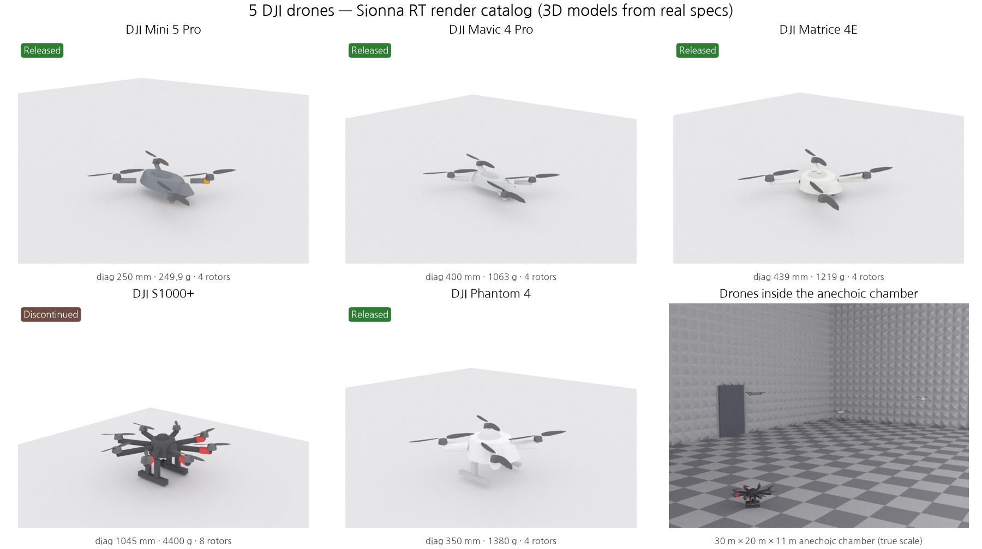
Stage 1 · Drone Meshes
The Catalog — and the Scale Problem
Sionna RT render catalog · the last panel puts the same drones inside the 30 × 20 × 11 m chamber, at true scale
Notes:
This is the render catalog — the five meshes, each with its diagonal, weight and rotor count from the spec sheet.
The bottom-right panel is the one that matters: the same drones dropped into the chamber at true scale. In a thirty meter room they are tiny — that is really the whole difficulty of the problem in one picture.

Slide 11
Stage 2 · Articulation
An Articulated Drone — Body ⟂ Props
Body tilt and rotor spin move on their own — here, both at once
Mavic 4 Pro: the body wobbles (roll/pitch/yaw) while the props keep spinning — two independent degrees of freedom
Notes:
Now the second stage.
The first meshes were a single rigid body, so I could not spin the blades. I split the model into a frame plus individual rotors, each with its own rotation.
In this animation the body wobbles — roll, pitch and yaw — while the propellers keep spinning. The two degrees of freedom are independent: when only the blades turn, the frame does not move at all.
That is what micro-Doppler needs. It is also the structure a flight simulator like Gazebo expects — one link and one joint per rotor — so the same model serves both.

Slide 12
Stage 2 · Micro-Doppler
The Spinning-Blade Signature
Even while hovering, the spinning blades ripple the echo — a fingerprint we can read
Notes:
And here is the micro-Doppler.
I let the blades spin and asked for the spectrogram — and this is what came out. The vertical stripes are the blade flashes, and the spread around the centre is the Doppler from the blade tips.
I am still building up the background to read this properly, so I am showing it as a first result rather than a conclusion.
If asked — for the Mavic the flashes come at about 183 hertz, and the tip Doppler is roughly plus-minus 1.7 kilohertz at 3.5 gigahertz.

Slide 13
Sionna Progress · Where This Sits
Where This Sits — and What Comes Next
Done ✓
Environment
→
Articulated drone
→
Micro-Doppler
Next
Illuminators
Wi-Fi / LTE / 5G
→
Bistatic (Tx ≠ Rx)
→
Clutter removal
+ CFAR
Then
Detection & tracking
→
Drone vs bird ID
blade signature
→
Export to PX4 / Gazebo
Notes:
This is where the work sits.
Done: the environment — the chamber and the five meshes — and the articulated drone with its blade signature.
Next is the illuminator study: Wi-Fi, LTE and 5G, and which reference signals a passive receiver can actually use. I have it running already, but I want to verify it properly before I present it.
After that, the real passive radar chain: a bistatic geometry with the transmitter and the receiver apart, clutter removal, and CFAR detection with tracking.
Further out: drone versus bird from the blade signature, and exporting the articulated model to PX4 or Gazebo.

Slide 14
PAPER INTRODUCTION
From Denoising to De-Channeling
Integrating physical channel priors into diffusion models
Background → Idea → Pipeline → Results
Liu et al., BUPT & Pengcheng Lab · github.com/BUPT-GAMMA/FoundWSR
ICML 2026 Spotlight Poster
Notes:
Now let me briefly introduce the paper from ICML that I found interesting, and then wrap up.

Slide 15
Paper Introduction · Background
Wireless Signal Recognition, Meet Diffusion
AI labels a received radio signal — but the channel distorts it first
What WSR does
Why bring in diffusion
Read the received signal
AI labels a passively-received IQ signal
Modulation type · wireless tech · anomaly
A cornerstone task for spectrum use & 6G
But it arrives distorted: y = h * x + n
Powerful denoisers
Forward: add Gaussian noise, step by step
Reverse: a network learns to remove it
Its learned features transfer well to WSR
So: borrow that denoising power for WSR
→ The plan: let a diffusion model clean the received signal before recognising it
Notes:
The task here is wireless signal recognition.
An AI reads a passively received IQ signal and labels it — the modulation type, the wireless technology, or an anomaly. It matters for spectrum management and for 6G.
The catch is the last line of the left card: the signal arrives distorted. What you receive is the transmitted signal convolved with the channel, plus noise.
Diffusion models are strong denoisers, and their learned features transfer well to this task. So the plan on this slide is: clean the signal first, then recognise it.

Slide 16
Paper Introduction · The Idea
The Idea — From Denoising to De-Channeling
The channel isn’t Gaussian — so add a learned channel to the diffusion, not just noise
Standard diffusion
PWC-Diff (proposed)
Denoising only
Forward adds only Gaussian noise
Reverse can’t undo the channel h
→ features stay channel-distorted
De-channeling + denoising
Forward adds a learned channel, then noise
Reverse learns to undo the channel and noise
→ recovers the transmitted signal x
→ Move the goal from denoising to de-channeling: model the physical channel, not just the noise
Notes:
But the authors point out a gap.
Standard diffusion only adds and removes Gaussian noise. A real channel is not Gaussian — it multiplies the signal, it does not just add to it. So the reverse process never learns to undo the channel, and the features stay distorted.
Their idea is to put a physical channel model inside the forward process: the forward step applies a learned channel and then adds noise, and the reverse step learns to undo both.
They call that de-channeling — and that is the title of the paper.

Slide 17
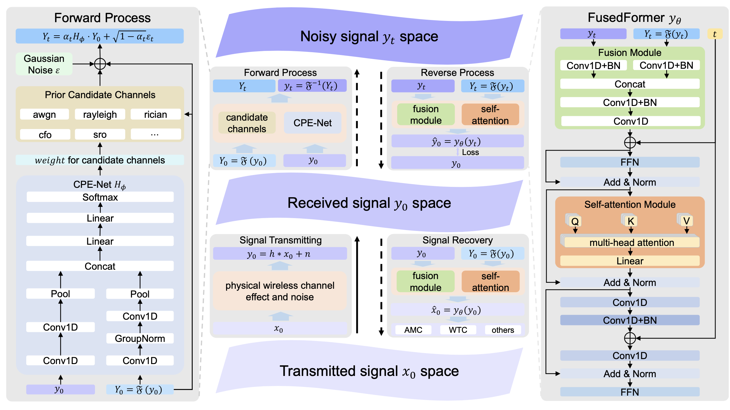
Paper Introduction · Pipeline
The PWC-Diff Pipeline, End to End
Forward corrupts with a learned channel + noise · Reverse (FusedFormer) recovers the signal
Notes:
This is the whole pipeline.
On the left is the forward process. Instead of adding only Gaussian noise, they first push the signal through a channel — but not a free-form neural channel. They keep a pool of real physical channels — AWGN, Rician, Rayleigh, Nakagami, multipath, carrier frequency offset and sampling rate offset — and the box in the figure only draws a few of them, which is what the dots mean. From that pool they pick a subset per dataset. A small network they call CPE-Net — channel parameter estimation — reads the signal and outputs softmax weights over that dataset's candidates. So the forward step is: mix the physical channels with those weights, apply them, then add Gaussian noise.
Why constrain it that way? Because they prove that if the channel is a free network, the loss has a local minimum where the channel simply becomes one. In other words, the model quietly switches the channel off and you are back to ordinary denoising. The physical candidates are what stop that.
On the right is the reverse process, which they call FusedFormer. A fusion module combines the time-domain and the spectral view of the signal, and a self-attention module sits on top. That is the part that learns to undo the channel and the noise.
I could not fully follow the attention details yet — that is part of the AI study I planned.

Slide 18
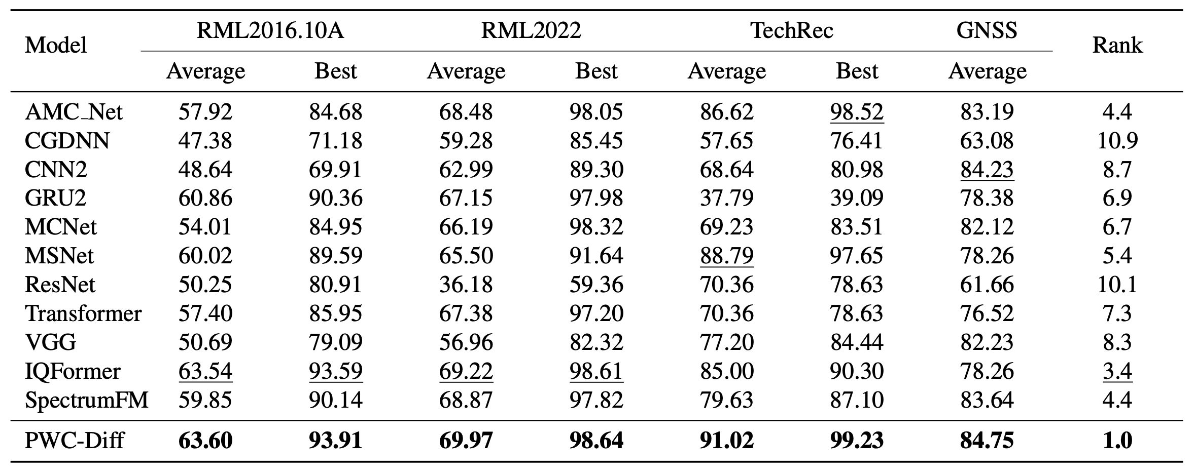
Paper Introduction · Results
SOTA — Let’s Read the Table Together
Rank 1.0 overall — the interesting part is where the margins are
Top rank on all four datasets — but some margins are thin (RML2016: 63.60 vs IQFormer 63.54)
Clearest win is TechRec (WTC): 91.0 avg vs 88.8 next best
→ Their own Fig. 4 answers it (RML2016.10A): FusedFormer alone 57.77 → +Gaussian-only pretraining 62.86 → +physical channels 63.60
Notes:
They report state of the art on all four datasets, with an average rank of one.
But look at the margins. On RML2016 they get 63.60 against IQFormer's 63.54 — six hundredths of a point. I honestly wonder whether that would survive a different random seed. The one clear win is TechRec: 91.0 against 88.8 for the next best.
So the fair question is: how much of this is the de-channeling idea, and how much is just the new backbone? Their own Figure 4 answers it. On RML2016, FusedFormer with no pretraining is 57.77 — below IQFormer, so the backbone alone is not what wins. Gaussian-only diffusion pretraining takes it to 62.86, and the physical channels add another 0.7 to reach 63.60.
But that split flips on the other datasets. On RML2022 the physical channels are worth 5.7 points. On TechRec, Gaussian-only pretraining is actually worse than no pretraining at all — 89.21 against 90.25 — and only the physical channels recover it to 91.02. So the idea is doing real work; it just does not show up in the RML2016 headline.
There is also a separate ablation on which channels: drop the carrier frequency offset from the candidate set and accuracy falls from 63.6 to 61.5.
One thing I take from this for our own work: learning buys you a few percentage points, but physics — bandwidth and integration time — buys you tens of decibels.

Slide 19
Thank you!
Notes:
That is everything from me. Thank you.

