Slide 1

Team Meeting
Yunjung Jeong
2026. 08. 18
Intelligent Radio Sensing Lab. (IRS Lab)
Department of Electrical Engineering and Computer Science
DGIST

Slide 2
RECAP
Last time
Our PO kernel and the Sionna PathSolver drew the same hovering drone
Across three ranges the story held
Notes:
Last week I fixed the viewing angle and compared our PO kernel against the Sionna PathSolver at one setting. The result looked fairly convincing.

Slide 3
TODAY
Today
Part 1 · The setup
Part 2 · Micro-Doppler maps
Part 3 · Propellers only
Notes:
The talk has three parts, the setup, the micro-Doppler maps, and the propellers on their own. The question stays the same as last week.

Slide 4
PART 1
The setup
How the runs were set up
Scene · Ceiling · Switches · Engines
Notes:
First, how the runs were set up.

Slide 5
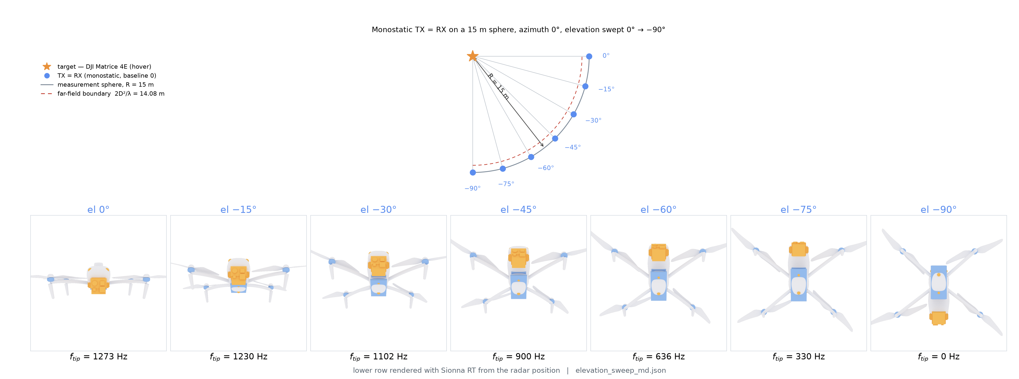
THE SCENE
The scenario
Notes:
This week, I ran tests using the same drone with the exact same settings as last time, and I experimented by changing the elevation angle.

Slide 6
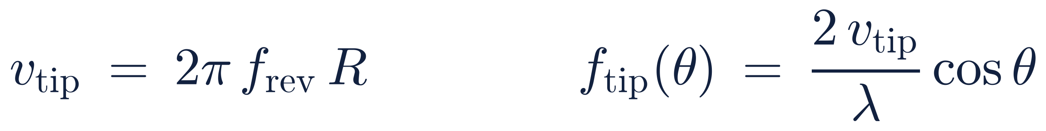
SETTING THE RULER
The blade ceiling
The blade tip is the fastest thing on the airframe, so it sets a hard ceiling
v_{tip} · speed of the blade tip through the air
f_{rev} · rotor turns per second at hover
R · propeller radius
λ · radio wavelength of the illuminator
θ · elevation angle, how far below level the radar sits
Any Doppler above this line cannot have come from a blade
Notes:
Since the blade tip is the fastest part of the drone, I can calculate the highest Doppler that blade rotation can produce, using the formula shown on the slide.

Slide 7
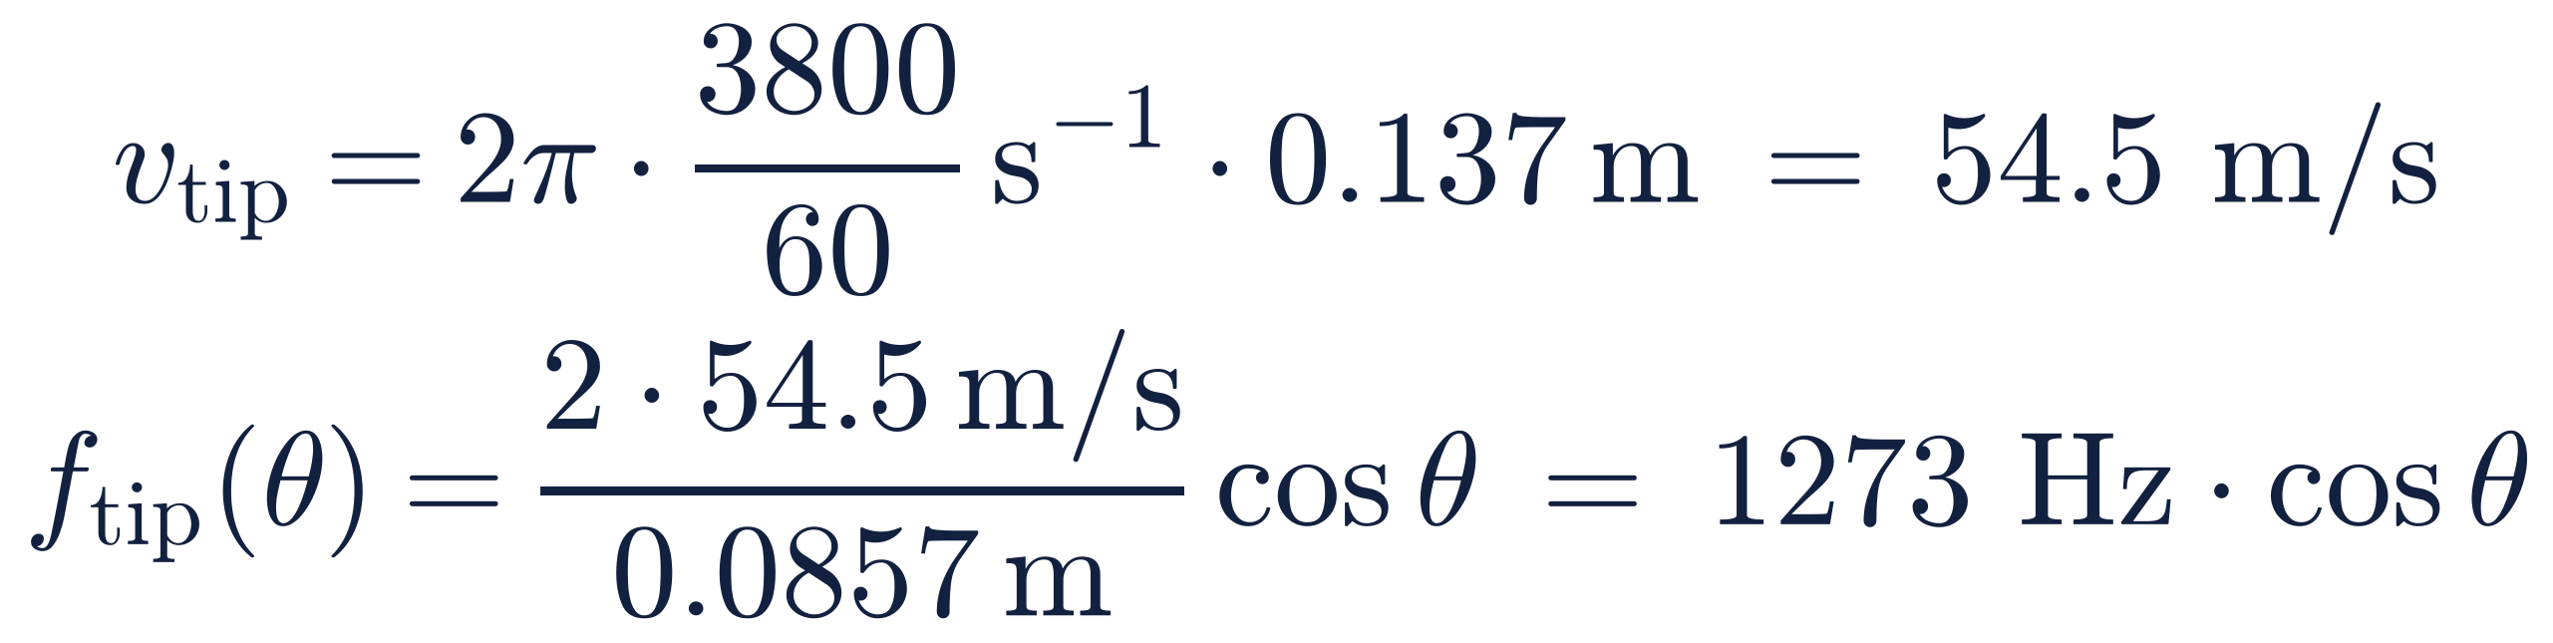
SETTING THE RULER
This drone's numbers
For the Matrice 4E at 3.5 GHz the ceiling is 1273 Hz when the radar looks level
propeller radius 0.137 m, hover speed 3800 rpm, wavelength 85.7 mm
Propeller radius comes from the DJI part number, 274 mm across
Hover speed setting same as last time
Notes:
Based on the formula I just showed and the same drone settings as last week, I calculated these specific values.
The f_tip values shown in the upcoming slides were plotted using this calculation.

Slide 8
THE SWITCHES
The four switches
Mirror reflection is always on, and four more wave effects are optional switches
Setting | Factory default | Our OFF arm (physics off) | Our ON arm (physics on) | What it adds
Diffuse scattering | off | on | on | surfaces scatter energy in all directions
Refraction | on | off | on | waves enter and pass through the material
Diffraction | off | off | on | waves bend around the body
Edge diffraction | off | off | on | extra bending at sharp free edges
Bounce depth | 3 | 1 | 1 | how many hops one ray may take
Notes:
I didn't go over the Sionna settings last week, but since I experimented with different settings this time, I prepared this slide to explain them.
In Sionna's factory default, diffuse scattering is off and refraction is on. However, if diffuse scattering is turned off, almost nothing comes back from a target as small as a drone. At 15 meters, six of the seven angles returned no paths at all.
Therefore, I kept diffuse scattering always on for my experiments, and compared two cases, turning the remaining wave effects all off versus all on.
As for bounce depth, which sets the maximum number of hops a single ray can take, changing it from one to three did not change the reading for the two versions in this deck.
In the upcoming slides, the 'physics off' version means only diffuse scattering is turned on, while the 'physics on' version means all features are enabled.

Slide 9
THREE ENGINES
Operation Time
 | Our kernel | Sionna, physics off | Sionna, physics on
- | surface scattering only | diffuse only | all four on
Time for one pose | 130 ms | 926 ms | 2.1 s
Notes:
In response to last week's question regarding computational cost, I evaluated the operation time per pose across the different setups.
Compared to our kernel, Sionna requires substantially more time. However, because runtime scales with the number of reflected rays, Sionna's operation time drops as the target moves out to about 60 meters and then levels off.
For this benchmark, the target distance was fixed relatively close at 15 meters.

Slide 10
PART 2
Micro-Doppler maps
Pictures first
Seven angles · Two puzzles · Band energy · Ours vs physics off
Notes:
Next, I'd like to share the micro-Doppler maps, the blade band energy just like last week, and a few interesting observations I made along the way.

Slide 11
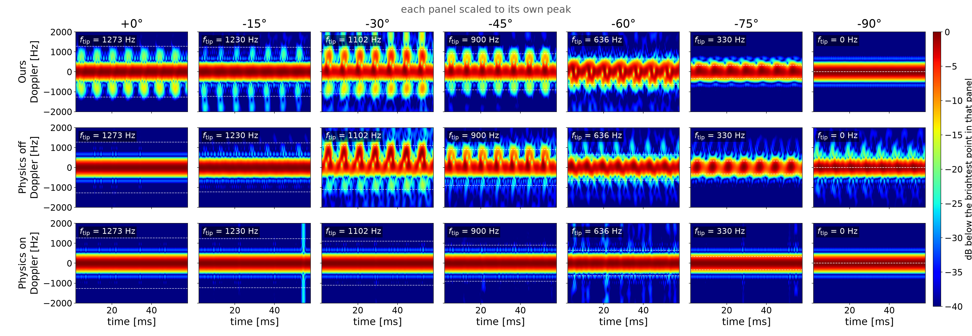
THE PICTURES
All seven angles
Notes:
First, I present the micro-Doppler maps across all seven elevation angles.
Each panel is normalized to its own peak intensity, meaning absolute level differences are not represented.

Slide 12
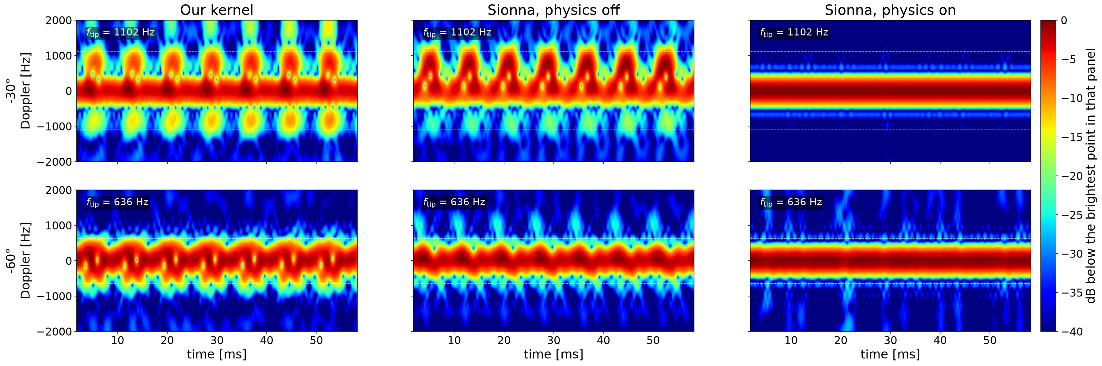
THE PICTURES
Mid angles
Ours and physics off keep the same beat, and physics on smears it
Notes:
This slide shows the zoomed-in results for the mid angles at -30 and -60 degrees.
While our kernel and Sionna physics off display quite similar patterns, the physics-on configuration smears the STFT results, making the rotation pattern hard to observe.
I will elaborate further on this behavior with the blade band energy data in the following slides.

Slide 13
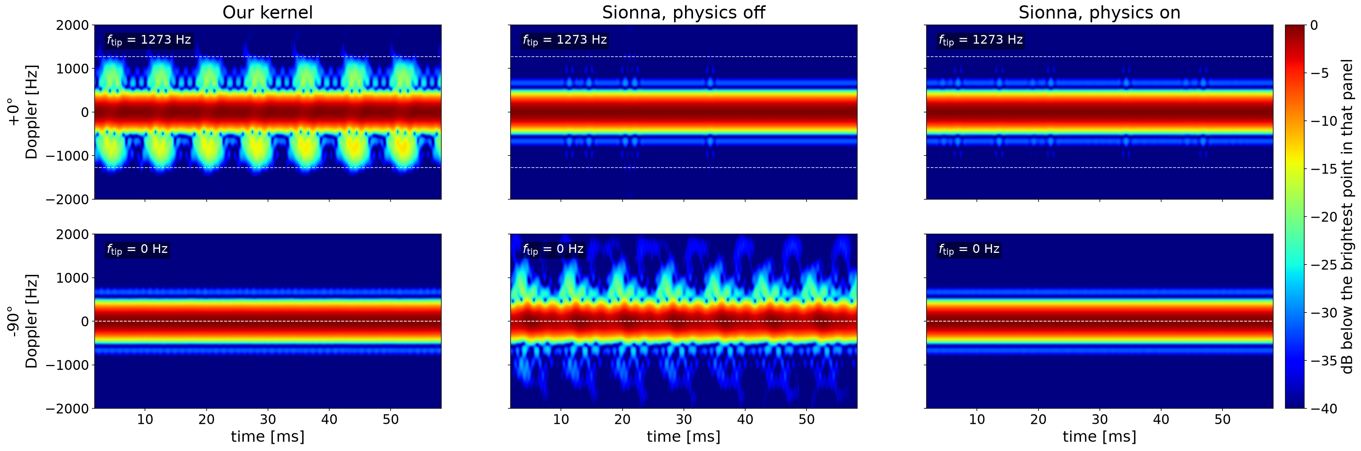
THE PICTURES
Two puzzles
The two ends of the sweep, where the maps run against physical expectation
Notes:
Moving on to the two puzzles at 0 and -90 degrees, these maps run against physical expectations.
Looking at the front view at 0 degrees, Sionna hardly shows any micro-Doppler signatures.
Conversely, at -90 degrees the ceiling is zero hertz so nothing should appear, yet the physics-off version of Sionna still draws a clear pattern.

Slide 14
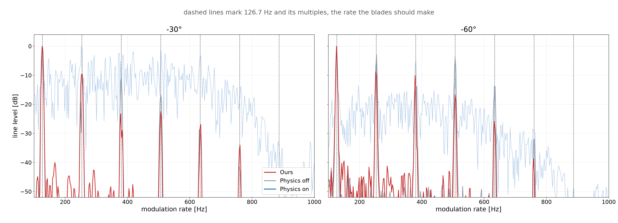
THE PICTURES
Blade band energy : -30°, -60°
Notes:
Looking at the blade band energy for the -30 and -60 degree angles shown earlier, the Sionna physics-off version matches our expectations and aligns very closely with our kernel.
On the other hand, when all physics features are turned on in Sionna, the lines are still on the same grid but they barely rise out of a rolling floor.

Slide 15
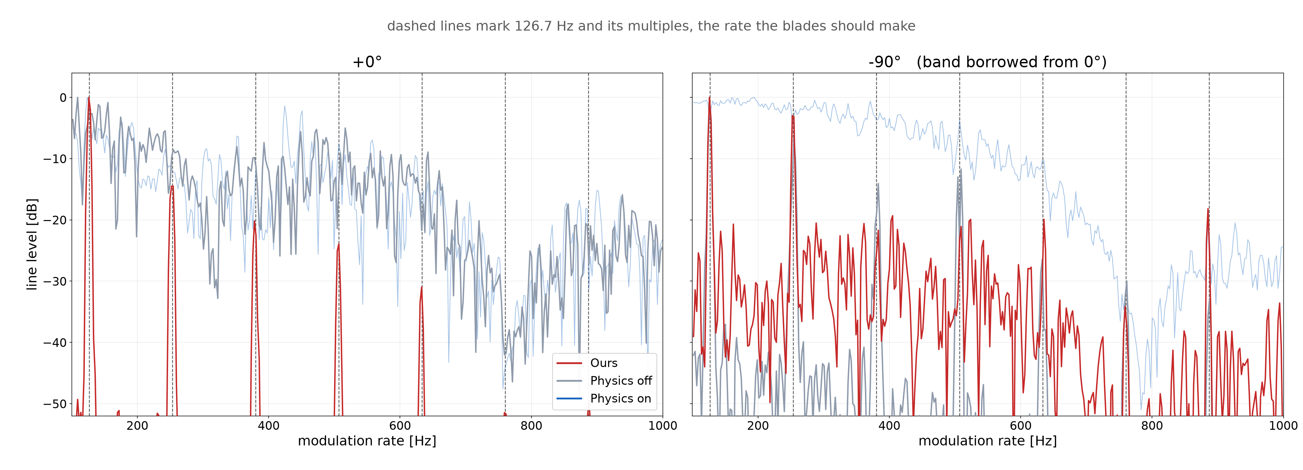
THE PICTURES
Blade band energy : 0°, -90°
Notes:
Moving to the 0 and -90 degree cases,
at 0 degrees, our kernel exhibits clean energy peaks exactly aligned with the expected blade harmonics, whereas Sionna fails to clearly show this pattern.
At -90 degrees, while our kernel shows a distinct peak at the first harmonic before degrading, Sionna physics off consistently displays noticeable peaks across the expected harmonic lines.

Slide 16
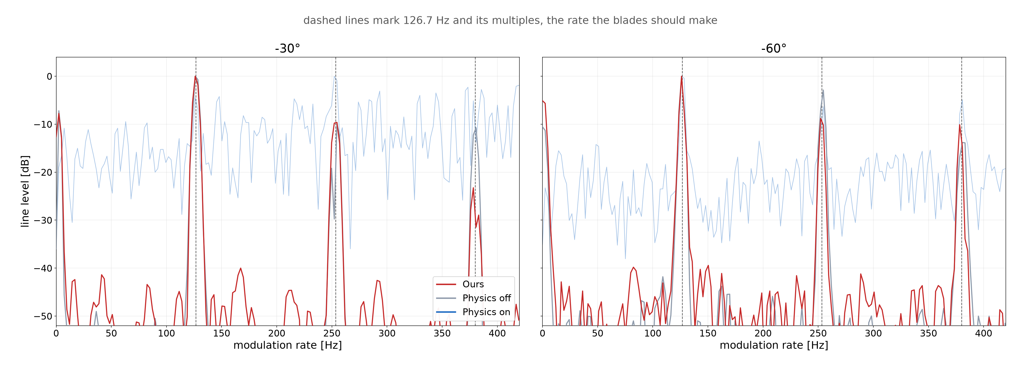
THE PICTURES
Zoom : -30°, -60°
Notes:
This slide presents a zoomed-in comparison for the -30 and -60 degree scenarios to clearly examine the early harmonics.

Slide 17
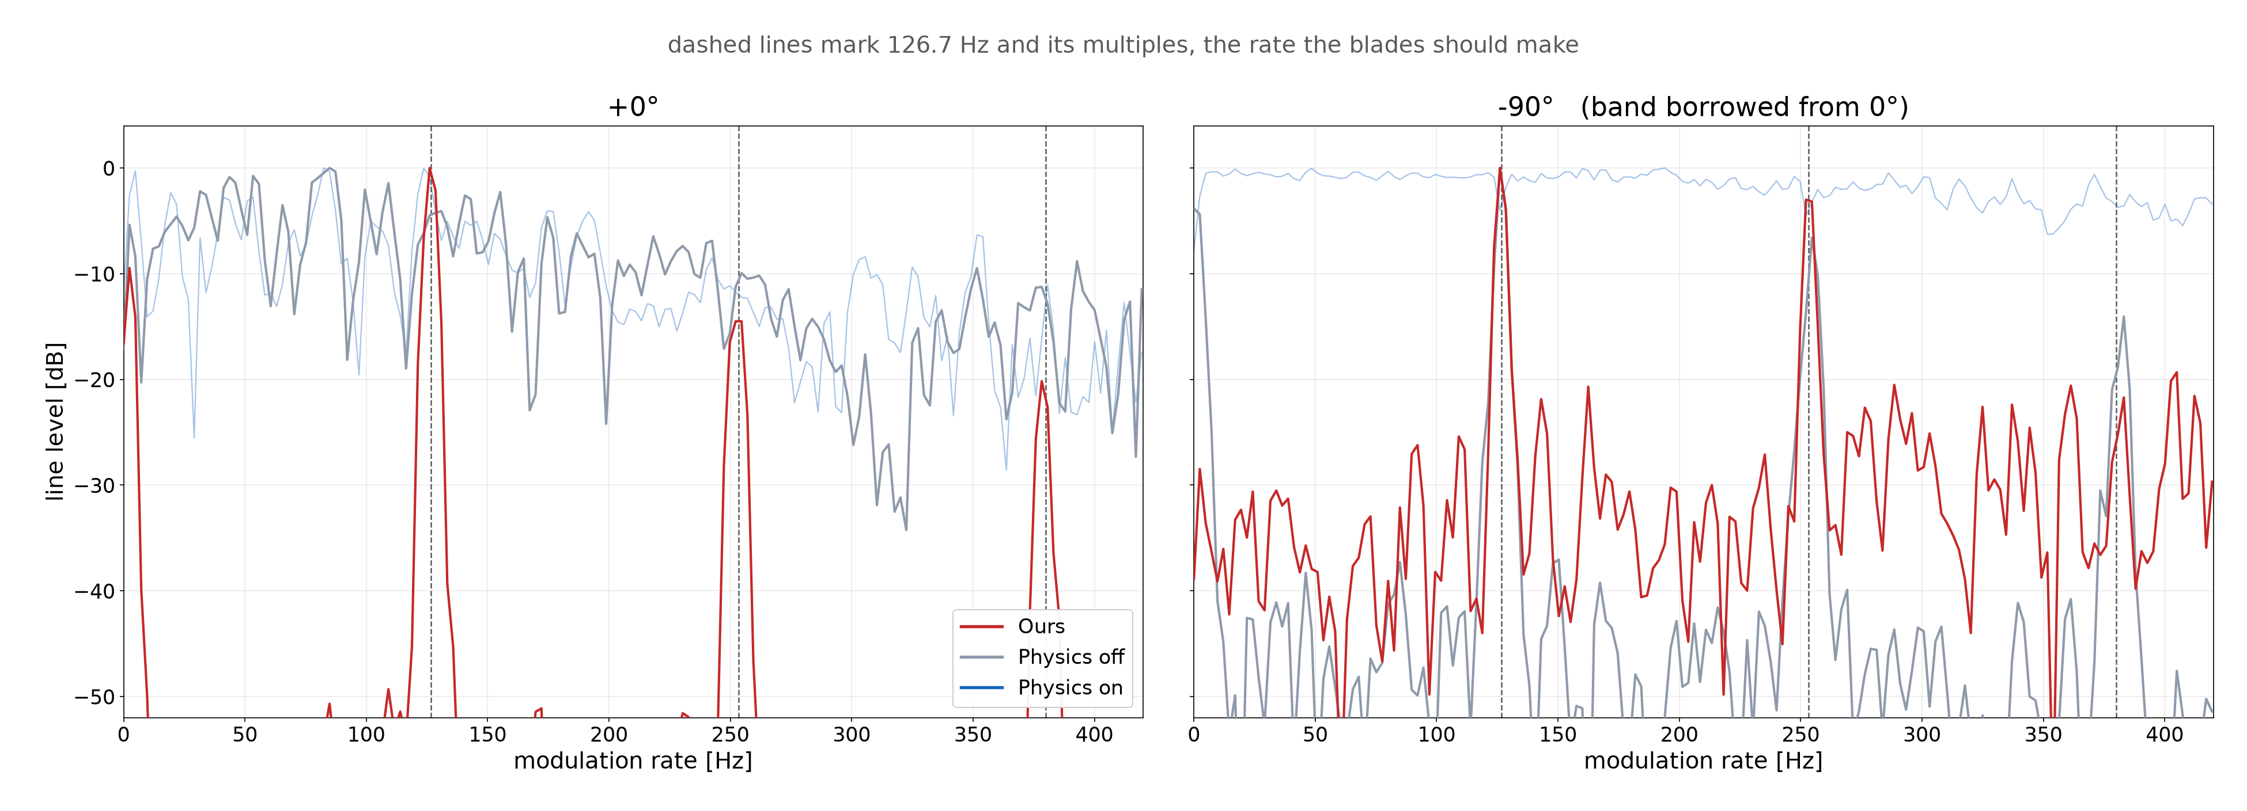
THE PICTURES
Zoom : 0°, -90°
Notes:
Similarly, this slide shows the zoomed-in comparison for the 0 and -90 degree configurations.

Slide 18
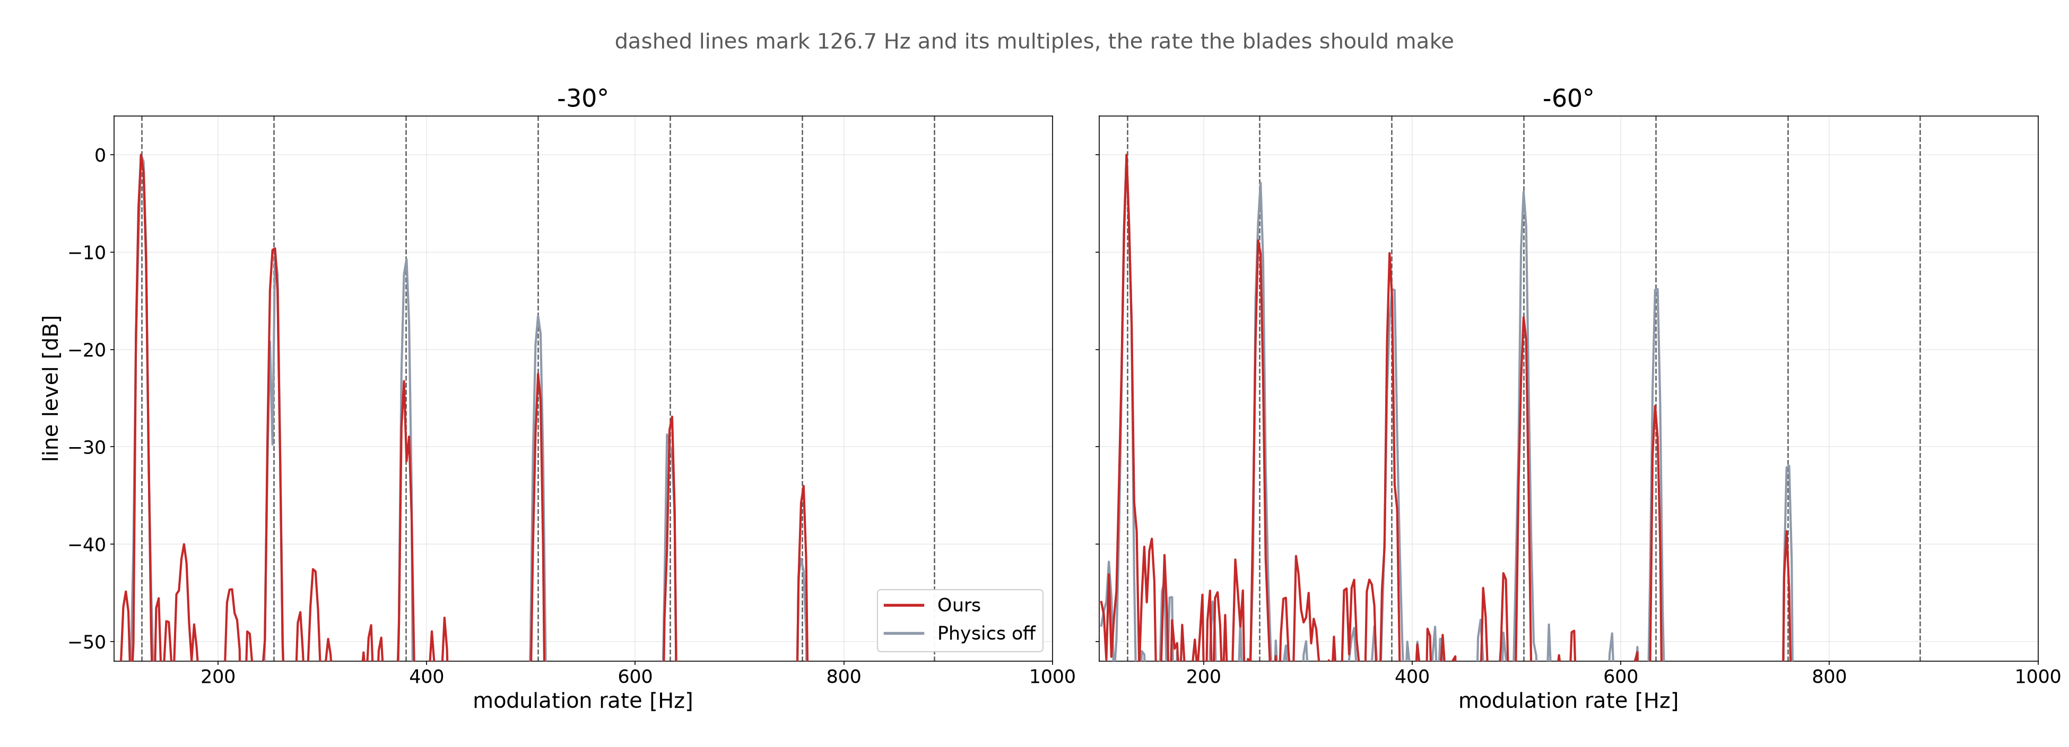
OURS VS PHYSICS OFF
Two arms : -30°, -60°
Notes:
Here I dropped the physics-on curve, since it was busy enough to hide the comparison I care about. At these two angles the harmonics of our kernel and physics off stand at the same places.

Slide 19
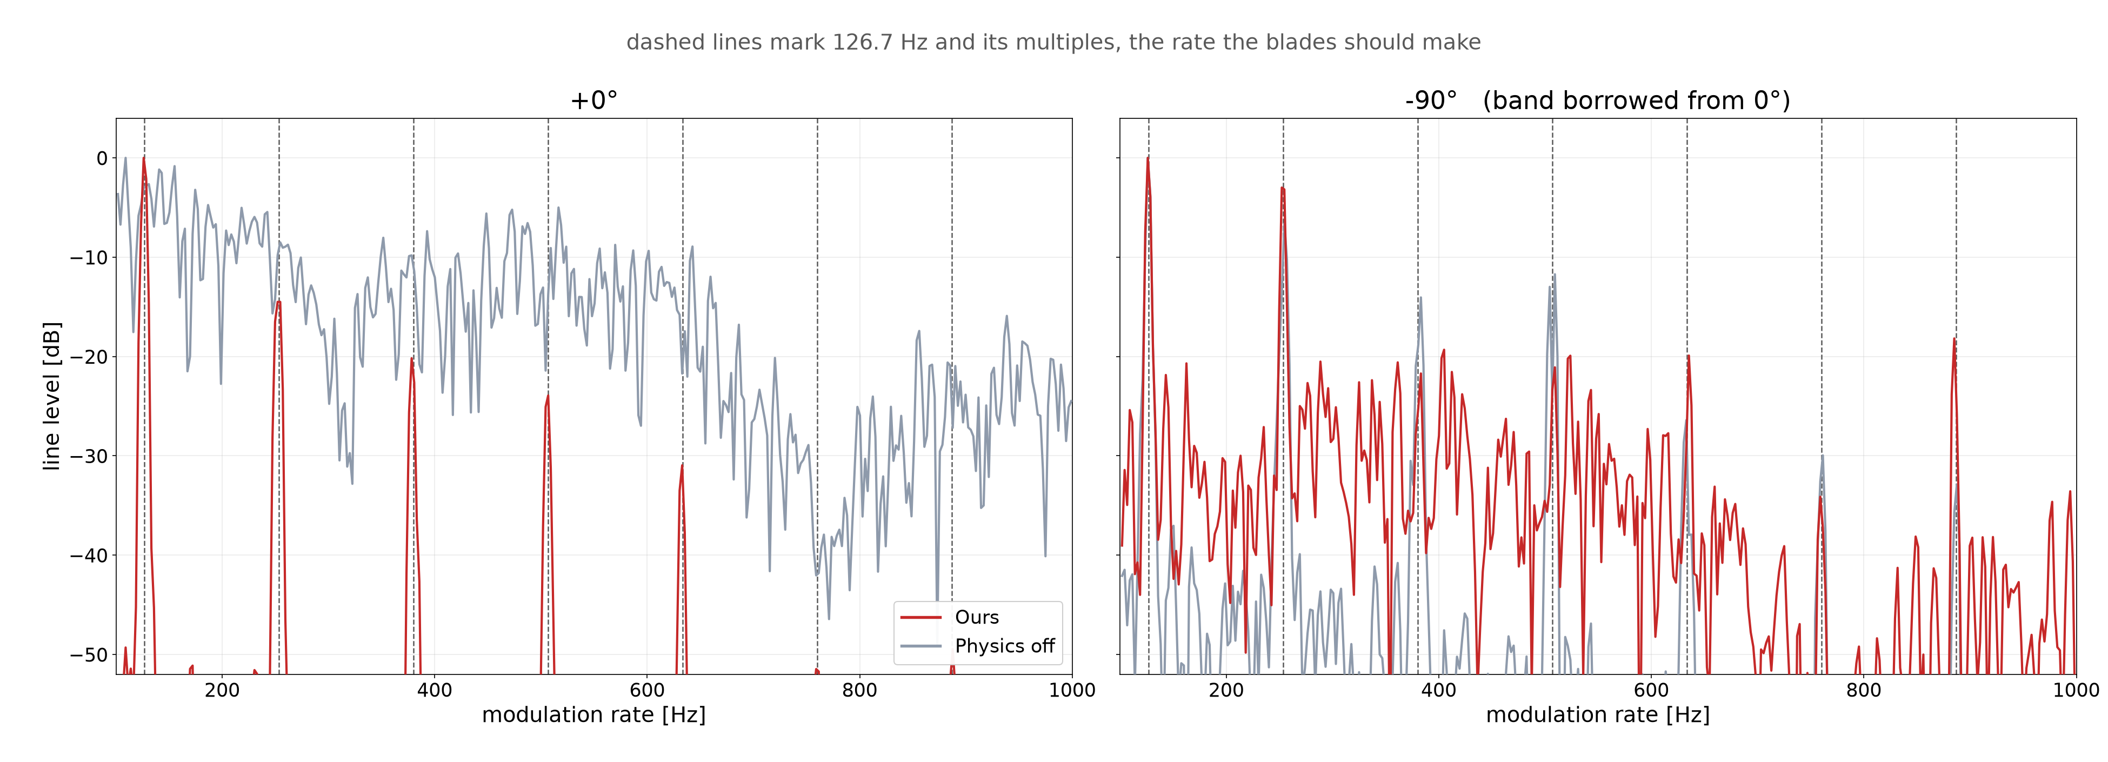
OURS VS PHYSICS OFF
Two arms : 0°, -90°
Notes:
The same two-curve view at the odd ends. At 0 degrees the physics-off curve keeps no peak on the expected lines, and at -90 degrees both curves put peaks on them even though the ceiling is zero hertz.

Slide 20
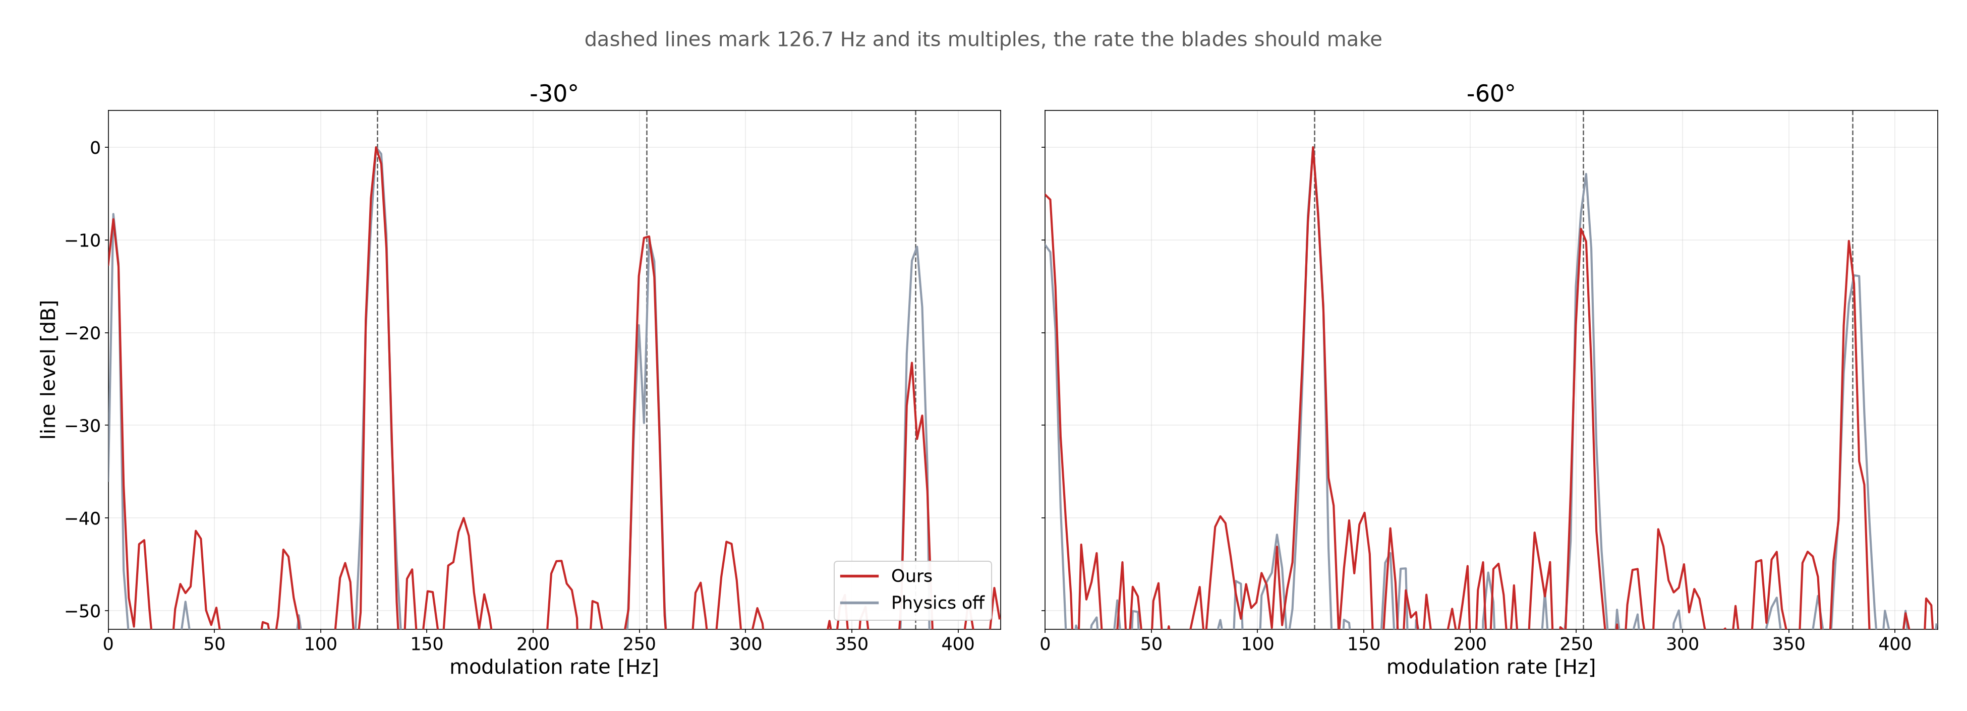
OURS VS PHYSICS OFF
Two arms zoom : -30°, -60°
Notes:
This is the zoomed-in view of the early harmonics for the two mid angles, with only the two curves left.

Slide 21
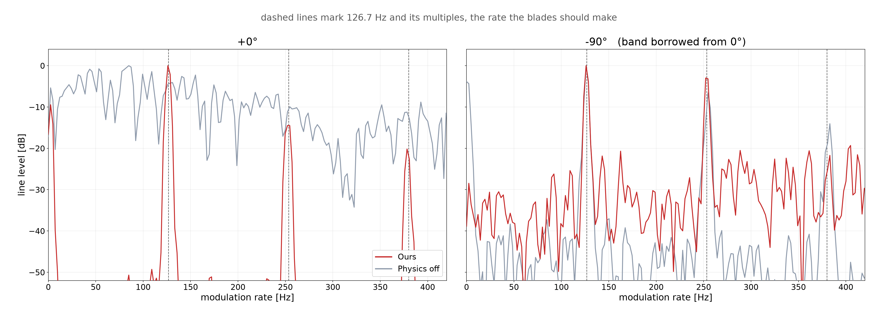
OURS VS PHYSICS OFF
Two arms zoom : 0°, -90°
Notes:
And the zoomed-in view for 0 and -90 degrees, where the gap between the two curves at 0 degrees is clearest.

Slide 22
PART 3
Propellers only
Notes:
Moving to Part 3, to look closer into the anomaly seen at 0 degrees, I conducted a test with an isolated mesh configuration, simulating only the spinning propellers in free space.

Slide 23
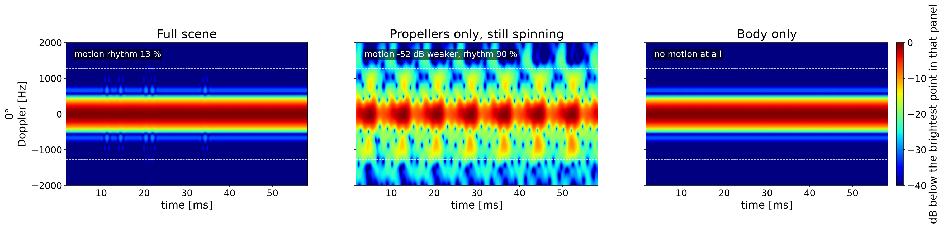
PROPELLERS ONLY
The drowned blades
Splitting the scene answers the first puzzle, since the blades are not missing but buried
Notes:
This slide shows the comparison across three configurations, the full mesh, propellers only, and the body only.
As shown here, the blade signatures are not absent, but rather drowned out and buried by the body.

Slide 24
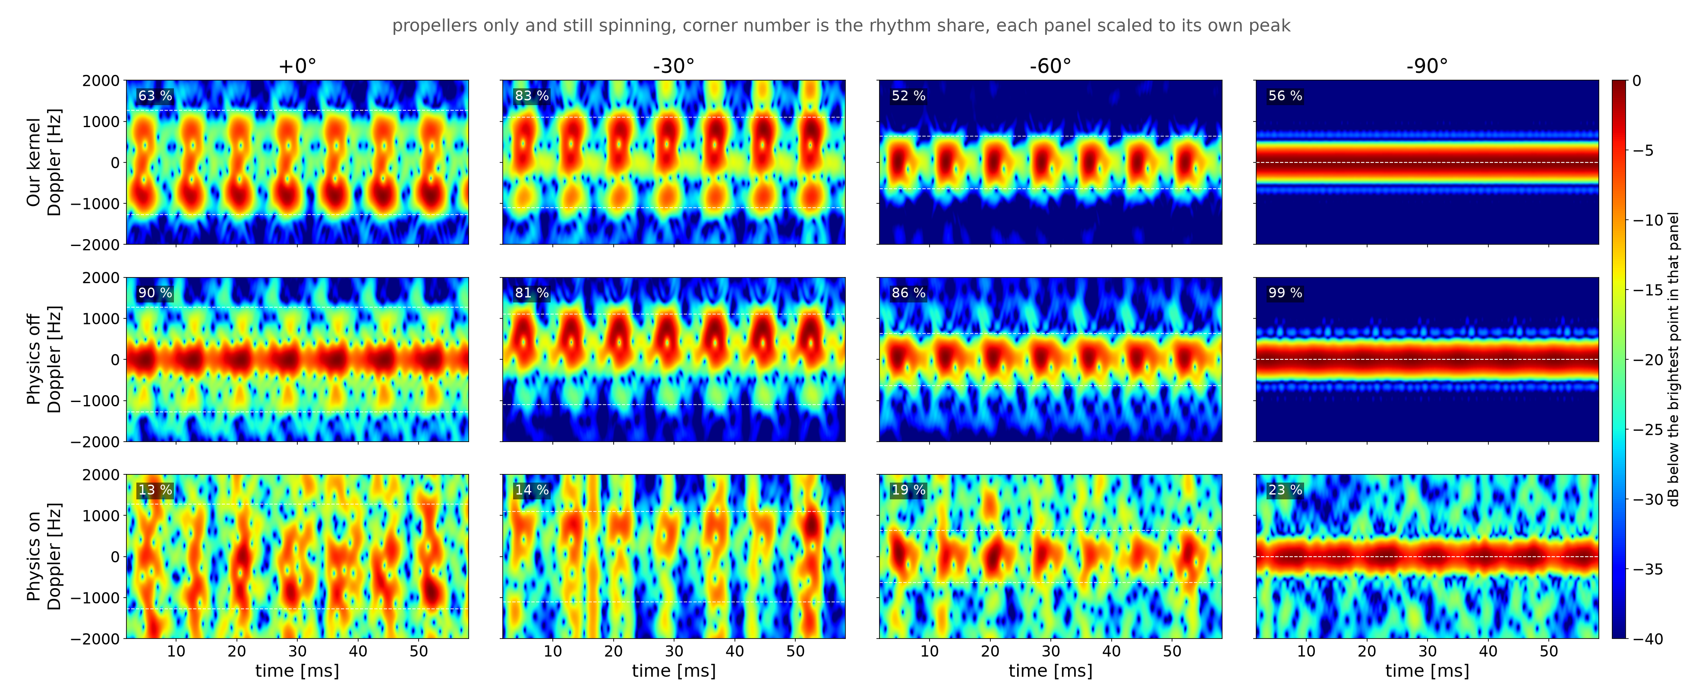
PROPELLERS ONLY
Propellers only : all angles
The same propellers only scene swept through all four viewing angles
Notes:
Moving on, this slide presents the micro-Doppler maps for the propellers-only scene, swept across all four viewing angles and evaluated using the three different setups.

Slide 25
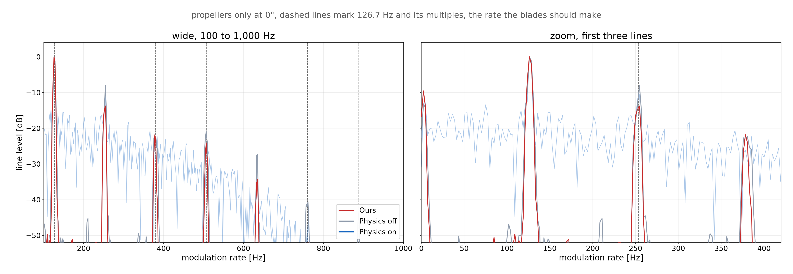
PROPELLERS ONLY
Propellers only : band energy at 0°
Notes:
Looking at the blade band energy at 0 degrees with only the propellers present, our kernel and Sionna physics off closely follow the expected harmonic peaks. In contrast, Sionna with physics on shows a much flatter spread across the band.

Slide 26
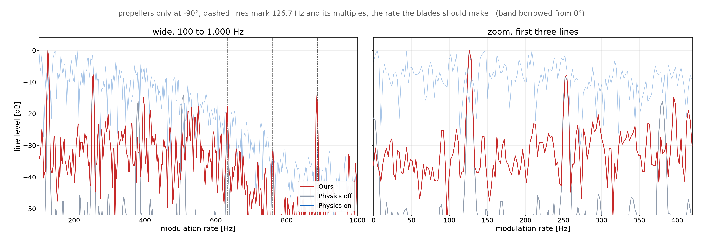
PROPELLERS ONLY
Propellers only : band energy at -90°
Notes:
This is the same blade band energy with only the propellers, now at -90 degrees. The blade ceiling is zero here, so the band is borrowed from the 0 degree case.
Both our kernel and Sionna physics off still put clean lines on the expected harmonics, which means the pulsing comes from the blades changing how much they reflect as they turn, not from Doppler.

Slide 27
FUTURE WORK
Future work
Close the bounce depth axis in the physics switch grid, where some settings still lift the level at three bounces
Drive the scene with a real flight log and add receiver noise, so the maps face maneuver and noise at once
Understanding the PathSolver behaviour comes first, and every later step builds on it
Notes:
Lastly, for our future work: first, I will keep working through the physics switch settings and bounce depths to isolate which mechanism degrades the results.
Once we fully understand Sionna's PathSolver behavior,
as discussed last week, the next steps will be incorporating realistic flight dynamics, receiver noise, and clutter modeling.

