Slide 1

Team Meeting
Yunjung Jeong
2026. 07. 14
Intelligent Radio Sensing Lab. (IRS Lab)
Department of Electrical Engineering and Computer Science
DGIST
Notes:
Let me start today's team meeting.

Slide 2
Recap
Last Meeting
What I did
Drone selection — Mavic 4 Pro vs Matrice 4E (echo vs RTK ground truth)
Reviewed LaSen (SenSys '26) — the one 5G tracking paper, with RTK ground truth
What I planned
Three parallel tracks — PHY anatomy, AI self-study, and the Sionna simulation
Sionna: a controlled RD-map detection benchmark
Today
Progress on Sionna — three stages now built (environment → radar → micro-Doppler)
Paper Introduction — From Denoising to De-Channeling (ICML 2026 Spotlight)
Notes:
Last time I did two things. First, drone selection — Mavic 4 Pro versus Matrice 4E, comparing echo strength against RTK ground truth. Second, a short review of LaSen, the SenSys paper that tracks a drone using 5G. Since then I was at ICML and had a few other things going on, so I prepared this meeting in a bit of a rush. Today I will show you the Sionna progress — three stages are now built — and then I will introduce one paper.

Slide 3
Today
Contents
1 · Sionna Progress
Three stages — environment, radar & RCS, and micro-Doppler
2 · Paper Introduction
From Denoising to De-Channeling (ICML 2026) — physics-informed diffusion for WSR
Notes:
Today has two parts. First, what I built in Sionna, with a lot of pictures. Second, a short introduction to a paper from ICML that I found interesting.

Slide 4
PROGRESS REPORT
Sionna Simulation
From an empty chamber to a drone's radar signature — in three stages
① Environment → ② Radar & RCS → ③ Micro-Doppler
Notes:
Let me start with the Sionna simulation.

Slide 5
Sionna Progress · Overview
Three Stages, Built on One Scene
Each stage reuses the same chamber and the dimension-accurate drone meshes
① Environment
Shielded chamber
→
5 DJI meshes
→
RF materials
② Radar & RCS
Monostatic setup
→
RCS (phys. optics)
→
WiFi / LTE / 5G
occupancy G1–G3
③ Micro-Doppler
Articulated drone
→
Blade flash
+ tip Doppler
→
PX4 / Gazebo basis
→ report1 · report2 · report3 — each a runnable notebook full of figures
Notes:
This is the overall path I took. First I built the chamber and five DJI drone meshes from their real specs. Then I set up a monostatic radar, computed the RCS, and set up three illuminators — Wi-Fi, LTE and 5G. After that I felt the drone meshes were too rough, so I refined them: I split the frame from the rotors, so each propeller can spin on its own. That refinement is also what we will need later if we want to fly these drones in PX4 or Gazebo.

Slide 6
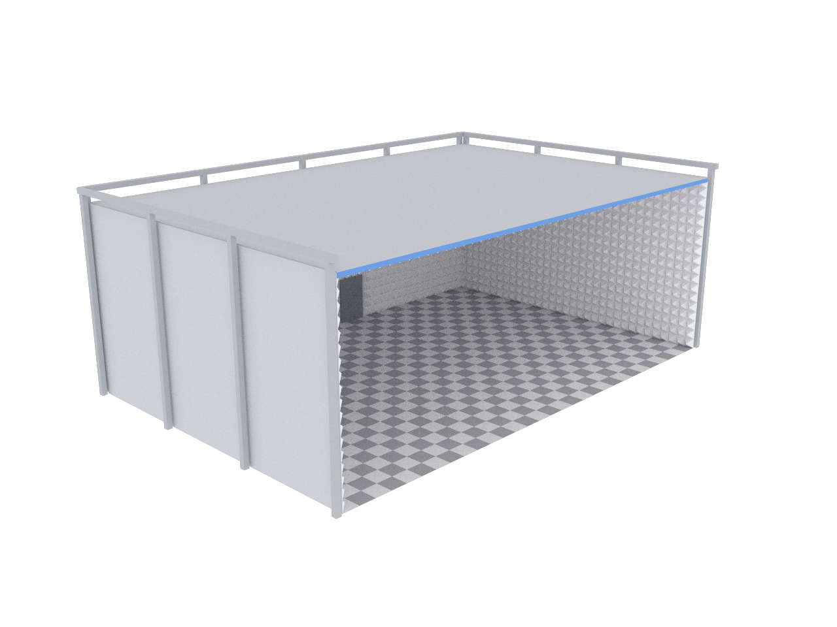
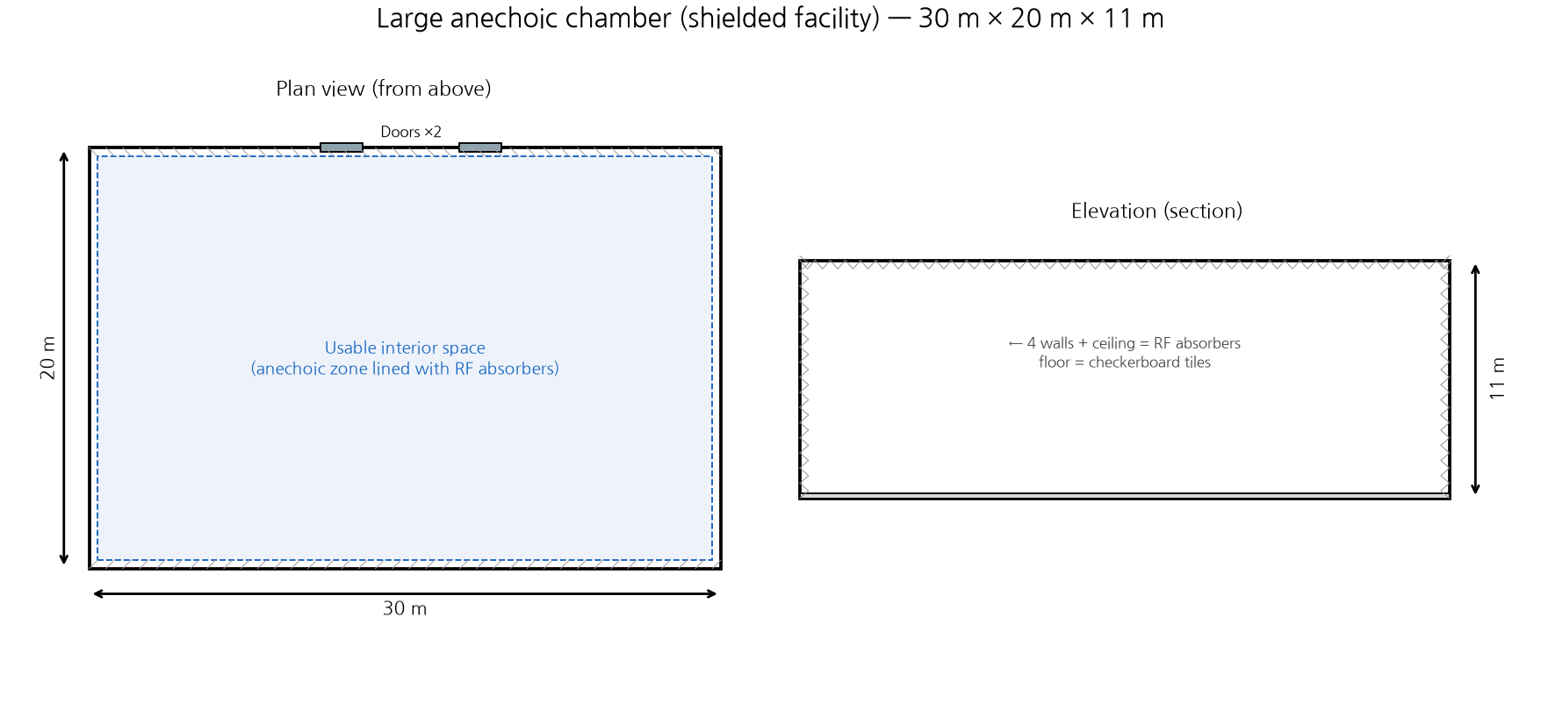
Stage 1 · Environment
The RF Playground — a Shielded Chamber
A 30 × 20 × 11 m shielded room — the walls soak up echoes, so we see only the drone
Sionna render of the chamber (left) · dimensioned plan & elevation (right) — modelled on a real facility
Notes:
For the chamber, I copied the specs of the RF playground we were planning to use for the real experiment. It is thirty by twenty by eleven meters. The walls absorb the echoes, so we see only the drone.

Slide 7
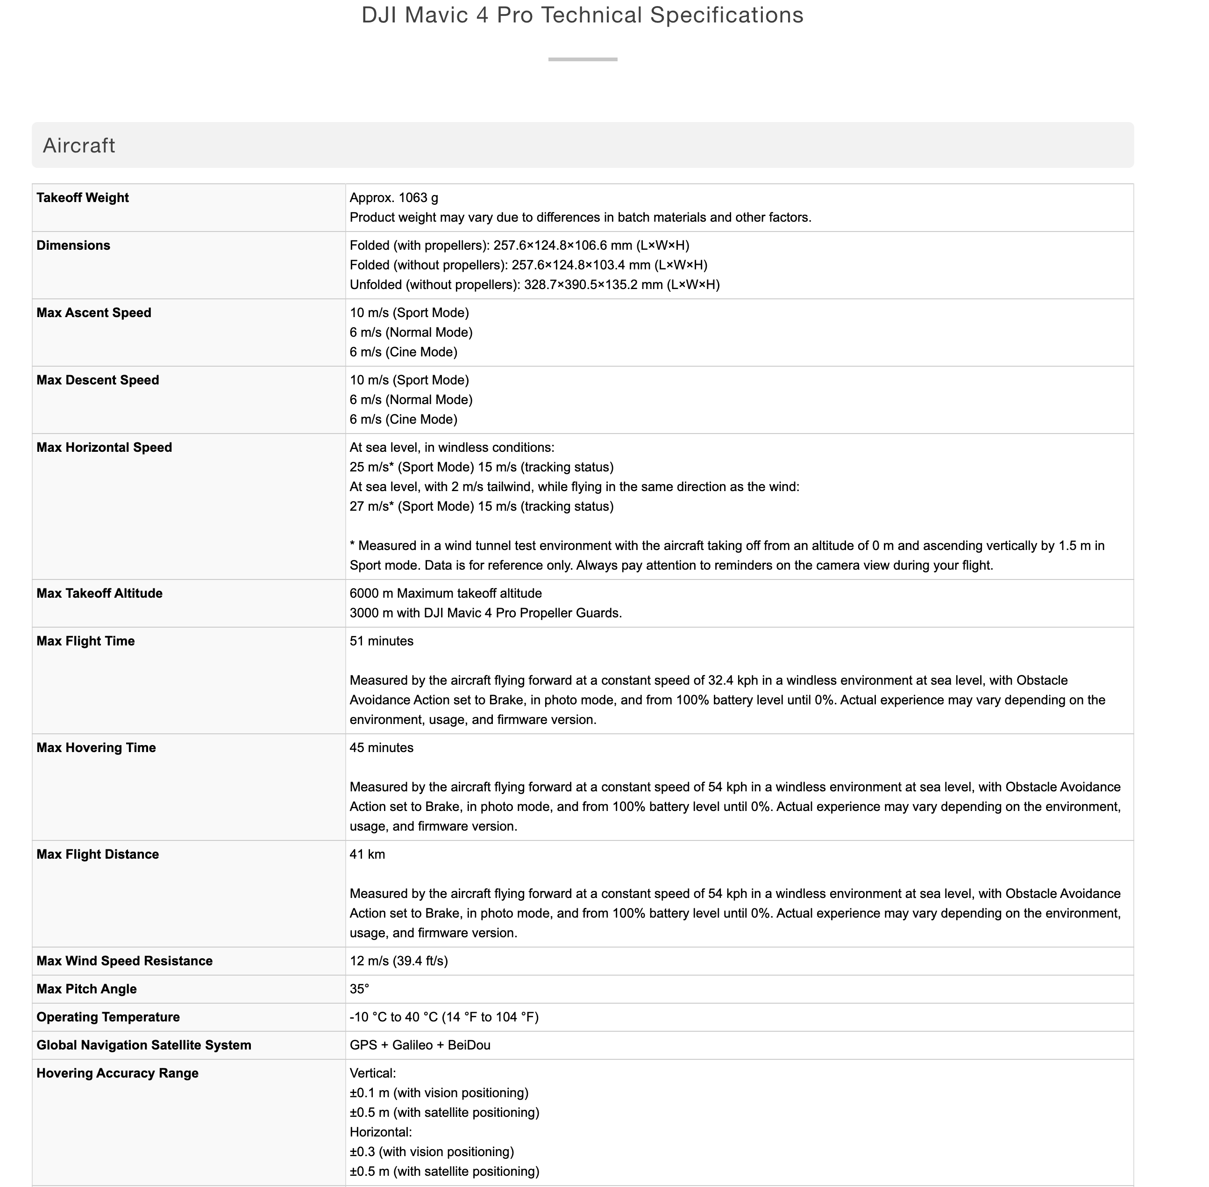
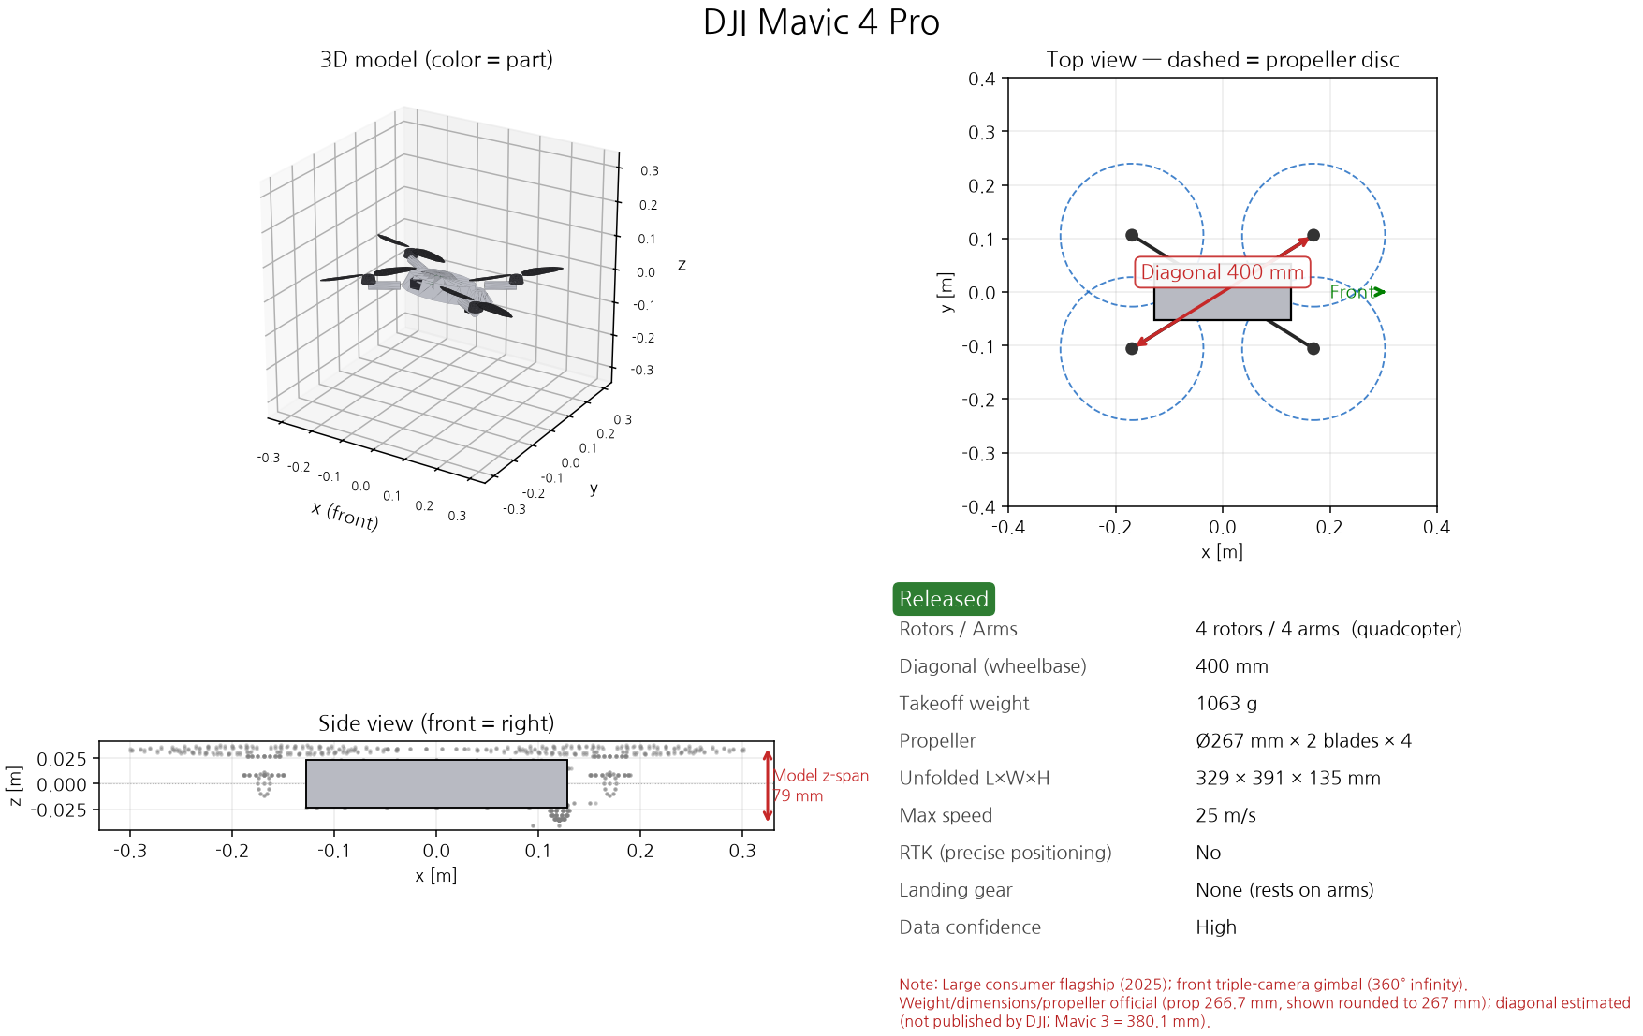
Stage 1 · Spec-Driven Meshes
From a Spec Sheet to a 3D Mesh
Real published specs → double-checked → built into an exact 3D model, part by part
Notes:
For the drone meshes, I first collected the detailed specs — this is the official DJI page on the left — and then I asked Claude to build the mesh from those numbers. Every part is modeled separately: body, arms, motors, propellers, gimbal, landing gear. Let me show you the visualizations.

Slide 8
Stage 1 · Drone Meshes
DJI Drone Meshes — Five Real Models
Meshes rotating (shape comparison) — 4-rotor quads vs the 8-rotor S1000+; each part is its own RF material
Notes:
These are the five meshes. Here they are drawn at the same size, so you can compare the shapes — four-rotor quads versus the eight-rotor S1000+. The real sizes are very different, and I show that on the next slide.

Slide 9
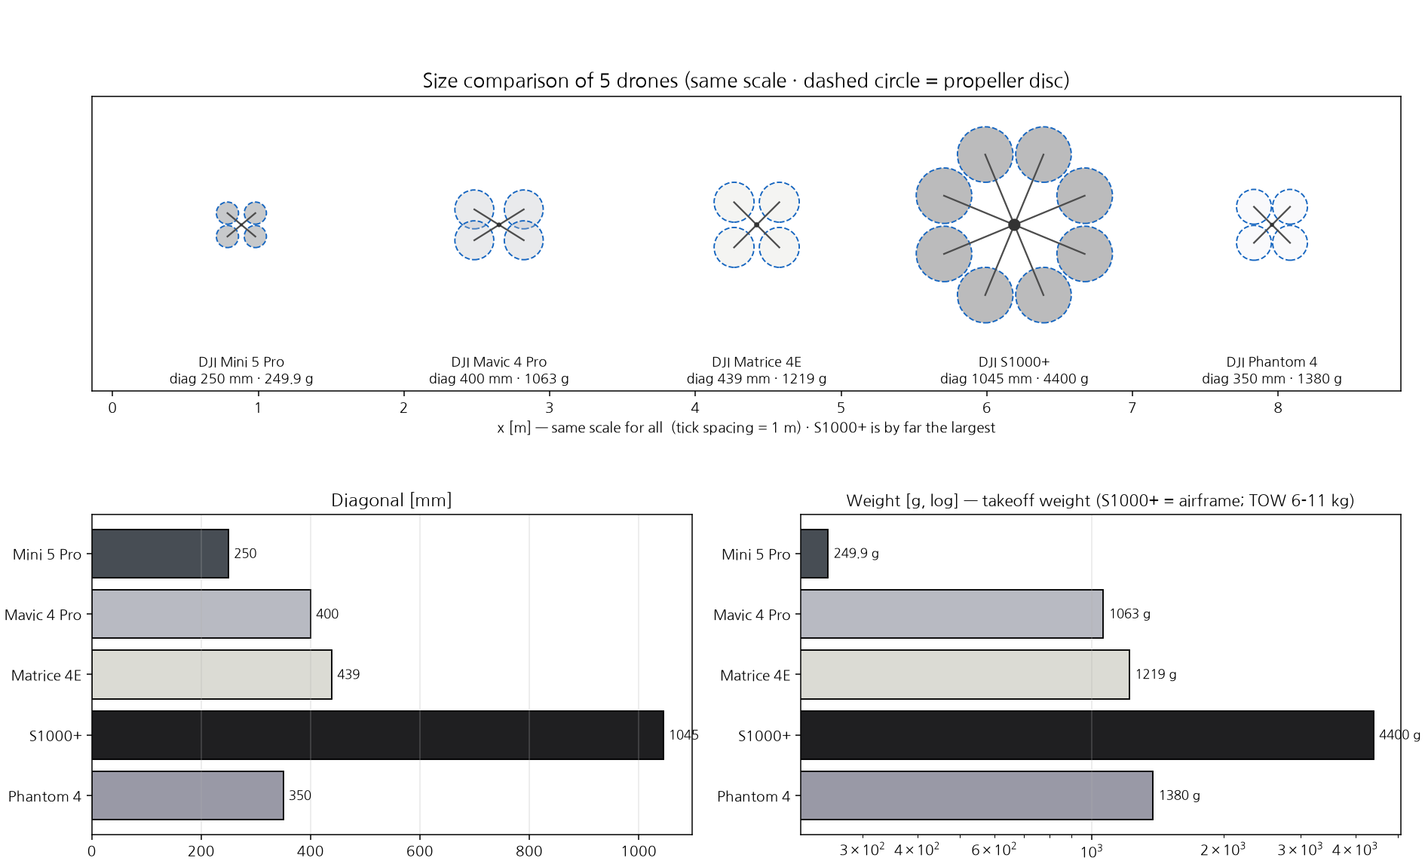
Stage 1 · Drone Meshes
DJI Drone Meshes — Five Real Models
Notes:
This is the real size comparison, all at the same scale. The S1000+ is by far the largest — about one meter across — and the Mini 5 Pro fits in your hand, at 250 grams. The dashed circles are the propeller discs.

Slide 10
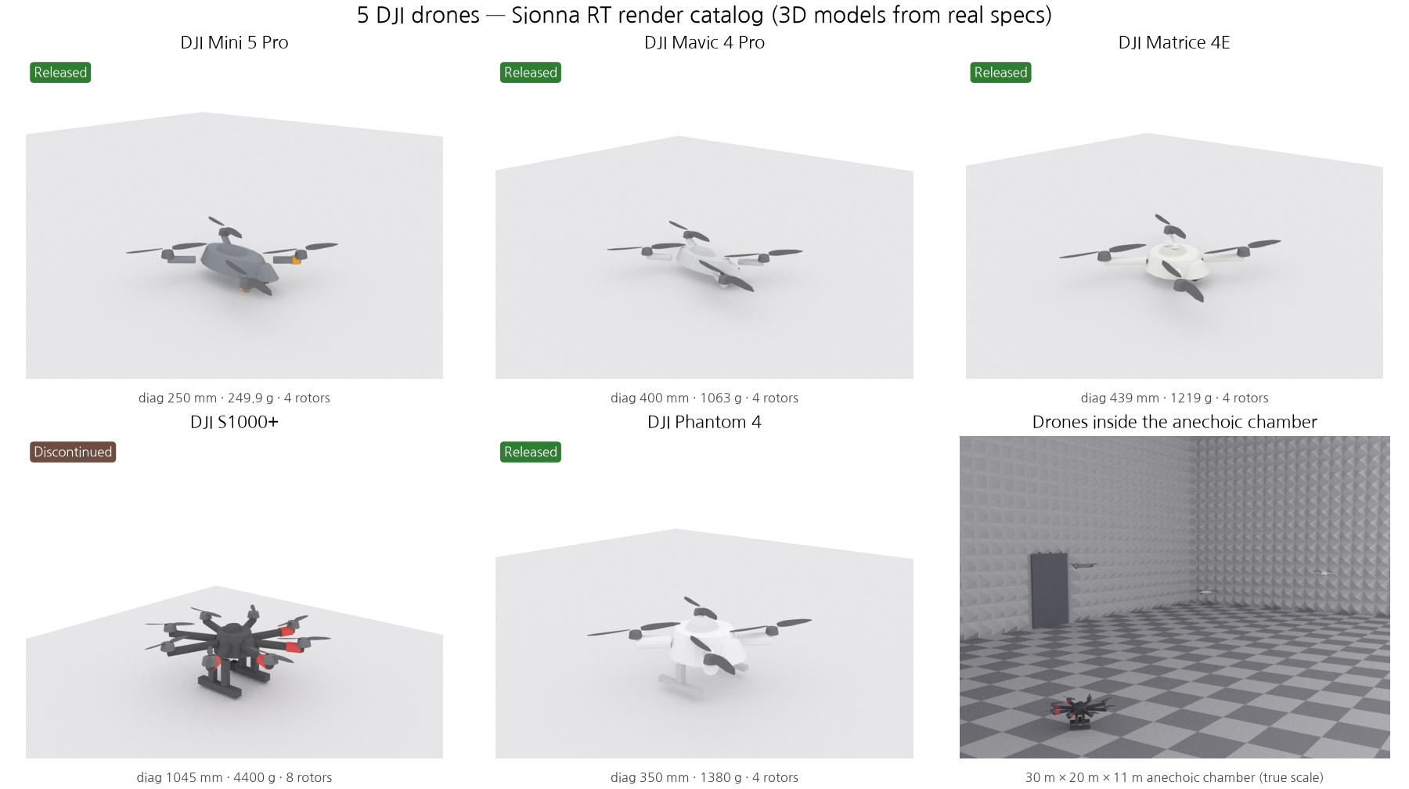
Stage 1 · Drone Meshes
DJI Drone Meshes — Five Real Models
Notes:
And this is what they look like inside the chamber. The point of this slide is scale: in a thirty meter room, these drones are really tiny.

Slide 11
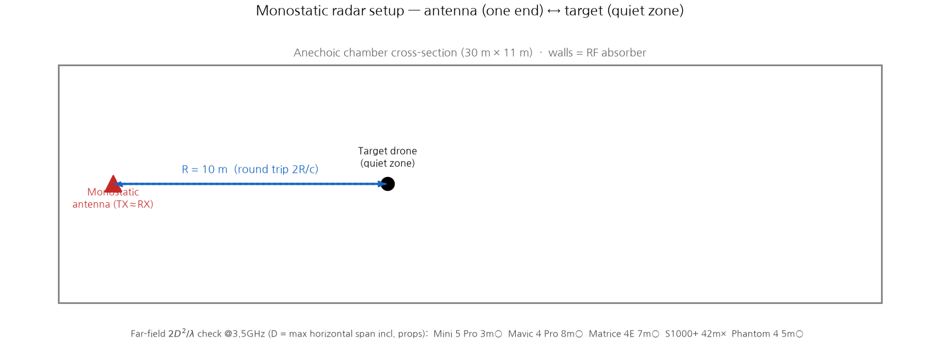
Stage 2 · Radar
Monostatic Radar in the Chamber
The measurement contract for what follows — R = 10 m, quiet zone — and the one drone the real chamber cannot characterise
Notes:
This slide is the measurement contract for everything that follows. One antenna both transmits and listens, the drone sits in the quiet zone, and the range is ten meters. That same ten meter geometry is what I use on the next two slides, when I compare the waveforms. Now, the far-field check at the bottom. Let me be precise about what it means. The physical optics numbers are far-field values by definition, so this is not saying my simulation is wrong. It is saying something about the real experiment we want to run. RCS is only measurable when the range is bigger than two D squared over lambda. At ten meters, the four small drones are fine. But the S1000+ needs forty-two meters, and our chamber is only thirty meters long. So I am flagging it up front: the S1000+ is the one drone this chamber cannot characterise, no matter where we stand it.

Slide 12
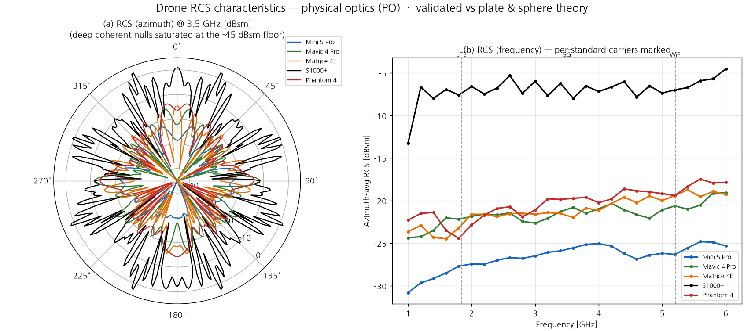
Stage 2 · RCS
Drone RCS, by Physical Optics
How strong an echo — and from which angles it spikes (“glint”)
Notes:
Now the RCS itself. A fair question here is: we are using NVIDIA Sionna, so why compute this by hand? The answer is that Sionna and physical optics do different jobs, and I use both. Sionna's ray tracer is a propagation engine — it is very good at the environment: the chamber walls, the multipath, the clutter. But the target is a different problem. These drones are small — thirty centimeters to one meter, at a wavelength of six to sixteen centimeters — and if I take the backscatter straight out of ray tracing, the absolute RCS is unstable: it is dominated by sampling noise and by glint, and calibrating the absolute power is hard. So I split the work. Physical optics gives the target's RCS — it is the standard method for CAD targets, and I validated it against theory: a metal plate gives four pi A squared over lambda squared, a sphere gives pi r squared, both match. Sionna gives the channel and the clutter. And the link budget gives the absolute power and noise. This is not just an argument — I checked it. In the benchmark, the same detection harness runs on both backends: Sionna's ray tracer found eight clutter paths in the chamber, and the detection result agreed with the analytic physical-optics model. So the two are consistent. One more detail: I do not treat the drone as solid metal. The plastic shell is semi-transparent to RF, so the echo is really dominated by the battery, the motors and the PCB. And the deep nulls in the polar plot are real physics — phase cancellations, only two or three degrees wide.

Slide 13
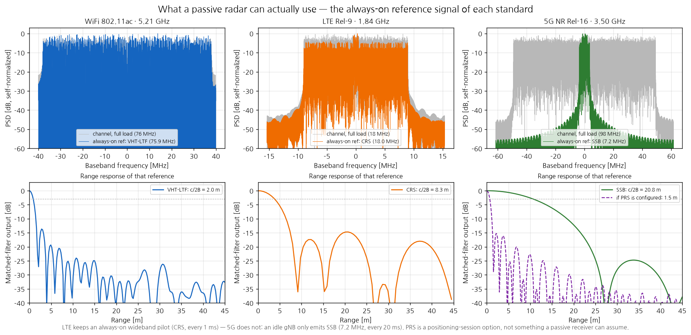
Stage 2 · Waveforms
Lighting It Up — Wi-Fi vs LTE vs 5G
Range resolution follows the reference signal's bandwidth — not the channel's (LTE CRS 18 MHz vs 5G SSB 7 MHz)
Notes:
These are the real Wi-Fi, LTE and 5G signals, built with the correct numerology and reference signals. Here is the key point. A passive radar can only use a signal it already knows — the reference signal. So the range resolution follows the bandwidth of that reference signal, not the bandwidth of the channel. Wi-Fi's preamble is always wideband, so about two meters. LTE's CRS is always on, across the full band, so about eight meters. And 5G, in an idle cell, sends only the SSB — a narrow seven megahertz beacon sitting in the middle of a one hundred megahertz channel — so about twenty-one meters. So the widest channel gives the worst range.

Slide 14
Stage 2 · Reality Check
Cells Aren’t Always Full — G1 / G2 / G3
G1→G2 sharpens only because a positioning session turns PRS on (7 → 98 MHz) — filling the cell with user data (G3) changes nothing
Notes:
This shows the three occupancy modes. Again, a passive radar can only use what it knows. In G1, the idle cell, 5G sends only the SSB, and the range profile is coarse. It becomes sharp at G2 — but not because the cell got busier. It is because a positioning session turns PRS on, and the reference bandwidth jumps from seven to ninety-eight megahertz. Then at G3, when the cell fills up with user data, nothing improves — because user data is unknown to us, we cannot use it as a matched-filter reference. So the occupancy goes from one percent to twenty-one to eighty percent, but the resolution stops improving after G2. And note that PRS is not always on — it only appears when the network runs a positioning session. So for a passive receiver borrowing someone else's cell, the honest baseline for 5G is the SSB.

Slide 15
Stage 3 · Articulation
An Articulated Drone — Body ⟂ Props
Body tilt and rotor spin move on their own — here, both at once
Mavic 4 Pro: the body wobbles (roll/pitch/yaw) while the props keep spinning — two independent degrees of freedom
Notes:
Stage three. I split the drone into a frame plus individually spinning rotors, so the body can tilt while the props spin independently — I verified that the frame vertices do not move at all when only the blades rotate. This is the basis for both micro-Doppler and, later, flight simulation.

Slide 16
Stage 3 · Micro-Doppler
The Spinning-Blade Signature
Even while hovering, the spinning blades ripple the echo — a fingerprint we can read
Notes:
Here is the micro-Doppler. Even when the drone just hovers, the spinning blades keep changing the phase of the echo. Two things show up. First, the blade flashes — the vertical stripes — at one hundred eighty three hertz for the Mavic, which is simply two blades times ninety-two turns per second. Second, the tip Doppler, at plus and minus one point three to one point seven kilohertz at 3.5 gigahertz. Now here is the part that connects back to the previous slides. To read that tip Doppler without aliasing, we need to sample the channel at least three kilohertz. But LTE's CRS repeats at one kilohertz, and 5G's SSB at only fifty hertz. So with commercial signals, this blade signature is folded — we cannot read it directly. That is a fundamental limit of passive sensing, and it is exactly why papers like LaSen try to use the data symbols as well, not only the pilots.

Slide 17
Sionna Progress · Where This Sits
Done in Three Stages — Next: Real Passive Radar
From monostatic RCS toward a full bistatic detection chain
Done ✓
Environment
→
RCS + waveforms
→
Micro-Doppler
Next
Bistatic (Tx ≠ Rx)
→
Clutter ECA + CFAR
→
Detection / tracking
CFAR → MTT
Then
Export to PX4 / Gazebo
→
Drone vs bird ID
blade signature
→
Wi-Fi/LTE/5G compare
→ scene, RCS & signatures are ready — next is the bistatic detection chain
Notes:
This is the roadmap. The three stages are done — the scene, the RCS with the waveforms, and the signatures. Next is the real passive radar chain: a bistatic geometry with transmitter and receiver apart, clutter cancellation, CFAR detection and tracking. I have actually started that part already, so I can show detection results next time.

Slide 18
PAPER Introduction
From Denoising to De-Channeling
Integrating physical channel priors into diffusion models
Background → Idea → Pipeline → Results
Liu et al., BUPT & Pengcheng Lab · github.com/BUPT-GAMMA/FoundWSR
ICML 2026 Spotlight Poster
Notes:
Now let me briefly introduce the paper from ICML that I found interesting, and then wrap up.

Slide 19
Paper Review · Background
Wireless Signal Recognition, Meet Diffusion
AI labels a received radio signal — but the channel distorts it first
What WSR does
Why bring in diffusion
Read the received signal
AI labels a passively-received IQ signal
Modulation type · wireless tech · anomaly
A cornerstone task for spectrum use & 6G
But it arrives distorted: y = h * x + n
Powerful denoisers
Forward: add Gaussian noise, step by step
Reverse: a network learns to remove it
Its learned features transfer well to WSR
So: borrow that denoising power for WSR
→ The plan: let a diffusion model clean the received signal before recognising it
Notes:
The task is wireless signal recognition. An AI reads a passively received IQ signal and labels it — the modulation type, the wireless technology, or an anomaly. A lot of recent work does this with deep learning, and diffusion models in particular have been doing well, because they are strong denoisers and their learned features transfer nicely to this task.

Slide 20
Paper Review · The Idea
The Idea — From Denoising to De-Channeling
The channel isn’t Gaussian — so add a learned channel to the diffusion, not just noise
Standard diffusion
PWC-Diff (proposed)
Denoising only
Forward adds only Gaussian noise
Reverse can’t undo the channel h
→ features stay channel-distorted
De-channeling + denoising
Forward adds a learned channel, then noise
Reverse learns to undo the channel and noise
→ recovers the transmitted signal x
→ Move the goal from denoising to de-channeling: model the physical channel, not just the noise
Notes:
But the authors point out a gap. Existing diffusion work only adds and removes Gaussian noise. A real channel is not Gaussian — it multiplies the signal, it does not just add to it. So they argue the physics is missing, and they put a physical channel model inside the forward process. The reverse process then learns to undo the channel, not just the noise. They call this de-channeling.

Slide 21
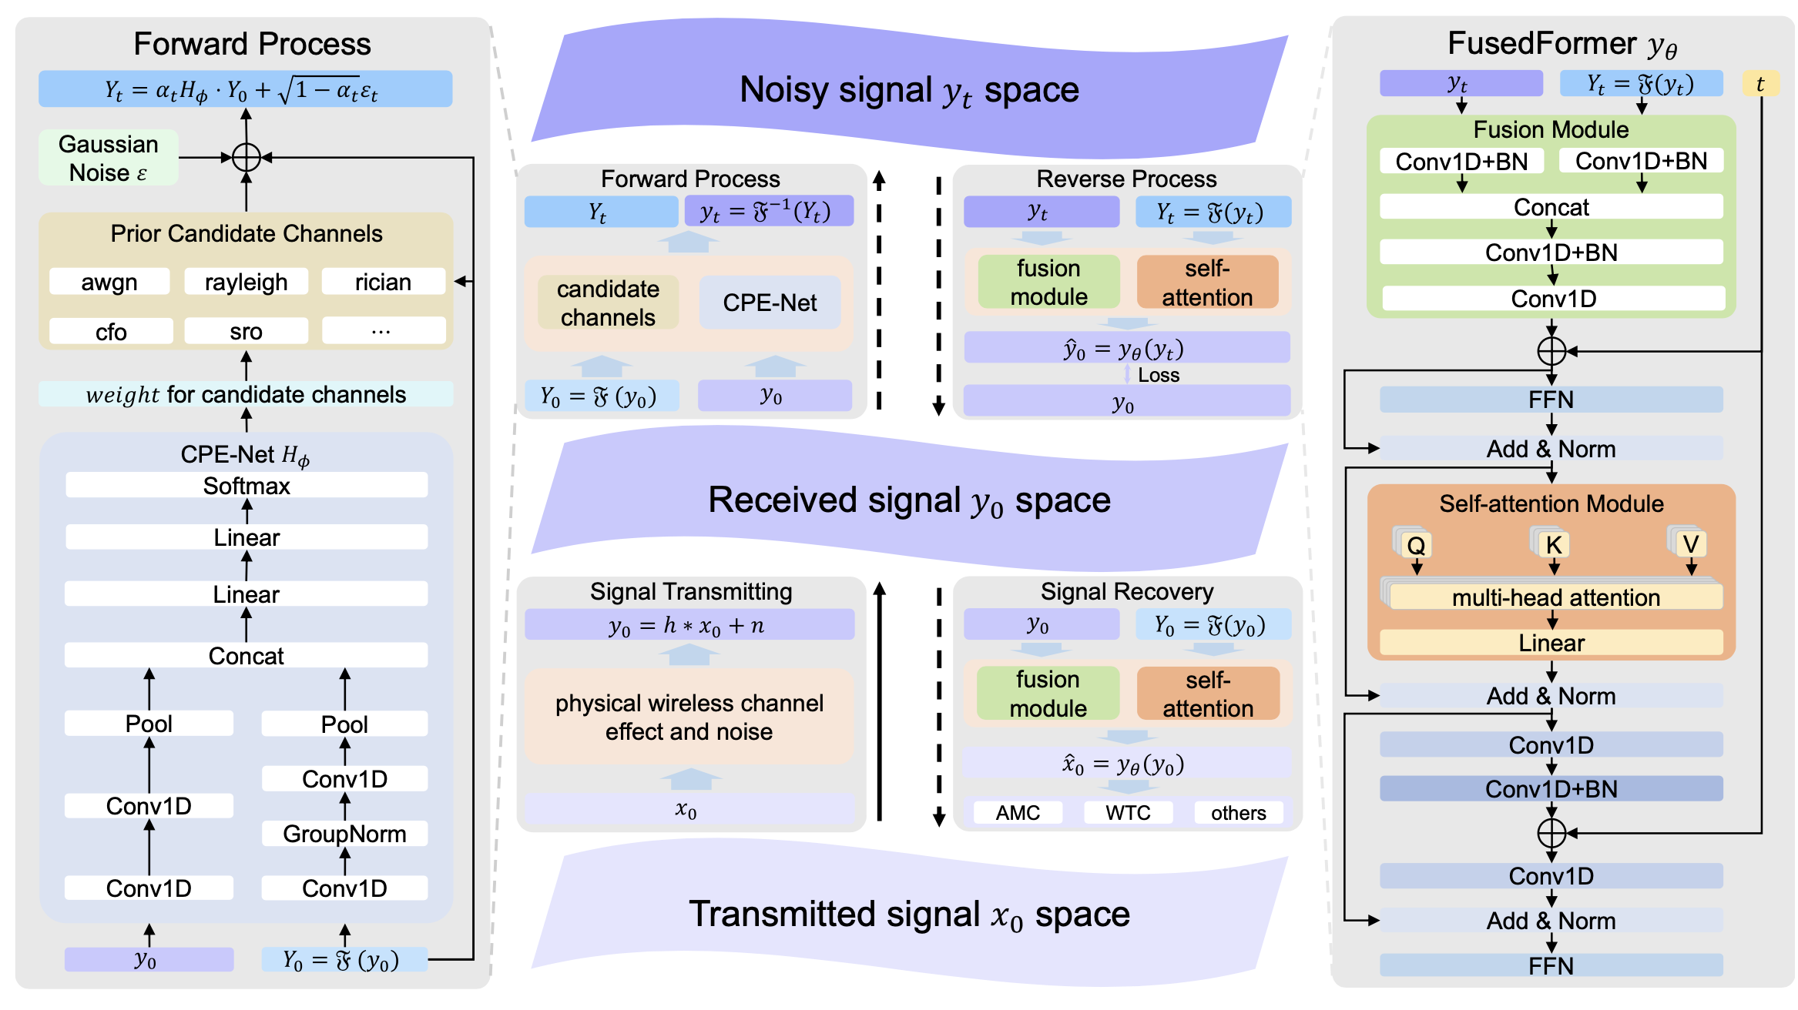
Paper Review · Pipeline
The PWC-Diff Pipeline, End to End
Forward corrupts with a learned channel + noise · Reverse (FusedFormer) recovers the signal
Notes:
This is the overall pipeline. On the left they take the time-domain and the frequency-domain features and concatenate them — they call that part CPE-Net. Then, instead of letting the network learn any channel it likes, they mix a set of predefined physical channel candidates with softmax weights, and add Gaussian noise on top. That constraint actually matters: they prove that if the channel is a free network, the easiest way to minimize the loss is to switch the channel off completely. The reverse process uses attention. I have to admit I could not fully follow that part yet — that is part of the AI study I planned, and I will get there.

Slide 22
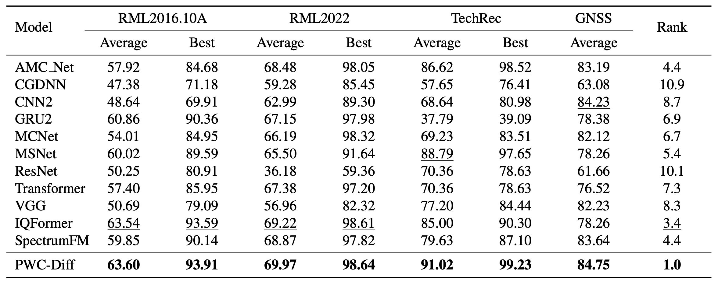
Paper Review · Results
SOTA — Let’s Read the Table Together
Rank 1.0 overall — the interesting part is where the margins are
Top rank on all four datasets — but some margins are thin (RML2016: 63.60 vs IQFormer 63.54)
Clearest win is TechRec (WTC): 91.0 avg vs 88.8 next best
→ Worth discussing: how much of the gain is the de-channeling idea vs the FusedFormer backbone?
Notes:
They report state of the art on all four datasets. But when you read the table, some of the margins are very thin — 63.60 versus 63.54 on RML2016 — and I honestly wonder whether that could flip just by changing the random seed. The clearest win is TechRec: 91.0 versus 88.8. So the fair question is how much of the gain comes from the de-channeling idea itself, and how much from the FusedFormer backbone. One thing I take from this paper for our own work: learning buys you a few percentage points, but physics — bandwidth and integration time — buys you tens of decibels. That is worth remembering when we look at the 5G problem from earlier.

Slide 23
Thank you!
Notes:
That is everything from me. Thank you.

