Slide 1

Team Meeting
Yunjung Jeong
2026. 07. 14
Intelligent Radio Sensing Lab. (IRS Lab)
Department of Electrical Engineering and Computer Science
DGIST
Notes:
Let me start today's team meeting.

Slide 2
Recap
Last Meeting
What I did
Drone selection — Mavic 4 Pro vs Matrice 4E (echo vs RTK ground truth)
Reviewed LaSen (SenSys '26) — the one 5G tracking paper, with RTK ground truth
What I planned
Three parallel tracks — PHY anatomy, AI self-study, and the Sionna simulation
Sionna: a controlled RD-map detection benchmark
Today
Progress on Sionna — three stages now built (environment → radar → micro-Doppler)
Paper Introduction — From Denoising to De-Channeling (ICML 2026 Spotlight)
Notes:
Last time I did two things. First, drone selection — Mavic 4 Pro versus Matrice 4E, comparing echo strength against RTK ground truth. Second, a short review of LaSen, the SenSys paper that tracks a drone using 5G. Since then I was at ICML and had a few other things going on, so I prepared this meeting in a bit of a rush. Today I will show you the Sionna progress — three stages are now built — and then I will introduce one paper.

Slide 3
Today
Contents
1 · Sionna Progress
Three stages — environment, illuminators (Wi-Fi / LTE / 5G), and micro-Doppler
2 · Paper Introduction
From Denoising to De-Channeling (ICML 2026) — physics-informed diffusion for WSR
Notes:
Today has two parts. First, what I built in Sionna, with a lot of pictures. Second, a short introduction to a paper from ICML that I found interesting.

Slide 4
PROGRESS REPORT
Sionna Simulation
From an empty chamber to a drone's radar signature — in three stages
① Environment → ② Illuminators → ③ Micro-Doppler
Notes:
Let me start with the Sionna simulation.

Slide 5
Sionna Progress · Overview
Three Stages, Built on One Scene
Each stage reuses the same chamber and the dimension-accurate drone meshes
① Environment
Shielded chamber
→
5 DJI meshes
→
RF materials
② Illuminators
Wi-Fi / LTE / 5G
real waveforms
→
Reference signals
CRS vs SSB
→
Occupancy
G1 – G3
③ Micro-Doppler
Articulated drone
→
Blade flash
+ tip Doppler
→
PX4 / Gazebo basis
→ report1 · report2 · report3 — each a runnable notebook full of figures
Notes:
This is the overall path I took. First the chamber, and the five DJI meshes built from their real specs. Then the radar side: I built the actual Wi-Fi, LTE and 5G waveforms, and looked at which reference signals a passive receiver can really use. And then stage three, where I split the frame from the rotors so each propeller can spin on its own — that gives us the micro-Doppler, and it is also what we would need if we later want to fly these in PX4 or Gazebo. (If asked: I also compute the drone's RCS from the mesh, using physical optics, validated against plate and sphere theory — Sionna's ray tracer supplies the environment and the clutter. I am skipping those details today for time.)

Slide 6
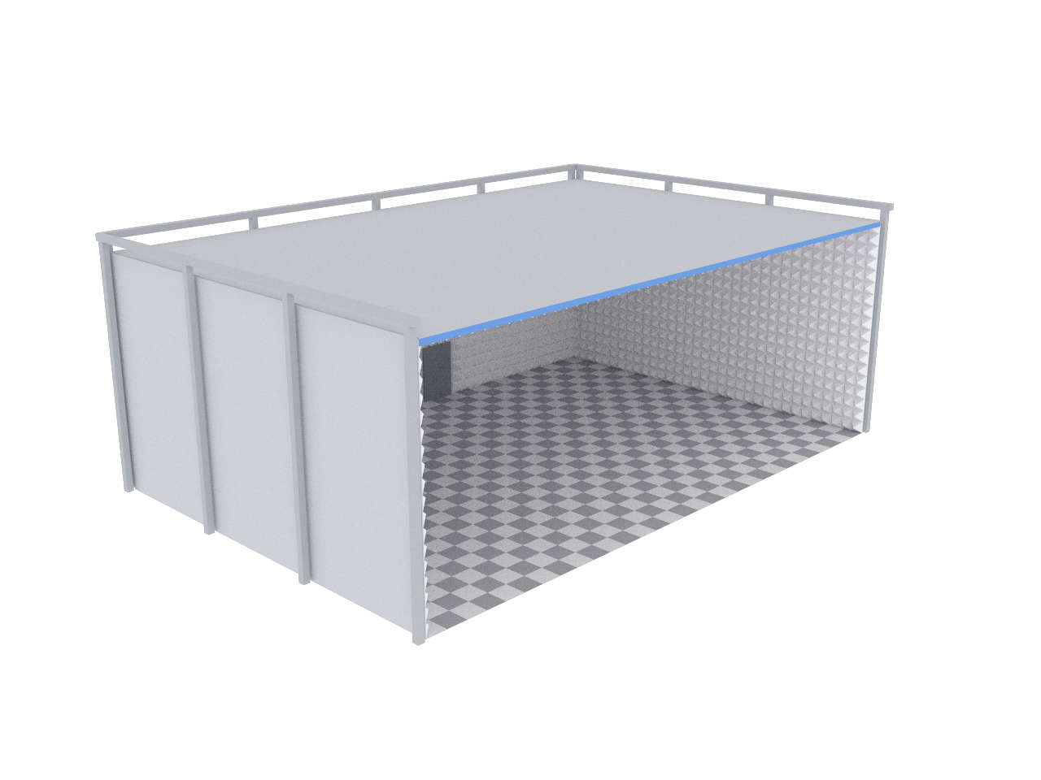
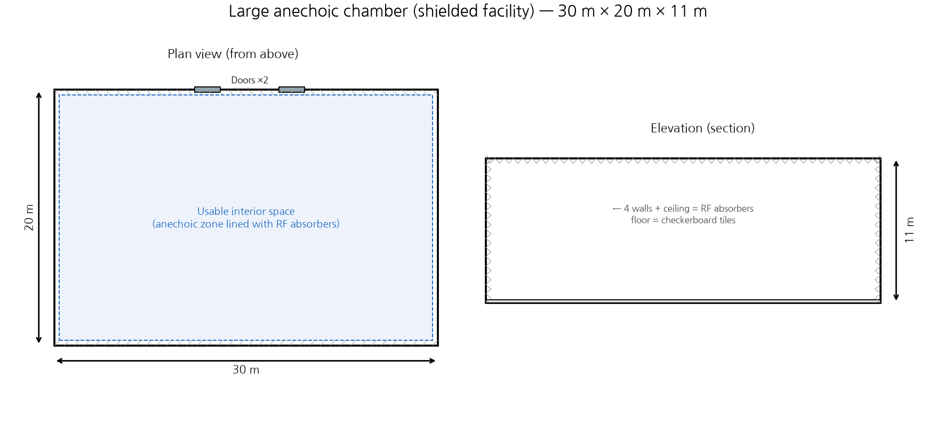
Stage 1 · Environment
The RF Playground — a Shielded Chamber
A 30 × 20 × 11 m shielded room — the walls soak up echoes, so we see only the drone
Sionna render of the chamber (left) · dimensioned plan & elevation (right) — modelled on a real facility
Notes:
For the chamber, I copied the specs of the RF playground we were planning to use for the real experiment. It is thirty by twenty by eleven meters. The walls absorb the echoes, so we see only the drone.

Slide 7
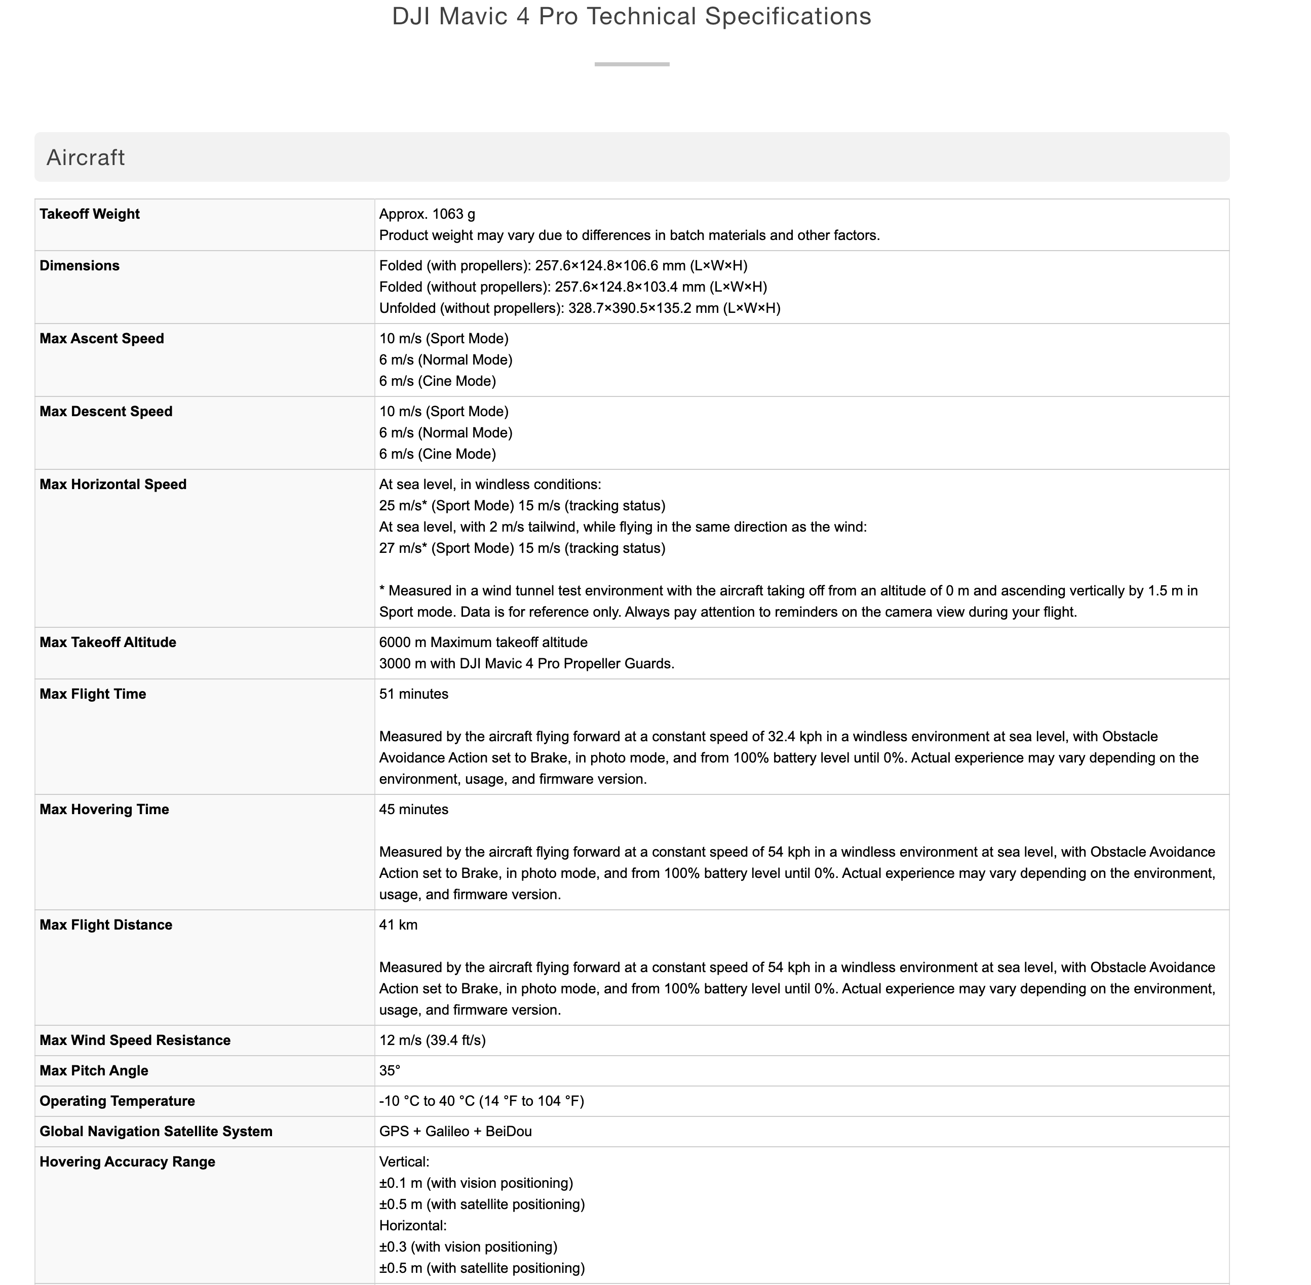
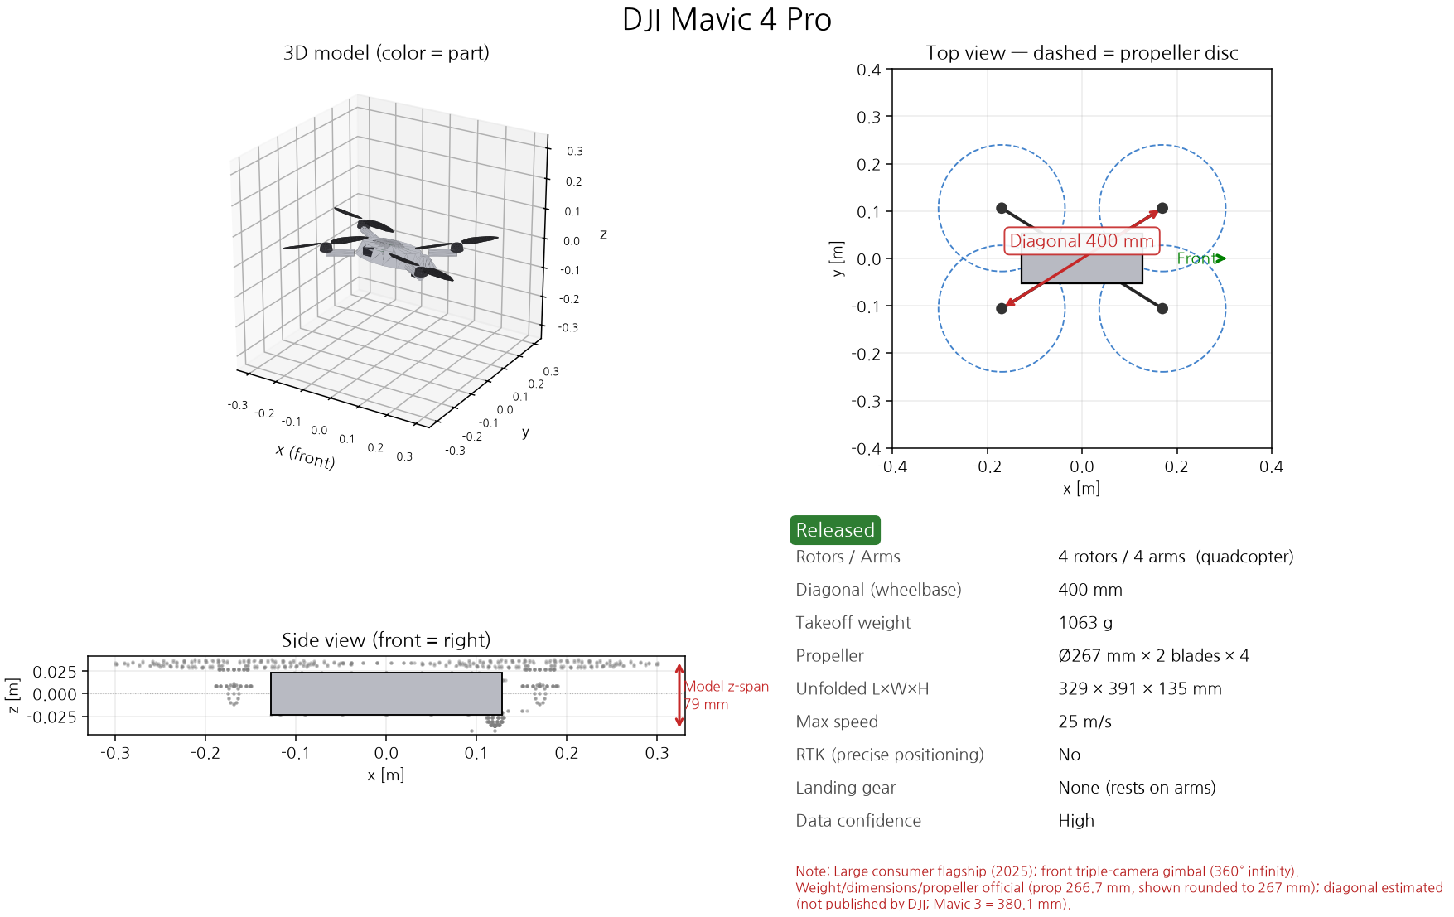
Stage 1 · Spec-Driven Meshes
From a Spec Sheet to a 3D Mesh
Real published specs → double-checked → built into an exact 3D model, part by part
Notes:
For the drone meshes, I first collected the detailed specs — this is the official DJI page on the left — and then I asked Claude to build the mesh from those numbers. Every part is modeled separately: body, arms, motors, propellers, gimbal, landing gear. Let me show you the visualizations.

Slide 8
Stage 1 · Drone Meshes
DJI Drone Meshes — Five Real Models
Meshes rotating (shape comparison) — 4-rotor quads vs the 8-rotor S1000+; each part is its own RF material
Notes:
These are the five meshes. Here they are drawn at the same size, so you can compare the shapes — four-rotor quads versus the eight-rotor S1000+. The real sizes are very different, and I show that on the next slide.

Slide 9
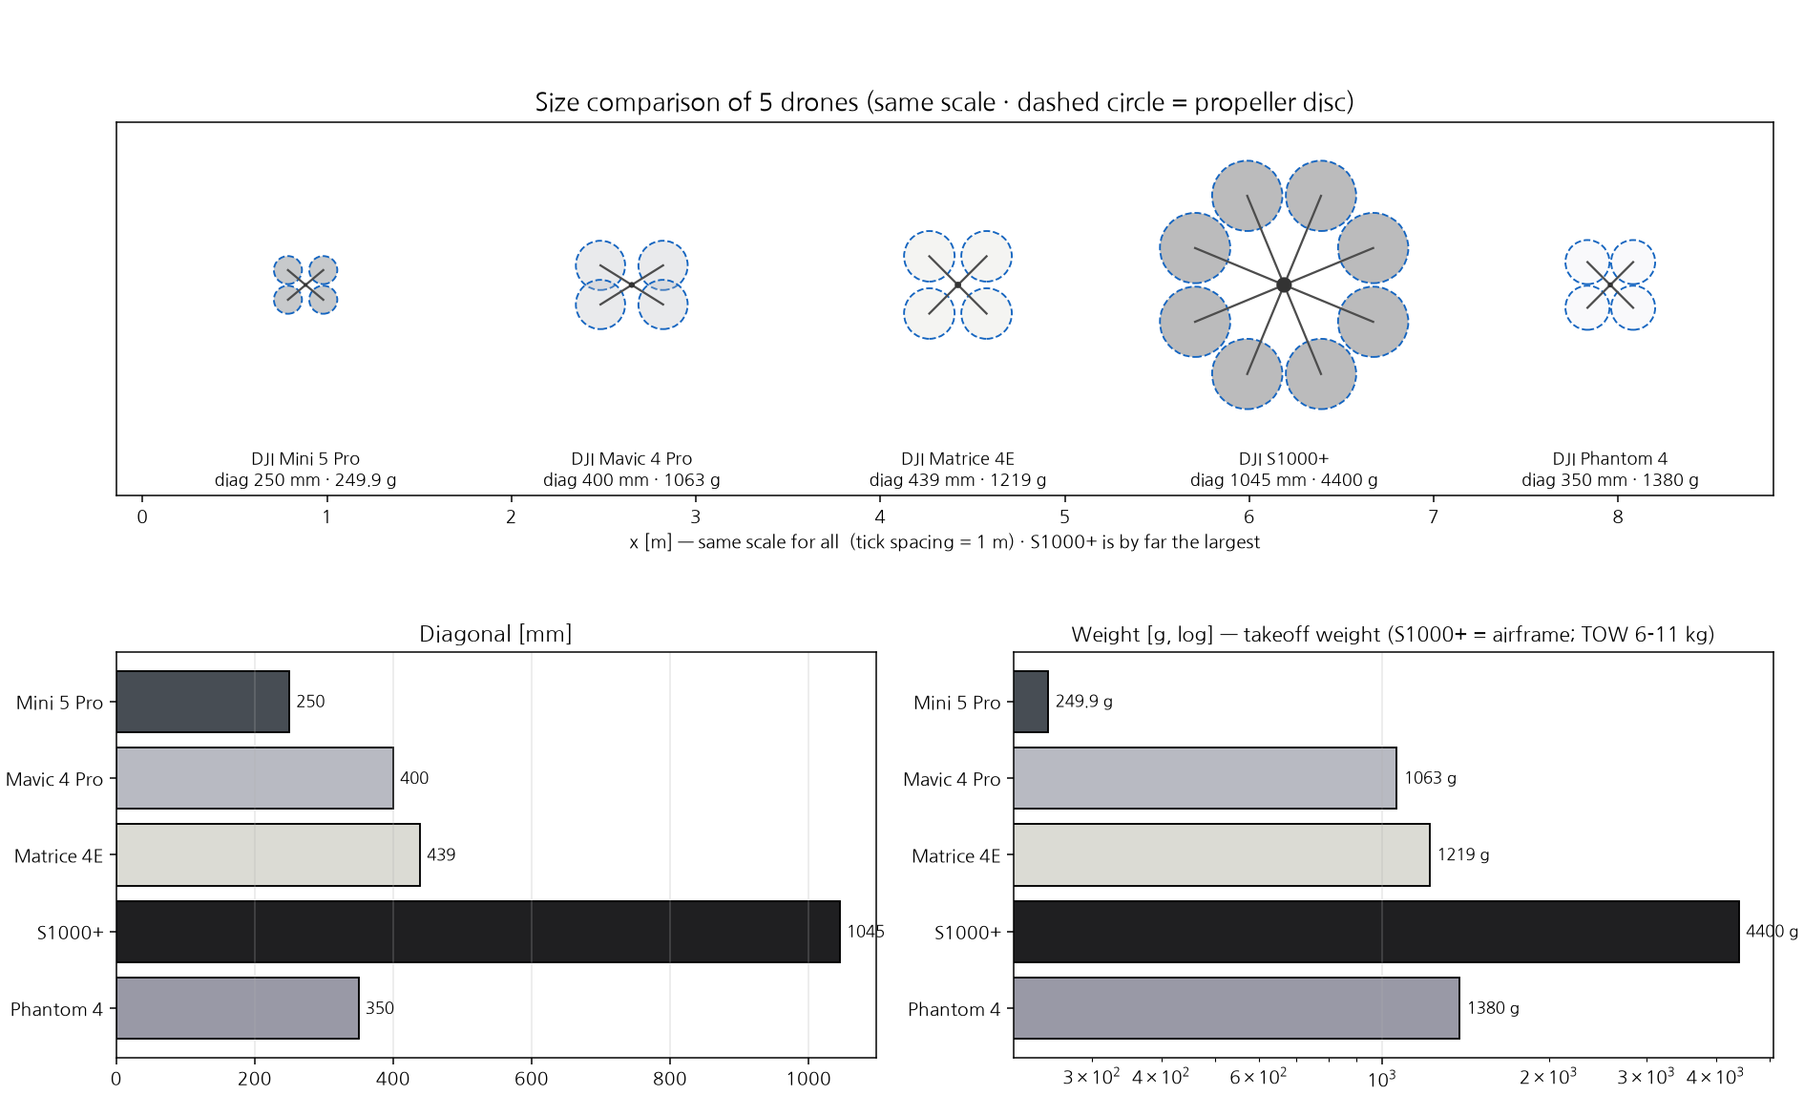
Stage 1 · Drone Meshes
DJI Drone Meshes — Five Real Models
Notes:
This is the real size comparison, all at the same scale. The S1000+ is by far the largest — about one meter across — and the Mini 5 Pro fits in your hand, at 250 grams. The dashed circles are the propeller discs.

Slide 10
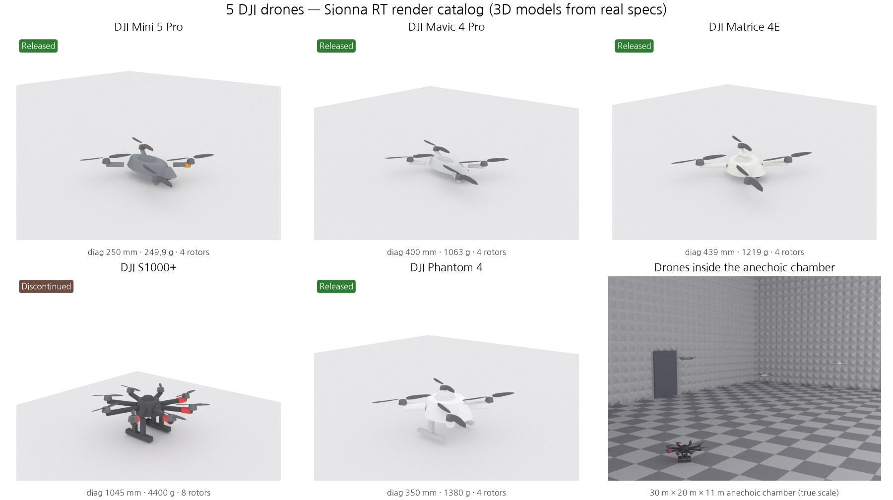
Stage 1 · Drone Meshes
DJI Drone Meshes — Five Real Models
Notes:
And this is what they look like inside the chamber. The point of this slide is scale: in a thirty meter room, these drones are really tiny.

Slide 11
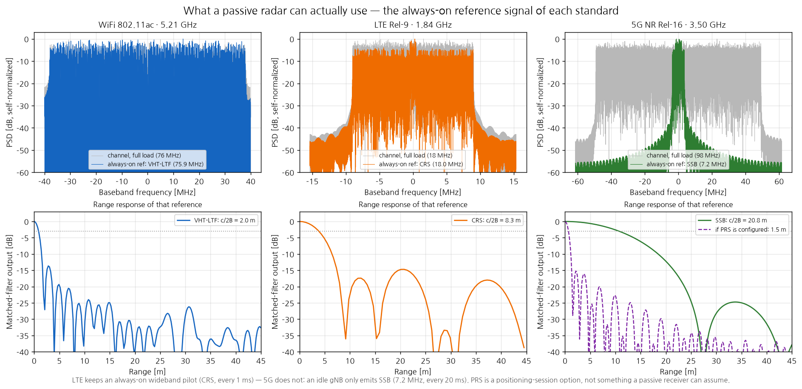
Stage 2 · Waveforms
Lighting It Up — Wi-Fi vs LTE vs 5G
Range resolution follows the reference signal's bandwidth — not the channel's (LTE CRS 18 MHz vs 5G SSB 7 MHz)
Notes:
These are the real Wi-Fi, LTE and 5G signals, built with the correct numerology and reference signals. Here is the key point. A passive radar can only use a signal it already knows — the reference signal. So the range resolution follows the bandwidth of that reference signal, not the bandwidth of the channel. Wi-Fi's preamble is always wideband, so about two meters. LTE's CRS — the cell reference signal — is always on, across the full band, so about eight meters. And 5G, in an idle cell, sends only the SSB — a narrow seven megahertz beacon sitting in the middle of a one hundred megahertz channel — so about twenty-one meters. So the widest channel gives the worst range.

Slide 12
Stage 2 · Reality Check
Cells Aren’t Always Full — G1 / G2 / G3
G1→G2 sharpens only because a positioning session turns PRS on (7 → 98 MHz) — filling the cell with user data (G3) changes nothing
Notes:
Before the result, one word about PRS, because SSB is familiar but PRS may not be. PRS is the Positioning Reference Signal. Think of it as a survey beacon: it is wideband, it is spread across the whole channel with a comb pattern, and the network switches it on only when it is actually running a positioning session — for example, locating a phone indoors where GPS does not work. It is not always on, and that is the whole point of this slide. Now the three modes. In G1, the idle cell, 5G sends only the SSB, and the range profile is coarse. It becomes sharp at G2 — but not because the cell got busier. It is because a positioning session turns PRS on, and the reference bandwidth jumps from seven to ninety-eight megahertz. Then at G3, when the cell fills up with user data, nothing improves — because user data is unknown to us, we cannot use it as a matched-filter reference. Occupancy goes one percent, twenty-one percent, eighty percent — but the resolution stops improving after G2. One detail in case it comes up: PRS and user data never sit on the same resource element. The standard rate-matches the data around the PRS, so in those symbols PRS takes one quarter of the subcarriers and the data fills the rest. And in practice networks tend to keep positioning occasions light on data, to keep the positioning accurate — which, if anything, makes G2 the realistic case and G3 an upper bound on energy. Either way the conclusion holds: for a passive receiver borrowing someone else's cell, the honest baseline for 5G is the SSB.

Slide 13
Stage 3 · Articulation
An Articulated Drone — Body ⟂ Props
Body tilt and rotor spin move on their own — here, both at once
Mavic 4 Pro: the body wobbles (roll/pitch/yaw) while the props keep spinning — two independent degrees of freedom
Notes:
Stage three. I split the drone into a frame plus individually spinning rotors, so the body can tilt while the props spin independently — I verified that the frame vertices do not move at all when only the blades rotate. This is the basis for both micro-Doppler and, later, flight simulation.

Slide 14
Stage 3 · Micro-Doppler
The Spinning-Blade Signature
Even while hovering, the spinning blades ripple the echo — a fingerprint we can read
Notes:
Stage three, the micro-Doppler. I separated the rotors so the blades can spin on their own, and then I simply asked for the micro-Doppler pattern — and this is what came out. The vertical stripes are the blade flashes, and the spread around the centre is the Doppler from the blade tips. That is as far as I have taken it for now.

Slide 15
Sionna Progress · Where This Sits
Done in Three Stages — Next: Real Passive Radar
From a static scene toward a full bistatic detection chain
Done ✓
Environment
→
Illuminators
Wi-Fi / LTE / 5G
→
Micro-Doppler
Next
Bistatic (Tx ≠ Rx)
→
Clutter ECA + CFAR
→
Detection / tracking
CFAR → MTT
Then
Export to PX4 / Gazebo
→
Drone vs bird ID
blade signature
→
Fair Pd benchmark
across signals
→ scene, illuminators & signatures are ready — next is the bistatic detection chain
Notes:
This is where the work sits right now. Done: the environment — the chamber and the five meshes; the illuminators — Wi-Fi, LTE and 5G, with their reference signals and the occupancy modes; and the micro-Doppler. Next is the real passive radar chain: a bistatic geometry with the transmitter and the receiver apart, clutter cancellation, and CFAR detection with tracking. I have already started that part, so I can show detection results next time. After that: a fair benchmark of the three signals in terms of detection probability, drone versus bird from the blade signature, and exporting the articulated model to PX4 or Gazebo.

Slide 16
PAPER Introduction
From Denoising to De-Channeling
Integrating physical channel priors into diffusion models
Background → Idea → Pipeline → Results
Liu et al., BUPT & Pengcheng Lab · github.com/BUPT-GAMMA/FoundWSR
ICML 2026 Spotlight Poster
Notes:
Now let me briefly introduce the paper from ICML that I found interesting, and then wrap up.

Slide 17
Paper Review · Background
Wireless Signal Recognition, Meet Diffusion
AI labels a received radio signal — but the channel distorts it first
What WSR does
Why bring in diffusion
Read the received signal
AI labels a passively-received IQ signal
Modulation type · wireless tech · anomaly
A cornerstone task for spectrum use & 6G
But it arrives distorted: y = h * x + n
Powerful denoisers
Forward: add Gaussian noise, step by step
Reverse: a network learns to remove it
Its learned features transfer well to WSR
So: borrow that denoising power for WSR
→ The plan: let a diffusion model clean the received signal before recognising it
Notes:
The task is wireless signal recognition. An AI reads a passively received IQ signal and labels it — the modulation type, the wireless technology, or an anomaly. A lot of recent work does this with deep learning, and diffusion models in particular have been doing well, because they are strong denoisers and their learned features transfer nicely to this task.

Slide 18
Paper Review · The Idea
The Idea — From Denoising to De-Channeling
The channel isn’t Gaussian — so add a learned channel to the diffusion, not just noise
Standard diffusion
PWC-Diff (proposed)
Denoising only
Forward adds only Gaussian noise
Reverse can’t undo the channel h
→ features stay channel-distorted
De-channeling + denoising
Forward adds a learned channel, then noise
Reverse learns to undo the channel and noise
→ recovers the transmitted signal x
→ Move the goal from denoising to de-channeling: model the physical channel, not just the noise
Notes:
But the authors point out a gap. Existing diffusion work only adds and removes Gaussian noise. A real channel is not Gaussian — it multiplies the signal, it does not just add to it. So they argue the physics is missing, and they put a physical channel model inside the forward process. The reverse process then learns to undo the channel, not just the noise. They call this de-channeling.

Slide 19
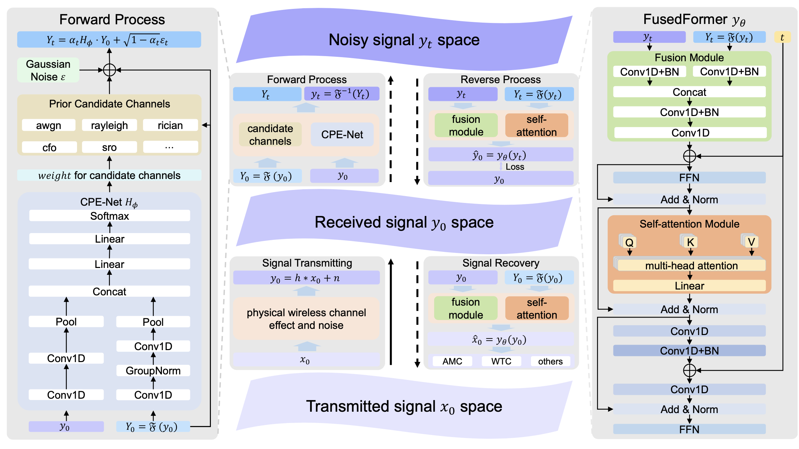
Paper Review · Pipeline
The PWC-Diff Pipeline, End to End
Forward corrupts with a learned channel + noise · Reverse (FusedFormer) recovers the signal
Notes:
This is the overall pipeline. On the left they take the time-domain and the frequency-domain features and concatenate them — they call that part CPE-Net. Then, instead of letting the network learn any channel it likes, they mix a set of predefined physical channel candidates with softmax weights, and add Gaussian noise on top. That constraint actually matters: they prove that if the channel is a free network, the easiest way to minimize the loss is to switch the channel off completely. The reverse process uses attention. I have to admit I could not fully follow that part yet — that is part of the AI study I planned, and I will get there.

Slide 20
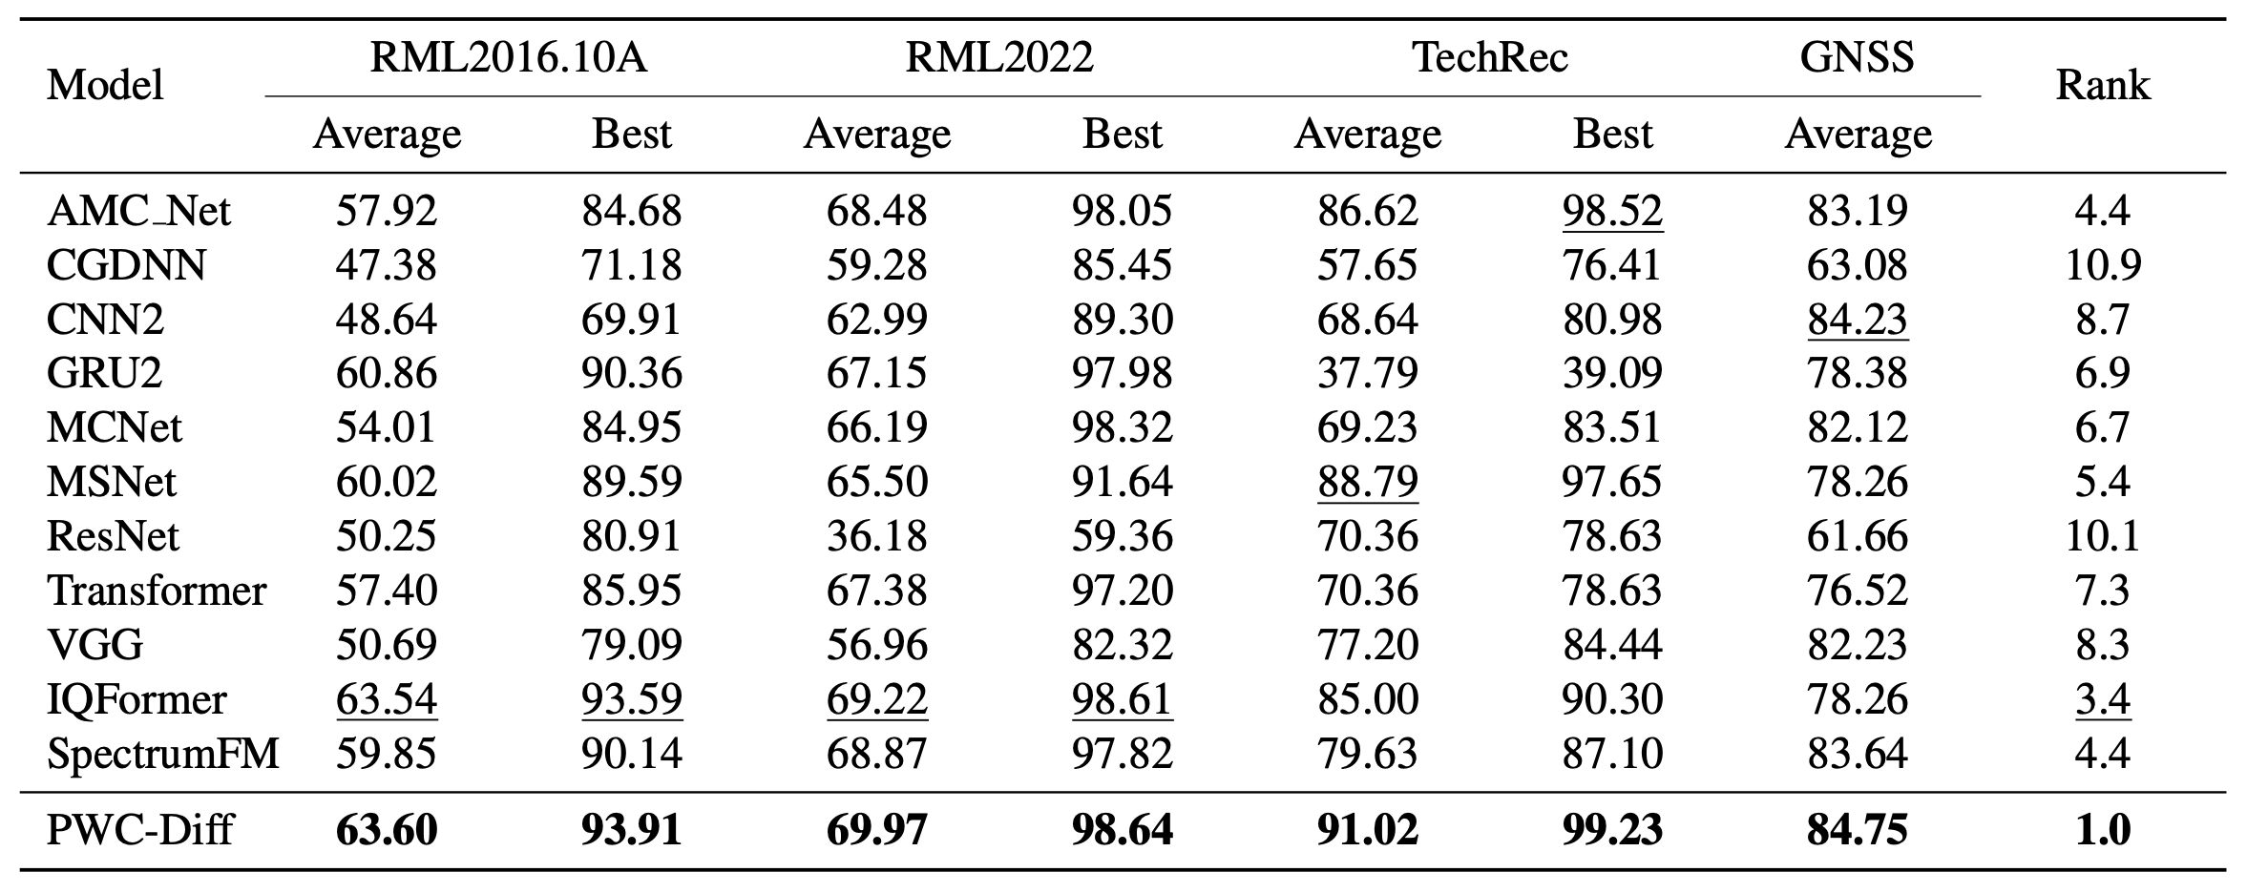
Paper Review · Results
SOTA — Let’s Read the Table Together
Rank 1.0 overall — the interesting part is where the margins are
Top rank on all four datasets — but some margins are thin (RML2016: 63.60 vs IQFormer 63.54)
Clearest win is TechRec (WTC): 91.0 avg vs 88.8 next best
→ Worth discussing: how much of the gain is the de-channeling idea vs the FusedFormer backbone?
Notes:
They report state of the art on all four datasets. But when you read the table, some of the margins are very thin — 63.60 versus 63.54 on RML2016 — and I honestly wonder whether that could flip just by changing the random seed. The clearest win is TechRec: 91.0 versus 88.8. So the fair question is how much of the gain comes from the de-channeling idea itself, and how much from the FusedFormer backbone. One thing I take from this paper for our own work: learning buys you a few percentage points, but physics — bandwidth and integration time — buys you tens of decibels. That is worth remembering when we look at the 5G problem from earlier.

Slide 21
Thank you!
Notes:
That is everything from me. Thank you.

