Slide 1

Team Meeting
Yunjung Jeong
2026. 08. 04
Intelligent Radio Sensing Lab. (IRS Lab)
Department of Electrical Engineering and Computer Science
DGIST

Slide 2
CONTENTS
Today
A short week, and two papers worth flagging
Part 1 - RCS references for the drone mesh
Paper 1: Mono-static 3D UAV RCS
Paper 2: Multiband monostatic and bistatic RCS
Part 2 - OpenISAC group meeting
Notes:
Last week I mostly spent most of time on preparing for the group meeting, since it is the first time for preparing such thing, I think I have fail to manage time.

Slide 3
PART 1
RCS references for the drone mesh
Two measurement papers found while preparing the Sionna work
Notes:
I found two papers that conducted detailed measurements related to RCS values, and using these two papers,
I plan to verify the drone meshes that I created and the RCS values generated by the physical optics method.

Slide 4
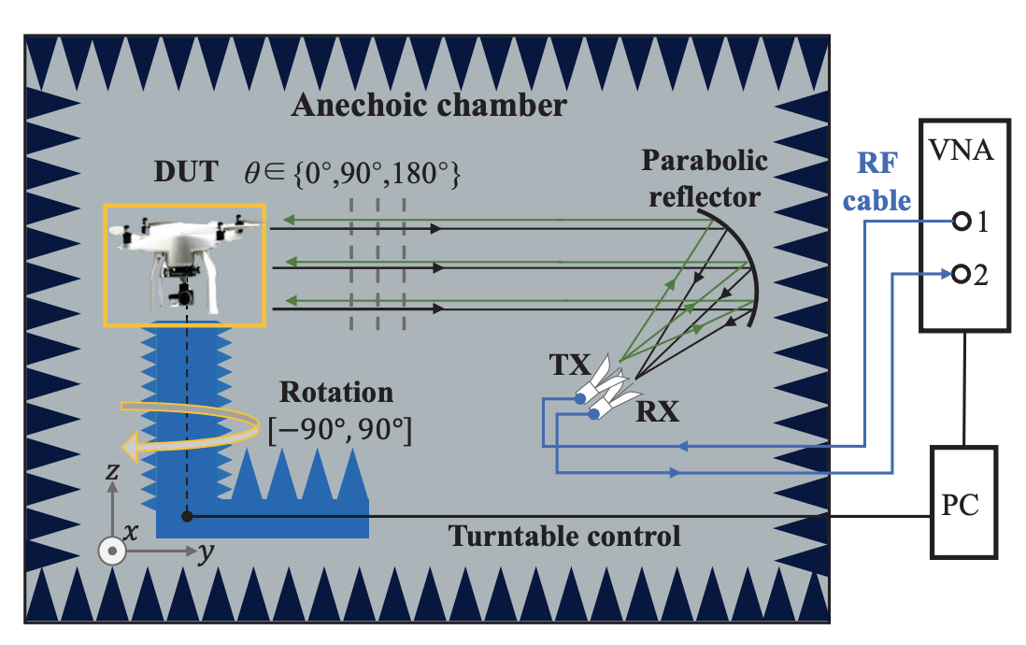
PART 1 · RCS REFERENCES
Two measured references
Measured RCS, which is what the mesh has never been checked against
1 Mono-static 3D UAV RCS
On Experimental Analysis of Mono-Static 3D UAV RCS for ISAC Channel Modeling
Yuan, Yu, Li, and Fan - EuCAP 2025
Measured mono-static UAV RCS over a three-dimensional aspect grid.
Notes:
The first paper was published in EuCAP, and as shown in the figure on the right,
it is a paper that obtained RCS values by illuminating the drone from various angles in a chamber.

Slide 5
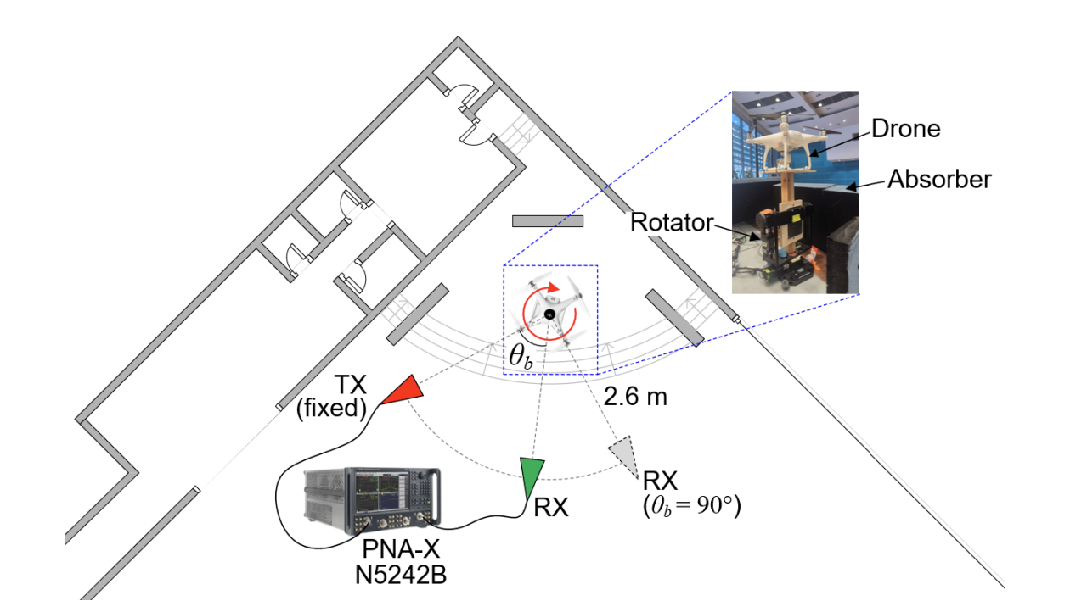
PART 1 · RCS REFERENCES
Two measured references
Measured RCS, which is what the mesh has never been checked against
2 Multiband monostatic and bistatic RCS
Multiband Monostatic and Bistatic RCS Characterization of AAVs for ISAC Channel Modeling
Das et al. - IEEE Wireless Communications Letters, 2026
Adds the bistatic geometry and several frequency bands.
Notes:
The second paper is a paper published in IEEE WCL, which references the previously introduced paper,
and it is a paper that measured not only monostatic but also bistatic settings, various models, and various bands
추가로 저번에 말씀드렸던 맥락인데 시오나의 경우 ray가 표면 재질의 반사율에 의한 변동이고, 물체 전체가 얼마나 되쏘냐가 아닙니다. 이때 물체 전체가 반사하는 값을 구하기 위한 과정이

Slide 6
PART 2
OpenISAC group meeting

Slide 7
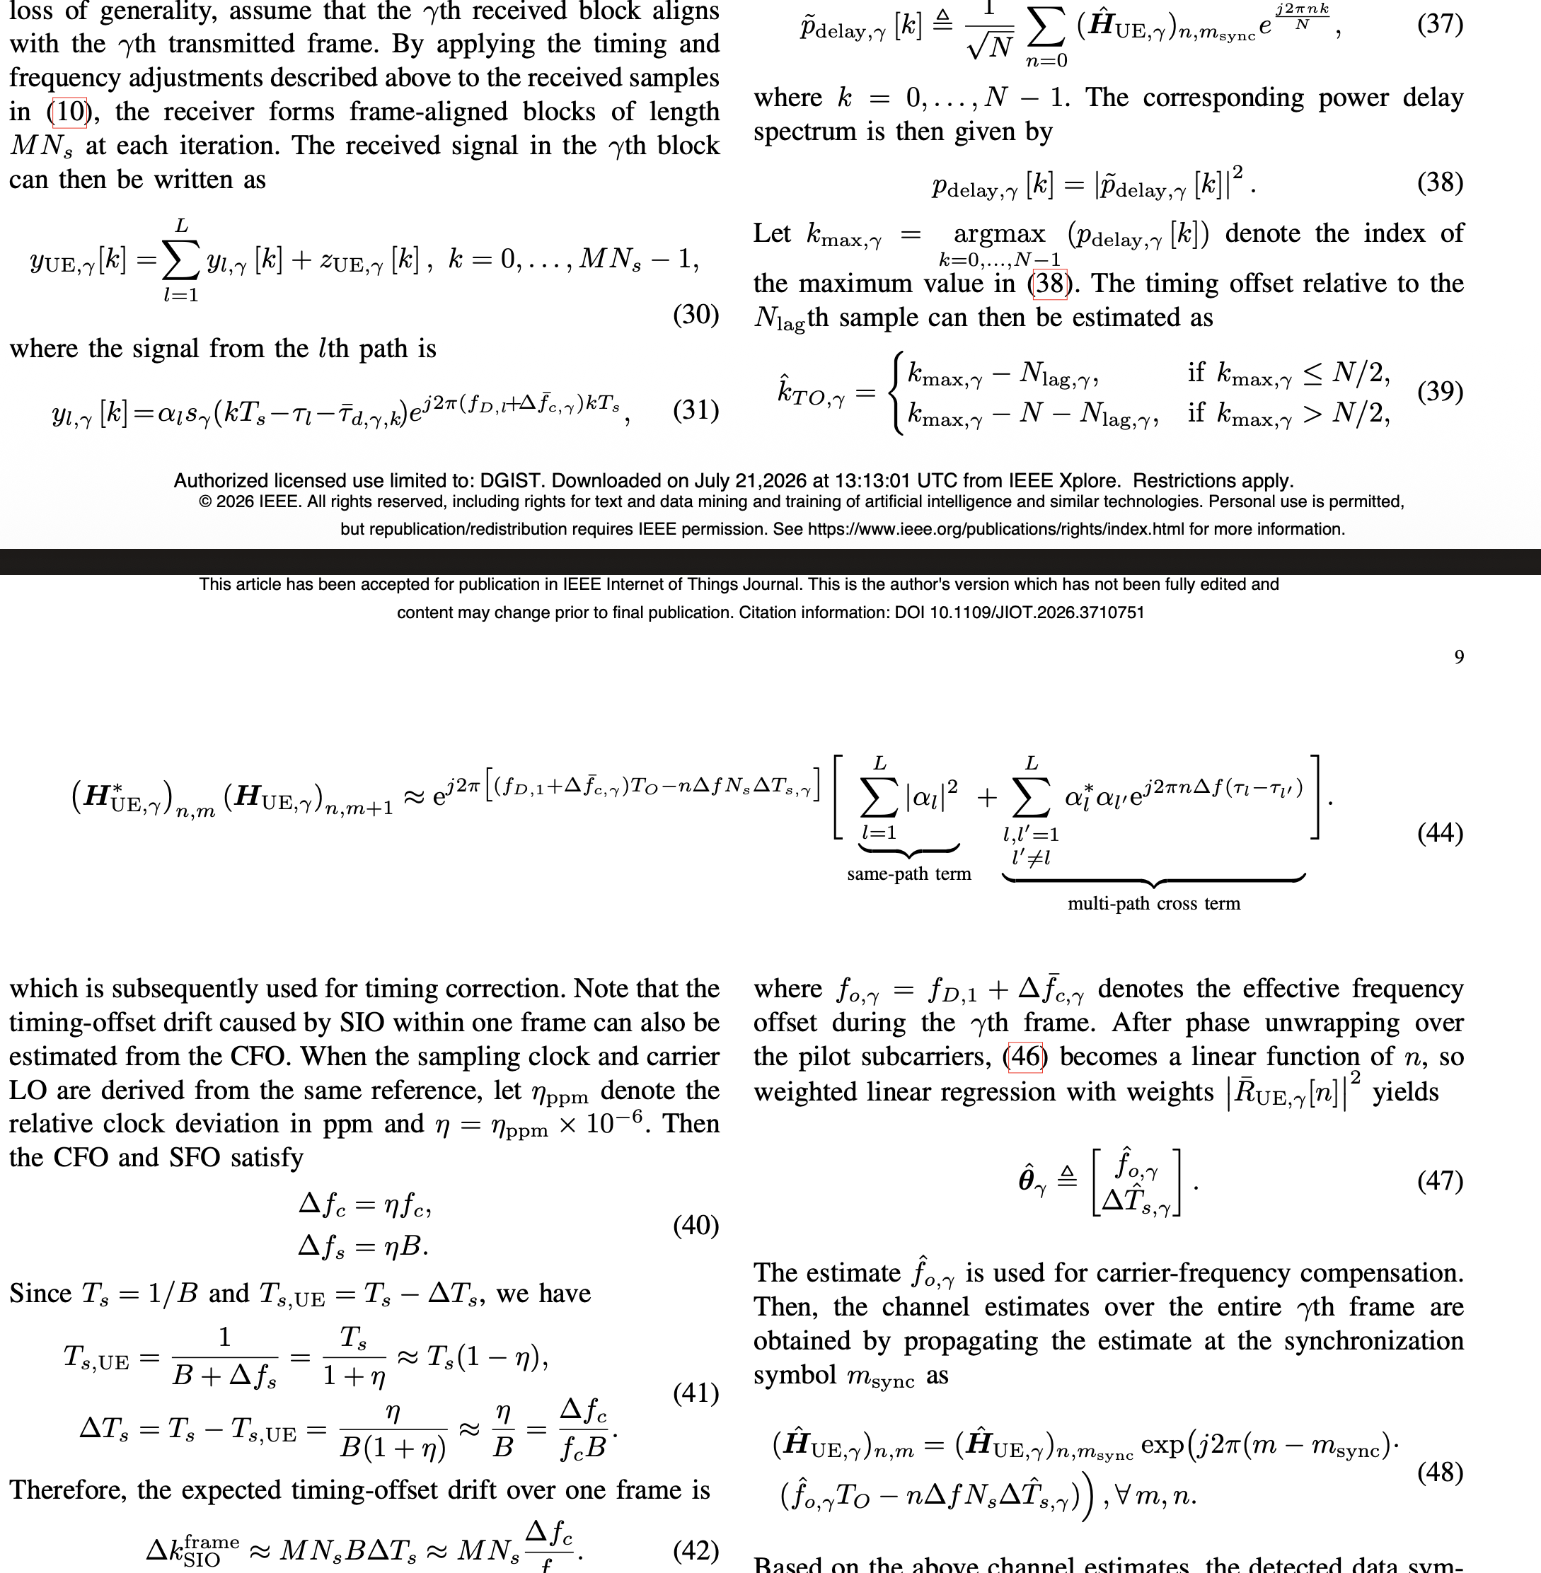
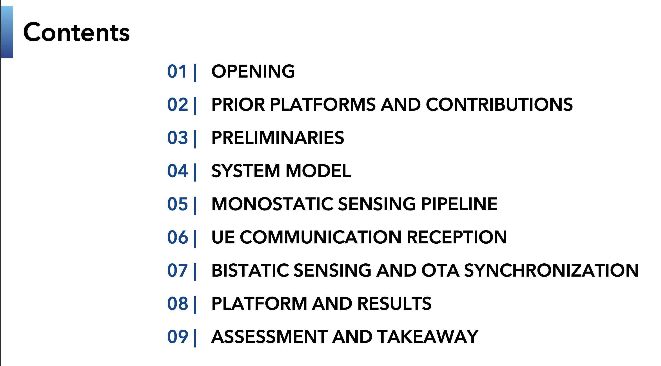
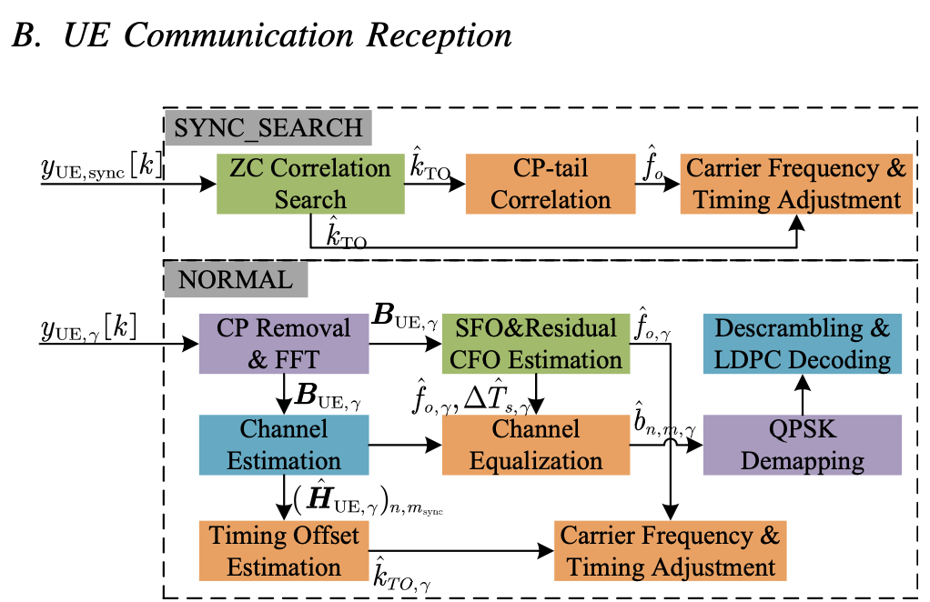
PART 2 · OPENISAC
Group meeting preparation
Most of this week went into the OpenISAC review
Notes:
And recently, I have been devoting most of my time to preparing for the group meeting.
I am currently creating it with my own thoughts on the overall structure and narrative.
However, there is a question I would like to ask.
Looking at the picture on the right,
this paper contains large number of equations. A total of 64 equations are written, and even while trying to understand them strictly, if I look at the later steps and go back to the previous steps, the equations become faint in my mind again,
and I feel like it is not very meaningful to explain all these equations at the group meeting seminar.
So, I am not sure to what level it is appropriate to explain the equations.
Also, since the novelty of this paper itself is presenting a new platform,
and the various equations seem to be a pipeline built by gathering and referencing already established contents scattered here and there into one place,
I am even more unsure if explaining the equations is meaningful.
그래서 전체적인 파이프라인이 어떻게 구축되어 있는지 설명하고

