Slide 1

Team Meeting
Yunjung Jeong
2026. 08. 11
Intelligent Radio Sensing Lab. (IRS Lab)
Department of Electrical Engineering and Computer Science
DGIST
Notes:
Good morning.
Three things this period.
First, I put our simulated RCS on top of the two measurement papers' own published figures, and I fixed one defect in our kernel that this comparison exposed.
Second, micro-Doppler, and this is the biggest part today. Three engines on one slow-time grid, what happens to the ray solver when the target moves away, the two time scales of one hover, and what the rotor spread does once we go outdoors.
Third, an honest correction about illuminators. The always-on signals cannot sample the blade tip at all, and I now have the picture that proves it. The flight-log chain that fixes the remaining assumptions already exists, because Jihyuk built it, and we ported two of his designs.
— 한국어 해설 —
이번 기간 세 가지입니다.
첫째, 측정 논문 두 편의 **그림 위에** 우리 RCS 를 얹었고, 그 비교가 드러낸 커널 결함 하나(각도의존 Γ)를 고쳤습니다.
둘째, 마이크로도플러입니다 — 오늘 분량이 가장 큽니다. 세 엔진을 한 슬로타임 격자에, 표적이 멀어질 때 광선 엔진에 무슨 일이 생기는지, 한 호버의 두 시간 스케일, 그리고 야외로 나가면 로터 산포가 무엇을 바꾸는지입니다.
셋째, 정직한 정정입니다. 상시 신호로는 날개끝을 아예 표본화할 수 없고, 이제 그것을 보여주는 그림이 있습니다. 남은 가정을 없애 줄 비행로그 사슬은 지혁 선배가 이미 만들었고 우리가 설계 둘을 이식했습니다.

Slide 2
CONTENTS
Today
Three parts, and one thing they have in common
Part 1 - Our RCS on the papers' own figures, plus one kernel fix it exposed
Part 2 - Micro-Doppler, three engines on one grid, range, time resolution and rotor spread
Part 3 - What always-on illuminators can sample, and the flight-log chain
What they share - each part separates what we can defend today from what is still open
The main task is detection and micro-Doppler classification. RCS is the input to that, not the claim.
Notes:
Three parts.
The common thread is that each part separates what we can defend today from what is still open.
One framing point before I start. The main task is drone detection and classification from micro-Doppler. RCS is infrastructure that feeds the detector, not the contribution. That is also why part two is the longest today.
And one honesty note up front. Part 3 corrects something I said too loosely last time, about what always-on signals can see.
— 한국어 해설 —
세 부분입니다.
공통점은, 각 부분이 **오늘 방어할 수 있는 것**과 **아직 열려 있는 것**을 갈라 놓는다는 점입니다.
틀 하나 — 메인 태스크는 **탐지와 마이크로도플러 분류**이고, RCS 는 인프라입니다. 오늘 2부가 가장 긴 이유이기도 합니다.
그리고 정직 노트 하나 — 3부에서, 상시 신호가 무엇을 볼 수 있는지에 대해 지난번에 뭉뚱그려 말한 것을 정정합니다.

Slide 3
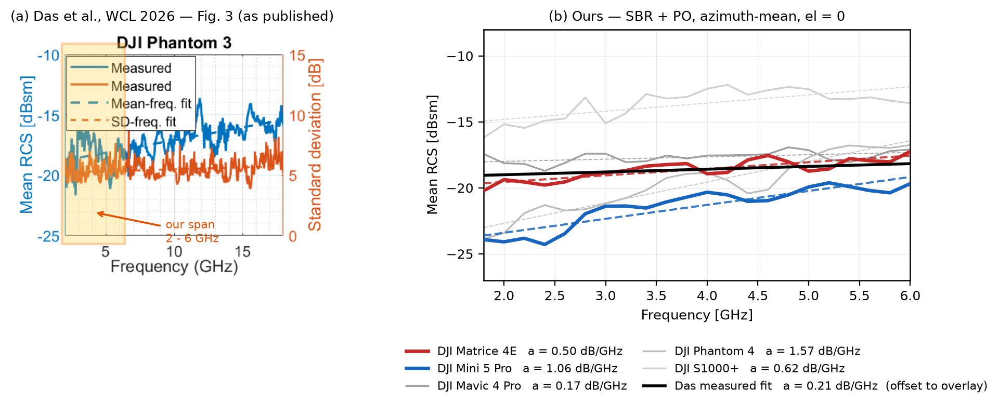
PART 1 · LEVEL AND SLOPE
Our curve on their axes
We fitted their span, and the slope gap narrowed to 2.4 times
(a) Das et al., IEEE WCL 2026, Fig. 3, from the PDF. (b) ours, same dBsm ticks, el = 0.
Same airframe, same span - our Phantom 3 fits 0.50 dB/GHz over 2 to 18 GHz with R2 = 0.82, against their measured 0.21
Fitting the same span moved the gap, but it did not close it. A factor of 2.4 remains, and the airframe is now matched so span is no longer the explanation
The span was part of it. The rest is open, and it is a slope question, not a level question.
Notes:
Left is their published figure, straight out of the PDF. Right is ours on the same dBsm ticks.
Two readings.
The level agrees. Our Matrice 4E sits around minus nineteen dBsm across the band, and their measured Phantom 3 sits in the same place inside our window. For a link budget that is the number that matters.
The slope does not agree. We fit half a dB per gigahertz, they measure about two fifths of that.
Last time I said this comparison could not be closed until we fit their span. We have now fitted it.
Same airframe, a Phantom 3 against their Phantom 3, and the same two to eighteen gigahertz. Ours comes out at half a dB per gigahertz against their measured two tenths.
So fitting the same span moved the number, but it did not close the gap. About a factor of two and a half remains, and the airframe now matches, so the span is no longer the explanation.
Q: what is left to explain it? A: our mesh against a real airframe, the polarisation convention, and their measurement conditions. That is the open list.
— 한국어 해설 —
왼쪽이 논문 그림 원본이고, 오른쪽이 **같은 dBsm 눈금**에 놓은 우리 것입니다.
두 가지로 읽습니다.
**레벨은 맞습니다.** 우리 Matrice 4E 가 대역 전체에서 −19 dBsm 근처에 있고, 그들이 측정한 Phantom 3 도 우리 창 안에서 같은 자리에 있습니다. 링크 버짓에서 중요한 것이 이 수입니다.
**기울기는 아직 안 맞습니다.** 지난번에 «같은 구간을 적합하기 전까지 닫을 수 없다» 고 말씀드렸는데, **그 적합을 했습니다.**
같은 기종(우리 Phantom 3 ↔ 그들 Phantom 3), 같은 2~18 GHz 로 재니 우리가 0.50, 그들이 0.21 dB/GHz 입니다.
⭐구간을 맞추니 수는 움직였지만 **차이가 닫히지는 않았습니다.** 약 2.4 배가 남고, 이제 기종까지 같으니 **구간 탓이라는 설명은 못 씁니다.**
남은 후보는 셋입니다 — 우리 메쉬와 실물의 차이, 편파 규약, 그들의 측정 조건. 그게 열린 목록입니다.

Slide 4
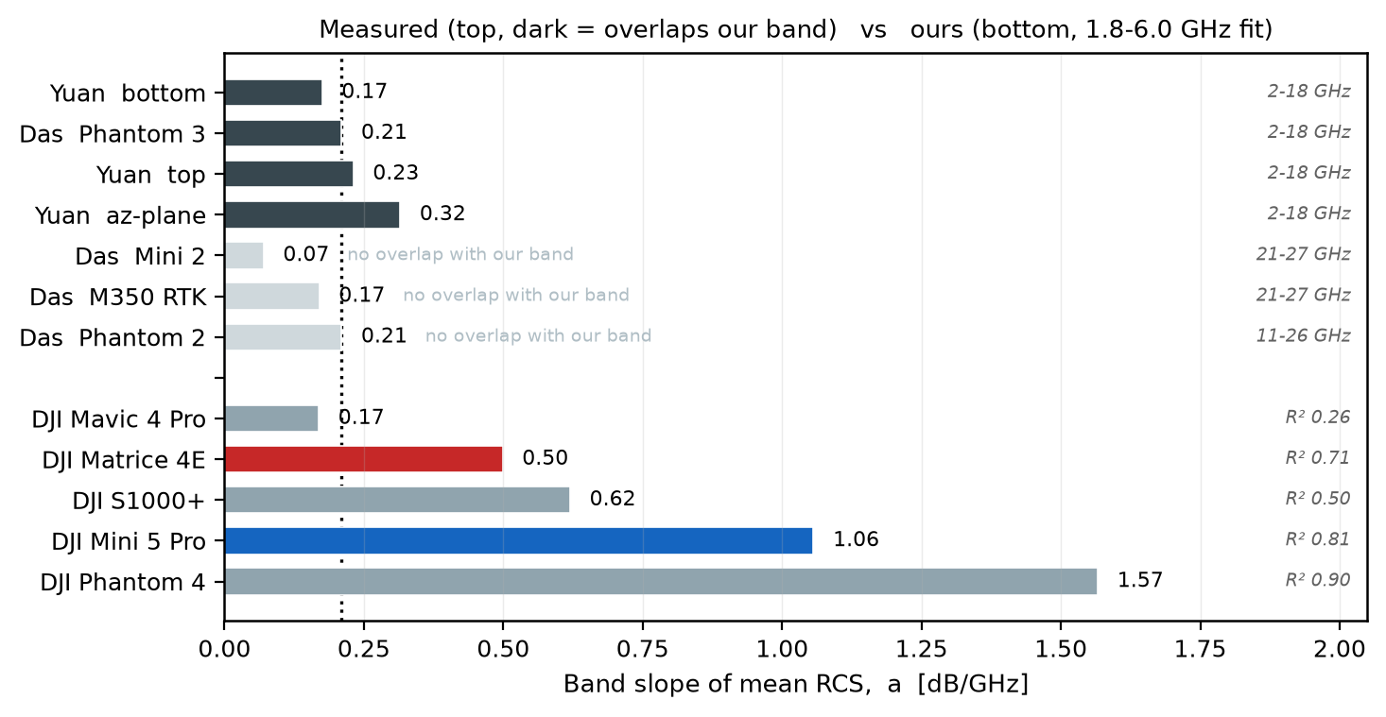
PART 1 · HOW MANY ANCHORS
We have one measurement in our band, not seven
7 measured rows exist, 4 overlap our band, and those 4 come from one experiment
Dark bars overlap 1.8 to 6.0 GHz. Pale bars are mmWave only. Source - our measured slope census.
The Das Phantom 3 row is a re-analysis of Yuan's raw data, so the dark bars are one aircraft, measured once, that we do not own
Our own 5 airframes spread from 0.17 to 1.57 dB/GHz, and R2 runs from 0.26 to 0.90
A single anchor cannot separate a modelling error from an aircraft difference.
Notes:
This slide is not about who is steeper. It is about how many independent measurements we can compare against.
Seven measured slope rows exist across the two papers. Only four overlap the band we simulate.
And those four are not four experiments. The Das Phantom 3 row is a re-analysis of Yuan's raw data. The setup in their Table one matches Yuan section two A character for character, and the Das acknowledgment says so directly.
So we have one measurement, on an aircraft we do not own, in our band.
Look at our own spread as well. Five airframes, from zero point one seven to one point five seven, and the R squared runs from twenty six to ninety percent. Where R squared is low the word slope is not even describing the curve.
This is why the field measurement matters. One anchor cannot tell a modelling error from an aircraft difference.
— 한국어 해설 —
이 장은 «누가 더 가파른가» 가 아닙니다. **비교할 독립 측정이 몇 건이냐**입니다.
논문 두 편에 측정 기울기 행이 7개 있습니다. 우리 대역과 겹치는 것은 **4개뿐**입니다.
그 4개가 실험 4건도 아닙니다. ⭐Das 의 Phantom 3 행은 **Yuan 원자료의 재분석**입니다. Das Table I 의 설정이 Yuan §II-A 와 글자 단위로 같고, Das 감사의 글이 그렇게 적습니다.
그래서 우리 대역의 실측은 **우리가 갖고 있지도 않은 기체 하나를 한 번 잰 것**뿐입니다.
우리 쪽 산포도 보십시오. 다섯 기체가 0.17~1.57, R² 는 0.26~0.90입니다. R² 낮은 자리에선 «기울기»라는 말 자체가 곡선을 설명하지 못합니다.
그래서 실측이 중요합니다. **앵커 하나로는 모델링 오차와 기체 차이를 못 가립니다.**
(원장 outputs/sigma_anchor.json 의 slope_census — 슬라이드 캡션은 밑줄이 렌더에서 삼켜져 말로 적었습니다.)
⭐주파수 표본 밀도(그들 2,801점 대 우리 3점)는 부록 첫 장에 뒀습니다 — 질문이 나오면 그리로 갑니다.

Slide 5
PART 1 · ONE KERNEL FIX
Reflectivity now depends on the incidence angle
The kernel used one normal-incidence value for every angle, and plastic gains +6.7 dB at 75 degrees
Sources - the two angle-dependent reflectivity impact ledgers, 3.5 GHz, TE and TM power mean.
Where it bites | Change after the fix | Reading
Reference solutions (all metal) | identical to the 3rd decimal | the fix touches nothing it should not
Propeller channel level | +5.2 / +6.5 dB (Matrice 4E / Mini 5 Pro) | the propeller is that plastic, and a turning blade lives at large angles
Sigma, azimuth mean | +0.04 to +0.33 dB | the Part 1 level comparisons stand as shown
Sigma, single aspects | up to 6.0 dB | the aspect structure is what actually moved
The anchored level stays put. The aspect structure is corrected, and that structure is our claim axis.
Notes:
This is the defect the RCS work exposed.
Our scattering kernel carried one reflection coefficient per material, taken at normal incidence, and used it at every angle. Fresnel says that is wrong, and it is most wrong for the dielectric, the plastic. At seventy five degrees plastic reflects about seven dB more than at normal incidence. The propeller is that plastic, and a turning blade spends most of its time at large incidence angles.
So we made the coefficient angle dependent. The design keeps normal incidence bit-identical to the old kernel, so everything anchored stays anchored.
The table is the impact. All-metal reference solutions do not move at all. The propeller channel rises five to six and a half dB. The azimuth-mean sigma moves by at most a third of a dB, which is why the Part 1 comparisons you just saw still stand. Individual aspects move by up to six dB.
That last row is the point. The level was already anchored. What was wrong, and is now fixed, is the structure over aspect, and that structure is exactly the axis we claim, because it feeds micro-Doppler. Which is part two.
— 한국어 해설 —
RCS 작업이 드러낸 결함입니다.
산란 커널이 재질당 **수직입사 반사계수 하나**를 모든 각도에 쓰고 있었습니다. 프레넬로는 틀린 것이고, 유전체(플라스틱)에서 가장 크게 틀립니다. 75°에서 플라스틱은 수직입사보다 약 +6.7 dB 더 반사합니다. **프로펠러가 그 플라스틱**이고, 도는 날개는 대부분의 시간을 큰 입사각에서 보냅니다.
그래서 계수를 각도의존으로 바꿨습니다. 설계상 수직입사에서는 옛 커널과 **비트 동일**이라, 앵커된 것은 전부 그대로입니다.
표가 영향입니다. 전부 금속인 기준해는 소수 셋째 자리까지 안 움직입니다. 프로펠러 채널은 +5.2~+6.5 dB 올라갑니다. σ 방위평균은 최대 0.33 dB — 그래서 방금 본 1부 비교가 그대로 섭니다. 개별 자세는 최대 6 dB 움직입니다.
마지막 행이 요점입니다. **레벨은 원래 앵커돼 있었고, 틀렸다가 고쳐진 것은 자세 구조**입니다. 그 구조가 바로 우리가 주장하는 축이고, 마이크로도플러로 이어집니다. 그게 2부입니다.
(원장 outputs/angle_gamma_impact.json · outputs/angle_gamma_sigma_impact.json)

Slide 6
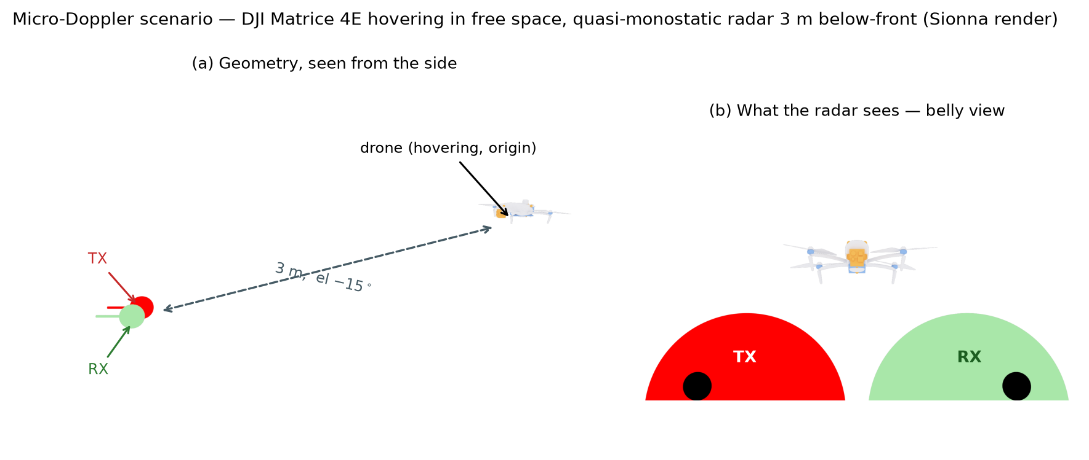
PART 2 · THE SCENE
A ground radar looks up at the belly
Matrice 4E hovering, radar 3 m below-front at el -15, tip Doppler 1,229 Hz
Sionna render of the simulated scene. Left - side geometry. Right - the belly view the radar sees.
Belly view is the honest aspect - a ground radar looks up, and the body then hides the propellers for part of every turn
Blade flashes every 7.9 ms. Capture convention here is full waveform at 5 kHz PRF, and Part 3 asks which illuminator can give that
Every spectrogram that follows is this scene.
Notes:
Part two, and this is the part closest to the main task.
Before the spectrograms, the scene itself, rendered from the actual simulation.
A Matrice 4E hovers, and a quasi-monostatic radar sits three metres below and in front, looking up at fifteen degrees. That belly view is deliberate. Earlier we scored the headline aspect from above, where nothing hides the propellers. A ground radar does not have that luxury. From below, the body hides each blade for part of every turn, and that hiding is signal, not noise.
Two numbers to keep. The blades pass the line of sight every seven point nine milliseconds. The tip Doppler reaches about twelve hundred hertz at three point five gigahertz.
And one convention to keep in mind. Everything in this part is captured as a full waveform at five kilohertz sampling. Whether a real illuminator can give us that is exactly the question of part three.
— 한국어 해설 —
2부입니다. 메인 태스크에 가장 가까운 부분입니다.
스펙트로그램 전에, 실제 시뮬레이션에서 렌더한 씬입니다.
Matrice 4E 가 호버링하고, 준모노스태틱 레이더가 **3 m 아래-앞**에서 el −15°로 올려다봅니다. 이 belly view 는 의도적입니다. 예전 헤드라인은 위에서 본 자세라 프로펠러가 안 가려졌습니다. 지상 레이더는 그런 사치가 없습니다. 아래에서 보면 동체가 매 회전의 일부 동안 블레이드를 가리고, **그 가림이 노이즈가 아니라 신호**입니다.
숫자 둘 — 블레이드가 시선을 지나는 주기 7.9 ms, 날개끝 도플러 3.5 GHz 에서 약 1,229 Hz.
그리고 규약 하나 — 이 부의 모든 그림은 **풀 파형 5 kHz 표본** 캡처입니다. 실제 조명원이 그걸 줄 수 있느냐가 3부의 질문입니다.

Slide 7
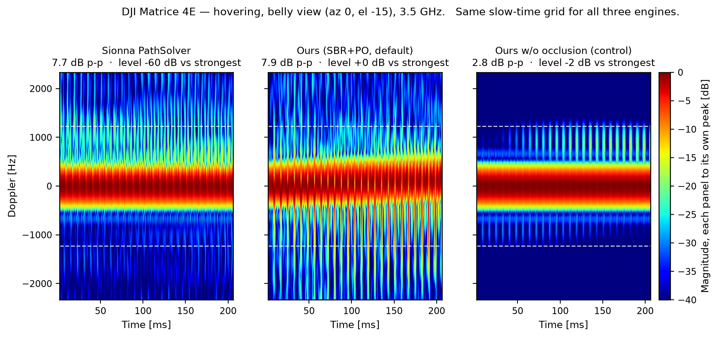
PART 2 · THREE ENGINES
Three engines, one slow-time grid
Sionna tracks the phase of turning geometry, our kernel puts the amplitude on it
Same slow-time grid for all three, each panel normalised to its own peak.
Occlusion writes the pattern - 7.9 dB peak to peak with it and 2.8 dB without, while Sionna sits 60 dB down with 0 of 1,152 cells hitting a propeller
Phase from Sionna, amplitude from our PO kernel. In-band cosine between Sionna and ours is 0.66 to 0.73 - same comb, not identical texture.
Notes:
Three engines, exactly the same scene and the same slow-time grid.
Left, Sionna PathSolver on its own. It does produce a comb, because stepping the rotor and re-tracing captures the phase of turning geometry. But look at the level line under the title. Its blade signal sits sixty dB below our kernel. We traced eleven hundred and fifty two aspect-by-rotor-phase cells and not one specular path landed on a propeller, so what Sionna shows is the diffuse channel breathing, not a blade glint. Rays discover paths by sampling, and a blade a few wavelengths wide is almost never found. The next slide makes that quantitative.
Middle, our default engine, physical optics with occlusion and the angle-dependent reflectivity from part one. Eight dB peak to peak in the flash band.
Right, the control, the same kernel with occlusion turned off. The pattern collapses to under three dB. So the pattern is not the blade alone. It is the body hiding the blade, once per turn.
On cross-validation I want to be precise, because I was loose about this before. The in-band cosine between Sionna and our two arms is about zero point six five to zero point seven three. That is the engine-to-engine number. The cosine between our own two arms is lower, but that is an ablation and not a cross-check, so it does not belong in the same range.
Two things I owe you here. The path render in the report shows that Sionna found ten paths in total for this scene, one direct and nine by way of the target, and ten paths is the entire material this engine has to work with. And one open doubt on our own side. Our default arm puts ridges slightly outside the kinematic tip frequency, where the kinematics forbid them, and we are measuring whether that is a ray-grid discretisation artefact.
Q: is the figure in the report the same one? A: the report now shows these three panels as the top row of the range figure, which is the appendix slide. Same ledger, same numbers, and I use the single-range render here because three panels read better on a projector.
— 한국어 해설 —
세 엔진, 완전히 같은 씬과 같은 슬로타임 격자입니다.
왼쪽, Sionna PathSolver 단독. 빗은 냅니다 — 로터를 한 칸씩 돌려 재추적하면 도는 기하의 **위상**은 잡히니까요. 그런데 제목 밑 레벨 줄을 보십시오. 블레이드 신호가 우리 커널보다 **60 dB 아래**입니다. 자세×로터위상 1,152칸을 추적해 프로펠러에 떨어진 정반사 경로가 **0개** — Sionna 가 보여주는 것은 블레이드 글린트가 아니라 확산 채널의 숨쉬기입니다. 광선은 표본으로 경로를 찾는데, 파장 몇 개 폭의 블레이드는 거의 안 잡힙니다. 다음 장이 그걸 수치로 만듭니다.
가운데, 우리 기본 엔진 — PO + 가림 + 1부의 각도의존 반사율. 플래시 대역에서 8.0 dB p-p.
오른쪽, 대조군 — 같은 커널에서 가림만 끈 것. 3 dB 아래로 무너집니다. 즉 **무늬는 블레이드 단독이 아니라, 동체가 블레이드를 회전마다 가리는 것**이 씁니다.
⭐교차검증은 정확히 말씀드립니다(예전에 뭉뚱그렸습니다). **엔진 간** 코사인은 Sionna 대 우리 두 팔로 0.65~0.73 입니다. 우리 두 팔끼리의 코사인은 더 낮은데, 그건 교차검증이 아니라 **가림 on/off 절제실험**이라 같은 범위에 묶으면 안 됩니다.

Slide 8
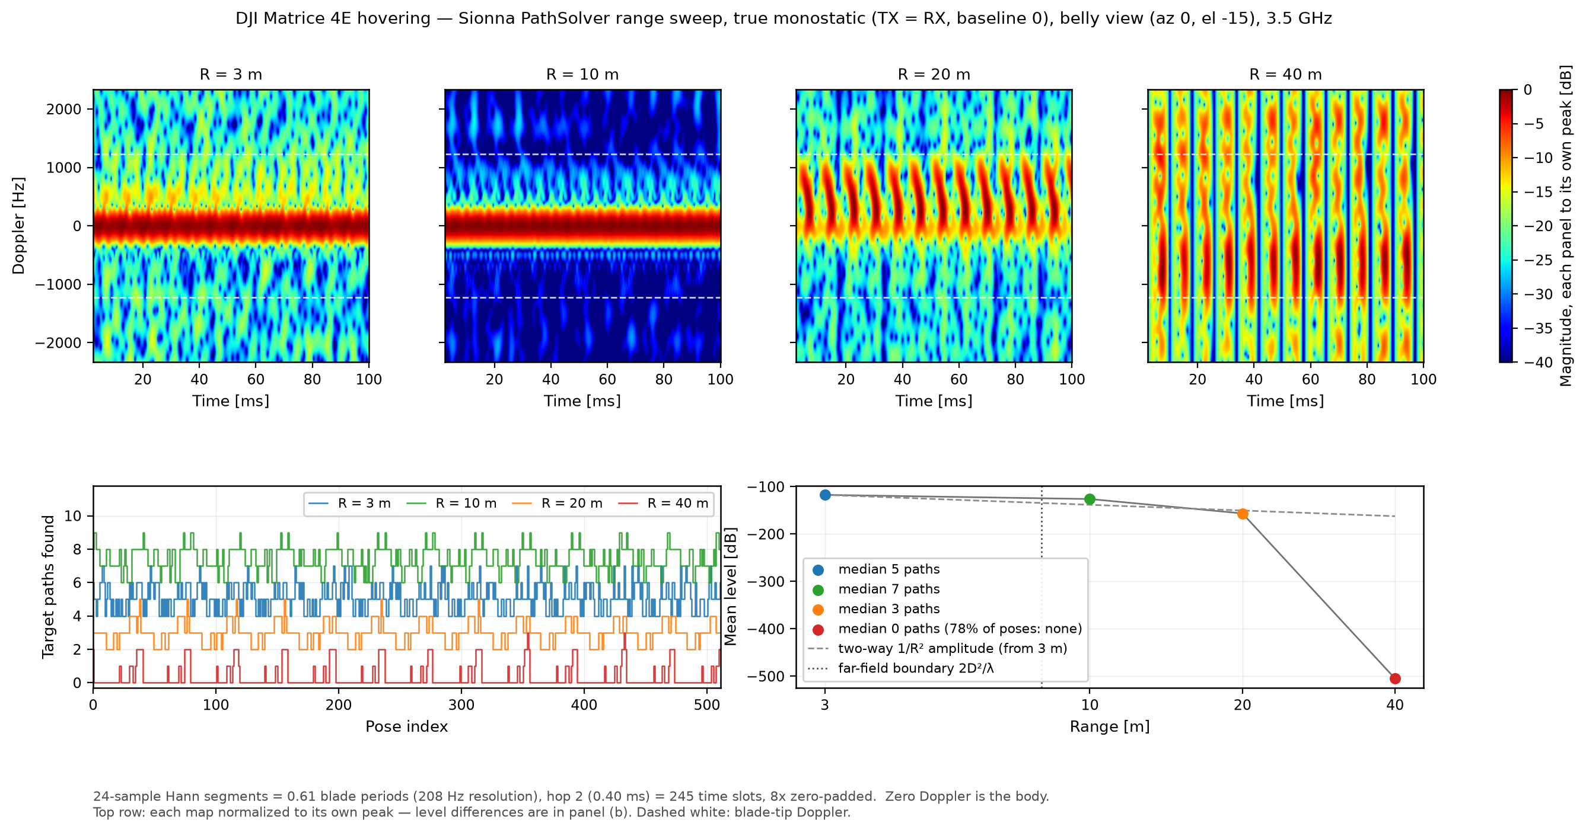
PART 2 · RANGE
Rays have to find the target, and at 40 m they stop
Rays scaled 32 times with range, and at 40 m the solver returns zero paths for 78 percent of poses
True monostatic, 3 to 40 m, rays scaled as (R/3) squared. Source - the Sionna range sweep ledger.
Our grid is anchored on the target under plane-wave illumination, so past the 8.0 m far-field boundary the pattern is range invariant and only the level falls
This is structure, not a ray budget. The target subtends (D/R) squared, so a source-launched ray solver loses it with range.
Notes:
This is the slide I would point at if someone asks why we do not simply use the ray tracer.
Same scene as before, one thing changed. I push the target out from three metres to ten, twenty and forty, and I scale the ray budget as range squared, so the target keeps the same expected number of hits. One million rays at three metres becomes thirty two million at forty.
At three, ten and twenty metres every pose still returns paths. At forty metres, seventy eight percent of poses return nothing at all, even with thirty two times the rays. The lower left panel is the path count per pose, and you can watch the red trace sit on zero.
This is not a budget problem that more compute fixes. It is structural. The solver launches rays from the transmitter and a path exists only if a ray hits the target, and the solid angle the target subtends falls as diameter over range, squared.
Our own kernel does not have this failure mode, because the ray grid is anchored on the target itself with plane-wave illumination. Past the far-field boundary at eight metres the pattern stops depending on range and only the level drops.
Two honest marks. The forty metre map is normalised to its own peak, so the few poses that do have paths flash as vertical stripes and the rest is floor. And the minus five hundred dB mean level in the ledger is the arithmetic of log of zero, not a physical number.
— 한국어 해설 —
«그냥 레이트레이서 쓰면 되지 않느냐» 는 질문에 제가 가리킬 장입니다.
같은 씬에서 하나만 바꿨습니다. 표적을 3 m 에서 10·20·40 m 로 물리고, **광선 수를 거리 제곱으로 보상**했습니다 — 3 m 100만 → 40 m 3,200만.
3·10·20 m 에서는 모든 자세에서 경로가 나옵니다. **40 m 에서는 광선을 32배 부어도 자세의 78 %가 경로 0** 입니다. 왼쪽 아래 판이 자세별 경로 수인데, 빨간 선이 0 에 붙어 있는 것이 보입니다.
이건 계산을 더 하면 되는 예산 문제가 아니라 **구조**입니다. 솔버는 송신기에서 광선을 뿌리고 그 광선이 표적을 맞혀야 경로가 생기는데, 표적이 차지하는 입체각은 (D/R)² 로 줄어듭니다.
우리 커널에는 이 실패 모드가 없습니다 — 광선 격자를 **표적에 앵커**한 평면파 조명이라, 원거리장 경계 8 m 밖에서는 무늬가 거리에 불변이고 레벨만 내려갑니다.
정직 표시 둘 — 40 m 맵은 자기 최대 정규화라 «경로 있는» 몇 자세만 세로줄로 번쩍입니다. 그리고 원장의 −505 dB 평균 레벨은 log(0) 바닥이 만든 산술이지 물리 수치가 아닙니다.
(원장 outputs/report07_sionna_ranges.json · 그림 report07_f9)

Slide 9
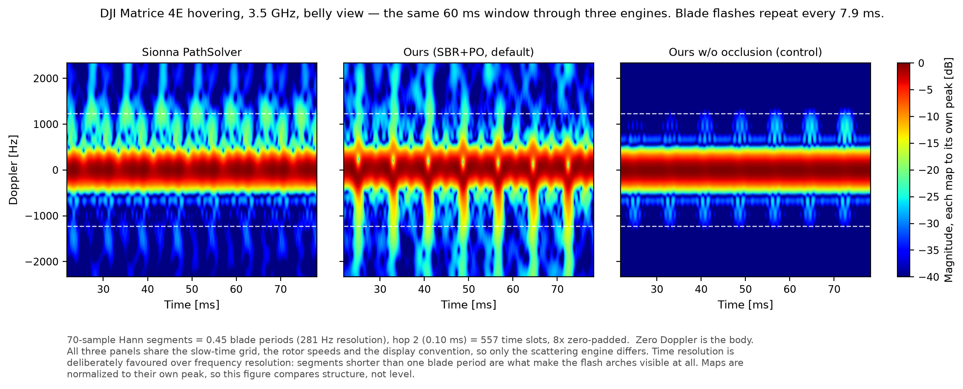
PART 2 · THE FLASH
Zoom to 60 ms and the flash arches appear
All three engines flash every 7.9 ms, and only the arch shape differs
Same grid as the three engines, 60 ms cut. Each panel is normalised to its own peak.
Segments shorter than one blade period are what make the arches visible at all, which is why time resolution comes before frequency resolution here
Occlusion widens the arch, the control drops it to a point, and Sionna leaves a smudge.
Notes:
Same ledger, same slow-time grid, same rotor speeds as the previous slide. I cut sixty milliseconds out of it and zoomed in, so the only difference between the three panels is the scattering engine.
The vertical arches are the blade flashes, and they repeat every seven point nine milliseconds, which is the hundred and twenty seven hertz flash rate. The first thing to take from this slide is that all three engines produce that period. That is a real cross-check.
The shapes differ, and each difference has a reason. Our default arm, with occlusion on, gives thick arches that spread along the Doppler axis. The control with occlusion off gives narrow sharp points. Sionna gives something closer to a smudge than an arch, because it found no specular path on a propeller and only the diffuse component is left.
One point about the display convention, because it is a standing rule for us. The segments are six tenths of one blade period. If I make the segment longer than a blade period the flash is averaged away inside it and only horizontal ridges remain. We do not use that ridge view here, because the event we need to read lives on the time axis.
And the honest limit. Each panel is normalised to its own peak, so this figure compares structure and not level. The sixty dB level gap is on the previous slide.
— 한국어 해설 —
앞 장과 **같은 원장·같은 슬로타임 격자·같은 로터 회전수**에서 60 ms 만 잘라 확대한 것입니다. 세 패널의 차이는 **산란 엔진뿐**입니다.
세로 아치가 블레이드 플래시이고 **7.9 ms 마다** 반복합니다(f_flash 127 Hz). 이 장에서 먼저 가져가실 것은 **세 엔진이 그 주기를 같이 낸다**는 확인입니다.
모양은 갈리고, 각각 이유가 있습니다. 가림을 켠 우리 기본팔은 아치가 굵고 도플러축으로 넓게 퍼집니다. 가림을 끈 대조군은 좁고 또렷한 점처럼 떨어집니다. Sionna 는 아치라기보다 얼룩에 가까운데, 프롭 정반사 경로가 0 이라 확산 성분만 남기 때문입니다.
표시 규약 하나 — 조각이 블레이드 한 주기의 0.61배입니다. 한 주기보다 길게 잡으면 플래시가 그 안에서 평균돼 사라지고 가로 능선만 남습니다. 우리는 그 능선판을 쓰지 않습니다. **읽어야 하는 사건이 시간축에 있기 때문**입니다.
정직한 한계 — 세 패널을 각자 최대로 정규화했으니 이 그림은 **구조를 비교하지 레벨을 비교하지 않습니다.** 60 dB 레벨 차이는 앞 장이 담습니다.

Slide 10
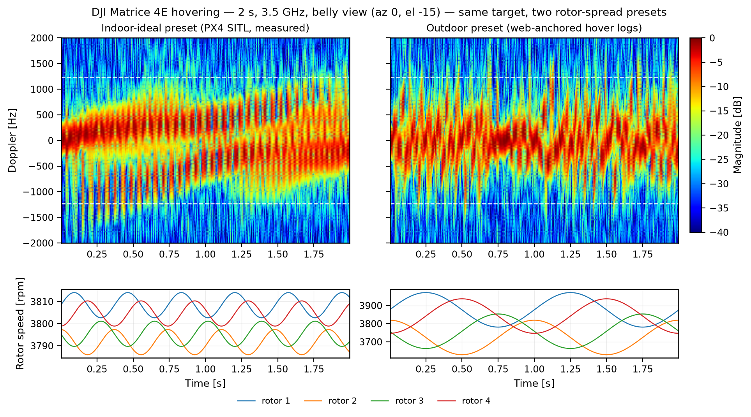
PART 2 · ROTOR SPREAD
Indoor-ideal is a lower bound, and we fly outdoors
Same 2 s hover, one preset changed - 0.22 against 2 percent rotor spread
Left - PX4 SITL measured. Right - outdoor preset cut from public hover logs.
Spread smears the harmonic ridges into crossing snakes, but the vertical flash arches survive on both sides. Flash-based reading is what carries outdoors
The outdoor preset comes from public flight logs we cut and measured ourselves (2.4 percent outdoor against 0.54 percent indoor), and not from our target aircraft.
Notes:
Same calculation as the two second hover, same aircraft, same aspect, same arm. One thing changed, the rotor spread preset.
On the left is what I showed as the hover result, driven by the spread I measured from Jihyuk's PX4 telemetry, about a quarter of a percent. The rotors are nearly identical, so the harmonic comb stays aligned and the envelope breathes slowly.
On the right is the outdoor preset, two percent. Now each rotor has its own tip frequency, tens of hertz apart, and the ridges cross like tangled snakes. That is what the outdoor measurement figures in the literature actually look like.
Here is the part that matters for us. The vertical flash arches survive on both sides. Spread destroys the frequency-axis structure and it does not erase the time-axis events. That is the physical reason our display convention puts time resolution first, and it is the reason a flash-based reading is the one I would bet on outdoors.
And the honest limit. The outdoor numbers are not from a paper and they are not from our target. We downloaded three public flight-log datasets, cut the hover windows out ourselves and measured them, and the procedure and the cautions are written into the ledger. Indoor motion-capture logs give about half a percent, outdoor position-hold logs give about two and a third percent with two and a half percent wobble, and a real DJI Phantom 3 command log converts to roughly two to six percent. The appendix has the table. SITL is the no-wind symmetric lower bound, and our demonstration is outdoors, so the real aircraft log replaces this preset entirely.
— 한국어 해설 —
2초 호버와 **완전히 같은 계산**입니다 — 같은 기체·자세·팔. 바꾼 것은 로터 산포 프리셋 하나뿐입니다.
왼쪽이 지금까지 호버 결과로 보여드린 것으로, 지혁 선배 PX4 텔레메트리에서 잰 **0.22 %** 산포입니다. 로터가 거의 같은 속도라 고조파 빗살이 정렬되고 포락이 느리게 숨쉽니다.
오른쪽이 **야외 프리셋 2 %** 입니다. 로터별 f_tip 이 수십 Hz 씩 갈라져 능선이 **얽힌 뱀처럼** 교차합니다. 문헌의 야외 실측 그림이 바로 이 형태입니다.
⭐우리에게 중요한 대목 — **세로 플래시 아치는 양쪽 다 남습니다.** 산포는 주파수축 구조를 뭉개지만 시간축 사건은 못 지웁니다. 우리 표시 규약이 시간 분해능을 앞에 두는 물리적 이유이고, 야외에서 제가 플래시 기반 읽기에 걸겠다는 이유입니다.
정직한 한계 — 야외 수치는 **논문이 아니라 공개 비행로그 데이터셋 세 종**에서 우리가 직접 호버 구간을 잘라 잰 값이고(측정 절차·창·주의사항은 원장에 그대로 있습니다), **우리 표적 기체의 실측은 아닙니다.** 실내 모션캡처 로그가 약 0.54 %, 야외 위치유지 로그가 약 2.35 %에 흔들림 2.5 %, 실기체 DJI Phantom 3 명령 로그가 rpm 환산 2~6 % 입니다. 표는 부록에 있습니다. SITL 은 무풍·대칭의 하한이고 우리 실증은 야외라, 실기체 로그가 오면 이 프리셋 자체를 갈아치웁니다.

Slide 11
PART 3 · WHAT ALWAYS-ON SIGNALS SAMPLE
Always-on signals reach the flash line, never the tip
Tip Doppler needs 2,459 Hz sampling for the Matrice 4E, the best always-on mode gives 1,000 Hz
Needs shown for Matrice 4E at 3.5 GHz. Across all 9 airframe-band cells the tip test fails 36 of 36 (needs 1,195 to 4,822 Hz) and the flash verdicts hold in every cell. Source - the PRF feasibility census.
Always-on mode | Rate | Tip band (needs 2,459 Hz) | Flash line (needs 253 Hz)
WiFi VHT-LTF | 1,000 Hz | ● No | ● Yes
LTE CRS | 1,000 Hz | ● No | ● Yes
5G NR-PRS | 200 Hz | ● No | ● No
5G SSB | 50 Hz | ● No | ● No
I said this too loosely last time. What survives on always-on signals is the flash line, and 5G folds even that.
Notes:
Part three, and this slide is a correction of something I presented too loosely before, so let me be precise.
To see the blade tip Doppler you must sample at twice the tip frequency. For the Matrice 4E that is about two and a half kilohertz. Now look at what the always-on signals actually give. WiFi and LTE both give one kilohertz. The 5G positioning signal gives two hundred hertz. The 5G broadcast block gives fifty. Every one of them fails, for every airframe and every band we simulate, thirty six cases out of thirty six.
So the tip extent, the feature that scales with blade length, is simply not observable on always-on illumination. Full stop.
What survives is the flash line, the blade passing rate. That needs only two hundred and fifty to three hundred and seventy hertz depending on the aircraft, so WiFi and LTE keep it comfortably. But the two 5G modes fold even that. Two hundred hertz of sampling cannot hold the two hundred and forty hertz line of the easiest cell.
This is the 5G double bind again, now on the micro-Doppler side. The always-on 5G signal is the worst illuminator twice over.
The next slide is the picture of this table.
— 한국어 해설 —
3부입니다. 이 장은 제가 예전에 뭉뚱그려 말한 것의 **정정**이라 정확히 말씀드리겠습니다.
날개끝 도플러를 보려면 팁 주파수의 **2배**로 표본화해야 합니다. Matrice 4E 는 약 2,459 Hz. 그런데 상시 신호가 실제로 주는 것은 — WiFi·LTE 1 kHz, 5G 측위 신호(PRS) 200 Hz, 5G 방송 블록(SSB) 50 Hz. **전부 미달**입니다. 우리가 시뮬하는 모든 기체·모든 밴드에서, 36칸 중 36칸 실패.
그러니 블레이드 길이에 비례하는 특징인 **팁 폭은 상시 조명으로는 관측 불가능**합니다. 이상 끝.
살아남는 것은 **플래시선** — 블레이드 통과율입니다. 기체에 따라 253~367 Hz 만 있으면 되므로 WiFi·LTE 는 여유 있게 지킵니다. 그런데 **5G 두 모드는 그것마저 접습니다.** 200 Hz 표본으로는 가장 쉬운 칸의 240 Hz 선도 못 담습니다.
지난 벤치마크의 «5G 이중고» 가 마이크로도플러 쪽에서도 반복되는 것입니다. 상시 5G 신호는 두 번 최악입니다.
다음 장이 이 표의 그림판입니다.
(원장 outputs/md_range_sweep.json 의 prf_feasibility — 9칸 × 4모드 = 36칸을 빌드 때 assert 로 기계검증합니다.)

Slide 12
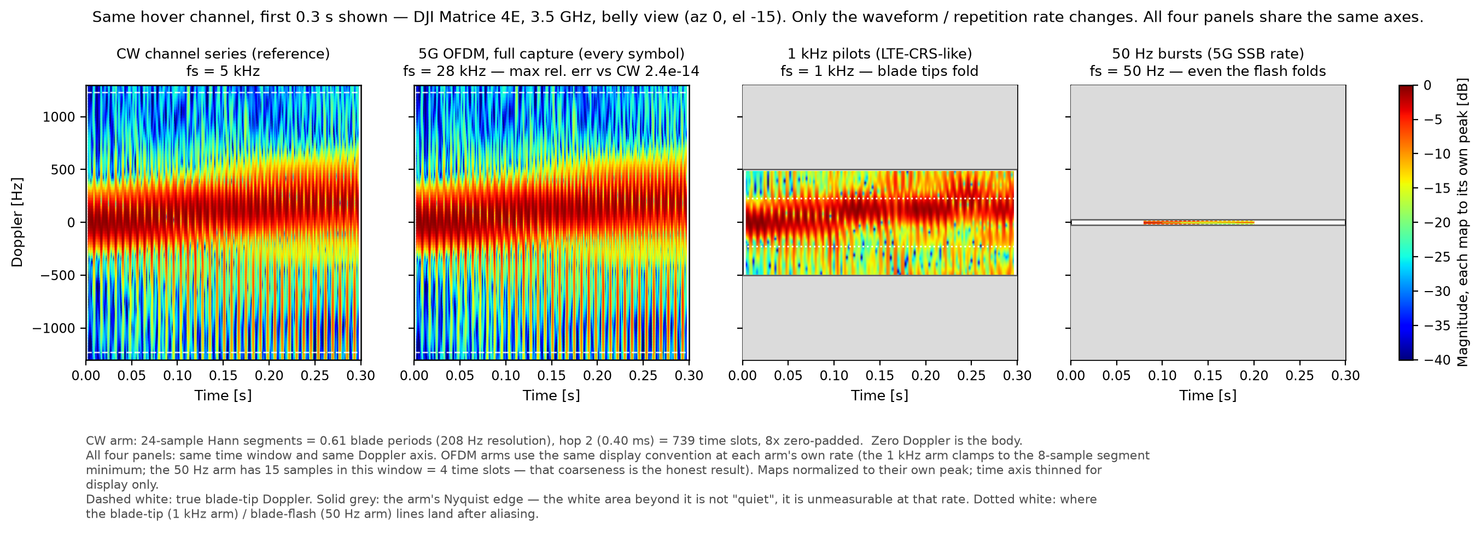
PART 3 · THE SAME CHANNEL, FOUR READ RATES
The waveform is not the problem, the rate is
A full 5G capture equals the CW reference to 2.4e-14 relative error, so only the read rate matters
Dashed white is the true blade-tip Doppler. Solid grey is each arm's own Nyquist edge.
5,000 Hz CW reference, 28,000 Hz full 5G capture, 1,000 Hz LTE-CRS-like pilots, 50 Hz SSB bursts, all four on identical axes
The white area in the low-rate panels is not quiet, it is unmeasurable at that rate. The tip folds at 1 kHz and the flash line folds too at 50 Hz
Passive 5G is the worst always-on illuminator twice over, on the link budget and now on the sampling rate.
Notes:
This is the picture of the previous table, and it also settles a question I could not answer before.
The channel is exactly the two second hover you already saw. Nothing about the target changed. What changed is the waveform and the read rate. I put a real 5G style OFDM waveform on it, thirty kilohertz subcarrier spacing, a thousand subcarriers, random QPSK on every symbol, and I recover the channel by dividing by the known symbols.
First result. A full capture, reading the channel on every symbol, is numerically identical to the CW reference, to two times ten to the minus fourteen. Look at the two left panels. They are the same map. So the OFDM waveform itself costs us nothing.
Second result, and this is the point. The third panel reads at one kilohertz, like LTE cell reference signals, and the blade tip folds inside the Nyquist edge. The fourth reads at fifty hertz, like the 5G broadcast block, and even the flash line folds. All four panels share the same axes, so the cost shows up directly as empty area, and I want to be clear that the white is not silence. It is territory that rate cannot measure at all.
Two honest limits. I interpolated the five kilohertz channel series up to the twenty eight kilohertz symbol rate, and the justification is that the band-limited guard energy is two times ten to the minus three. And a first order estimate of inter-carrier interference from the channel turning within one symbol sits at minus eighteen dB, which I did not put into the channel model, so a real receiver floor can be worse than this figure.
— 한국어 해설 —
앞 표의 그림판이자, 제가 전에 답 못 하던 질문 하나를 닫는 장입니다.
채널은 방금 보신 **2초 호버 그대로**입니다. 표적 쪽은 아무것도 안 바꿨습니다. 바꾼 것은 파형과 읽는 속도입니다. 진짜 5G 형 OFDM 을 태웠습니다 — SCS 30 kHz, 부반송파 1,024, 심볼마다 무작위 QPSK, 기지 심볼 나눗셈으로 채널 복원.
첫째 결과 — **심볼마다 읽는 풀캡처는 CW 와 수치적으로 같습니다**(상대오차 2.4e-14). 왼쪽 두 판이 같은 맵인 것이 그 뜻입니다. 즉 OFDM 파형 자체는 대가가 없습니다.
둘째 결과가 핵심입니다. 셋째 판은 LTE CRS 급 1 kHz 로 읽는데 **날개끝이 나이퀴스트 안으로 접힙니다.** 넷째는 5G SSB 급 50 Hz 인데 **플래시선마저 접힙니다.** 네 판의 축이 완전히 같아서 대가가 «빈 자리»로 그대로 보이는데, ⚠그 하양은 조용함이 아니라 **그 표본율로는 측정 자체가 불가능한 영역**입니다.
정직한 한계 둘 — ① 5 kHz 채널열을 28 kHz 심볼율로 보간했고 근거는 대역제한 가드 에너지 2.1e-03 입니다. ② 심볼 안에서 채널이 도는 ICI 를 1차로 재면 −17.8 dB 인데 채널 모형에는 안 넣었습니다. 실제 수신기 바닥은 이 그림보다 나쁠 수 있습니다.

Slide 13
PART 3 · FLIGHT LOG AS INPUT
The log-to-simulation chain already exists
Jihyuk built PX4-to-pulse pose, we ported two designs, the field log replaces the rest
His chain takes a PX4 log to a per-pulse pose. Ported so far - mesh assembly (20,291 times faster, identical vertices) and the measured rotor spread.
Quantity | In the simulation today | What the field log replaces
Rotor speed | hand-set 3,800 rpm, plus the 0.22 percent spread ported from his SITL telemetry | per-motor rpm at 5 to 10 Hz. Public outdoor hover logs already read 2.4 percent, an order above SITL
Rotor phase | four independent rotors since the port, random initial phase | phase evolution integrated from each motor's own ESC record
Control-loop wobble | declared 0.15 percent at 2.7 Hz | measured. Outdoor logs read 2.5 percent at 0.74 Hz
Attitude and position | one fixed pose per grid cell, fixed range, target on the boresight | roll, pitch and yaw per sample, plus an RTK track with centimetre accuracy
Not a proposal. The chain runs on his SITL logs today, and the field log swaps in the real aircraft.
Notes:
Last time I presented the flight-log-to-simulation idea as a design proposal. That was out of date, and I want to set the record straight.
Jihyuk already built this chain. His po_mdoppler pack takes a PX4 log and produces a per-pulse pose, position interpolated, attitude from quaternions, blade angle integrated from each motor's ESC record. It runs, and there are twenty three completed runs on disk.
What we did this period is port two of his designs into our engine. First, his build-once-then-matrix-multiply mesh assembly. That made our articulation twenty thousand times faster with identical vertices, and it is what made per-rotor speeds and two-second windows affordable at all. Second, the rotor spread you saw two slides ago, measured from his telemetry rather than assumed.
The table shows what remains. Each row is an assumption in today's simulation, and the right column is the measurement that retires it. Note the first and third rows. His telemetry is an ideal simulated controller with no wind, so it is a lower bound, and the public outdoor logs already sit an order of magnitude above it. Only a log from our own aircraft settles which number belongs in our headline figures.
And the practical must-record list stays as before. Raw log with per-motor rpm, RTK track, and one sharp manoeuvre at the start and end for time sync. Time sync is still the part without a clean answer, so the protocol has to be agreed before we fly.
— 한국어 해설 —
지난번에 저는 «비행로그→시뮬 입력» 을 설계 제안으로 냈습니다. 그건 낡은 정보였고, 바로잡습니다.
**지혁 선배가 이 사슬을 이미 만들었습니다.** po_mdoppler 팩이 PX4 로그를 받아 펄스별 pose 를 냅니다 — 위치는 보간, 자세는 쿼터니언, 블레이드각은 모터별 ESC 기록의 적분. 실제로 돌고, 디스크에 완료된 런이 23개 있습니다.
이번 기간 우리가 한 것은 그 설계 둘의 **이식**입니다. 첫째, «한 번 짓고 행렬곱만» 메쉬 조립 — 우리 관절화가 2만 배 빨라졌고 정점은 동일합니다. 로터별 속도와 2초 창이 감당 가능해진 것이 이것 덕입니다. 둘째, 두 장 전에 보신 로터 산포 — 가정이 아니라 선배 텔레메트리에서 잰 값입니다.
표는 남은 것입니다. 각 행이 오늘 시뮬레이션의 가정 하나이고, 오른쪽 열이 그것을 은퇴시키는 측정입니다. 첫 행과 셋째 행을 보십시오 — 선배 텔레메트리는 바람 없는 이상적 시뮬 제어기라 **하한**이고, 공개 야외 로그는 이미 한 자릿수 위입니다. 우리 헤드라인에 들어갈 수가 무엇인지는 **우리 기체 로그**만이 정합니다.
꼭 챙길 목록은 그대로입니다 — 모터별 rpm 원본 로그, RTK 궤적, 시작·끝의 **시각동기용 급기동 한 번씩**. 시각 동기는 아직 깔끔한 답이 없는 부분이라, 규약을 **비행 전에** 정해야 합니다.
(선배 팩 이름은 po_mdoppler, 야외 앵커 원장은 outputs/rotor_rpm_web_anchor.json)

Slide 14
CLOSING
Where this goes
The next steps are ordered upstream first, and the order matters
Kernel fixed, so the sigma grid is recomputing now - single aspects moved up to 6 dB
The mesh item is closed - the Mini 5 Pro blade root sat 0.86 mm inside the motor bell, now lifted clear, and the solid ruler reads 0.00 percent
For RCS, fit the span they fit, so the slope reading can be settled
Field test - Matrice 4E first with the X410 in full-waveform capture, since always-on signals cannot give the tip
Must record - per-motor rpm log, RTK track, and a sync manoeuvre at start and end, agreed before we fly
Detection and micro-Doppler classification are the task. Everything above feeds that.
Notes:
Closing, ordered upstream first, because recomputing downstream of a known defect burns the run.
The kernel fix is in, and the sigma grid recompute is already running. Single aspects moved by up to six dB, and every aspect-dependent number we publish inherits that recompute.
The mesh item is closed. The Mini 5 Pro blade root sat under a millimetre inside its motor bell, which double-counted surface in physical optics. It is lifted clear now, the solid containment ruler reads zero, and the other nine airframes were verified bit-identical. The Matrice 4E was already inside budget, which is one more reason it flies first.
On RCS the open item is unchanged and narrow. Fit the same sixteen gigahertz span they fit, and the slope reading either survives or it does not.
And the field test. Matrice 4E first, X410 recording full waveform, because part three showed that no always-on signal can hand us the tip. The log must carry per-motor rpm, the RTK track, and one sharp manoeuvre at each end for time sync, and that protocol needs to be agreed before we fly.
The closing frame stays the same. Detection and micro-Doppler classification are the task. Everything today feeds that.
— 한국어 해설 —
마무리입니다. 순서는 **상류부터**입니다 — 결함 하류에서 재계산하면 버릴 결과에 계산을 태우니까요.
커널 수정이 들어갔고 **σ 격자 재계산은 이미 돌고 있습니다**. 개별 자세가 최대 6 dB 움직였고, 자세 의존 수치 전부가 그 재계산을 상속합니다.
메쉬 항목은 닫았습니다 — Mini 5 Pro 블레이드 뿌리가 모터벨 안에 0.86 mm 파고들어 PO 가 면적을 이중계상했는데, 이제 벨 위로 올려 솔리드 자 0.00 %이고 나머지 9기는 비트동일 확인까지 마쳤습니다. Matrice 4E 는 원래 예산 안이었고, 그래서 1차 실측 기체이기도 합니다.
RCS 쪽 남은 일은 그대로 좁습니다 — **그들이 적합한 16 GHz 구간을 적합**하면 기울기 읽기가 살든 무너지든 결판납니다.
그리고 실측 — Matrice 4E 먼저, X410 **풀 파형 캡처**로. 3부에서 본 대로 상시 신호는 팁을 못 주기 때문입니다. 로그에는 모터별 rpm·RTK 궤적·양 끝의 시각동기 기동이 꼭 들어가야 하고, 그 규약은 **비행 전에** 정합니다.
마무리 틀은 같습니다. **탐지와 마이크로도플러 분류가 태스크**이고, 오늘 것 전부가 거기에 먹입니다.

Slide 15
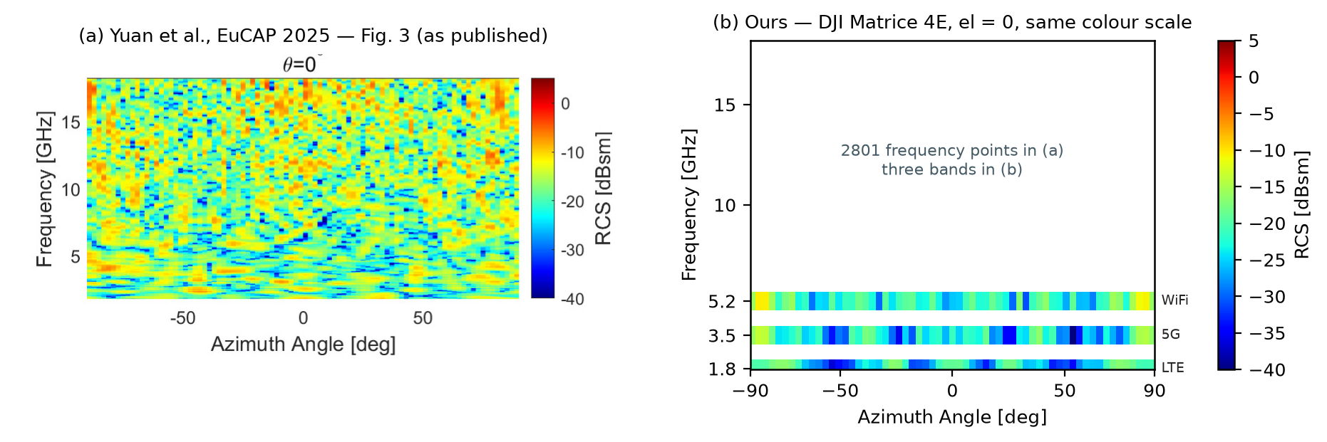
APPENDIX · SAMPLING DENSITY
What we can compare today is a level, not a pattern
They sample 2801 frequency points. We have three bands.
(a) Yuan et al., EuCAP 2025, Fig. 3, taken from the PDF. (b) ours, same frequency axis and same colour scale, Matrice 4E at el = 0.
Azimuth is comparable at 2 degrees against 3 degrees. Frequency is not, at 2801 points against three centre frequencies
So a pattern-to-pattern test is not available yet and the level test is. Filling the frequency axis is a compute question, not a physics question
The gap here is sampling, and we can close it by running more bands.
Notes:
Backup for part one. Their measurement fills the frequency axis and ours does not.
The azimuth axis is comparable, two degrees against three. The frequency axis is not, two thousand eight hundred points against three.
So today we can test whether we land at the right level, and we cannot test whether the interference pattern in frequency is right. The good news is that this one is only compute.
— 한국어 해설 —
1부 백업입니다. 그들의 측정은 주파수축을 꽉 채우고, 우리 것은 못 채웁니다.
**방위축은 비교 가능합니다**(2도 대 3도). **주파수축은 아닙니다**(2,801점 대 3점).
그래서 오늘 할 수 있는 것은 «레벨이 맞느냐»이고, 못 하는 것은 «주파수 방향 간섭 무늬가 맞느냐»입니다. 다행히 이건 **계산량 문제일 뿐**입니다.

Slide 16
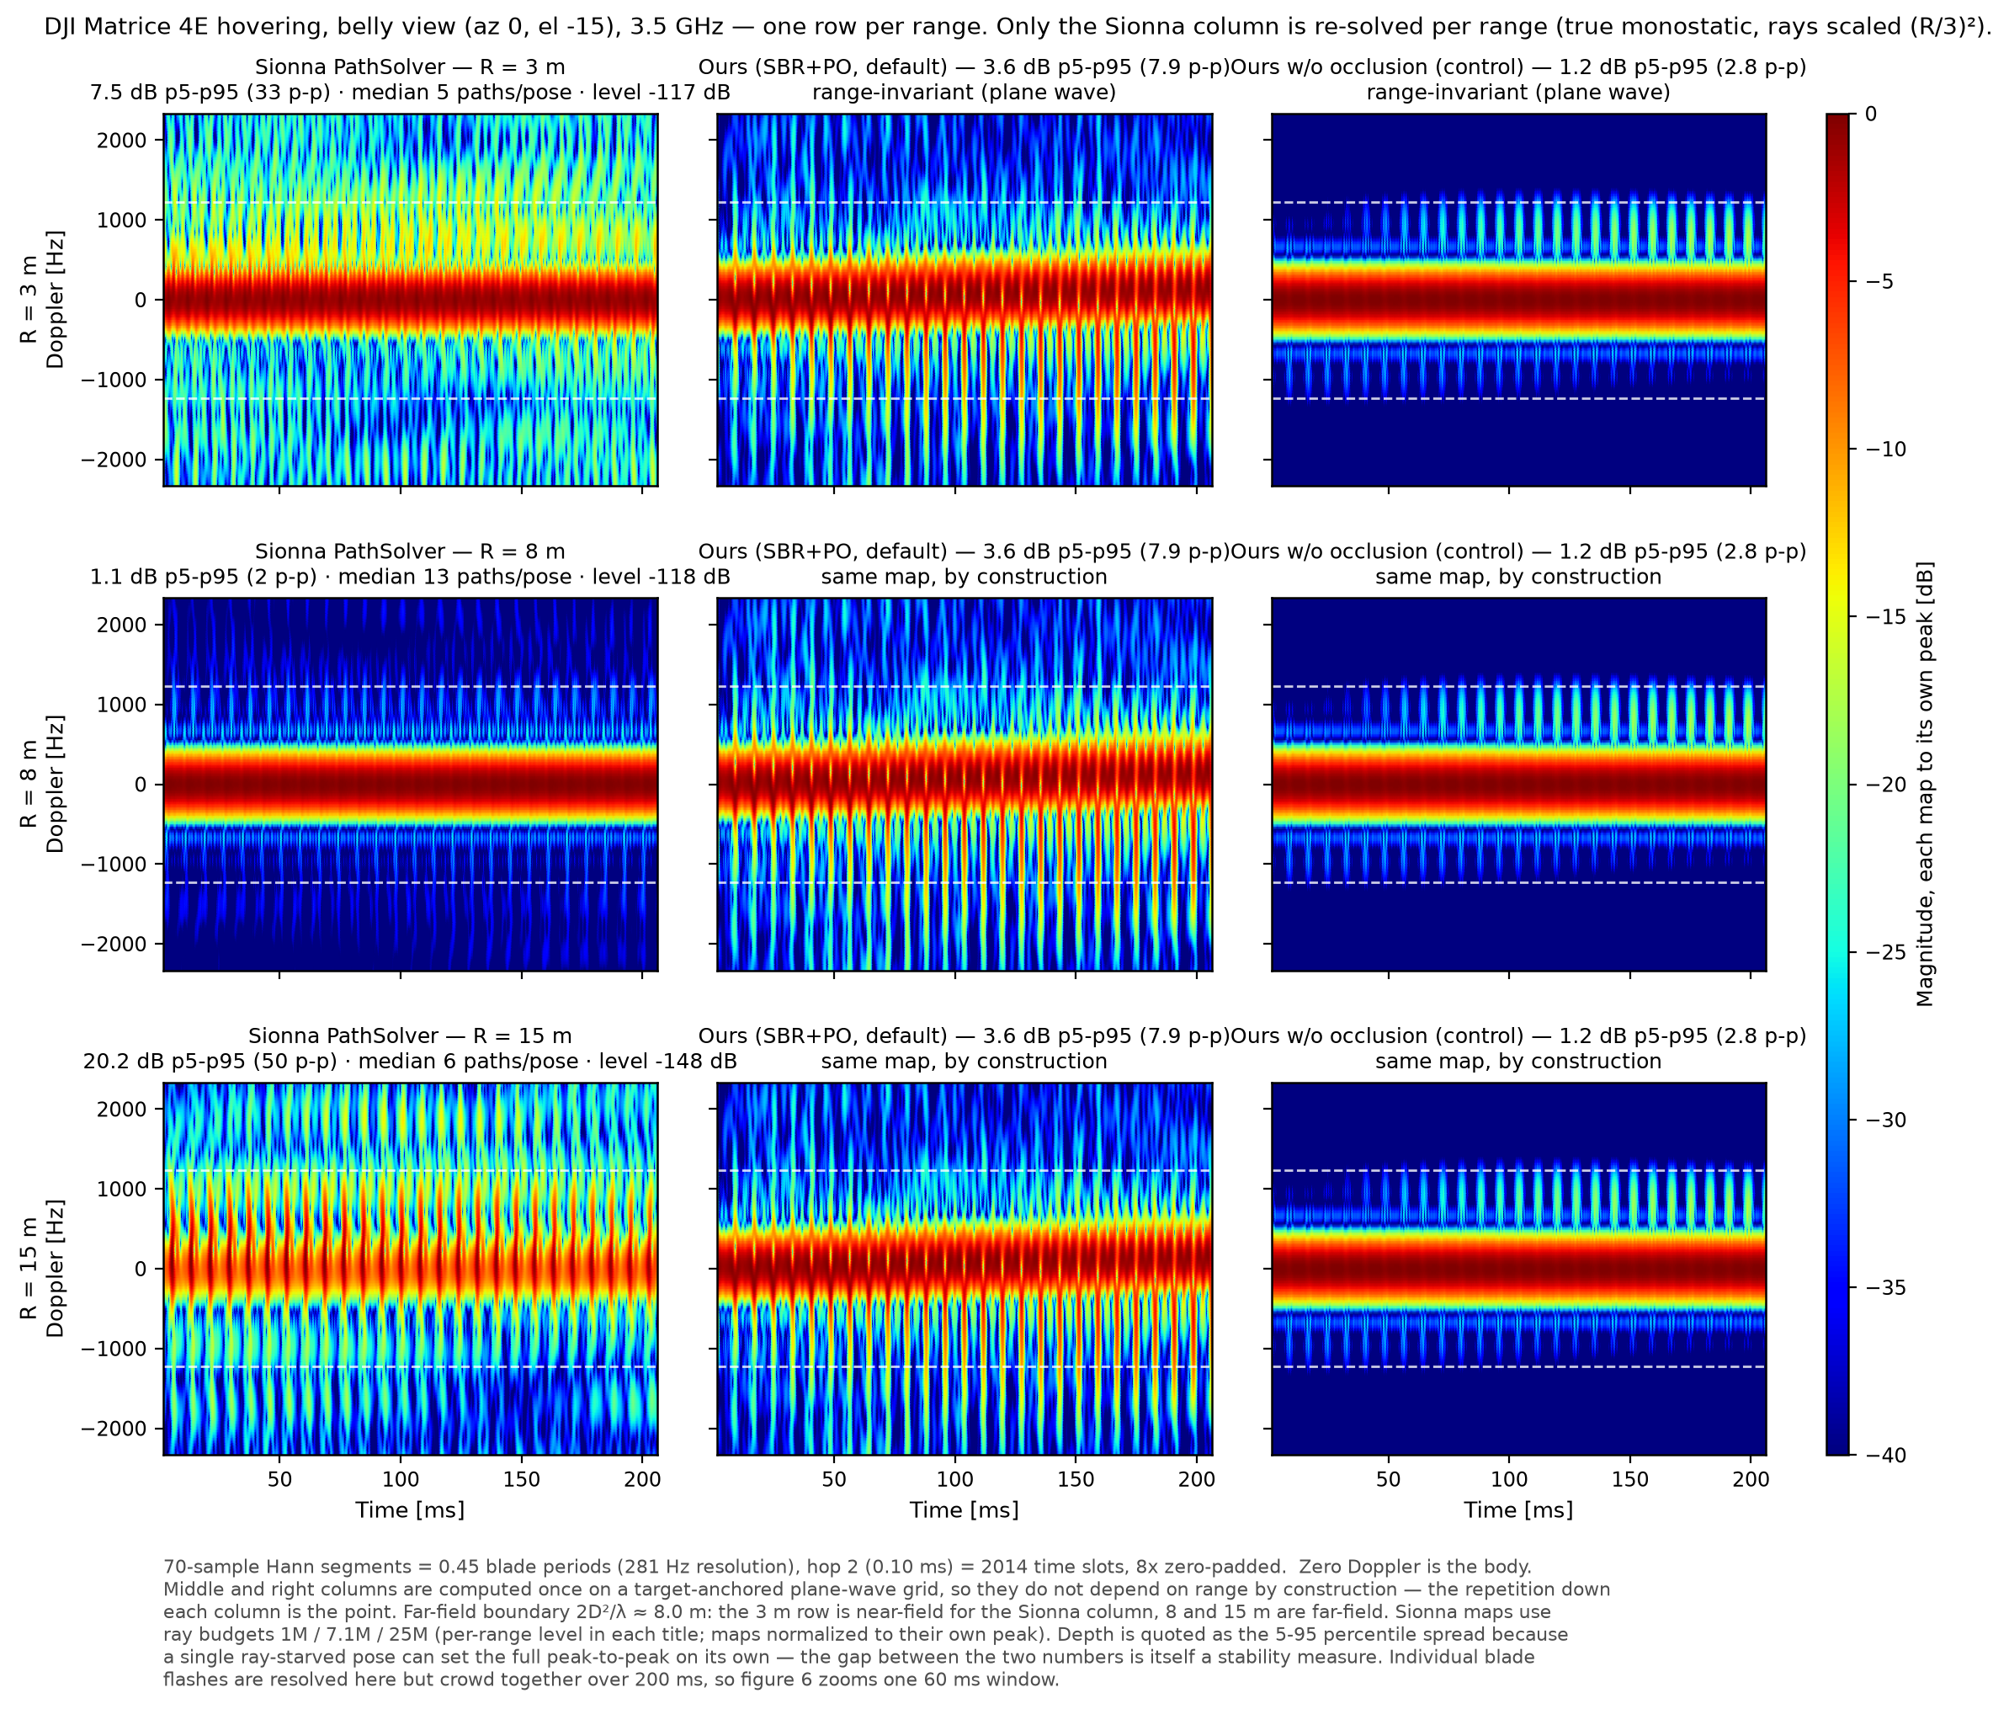
APPENDIX · THREE ENGINES ACROSS RANGE
The same three engines at 3, 8 and 15 m
This is how the report now shows the three engines, with a range axis added
Our two columns are range invariant by construction, so the same map repeats down every row
Mean Sionna level falls 31 dB from 3 to 15 m, which the per-panel normalisation hides
Path counts stay healthy here, so the 40 m collapse is a separate story
One row per range. Only the Sionna column is re-solved.
Notes:
Backup for the range slide. Same grid as the three engine figure, with the Sionna column re-solved at three, eight and fifteen metres.
In this range band the ray compensation works, so there are no zero-path poses. Two things do change. The absolute level falls about thirty dB from three to fifteen metres, which the per-panel normalisation hides and the titles state. And the texture changes, because a different set of paths is caught at each pose.
Our two columns repeat identically down the rows, and that repetition is the point. A target-anchored plane wave grid has no range variable in it.
One honest note. The eight metre row looks calmer because the compensation overshot and the path count rose to thirteen. The (R/3) squared rule is an approximation, not an exact equivalence.
— 한국어 해설 —
거리 슬라이드의 백업입니다. 세 엔진 그림과 같은 격자에서 **Sionna 열만** 3·8·15 m 로 다시 풀었습니다.
이 거리대에서는 광선 보상이 먹혀서 경로 0 자세가 없습니다. 대신 둘이 변합니다 — 절대 레벨이 3→15 m 에서 약 30 dB 내려가고(패널별 정규화가 가리는 사실이라 제목에 적혀 있습니다), 자세마다 잡히는 경로 집합이 달라져 결이 바뀝니다.
우리 두 열은 세 줄에서 **똑같이 반복**되고, 그 반복이 이 그림의 절반입니다 — 표적 앵커 평면파 격자에는 거리라는 변수가 아예 없습니다.
정직 노트 — 8 m 줄이 오히려 차분한 것은 보상이 초과해 경로가 13개로 늘었기 때문입니다. (R/3)² 규칙은 근사이지 정확한 등가가 아닙니다.

Slide 17
APPENDIX · ROTOR SPREAD ANCHORS
Where the outdoor preset comes from
Public hover logs, not our target. The field log replaces all of it.
We cut the hover windows out of three public log datasets ourselves. Static spread is the between-motor standard deviation, in percent of mean rpm.
Log | Vehicle and setting | Static spread | Wobble
NeuroBEM | racing quad, indoor motion capture, no wind | 0.54 percent | 0.74 percent at 0.7 to 2.2 Hz
PX4 Flight Review | large commercial quad, outdoor position hold | 2.35 percent | 2.52 percent at 0.74 Hz
DJI Phantom 3 DAT | real DJI airframe, outdoor, PWM command proxy | 5.8 percent PWM, about 2 to 6 percent in rpm | 5.3 percent PWM at 0.3 to 4 Hz
Ours today (PX4 SITL) | ideal controller, no wind, no airframe asymmetry | 0.22 percent | 0.15 percent at 2.7 Hz
SITL is the symmetric no-wind lower bound. Outdoor logs sit an order of magnitude above it.
Notes:
Backup for the rotor spread slide. These are the anchors behind the outdoor preset.
Indoor motion capture with a racing quad gives about half a percent. Outdoor position hold on a large commercial quad gives about two and a third percent, with two and a half percent wobble near three quarters of a hertz. A real DJI Phantom 3 command log gives about six percent in PWM, which converts to roughly two to six percent in rpm.
Three cautions I want on the record. None of these is our target aircraft. The Phantom 3 row is command, not measured rpm. And the outdoor spread includes wind trim, so it is not purely a motor property.
— 한국어 해설 —
로터 산포 슬라이드의 백업입니다. 야외 프리셋의 근거 앵커입니다.
실내 모션캡처(레이싱 쿼드) 약 0.54 %, 야외 위치유지(대형 상용 쿼드) 약 2.35 % 에 흔들림 2.5 % @ 0.74 Hz, 실기체 DJI Phantom 3 명령 로그 PWM 5.8 %(rpm 환산 2~6 %).
기록해 둘 주의 셋 — ① 어느 것도 우리 표적 기체가 아닙니다. ② Phantom 3 행은 실측 rpm 이 아니라 **명령(PWM) proxy** 입니다. ③ 야외 산포에는 바람 보정 트림이 섞여 있어 순수 모터 특성이 아닙니다.
(원장 outputs/rotor_rpm_web_anchor.json — 측정 절차·창 정의·주의사항이 그 안에 그대로 있습니다.)

