Slide 1

Team Meeting
Yunjung Jeong
2026. 08. 11
Intelligent Radio Sensing Lab. (IRS Lab)
Department of Electrical Engineering and Computer Science
DGIST

Slide 2
TODAY
Micro-Doppler of a hovering drone
Sionna PathSolver vs Our SBR + PO
Notes:
Today I have done sionna simulation and drew some micro doppler map

Slide 3
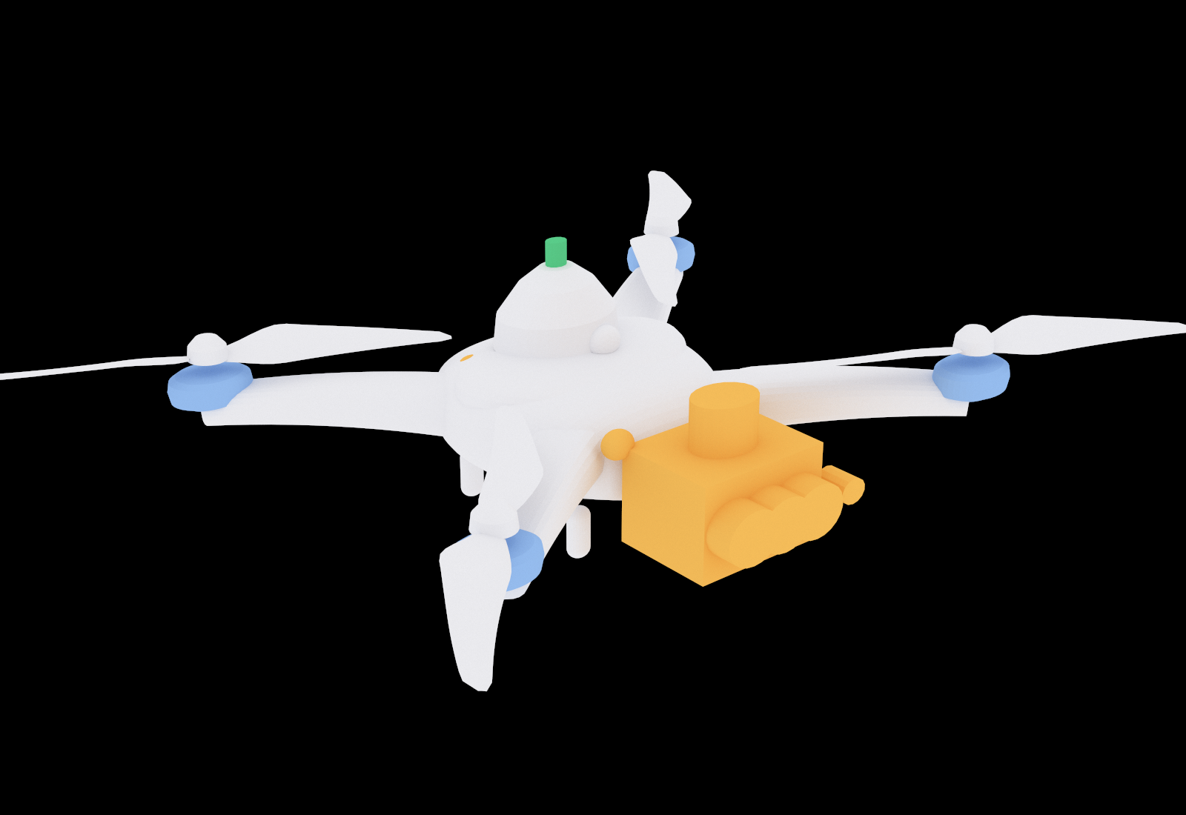
THE TARGET
The scenario
The aircraft
Model
DJI Matrice 4E
Propeller
274 mm, 2 blades
Rotor speeds
Rotor 1
3808.4 rpm
Rotor 2
3791.6 rpm
Rotor 3
3795.4 rpm
Rotor 4
3804.6 rpm
Spread
0.22 %, from Jihyuck prior work
Notes:
For this week's progress, I generated the micro-Doppler signatures for a drone hovering scenario using the Sionna Path Solver and the physical optics approach I mentioned before.
In the simulation, the rotation speed of each rotor was centered around a calculated estimate of 3,800 RPM. To account for variance,
I applied the dispersion data from Ji-hyuk's previous work and hard-coded randomized values to set fixed rotation speeds for each rotor.
A more precise modeling regarding this rotor speed will be refined in my future work."

Slide 4
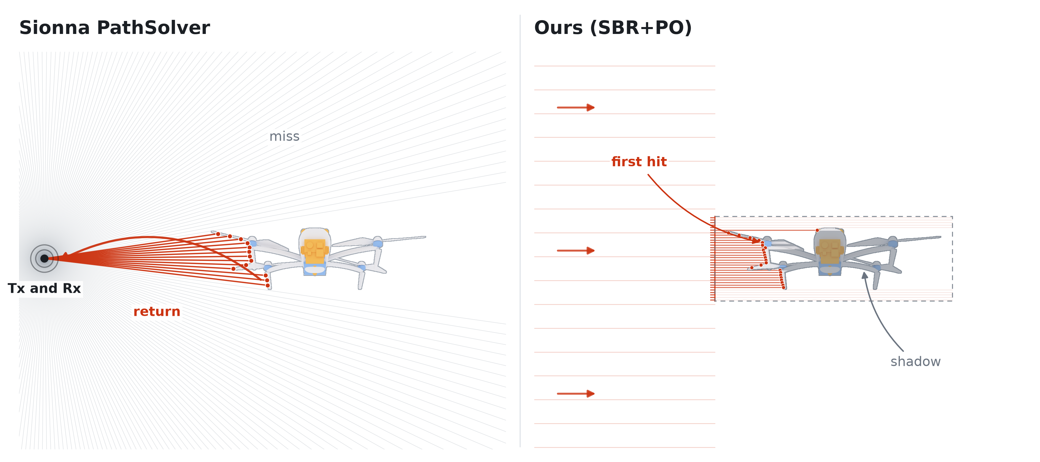
THE TWO ENGINES
How each engine lights the target
Notes:
To give you some background, Sionna’s Path Solver works by launching rays isotropically from the transmitter.
Each time a ray hits a surface, it obtains the reflection coefficient from that material and multiplies it cumulatively.
The final calculation is then based on the few paths that actually return.
On the other hand, our SBR + PO method calculates the physical optics scattering integral using a defined formula under a plane-wave illumination assumption.
To determine exactly which surfaces are actually illuminated, we shoot a grid of parallel rays at the target and compute the scattering based on the first hit point of each ray.
And for the components designated as transmissive the rays penetrate through.
We then calculate the echo from the internal metal structures and add it to the total, weighted by the transmittance rate.

Slide 5
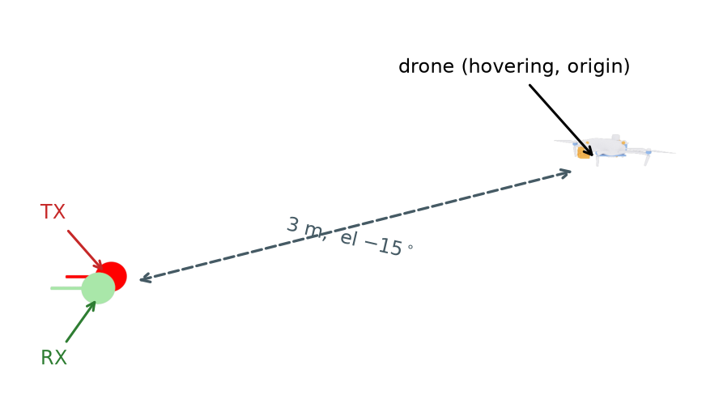
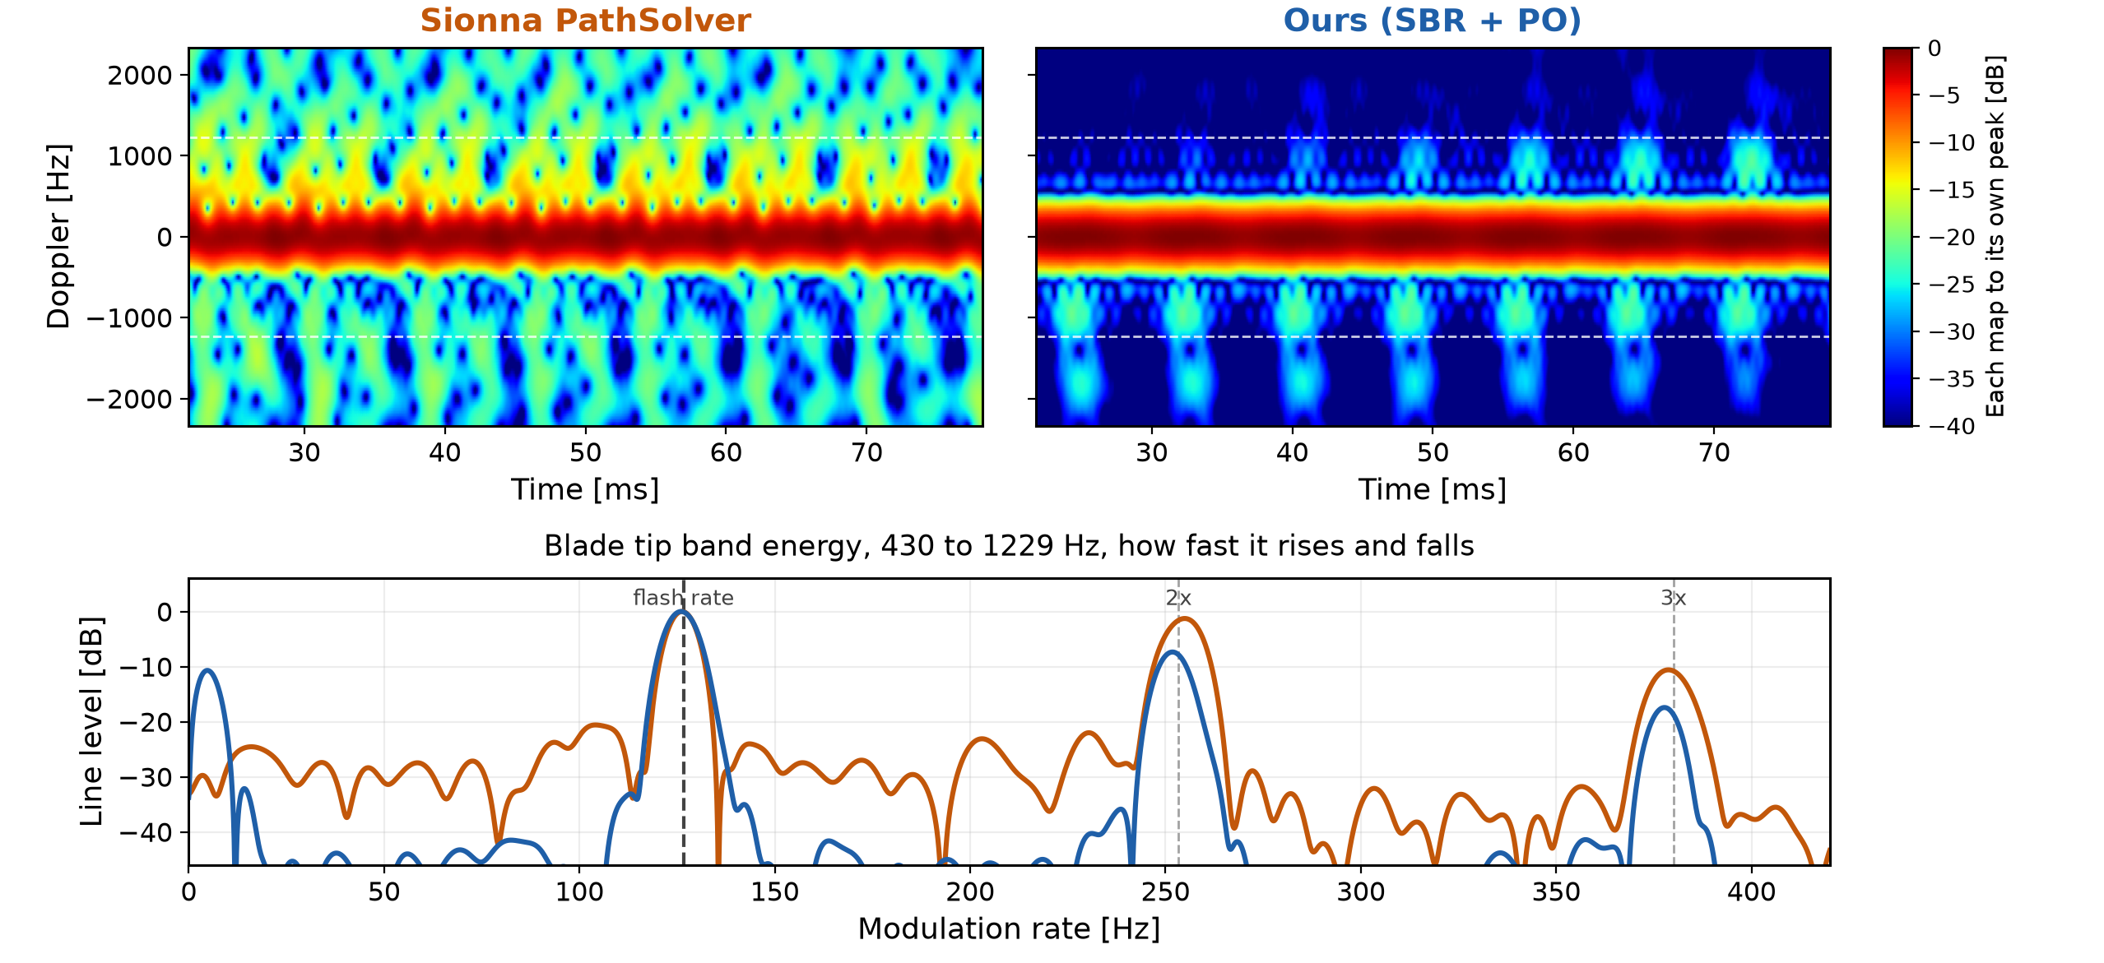
RESULT ONE
Three metres
3.5 GHz CW Scenario
STFT Parameters
Window
Hann, 70 samples
3.553 ms
Hop size
2 samples
0.101 ms
FFT size
560 points
Notes:
For the simulation setup, I set the center frequency to 3.5 GHz, representing a standard 5G band. To keep things simple at this stage, I generated the micro-Doppler map based on a scenario using a CW (Continuous Wave) waveform.
For the STFT parameters, I used a window size of 70 samples, which corresponds to about 3.553 milliseconds. The hop size was set to 2 samples, or roughly 0.1 milliseconds, and the FFT size was 560 points.
If you look at the bottom figure, it plots the energy in the 430 Hz to 1229 Hz band
I targeted this specific range because it is considered to be outside the energy contribution of the drone's rigid body.
In this analysis, a distinct peak appeared around 127 Hz, which closely aligns with the expected frequency for the propeller rotation speed. Additionally, we could clearly observe peaks emerging at its harmonic frequencies as well."

Slide 6
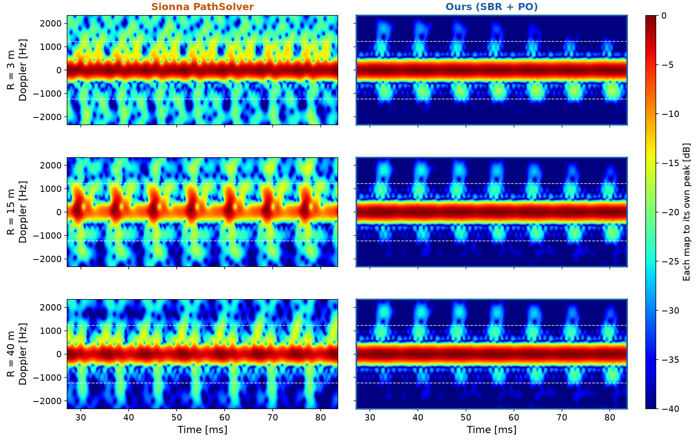
RANGE
Three ranges
Notes:
Just to clarify, the results shown on the previous slide were specifically limited to a scenario where the drone was 3 meters away.
Following that, I expanded the simulation and performed the STFT analysis across varying distances—specifically at 3 meters, 15 meters, and 40 meters.
As a result, I was able to confirm that the visual STFT patterns remained highly consistent, even in scenarios where the target distance significantly increased

Slide 7
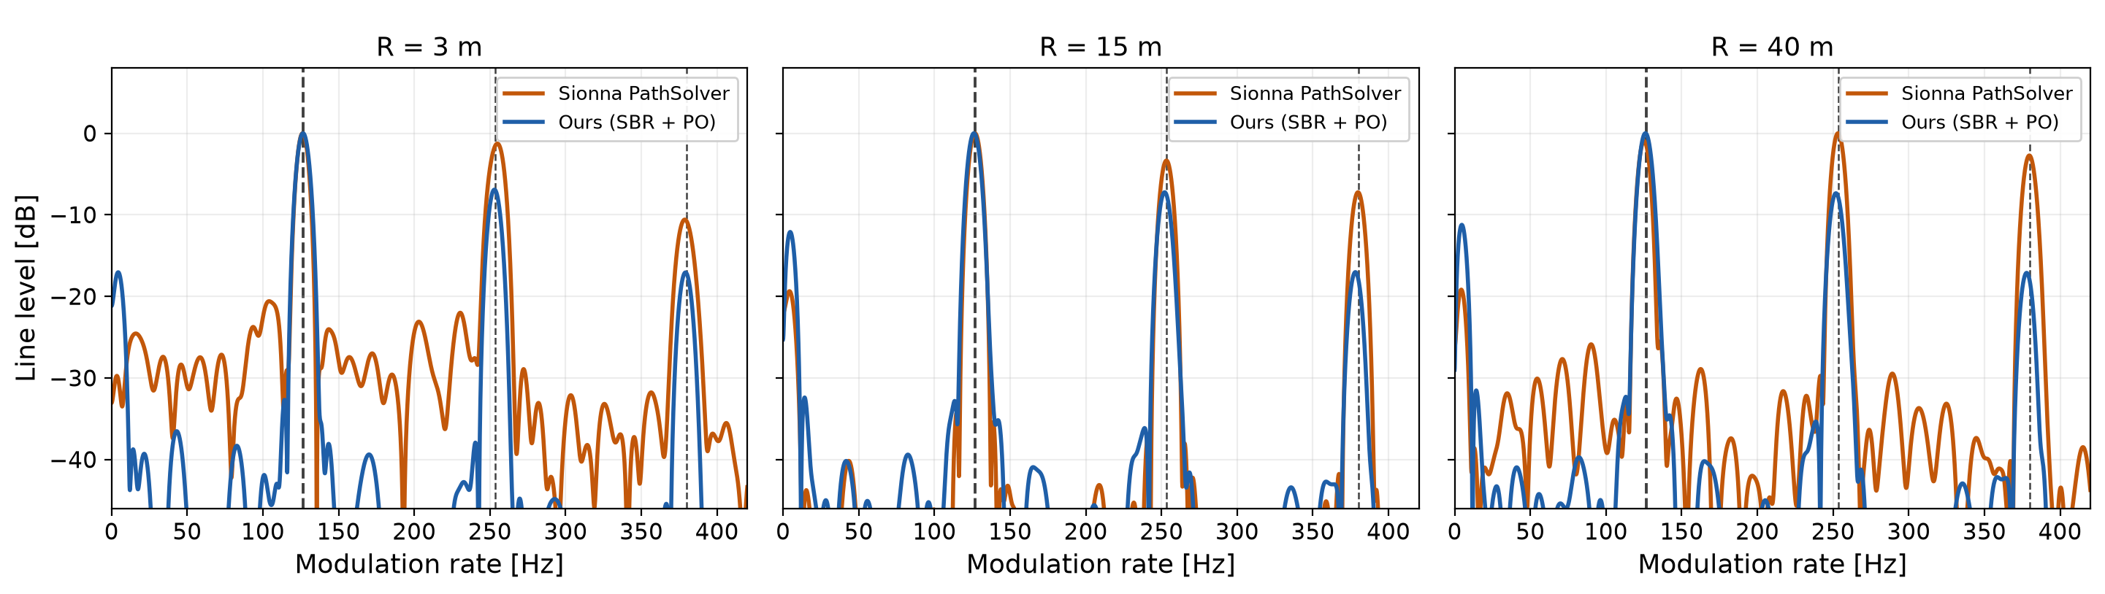
BAND ENERGY
Blade tip band energy
Both engines put the first line where kinematics says it should be.
Notes:
Furthermore, across these varying distances, I observed that the energy peaks within the previously mentioned frequency band—along with the peaks at the harmonic positions—remained largely similar.
Additionally, I noticed an interesting observation regarding the harmonics.
With my PO approach, it is clearly observed that the peak intensity gradually decreases as it moves to higher harmonics.
On the other hand, with the Path Solver method, there were quite a few instances where the peak at the first harmonic appeared almost as high as the original peak.

Slide 8
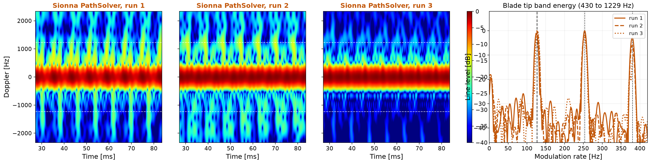
TWICE
Forty metres, repeated runs
Only the random start differs between these runs.
Notes:
Lastly, in the 40-meter scenario, I generated multiple micro-Doppler maps by varying the random seed values. I observed that the clarity of the maps varied depending on the seed.
In contrast, my PO approach always yields the exact same result, provided that the distance is fixed and the drone's pose remains the same.

Slide 9
FUTURE WORK
Future work
Three pieces are missing, and each one takes the model closer to reality
Let each rotor wander in speed the way a real one does while holding station
Add receiver noise, so that distance finally costs something in the picture
Move to the bistatic or put clutter into the enviornment
Each step brings the simulation closer to a real measurement.
Notes:
For my future work, I want to make the simulation more realistic. I have three directions.
First, the rotor speeds. Right now each rotor turns at a hard-coded value, and the spread between them comes from a flight simulator, not from a real drone. I want to use real flight log data instead, and also introduce temporal variation, the way a real drone adjusts its rotors while it stays in place.
Second, noise. There is no receiver noise in this simulation. That is why nothing became harder when the drone moved further away. The echo does get weaker with distance, but each map is scaled to its own brightest point, so we cannot see that. And with no noise, nothing is ever buried. In the real world, noise is what decides how far we can detect, so I want to add it.
Third, the geometry and the environment. Everything today uses one station that sends and receives at the same place, in empty space. Our real experiment is a passive bistatic setup, where the signal comes from someone else's base station, and it happens in a room with walls and a floor. I want to move to that geometry and add clutter modelling.
All three will make the results worse, and that is the point. They bring the simulation closer to a real measurement.

