Slide 1

Team Meeting
Yunjung Jeong
2026. 08. 11
Intelligent Radio Sensing Lab. (IRS Lab)
Department of Electrical Engineering and Computer Science
DGIST

Slide 2
TODAY
Micro-Doppler of a hovering drone
Sionna PathSolver vs Our SBR + PO
Notes:
Today I will show micro-Doppler maps of a hovering drone,
computed two ways: with Sionna's Path Solver, and with our own SBR + physical optics kernel.

Slide 3
THE TARGET
The scenario
The aircraft
Model
DJI Matrice 4E
Propeller
274 mm, 2 blades
Rotor speeds
Rotor 1
3808.4 rpm
Rotor 2
3791.6 rpm
Rotor 3
3795.4 rpm
Rotor 4
3804.6 rpm
Tx/RX
Spread
0.22 %, from Jihyuck prior work
Notes:
The target is a DJI Matrice 4E. Each rotor spins at a fixed speed near 3,800 RPM.
(That is a calculated value using the weight and the blade size)
The four rotors differ slightly from each other, and that spread comes from Ji-hyuk's prior simulation data.
These are hard coded constant values, not taken from a real flight.
So Better rotor modelling is future work.

Slide 4
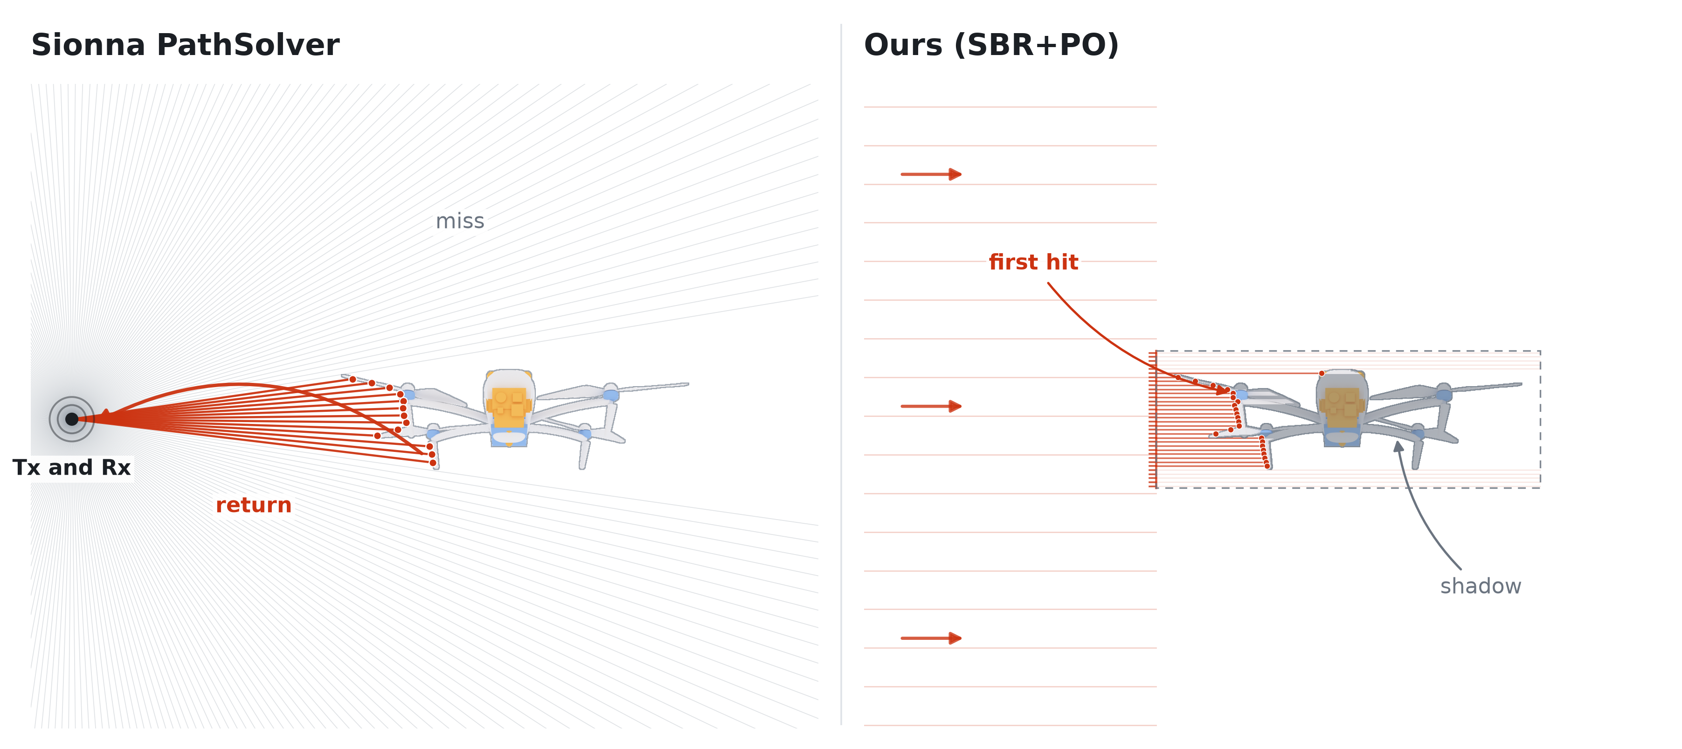
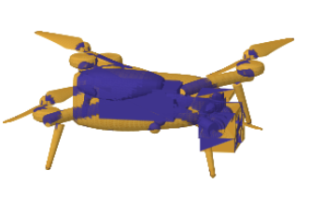
THE TWO ENGINES
How each engine lights the target
Notes:
Sionna's Path Solver launches rays isotropically from the transmitter, that is, evenly in every direction.
When the geometry is fixed The directions are fixed as well, so where the rays land on the drone is always the same.
With the random seed changing.
At each hit, the solver picks one outcome, a mirror reflection or a diffuse scatter, and the material decides how likely each one is.
That pick is what the random seed controls. The result then comes from the few paths that actually come back.
같은 지점에 맞아도 반사, 확산, 굴절 등의 비율이 정해진 형태로 랜덤성이 존재하게 설계되어있음
Our kernel does something different. We shoot a grid of parallel rays at the target, take the first point each ray hits, and sum the physical optics scattering integral over those points.
For parts we treat as transmissive, the ray passes through, and we add the echo from the metal inside, scaled by how much gets through.
[if asked] For our plastic parts the chance of a scatter is about four percent. That sounds small, but only a handful of paths come back at each rotor position, so one path more or less changes the answer.
[if asked] Parallel rays do not mean a flat wave. I put the transmitter at the real distance and give every hit point its true two-way path, so 3, 15 and 40 metres are three separate runs. At 3 metres the phase across the airframe bends by about 3.7 radians, so distance really is an input. What I do not model yet is the one over r spreading, so the maps do not get weaker with range.

Slide 5
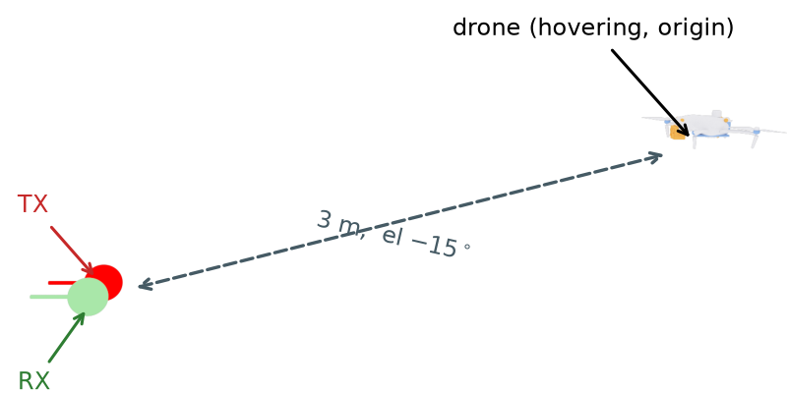
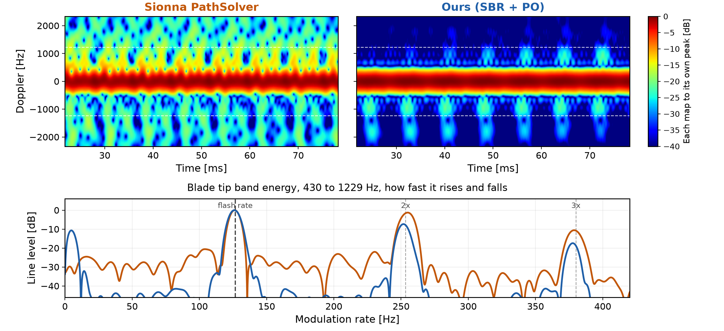
RESULT ONE
PathSolver vs SBR + PO
3.5 GHz CW Scenario
STFT Parameters
Window
Hann, 70 samples
3.553 ms
Hop size
2 samples
0.101 ms
FFT size
560 points
Notes:
The center frequency is 3.5 GHz, a standard 5G band. For the waveform I used a simple continuous wave.
This is an early experiment, and CW is the easiest thing to work with.
What I want to see first is the micro-Doppler itself, so I did not need a more complicated waveform yet.
And I put the drone 3m far from the Tx and Rx
For the STFT: window 70 samples, about 3.5 milliseconds; hop 2 samples; FFT size 560.
The bottom figure is made in two steps. First I add up the energy from 430 to 1229 Hz
I keep away from zero on purpose, because the strong band there is mostly the rigid body of drone.
What I keep is where the outer part of the blades lands. It is much weaker, but most of it belongs to the blades.
Then I ask how that energy rises and falls over time, and take its spectrum.
The peak sits at about 127 Hz. That is the blade flash rate: two blades passing per revolution, so twice the rotation rate.
Its harmonics show up clearly too.
[if asked] The band near zero moves as well, and it is much stronger. That is the body and the blades adding together, so it does carry the blade timing, but it is mixed with the body. I stay away from it for that reason.

Slide 6
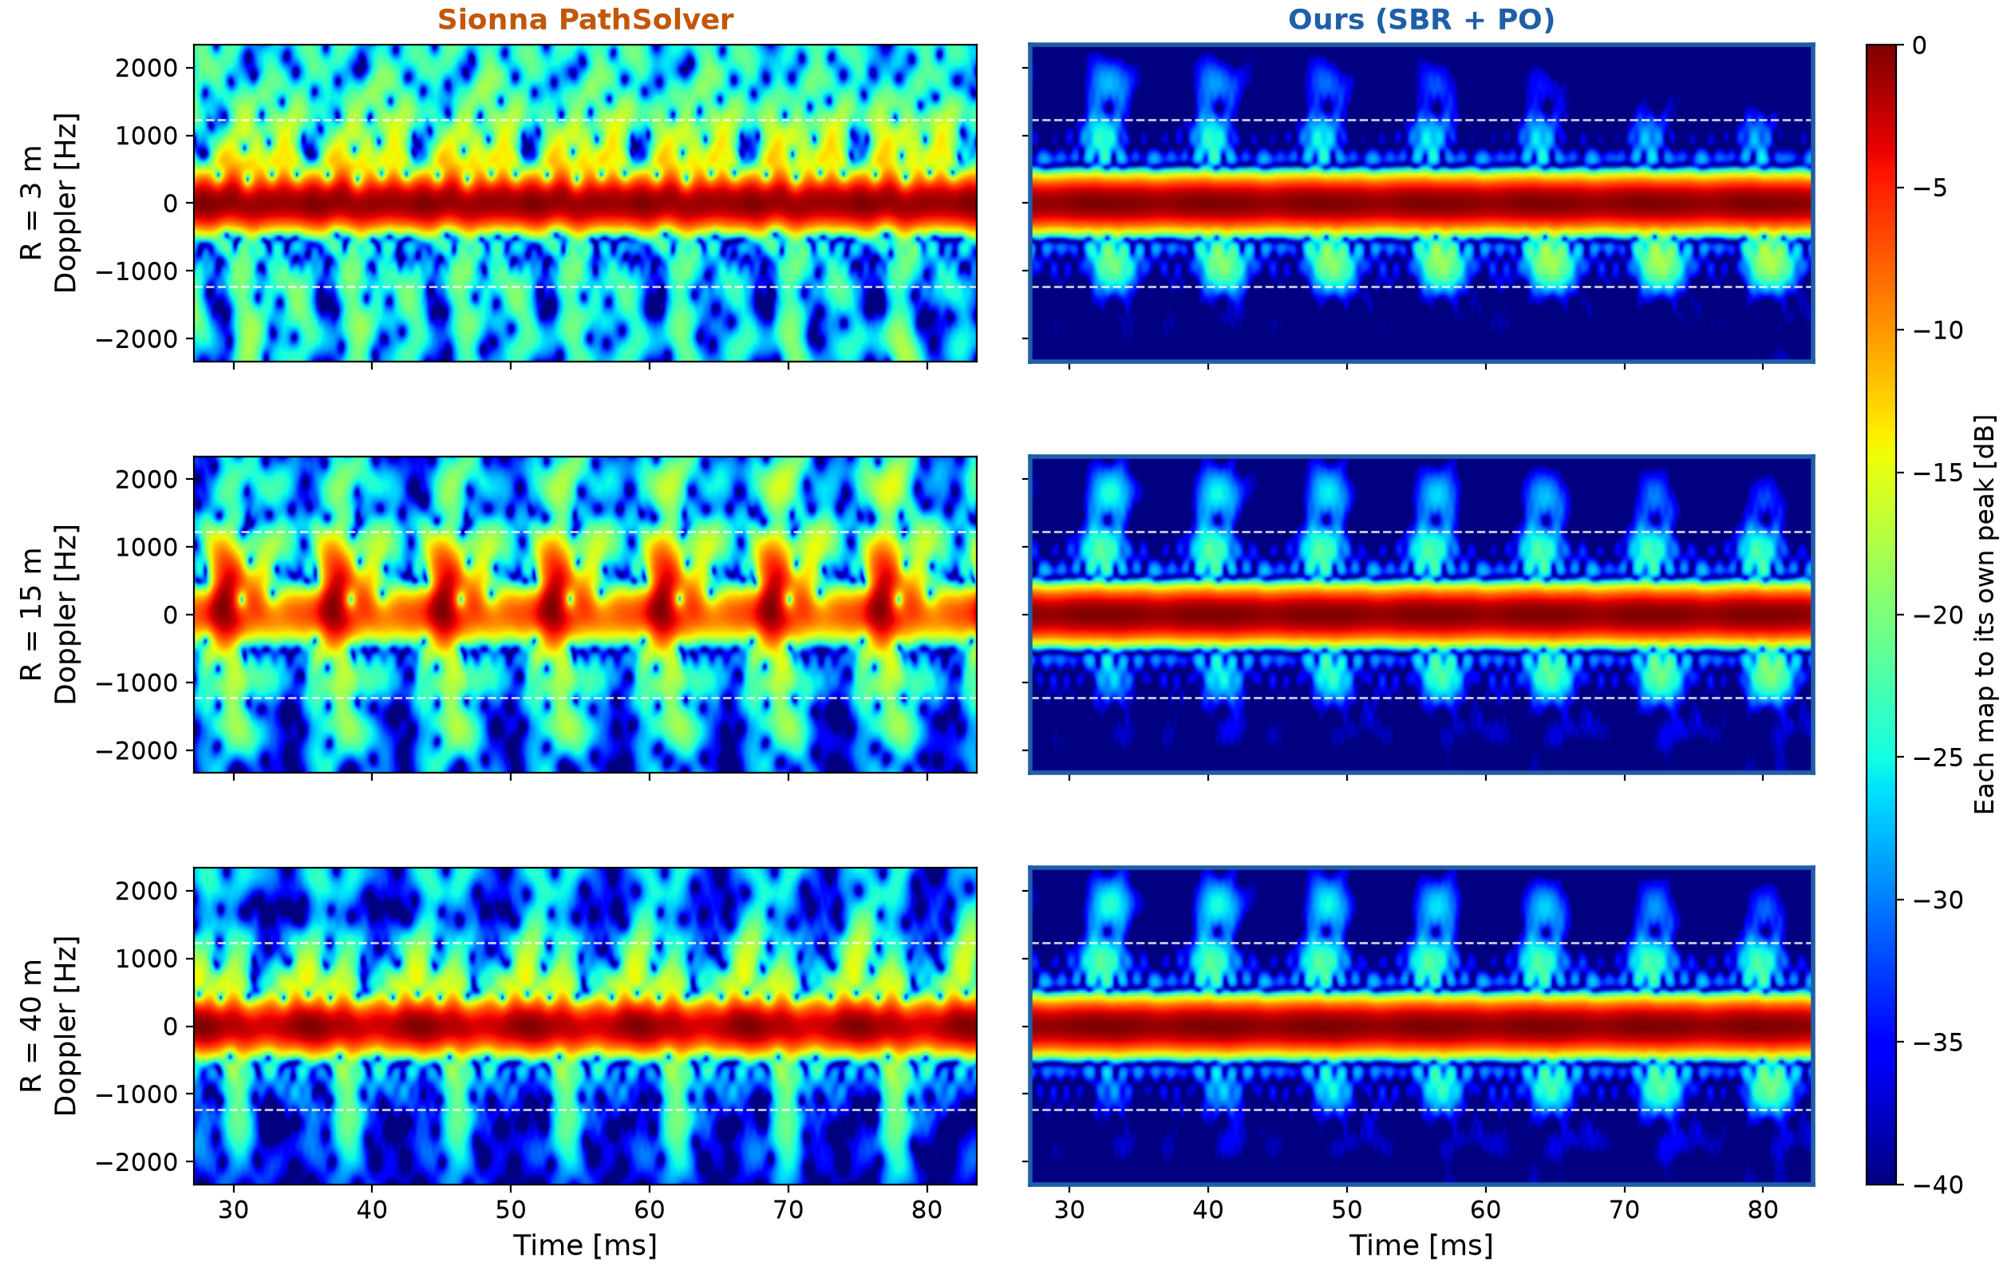
RANGE
PathSolver vs SBR + PO : Three ranges
Notes:
Here I ran the same thing at 15 and 40 meters far
Our kernel gives nearly the same map at every range. (원거리장을 가정해서 근거리에서는 약간 다르게 나오나 3m 측정치에서도 큰 문제 없었음)
The Path Solver does not. Its three maps look quite different from each other, and not in order of range.

Slide 7
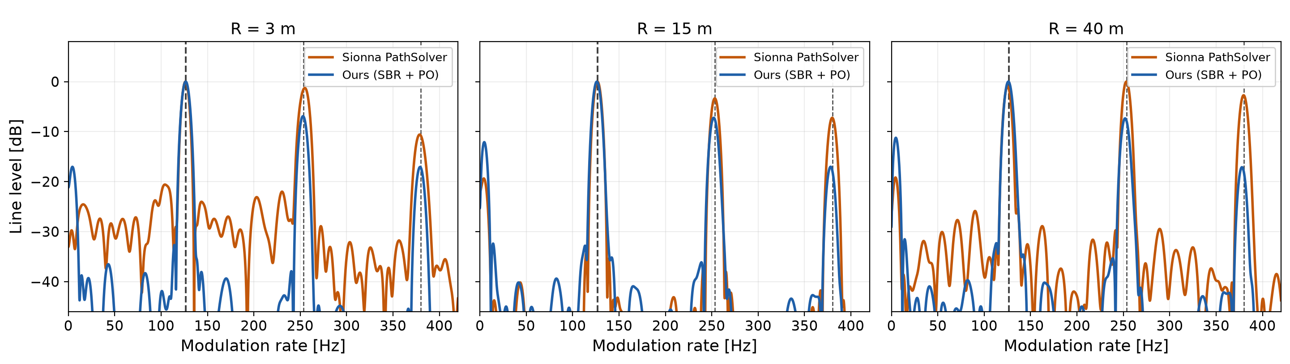
BAND ENERGY
Blade tip band energy
Both engines put the first line where kinematics says it should be.
Notes:
This is the band energy for each range.
One thing stands out in the harmonics. With our PO approach, the peak height gradually decreases as we move to the higher harmonics.
With the Path Solver, the second harmonic often comes out almost as high as the first one, and sometimes higher.

Slide 8
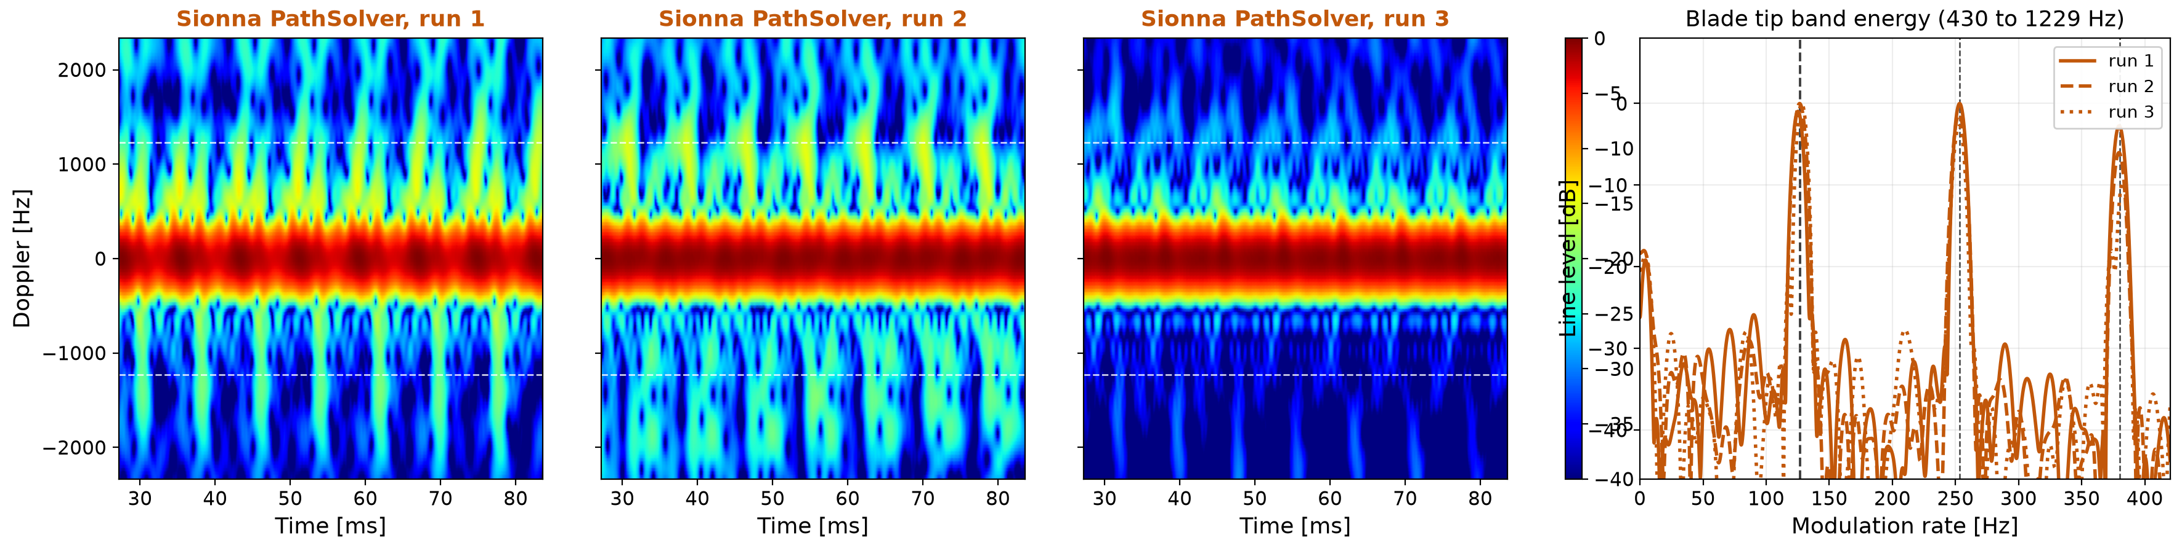
TWICE
PathSolver Random Seed
Only the random start differs between these runs.
Notes:
At 40 meter setting
I ran the Path Solver again, changing only the random seed.
Even with the same drone, the same pose and the same orientation, the seed changes the result.
One seed puts the strongest energy line on the second harmonic instead of the first one.
and Our PO approach has no randomness.

Slide 9
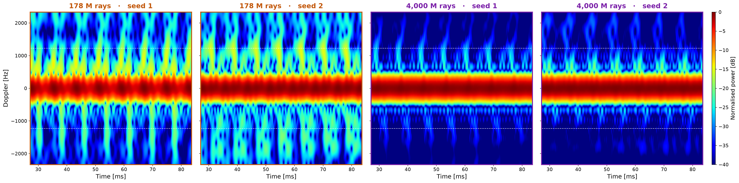
RAY BUDGET
More rays, cleaner background
Pushing the ray budget to its maximum cleaned up the background.
Notes:
One last thing. I raised the ray count to the maximum the solver allows.
It takes a long time to run, so I only got the result just before this meeting.
as you can see The background is much cleaner.
[if asked] The specks did not go away. With twenty times more rays the solver finds about twenty times more paths, so the signal comes up by more than ten decibels while the specks stay where they were. Each map is scaled to its own strongest point, so the specks drop below the colour scale. The useful range in the picture really is better, but it is the signal coming up, not the noise averaging away.
[if asked] The seed still decides which harmonic comes out strongest.

Slide 10
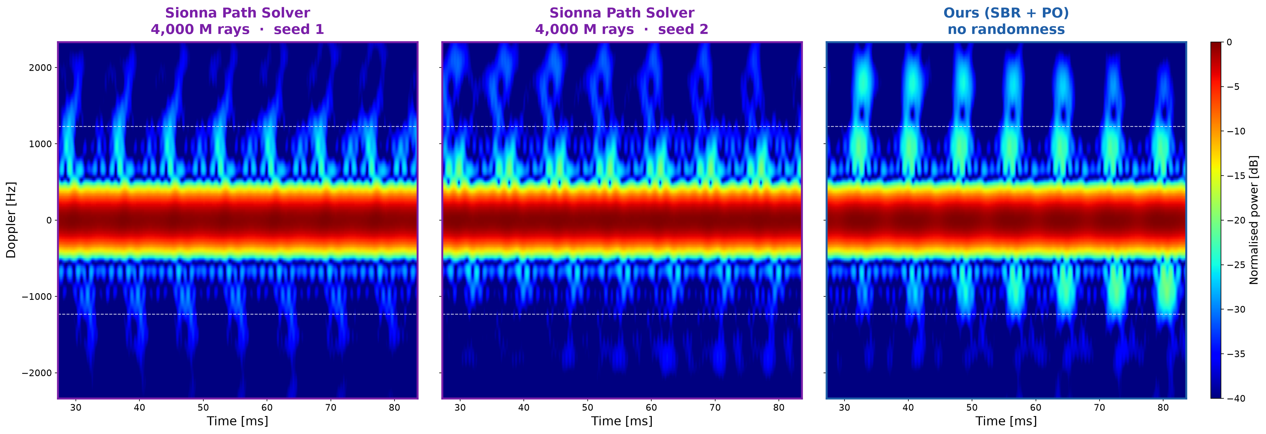
SIDE BY SIDE
The two engines at forty metres
Same distance, same drone. Ours repeats exactly, the Path Solver does not.
Notes:
and this is results comparing between the Two
Path Solver runs with the full ray budget, and our PO result.
[if asked] The blade lines land in the same place. What changes between the two Path Solver runs is only the random seed.

Slide 11
FUTURE WORK
Future work
Three pieces are missing, and each one takes the model closer to reality
Let each rotor wander in speed the way a real one does while holding station
Add receiver noise, so that distance finally costs something in the picture
Move to the bistatic or put clutter into the enviornment
Each step brings the simulation closer to a real measurement.
Notes:
For my future work, I want to make the simulation more realistic. I have three directions.
First, the rotor speeds. Right now each rotor turns at a hard-coded value, and the spread between them comes from a flight simulator, not from a real drone.
I want to use real flight log data instead, and also introduce temporal variation, the way a real drone adjusts its rotors while it stays in place.
Second, noise. There is no receiver noise in this simulation.
That is why nothing became harder when the drone moved further away.
The echo does get weaker with distance, but each map is scaled to its own brightest point, so we cannot see that.
And with no noise, nothing is ever buried.
In the real world, noise is what decides how far we can detect, so I want to add it.
Third, the geometry and the environment.
Everything today uses monostatic setting.
Our real experiment setting could be passive bistatic setup, and it will be outdoors,
I want to move to that geometry and add the ground reflection and the clutter.
All three will make the results worse, and that is the point. They bring the simulation closer to a real measurement.
드론 rpm, 엘리베이션,

