Slide 1

Team Meeting
Yunjung Jeong
2026. 08. 18
Intelligent Radio Sensing Lab. (IRS Lab)
Department of Electrical Engineering and Computer Science
DGIST
Notes:
— SCRIPT —
Good afternoon. Today I ask one question, does an off the shelf radio simulator draw a spinning propeller. Last week I looked at one viewing angle, and this week I swept the angle from level down to straight below the drone.

Slide 2
RECAP
Last time
Our PO kernel and the Sionna PathSolver drew the same hovering drone
Across three ranges the story held, and away from nose on more rays only cleaned the background
Blade tip band energy separated the two engines
Notes:
— SCRIPT —
Last week I fixed the viewing angle and compared our PO kernel against the Sionna PathSolver at one setting, the one this deck calls physics off. The result looked fairly convincing. Today I ask what happens when the viewing angle changes.

Slide 3
TODAY
Today
Three parts
Part 1 · The setup
Part 2 · Micro-Doppler maps
Part 3 · Propellers only
The question stays the same, does the simulator draw a spinning propeller
Notes:
— SCRIPT —
The talk has three parts, the setup, the micro-Doppler maps, and the propellers on their own. The question stays the same as last week.

Slide 4
PART 1
The setup
How the runs were set up
Scene · Ceiling · Switches · Engines
Notes:
— SCRIPT —
First, how the runs were set up. Scene, then the ceiling I measure against, then the switches, then the engines.

Slide 5
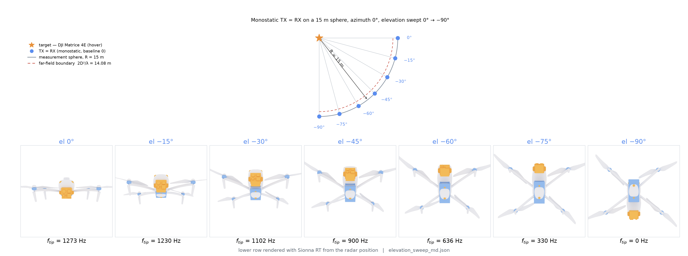
THE SCENE
The scenario
Notes:
— SCRIPT —
One Matrice 4E hovers 15 meters in front of the radar at 3.5 gigahertz, and the radar views it from seven angles, from level down to straight below. Fifteen meters sits just outside the far field boundary, so no map here needs a near field caveat.

Slide 6
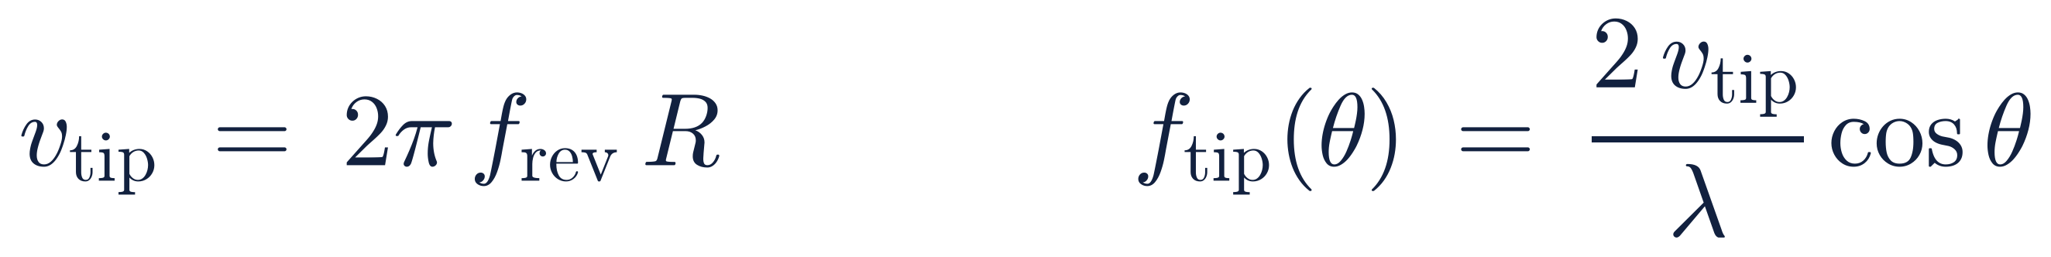
SETTING THE RULER
The blade ceiling
The blade tip is the fastest thing on the airframe, so it sets a hard ceiling
the tip speed sets the ceiling, and looking from below shrinks it by cos of the angle
v_{tip} · speed of the blade tip through the air
f_{rev} · rotor turns per second at hover
R · propeller radius
λ · radio wavelength of the illuminator
θ · elevation angle, how far below level the radar sits
Any Doppler above this line cannot have come from a blade
Notes:
— SCRIPT —
This is how I compute the blade ceiling. The blade tip is the fastest thing on the airframe, so it caps the Doppler that spinning can produce, and the ceiling falls to zero as the radar moves straight under the drone.

Slide 7
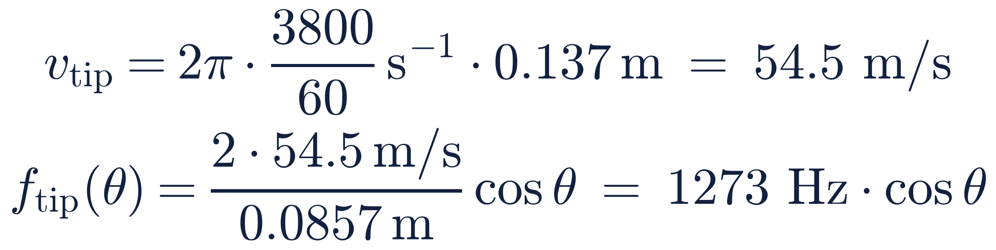
SETTING THE RULER
This drone's numbers
For the Matrice 4E at 3.5 GHz the ceiling is 1273 Hz when the radar looks level
propeller radius 0.137 m, hover speed 3800 rpm, wavelength 85.7 mm
Propeller radius comes from the DJI part number, 274 mm across
Hover speed is checked against a measured thrust coefficient and agrees within half a percent
1273 Hz looking level, and 0 Hz looking straight up at the belly
Notes:
— SCRIPT —
Feeding this drone's numbers into that formula gives 1273 hertz when the radar looks level and zero when it looks straight up at the belly. I kept the same rotor speed as last week, and it matches a measured thrust coefficient to within half a percent. The ceiling is a number I compute up front, not something the simulation produced, so anything above the line cannot have come from a blade.
⚠질문 대비 한 줄: 회전수 ±5 % 를 넣어 천장을 다시 그어도 세 팔의 판정 순서는 안 바뀐다.

Slide 8
THE SWITCHES
The four switches
Mirror reflection is always on, and four more wave effects are optional switches
Setting | Factory default | Our OFF arm (physics off) | Our ON arm (physics on) | What it adds
Diffuse scattering | off | on | on | surfaces scatter energy in all directions
Refraction | on | off | on | waves enter and pass through the material
Diffraction | off | off | on | waves bend around the body
Edge diffraction | off | off | on | extra bending at sharp free edges
Bounce depth | 3 | 1 | 1 | how many hops one ray may take
Notes:
— SCRIPT —
Mirror reflection is always on, and four more wave effects are optional switches. Sionna ships with diffuse scattering off, and on a target this small, mirror rays alone give almost nothing back, so I turn diffuse on for both arms. Physics off means diffuse only, physics on means all four, and running bounce depth from one to three did not change the reading for the two arms in this deck.
⭐기본값 그대로 같은 장면을 쐈더니 빗각 여섯 각도(−15~−90°)는 되돌아온 경로가 정확히 0 이었다. 그것을 확인했기 때문에 확산을 켜고 실험한다.
⚠깊이 단서: 정확히는 «오늘 싣는 두 팔에서 판독이 안 바뀐다» 이고, 회절을 켠 조합에서만 세기가 오른다.
⚠ON↔OFF 사이에서 바뀌는 것은 굴절·회절·모서리회절 세 스위치뿐이다(반사 깊이는 두 팔 다 1, 공장 기본값만 3) — 차이를 스위치 하나에 귀속시키지 않는다.

Slide 9
THREE ENGINES
Three engines
Same drone, same place, and the same 8,192 poses, so what differs is only how each engine samples the target
 | Our kernel | Sionna, physics off | Sionna, physics on
Rays landing on a square meter of target | 19,626 | 1,414,711 | 1,414,711
Switches beyond the mirror | surface scattering only | diffuse only | all four on
Bounce depth | single scatter | one bounce | one bounce
Time for one pose | 130 ms | 926 ms | 2.1 s
Notes:
— SCRIPT —
This is a cost comparison of the three engines, our kernel and the two Sionna engines. Same drone, same place, and the same 8,192 poses, so what differs is only how each engine samples the target.
⚠질문이 나오면 두 줄만: «광선 수» 는 세 팔에서 같은 뜻이 아니고(Sionna 는 레이더에서 뿌리고 우리는 표적 격자에서 적분), 자세당 시간은 GPU 를 나눠 쓰며 잰 벽시계라 자릿수로만 말한다.

Slide 10
PART 2
Micro-Doppler maps
Pictures first
Seven angles · Two puzzles · Band energy · Ours vs physics off
Notes:
— SCRIPT —
Part two is the pictures. Before any numbers, I look at what the maps show.

Slide 11
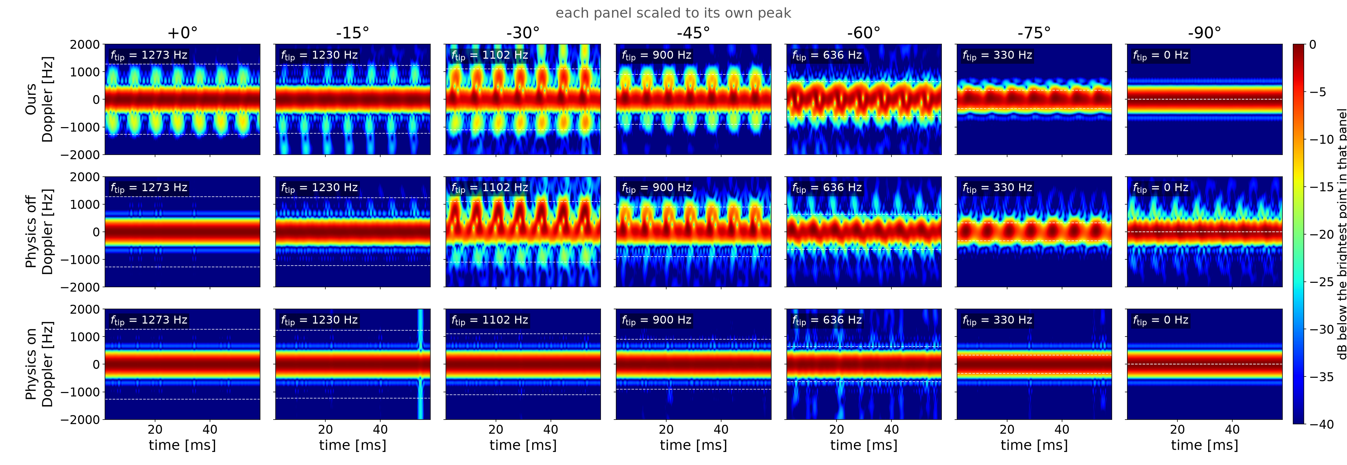
THE PICTURES
All seven angles
Notes:
— SCRIPT —
Rows are the three engines and columns are the seven viewing angles. The bright blobs marching along the time axis are the blades, and the flat band across the middle is the body sitting still. I draw no verdict from them yet.
⚠패널마다 자기 최댓값으로 밝기를 맞췄다 — 판 사이 세기 비교는 이 그림 밖이다.
⛔아랫줄(물리 켬)을 «무늬가 없다» 고 말하지 않는다 — 정확히는 «윗줄보다 약하다» 이고, 빗살 대비가 백색잡음 위인 각도는 −30°~−60° 뿐이다(0°·−15° 는 백색잡음 아래, −75°·−90° 는 이 잣대가 정의되지 않는다).

Slide 12
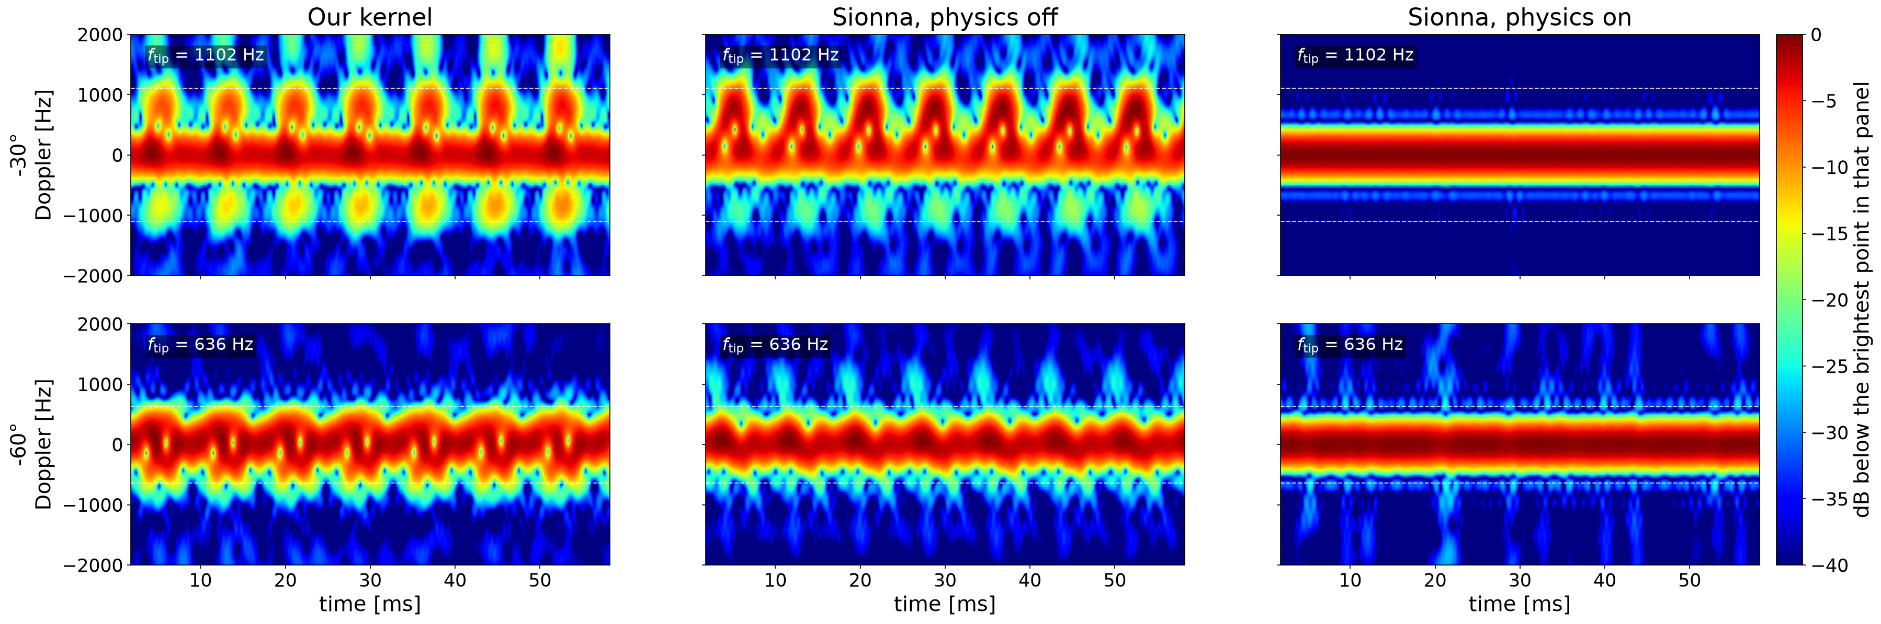
THE PICTURES
Mid angles
Ours and physics off keep the same beat, and physics on smears it
Notes:
— SCRIPT —
Here are two middle angles, minus 30 and minus 60 degrees. Our kernel and physics off keep the same blade beat, and physics on smears it. That is as far as I read these two.
⛔리듬 몫으로 두 팔을 잇지 않는다 — −30° 는 격자 흔들림 밴드 안이라 구별 불가. 두 팔을 잇는 근거는 박자와 빗살 대비다.

Slide 13
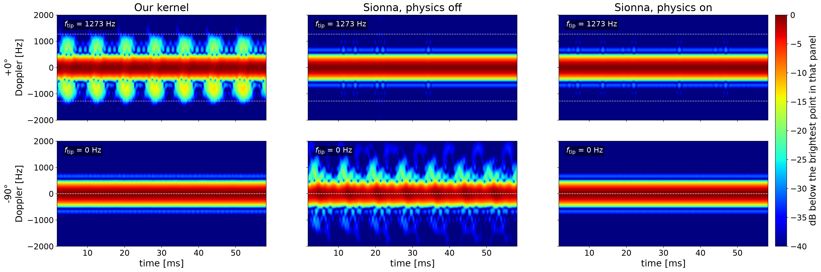
THE PICTURES
Two puzzles
The two ends of the sweep, where the maps run against physical expectation
Notes:
— SCRIPT —
At zero degrees, where the blade Doppler should be strongest, physics off falls to the level of white noise while our kernel keeps its pattern. At minus 90 the blade ceiling is zero hertz, yet physics off still draws a pattern. Both ends of the sweep run against physical expectation, and I would like your view on which one we should trust.
⛔«앙각이 내려갈수록 몫이 커진다» 라고 말하지 않는다 — 정확히는 «0° 만 무너지고 −15° 부터는 전부 포화» 다.
⛔«방위에 둔감하다 / 프로펠러 에코가 방위에 안 변한다» 라고 말하지 않는다 — 변화 폭 3.4 dB 가 격자 흔들림 3.9 dB 안이라 정확히는 «이 격자로는 잴 수 없다».
⚠−90° 는 날개 천장이 0 Hz 라 리듬 몫이 «전체 AC 중 빗살 몫» 으로 퇴화한다 — 다른 각도보다 후한 시험이니 수치를 인용하면 단서를 같이 단다.

Slide 14
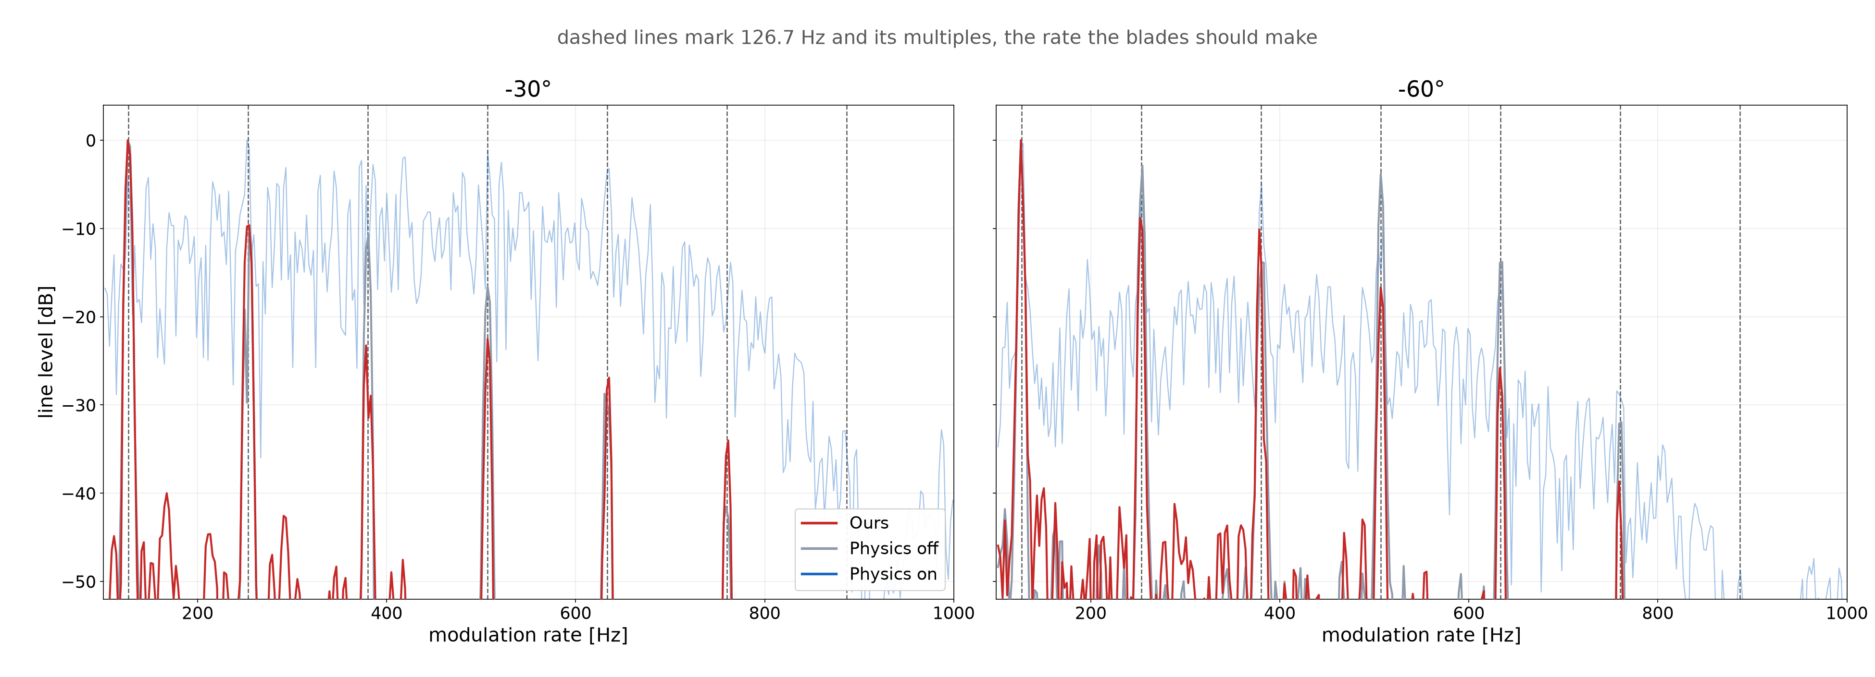
THE PICTURES
Blade band energy : -30°, -60°
Notes:
— SCRIPT —
Now the same evidence as lines. I take the energy inside the blade band and ask how it pulses in time, and the dotted lines mark multiples of the predicted blade beat. At these two angles our kernel and physics off land on them even at the higher harmonics, and physics on has lines on the same grid but they barely rise out of a rolling floor.
⛔물리 켬을 «선이 없다» 고 말하지 않는다 — 바닥이 높아 선이 안 서 보일 뿐이고, 빗살 대비는 −30° +6.3 · −60° +7.0 dB 로 백색 위다.

Slide 15
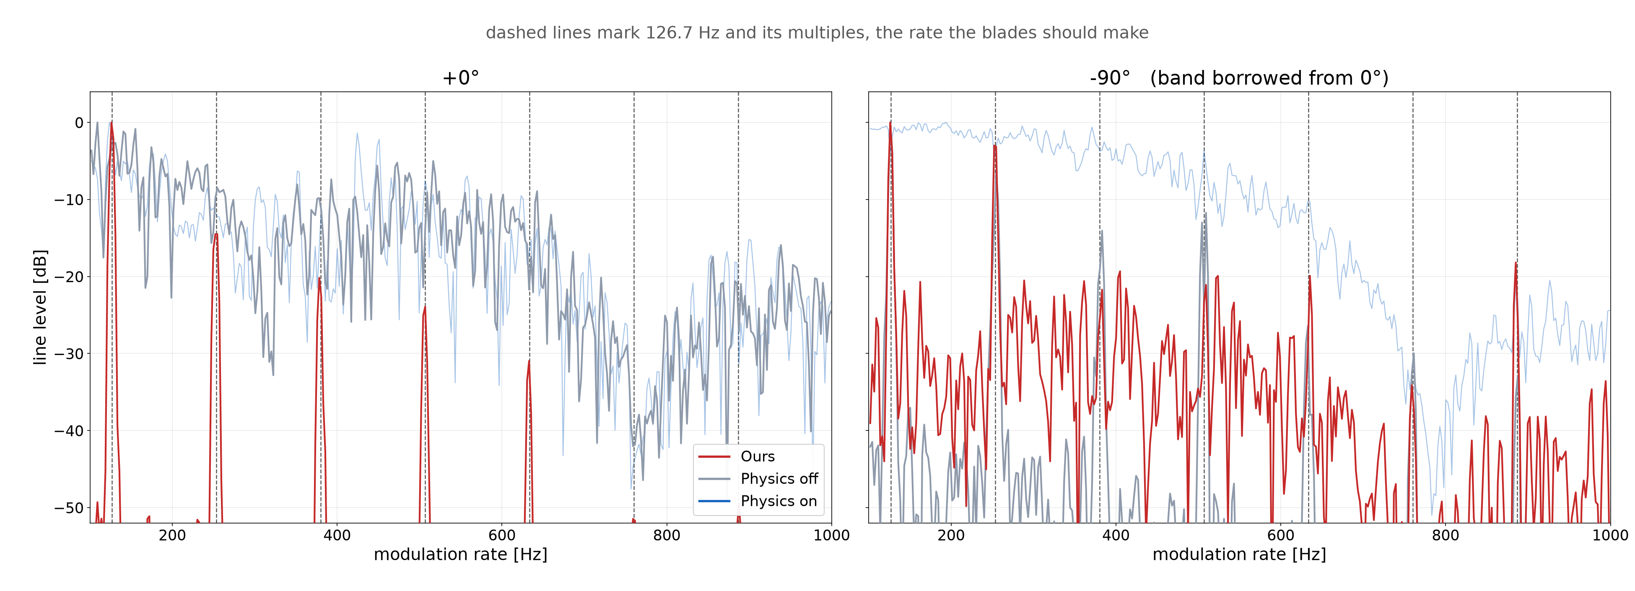
THE PICTURES
Blade band energy : 0°, -90°
Notes:
— SCRIPT —
The same plot at the two odd ends. At zero degrees only our kernel raises lines on the beat and physics off keeps a broad ripple that peaks nowhere near them. At minus 90 the blade ceiling is zero hertz, yet our kernel and physics off both raise evenly spaced lines that no blade could make.
⚠−90° 패널은 날개 천장이 0 Hz 라 대역이 정의되지 않아 0° 대역을 빌려 쟀고, 곡선마다 자기 최대값 기준이라 절대량은 이 그림 밖이다.

Slide 16
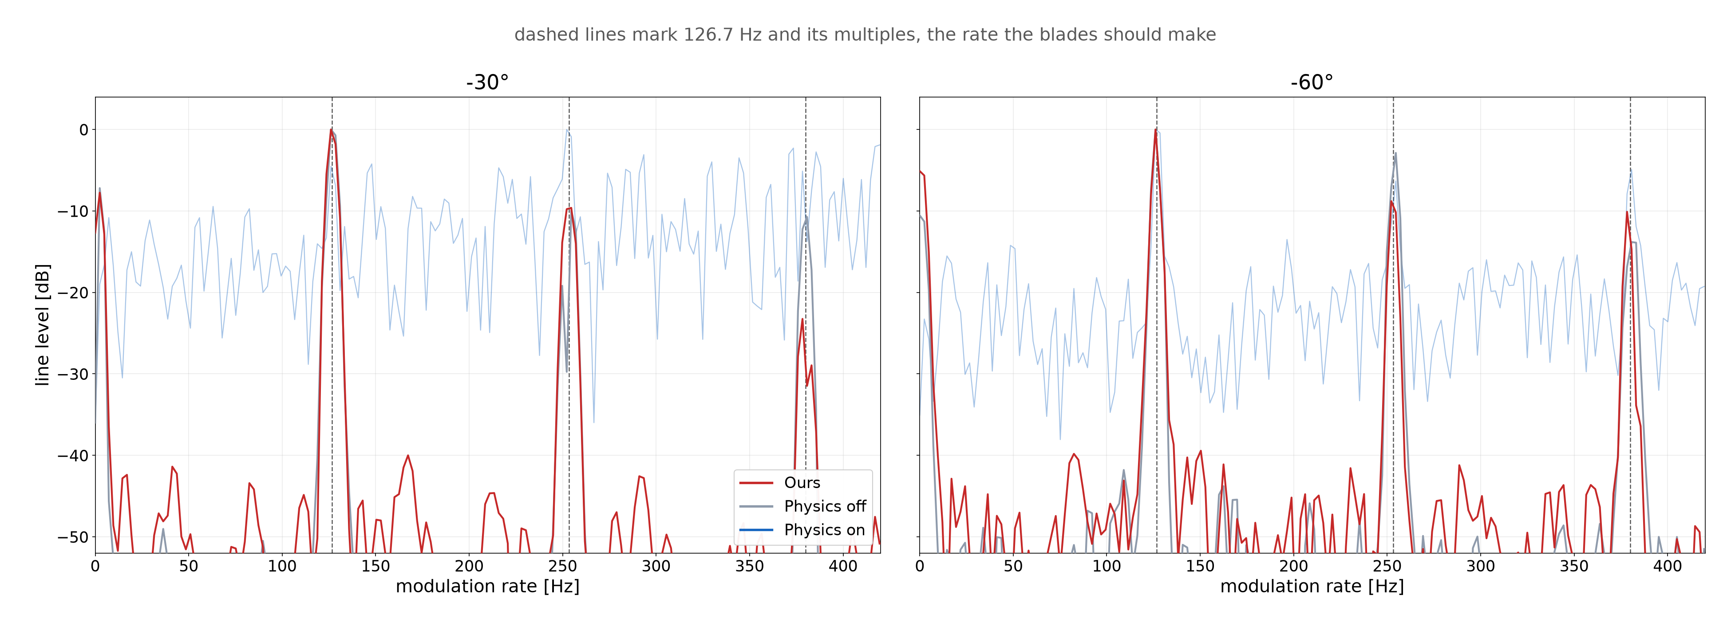
THE PICTURES
Zoom : -30°, -60°
Notes:
— SCRIPT —
This zooms in on the first three harmonics. At both angles the peaks sit right on the dotted lines. What ties our kernel and physics off together is where the lines stand, not how tall they are.
⛔«두 팔이 나란히 같다» 라고 말하지 않는다 — 변조 깊이는 −30° 에서 우리 52 대 끔 66 dB 로 벌어져 있다.

Slide 17
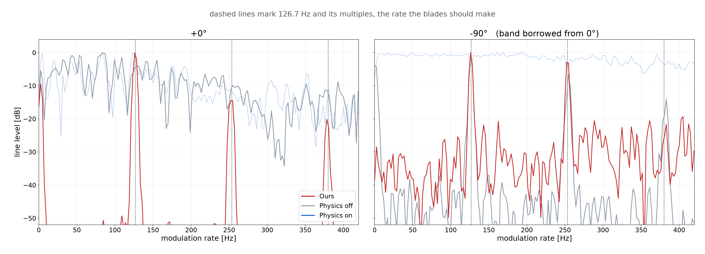
THE PICTURES
Zoom : 0°, -90°
Notes:
— SCRIPT —
The same zoom at the two odd ends. At zero degrees our kernel lands on multiples of the predicted beat and the physics off ripple peaks between them. At minus 90 both arms put peaks on those same lines, the second puzzle in close view.
⭐0° 에서 물리 끔의 박자 추정은 예측 박자의 정수배가 아니다 — 이 장의 근거는 봉우리의 «자리» 다.
⚠−90° 는 0° 대역을 빌려 쟀다(절대량은 이 그림 밖).

Slide 18
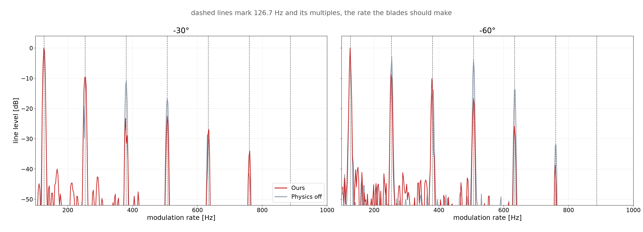
OURS VS PHYSICS OFF
Two arms : -30°, -60°
Notes:
— SCRIPT —
Here I drop the physics on curve, because it is busy enough to hide the comparison I care about. At these two angles the harmonics of the two arms stand at the same places.
⛔«두 팔이 똑같다» 라고 말하지 않는다 — 겹치는 것은 선의 자리(박자)이지 선의 높이가 아니다.

Slide 19
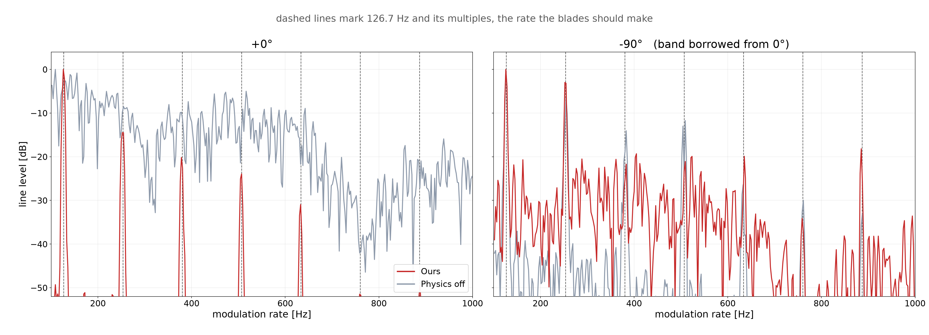
OURS VS PHYSICS OFF
Two arms : 0°, -90°
Notes:
— SCRIPT —
The two arm view at the odd ends. At zero degrees the gray curve keeps no peak on the dotted lines, and at minus 90 both curves put peaks on them even though the ceiling is zero hertz.
⚠−90° 는 0° 대역을 빌려 쟀다(절대량은 이 그림 밖).

Slide 20
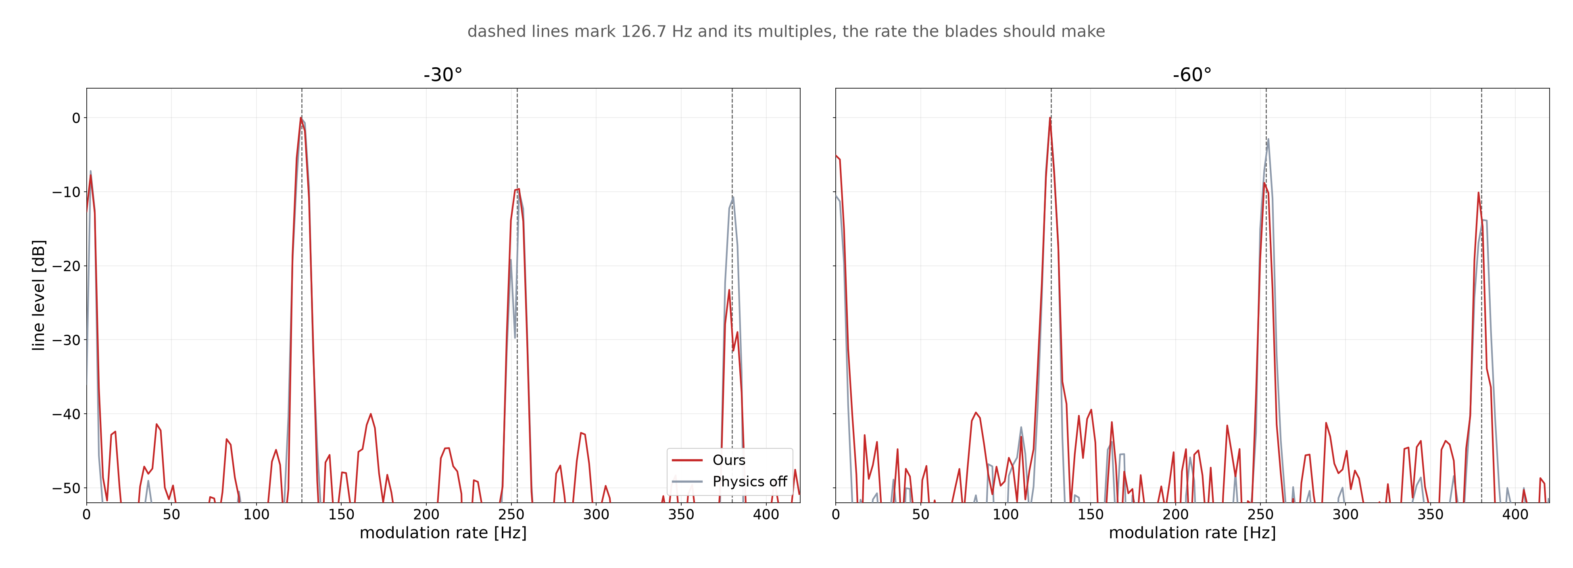
OURS VS PHYSICS OFF
Two arms zoom : -30°, -60°
Notes:
— SCRIPT —
The two arm zoom. Without the physics on curve the first three harmonics line up cleanly, and what is left between the two arms is height, not place.
⛔«두 팔이 똑같다» 라고 말하지 않는다 — 정확히는 «겹치는 것은 선의 자리(박자)이지 선의 높이가 아니다».

Slide 21
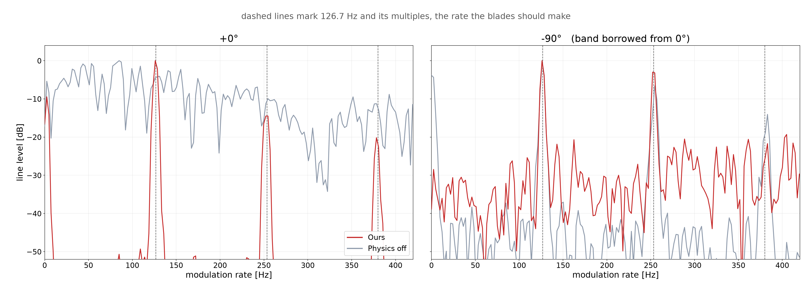
OURS VS PHYSICS OFF
Two arms zoom : 0°, -90°
Notes:
— SCRIPT —
The two arm zoom at the odd ends. This is where the zero degree failure shows most clearly, our kernel stands on the predicted beat and the gray ripple stands between the lines.
⚠−90° 는 0° 대역을 빌려 쟀다(절대량은 이 그림 밖).

Slide 22
PART 3
Propellers only
The scene split in half at 0 degrees, with the rotors still spinning
Drowned blades · Three engines · All angles · Band energy
Notes:
— SCRIPT —
Part three dissects the collapse at zero degrees. I split the scene in half, propellers only and body only, with the rotors spinning exactly as before. From here I quote one number, the rhythm share, meaning how much of the energy above the blade ceiling lands on multiples of the blade beat, and pure noise alone already gives about 13 percent.

Slide 23
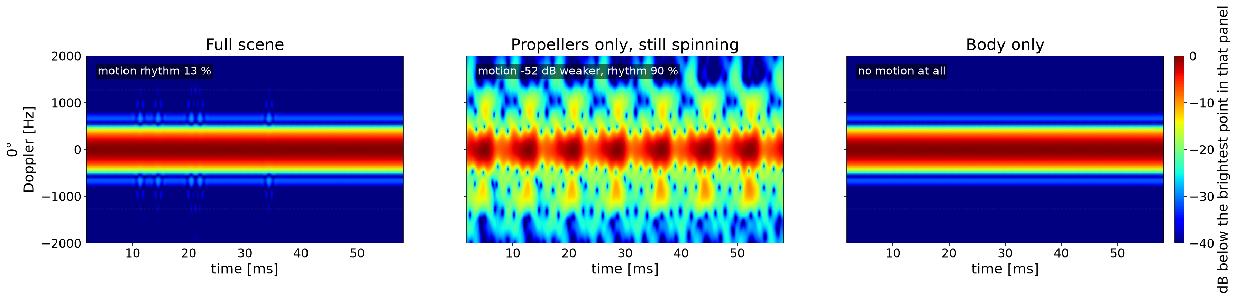
PROPELLERS ONLY
The drowned blades
Splitting the scene answers the first puzzle, since the blades are not missing but buried
Sionna with physics off, same rays, and the same 8,192 spinning poses, all at 0 degrees elevation and nose on. Left the full scene, middle only the propellers still spinning, right only the body.
Alone the blades beat at 90 percent, but sit at least 78 dB under the body echo
Notes:
— SCRIPT —
Splitting the scene answers the first puzzle. On their own the propellers beat at 90 percent, so Sionna with physics off can draw a spinning propeller, but seen edge on their echo sits at least 78 decibels below the body echo. The blades are not missing, they are buried.
⚠그림의 −52 dB 와 입으로 말하는 78 dB 는 다른 양이다 — 앞은 «움직이는 부분 대 전체 장면», 뒤는 «로터 에코 진폭 대 동체».
⚠«at least» 인 이유: 익사시키는 거울면은 배터리·카메라·기판이라 금속이고 재질을 어느 쪽으로 고쳐도 간격이 벌어지는 방향이다. 재질 이야기는 먼저 꺼내지 않는다.
⚠범위: 이 익사는 시선이 평판에 정확히 마주 서는 한 칸(방위 0°·앙각 0°)의 성질이다.
⛔«광선을 더 쏘면 되지 않나» — 방향이 반대다. 광선을 늘리면 움직이는 부분과 상한 위 바닥이 같이 올라간다.

Slide 24
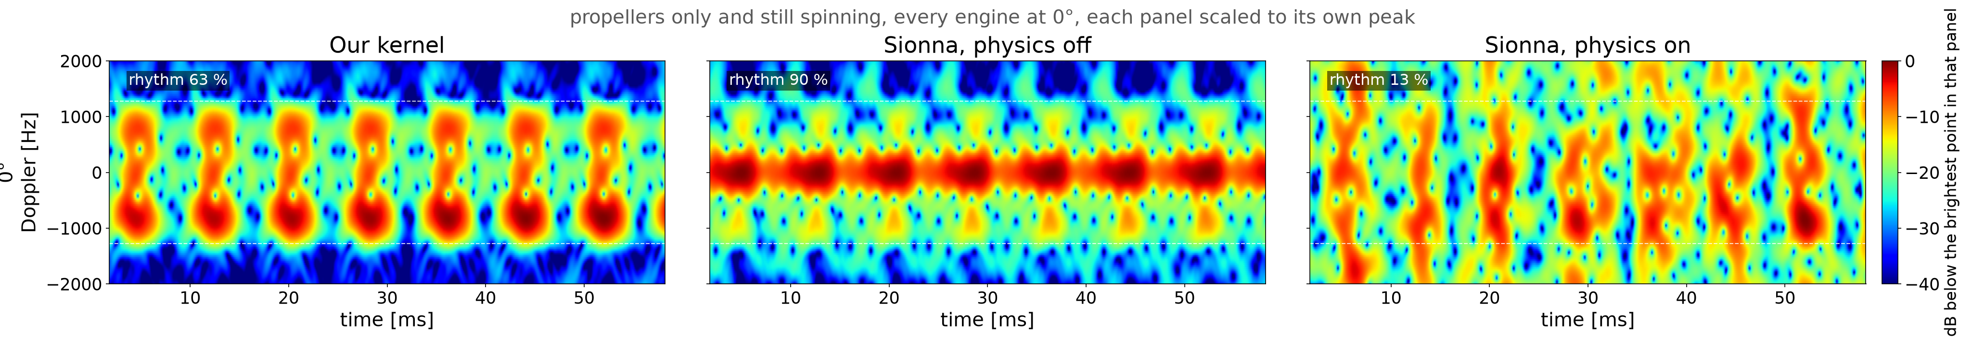
PROPELLERS ONLY
Propellers only : three engines
The same propellers only scene, now drawn by all three engines
Propellers only and still spinning at 0 degrees. Our kernel, Sionna with physics off, and Sionna with physics on.
Even with the body gone, turning the physics on still buries the rhythm
Notes:
— SCRIPT —
Now the same propellers only scene drawn by all three engines. This settles whether physics on lost the pattern because of the body or because of diffraction, and with the body gone it still stays down. At minus 30 degrees, where I measured it directly, diffraction does not erase the pattern but lifts the floor around it until the pattern is buried.
⛔이 그림이 «회절이 덮는다» 를 증명한다고 말하지 않는다 — 출처는 기체 전체 장면의 빗각이고(담김 시험 통과는 −30·−45·−75° 세 칸뿐, 전수 아님), 정면 0° 는 오히려 예외다(회절이 오기 전에 이미 익사).
⛔물리 켬을 «무늬가 아예 없다» 로 읽지 않는다 — 정확히는 «무늬가 잠겼다» 이고, 상한 아래를 보는 짝 잣대로는 백색 위다.
⛔우리 커널 줄을 가림 대조군으로 소개하지 않는다 — 우리 커널엔 동체 가림 계산이 없어 0° 에서 전체 장면 팔과 값이 같다(참조로만 읽는다).

Slide 25
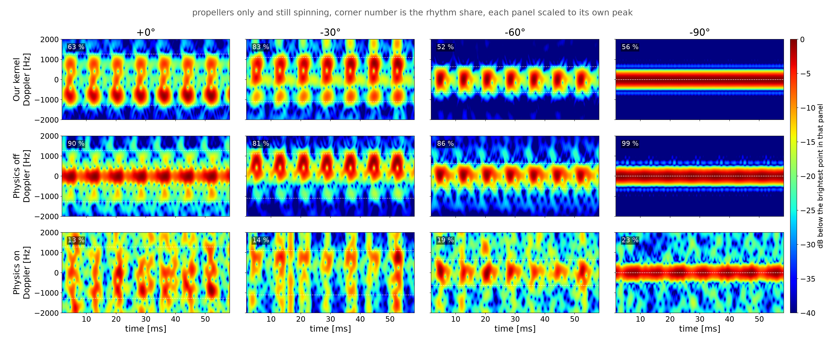
PROPELLERS ONLY
Propellers only : all angles
The same propellers only scene swept through all four viewing angles
Rows are the three engines and columns the viewing angle. The corner number is the rhythm share, and the last column has no blade ceiling left.
Physics off keeps the blade rhythm at every angle, and physics on keeps a trace at least 32 dB weaker
Notes:
— SCRIPT —
The same propellers only scene, recomputed at four of the seven angles, rows the engines and columns the angle. The corner number is the rhythm share again, where pure noise alone already gives about 13 percent. Physics off keeps the blade rhythm at every angle, and physics on leaves only a trace at least 32 decibels weaker at the three angles where I can measure that gap.
⛔아랫줄을 «잡음뿐» 이라고 말하지 않는다 — 짝 잣대(빗살 대비)로 다시 재면 물리 켬도 백색 위이고, 정확한 말은 «나머지 두 엔진보다 최소 32 dB 약한 흔적» 이다.
⚠−90° 열은 날개 천장이 0 Hz 라 리듬 잣대가 퇴화한다(다른 각도보다 후한 시험).

Slide 26
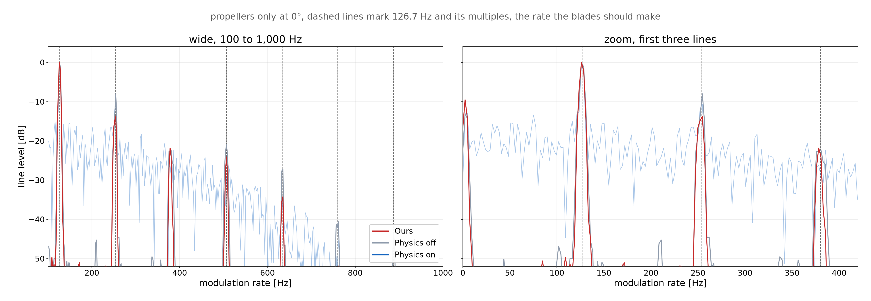
PROPELLERS ONLY
Propellers only : band energy
The verdict repeats in the lines, ours and physics off on the beat and physics on a rolling floor
Notes:
— SCRIPT —
The same three engines as lines, wide on the left and zoomed on the first three harmonics on the right. The map verdict repeats here, our kernel and physics off stand on the predicted beat while physics on leaves a rolling floor.

Slide 27
FUTURE WORK
Future work
Two lines of work come next
Close the bounce depth axis in the physics switch grid, where turning diffraction on still lifts the level at three bounces
Drive the scene with a real flight log and add receiver noise, so the maps face maneuver and noise at once
Understanding the PathSolver behaviour comes first, and every later step builds on it
Notes:
— SCRIPT —
Two lines of work come next. First I want to close the bounce depth axis, because with diffraction on the level still rises at three bounces. Second I want to drive the scene with a real flight log and add receiver noise.
⚠깊이 축은 회절을 켠 조합만 남았고, 3차 튕김이 2차의 4.9 배를 더해 물리답지 않다 — 표집 부산물일 수 있어 광선 사다리를 돌리는 중이다. 질문이 나오면 여기까지만 답한다.

