Slide 1

Team Meeting
Yunjung Jeong
2026. 08. 11
Intelligent Radio Sensing Lab. (IRS Lab)
Department of Electrical Engineering and Computer Science
DGIST

Slide 2
TODAY
Micro-Doppler of a hovering drone
Sionna PathSolver vs Our SBR + PO
Notes:
Today I show micro-Doppler maps of a hovering drone, computed two ways: with Sionna's Path Solver, and with our own SBR plus physical optics kernel.

Slide 3
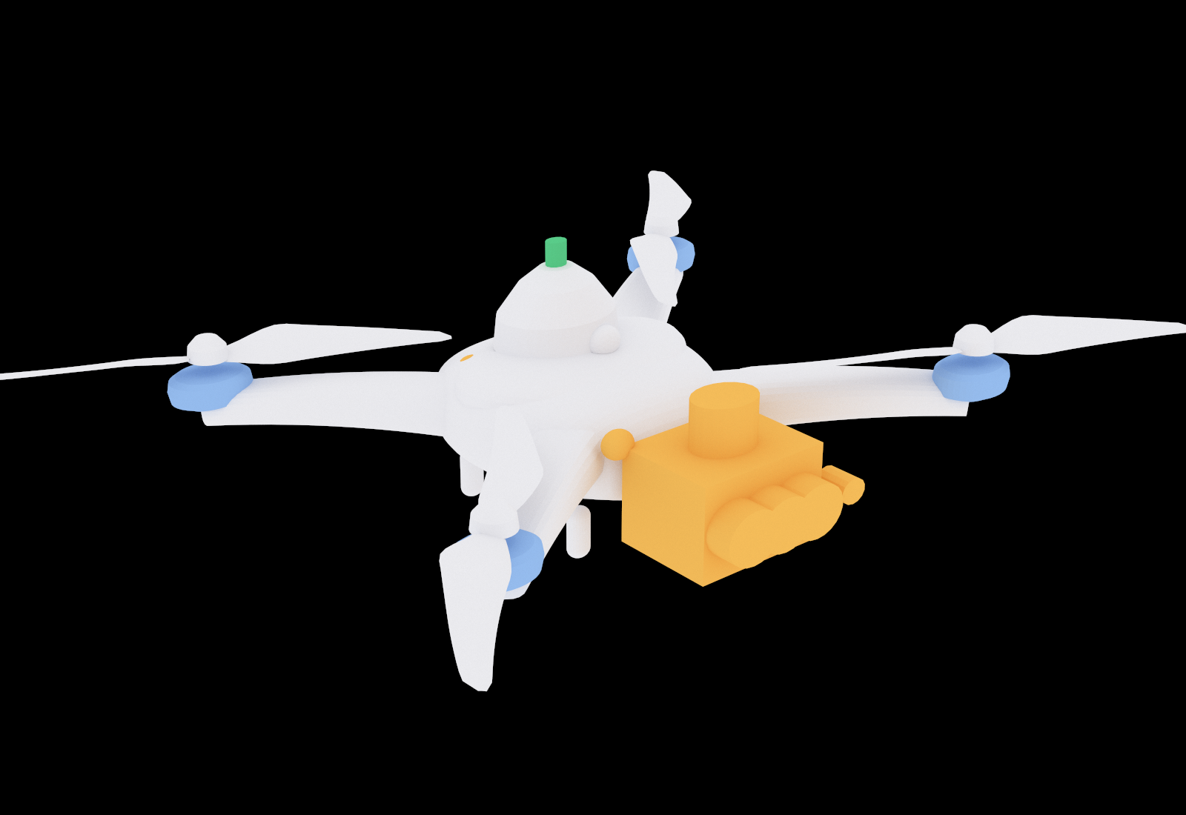
THE TARGET
The scenario
The aircraft
Model
DJI Matrice 4E
Propeller
274 mm, 2 blades
Rotor speeds
Rotor 1
3808.4 rpm
Rotor 2
3791.6 rpm
Rotor 3
3795.4 rpm
Rotor 4
3804.6 rpm
Spread
0.22 %, from Jihyuck prior work
Notes:
The target is a DJI Matrice 4E. Each rotor spins at a fixed speed near 3,800 RPM. That is a calculated value, not something I measured. The four rotors differ slightly from each other, and that spread comes from Ji-hyuk's prior work. These are hand-set constant values, not taken from a real flight. Better rotor modelling is future work.

Slide 4
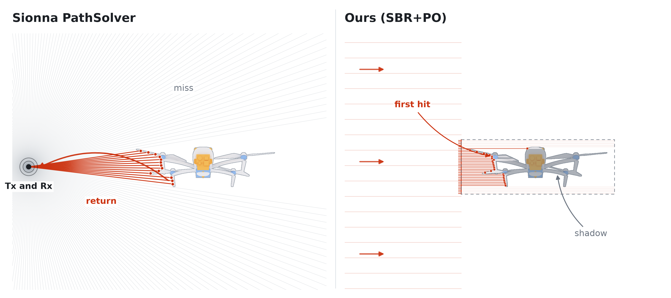
THE TWO ENGINES
How each engine lights the target
Notes:
Sionna's Path Solver launches rays isotropically from the transmitter, that is, evenly in every direction. When a ray hits a surface it picks up that material's reflection coefficient, and the result comes from the few paths that actually come back.
Our kernel does something different. We shoot a grid of parallel rays at the target, take the first point each ray hits, and sum the physical optics scattering integral over those points. For parts we treat as transmissive, the ray passes through, and we add the echo from the metal inside, scaled by how much gets through.

Slide 5
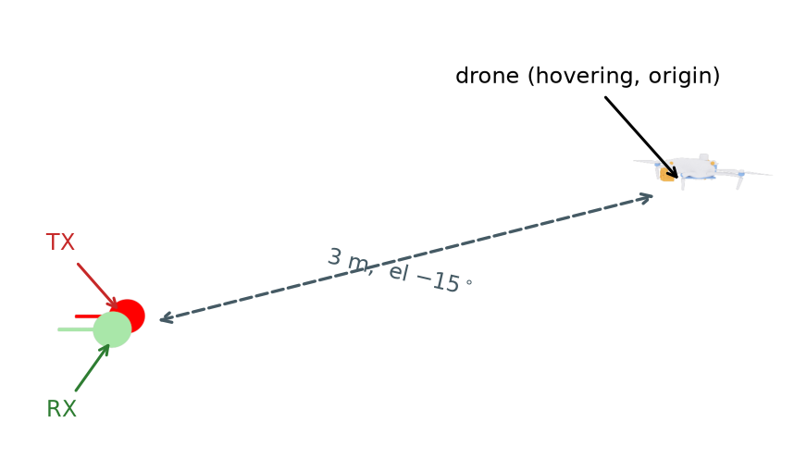
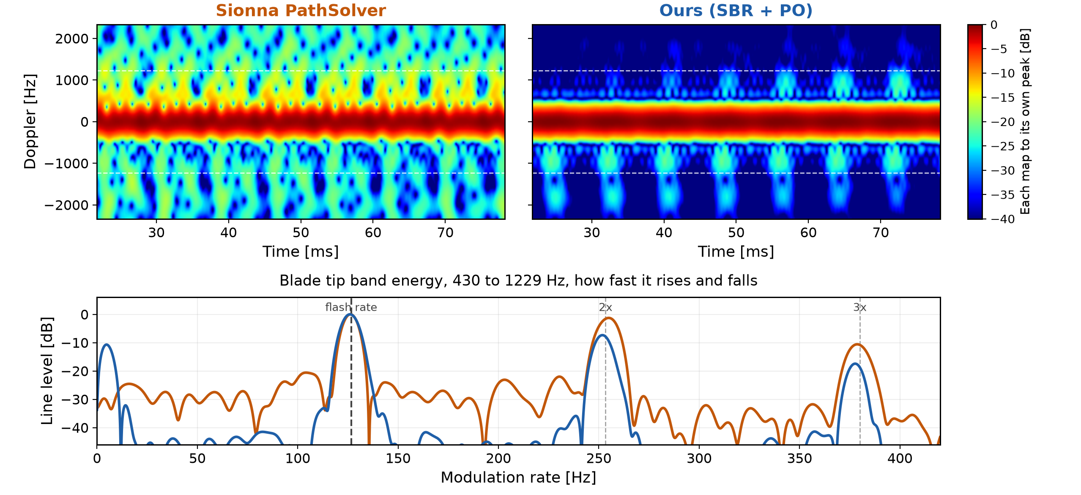
RESULT ONE
Three metres
3.5 GHz CW Scenario
STFT Parameters
Window
Hann, 70 samples
3.553 ms
Hop size
2 samples
0.101 ms
FFT size
560 points
Notes:
The centre frequency is 3.5 GHz, a standard 5G band. For the waveform I used a simple continuous wave. This is an early experiment, and CW is the easiest thing to work with. What I want to see first is the micro-Doppler itself, so I did not need a more complicated waveform yet.
For the STFT: window 70 samples, about 3.6 milliseconds; hop 2 samples; FFT size 560.
The bottom figure is made in two steps. First I take the energy in the 430 to 1229 Hz band, which is above the body and belongs to the blade tips. Then I ask how that energy rises and falls over time, and take its spectrum.
The peak sits at about 127 Hz. That is the blade flash rate: two blades passing per revolution, so twice the rotation rate. Its harmonics show up clearly too.

Slide 6
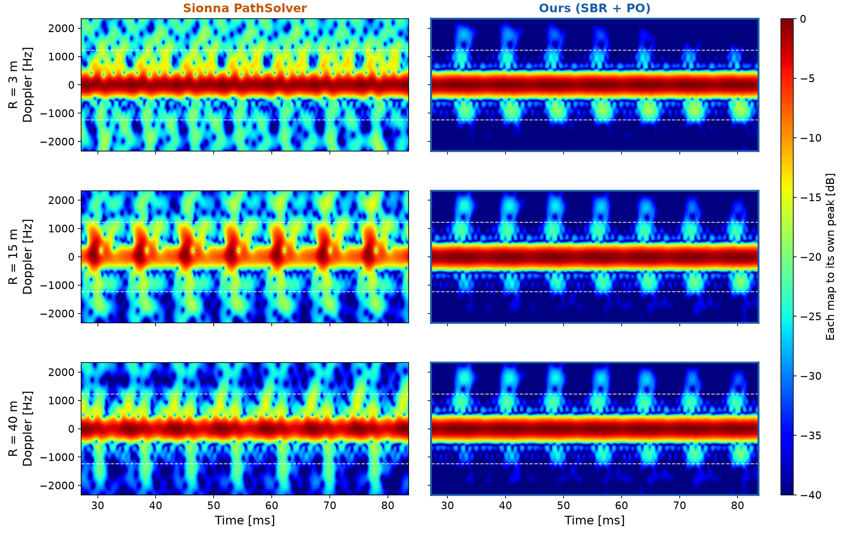
RANGE
Three ranges
Notes:
The previous slide was 3 metres only. Here I ran the same thing at 3, 15 and 40 metres.
Our kernel gives nearly the same map at every range. The Path Solver does not. At 40 metres its map changes, and I will come back to why.

Slide 7
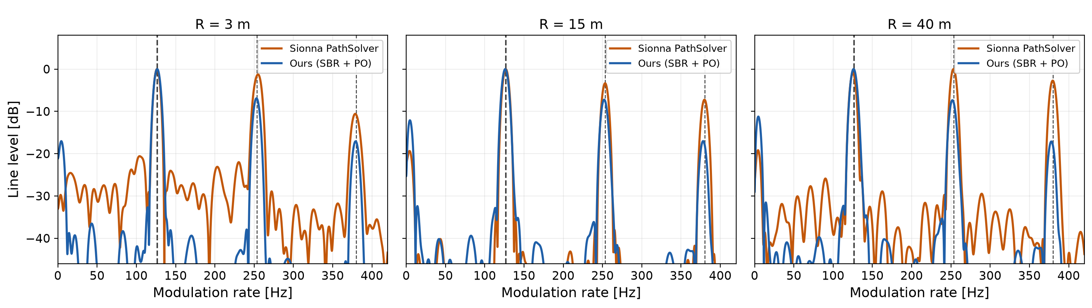
BAND ENERGY
Blade tip band energy
Both engines put the first line where kinematics says it should be.
Notes:
This is the band energy for each range. One thing stands out in the harmonics. With our PO approach, the peak height gradually decreases as we move to the higher harmonics. With the Path Solver, the second harmonic often comes out almost as high as the first one, and sometimes higher.

Slide 8
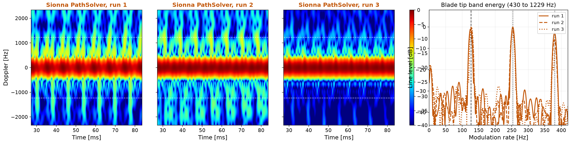
TWICE
Forty metres, repeated runs
Only the random start differs between these runs.
Notes:
At 40 metres I ran the Path Solver again, changing only the random seed. Even with the same drone, the same pose and the same orientation, the seed changes the result. One seed puts the strongest line on the second harmonic instead of the first one.
Our PO approach has no randomness. Same pose, same orientation, same answer every time.

Slide 9
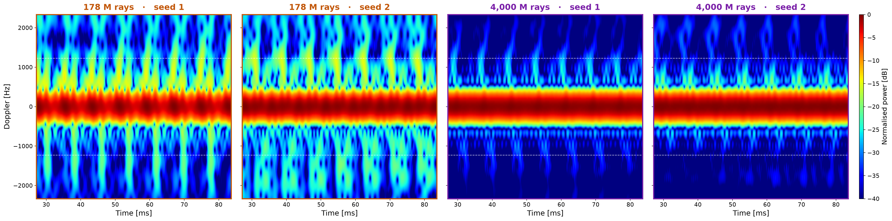
RAY BUDGET
More rays, cleaner background
Pushing the ray budget to its maximum cleaned up the background.
Notes:
One last thing. I raised the ray count to the maximum the solver allows. It takes a long time to run, so I only got the result just before this meeting. The background is much cleaner.
[if asked] The seed still decides which harmonic comes out strongest.

Slide 10
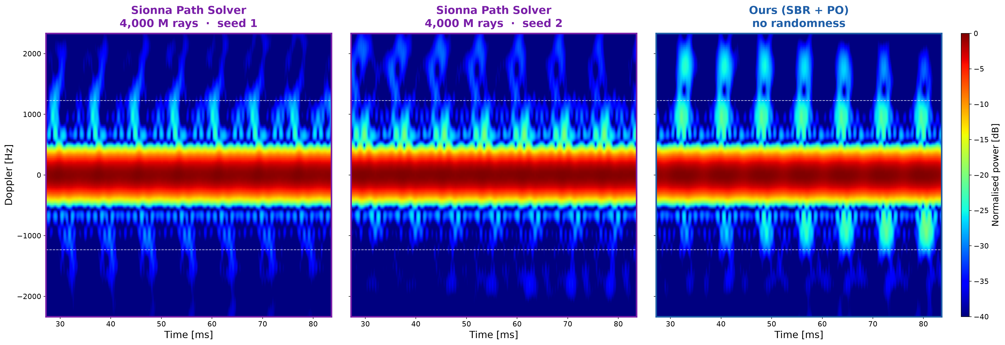
SIDE BY SIDE
The two engines at forty metres
Same distance, same drone. Ours repeats exactly, the Path Solver does not.
Notes:
And here they are next to each other at 40 metres. Two Path Solver runs with the full ray budget, and our PO result.
[if asked] The blade lines land in the same place. What changes between the two Path Solver runs is only the random seed.

Slide 11
FUTURE WORK
Future work
Three pieces are missing, and each one takes the model closer to reality
Let each rotor wander in speed the way a real one does while holding station
Add receiver noise, so that distance finally costs something in the picture
Move to the bistatic or put clutter into the enviornment
Each step brings the simulation closer to a real measurement.
Notes:
For my future work, I want to make the simulation more realistic. I have three directions.
First, the rotor speeds. Right now each rotor turns at a hard-coded value, and the spread between them comes from a flight simulator, not from a real drone. I want to use real flight log data instead, and also introduce temporal variation, the way a real drone adjusts its rotors while it stays in place.
Second, noise. There is no receiver noise in this simulation. That is why nothing became harder when the drone moved further away. The echo does get weaker with distance, but each map is scaled to its own brightest point, so we cannot see that. And with no noise, nothing is ever buried. In the real world, noise is what decides how far we can detect, so I want to add it.
Third, the geometry and the environment. Everything today uses one station that sends and receives at the same place, in empty space. Our real experiment is a passive bistatic setup, where the signal comes from someone else's base station, and it happens in a room with walls and a floor. I want to move to that geometry and add clutter modelling.
All three will make the results worse, and that is the point. They bring the simulation closer to a real measurement.

