Slide 1
Machine Learning
Maternal Health Risk Classification

Slide 2
What we will see?
Dataset
The Classifier that was used
The proposed method
Evaluation
Conclusion

Slide 3
The Dataset
The dataset contains data from pregnant women and it targets to classify the risk of having health issues. The dataset provides the following 6 variables.
Age: Age in years when a woman is pregnant.
SystolicBP: Upper value of Blood Pressure in mmHg, another significant attribute during pregnancy.
DiastolicBP: The lower value of Blood Pressure in mmHg, another significant attribute during pregnancy.
BS: Blood glucose levels are in terms of a molar concentration, mmol/L.
HeartRate: A normal resting heart rate in beats per minute.
Risk Level: Predicted Risk Intensity Level during pregnancy considering the previous attribute.

Slide 4
The Dataset
The dataset was separated in 3 groups before any test.
1. Training Data that will be using on the training process for train and validation
2. Testing Data that will be used for the evaluation
3. Some samples that the model will not see on any process so we can show the abilities of the method.

Slide 5
Classifier
For classifier will be using the Random Tree Forest classifier.
The Random Tree operates by constructing a multitude of decision trees at training time and then when it predicts an answer it output the answer that the most trees predict.
In this method we will use 2 Random Tree classifiers for making the final prediction.

Slide 6
The proposed method
As we can see in the distributions of data the category of high risk is more separated that the other two categories.
In this method we will initially separate in with the first classifier the high category from the low-mid, and then we will use a second classifier for predicting between the low mid categories.
The training process will be repeated 20 times and will we extract a average score from the classifiers and then will we use the best one for further analysis.

Slide 7
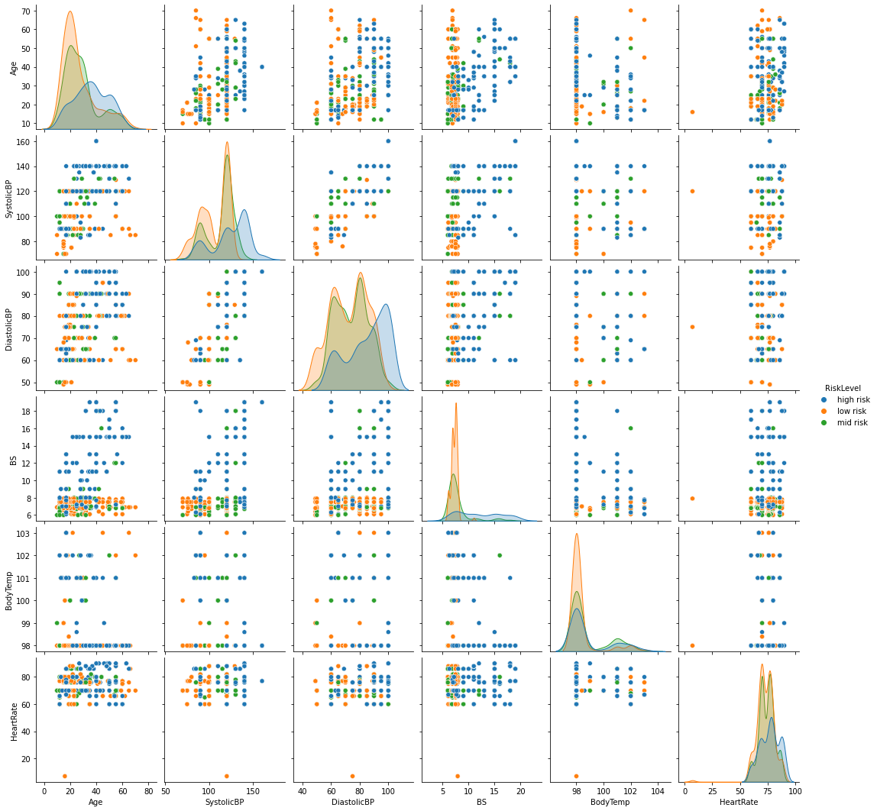

Slide 8
Evaluation
As we can see on the average scores and the best model is perform relative good. In comparison with other methods that was submitted to kagle, my method perform better by a small margin but direct comparison hasn't be made do to different methods on the data separation for the evaluation.
On the classification report of the best model we can see that the high risk method perform the best and the it followed from the low risk with a good precision score and finally the mid that perform marganly worst on precision but on par with low risk on recall.
In general the result are good with the high risk category, which is the most in danger performing good but with room for improvements.

Slide 9
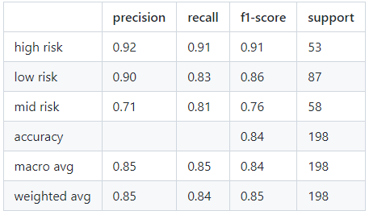
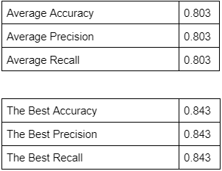
Evaluation

Slide 10
Conclution
This method provides a interesting way for further expansion. The decision of using the Random forest classifier for both steps was chosen because it could perform better at most of the times, but we didn't test methods beyond the scope of this class, like neuron networks.
Also this method show as the benefits of separating the classification into a two step problem and provided better performance.

Slide 11
THE END
Thank you for your attention.
Dimitris Koutrintzes.

