Slide 1

AZ-900 Microsoft Azure Fundamentals

Slide 2


Facilities
Class hours
Building hours
Parking
Restrooms
Meals
Phones
Messages
Smoking
Internet access
Emergency procedures

Slide 3
Course description
This course will provide foundational level knowledge of cloud services and how those services are provided with Microsoft Azure. The course can be taken as an optional first step in learning about cloud services and Azure, before taking further Azure or Microsoft cloud services courses.
The course will cover general cloud computing concepts in addition to general cloud computing models and services such as public, private, and hybrid cloud, and infrastructure as a service (IaaS), platform as a service (PaaS) and software as a service (SaaS).
It will also cover some core Azure services and solutions, in addition to key Azure pillar services concerning security, privacy, compliance, and trust. Finally, it will cover pricing and support services available with Azure.

Slide 4
Audience
The course is intended for a broad range of candidate backgrounds. It’s suitable for candidates with non-technical backgrounds, such as those involved in selling or purchasing cloud-based solutions and services, or those who have or will have some involvement with cloud-based solutions and services.
It would also be suitable for candidates with a technical background who may be looking to take a first look at cloud services and Azure.

Slide 5
Course Agenda
M01 – Cloud Concepts
M02 – Core Azure Services
M03 – Security, privacy, compliance and Trust
M04 – Azure pricing and support
M05 – Final Exam

Slide 6
Certification areas (AZ-900)
Study areas | Weights
Understanding cloud concepts | 15-20%
Understanding core Azure services | 30-35%
Understand security, privacy, compliance, and trust | 30-35%
Understand Azure pricing and support | 25-30%
This course maps directly to the exam AZ-900 Microsoft Azure Fundamentals
Percentages indicate the relative weight of each area on the exam.
The higher the percentage, the more questions you are likely to see in that area.
Notes:
AZ-900 Certification Areas - Microsoft Azure Fundamentals - Exam AZ-900

Slide 7
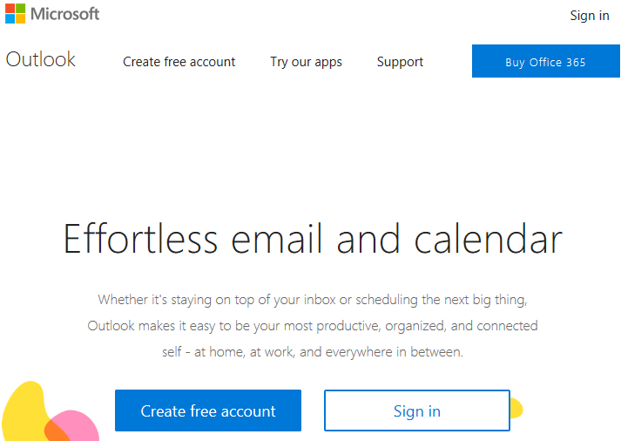
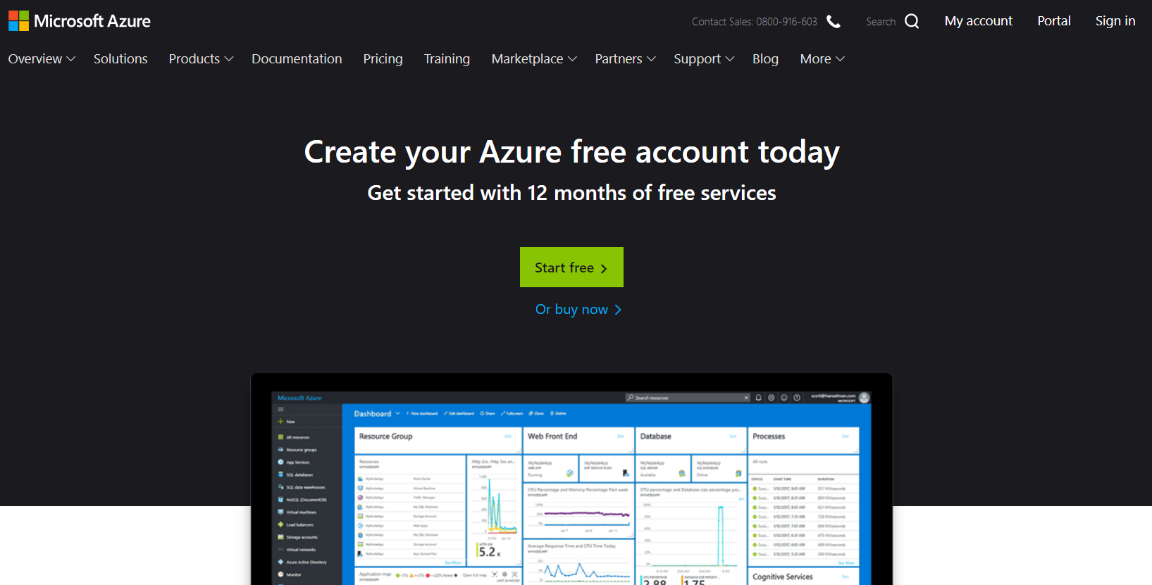
Create your account
https://www.live.com
https://azure.microsoft.com/en-us/free

Slide 8

Let’s get acquainted !
Name
Company affiliation
Business role
Office / Microsoft 365 experience
Expectations for the course

