Slide 1
AZ-100 Microsoft Azure Infrastructure and Deployment

Slide 2
Extra : Implementing Automation
Introducing Automation Creating Automation accounts and assets
Introduction to Automation runbooks Graphical authoring of Automation runbooks Textual authoring of PowerShell workflow runbooks Implementing Automation DSC
Automation runbook lifecycle Protecting the Automation environment
Notes:
20533E
11: Using Microsoft Azure-based management, monitoring, and automation

Slide 3
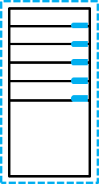









Introducing Automation
Local server
Local resources Hybrid Runbook Worker
VMs
Azure resources
DSC configurations
Runbooks
Azure Automation
Automation solution
Operations Manager Suite workspace
Local
External resources
Azure
Internet
Notes:
20533E
11: Using Microsoft Azure-based management, monitoring, and automation

Slide 4
Creating Automation accounts and assets
Create an Automation account by using:
Automation & Control from the Azure Marketplace
Automation service from the Azure Marketplace
Log Analytics management solutions
Azure Automation shared resources are grouped into the following categories:
Modules
Schedules
Certificates
Connections
Variables
Credentials
Notes:
20533E
11: Using Microsoft Azure-based management, monitoring, and automation

Slide 5
Introduction to Automation runbooks
Graphical runbooks:
Based on PowerShell workflows or PowerShell scripts
Edited by using the graphical editor in the Azure portal
Textual runbooks:
Based on PowerShell workflows or PowerShell scripts
Edited by using the textual editor in the Azure portal or imported from workflows and scripts created on-premises
Converting runbook types:
No support for converting between graphical and textual
Support for converting between graphical workflows and runbooks during import
Notes:
20533E
11: Using Microsoft Azure-based management, monitoring, and automation

Slide 6
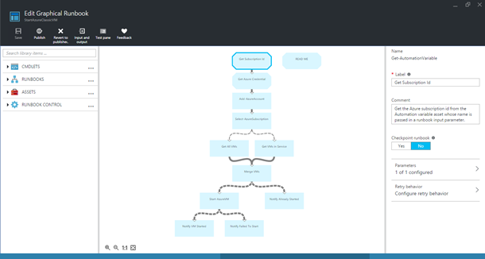
Graphical authoring of Automation runbooks
Library
Notes:
20533E
11: Using Microsoft Azure-based management, monitoring, and automation

Slide 7
Textual authoring of PowerShell runbooks
To create Automation PowerShell scripts:
Write code in textual editor
Add PowerShell cmdlets from integration modules imported into the Automation account
Reference Automation assets
Add runbooks
Notes:
20533E
11: Using Microsoft Azure-based management, monitoring, and automation

Slide 8
Implementing Automation DSC
Configurations
Node configurations
(.mof configuration
documents)
Configuration SharePoint {
Node WebService {
#Install the IIS Role
WindowsFeature IIS {
Ensure = “Present”
Name – “Web-Server”
}
#Install ASP.NET 4.5
WindowsFeature ASP {
Ensure = “Present”
Name – “Web-Asp-Net45”
}
}
}
Nodes
SharePoint.WebService
Compiled,
put on pull
server
via
compilation
jobs
Applied
via node pulls
One or more per
Automation account
One or more
per configuration
One or more
per node configuration
Notes:
20533E
11: Using Microsoft Azure-based management, monitoring, and automation

Slide 9

Automation runbook lifecycle
Revert
Publish
New
In edit
Published
Publish
Possible actions in
the New status:
Test
Publish
Possible actions in
the Published status:
Start via Webhook
Start on schedule
Possible actions in
the In edit status:
Test
Publish (overwrite
published runbook)
Notes:
20533E
11: Using Microsoft Azure-based management, monitoring, and automation

Slide 10
Protecting the Automation environment
Built-in geo-replication of Automation accounts
90-day log retention period
Custom backup options for:
Runbooks
Assets
DSC configurations
Notes:
20533E
11: Using Microsoft Azure-based management, monitoring, and automation

