Slide 1
AZ-300T00A Microsoft Azure Architect Technologies

Slide 2

Welcome
Thank you for joining us today.
We’ve worked together with the Microsoft Partner Network and Microsoft IT Academies to bring you a world-class learning experience.
Microsoft Certified Trainers + Instructors. Your instructor is a premier technical and instructional expert who meets ongoing certification requirements.
Customer Satisfaction Guarantee. Our partners offer a satisfaction guarantee and we hold them accountable for it. At the end of class, please complete an evaluation of today’s experience. We value your feedback!
Certification Exam Benefits. After training, consider pursuing a Microsoft Certification to help distinguish your technical expertise and experience. Ask your instructor about available exam promotions and discounts.
We wish you a great learning experience and ongoing career success!

Slide 3


Facilities
Class hours
Building hours
Parking
Restrooms
Meals
Phones
Messages
Smoking
Internet access
Recycling
Emergency procedures

Slide 4
Azure Solution Architect Role
Azure Solution Architects advise stakeholders and translate business requirements into secure, scalable, and reliable solutions.
have advanced experience and knowledge across various aspects of IT operations, including networking, virtualization, identity, security, business continuity, disaster recovery, data management, budgeting, and governance.
Requires managing how decisions in each area affects an overall solution.
Must be proficient in Azure administration, Azure development, and DevOps, and have expert-level skills in at least one of those domains.

Slide 5
About this Course: Course Outline (1/2)
T01 : Deploying and Configuring Infrastructure
M01 : Managing Azure Subscriptions and Resources
M02 : Implementing and Managing Storage
M03 : Deploying and Managing Virtual Machines
M04 : Configuring and Managing Virtual Networks
M05 : Managing Identities
T02 : Implementing Workloads and Security
M01 : Evaluating and Performing Server Migration to Azure
M02 : Implementing and Managing Application Services
M03 : Implementing Advanced Virtual Networking
M04 : Securing Identities
T03 : Understanding Cloud Architect Technology Solutions
M01 : Selecting Compute and Storage Solutions
M02 : Hybrid Networking
M03 : Measuring Throughput and Structure of Data Access

Slide 6
About this Course: Course Outline (2/2)
T04 : Creating and Deploying Apps
M01 : Creating Web Applications using PaaS
M02 : Creating Apps and Services Running on Service Fabric
M03 : Using Azure Kubernetes
T06 : Developing for the Cloud
M01 : Developing Long-Running Tasks and Distributed Transactions
M02 : Configuring a Message-Based Integration Architecture
M03 : Developing for Asynchronous Processing
M04 : Developing for Autoscaling
M05 : Developing Azure Cognitive Services Solutions
M06 : Develop for Azure Storage

Slide 7
Certification Areas (AZ-300)
Study Areas | Weights
Deploy and configure infrastructure | 25-30%
Implement workloads and security | 20-25%
Create and deploy apps | 5-10%
Implement authentication and secure data | 5-10%
Develop for the cloud and for Azure storage | 20-25%
Percentages indicate the relative weight of each area on the exam
The higher the percentage, the more questions you are likely to see in that area
Notes:
AZ-300 Certification Areas - https://www.microsoft.com/en-us/learning/exam-AZ-300.aspx

Slide 8
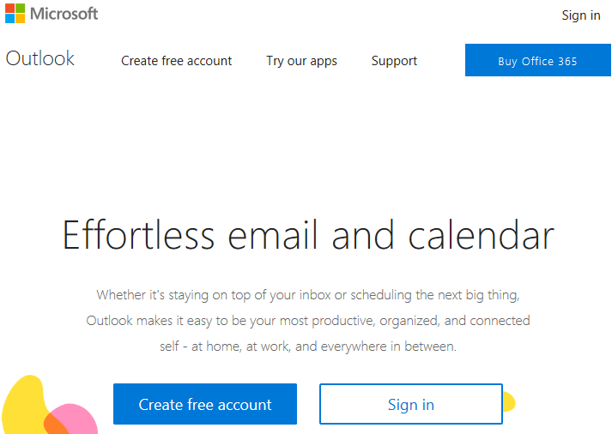
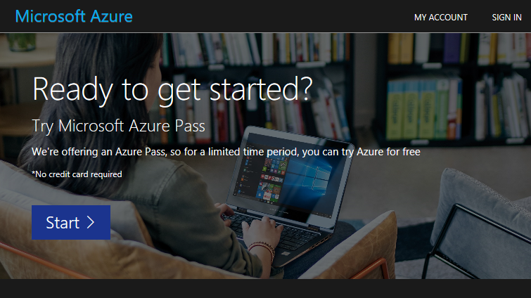
Create your account
https://www.live.com
https://www.microsoftazurepass.com

Slide 9

Hello! Student Introductions
Let’s get acquainted:
Your name
Company affiliation
Title/function
Cloud/Microsoft Azure experience
Your expectations for the course

