Slide 1
AZ-301T00A Microsoft Azure Architect Design

Slide 2

Welcome
Thank you for joining us today.
We’ve worked together with the Microsoft Partner Network and Microsoft IT Academies to bring you a world-class learning experience.
Microsoft Certified Trainers + Instructors. Your instructor is a premier technical and instructional expert who meets ongoing certification requirements.
Customer Satisfaction Guarantee. Our partners offer a satisfaction guarantee and we hold them accountable for it. At the end of class, please complete an evaluation of today’s experience. We value your feedback!
Certification Exam Benefits. After training, consider pursuing a Microsoft Certification to help distinguish your technical expertise and experience. Ask your instructor about available exam promotions and discounts.
We wish you a great learning experience and ongoing career success!

Slide 3


Facilities
Class hours
Building hours
Parking
Restrooms
Meals
Phones
Messages
Smoking
Internet access
Recycling
Emergency procedures

Slide 4
Azure Solution Architect Role
Azure Solution Architects advise stakeholders and translate business requirements into secure, scalable, and reliable solutions.
have advanced experience and knowledge across various aspects of IT operations, including networking, virtualization, identity, security, business continuity, disaster recovery, data management, budgeting, and governance.
Requires managing how decisions in each area affects an overall solution.
Must be proficient in Azure administration, Azure development, and DevOps, and have expert-level skills in at least one of those domains.

Slide 5
About this Course: Course Outline
T01 : Designing for Identity and Security
M01 : Managing security and identity for Azure solutions
M02 : Integrating Saas Services available on the Azure platform
T02 : Designing a Data platform solution
M01 : Backing Azure solutions with Azure storage
M02 : Comparing Database options in Azure
M03 : Monitoring and automating Azure solutions
T03 : Designing for deployment migration and Integration
M01 : Deploying resources with Azure Resource Manager
M02 : Creating Managed server applications in Azure
M03 : Authoring serverless applications in Azure
T04 : Designing an Infrastructure Strategy
M01 : Application architecture patterns in Azure
M02 : Building Azure IaaS-based server applications
M03 : Networking Azure application components
M04 : Integrating Azure solution components using Messaging services

Slide 6
Certification Areas (AZ-301)
Study Areas | Weights
Determine workload requirements | 10-25%
Design for identity and security | 20-25%
Design a data platform solution | 15-20%
Design a business continuity strategy | 15-20%
Design for deployment, migration, integration | 10-15%
Design an infrastructure strategy | 15-20%
Percentages indicate the relative weight of each area on the exam
The higher the percentage, the more questions you are likely to see in that area
Notes:
AZ-301 Certification Areas - https://www.microsoft.com/en-us/learning/exam-AZ-301.aspx

Slide 7
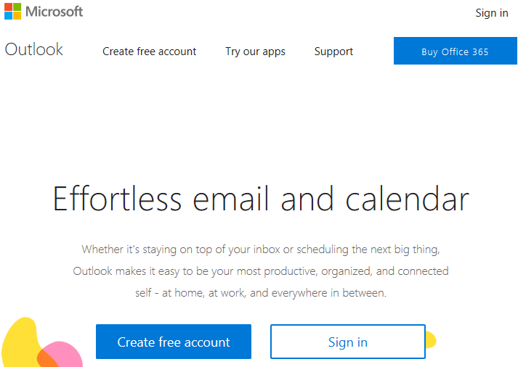
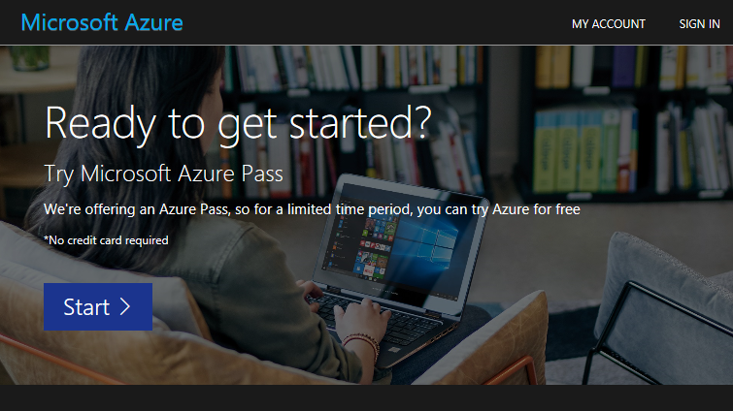
Create your account
https://www.live.com
https://www.microsoftazurepass.com

Slide 8

Hello! Student Introductions
Let’s get acquainted:
Your name
Company affiliation
Title/function
Cloud/Microsoft Azure experience
Your expectations for the course

